Slide 1
TRANSPORTATION REVOLUTION
& THE CREATION OF A NATIONAL MARKET ECONOMY

Slide 2
Regional Specialization
EAST → Industrial
SOUTH → Cotton & Slavery
WEST → The Nation’s “Breadbasket”

Slide 3
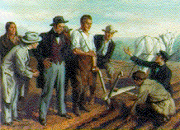
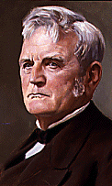
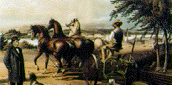
John Deere & the Steel Plow
Notes:
Pojer – Early 18C Industrialization

Slide 4
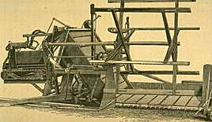
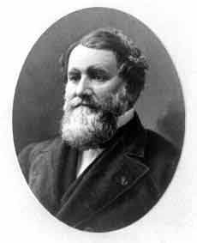
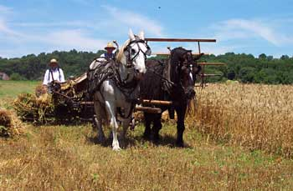
Cyrus McCormick & the Mechanical Reaper
Could do the work of
five men
Became the most significant
technology on the frontier
Notes:
Pojer – Early 18C Industrialization

Slide 5
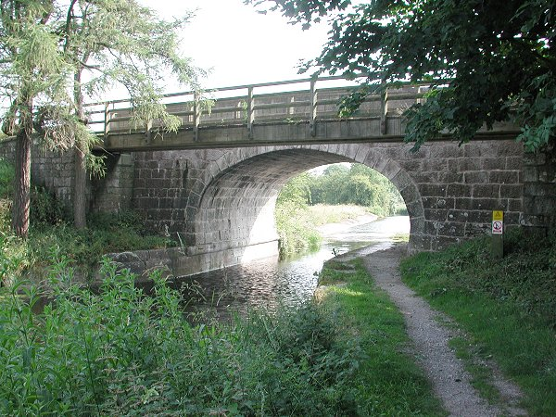
First Turnpike- 1790 Lancaster, PA
By 1832, nearly 2400 mi. of road connected most major cities.

Slide 6
Turnpikes
1st turnpike built 1790- Lancaster, Pa.- 62 miles connected Lancaster to Philadelphia
Highly profitable broad hard surface highway
Tolls were collected, drivers were confronted with spike barriers until toll was paid
Touched off a turnpike boom
State righters opposed federal aid to local projects
Eastern states protested against exodus of their population

Slide 7
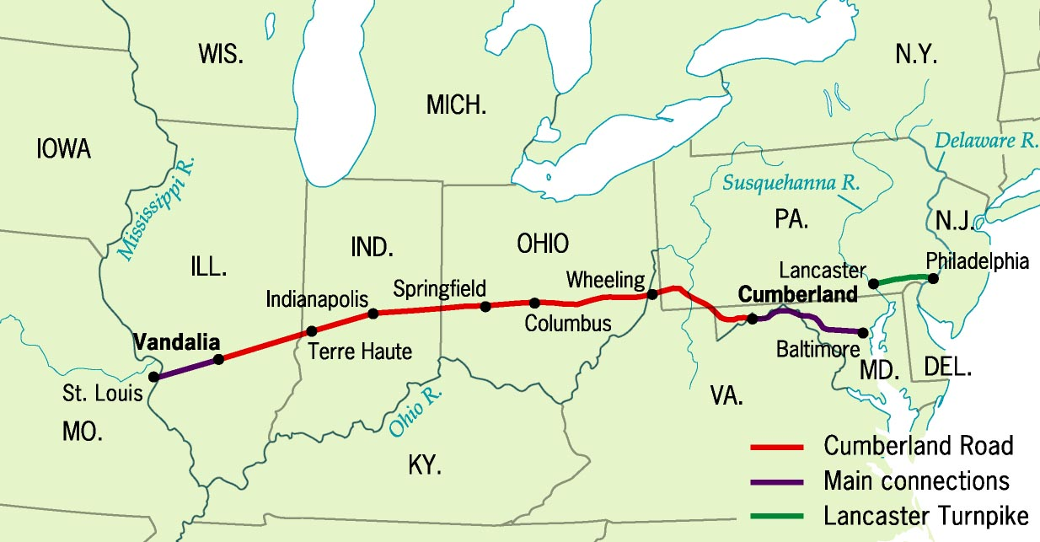
TRANSPORTATION REVOLUTION
turnpikes
National Road
Notes:
Pojer

Slide 8
Cumberland Road (1811)
National Road passed by Congress
591 miles connected Cumberland, Maryland to Vandalia, Illinois
Both state and federal funding
Became vital highway to the west
Freight cheaper became cheaper
Population centers boomed in the west
Land values along road enhanced

Slide 9
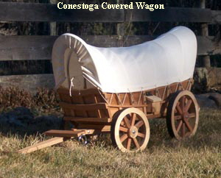
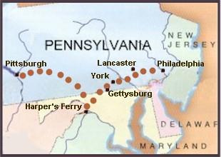
Conestoga Covered Wagons
Conestoga Trail, 1820s

Slide 10
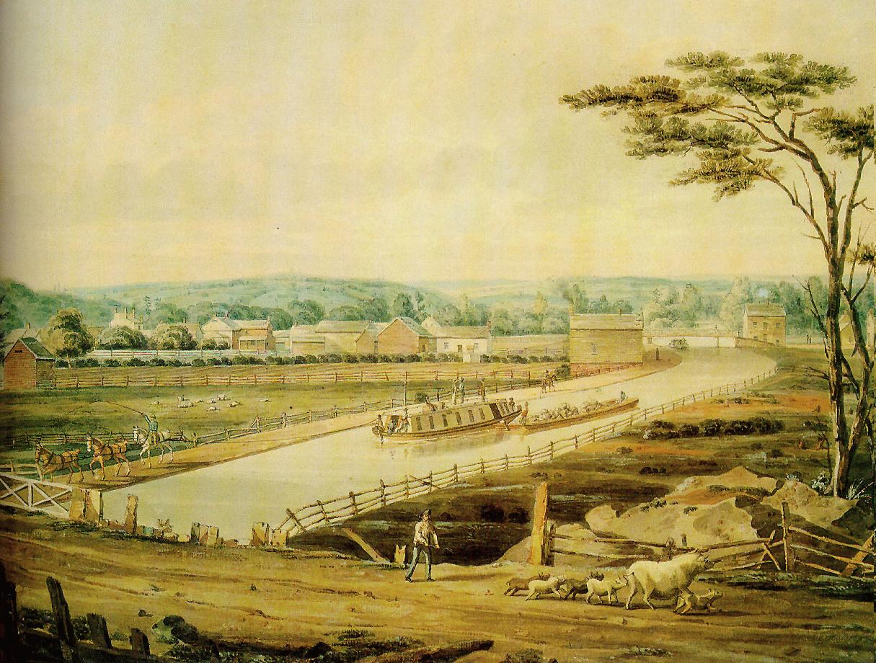
Erie Canal, 1820s
Begun in 1817; completed in 1825

Slide 11
Erie Canal
New York dug a 363 mile canal linking the Hudson River to Great Lakes
Completed in 1825
Governor DeWitt Clinton built using only state money

Slide 12
Erie Canal
Connected Eastern manufacturing and western agriculture
Cost of shipping a ton of grain from Buffalo to NYC fell from $100 to $5
Time fell from 20 to 6 days
Land value skyrocketed and new cities like Syracuse, Utica and Rochester emerged along canal
Great Lake towns exploded Cleveland, Detroit, Chicago
Immigrants traveled west using canal

Slide 13
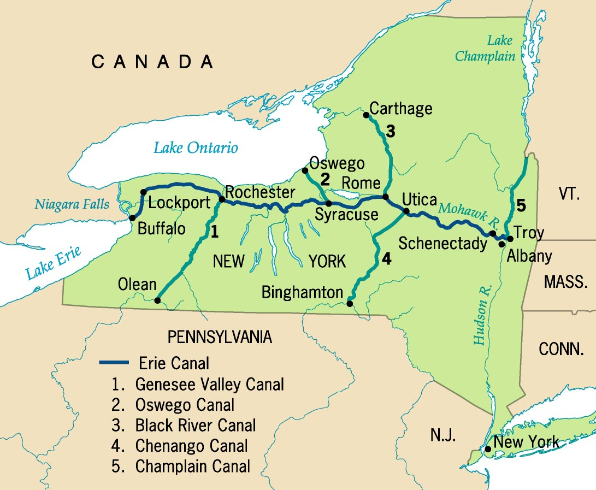
Erie Canal System

Slide 14
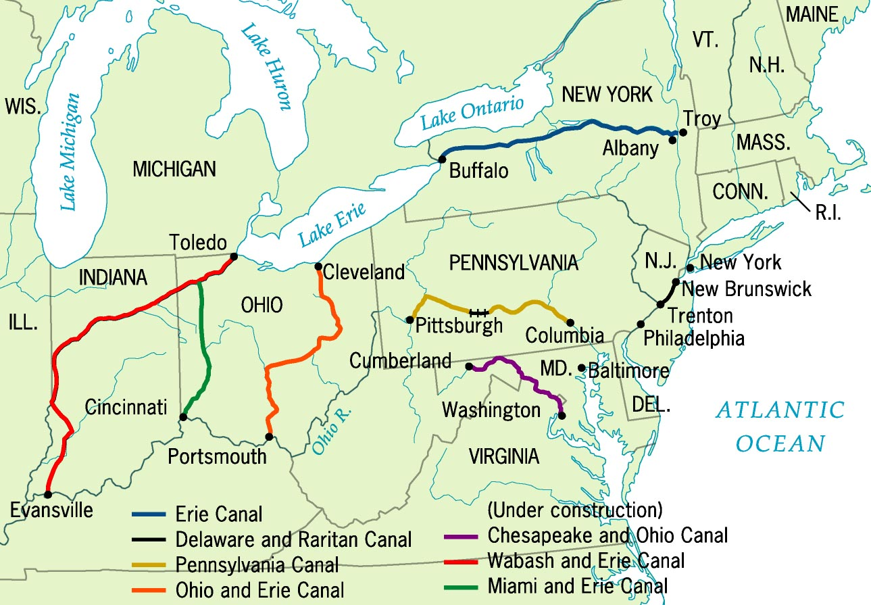
Principal Canals in 1840

Slide 15
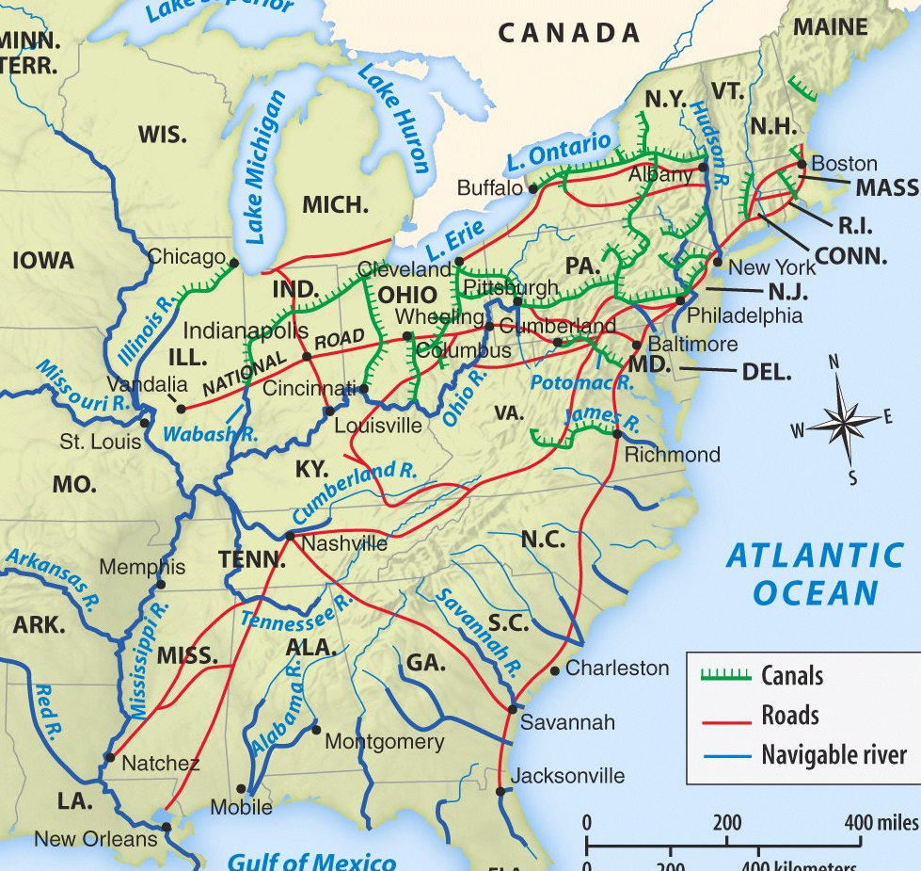
TRANSPORTATION REVOLUTION
Principal Canals in 1840
Roads and Canals, 1820-1850
Canal boom
Effect on transportation and trade patterns
Notes:
Principal canals – Pojer; Roads & Canals 1850 - Henretta, America’s History 5e from http://www.bedfordstmartins.com/mapcentral

Slide 16
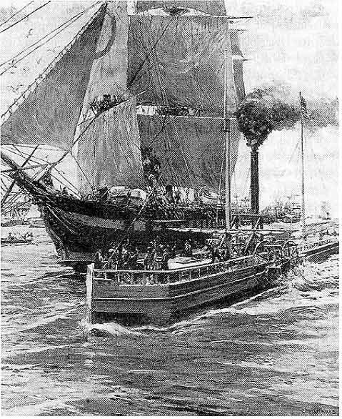
TRANSPORTATION REVOLUTION
Steamboats
Robert Fulton (1807) installed a steam engine on the Clermont
Made 2 way river travel possible
Robert Fulton’s Clermont plies the Hudson River
Notes:
http://www.wadsworth.com/history_d/special_features/image_bank_US/1815_1860.html

Slide 17
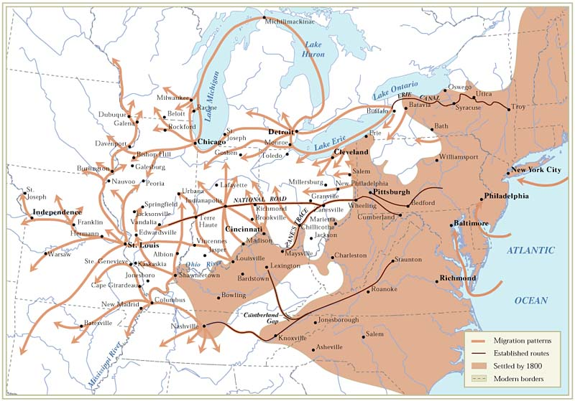
Paths of Northern Migration after 1800
Notes:
http://www.wadsworth.com/history_d/templates/student_resources/0030724791_ayers/maps/9.4.html

Slide 18
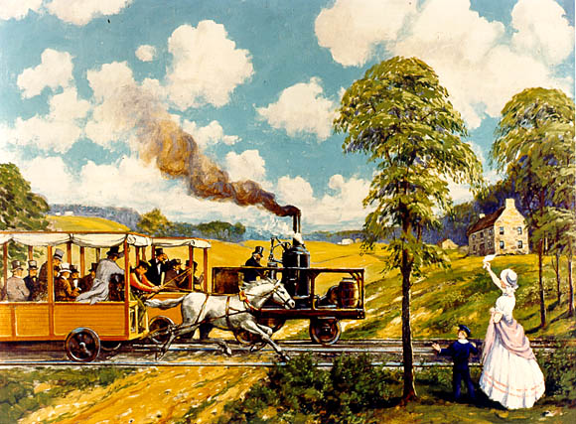
The “Iron Horse” Wins! (1830)
1830 → 13 miles of track built by Baltimore & Ohio RR By 1850 → 9000 mi. of RR track [1860 → 31,000 mi.]

Slide 19
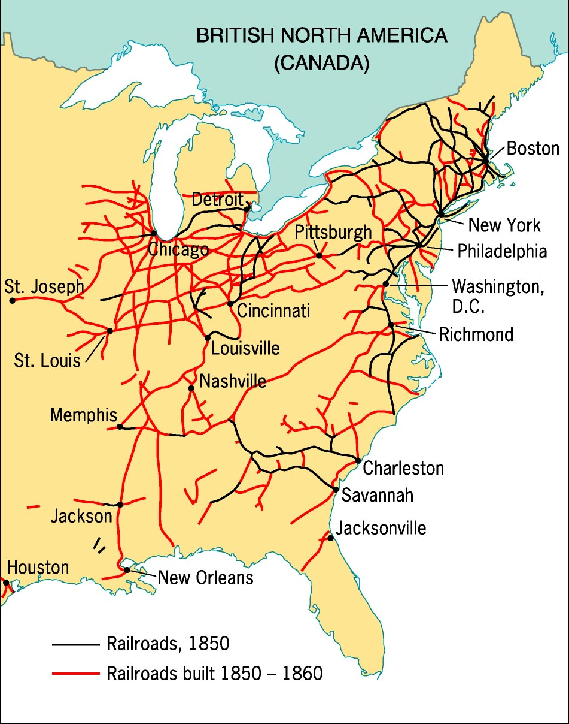
TRANSPORTATION REVOLUTION
Steam locomotives were pioneered in England
John Stevens demonstrated a locomotive in NJ 1820
Allowed people and products to be shipped great distances
Fast, reliable, and cheaper than canals to construct
Not frozen in winter
Able to go almost anywhere
Notes:
Pojer

Slide 20
Railroad Revolution 1850s
Supported by…
Funding
Private investors and states
Cornelius Vanderbilt made a fortune with NY Central Railroad
Land Grants
- Federal governments
Built by…
Immigrants in the No.
Slaves in the South RRs

Slide 21
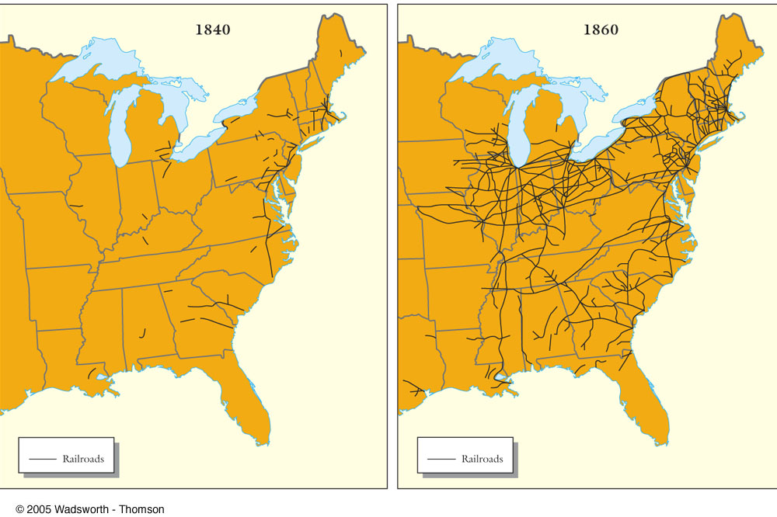
TRANSPORTATION REVOLUTION
Notes:
http://www.wadsworth.com/history_d/special_features/image_bank_US/1815_1860_maps.html

Slide 22
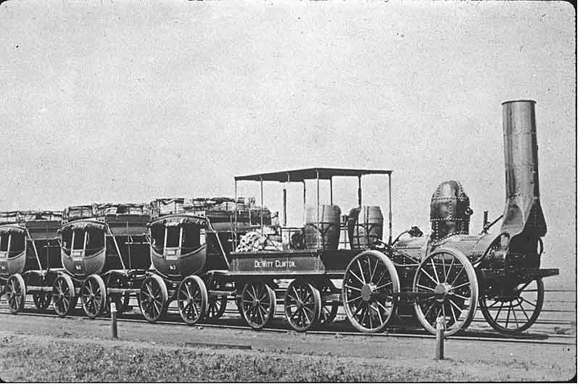
Mohawk And Hudson Railroad’s Dewitt Clinton
Notes:
http://www.wadsworth.com/history_d/special_features/image_bank_US/1815_1860.html

Slide 23
TRANSPORTATION REVOLUTION
Impact of Railroads
a) Promoted national trade and economic growth
b) Linked Northeast and old Northwest for trade
Consolidation of early short lines leads to E-W orientation
Chicago
c) Promoted the growth of other industries
Iron
Coal
Telegraph
d) Encouraged farmers to specialize
First great corporations in US – model for later large businesses

Slide 24
Rise to New Market Economy
Push west in search of cheap land
A vast number of immigrants settling in the cities
Newly invented machinery
Better roads, faster steamboats, farther reaching canals and railroads
Thoreau- The Walden – questioned the spiritual cost of the market revolution

Slide 25
Eras of Transportation
Turnpike & River Era 1790s-1820s
Canal Era 1825-1840s
Railroad Era 1850s-1940s
Automobile Era 1920s-present

Slide 26
BEGINNINGS OF INDUSTRIALIZATION
Factory System
Rise of Corporations
Technological Innovations
Labor

Slide 27
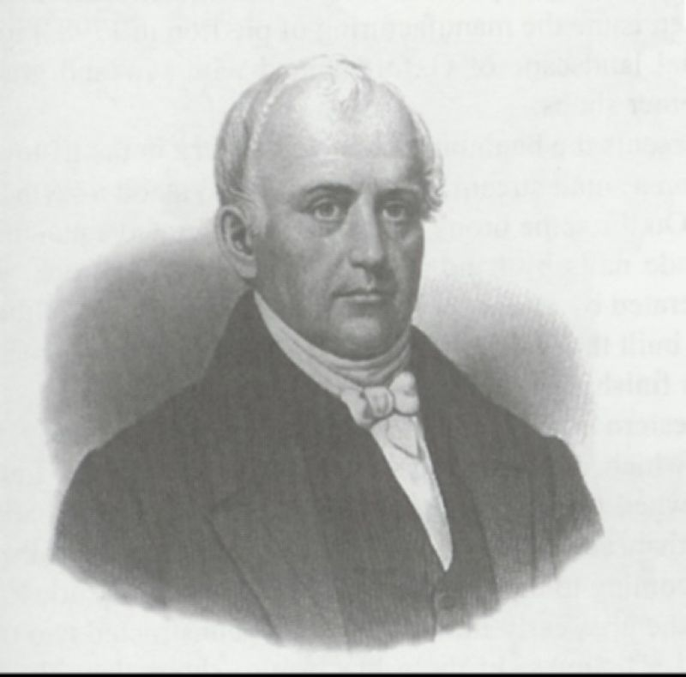
BEGINNINGS OF INDUSTRIALIZATION
1791 Samuel Slater” Father of the American Factory System” built the first efficient cotton spinning machine in America
Eli Whitney’s cotton gin stimulated American Industrial Revolution by supplying cotton to New England textile mills
Samuel Slater (“Father of the Factory System”)

Slide 28
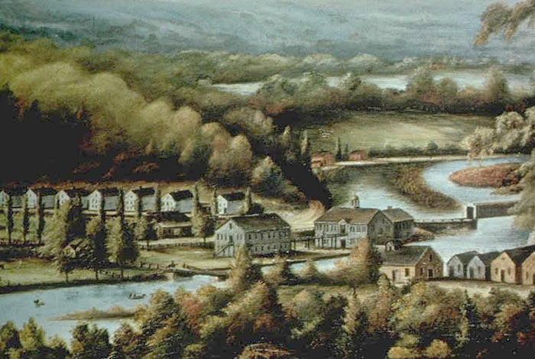
Eli Whitney’s Gun Factory
Interchangeable Parts Rifle
Notes:
Pojer – Early 18C Industrialization

Slide 29
Interchangeable Parts
1798 Eli Whitney mass produced muskets for army
Principle of interchangeable parts becomes widely adopted by 1850
Becomes the basis of modern mass production and assembly line methods

Slide 30
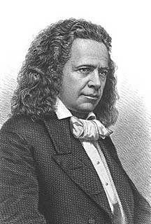
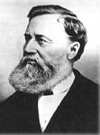
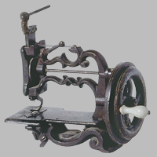
Elias Howe & Isaac Singer
Patent Wars
1840-50s Sewing Machine

Slide 31
Sewing Machine
Elias Howe invented one in 1846
Isaac Singer more successful in improving and promoting the machine
Significance- became the foundation of ready made clothing industry
It drove many a seamstress from their home to the factory

Slide 32
Charles Goodyear
Received a patent for vulcanizing rubber (1844)
Over 500 different uses in the new industry

Slide 33
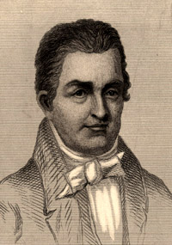
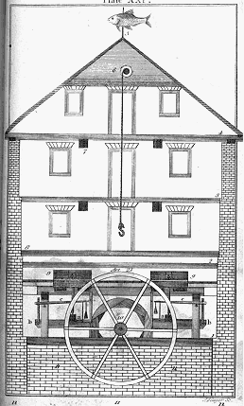
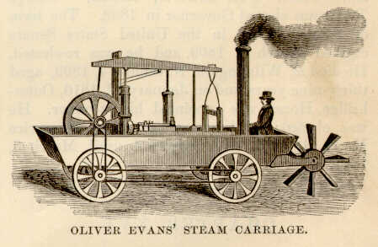
Oliver Evans
First automated flour mill
First prototype of the locomotive

Slide 34
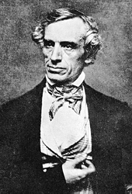
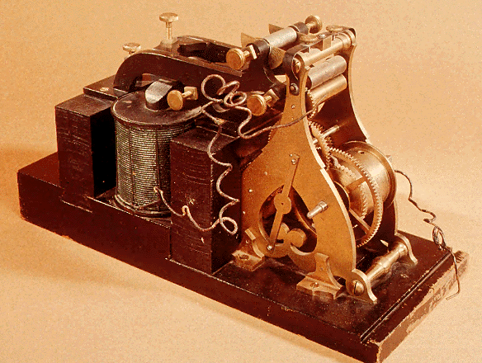
Samuel F. B. Morse
1840 – Telegraph
Notes:
Pojer – Early 18C Industrialization

Slide 35
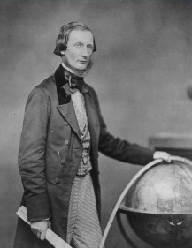
Cyrus Field & the Transatlantic Cable, 1858
Notes:
Pojer – Early 18C Industrialization

Slide 36
Why did New England become the center of the Industrial Revolution
Rocky soil discouraged farming and made manufacturing more attractive
Dense population to provide labor
Seaports made it easy to import and export goods
Swift flowing rivers provided the abundant power needed
Capital available from merchants who suffered from War of 1812

Slide 37
The Lowell/Waltham System: First Dual-Purpose Textile Plant
Francis Cabot Lowell’s town - 1814

Slide 38
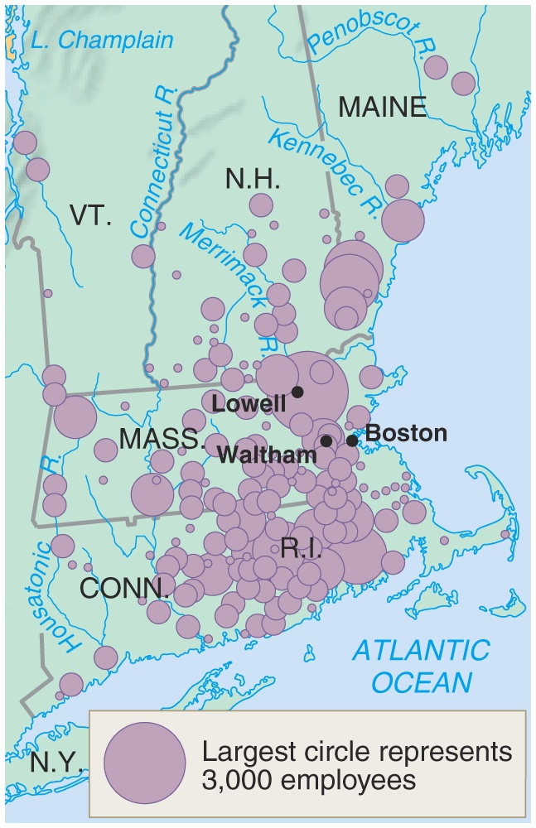
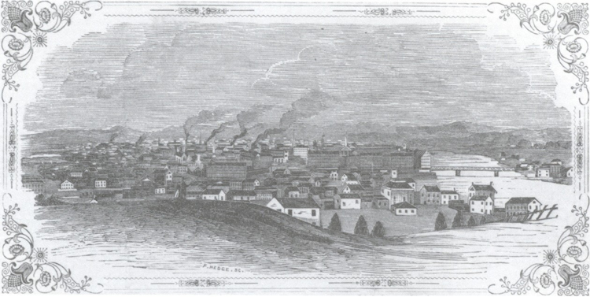
BEGINNINGS OF INDUSTRIALIZATION
Lowell (or Waltham) Factory System
Francis Cabot Lowell
First dual-purpose textile plants (1814)
Brought all aspects of cloth production under one roof
Brought cloth manufacturing from the home to the factory
New England Textile Centers: 1830s
Lowell, Mass. in 1850
Notes:
Pojer (both)

Slide 39
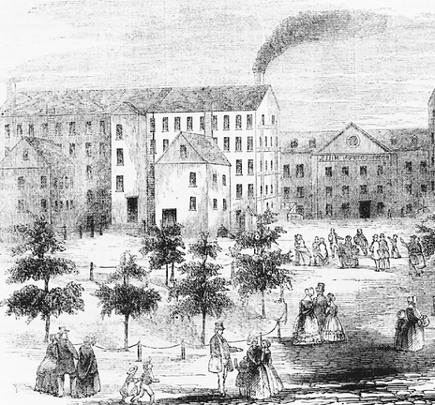
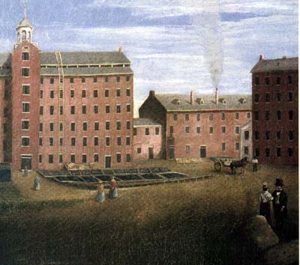
Lowell Mill

Slide 40
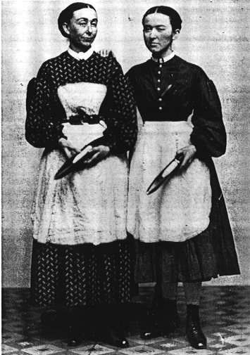
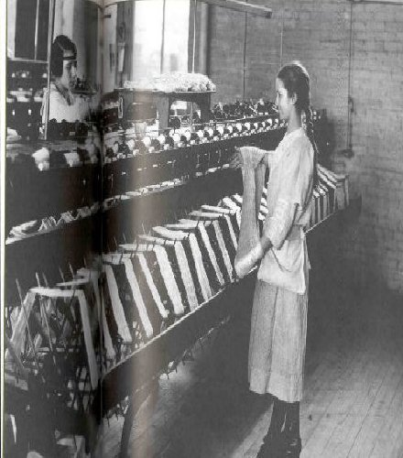
Lowell Girls
What was their typical “profile?”

Slide 41
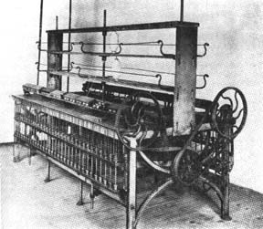
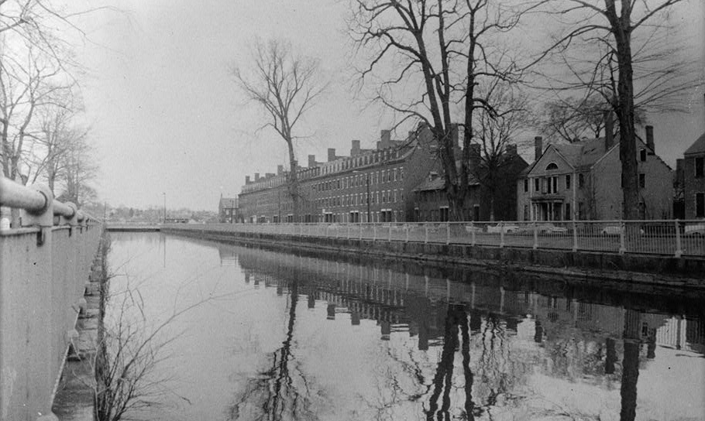
Lowell Girls
Lowell Girls
Early Textile Loom
Lowell Girls - typical “profile”
Factory Girls Association
Lowell Boarding Houses
Notes:
Pojer

Slide 42
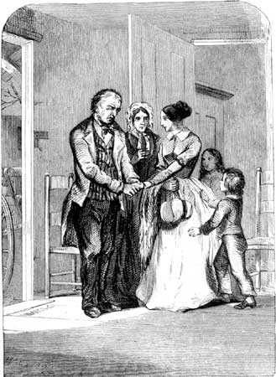
Lowell System
Recruited women in teens and twenties
Mainly unmarried farmer’s daughters
Lived in company towns
Lowell promised strict moral supervision and mandatory church attendance
Worked for years and saved wages
Initially offered fair working conditions with generous wages
Conditions gradually worsened

Slide 43
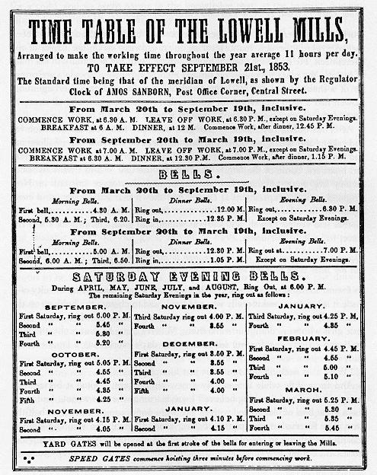
Lowell Mills Time Table

Slide 44
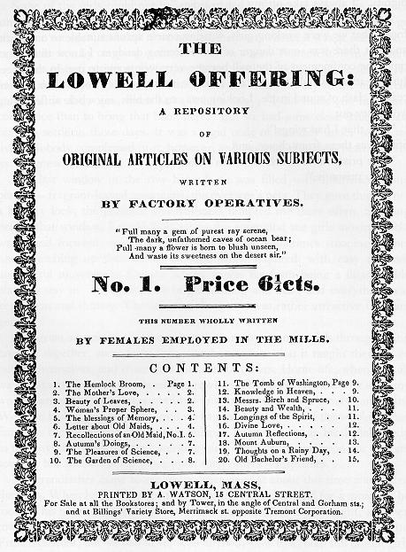
Early “Union” Newsletter

Slide 45
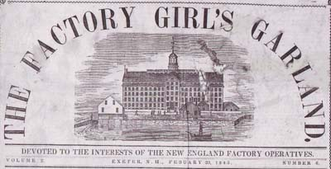
The Factory Girl’s Garland
February 20, 1845 issue.

Slide 46
I’m a Factory Girl Filled with Wishes
I'm a factory girl Everyday filled with fear From breathing in the poison air Wishing for windows! I'm a factory girl Tired from the 13 hours of wok each day And we have such low pay Wishing for shorten work times! I'm a factory girl Never having enough time to eat Nor to rest my feet Wishing for more free time! I'm a factory girl Sick of all this harsh conditions Making me want to sign the petition! So do what I ask for because I am a factory girl And I'm hereby speaking for all the rest!

Slide 47
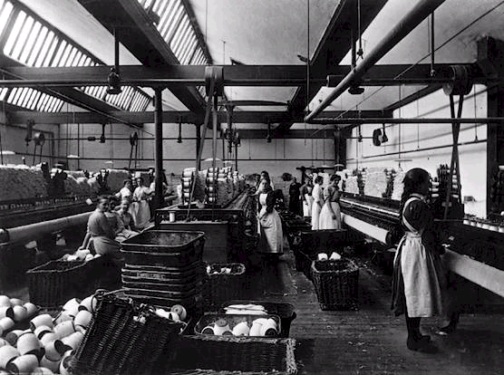
Irish Immigrant Girls at Lowell

Slide 48
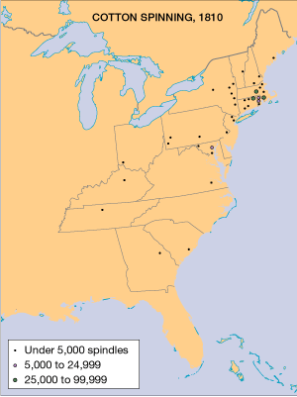
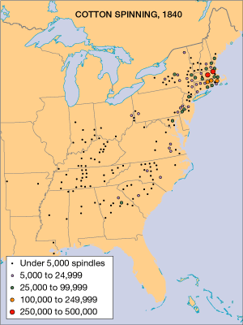
The Growth of Cotton Textile Manufacturing, 1810–1840
Notes:
Faragher, Out of Many, 3rd Ed.; http://wps.prenhall.com/hss_faragher_outofmany_ap/

Slide 49
BEGINNINGS OF INDUSTRIALIZATION: Legal and Financial Developments
Corporations
In 1800, c. 20 corps US; by 1817, over 1800
General incorporation laws
New York, 1848
stock
limited liability
Banking – paper banknotes

Slide 50
Creating a Business-Friendly Climate
General Incorporation Law 1848 - Allows for “Limited Liability”
Laissez faire → BUT, govt. did much to assist capitalism!

Slide 51
Distribution of Wealth
During the American Revolution, 45% of all wealth in the top 10% of the population.
1845 Boston → top 4% owned over 65% of the wealth.
1860 Philadelphia → top 1% owned over 50% of the wealth.
The gap between rich and poor was widening!

Slide 52
Results of Industrialization
Increased productivity began to feed mass consumption markets
Towns and cities grew around factories
Labor shortage stimulated immigration and encouraged inventiveness
Effects of boom and bust cycles were broadly felt
Government was increasingly promoting industry
sectionalism

Slide 53
Northern Working Conditions
Long hours, low wages, few breaks, poor ventilation, poor lightning and poor heating
Workers forbidden by law to form unions
Strikes were rare
Workers had a difficult time of keeping precise timetable
Women and children toiled 6 days a weeks while earning small wages

Slide 54
Expected attitudes and habits of the new economic order
Responsibility
Hard work
Steadiness and sobriety
Reining in of employee spontaneity

Slide 55
LABOR & THE EARLY UNION MOVEMENT
National Trades’ Union- Philadelphia (1834)
Early issues:
Child Labor Laws
10 Hour Workday
Right to Strike
Commonwealth v. Hunt (Massachusetts,1842)
- ruled forming unions were not illegal if their methods were honorable and peaceful
Early unions were usually local, social, and weak – and were largely ineffective before the Civil War

Slide 56
CHANGES IN SOCIAL AND CLASS STRUCTURES

Slide 57
Guiding Question
How did the transformation of the American economy in the first half of the nineteenth century bring about changes to society, including the role of women?
Notes:
(Based on 1989 FRQ)

Slide 58
CHANGES TO SOCIETY
The market economy changed:
class structure
The nature and location of work
Gender roles (Middle class)
the standard of living
Social Class structure
Working class
Rise of the middle class
Social mobility?
Geographic mobility
UPPER
MIDDLE
WORKING
LOWER
Where do Farmers fit?

Slide 59
Northern Middle Class
“The most valuable class in any community is the middle class” - Walt Whitman 1858
The Market Revolution and Industrialization:
Created new cities
Transformed old cities
Rural North became a collective of family-owned commercial farms

Slide 60
Who Were The Middle Class???
City and country merchants
Master Craftsmen/Manufacturers
Market-oriented farmers
Many were New Englanders
South still remained primarily rich or poor

Slide 61
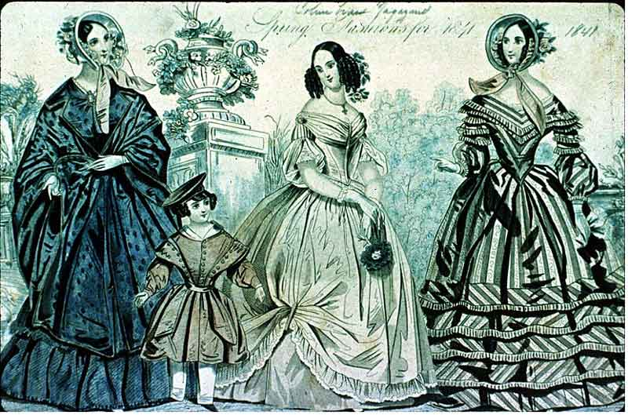
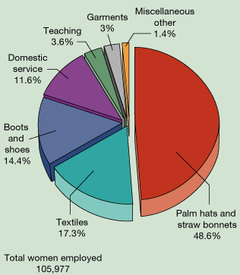
CHANGES TO SOCIETY
Work & Home
Lower birthrates
“Separate Spheres”
end of cottage industry
new gender roles
“cult of domesticity”
employment opportunities
Education of women
Oberlin College
Occupations of Women Wage Earners in Massachusetts, 1837
Notes:
Spring Fashions - http://www.wadsworth.com/history_d/special_features/image_bank_US/1815_1860.html
Occupations of Women - Faragher, Out of Many, 3rd Ed.; http://wps.prenhall.com/hss_faragher_outofmany_ap/

Slide 62
Cult of Domesticity
Men went to work leaving wife and children home alone
Separated into spheres
Mothers replaced fathers as rearers of children
Replaced fear with love and reason
Family size decreased
Became the expected and accepted role of women…whether they liked it or not

Slide 63
POPULATION GROWTH, IMMIGRATION AND NATIVIST REACTION

Slide 64
Guiding Question
“Throughout its history, the United States has been a land of refuge and opportunity for immigrants.”
Assess the validity of this statement in view of the experiences of the English, Germans, & the Irish in the 19th-century urban Northeast.
Notes:
(1987)

Slide 65
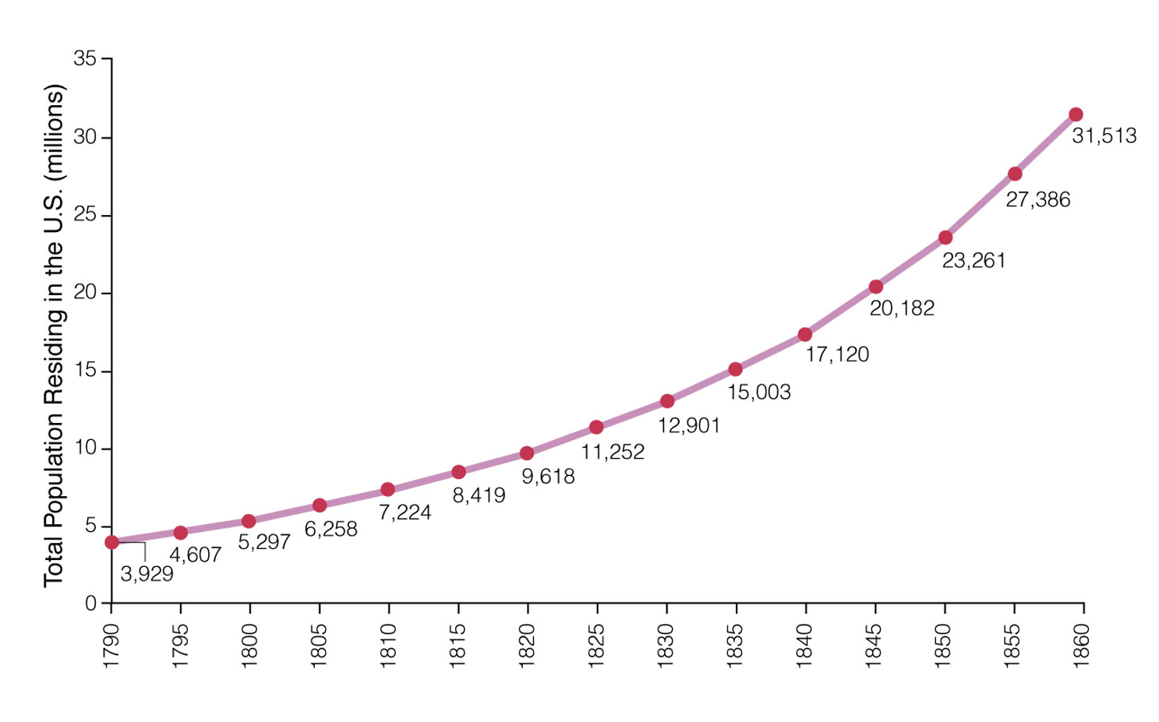
POPULATION GROWTH
1775 2.5 Million
1790 4 Million
1820 10 Million
1840 17 Million
1860 32 Million
Notes:
Jones, et al., Created Equal

Slide 66
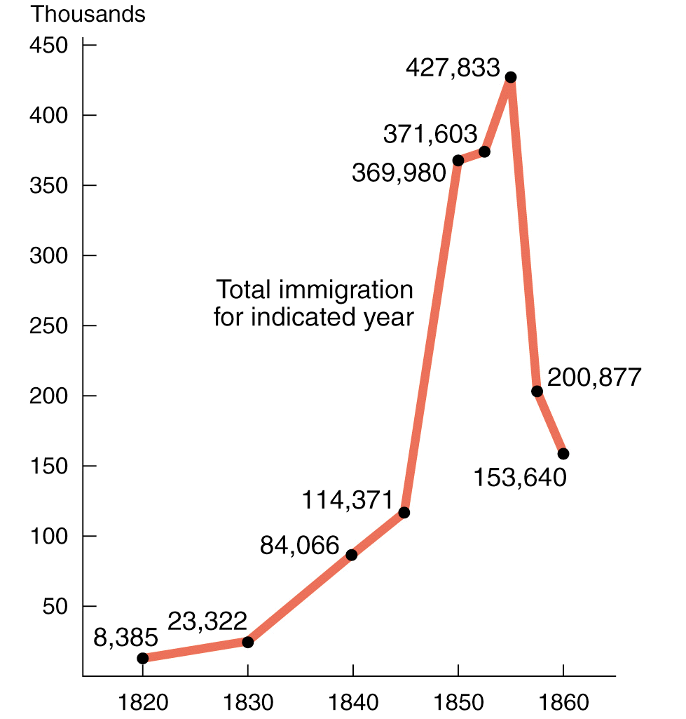
POPULATION GROWTH
Causes
Natural increase
Immigration
Immigration to the United States, 1820-1860
Notes:
Divine, America Past & Present 7e

Slide 67
Immigration
National Origin of Immigrants: 1820 - 1860
Major immigrant groups
Irish
Germans
English
When did they come?
Where did they settle?
Immigration to the United States, 1820-1860
Notes:
Pie chart - Pojer
Graph - Faragher, Out of Many, 3rd Ed.; http://wps.prenhall.com/hss_faragher_outofmany_ap/

Slide 68
Participation of Irish and German Immigrants in the New York City Workforce for Selected Occupations, 1859
Notes:
Faragher, Out of Many, 3rd Ed.; http://wps.prenhall.com/hss_faragher_outofmany_ap/

Slide 69
The distribution of foreign-born residents of the United States in 1860.
Notes:
Faragher, Out of Many, 3rd Ed.; http://wps.prenhall.com/hss_faragher_outofmany_ap/

Slide 70
Rise of Nativism
Began as “Native American Party”
Know-Nothing Party
AKA“ The Supreme Order of the Star-Spangled Banner”
Promoted…
Banning of Catholics from holding office
Stricter naturalization laws
Literacy tests

Slide 71
ECONOMIC?
POLITICAL?
The results of
early 19th Century
industrialization
in America?
SOCIAL?
FUTURE PROBLEMS?

