Slide 1
The First Historians:
Herodotus and Thucydides
Notes:
To follow “Why Study History?” PPT

Slide 2
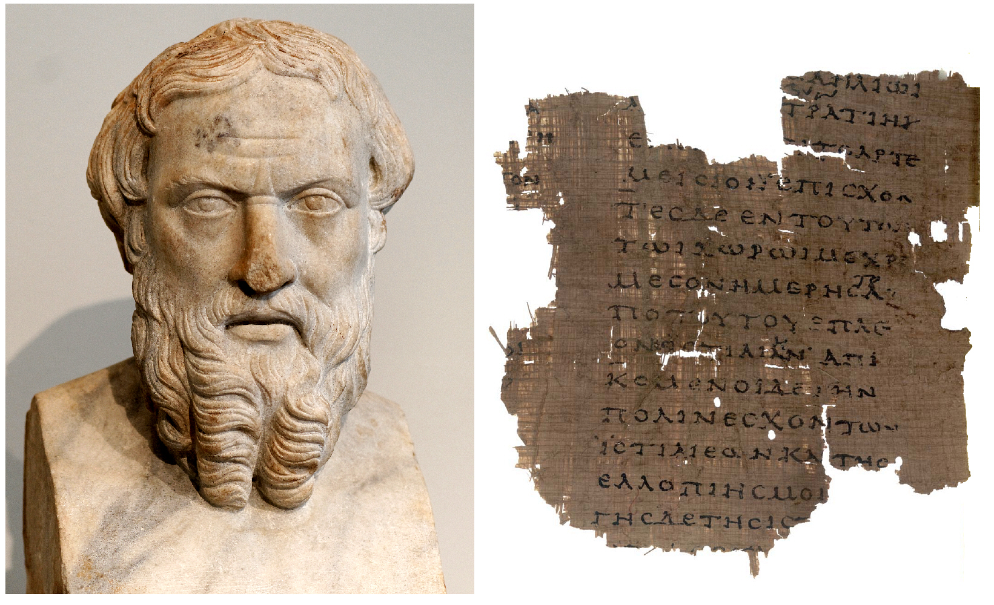
Herodotus

Slide 3
Herodotus wrote mainly about the Persian Wars, in which Greece faced down the invading Persian Empire at famous battles like Marathon and Thermopylae (that’s where Leonidas and his 300 Spartans became famous).
Father of History or the Father of Lies?
Strengths of Herodotus:
• traveled widely gathering information
• tells an interesting story dwelling not just on warfare but social history as well
Weaknesses of Herodotus:
• not contemporaneous; wrote after the wars
• supernatural causation (gives the gods ample space)
• tends to embellish, especially where numbers are concerned (e.g., the size of the Persian army)

Slide 4
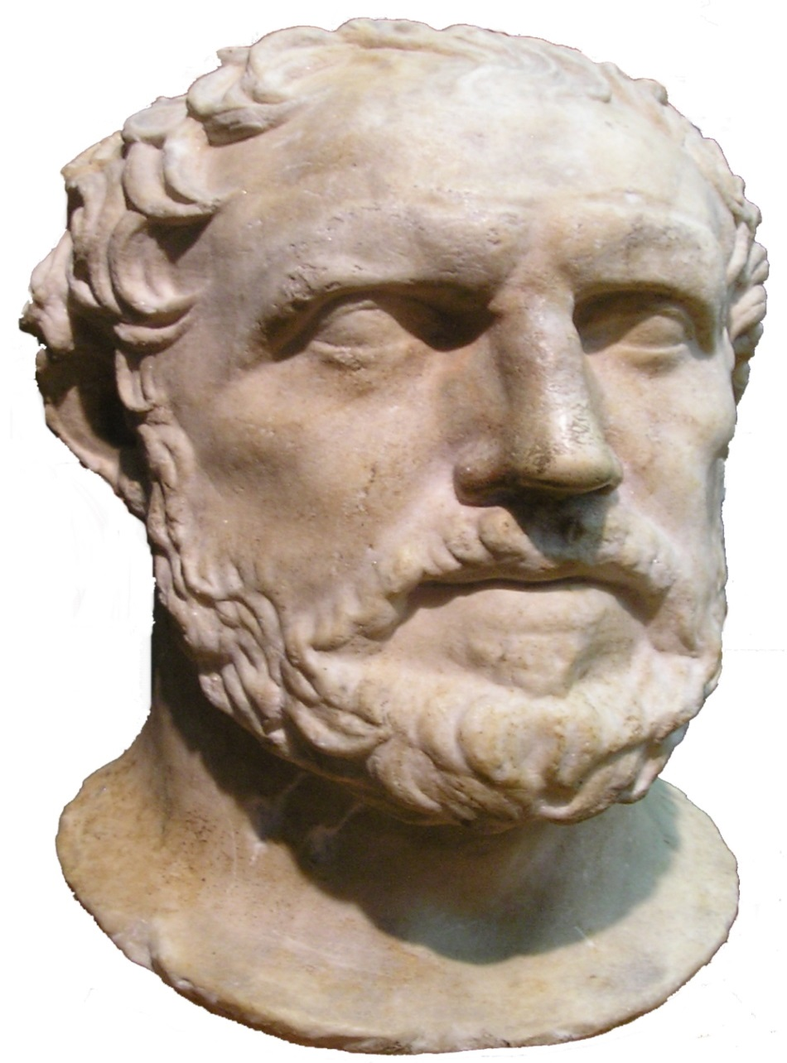
Thucydides

Slide 5
Thucydides
First truly scientific historian
(quite a contrast with Herodotus)
Strengths:
• contemporaneous with war; actually served as an Athenian general in early stages until, because of a military blunder, he was relieved of his command. That gave him time to chronicle the rest of the conflict
• thorough; objective; interested in the truth
• little emphasis on the gods and entertainment.
Weaknesses:
• a little too much emphasis on politics and warfare at the expense of culture.

Slide 6
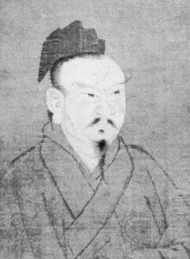
Ssu-ma Ch'ien 145 BC-185 BC
Also spelled “Sima Qian”
Astronomer,
Calendar expert,
The first great Chinese historian,
Noted for his authorship of the Shih-chi (“Historical Records”) also spelled “Shiji. ”
Considered to be the most important history of China down to the end of the 2nd century.

Slide 7
As an Historian
Although the style and form of Chinese historical writings varied through the ages, Shiji has defined the quality and style from then onwards.
Before Sima, histories were written as dynastic history; his idea of a general history affected later historiographers.
Sima’s work became the "official format" of the history of China.

Slide 8
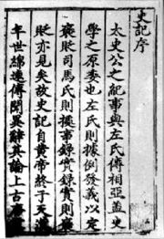
In writing Shiji, Sima initiated a new writing style by presenting history in a series of biographies. His work extends over 130 chapters — not in historical sequence, but was divided into particular subjects, including annals, chronicles, treatises — on music, ceremonies, calendars, religion, economics, and extended biographies. Sima's influence on the writing style of histories in other places is also evident in, for example The History of Korea

