Slide 1
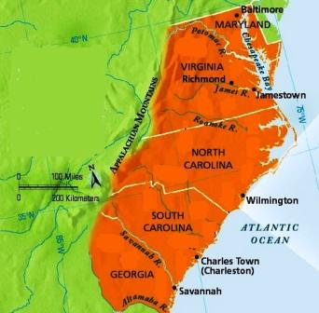
England in America
The Southern Colonies

Slide 2
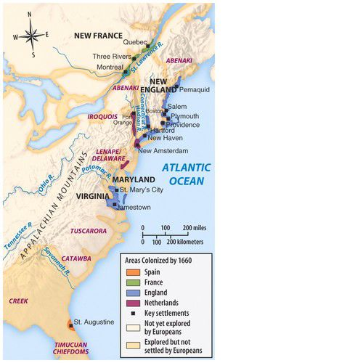
The Wilderness Below the Chesapeake
• With Spain claiming all North American territory up to the Chesapeake Bay, England was reluctant to plant colonies south of Jamestown…
… though John Harvey, Nathaniel Batts and George Durant became the first settlers in the Carolina Albemarle after acquiring a grant from a local Indian chief around 1660.
• Other settlements were established – at least for a short time - by France and Spain in what is now Georgia and South Carolina.

Slide 3
Before 1660, what is now North Carolina was simply considered a part of Virginia.

Slide 4
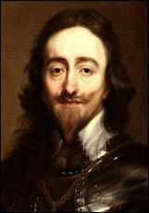
Heath’s Plan…
• Sir Robert Heath envisioned Carolana in 1629, as a refuge for Protestant Huguenots who had fled to England after the revocation of the Edict of Nantes
- He may also have been hoping to establish a military staging area from which to raid Spanish treasure fleets.
• King Charles I granted Heath’s petition partly to establish a new colony, but mostly to get rid of the French Protestant Huguenots who were becoming too sizeable a population in London for the king’s comfort.
• The king soon realized, though, that having a colony full of Frenchmen on English land an ocean away was not a good idea either, so he squashed Heath’s plan to transplant the Huguenots.
King Charles I

Slide 5
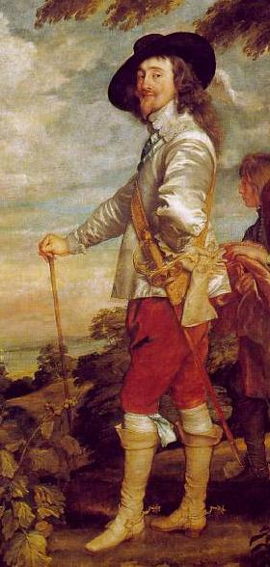
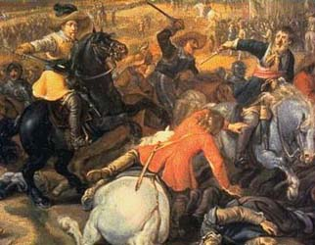
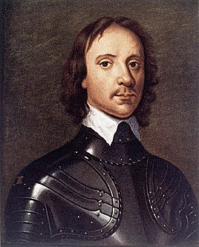
The English Civil War and Cromwellian rule interrupted American colonization, circa 1642-1660.
Oliver
Cromwell
King Charles I

Slide 6
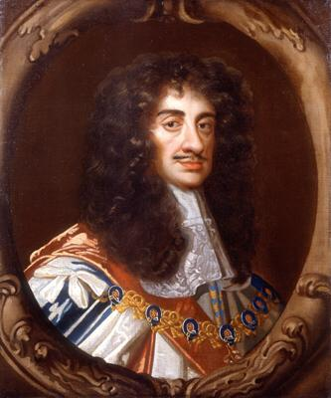
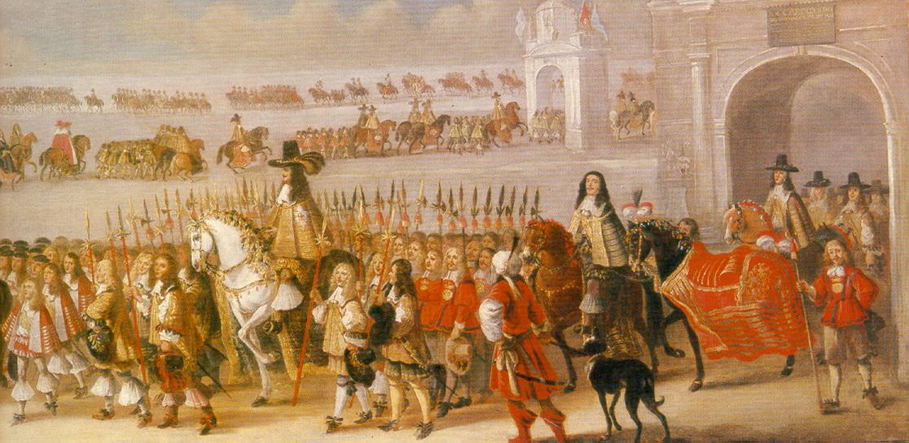
The English monarchy was restored in 1660, with the ascension of Charles II to the throne.
King Charles II

Slide 7
Eight Loyal Men…
Among those who helped Charles Stuart return from exile and assume the throne as King Charles II were eight aristocrats who were rewarded with a charter from the king to settle lands below the Chesapeake they named Carolina, after the monarch who gave it to them.

Slide 8
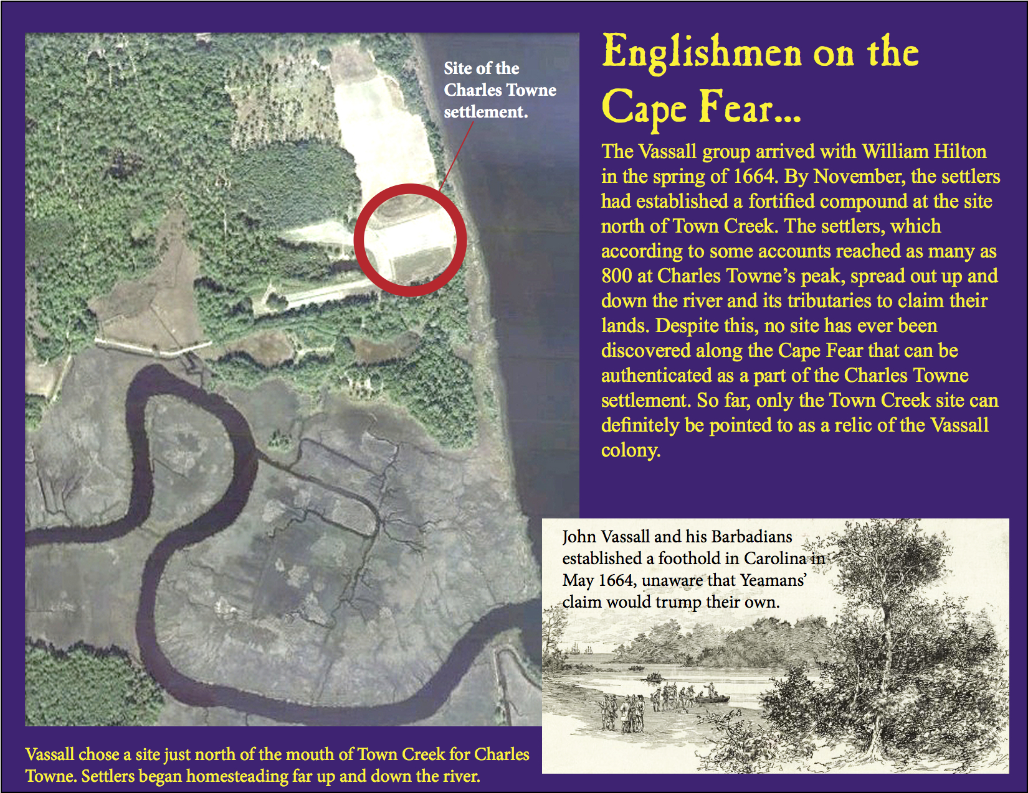
Charles Towne on the Cape Fear (1663-1667)…

Slide 9
One Carolina, Three Counties…
• Albemarle (northermost)
• Clarendon (middle)
• Craven (southern)

Slide 10
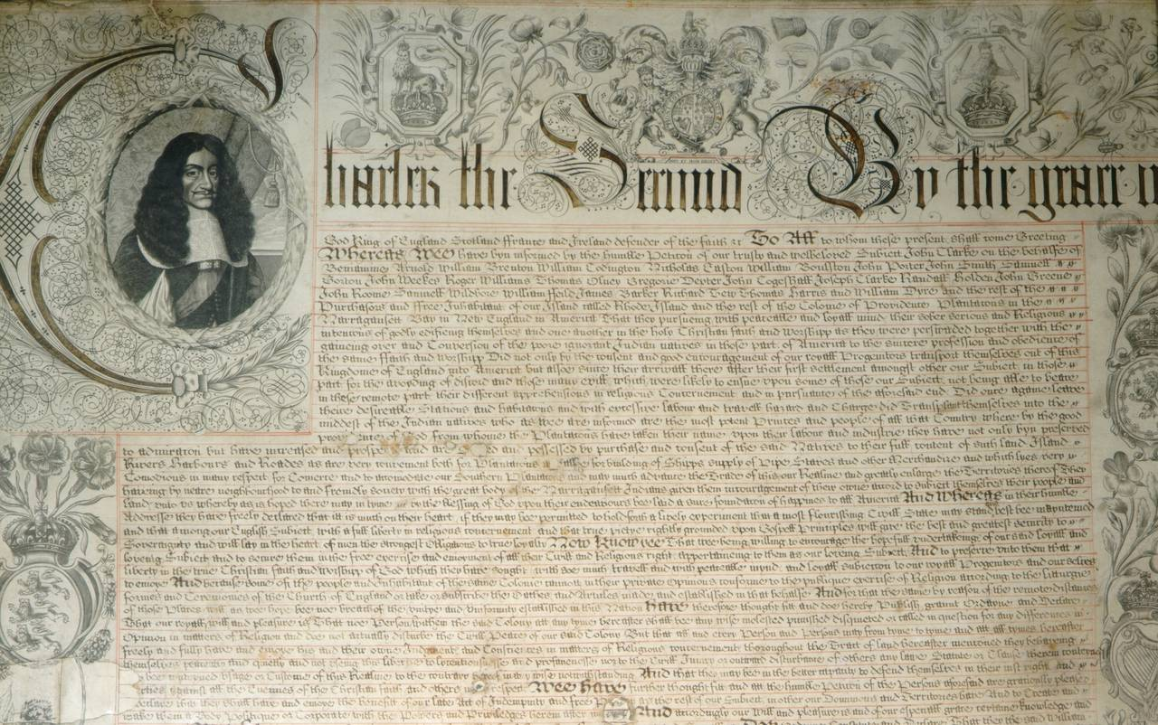
King Charles II granted Carolina to eight Lords Proprietors, with the Carolina Charter of 1663, revised as Concessions and Agreement in 1665.
The Carolina Charter
• Ultimately replaced by the Fundamental Constitutions of Carolina, written by English Enlightenment philosopher John Locke in 1669.

Slide 11
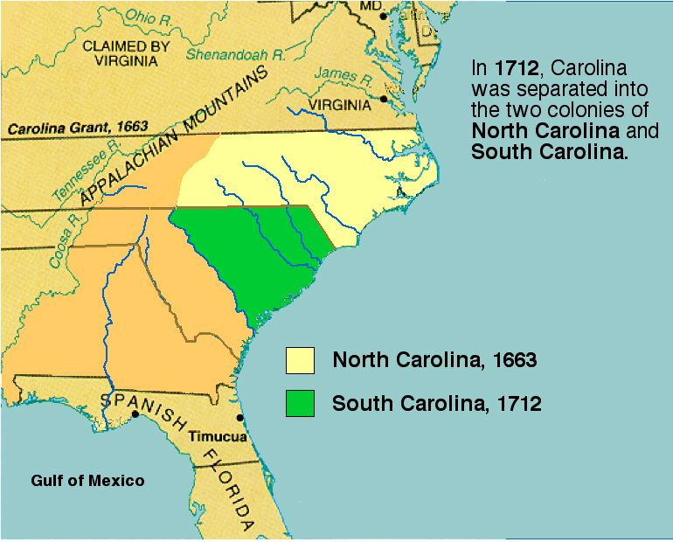
Carolina becomes two colonies (1712)…

Slide 12
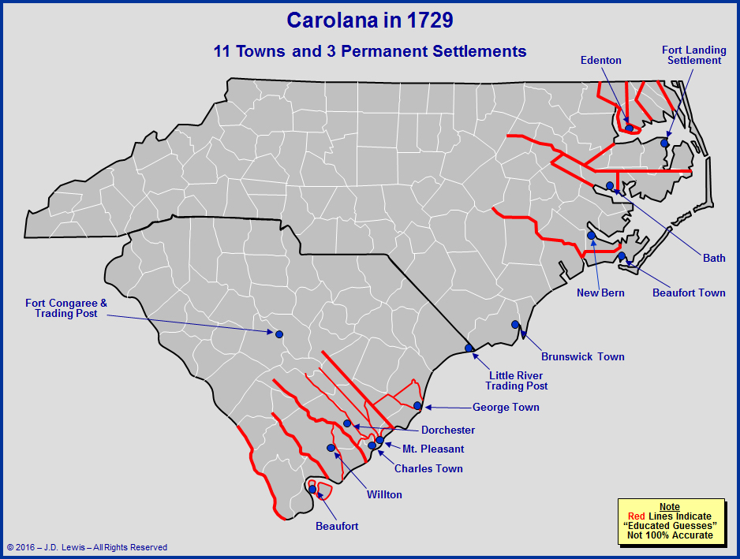
Settlements begin to pop up…

Slide 13
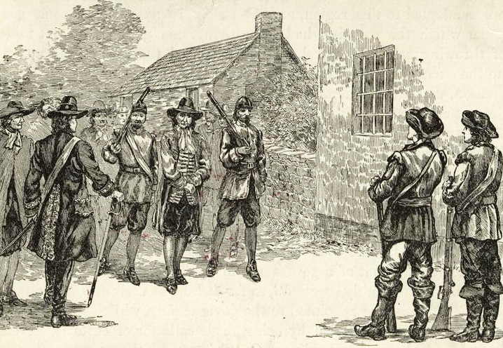
Reluctant settlers…
• When the Lords Proprietors took control of Carolina, the ex-Virginians living in the Albemarle resisted their rule.
• A time of civil discontent and Indian troubles followed, including Culpepper’s Rebellion, the Seth Sothel expulsion and the Tuscarora Indian War,
Thomas Miller placed under arrest after the Culpepper Rebellion

Slide 14
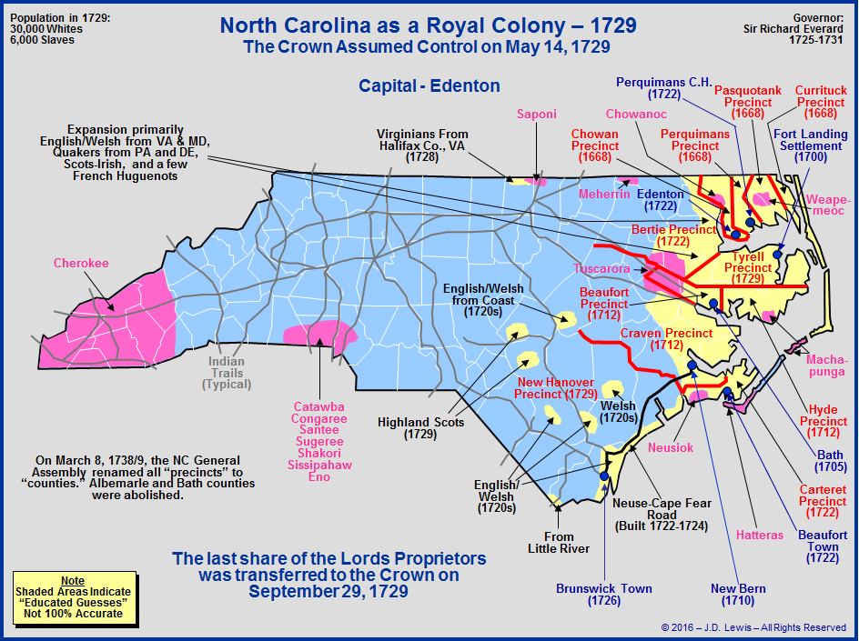
NC becomes a royal colony…
• By 1729, the heirs to the original Lords Proprietors of Carolina came to the decision that the colonies were too troublesome for too little profit, and sold North and South Carolina back to the Crown in May of 1729. The Carolinas at that point became royal colonies.

Slide 15
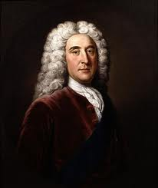
South Carolina…
• Although Barbadian settlers had already planted a colony along the Cape Fear River, another proposal proved more to the liking of the Lords Proprietors.
- Sir John Yeamans, a Barbadian planter in competition with the Vassall group at Cape Fear, proposed a colony further south, at a place just 250 miles from the Spanish fort at Saint Augustine. The Yeamans proposal became the favorite of the Lords Proprietors.
- The law of territorial claims of the seventeenth century said it was not enough to claim land, but that you also had to protect that claim by keeping others out.
• By planting a colony so close to the Spanish, the English were challenging their claim to the east coast of North America.
• The move reflects England’s growing power, while Spain’s power was eroding.
Sir John Yeamans

Slide 16
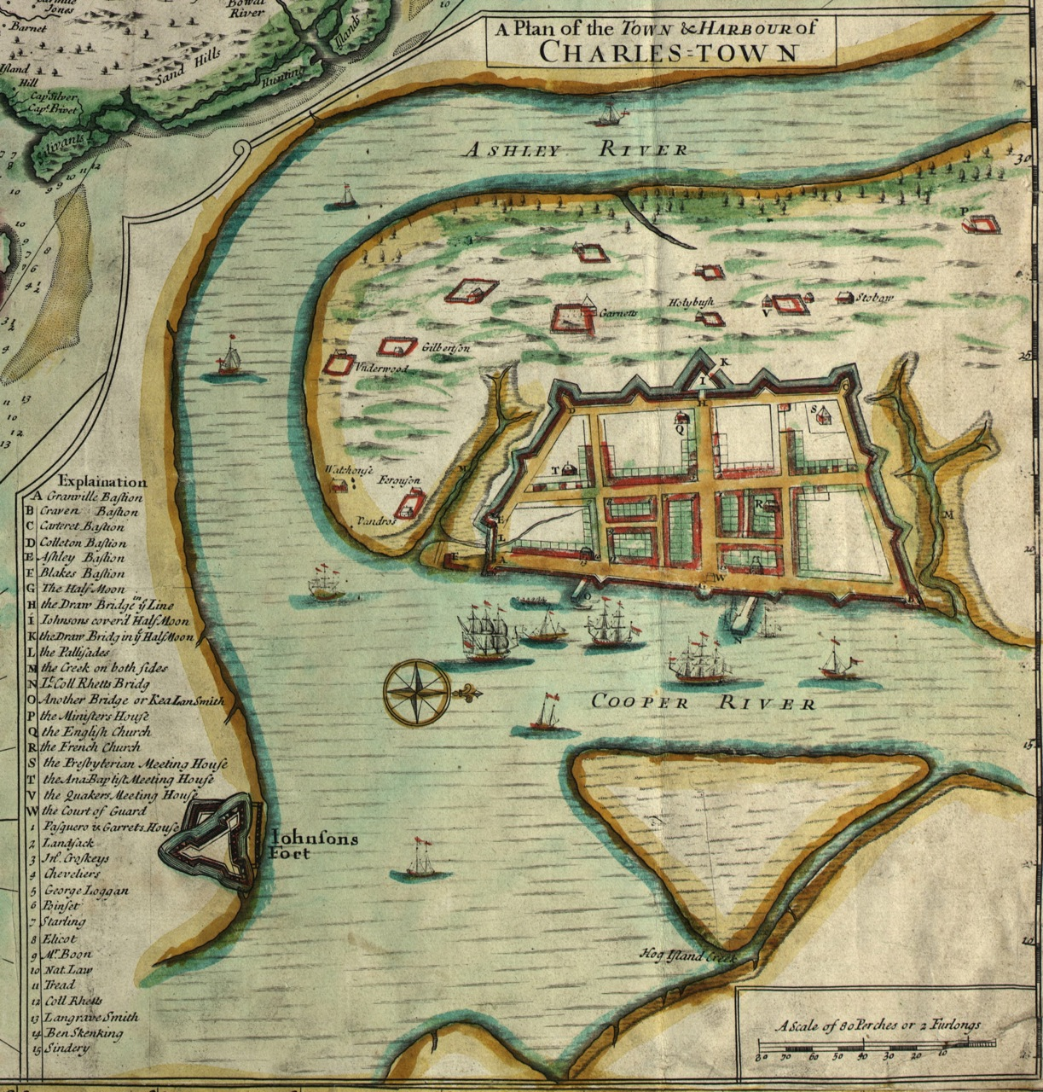
Settlers on the Ashley…
After the failure of the colony at Cape Fear in 1667, some of the settlers there traveled south to join the Yeamans group at Port Royal on Albemarle Point in 1670. Some time later, they moved to the east side of the river, to the point where the Ashley and Cooper Rivers meet. They named the new settlement Charles Town, after the king. By the 1700s, the settlement was being called by the name it carries today, Charleston.

Slide 17
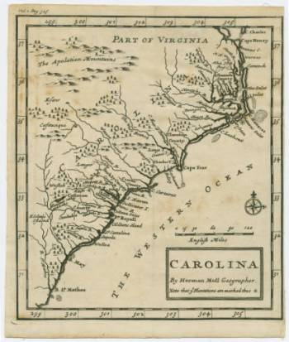
The Lords Proprietors’ Favorite…
• The Lords Proprietors preferred the Charles Town settlement over both the Cape Fear and Albemarle.
• For economic reasons, the Yeamans colony on the Ashley & Cooper Rivers had a much better harbor to facilitate trade.
• Politically, Charles Town was far removed from the problematic Albemarle.

Slide 18
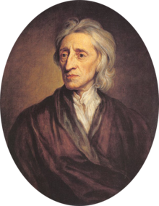
Transplanted Aristocracy & Feudalism…
The Lords Proprietors hoped to establish a society in Carolina (both North and South) that mimicked the aristocracy of England. Their secretary, John Locke, was able to help with that by designing a colonial hierarchy that had a monarch, an aristocracy, and commoners.
• The LPs would function as the monarchy, subservient only to the king.
• People called “landgraves,” granted huge swaths of land by the LPs, would form the aristocracy in Carolina.
• Everyone else would be the commoners who completed the feudal society envisioned by the Lords Proprietors.
John Locke

Slide 19
A colony in need of colonists…
The Lords Proprietors were eager to populate Carolina, both to secure it against Spanish attacks, and also to spur economic growth. Those who agreed to colonize were to be guaranteed:
• Religious tolerance to everyone except atheists (and there weren’t many of those around in Europe anyway)
- Even Jews were allowed to practice their faith
• Political representation in an assembly with power over public taxation and expenditures
• A long exemption from paying quitrents
- Quitrents were low, and postponed until 1689.
• Large grants of land
- The headright system granted 150 acres for each family member who settled in Carolina, plus another 50 acres for each slave the brought with them
The incentives worked. South Carolina’s population soared from 200 in 1670 to 6000 in 1700 (3800 white, 2800 black)
For Carolina to be successful (both North and South), it was essential that people choose to settle there. To insure that, the Lords Proprietors offered lucrative terms for those willing to colonize their patent.

Slide 20
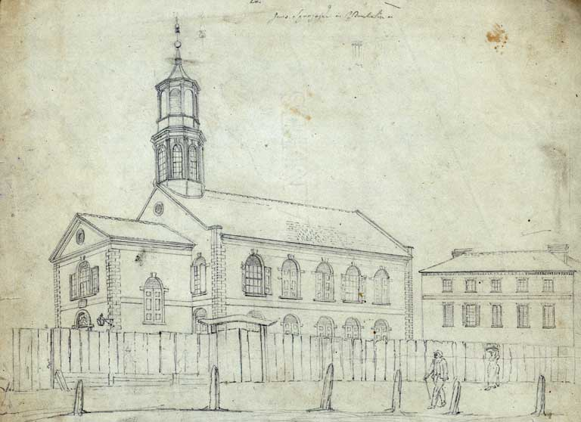
South Carolina as a place of religious refuge…
French Huguenots
The Huguenots were French Protestants who were persecuted in Catholic France. They came to South Carolina for religious freedom. The Huguenots started schools and helped the poor.
• The Huguenots fled France after the revocation of the Edict of Nantes, and many landed in England.
European Jews
The colony became a haven for religious dissenters and others seeking to worship as they pleased
European Jews were also attracted to the colony because of its religious toleration. They established a synagogue in Charleston and contributed to the city’s economic growth.

Slide 21
Settler origins, risks, and rewards…
Most Carolina settlers were from the Chesapeake region or the West Indies (primarily Barbados). It was they who did the hard work of building farms, establishing settlements, and fighting Indians on the frontier.
• At least a third of the common settlers started out as indentured servants, either from England or Barbados
- In 1671, the SC governor urged the LPs to send more English, because “ wee find that one of our Servants wee brought out of England is worth 2 of the Barbadians, for they are so much addicted to Rum, yet they will doe little but whilst the bottle is at their nose.”
• Once the indenture was served, the servant got his “freedom dues”: a barrel of maize, tools, and 100 acres of land.
- It was a way poor people could prosper. Most former indentures eventually accrued about 330 acres.

Slide 22
Rice Riches and Indigo…
While sugar was not a good fit for growth in the Carolinas, rice and indigo were perfectly suited to the warm summers and mild winters there.
• The English imported the plantation system of agriculture to the Carolinas from Barbados.
• Plantation agriculture required a large, cheap labor force. Slavery was the way the planters filled that need.
- Initially, the Indians of Carolina were enslaved, but they were sent to plantations in the West Indies.
- Eventually Indian slavery died out as the numbers of available Indians fell. African slaves replaced them, both in the West Indies and in Carolina.
South Carolina planters turned rice and indigo into hugely profitable plantations in the Lowcountry It made South Carolina one of the wealthiest of the thirteen colonies. Rice grew as far north as the Cape Fear River.

Slide 23
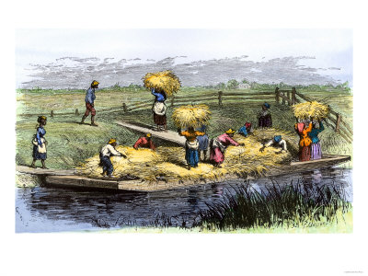
Slaves: the key to rice’s success…
Slaves were valuable to the wealthy lowcountry planters because they knew how to grow rice. This became central to the plantation economy and wealth of South Carolina.
• The institution of slavery came to dominate the culture of the lowcountry and eventually the culture of all of South Carolina.
• The slave trade included slave auctions: selling the enslaved people who arrived on the ships. from Africa.
• Slaves were inspected by potential buyers and sold to the highest bidder.

Slide 24
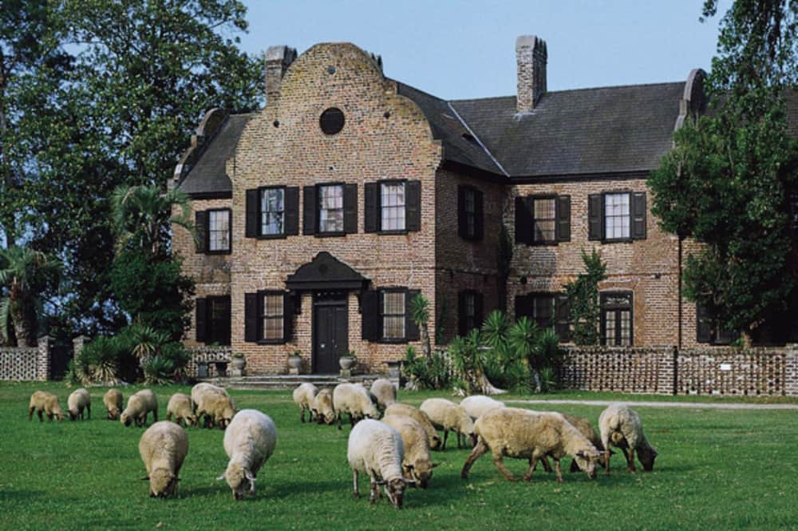
Settlers of the better sorts…
While the Lords Proprietors wanted large numbers of common settlers, they also made sure to encourage emigration by the upper classes. To attract rich investors, the LPs promised them great power within their Carolina domains.
- Great planters who settled in Carolina were assured of “absolute Power and Authority over his Negro slaves.”
- While the LPs encouraged that slaves convert to Christianity, they guaranteed that it would not affect the legal status of slaves.
Middleton Place in SC.
• The offer was attractive for the large planters, who saw it as a way to provide for younger sons who would not inherit estates otherwise.
• It also was a way to prevent downward mobility from setting in, devaluing the family net worth
• The Middleton family of South Carolina by way of Barbados and Antigua are a prime example, with older son Benjamin retaining the Barbados estates, while his younger brothers Arthur and Edward settling in Carolina.

Slide 25
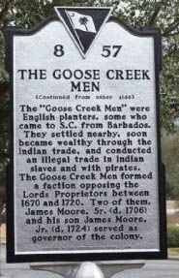
The Goose Creek Men…
Many of the planters who would become South Carolina elites and wealthy plantation owners settled outside Charleston at Goose Creek. Their political power was substantial because of their wealth and the amount of land they owned. The “Goose Creek Men” became serious opponents of the Lords Proprietors.
They came primarily from Barbados , where their families already had large sugar plantations. Their economic and political power in the Carolinas was substantial. Two of them, James Moore Sr. and James Moore Jr., would both serve as governors of the colony. Maurice and Roger Moore founded Brunswick Town on the Cape Fear River in 1725.

Slide 26
Slave resistance…
Enslaved Africans sometimes practiced acts of resistance against white authority. The effort to keep their African traditions alive was a silent statement of resistance against their plantation owners.
• Enslaved people could also ruin tools, work slowly, or in more drastic situations, run away or rebel against their owners.
• Agency also took the form of the development of covert communities within the plantation that preserved the languages, ways, and traditions of their African homelands.
• Sometime slave resistance took the form of violence. Planters were always terrified of slave uprisings. Even in the earliest days, plantation owners were frightened of the possibility of African-Indian alliances that might team up on them to eliminate their white oppressors.
Despite the horrid nature of their lives in bondage, slaves still managed to take some agency for their own lives.

Slide 27
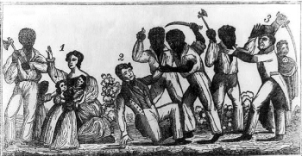
The Stono Rebellion…
An example of Slaves acting in violence against owners is the Stono Rebellion. This rebellion was quickly put down, participating slaves were executed and a new set of laws was passed in South Carolina to control slaves.

Slide 28
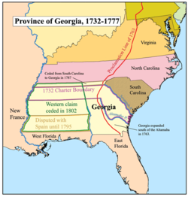
Georgia…
• Georgia wasn’t founded until fifty years after all the other colonies were established (1732).
• While there had been explorations in the territory that would become Georgia since 1717, it wasn’t until James Oglethorpe approached King George II for a patent to establish the new colony from territory that had previously been part of the Carolina grant.
Colonial Georgia

Slide 29
Oglethorpe’s Reasons for Georgia…
James Oglethorpe had three main reasons to found Georgia when he went to King George II for a charter:
• Political: the new colony would provide relief for the crowded prisons filled with debtors who contributed nothing to British society, and would also provide a refuge for Protestants who often found themselves persecuted in Europe.
• Military: Georgia would act as a buffer between Spanish Florida and South Carolina, a protection for the King’s richest colony. It would also expand the King’s North American empire.
• Economic: Georgia would enhance the British treasury as a source of silks, wine, hemp, and flax; and it would also remove some of the burden from the government for taking care of the poor and unemployed.

Slide 30
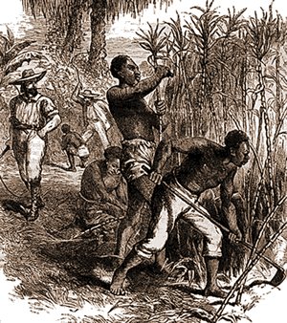
Growing pains…
The pre-war restrictions the trustees ended in Georgia did not stop with land, slaves, and liquor.
• The Georgians were also granted permission to form a colonial assembly
- While the colonists could express their opinions in the assembly, they were still prohibited from enacting any laws
• As a result, the colonists remained unsatisfied, so much so that the trustees turned the colony over to the Crown two years before they were due to, in 1751.
• As a Crown colony, population began to rise, and rice, indigo, and tobacco became the primary cash crops produced in Georgia – all thanks to African slaves.

