Slide 1
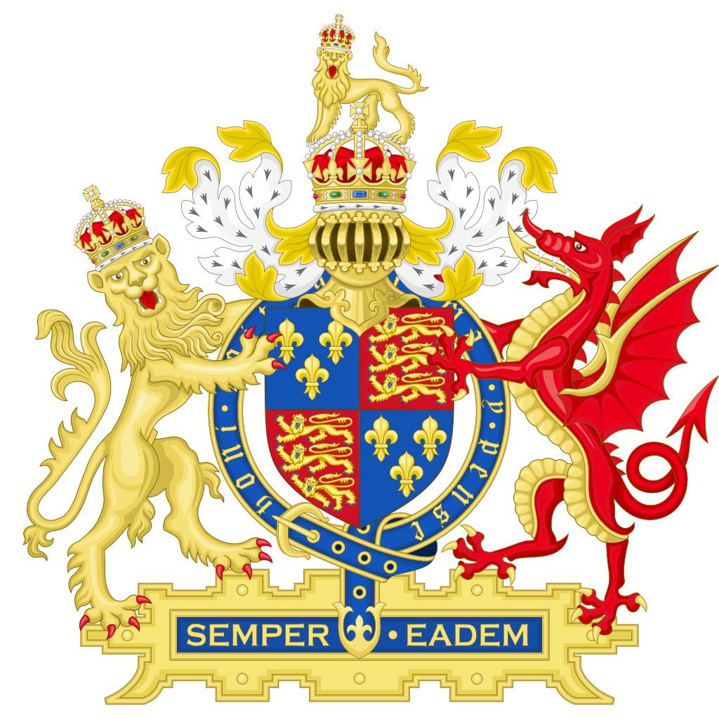
Roanoke
England comes to North America

Slide 2
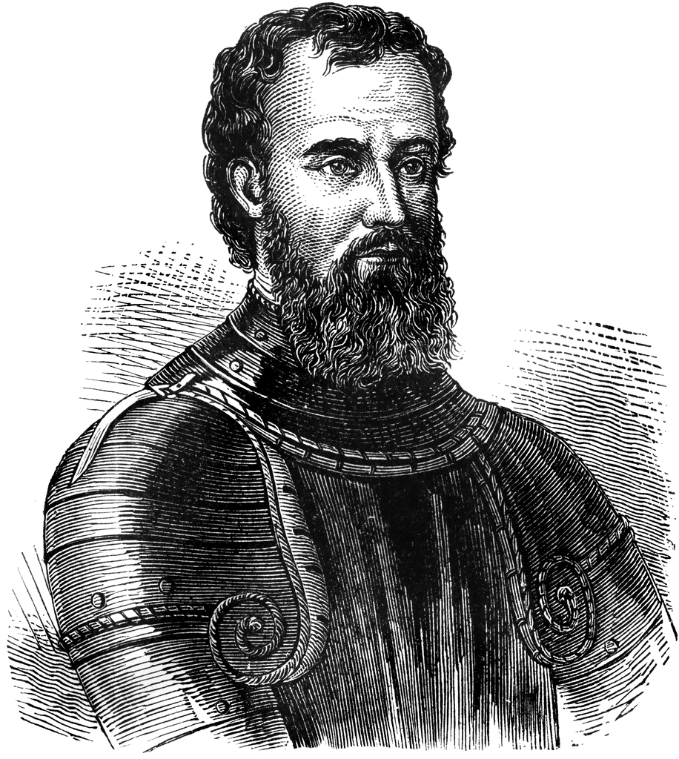
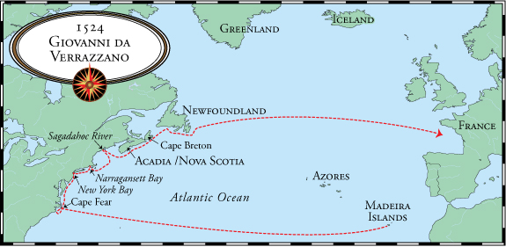
Europeans explore the Carolina coast…
The first explorers to conduct detailed explorations of the Carolina coast were Pedro de Quejo for Spain, and Giovanni de Verrazzano for King Francis I (1524)
Giovanni de Verrazzano
Verrazzano explored all along the East Coast, from Cape Fear to Newfoundland.

Slide 3
Incentives for English Settlement of North America
1. military
a. undermine Spain’s transatlantic empire
1. establish commerce raiding and naval bases
2. make military allies of Native Americans
3. glory for the queen, glory for the realm, glory for
themselves
2. economic
a. Richard Hakluyt the Younger
1. Discourse on Western Planting (1584)
a. discovery and development of resources
1. commercial exploitation
a. “merchantable commodities”
2. materials for the construction of fleets of ships
b. provide employment opportunities for disadvantaged people
c. make trade alliances with Native Americans
3. religious
a. extend Protestantism
1. convert Native Americans to the Anglican faith
2. rediscover God’s wonders in the New World

Slide 4
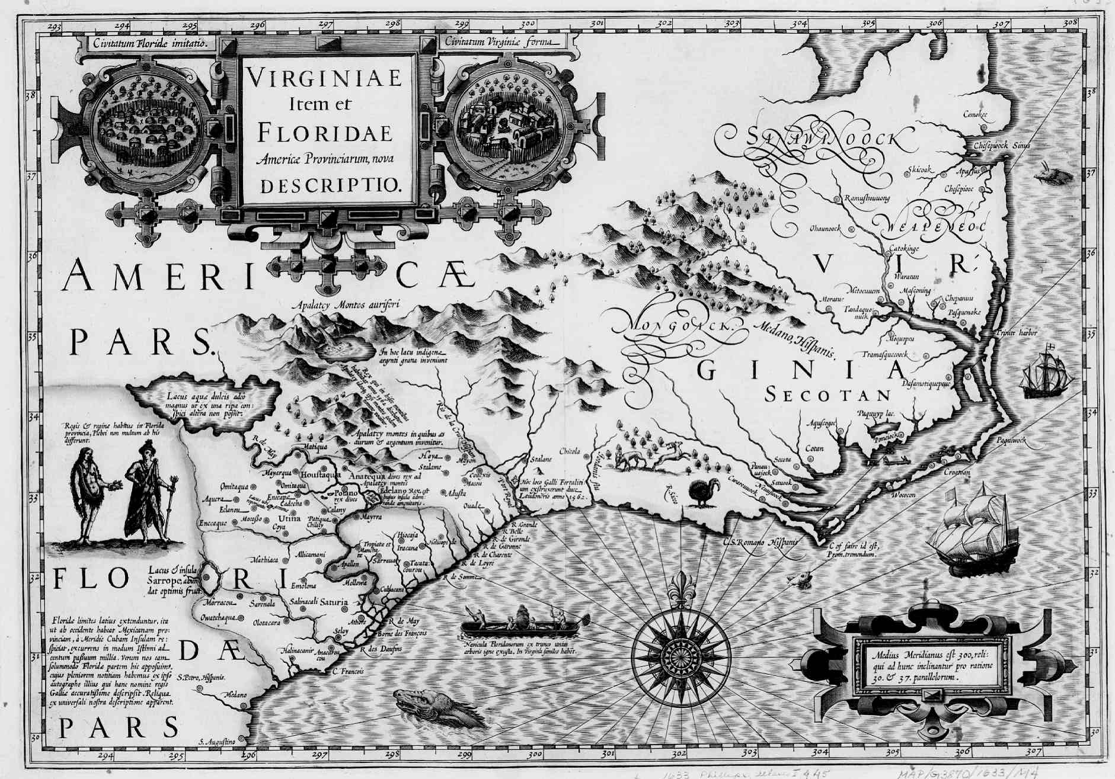
Raleigh gets permission to plant a colony…
Under Raleigh’s charter, the English made three voyages to North America. Raleigh never led or accompanied any of the expeditions.
Raleigh was commanded to “…discover and search find out and view such remote heathen and barbarous lands Countries and territories not actually possessed of any Christian Prince and inhabited by Christian people…”
- from Raleigh’s letters patent from Queen Elizabeth I

Slide 5
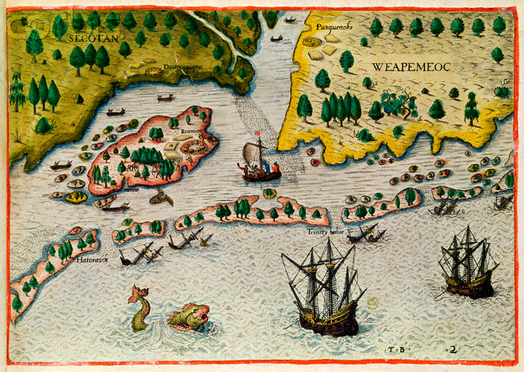
Voyage #1 – Amadas & Barlowe
1584
Finding a place to colonize:
Phillip Amadas and Arthur Barlowe led an exploratory mission to North America, making landfall in modern North Carolina, “a most fertile land.” They remained there for 77 days, from mid-July to early October 1584.

Slide 6
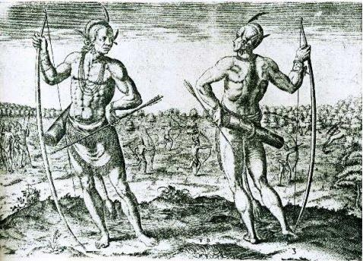
Amadas & Barlowe deliver a favorable report…
Amadas and Barlowe returned to England with a glowing report that told of “numerous fertile islands covered with timber and teeming with game.” They described local Indians as “very handsome, and goodly people, and in their behavior as mannerly, and civil, as any of Europe.”
Roanoke Island, ten miles long and two wide, was specifically pointed out by the two explorers as being a likely place to plant a settlement.
To support their claims, the English carried two natives (Manteo of the Croatans, and Wanchese of the Roanokes) back home with them.

Slide 7
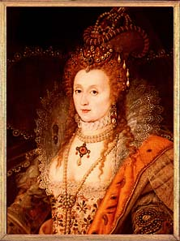
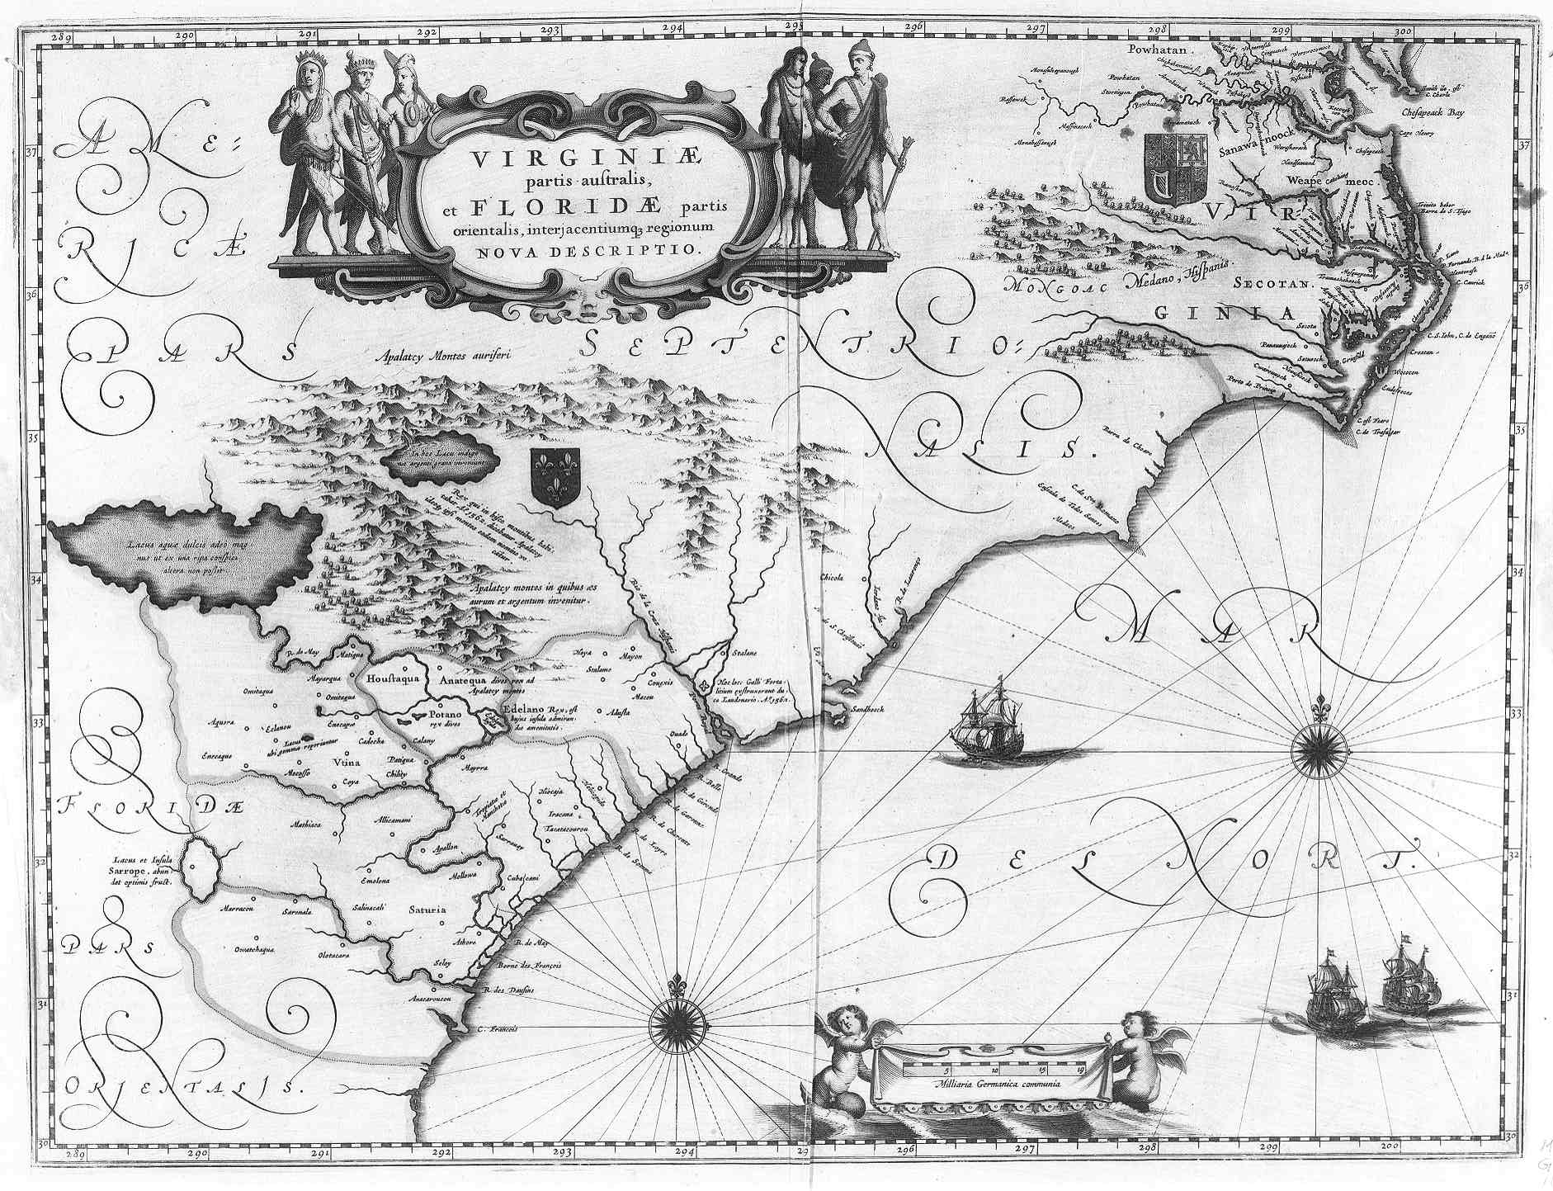
Land of the Virgin Queen…
Raleigh claimed all of the territories explored by Amadas and Barlowe for Queen Elizabeth I. The name for the territory was taken from the queen’s nickname.

Slide 8
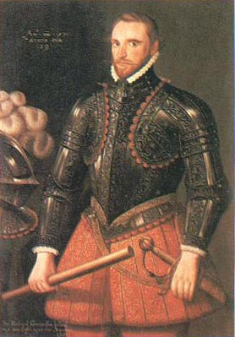
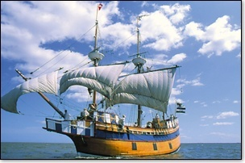
The Grenville Expedition…
1585
In April 1585, Raleigh’s cousin, Sir Richard Grenville, led an expedition of five ships and two pinnaces carrying 600 soldiers to the Outer Banks. They landed in June.
• After exploring the Pamlico Sound area, Grenville sent Capt. Ralph Lane to establish a fort on Roanoke while Grenville returned to outfit another expedition with settlers.
• Grenville and the bulk of the men departed Roanoke for England, leaving 108 men behind to maintain their claim until the settlers could arrive.
• In the winter of 1585-86, Lane’s men discovered the Chesapeake Bay, and learned rumors of gold to be found to the west.
• Lane decided the colony would be better off at Chesapeake, where anchorages were deeper and safer than Roanoke on the treacherous Outer Banks.
Sir Richard Grenville,
cousin of Sir Walter Raleigh

Slide 9
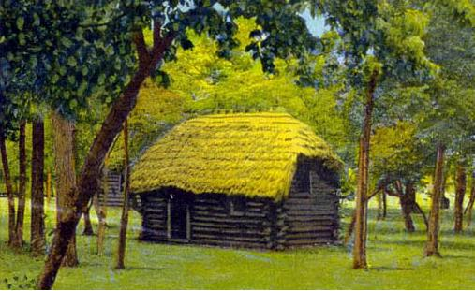
Cittie of Raleigh…
Ralph Lane and his men established the Cittie of Raleigh, reportedly located on the north end of Roanoke Island.

Slide 10
The “Cittie of Raleigh” also had a fort to protect it, as seen in this period map.

Slide 11
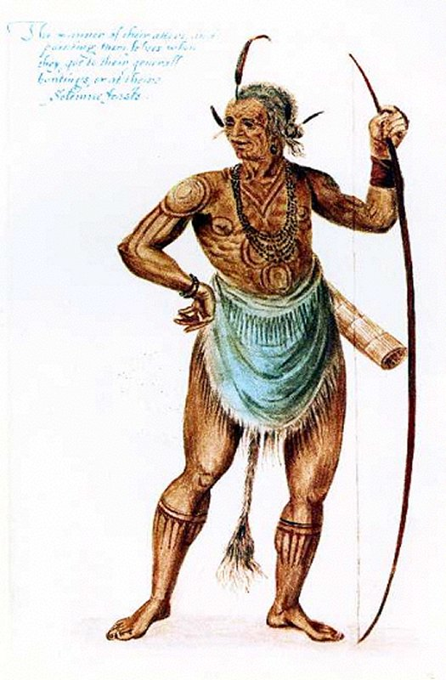
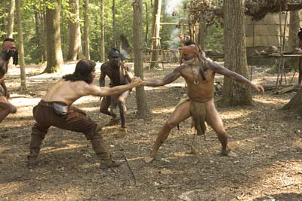
Militaristic & Murderous…
Lane’s men were militaristic and dependent on Native Americans for food and sustenance, creating a high level of tension between the two groups. To establish their dominance, Lane’s men murdered and decapitated Wingina, chief of the Weapemeocs.

Slide 12
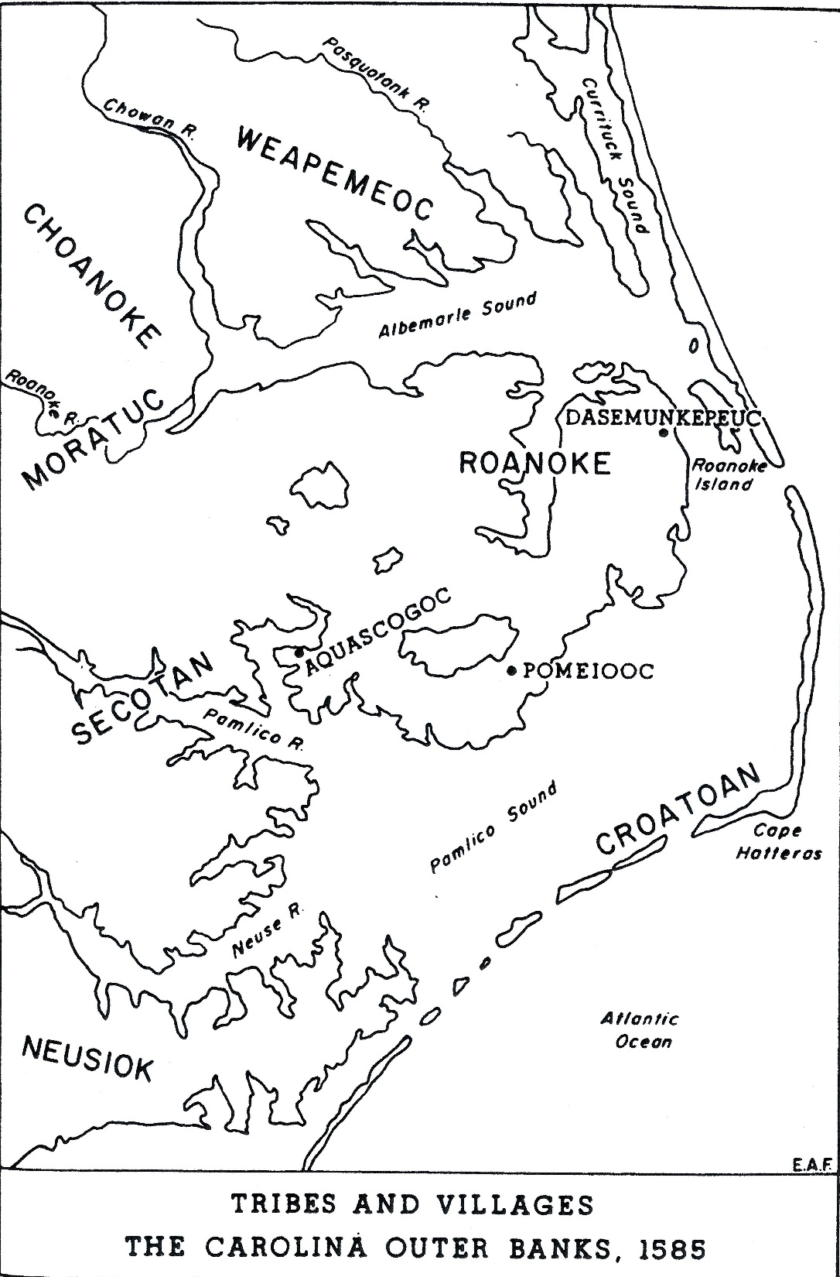
Indian troubles…
• Lane’s men were soldiers, not farmers. They depended on the nearby Secotans for food. Relations between the two soured when the Englishmen began to demand food that the Secotans did not have to spare.
• Ralph Lane made the decision to abandon Roanoke because of the troubles with the natives. Fortunately, Sir Francis Drake arrived from the West Indies in July 1586 and took off the Lane company.
• Back in England, Lane delivered a favorable report to Raleigh, who began preparations for a third expedition to Roanoke, this one led by John White.
1585

Slide 13
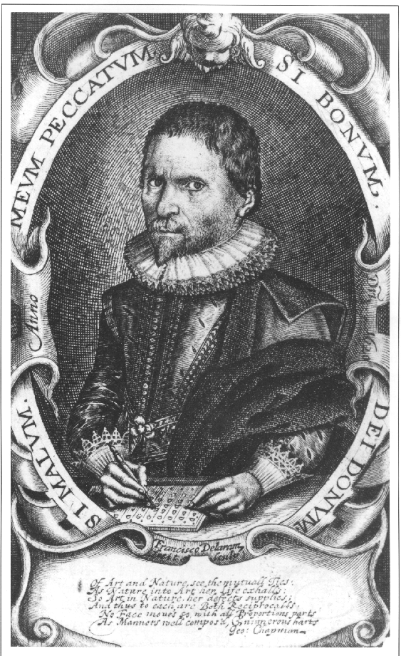
“A Brief and True Report…”
1588
Virginia could produce many things England wanted and needed: food, building material, and “merchantable” commodities (furs, skins, medicines, iron, copper, pearls, hemp, dyes, oils, tobacco, grapes for wine). Virginia would also satisfy the quest for knowledge among scientists and religious men. Several of the members of the expedition were bona fide scientists and men of letters of their day.
Thomas Harriot

Slide 14
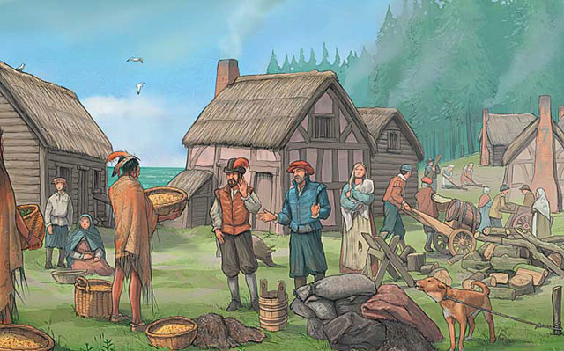
The John White Expedition…
John White led approximately 117 colonists, including 17 women and 9 children, to Virginia in 1587. Among the group was his daughter, Eleanor Dare, who was “highly pregnant,” and his son-in-law, Ananias Dare. They made landfall at Roanoke on July 22, 1587. Their daughter, Virginia, would be the first English child born in America.
1587
Virginia Dare was born on August 18, 1587

Slide 15
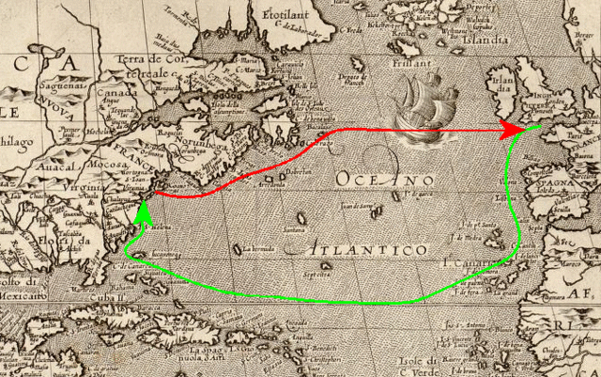
White returns to England…
In late August 1587, White, pressed by his colonists, set sail for England for reinforcements and supplies, but promised to return by the following spring. But world events would conspire to keep him from fulfilling his promise.

Slide 16
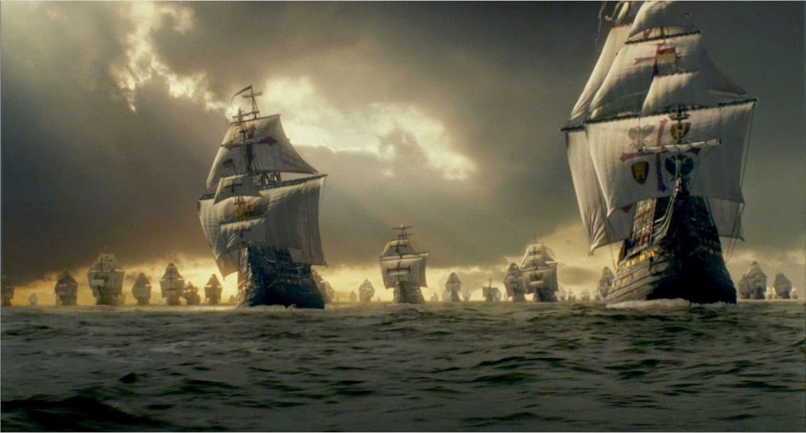
Keeping John White away…
• The Spanish Armada sent by King Philip of Spain to invade England in August 1588 forced all English ships to be used for home defense.
• A hurricane at sea forced another attempted return to
turn back
• Sir Walter Raleigh’s enthusiasm for the Roanoke settlement began to wane as he fell out of favor with the queen.
Events on the global stage prevented John White from returning to Roanoke as soon as he promised. He would not get back until 1590.

Slide 17
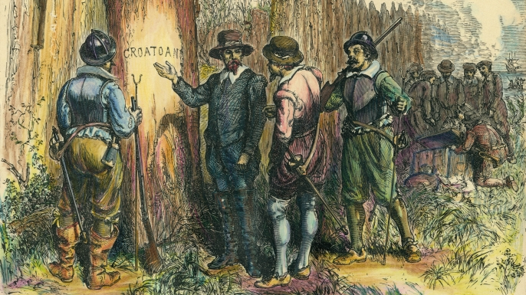
Roanoke’s “Lost Colony”…
1590
When White returned to Roanoke, there was no sign of the colonists he left behind three years earlier.
Clues as to the whereabouts of the colonists seemed to indicate that at least a portion of them had gone to reside with Manteo’s people, the Croatoans, at Hatorask (modern Cape Hatteras) on the Outer Banks.

Slide 18
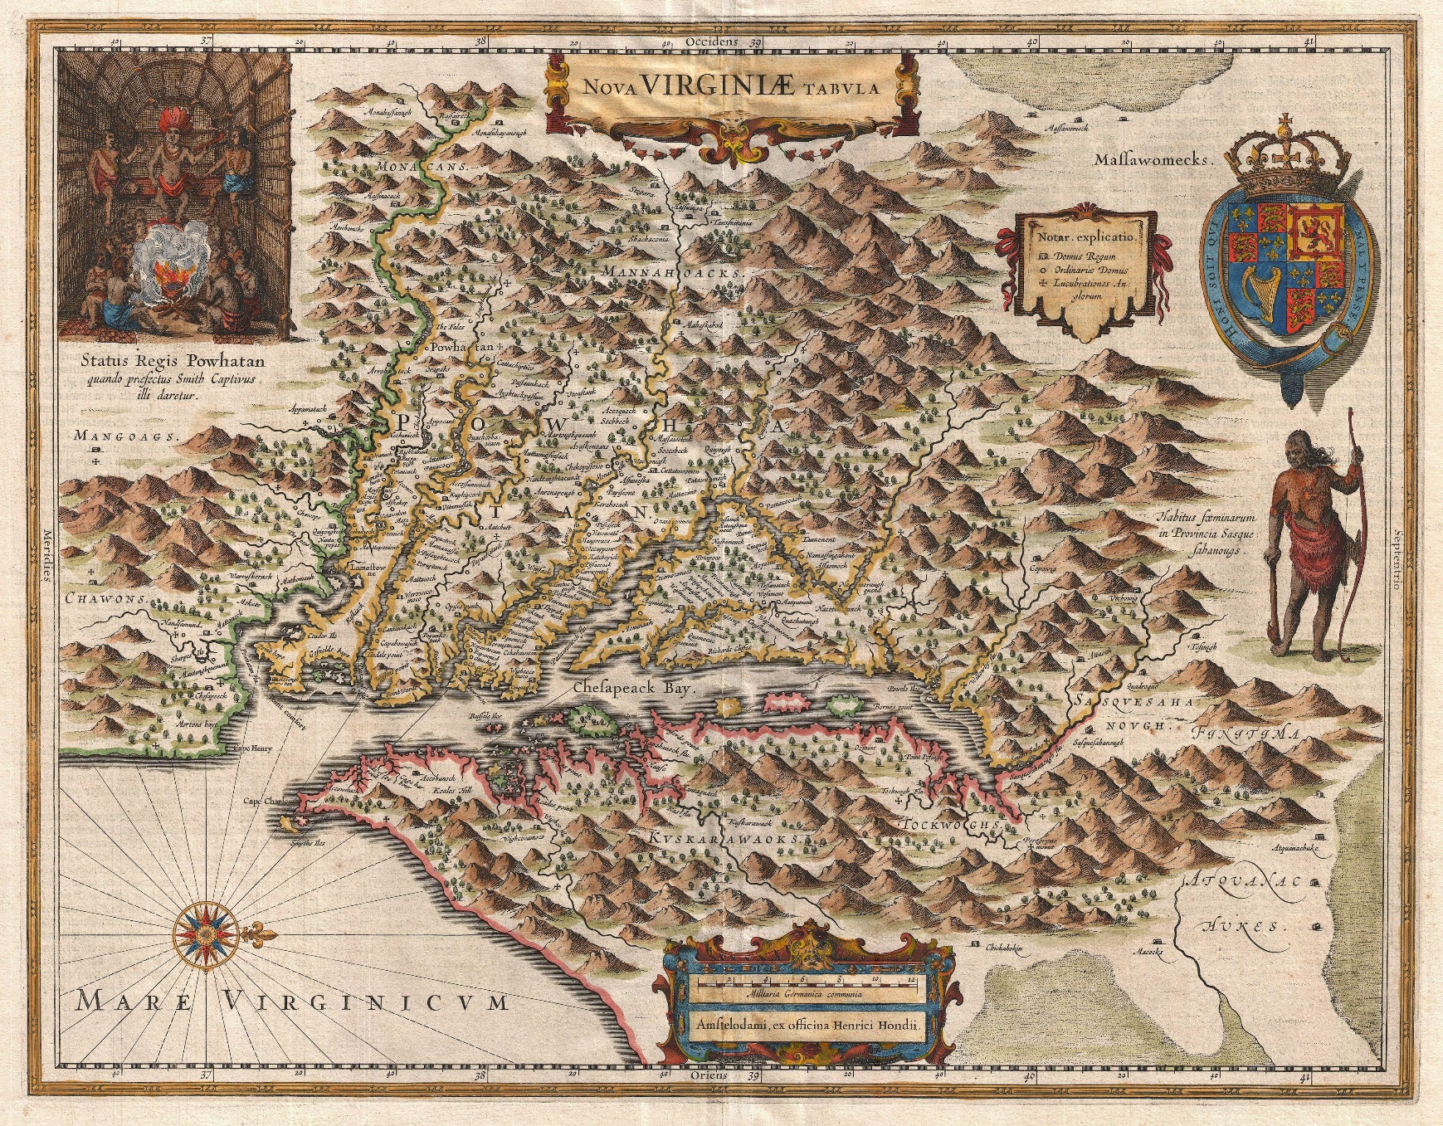
Where did they go?...
The late David Beers Quinn, historian of English America, argued in his books that the colonists actually migrated northward to Chesapeake, their original destination, to live with the Chesepians. But other theories abound:
• Some say they were killed by hostile Indians
• Some say they migrated into the interior and became part of the Lumbee tribe.
• Some say they were killed by the Spanish
• Others believe a hurricane wiped them out.

Slide 19
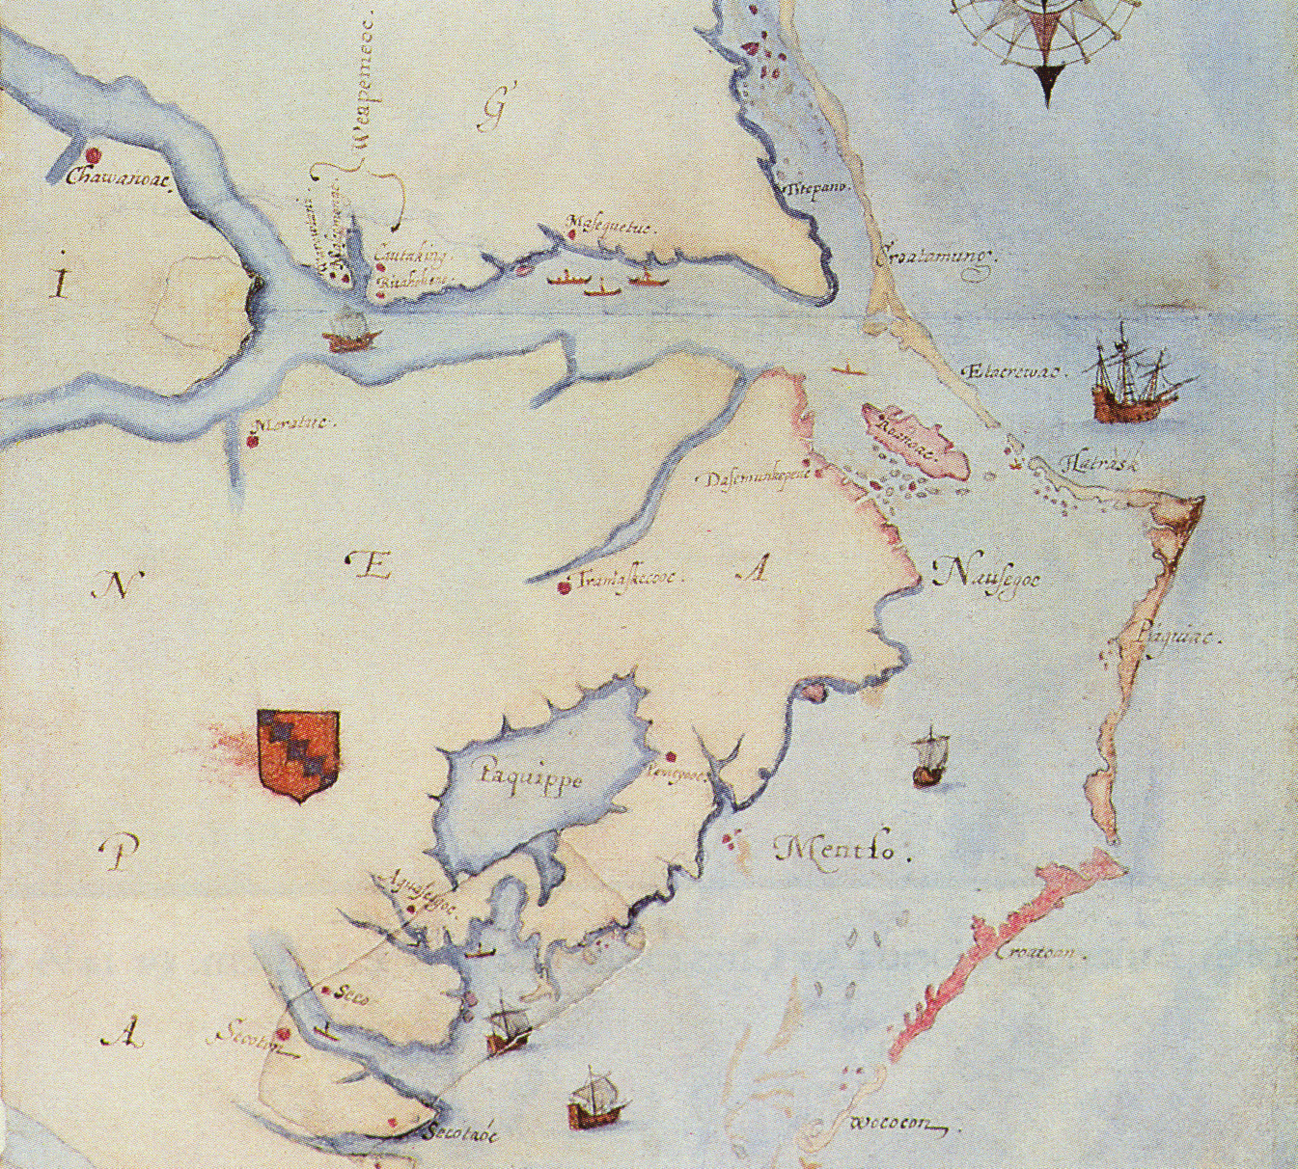
New evidence found…
• Recently, Professor Edward Brent Lane of NCSU discovered a tantalizing clue to the fate of the Lost Colony. In examining a map of the period, he detected a patch over a part of the chart in the area of what is now Edenton, NC.

Slide 20
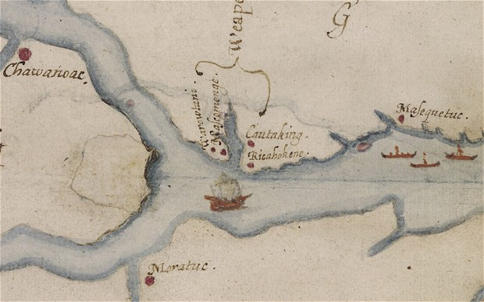
Look closer…

Slide 21
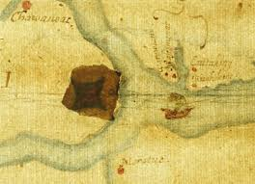
Look under X-ray…
Under the patch is a hand drawn symbol common for mapmakers of the time that indicates a fort or settlement. Based on this new clue, excavations were begun on a golf course at Edenton, NC. To date, several artifacts dating from the 16th. Century have been discovered, though nothing definitive.

