Slide 1
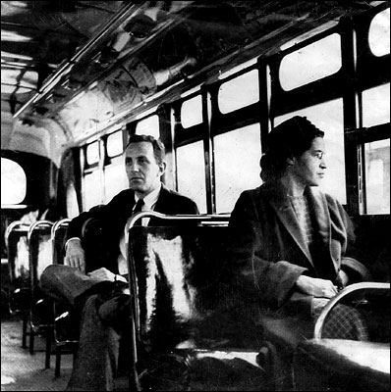
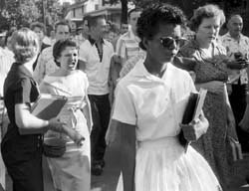
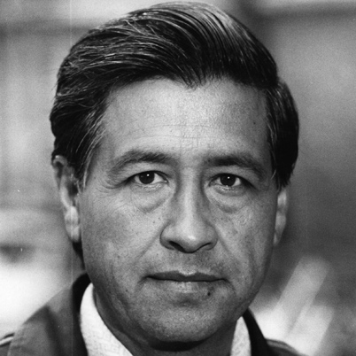
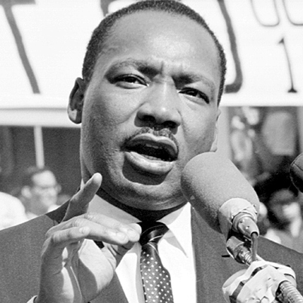
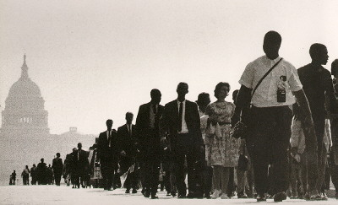
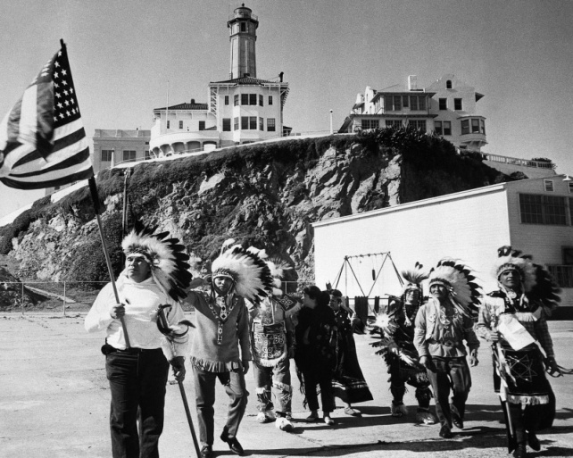
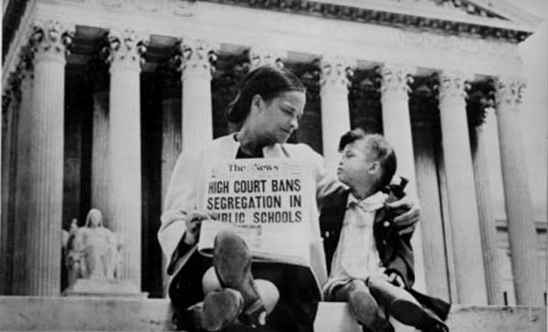
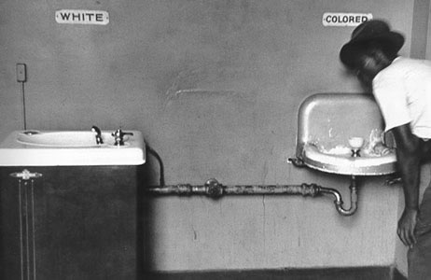
Civil Rights: Reconstruction &
the Black Codes

Slide 2
Oppression
Taunting an individual based on their appearance
Definition: prolonged cruel or unjust treatment or control.
Denying people access to jobs based on their gender, sexual orientation, or race
Individual
Institutional
Societal/Cultural
Denying individuals the right to
attend a school based on
their race
Denial of membership in private organization
such as country clubs, fraternities
based on a person’s race, gender….

Slide 3
Brainstorm other
examples of “Oppression”
And identify if each example is:
Individual
Institutional
Societal
Notes:
Students are to come up with their own examples.

Slide 4
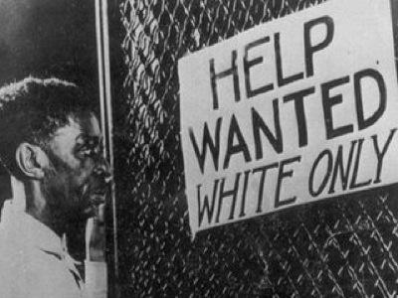
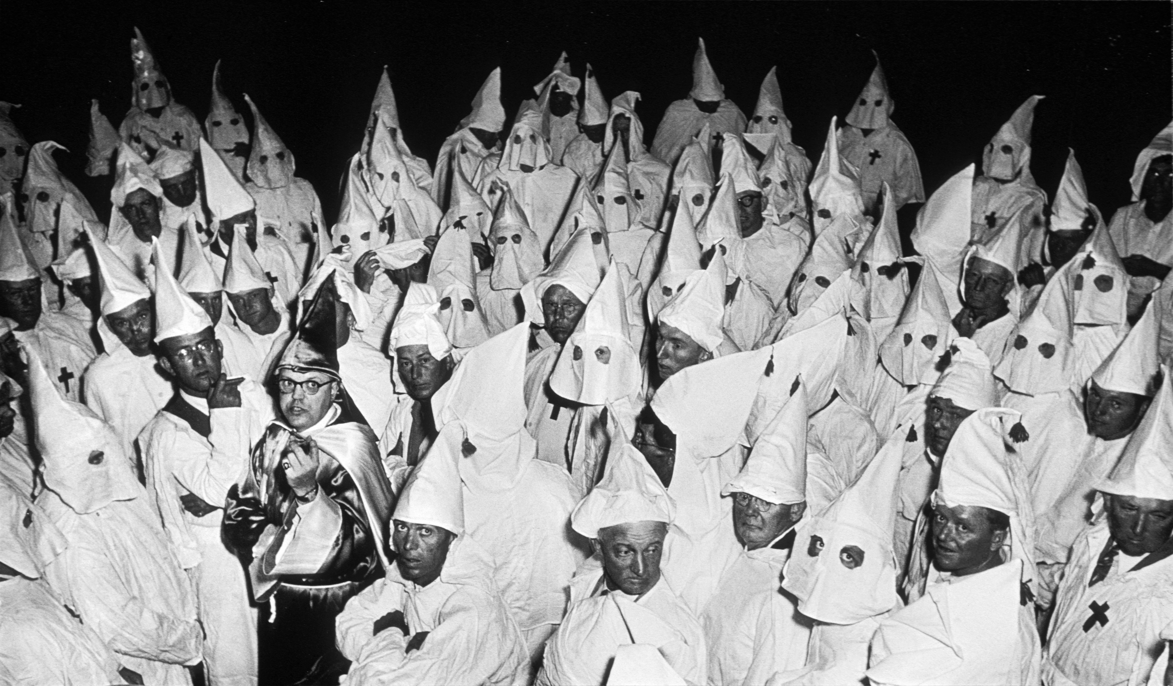
Instructions: As the power-point unfolds, write in your notes any examples
of oppression and identify which level the examples fits.
Individual
Institutional
Societal-Cultural
Attitudes and actions of an individual that reflect prejudice against a social group | Policies, laws, rules, social institutions that disadvantage some social groups, and advantage other social groups. These institutions include: government, education, law, the media, and health care systems. | Societal/Cultural: Societal norms, roles, rituals, language, social groups that reflect the belief that one social group is superior to another.
Notes:
Students are not to copy this slide. Instead, the teacher will read through each level, and discuss with the class the differences between each level .

Slide 5
During the Reconstruction era….
We see some old patterns resurface, but we also see a great of change take place for many African Americans and poor white people in terms of social justice.
The ‘Radical Republicans’ helped pushed through…..

Slide 6
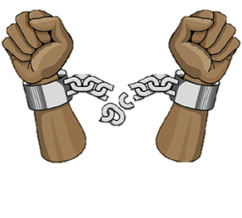
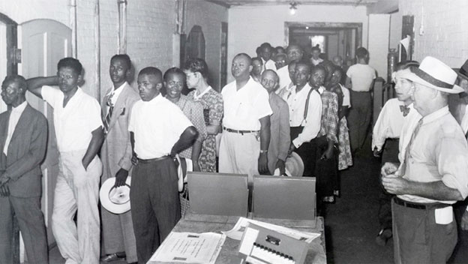
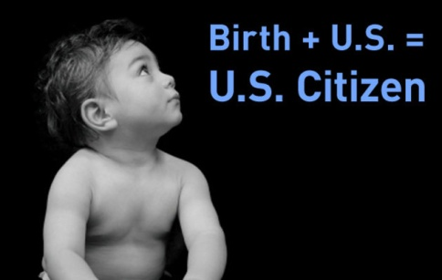
…The Civil War & Reconstruction Amendments
The 13th, 14th, and 15th Amendments were added to the Constitution
13th: freed the slaves
14th: no state can take away anyone’s rights or deny
them equal protection under the laws
15^{th :} guaranteed the right to vote regardless
of race

Slide 7
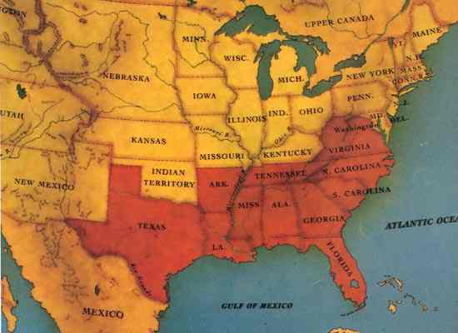
However, the governments of the ex-Confederate states– soon created a system to undermine the freedom that the slaves fought for in the war
Brainstorm TWO possible ways
the ex-confederates denied former slaves their new found freedom.

Slide 8
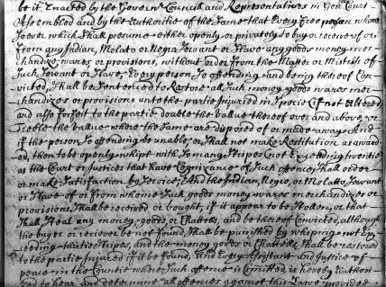
Black Codes
Pro-slavery Democratic Party:
Created Black Codes
Set of laws that, in essence, deprived newly freed blacks from the….
Right to vote
Hold office
Serve on juries
Testify in courts against Whites
Assemble without official permission

Slide 9
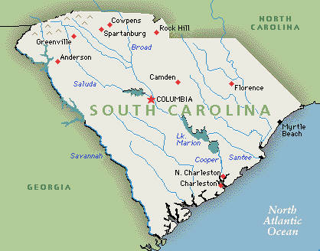
For Example, the S. Carolina code…
Required Blacks to have a special license for any job except farmhand or servant, it required an annual tax of $10.00 to $100.00 for the license
THINK: Write down HOW these Black code laws may
have impacted the newly freed slaves.

Slide 10
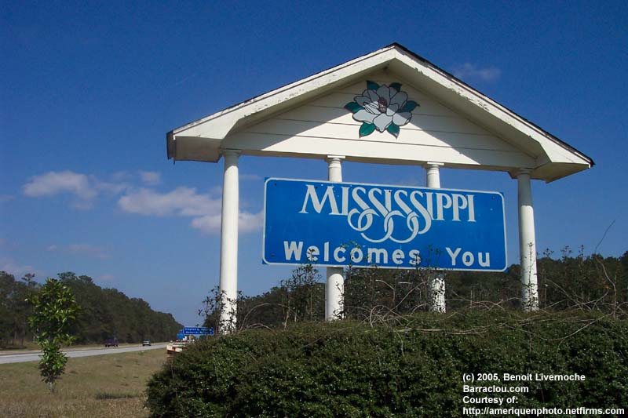
Mississippi Codes…
Forbade Blacks to rent or lease their own land

Slide 11
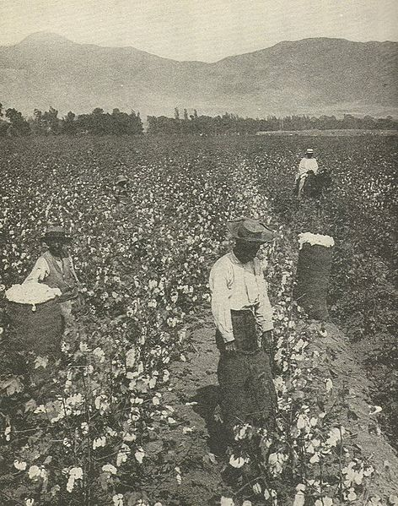
Louisiana’s Code…
All agricultural workers were required to make contracts with employers during the first ten days of each January
Workers couldn’t leave their employers until the contract expired, & refusal to work was punished by force labor

Slide 12
Game time!!! analyzing the Black Codes
Notes:
This game can be played at this point in the power-point or the following day as a means to access student’s knowledge of the material.

Slide 13
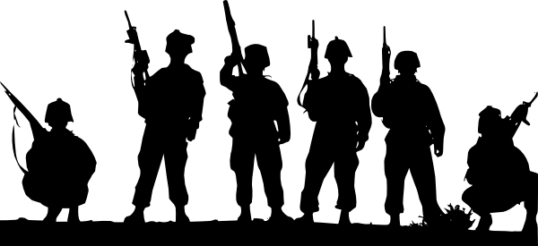
1867, Congress passed the…
Invalidated the Black Codes
Placed the South under military rule
Mandated elections in which all males over 18 could vote
Reconstruction Act

Slide 14
Continuing to Cling to the
Previous System
During this period known as Reconstruction, the government was able to provide some protection for the civil rights of the newly-freed slaves.
But when Reconstruction abruptly ended with the Compromise of 1877 and federal troops were withdrawn, southern state governments began to…
Undermine the new Constitutional
Amendments.

Slide 15
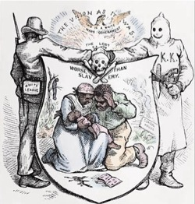
Compromise of 1877
The Compromise of 1877 settled the intensely disputed1876 U.S. presidential election, pulled federal troops out of state politics in the South, and ended the Reconstruction Era. Through the Compromise, Republican Rutherford B. Hayes was awarded the White House.

Slide 16
Challenges & Obstacles in
the Voting Process?
Notes:
At this point in the power-point, the teacher will instruct their students to imagine that they are newly freed slaves. They each have the strong desire to practice their newly created constitutional rights. However, it may not be as easy as simple as going down to the nearest ballot box and casting a vote. Guide the students through each of the obstacles as this ppt unfolds and ask students along the way how many of them could or would continue in their pursuit to vote….

Slide 17
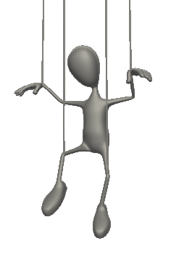
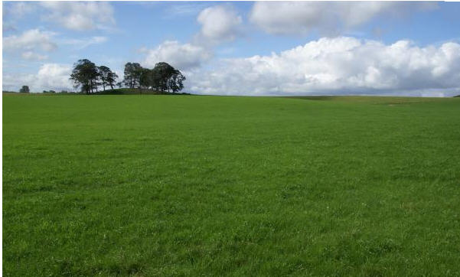
Inequality & Power
Control of the land and most of the resources enabled wealthy whites to pressure many African Americans, who were economically dependent upon them, not to exercise their political rights
Yet many poor Whites & Blacks continued to fight to build a more just, free, democratic society

Slide 18
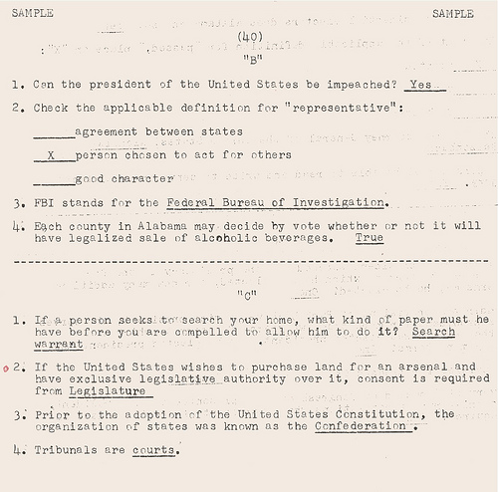
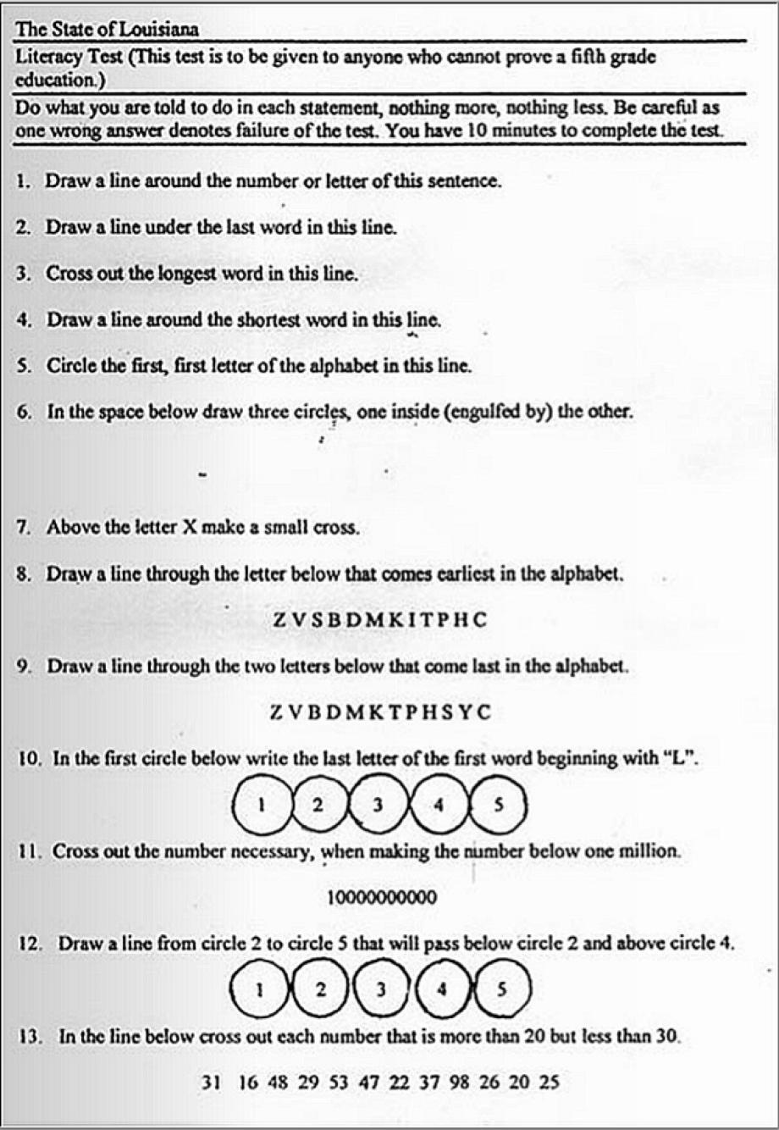
Literacy Tests
Literacy tests:
All citizens had to pass a literacy test in order to vote.

Slide 19
Would you pass?

Slide 20
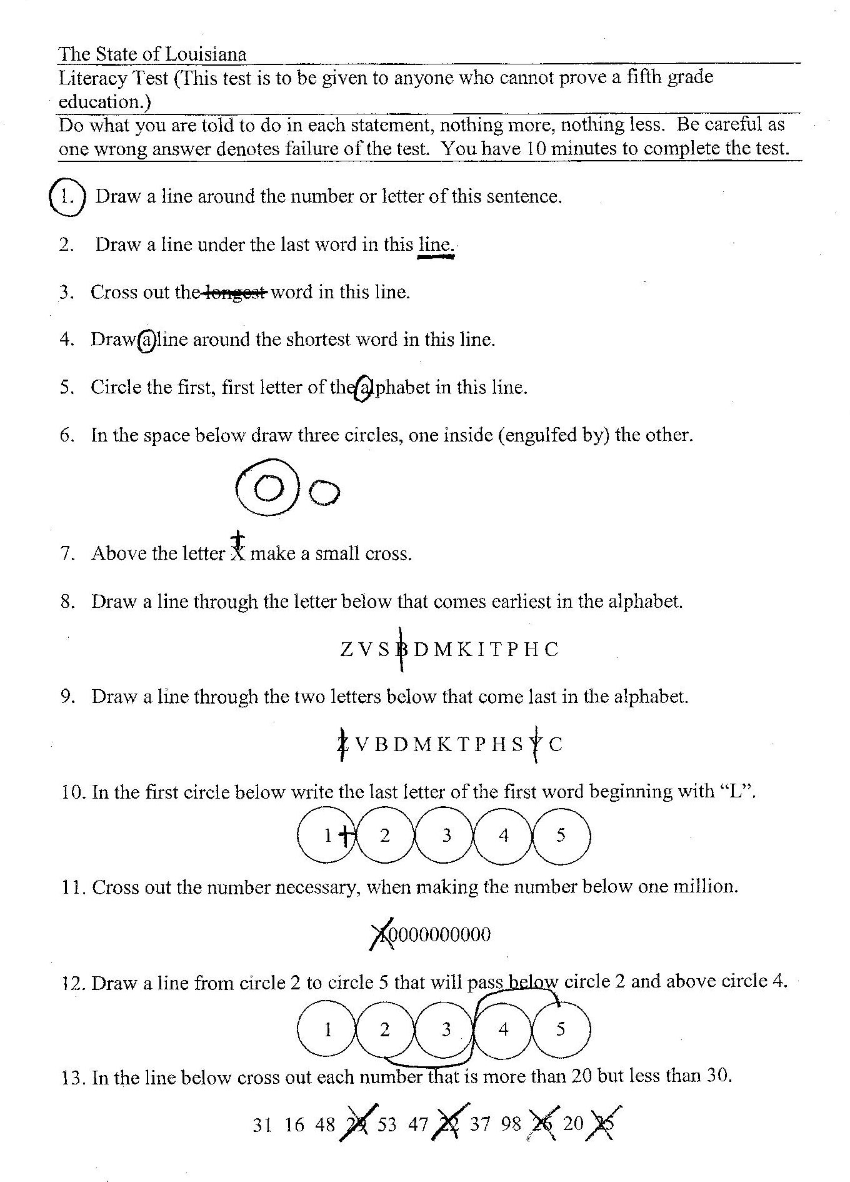
The “Answers”

Slide 21
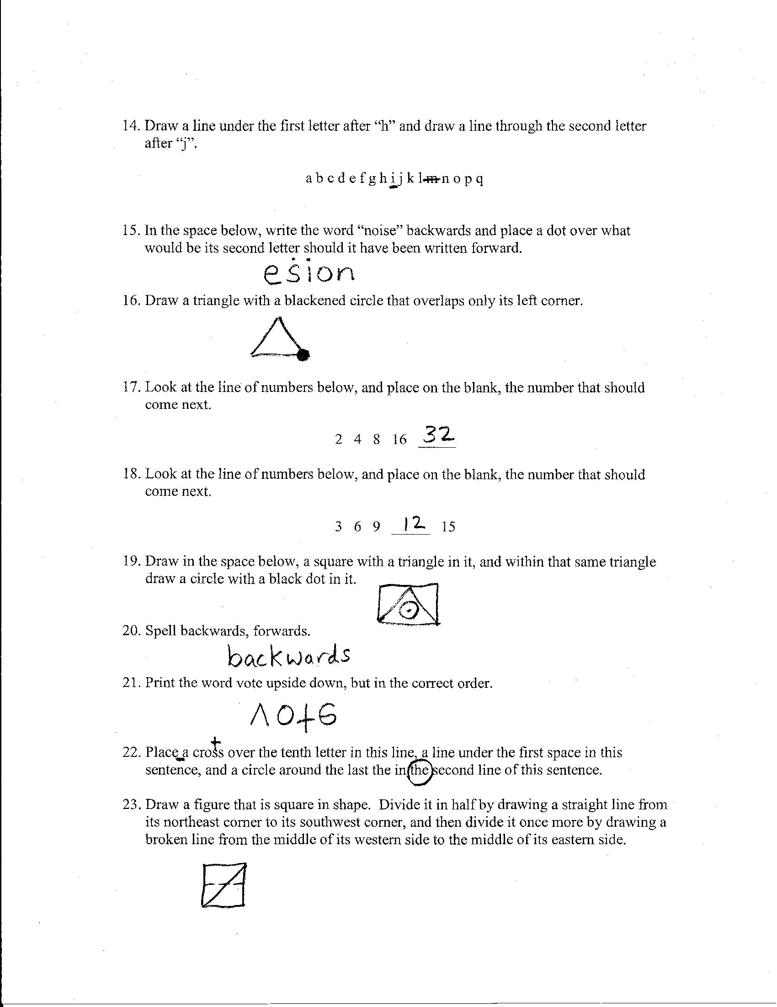

Slide 22
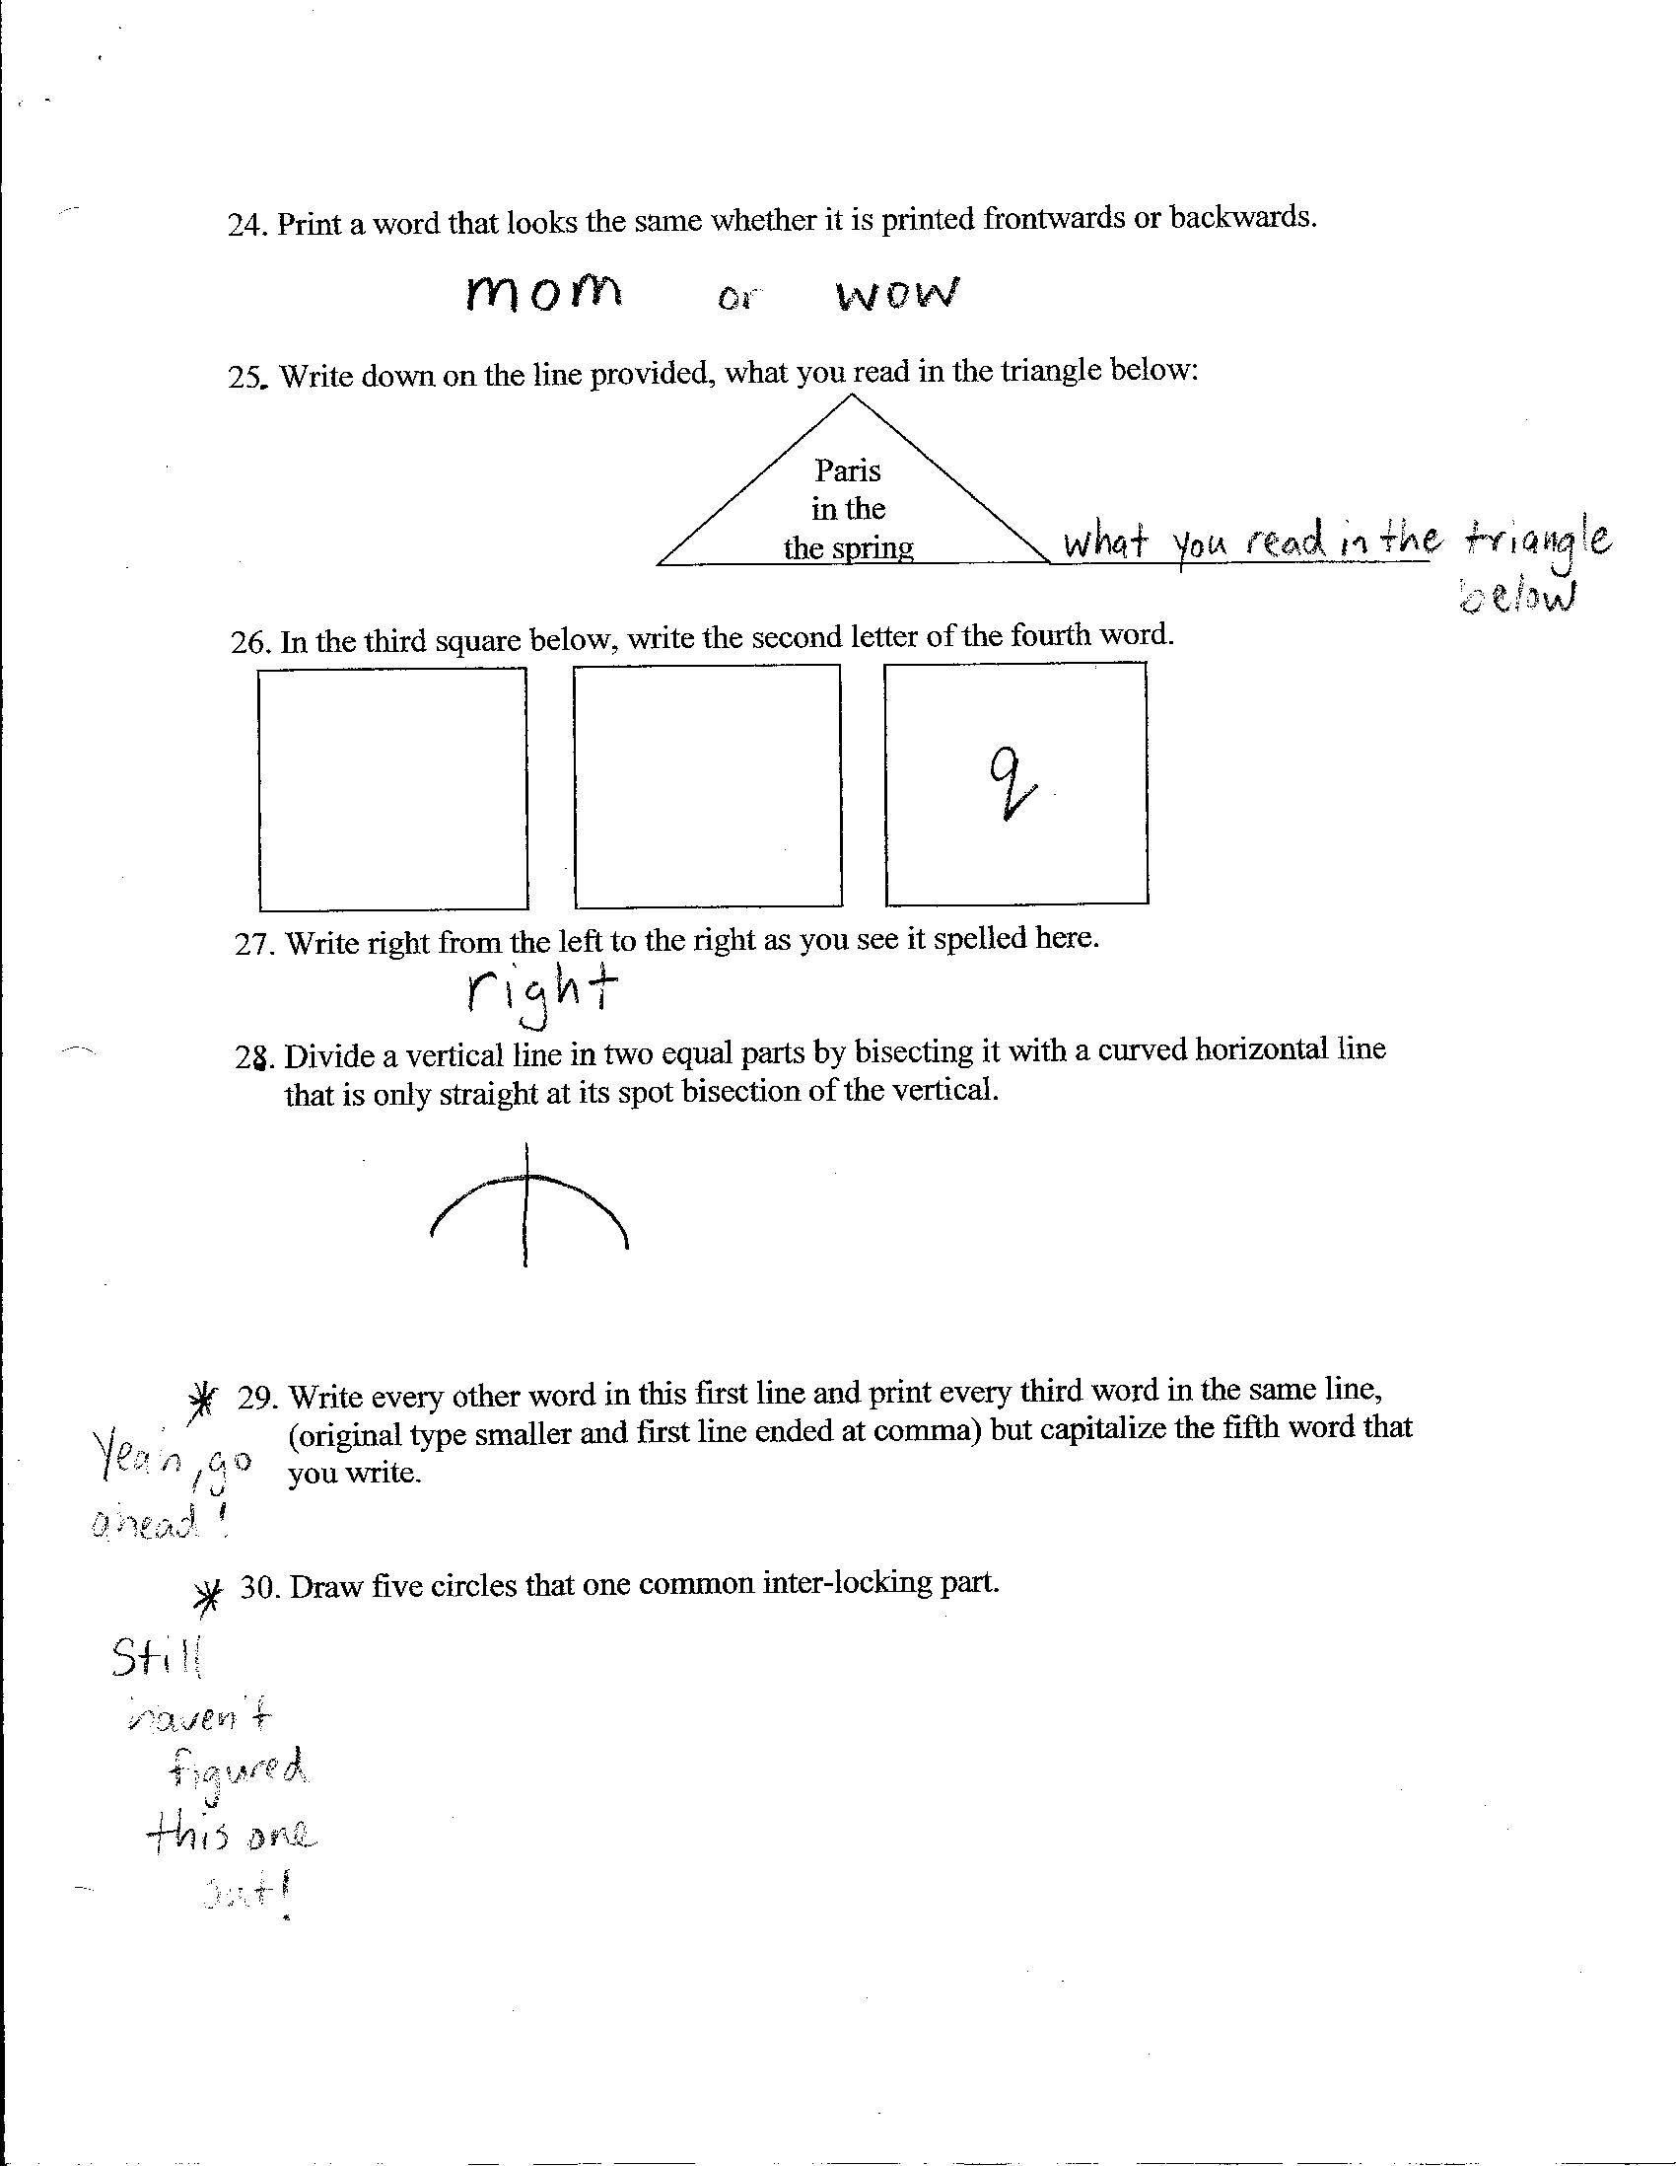

Slide 23
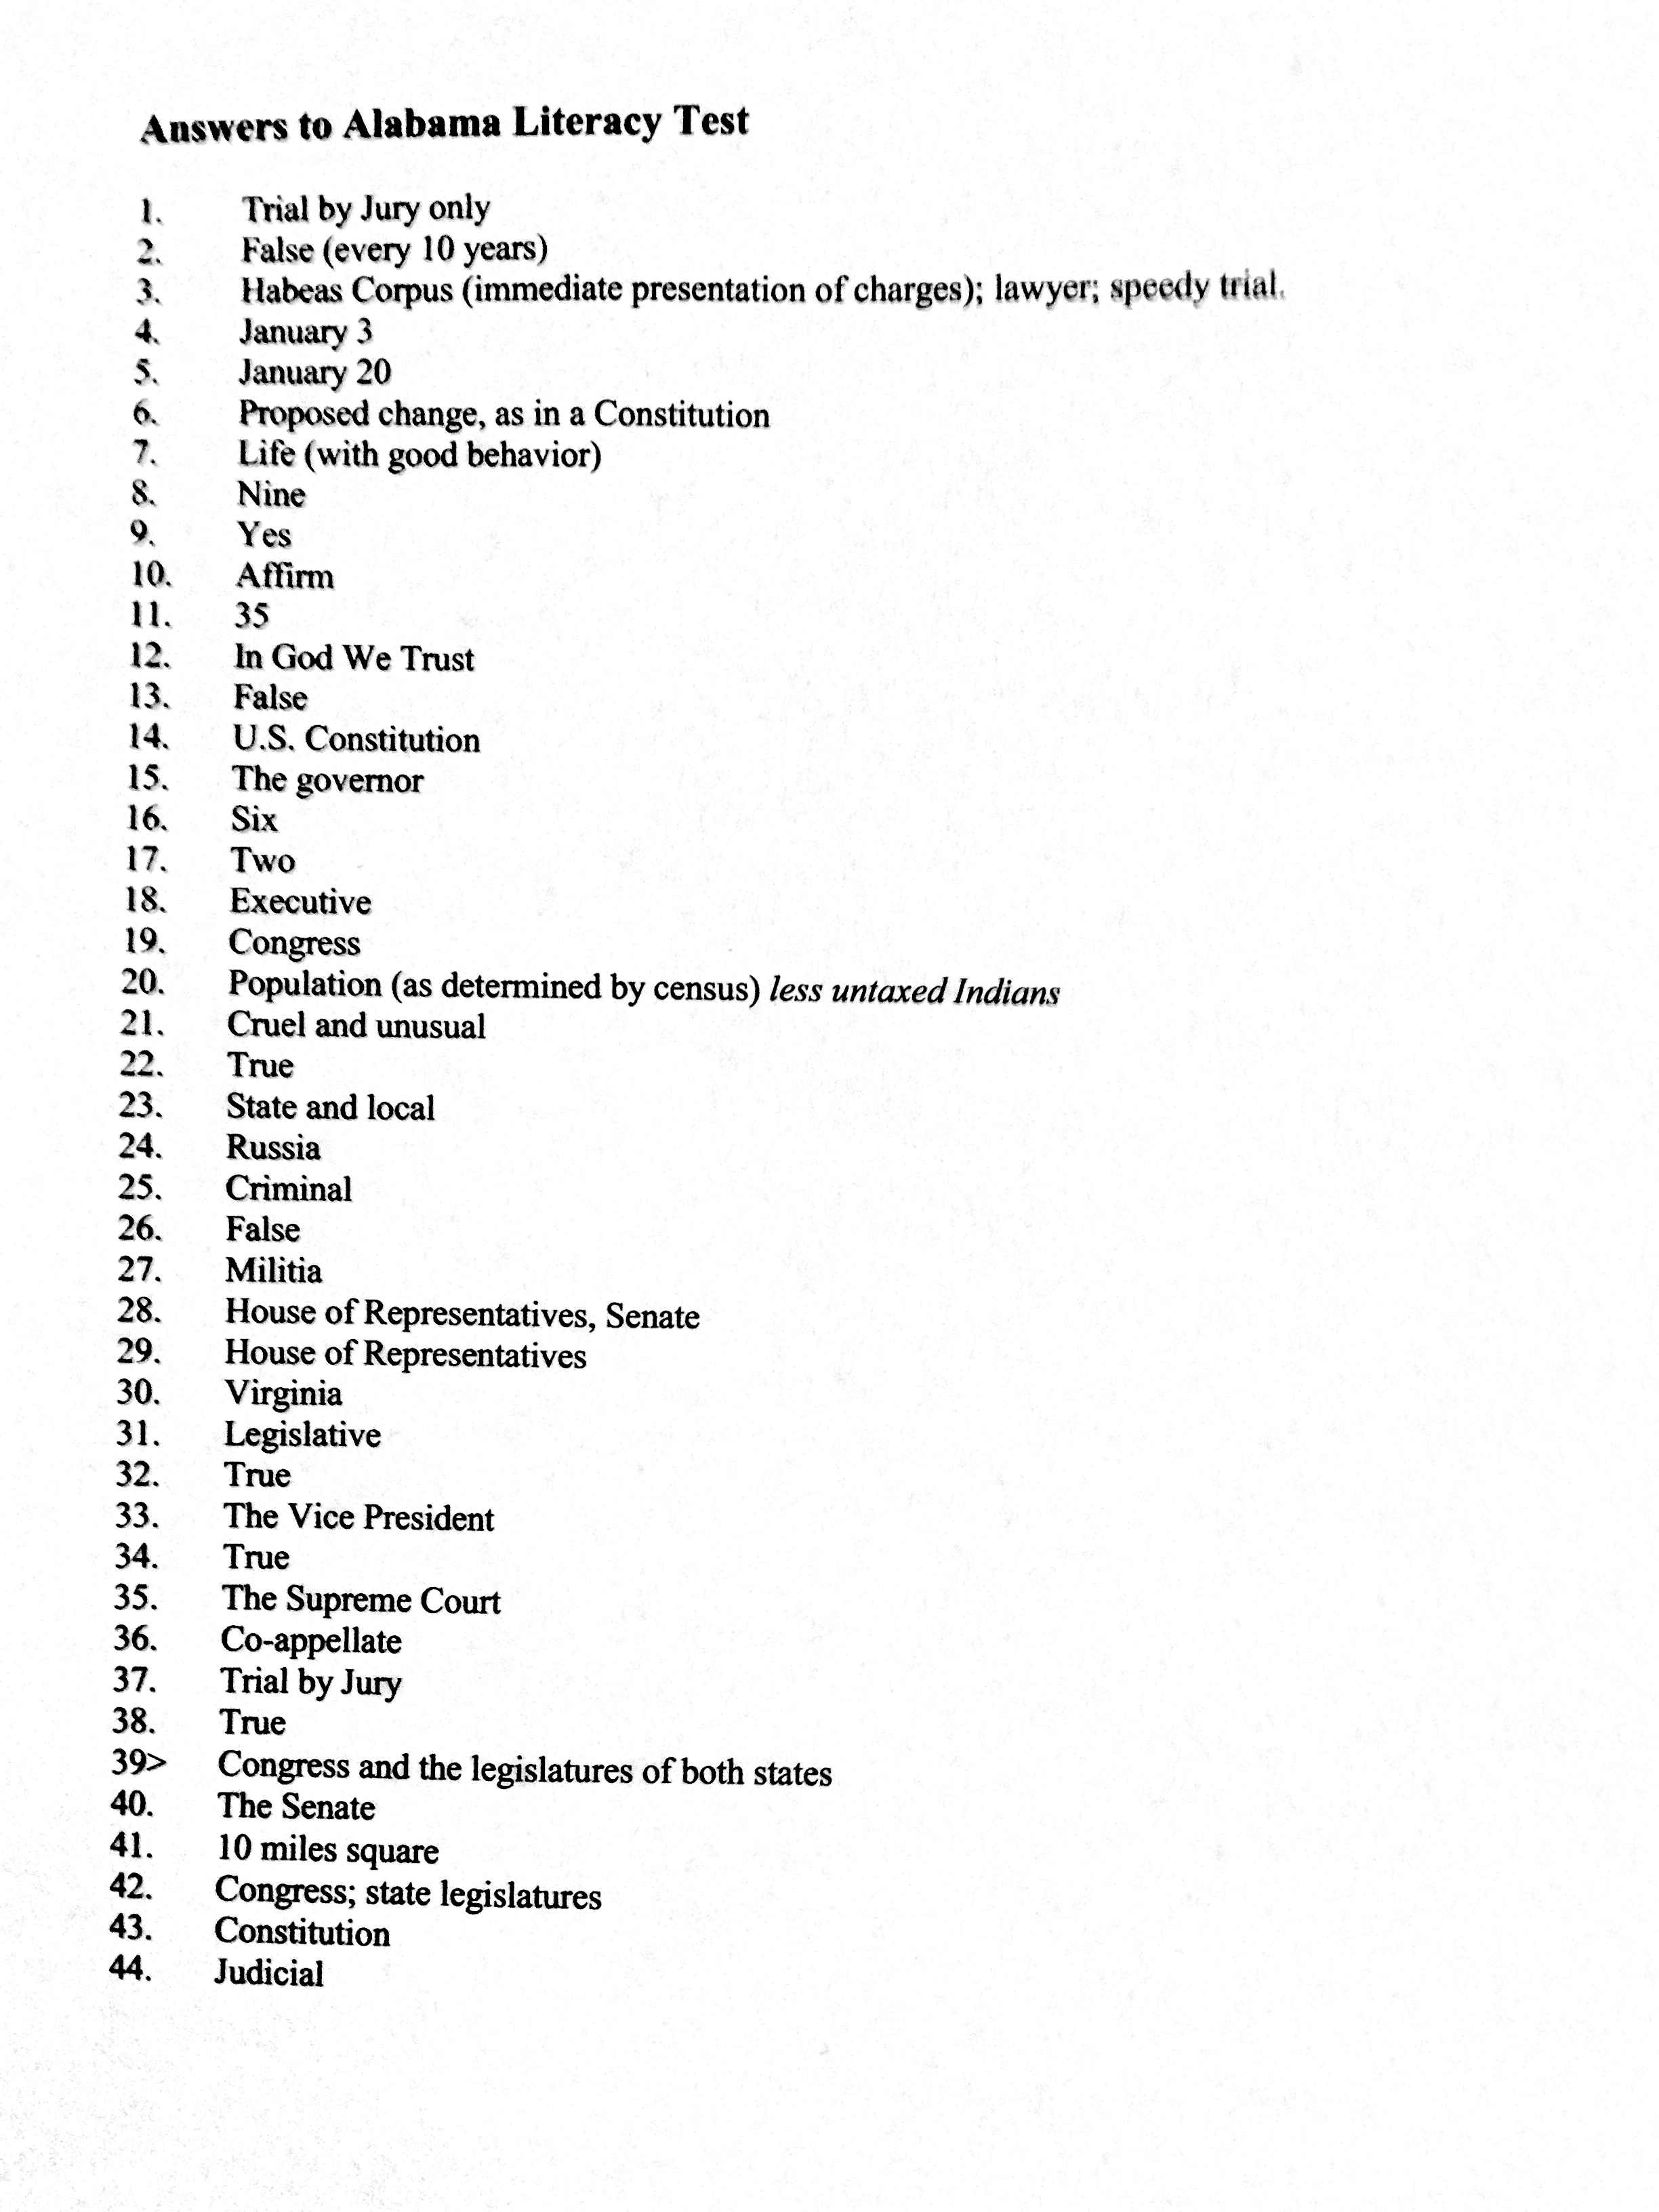

Slide 24
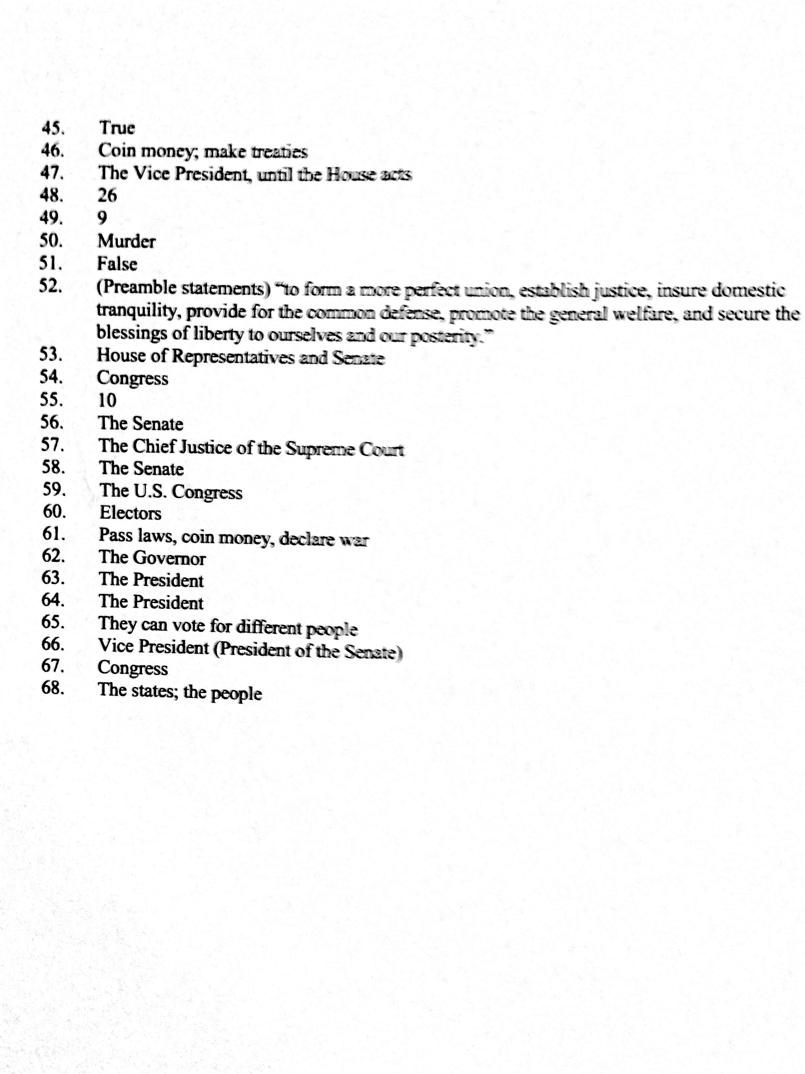

Slide 25
Class Discussion
Raise your hand if you passed either of the two tests?
Is the test designed for failure?
Is it reasonable to expect that African American could pass a literacy test like this one after the Civil War? Why?
Do you think the test's intent was to keep minorities from voting? Why or How?

Slide 26
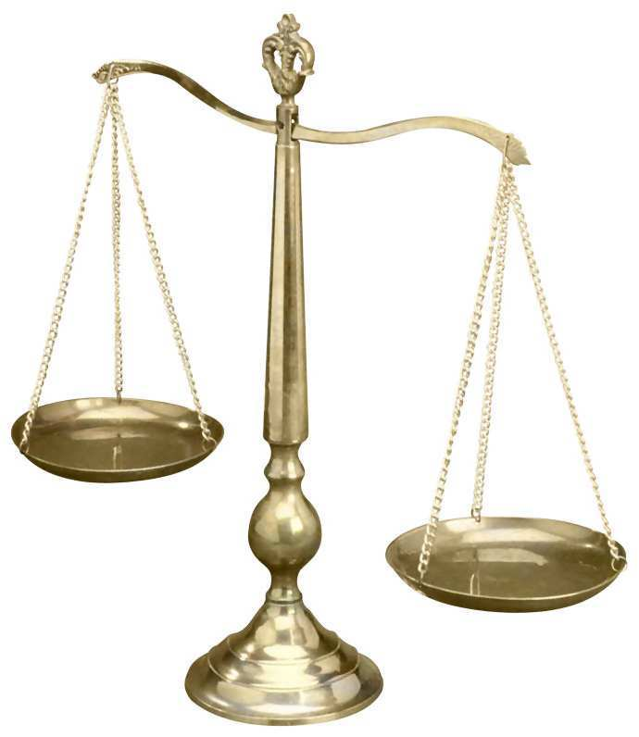
Fairness
BUT….. Do not all men, regardless of race, have to take the test, therefore, isn’t it fair?
It is more arbitrary than you think…….

Slide 27
Literacy Tests
Literacy tests were used to keep people of color -- and, sometimes, poor whites -- from voting, and they were administered at the discretion of the officials in charge of voter registration. If the official wanted a person to pass, he could ask the easiest question on the test -- for example, "Who is the president of the United States?“
The same official might require a black person to answer every single question correctly, in an unrealistic amount of time, in order to pass.

Slide 28
In Part "A" you are given a section of the Alabama Constitution to read aloud.
The sections are taken from a big loose-leaf binder.
Some are easier than others. If white applicants are given the test at all, they
generally get the easy ones.
The Registrar makes sure that Black applicants get the hardest ones — the ones filled with legalese and long convoluted sentences.
For example, a white applicant might be given:
SECTION 20: That no person shall be imprisoned for debt.

Slide 29
SECTION 20: That no person shall be imprisoned for debt.
While a Black applicant might be given:
SECTION 260: The income arising from the sixteenth section trust fund, the surplus revenue fund, until it is called for by the United States government, and the funds enumerated in sections 257 and 258 of this Constitution, together with a special annual tax of thirty cents on each one hundred dollars of taxable property in this state, which the legislature shall levy, shall be applied to the support and maintenance of the public schools, and it shall be the duty of the legislature to increase the public school fund from time to time as the necessity therefor and the condition of the treasury and the resources of the state may justify; provided, that nothing herein contained shall be so construed as to authorize the legislature to levy in any one year a greater rate of state taxation for all purposes, including schools, than sixty-five cents on each one hundred dollars' worth of taxable property; and provided further, that nothing herein contained shall prevent the legislature from first providing for the payment of the bonded indebtedness of the state and interest thereon out of all the revenue of the state.

Slide 30
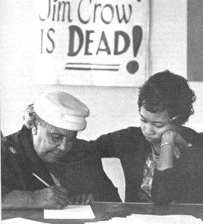
Does the literacy test violate any of the 3 Reconstruction Amendments?
Amendment XV (1870)
The right of citizens of the United States to vote shall not be denied or abridged by the United States or by any State on account of race, color, or previous condition of
servitude.
Amendment XIII (1865)
Neither slavery nor involuntary servitude, except as a punishment for crime whereof the party shall have been duly convicted, shall exist within the United States, or any place
subject to their jurisdiction.
Amendment XIV (1868)
All persons born or naturalized in the United States, and subject to the jurisdiction thereof, are citizens of the United States and of the State wherein they reside. No State shall make or enforce any law which shall abridge the privileges or immunities of citizens of the United States; nor shall any State deprive any person of life, liberty, or property, without due process of law; nor to deny to any person within its jurisdiction the equal protection of the laws.

Slide 31
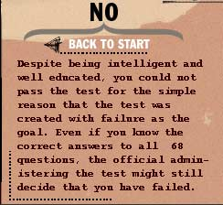
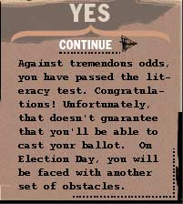
Do You Think You Passed the Test?

Slide 32
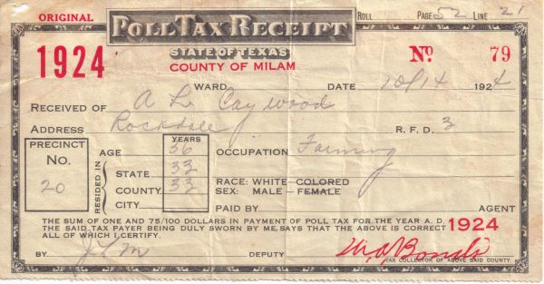
Poll Tax
Poll taxes enacted in Southern states between 1889 and 1910 had the effect of disenfranchising many blacks as well as poor whites, because payment of the tax was a prerequisite for voting.
The tax has long been attacked as being an unfair burden upon those less able to pay.
In order to vote, you had to pay a capital tax levied equally on every adult in the community.

Slide 33
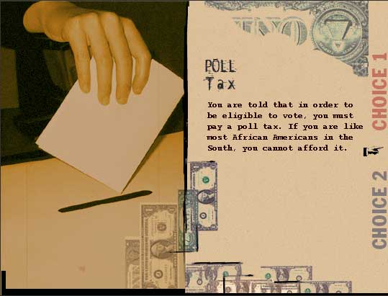
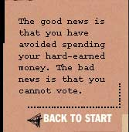
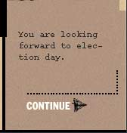
Poll Tax

Slide 34
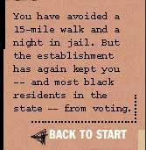
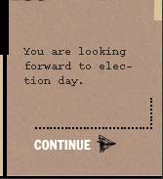

Slide 35
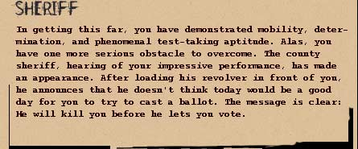
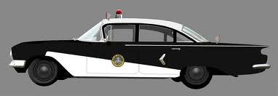

Slide 36
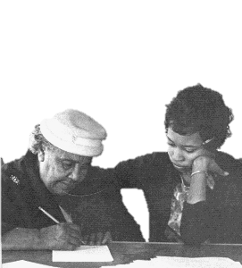
How long do you think these obstacles
existed in America and what did it take for
these forms of control to be invalidated?

Slide 37
Civil Rights Movement
Only the enforcement of the
Voting Rights Act of 1965 invalidated literacy tests, terrorism, and other methods that had been implemented to deny African Americans the right to vote during the Jim Crow era.

Slide 38
3 Level Chart: What examples did you see in the presentation?
Individual
Institutional
Societal-
Cultural

