Slide 1
Protestant Reformation and Religious Wars

Slide 2
Obj. What were the central ideas of the reformers, and why were they appealing to different social groups?
In the 16th C. people were very pious
Processions for saints, pilgrimages, merchants and guilds paid for altars, people left money to the church in their wills
Many were also highly critical of the church and clergy
Church patronage of the arts
Family power such as Borgias, or other who influenced the church
Papal tax collections
The papacy itself
Wealth of the church
Even some doctrine was incorrect– veneration of saints and centrality of the sacraments

Slide 3
Anticlericalism
Anticlericalism—opposition to the clergy
3 Big areas of concern
Clerical immorality (drunkenness, not celibate, gamblers, fancy dress)
Clerical ignorance (barely literate, didn’t seem to understand the Bible)
Clerical pluralism (holding more than one church office) (absenteeism---collected dues from these areas but hired out their jobs or were absent
Clerical privileges– did not pay taxes, did not defend the city
So cities wanted to appoint church offices

Slide 4
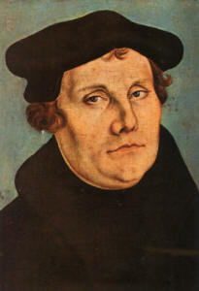
Martin Luther (1483-1546)
Born in Saxony (Germany)
Studied under Northern Humanists
Was going to be lawyer and perhaps public office until
He survived a lightening storm
Ordained an Augustinian priest in 1507
Professor at the University of Wittenberg

Slide 5
Parting with traditional doctrine
Luther came to believe “faith alone, grace alone, scripture alone”
Salvation comes only through faith and God’s grace
This contradicts the Church’s idea that God is revealed in church traditions and salvation by good works

Slide 6
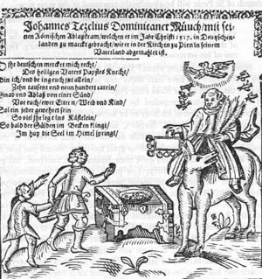
Sale of Indulgences
Pope Leo X needed to finance buildings in Rome
Issued the Saint Peter’s Indulgence
Indulgence– a document issued by the church lessening penance or time in purgatory or forgiving all sins---for a fee
Archbishop Albert of Mainz in Wittenberg gladly enforced indulgence
Johann Tetzel was the most notorious, collected and of course was in Wittenberg
“As soon as coin in coffer rings, the soul from purgatory springs”

Slide 7
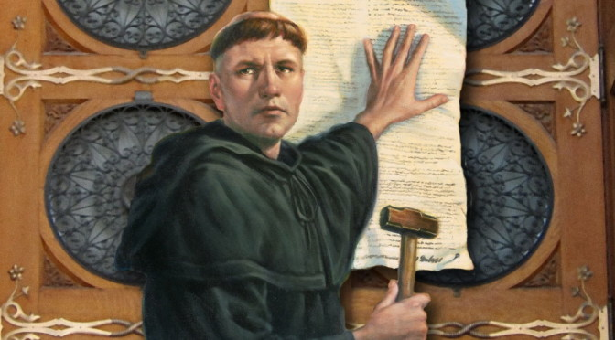
95 Theses
1517 Luther sends Archbishop Albert a letter with 95 theses on the Powers of indulgences
He said indulgences undermined the sacrament of penance, competed with preaching the Gospel, and downplayed charity
People no longer needed the church, just the paper indulgence
Rumors say he nailed the 95 theses to the church door at Wittenberg castle
Either way they were printed and circulated

Slide 8
Martin vs. The Church…
More of his ideas came out when he debated with church representative, Johann Eck in 1519
Pope and church councils were not infallible
Secular leaders should reform the church
Requiring celibacy was futile
Luther’s ideas spread through the printing press essays and books were widely published in the vernacular

Slide 9
Diet at Worms 1521
Papacy sent Luther a letter condemning his ideas, demanded that his books be burned and giving him 2 months to recant or be excommunicated
Charles V holds his first diet (people were on the verge of revolt)
Diet –assembly of nobility, clergy, and cities of the Holy Roman Empire
Luther refused to recant
Made him and his works, and teachings more popular

Slide 10
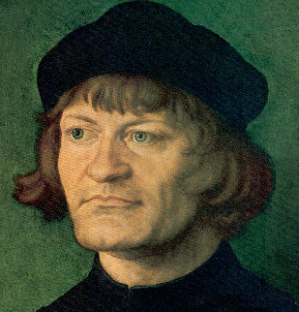
Ulrich Zwingli
Switzerland, priest
Follower of Erasmus and Luther
1519 announced that he would not preach from the church’s prescribed teachings
Only taught the New Testament
Attacked indulgences, the Mass, monasticism, and clerical celibacy

Slide 11
Protestants and their beliefs
Protestant---followers of Luther, now all non-Catholic Christians
Named after a group of German Princes “protested” catholic majority
1.Protestants all believe that salvation is achieved through Faith and Grace, not good works
2.Authority rests in the Bible alone, church has no actual authority in teaching or tradition
So Protestants reject sacraments except for Baptism and Eucharist, which have scriptural support
3. The “Church” is a spiritual priesthood of all believers, not a hierarchal clerical institution with a Pope
4. Disagreed on highest form of life: Catholics said monastic life over secular. Protestants said everyone should serve god in his/her individual calling

Slide 12
Protestant disagreements
Agreed on pretty much everything from previous slide
1.Disagreed on the Eucharist
Luther believed in transubstantiation (that God is in the Eucharist)
Zwingli said Eucharist is a memorial but God isn’t literally in it
2. purpose of art
Luther said art can spread the word because kids and simple folk can understand them
Zwingli and John Calvin said only the “word” of god should be used in evangelism, not visuals. Stripped churches of images, sculptures. Many Protestant churches were very bare

Slide 13
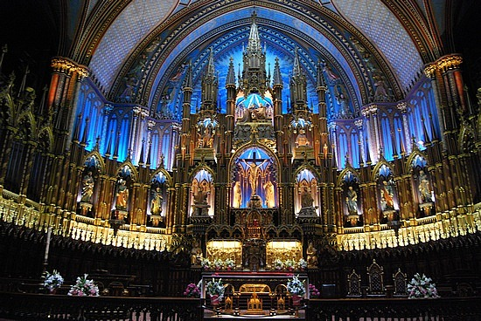
Pic of churches
Plain Protestant Church Ornate Catholic Church

Slide 14
Why was Protestantism so appealing?
1. Reforms that everyone wanted
2. stressed that everyone should read the Bible, attracted literate people
3. stressed that churches and clergy should pay taxes, no privileges
Printing press helped
Woodcuts for illiterate
Luther translated New Testament into German

Slide 15
Politicking for Protestantism…
Need leaders to support the change from Catholic to Protestant
Zwingli worked with city councils
City councils supported Protestant throughout Germany and Switzerland
Luther worked with Prince of Saxony, other Princes followed and asserted secular control over the church and appointed Protestant friendly priests

Slide 16
Reaction
Who might reject Protestantism and the idea that the state and church need to be united?
Some “radicals” wanted to be separate
Anabaptists—wanted to live separately (think Puritans) and believed only adults can consent to baptism, communal property and living
Attack at Munster
Radicals attacked and called for communal property, expelled those who refused to be Baptized
Armies of Catholics and Protestants besieged city and executed leaders
Both Protestants and Catholics authorities saw a state church as a means to keeping order
Anabaptists and other radicals were expelled or executed by burning, beating, drowning

Slide 17
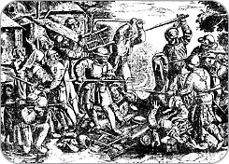
German Peasant Revolt 1525
Peasant conditions were deteriorating
Crop failures 1523, 1524
Nobles seized common lands,
Charged higher rents
Required additional duties of peasants
Took best horse and cow whenever head of house died
Peasants linked religious reform with social reform
Peasants made demands and cited scripture as well as Luther

Slide 18
Reformation has its limits…
Once violence broke out Luther couldn’t support peasants, why?
Luther opposed Catholics church not secular powers plus those powers protected him
Luther said scripture didn’t say anything about material gains
Wrote Against the Murderous, thieving Hordes of the Peasants
Nobility crushed the revolt
75,000+ peasants were killed

Slide 19
Effects of revolt
Secular rulers increased power
Reformation lost power
Peasant conditions a little better
Fields and forests returned for common use

Slide 20
What about women?
Luther married a former nun, Katharina von Bora
Zwingli married a widow, Anna Reinhart
Marriage was created by God to deal with human lust and sin
These women had to create the role of pastor’s wife
Models of wifely obedience and Christian charity
Protestants kept idea of women subject to men, could treat women like breaking a horse
Allowed divorce
Condemned prostitution, Protestant cities closed brothels, many Catholics cities did too
Convents allowed upper class women to indulge in writing, arts, their own life----most closed and now their only option was to get married

