Slide 1
Prelude to Colonization
England in America…

Slide 2
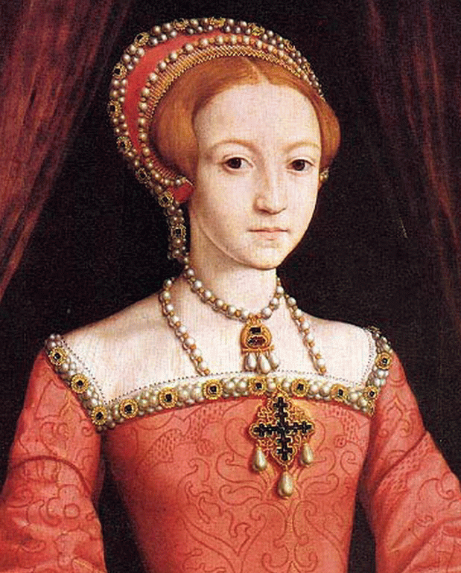
England is late to the colonizing party…
• Though John Cabot made preliminary explorations of North America in 1497, England was far behind Spain and Portugal when it came to colonizing the New World.
- Neither King Henry VII nor his successor, Henry VIII, was inclined to do anything with the information Cabot brought back
• England was still trying to recuperate from the War of the Roses and Henry VIII’s split from the Catholic Church
- But by the time Elizabeth II was on the throne, she was ready to start securing New World riches for England too

Slide 3
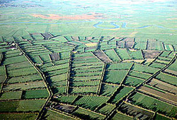
England’s Motives: Economic…
• The Enclosure Movement spurred by the woolens boom displaced England’s tenant farmers
- England’s working class was suddenly only able to find jobs as seasonal workers or were unemployed.
- Small landowners were also adversely affected.
• The inflation caused by Spain & Portugal flooding Europe with New World gold and silver was a severe economic blow. They also started to think of heading to the colonies
- Primogeniture was another source of settlers as younger sons of the wealthy opted to travel overseas to make their fortunes
- Joint stock companies provided a workable economic model for funding colonial ventures

Slide 4
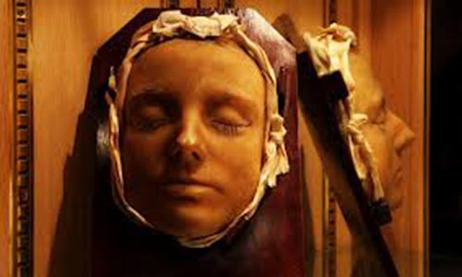
England’s Motives: Religious…
• Henry VIII’s decision to break England from the Catholic Church set off years of turmoil
- After Henry VIII’s death, the Anglican Church he created moved further and further away from the doctrines and ceremonies of the Catholic Church and closer to the Protestant idea of religion
- Queen Mary, Henry’s daughter and a staunch Catholic, reinstated Catholicism as the state religion. The queen was nicknamed “Bloody Mary” because of the reprisals she mounted against Protestants in England who refused to convert to Catholicism
- Mary only ruled for five years. When she died, her half-sister Elizabeth took the throne and reversed Mary’s policies on religion to favor Protestantism again.

Slide 5
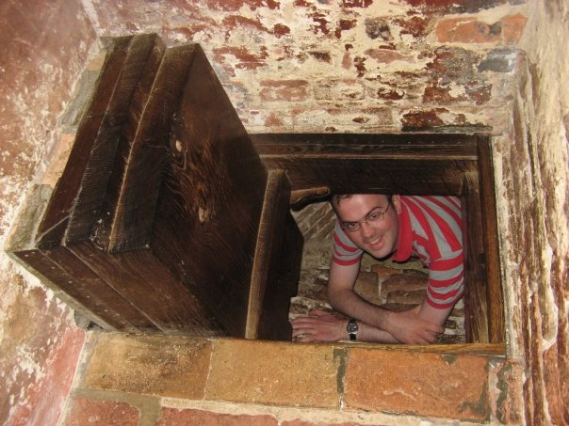
England’s Motives: Religious…
• Just as Mary had persecuted Protestants, Elizabeth returned the favor by persecuting Catholics.
• Many Catholics had “priest holes” in their homes to hide clergy from the authorities
• The persecution prompted many Catholics to consider moving to the Americas for religious freedom

Slide 6
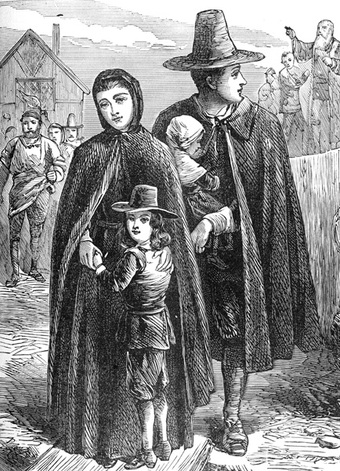
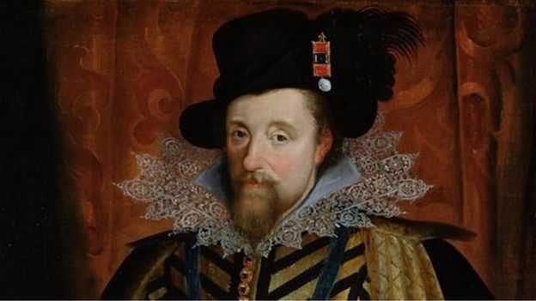
England’s Motives: Religious…
• Meanwhile, Puritans objected to both the Catholic Church and the Anglican Church that so closely mimicked it
- Church officials in England saw the Puritans as a threat to the Catholic and Anglican churches too
• For instance, the Puritans demanded that all archbishops be done away with and replaced with synods that would decide church policies
- And once King James I took the throne, he saw the Puritans as a threat to his authority as well
• As a result, Puritans also began looking to the New World as a solution to an inhospitable England

Slide 7
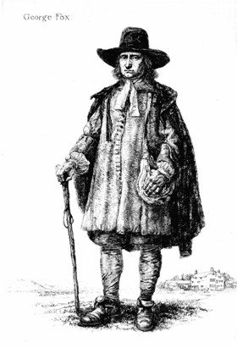
England’s Motives: Religious…
• Separatists and Quakers were also religious groups who looked to the New World or the religious freedom they lacked in England
- Separatists believed there was no way to “purify” the Anglican church, so the only option for them was to leave
- The Society of Friends, more commonly known as Quakers, believed religion was a matter of individual conscience
• For Quakers churches, doctrine, and ritual were all obstacles to true faith.
• Because Quakers abhorred violence they refused to serve in the military or even pay taxes that might support an army. They also refused to pay taxes, or to take their hats off to show respect to church or civilian authorities
George Fox, founder of the Quakers

Slide 8
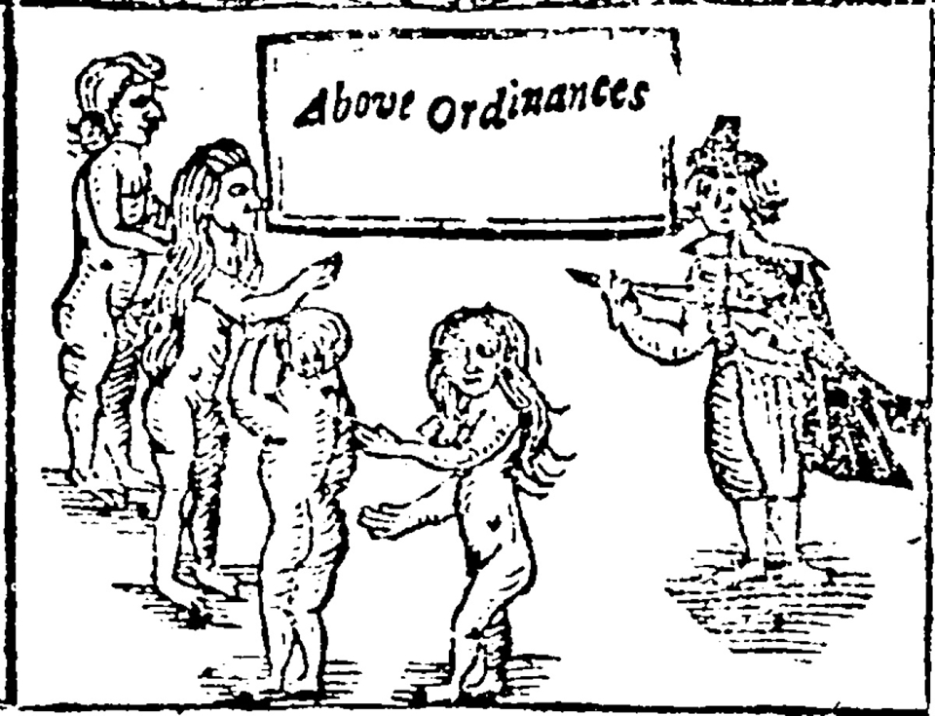
Quaker Militancy…
• Quakers of the 17th c. were known to interrupt church services, assault clergymen, or run through the streets completely nude in a defiance of ordinances!
To the government, Quakers were the ultimate threat to their rule. They imprisoned thousands of them and deported hundreds more. No wonder the Quakers decided to start anew in America!

Slide 9
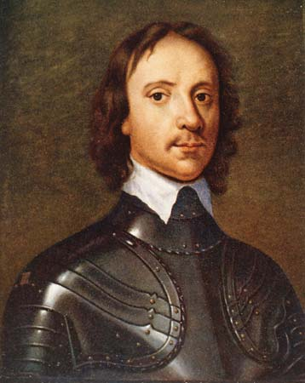
England’s Motives: Political…
• With the Puritan revolt against King Charles I that turned into the English Civil War, many royalists found it a good idea to be somewhere else. America and the colonies of the West Indies fit the bill. After the royal line was restored in 1660, many Puritans found themselves exiled to the New World too.
Oliver Cromwell, who led the Puritans and Parliamentarians against King Charles I in the English Civil War
The coronation procession of King Charles II in 1660

Slide 10
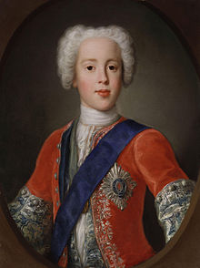
England’s Motives: Political…
More Unrest in England…
• After King Charles II died, the Duke of Monmouth tried to seize the throne from Charles’ brother, James, Duke of York. Hundreds of Monmouth’s supporters were deported to America as a result.
• King James I was only on the throne 3 years when his autocratic tendencies and Catholic faith caused another upheaval. James left England and was replaced by William of Orange and hi wife, Mary. This would have tremendous consequences for English colonization.
• More unrest occurred when George I came to power and initiated the Hanoverian line of English monarchs. Supporters of James II tried twice to reinstate the Stuart line, but failed. Large numbers of Scots were deported to America as a result, or else left on their own.
Charles Edward Stuart, aka “Bonny Prince Charlie,” who tried to reclaim the English throne for the Stuarts

Slide 11
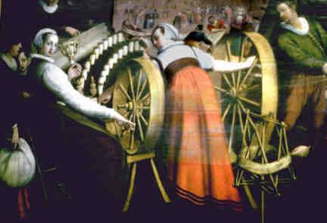
England’s Motives: Political…
• In 16th century England, because of many factors, there were a large number of what some called “sturdy beggars,” people who were unemployed or underemployed, and who posed a threat to the establishment if they chose to rebel against their lot in life. For the government, sending them off to overseas colonies removed that threat.
- The government reasoned that having them an ocean away would diminish their influence
• England suffered from a trade imbalance where what they made off of wool exports did not equal what they paid out for imported items like silks, wines, spices, and timber
• England embraced mercantilism as a means of correcting that trade imbalance.
- Overseas colonies would provide the material wealth to make England rich, and at the same time provide a place to get rid of those who did not fit in
England’s main export in the 1600s was wool products, but the market for wool soured and the English economy suffered as a result.

Slide 12
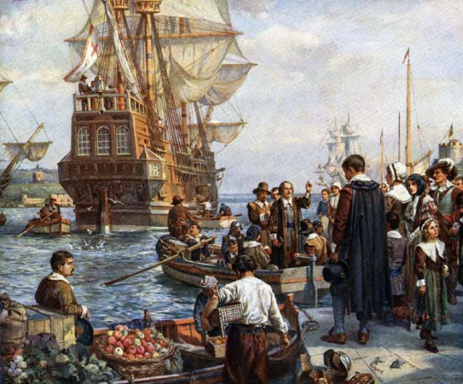
England’s Great Migration…
• Because of all of these “push factors,” (the political, economic, and religious reasons an Englishman might choose to come to the colonies), and the fact that authorities in England were okay with them leaving, by 1660 roughly 250,000 Englishmen had left for America and the English colonies of the West Indies.
- 50,000 went to Virginia and Maryland
- 20,000 went to New England
- 110,000 went to the West Indies

Slide 13
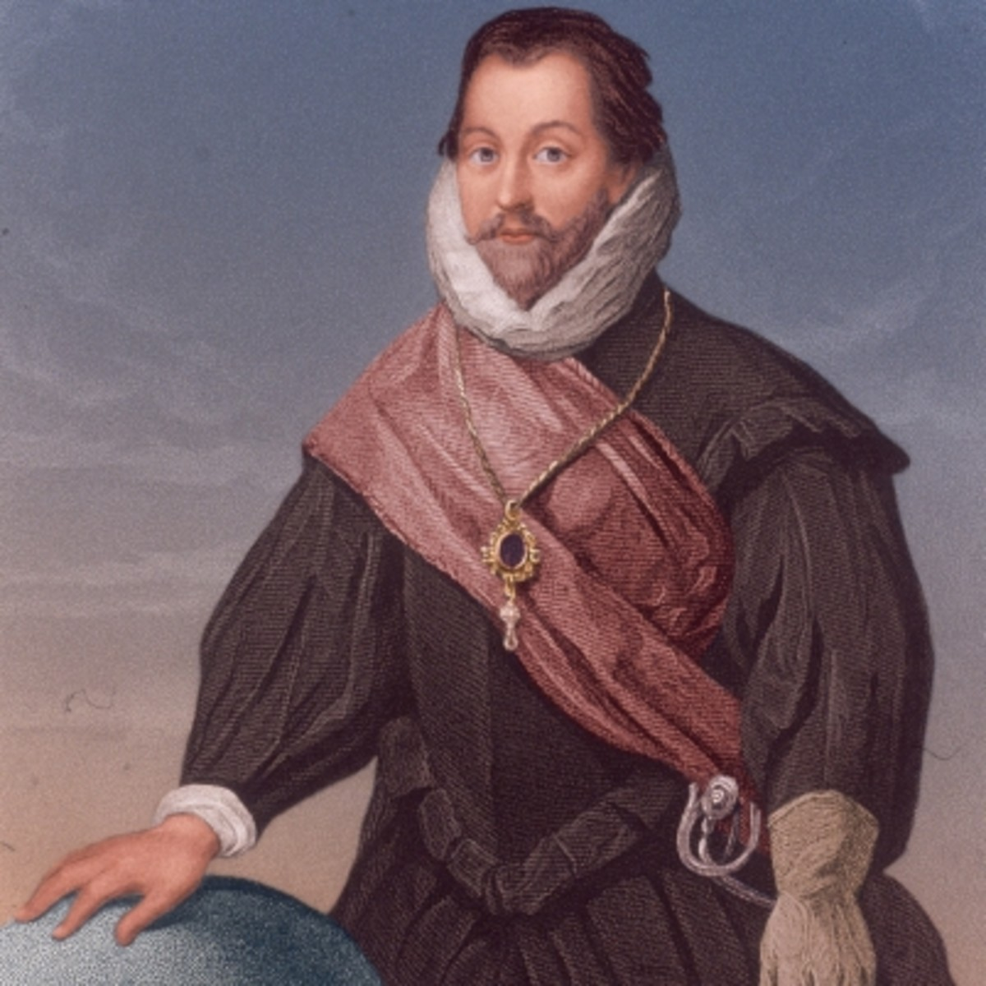
Queen Elizabeth’s Sea Dogs…
England could not compete with Spain in the New World because she was pretty much broke (remember that trade imbalance?). But there was more than one way to collect New World riches:
• After 1560, Elizabeth’s government allowed English “privateers” like John Hawkins, Francis Drake, and Richard Grenville to plunder 60k pounds worth of loot from Spanish treasure ships and towns in the New World. These men were England’s “Sea Dogs.”
- But for England’s challenge to Spain to succeed, they had to have American colonies of their own.
Sir Francis Drake

Slide 14
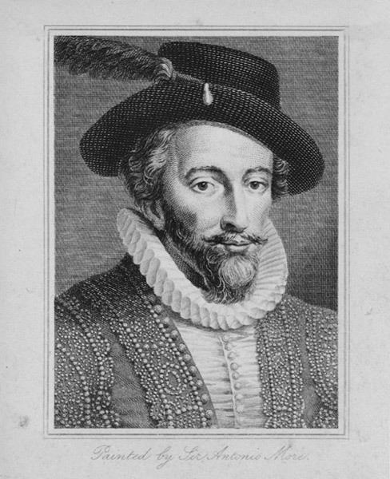
Richard Hakluyt Advocates Colonization…
In England, Richard Hakluyt the Younger became a big proponent of England establishing colonies in North America. Based on John Cabot’s earlier explorations, he claimed England had a right to do so. He also recognized the value of colonies to relieve many of the problems the country was experiencing.
England must, Hakluyt said, “…settle those lands which of equity and right appertain to us.” Sir Humphrey Gilbert accepted the challenge.
Richard Hakluyt

Slide 15
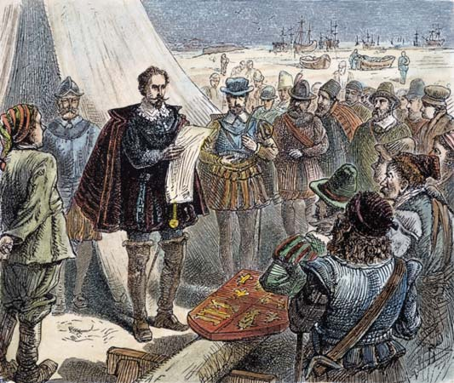
Gilbert’s Expeditions…
In 1578, Queen Elizabeth granted to Sir Humphrey Gilbert a commission that allowed him six years to explore North America. Gilbert was to find a suitable place for settlement, and if possible, a Northwest Passage to the Orient.
• Gilbert set sail that same year with 400 men but had to turn back because of unfavorable weather.
• Six years in 1583 later he tried again, and this time discovered Newfoundland.
• Gilbert claimed Newfoundland for England and set sail for home. Unfortunately, Gilbert and his ship was lost at sea and he never made it back to England.

Slide 16
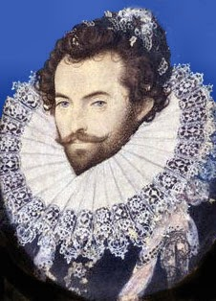
Raleigh Takes Over Where Gilbert Left Off…
After Gilbert’s death, his half-brother, Sir Walter Raleigh, took over his commission. Raleigh, like Gilbert, was a favorite of Queen Elizabeth. The queen allowed him to mount his own expeditions to North America, but only on the condition that he himself remain in England. Elizabeth could not bear to lose Raleigh the same way she had lost Gilbert.
• Queen Elizabeth granted Raleigh a charter in 1584 that was essentially the same as Gilbert’s. Raleigh sent two experienced sea captains, Philip Amadas and Arthur Barlowe, to explore and find a place for settlement.
• After landing and interacting with the Native Americans they found there, Amadas and Barlowe returned to England and recommended Roanoke Island as the place to plant the first English settlement in North America.
Sir Walter Raleigh

