Slide 1
England in America…
The Northern and middle colonies

Slide 2
Colonization in the North vs the South…
The fertile soil of the South allowed settlers in places like Jamestown and Maryland to range up and down the Chesapeake, establishing large plantations based purely on agriculture. In the North, the rocky New England soil and organized habits of the Puritans who lived there forced colonists into a much more regimented style of land allotment.

Slide 3
Pattern of Settlement in New England
Puritan settlers were mostly married couples and from the start immigrated as families (“little commonwealth”) to America
Comprised middle class settlers
Clustered in villages and towns for security reasons and religious solidarity
Engaged in fish, fur, and lumber industries

Slide 4
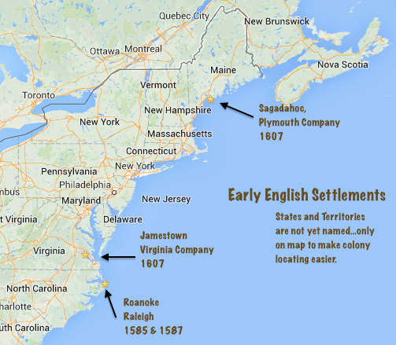
Sagadahoc…
• After Roanoke and Jamestown, the next English attempt at settlement came in 1609 in Maine, at a place called Sagadahoc by the natives.
• It failed mainly because of internal tensions over leadership and external tensions with local Indians.
• William Strachey also claimed bad weather also played a role in the settlement’s failure.
• Most historians point to its isolation as a major factor in Sagadahoc’s failure.

Slide 5
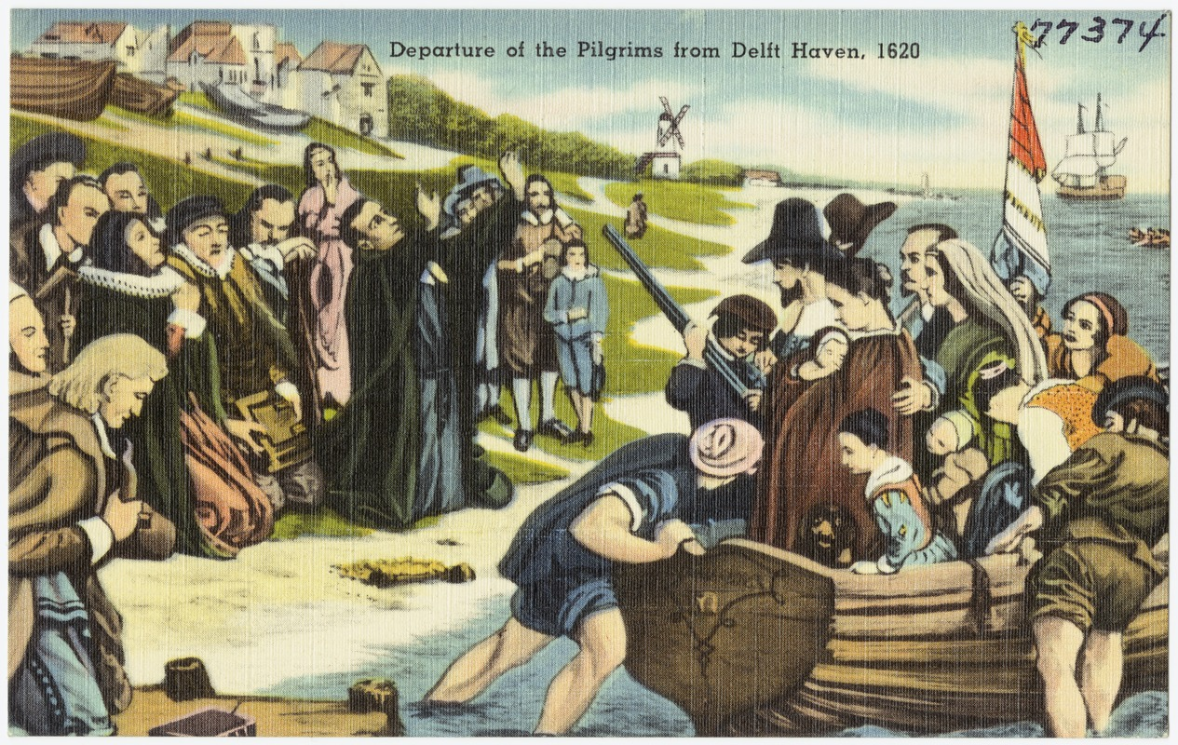
The Pilgrims…
• Persecution in England caused Separatists who came to be called Pilgrims to move to Holland.
- But the Pilgrims, led by William Bradford and their minister, John Robinson, had a hard time assimilating.
• In 1621, the London Company granted the Pilgrims permission to settle on their territory in North America.
• A joint stock company was formed to raise funds, with each settler granted one share of the company in return for seven years labor. At the end of that period, all lands and profits would be split between the settlers and the company.
Pilgrims shove off from Delft Haven in 1620 to board ship for America.

Slide 6
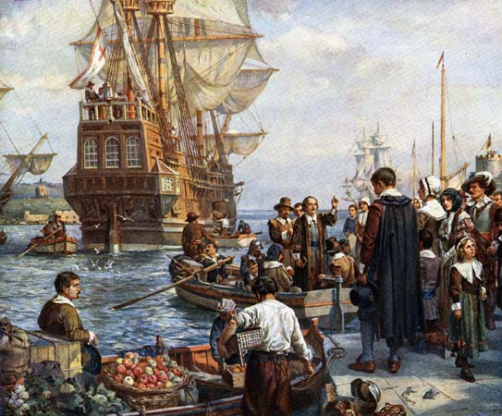
The Mayflower…
• In September 1620, 35 Pilgrims and 67 other English men, women, and children boarded the ship Mayflower and set sail for America. The voyage lasted for two months.
• Whether because of being blown off course, or because Johns Smith’s stories of abundant New England furs and timber, or because they sought a place where they would be free to worship as they pleased, the Pilgrims landed on Cape Cod instead of Virginia..
• That created a problem: how, and by whom, would they be governed? The answer: the Mayflower Compact.
Pilgrims boarding the Mayflower

Slide 7
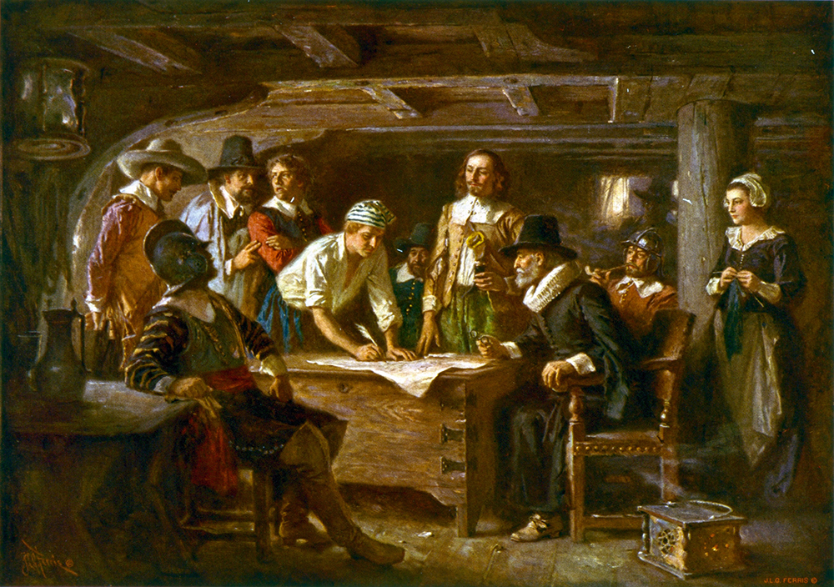
The Mayflower Compact…
• To solve the governance issue, forty-one Pilgrim adult males of the Mayflower agreed to “…enact, constitute, and frame such just and equal Laws, Ordinances, Acts, Constitutions, and Offices, from time to time, as shall be thought most meet and convenient for the general Good of the Colony, unto which we promise all due Submission and Obedience.”
Pilgrims signing the Mayflower Compact aboard ship.

Slide 8
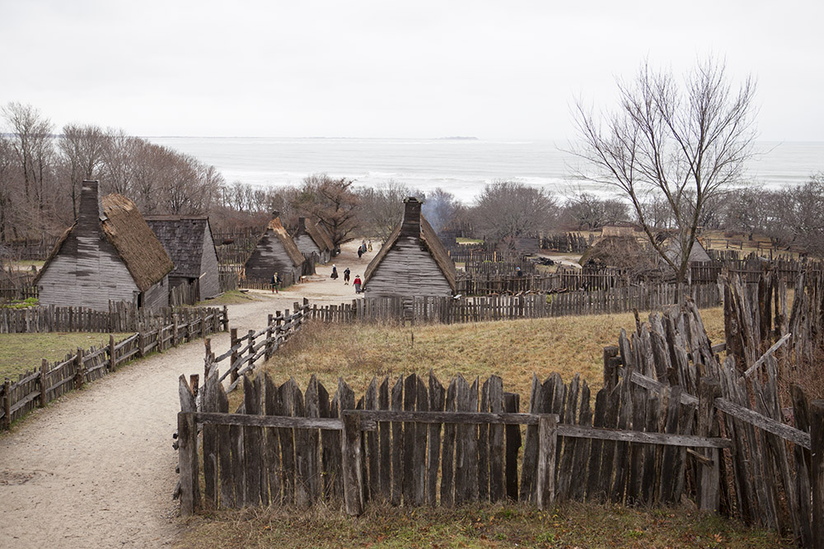
The Plymouth Colony…
• After exploring the region, the Pilgrims settled on Plymouth as a site for their settlement, and began building on Christmas Day 1621.
• The first winter at Plymouth was hard, Half the settlers died, and more likely would have if the local Indians had not been generous with their food and support of the newcomers.
- This was all the more remarkable, because the local Indians had been decimated by what King James I called “the wonderful plague.”
Plymouth colony in Massachusetts

Slide 9
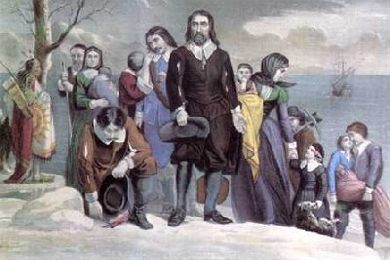
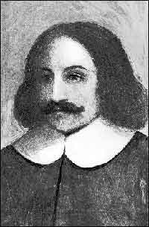
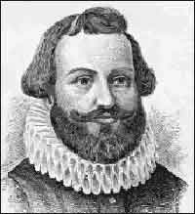
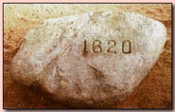
The Pilgrims, led by Captain Miles Standish (left) and Governor William Bradford, landed at Plymouth in late December 1620.

Slide 10
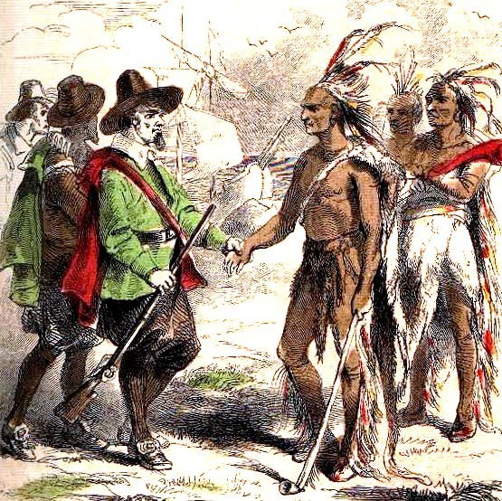
Samoset and Squanto…
• The Pilgrims first made contact with local Indians when Samoset wandered into Plymouth asking for beer. He later brought his friend Squanto to meet the newcomers.
• Squanto stayed with the colonists until he died in 1622, teaching them skills like fishing and how to raise corn.
• Squanto also acted as emissary to Chief Massasoit of the Wampanoag Confederacy, who signed a defensive and offensive treaty with the Pilgrims that lasted until King Philip’s War broke out in 1675.
• Relations were not always smooth. Miles Standish raided neighboring tribes so often that John Robinson called him out on it.

Slide 11
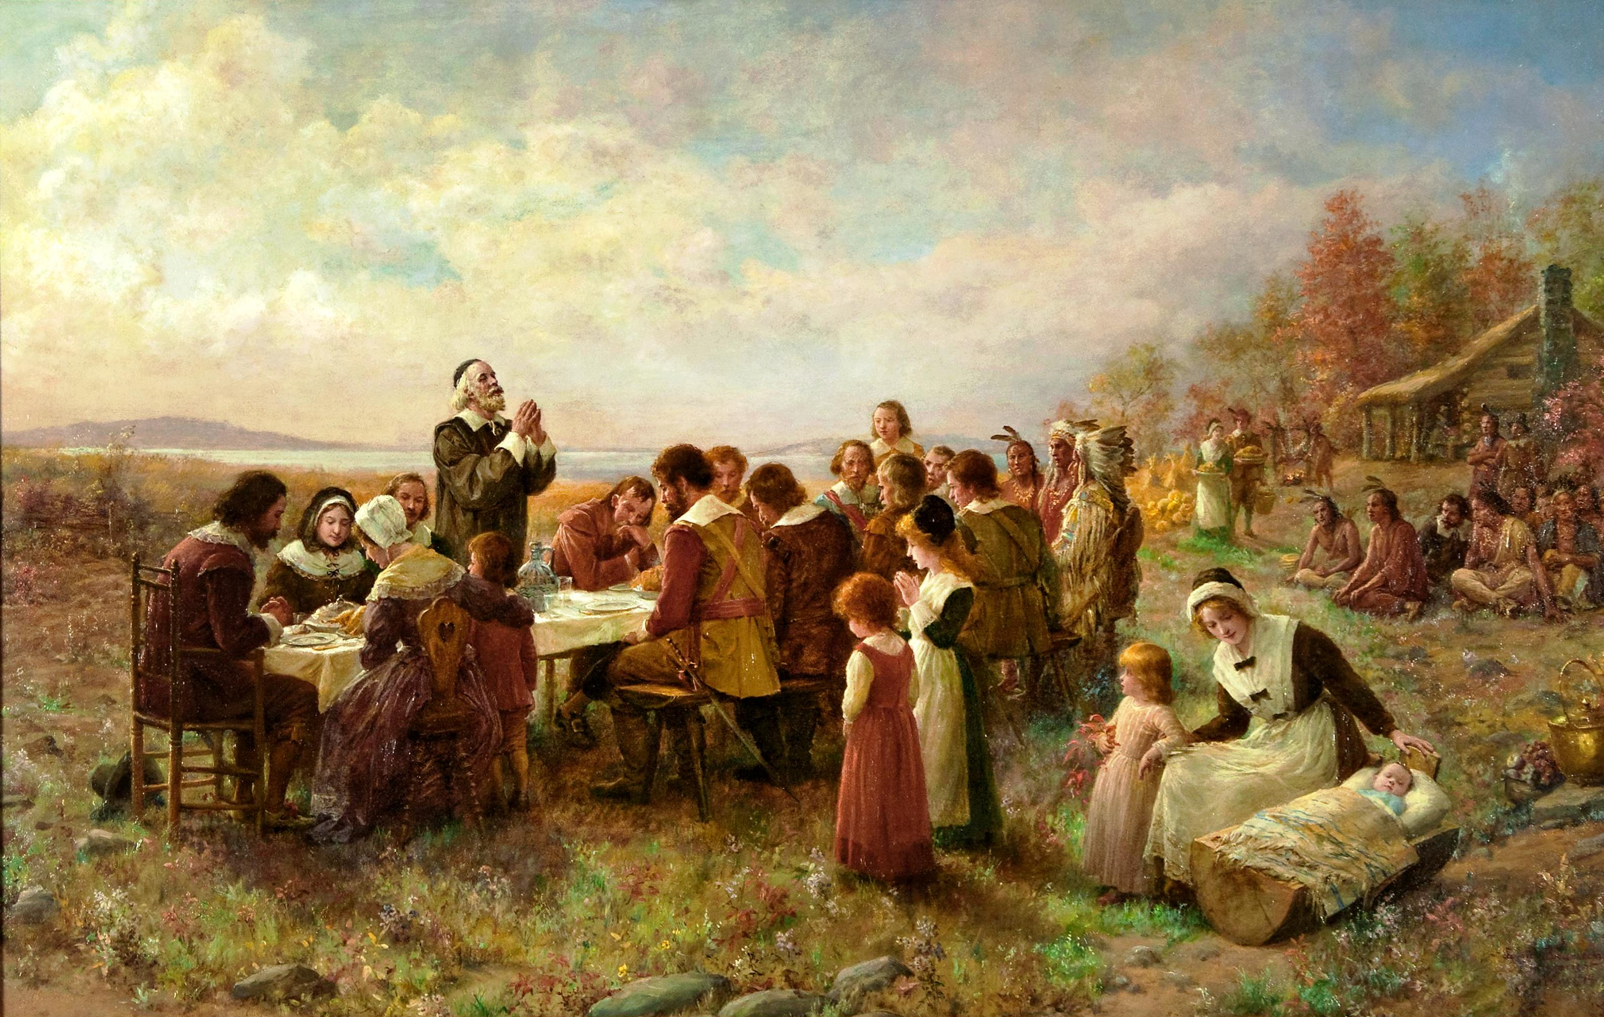
The First Thanksgiving…
• Thanks to Squanto and his friends, the Pilgrims’ first harvest was so bountiful that they invited Massasoit and 90 of his warriors to join them in a feast of thanks.
• Those settlers were soon joined by 35 more, once again making food scarce.

Slide 13
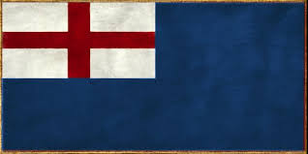
The colonists become owners…
• To ease the food shortage, Gov. William Bradford on his own initiative began dividing Plymouth land among the settlers.
• When the Plymouth Company realized there was not going to be a profit in the near future, they agreed to sell the venture to the Pilgrims for the sum of £2,400.
• It took the Pilgrims seventeen years to pay off that purchase price.
• It soon became apparent that the colony at Plymouth was never going to produce a profit for the joint stock company that had invested in it.

Slide 14
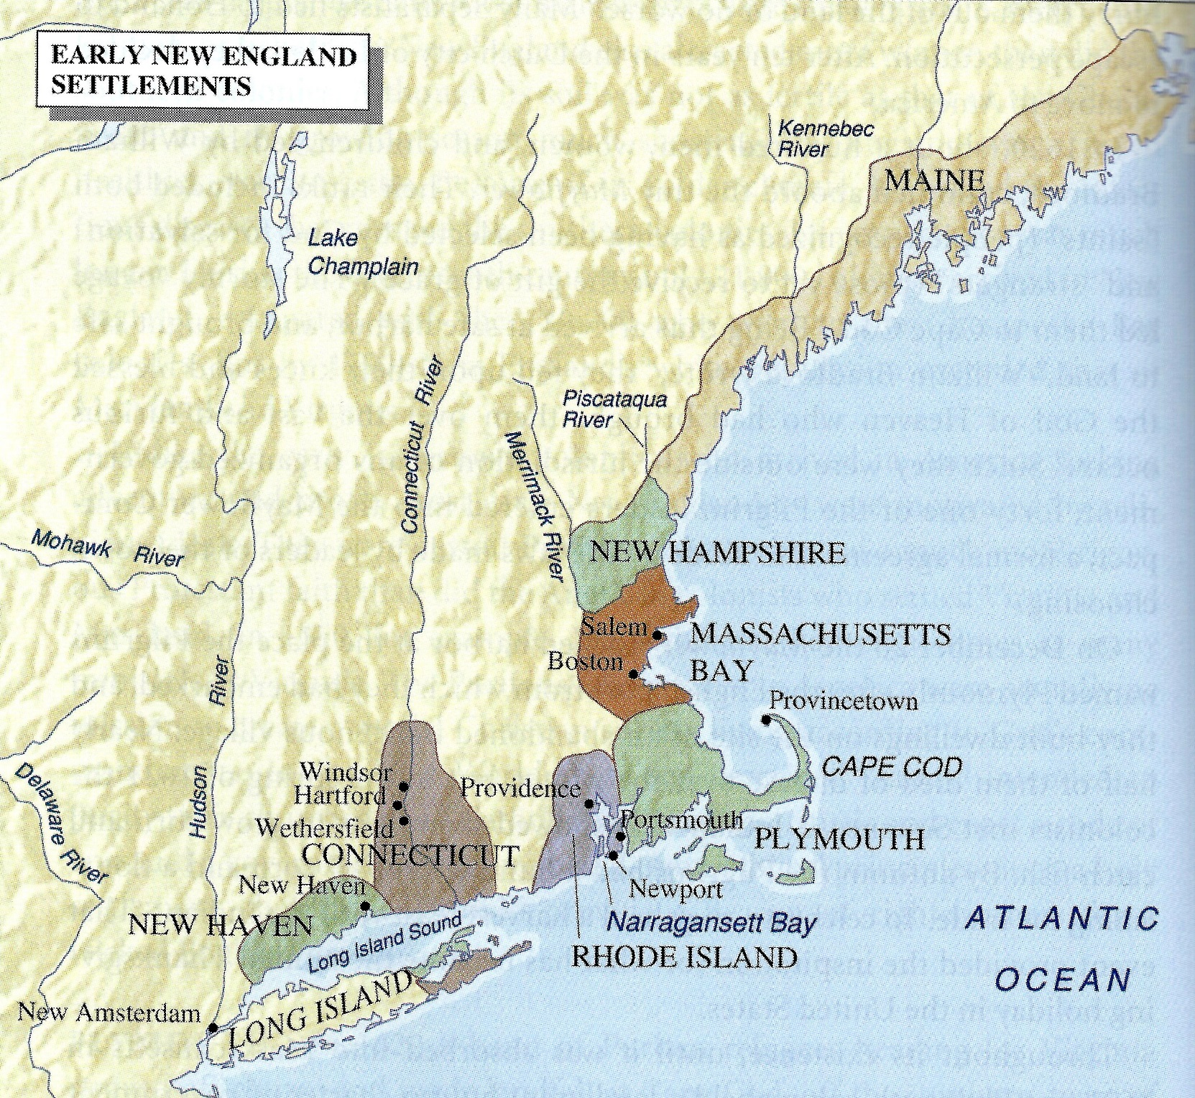
From Plymouth, other colonies emerged.
- The Plymouth Plantations became the Massachusetts Bay Colony in 1623.
- Roger Williams traveled south and established the Providence Plantations after being expelled by the Puritans in 1636. This would eventually develop into Rhode Island.
- Connecticut first settled by Dutch, Plymouth farmers, and English Puritans between 1633-1662.
- Maine and New Hampshire settled in 1620s
- New Jersey was formed as a proprietary colony in 1664, while Pennsylvania was formed by Quakers in 1681. Delaware was a latecomer, forming in 1701-1704.

Slide 15
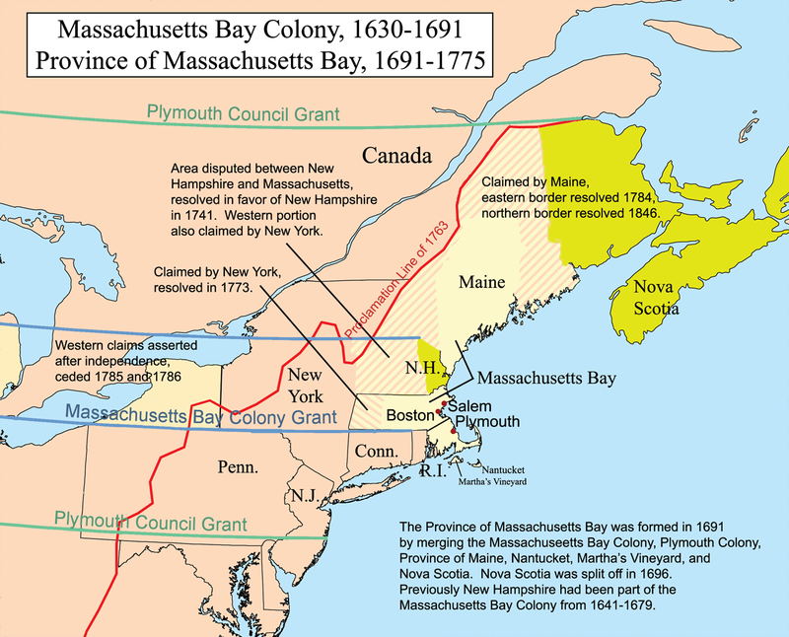
Massachusetts Bay Colony…
• Formed in 1629, and initiates the Great Puritan Migration to the New World of the 1630s.
• John Winthrop and other investors bought out the Massachusetts Bay Company, making them the owners of the colony, and the colony self-governing.

Slide 16
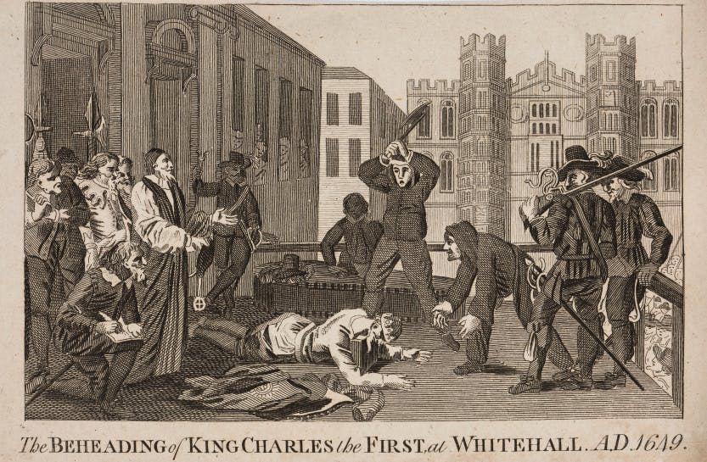
England at arms length…
• The Massachusetts Bay Colony tried to distance themselves from England.
- Winthrop and others were worried King Charles I would try to nullify their charter.
- The Puritans are able to stall any potential takeover by the king, mostly because King Charles I loses his head when he’s executed by Oliver Cromwell after losing the English Civil War.
• It isn’t until King Charles II takes the throne after Cromwell’s Interregnum that Massachusetts becomes a royal colony in 1684.

Slide 17
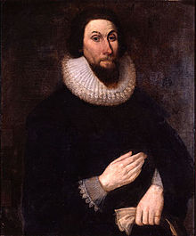
The “City upon a hill”…
“For we must consider that we shall be as a city upon a hill. The eyes of all people are upon.” Governor John Winthrop of Massachusetts Bay Colony, 1630
Winthrop believed God had chosen the Puritans to go to America and establish a “city upon a hill,” a holy commonwealth that would draw the eyes of all Europe as an example of what a Godly city should be.
• Before the end of 1630, 2000 Puritan families left England for America. Their number would grow to 16,000 just a few years later.

Slide 18
No rules but Winthrop’s…
• For the first ten years of its existence, the Massachusetts Bay Colony had no legal code. Winthrop believed the assistants who acted as judges should have great leeway in their decisions.
• He also was scared that if Massachusetts law deviated too much from English law, the colony’s charter might be in jeopardy.
• But Winthrop eventually came to realize the danger of no written legal code, and in 1641 Nathaniel Ward prepared the Body of Liberties based on English common law.
- A more complete set of laws, the Laws and Liberties of Massachusetts, was produced in 1648.

Slide 19
What Massachusetts Bay Colony was NOT…
• IT WAS NOT A THEOCRACY: State and church were specifically separate, though the clergy often were sought for advice. The colony supported the church, and attending church was compulsory. In return, churches preached support of the civil government.
• IT WAS NOT A DEMOCRACY: The Puritans did not think democracy was a fit government for either church or a commonwealth. John Cotton, for instance, said “If the people governors, who shall be governed?”
- The Puritan view was that the church members, as the least depraved among them, should select leaders from a select group of men who could be counted on to carry out God’s will.
- Winthrop called this a “mixed democracy.” Cotton called it a “mixed aristocracy.”
•Cotton’s description may be most accurate: the same men were elected to leadership roles over and over, while only a quarter of the men in the colony were admitted to church membership (hence on 25% had a vote on who ran things).

Slide 20
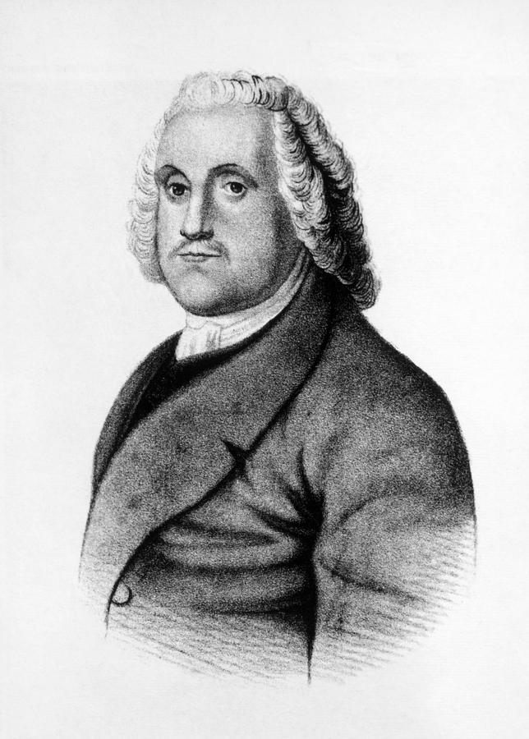
The Puritan Church expelled Roger Williams, whom it considered a zealot for supporting separation of church and state. Williams sought refuge with Narragansett Indians south of Massachusetts, and soon established the town of Providence, the first settlement in what would become Rhode Island. Williams welcomed people of all faiths to the colony. In 1652, Rhode Island passed the first law in North America outlawing slavery.
Roger Williams wears out his welcome…
“ A false religion out of the church will not hurt the church, no more than weekends in a wilderness hurt the enclosed garden…and a false religion – will not hurt the civil state in case the worshipper break no civil law.”

Slide 21
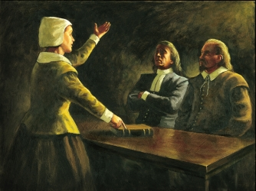
Williams is joined by Ann Hutchinson…
Williams’ female counterpart was Anne Hutchinson, an intelligent, strong-willed woman, and theologian. Her outspokenness on matters of faith in the male dominated Puritan community got her banished from Massachusetts, and she, too, settled in Rhode Island.

Slide 22
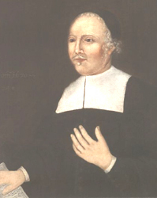
Connecticut…
• By 1633, Dutch and Plymouth farmers had spread to settle along the Connecticut River Valley. The towns of Sayebrook and Hartford are established as a resut.
• Connecticut starts as a Puritan colony, but the Restoration sees King Charles II grant a charter that allows for self-governing.
• New Haven is established as a Puritan colony in 1638 as a refuge for Puritans fleeing Massachusetts during the Antinomian controversy (a religious conlict).
- The Fundamental Articles of 1639 made New Haven a true religious colony.
• By 1662, New Haven had joined other towns led by Rev. John Davenport. and Theophilus Eaton under the Connecticut Charter.
Rev. John Davenport

Slide 23
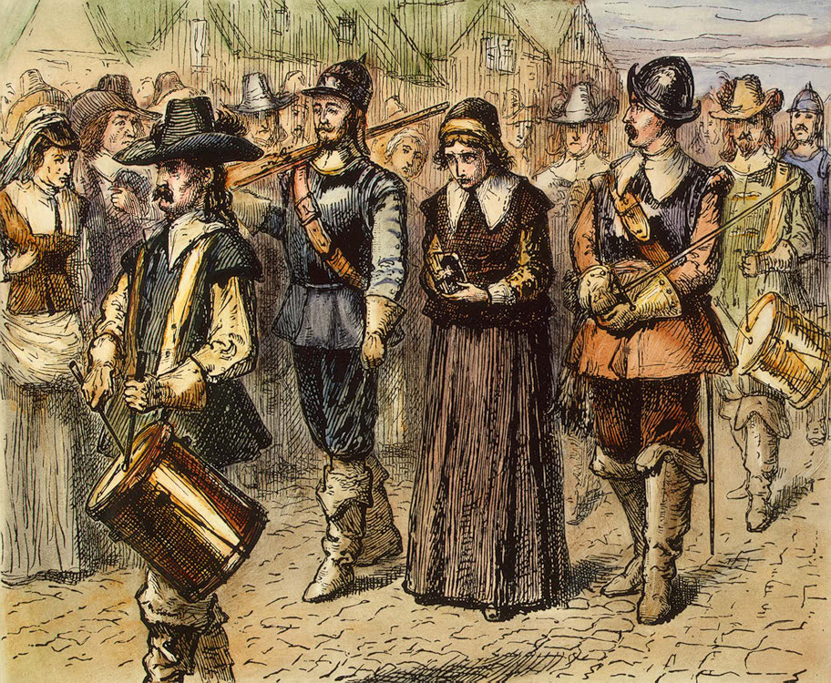
The Antinomian Controversy…
• The Antinomian Controversy indirectly led to the formation of both Rhode Island and Connecticut by forcing dissenters to flee Massachusetts.
• Anne Hutchinson held regular meetings in her home to discuss the sermons delivered each Sunday. She insisted some clergymen, like John Cotton, had more insight than others.
• Hutchinson and her friends believed in a covenant of grace (you knew you were saved by a an inner light, or the feeling that the Holy Spirit had blessed them). The official Puritan church believed in a covenant of good works (a person’s good conduct was necessary for, and a sign of, their salvation). This put Hutchinson and her friends at odds with John Winthrop and the Puritan church.
Hutchinson was put on trial for “having troubled the peace of the commonwealth” in Massachusetts.

Slide 24
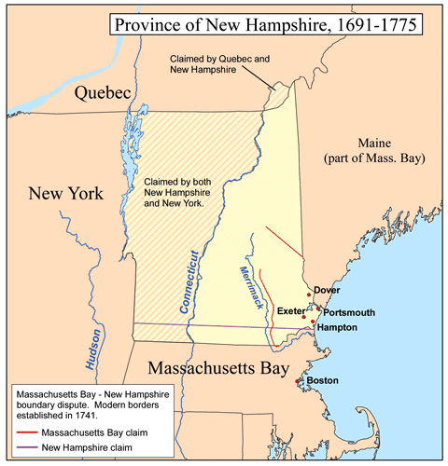
Maine and New Hampshire…
• Maine and NH were originally proprietary holdings of John Mason and Sir Francis Gorges
- Maine was probably settled in the 1620s
- New Hampshire was settled by 1629
• Both were proprietary colonies intended to make money, but they failed to do that.
- The region had a poor climate
- There were competing claims to the territory from the French
- The proprietors ignored Maine and NH, so Massachusetts steps in to establish a government there.
• After Mason and Gorges die, their heirs sue Massachusetts to get control. They win.
- They sell Maine to Massachusetts in 1679
- NH bought by the Crown in 1679

Slide 25
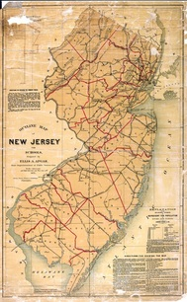
New Jersey…
• Founded as a proprietary colony by a royal charter granted to John, Lord Berkeley and Sir George Carteret (both were also Lords Proprietors of Carolina) in 1664.
• To increase settlement, the proprietors issued the Concessions and Agreement that promised a representative assembly, religious freedom, and land grants free of taxes until 1670.
• East Jersey settled by Quakers, West Jersey by Puritans
• Issues over taxes caused Carteret and Berkeley to sell their claims. Berkeley sold his to Quakers in 1674, while Carteret sold his to group of 23 other Quakers led by William Penn.
• By 1702, both East and West Jersey came under the authority of the king when the proprietors relinquished their control after pressure from the English government.

Slide 26
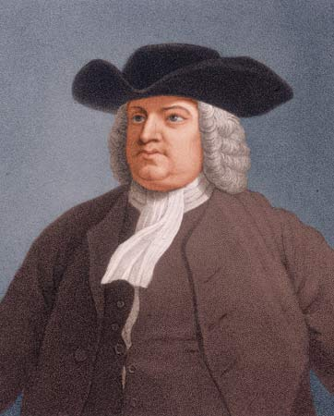
Pennsylvania…
• Rioting over quitrents and ownership issues in New Jersey led William Penn to consider forming a Quaker sanctuary elsewhere.
• To pay off a debt to the Penn family, King Charles II grants William a charter for a colony in 1681
- Heavy Restrictions: all laws need royal approval • all decisions are subject to royal appeal • the colony had to keep an agent in England at all times
• Colony settled by 1681, Penn arrives in 1682
- Pennsylvania has no Indian trouble early on because Penn insists they be treated fairly
• Penn’s First Frame blueprint for government guarantees:
- Religious toleration as long as the Trinity is recognized and non-Quakers behave themselves
• 1701: Charter of Privileges replaces First Frame
- It was amendable – something unique in the colonies
- Liberty of conscience was protected absolutely: no man could be forced to act against his conscience
• Good land/location made it one of the most popular colonies
William Penn

Slide 27
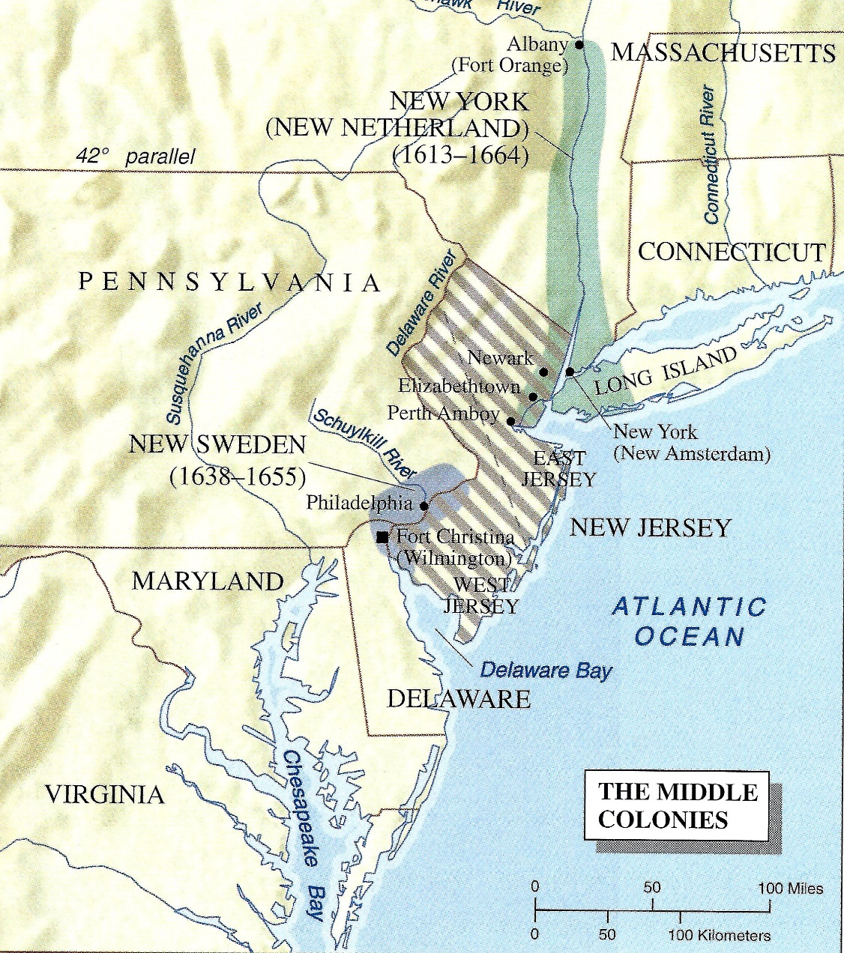
The Middle Colonies…
Expansion of the Mid-Atlantic colonies New Jersey (1676) Delaware (1682)

Slide 28
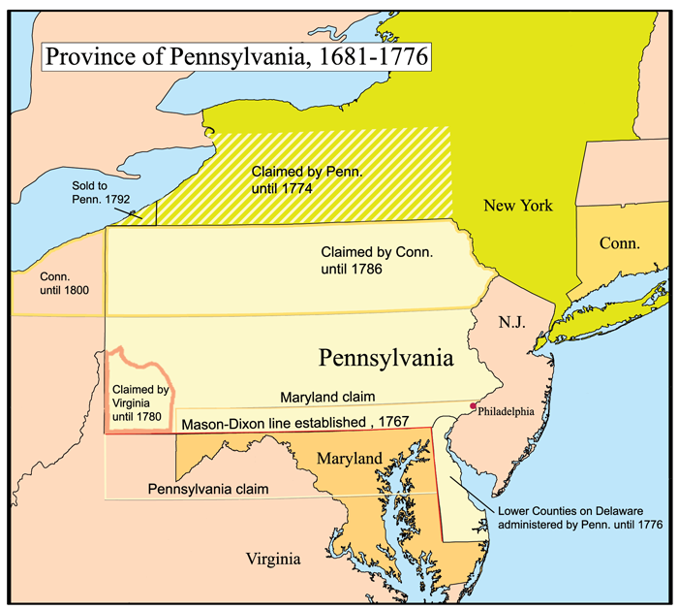
Delaware…
• Originally the three lower counties of Pennsylvania
• Residents were unsatisfied being part of Pennsylvania and wanted a colony of their own
- Sometime between 1701-1704 they got it.
• Delaware was a proprietary colony owned by the Penn family until the Revolutionary War

Slide 29
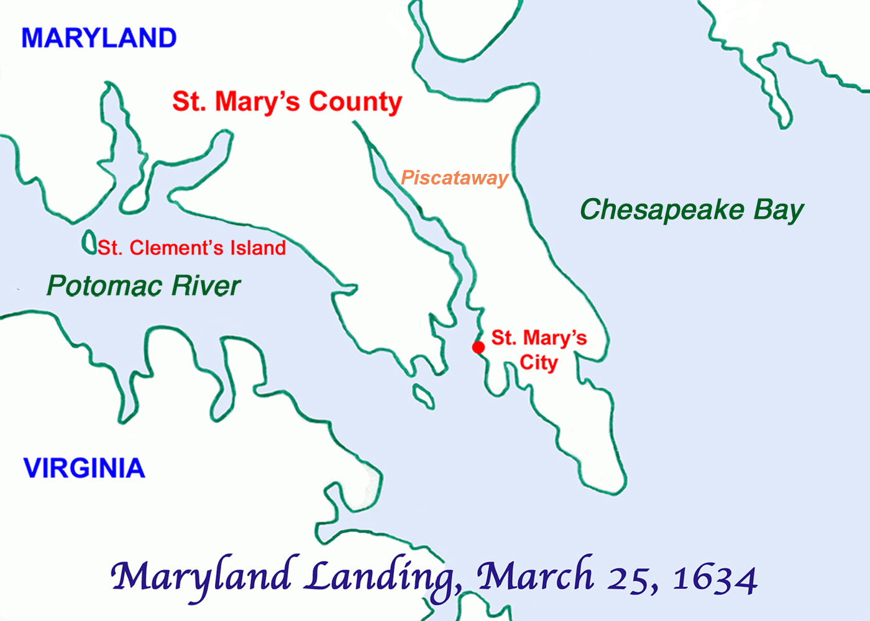
Maryland…
In 1632, King Charles I granted Lord Baltimore, George Calvert, the first proprietary colony, named Maryland after Queen Henrietta Maria. Cecilius Calvert settled the colony in 1634.

Slide 30
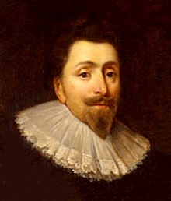
Maryland…
• Calvert’s Maryland colony succeeded where others had failed in part because Virginia was there to give it support.
• Calvert’s conversion to Catholicism in the 1620s made him begin searching for a place to colonize where Catholics would be welcome
• Calvert’s charter was essentially feudal, and he called all the shots in Maryland
• The first Lord Baltimore died as his charter was being drafted, so his son Cecil oversaw the settlement of the colony.
• About 200 mostly Protestant settlers landed at Saint Mary’s near the mouth of the Potomac River in 1634.

Slide 31
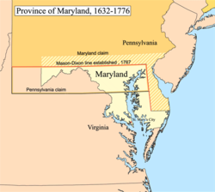
Attracting settlers…
• Generous land grants were not enough to attract settlers to Maryland.
- Potential settlers wanted a say in their government and the laws it made like settlers in Virginia enjoyed.
- Lord Baltimore resisted it for a number of years, but he eventual gave in to their demands
• Baltimore allowed the colonial legislature to initiate laws, but kept the right to veto any law at any time, even if it had already been approved by the governor.

Slide 32
Religious frictions…
• Though Baltimore planned Maryland as a refuge for Catholics, most settlers were Protestants.
• Lord Baltimore was under constant pressure to protect Maryland Catholics from their Protestant neighbors.
- It became even harder to do once Puritans came to power in England after the English Civil War
• Governor Calvert was even forced into exile in Virginia between 1645-1647. But then Baltimore named a Protestant governor, and proposed an act to protect Catholic Marylanders.
- In 1649, the legislature passed the Toleration Act, that declared in part:
“…no persons…professing to believe in Jesus Christ shall from henceforth be any ways troubled, molested, or discountenanced for or in respect to his or her religion…”
• It did little to heal hard feelings between Protestants and Catholics

Slide 33
Settlers in English America, regardless of their religious affiliation or class standing, viewed the colonies as a land of opportunity, new beginnings, and hope. Although they intended to transplant, and perhaps improve upon, Old World society and culture, conditions inevitably led to the creation of unique and distinctive social and political institutions. Whether they knew it or not, they were slowly but surely becoming Americans. Those bonds would prove fateful in the coming years.

