Slide 1
Religious Wars
Write Down Anything in RED for your notes!
And more Secularization of power

Slide 2
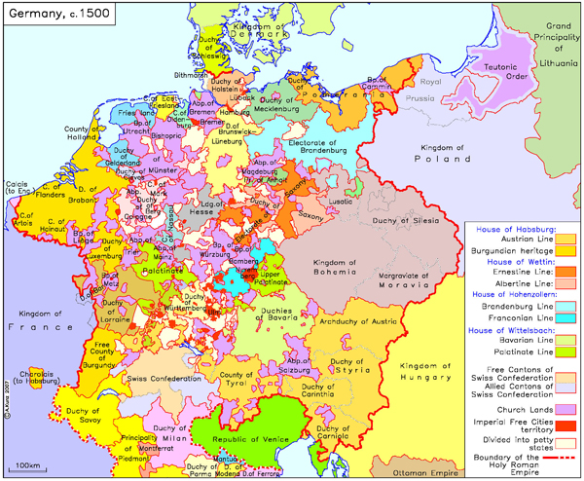
Where the wars started: Germany
Germany was a loose confederation of states
Connected culturally via language and traditions
Basically the ruler chose the religion, best interest was what the majority preferred.
No one believed in religious freedom or honoring multiple religions
German rulers chose Protestantism
They believed in
Could confiscate church farmlands and property, increase their wealth
Gain power and perhaps independence from HRE (Holy Roman Empire)

Slide 3
Switzerland
Charles V defended Catholicism so religious wars broke out
Switzerland had 13 cantons, some Catholic, some not
1520s both sides go to war
Zwingli dies on battlefield in 1531 and they stop fighting
Treaty
Each canton determines its own religion
Each side has to give up its foreign alliance (beginning of Switzerland’s neutrality

Slide 4
Holy Roman Emperor defends the Faith…
Charles V calls the Imperial Diet at Augsburg in 1530
Lutherans present the Augsburg Confession (statement of beliefs)
Charles refuses and orders everyone to return to Catholic and give up any confiscated land
Can’t send troops because they are fighting Habsburg-Valois Wars and Ottomans in Hungary
Needs to curb German princes and local rulers, so Charles V is fighting for religion and to maintain his empire

Slide 5
Charles V finally sent in troops in 1546 and was successful
This scared France and the Pope, who didn’t want Charles V to get too powerful
Pope withdrew his troops and Catholic King of France sent money and troops to Lutheran princes
1555 Peace of Augsburg
Officially recognized Lutheranism
Ruler of the land determines the religion (gives states more power)
Still no religious freedom (Catholic or Lutheran and every citizen must join the state church)
Charles V abdicates thrown because he couldn’t unite empire under a single church
Philip his son gets Spain and Netherlands
Ferdinand his brother got rest of empire
North was very Lutheran, South mostly Catholic

Slide 6
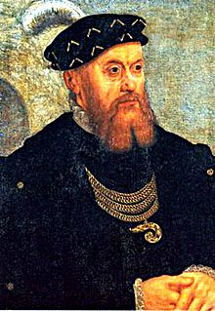
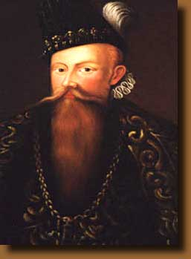
Scandinavia
King Christian III of Denmark- Norway accepts Lutheranism
Easy transition in Denmark
Norway and Iceland people refused and it was forced on them
Sweden—King Gustavus Vasa takes over the church and its income and eventually accept Lutheranism

Slide 7
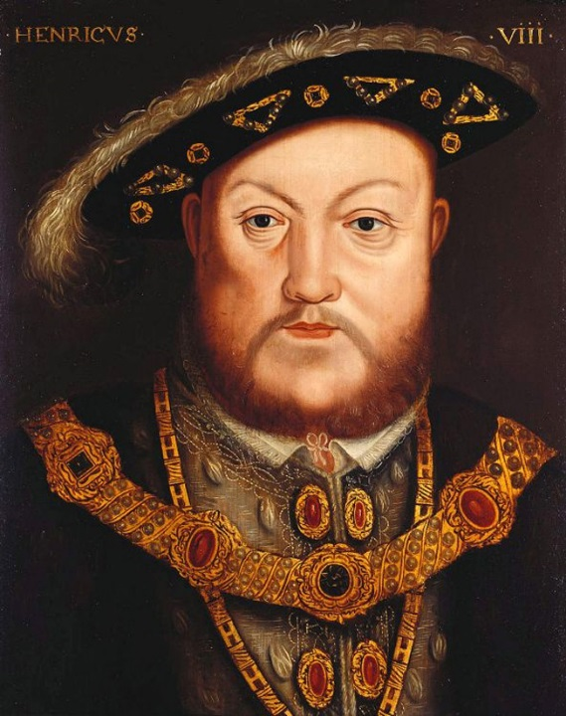
England
Henry VIII wants an annulment from Catherine of Aragon because she didn’t give him a son (Just a daughter, Mary Tudor)
Pope Clement stalled because HRE army was in Rome and divorce would dishonor Charles V’s aunt Catherine and cousin Mary
Henry VIII uses parliament to make the King head of the church in England
Opponents such as Sir Thomas More were killed
Had 6 wives altogether

Slide 8
Church of England or Anglican Church
Kept Catholic practices such as
Confession, clerical celibacy, and transubstantiation
Dissolved the monasteries and took their land to enrich the treasury
Middle and upper classes bought that land and become tied to the monarchy

Slide 9
Leads to the beginnings of modern bureaucracy…
New departments and jobs were created to manage the confiscated land
Surplus funds balanced deficit areas
Better efficiency and economy
Growth of modern centralized bureaucratic state

Slide 10
Not so fast …
Some English converted easily, others did not
Pilgrimage of Grace was the largest rebellion
Leaders were executed
Ireland parliament was ordered to create Protestant Church of Ireland
Catholic peasants fought back and were crushed

Slide 11
Under Edward VI The Book of Common Prayer was established
Mary Tudor brought back Catholicism (many Protestants executed)
Elizabeth I was Protestant (middle ground)
Queen supreme over church
Required citizens to attend services
Service in English
No monasteries
Clergy can marry
But church remained hierarchal with archbishops, bishops
Services were elaborate

Slide 12
Palace intrigue…
Mary Tudor (Catholic) married Phillip II (Catholic) of Spain, died
Next in line for throne was Mary Queen of Scots (Catholic)
Elizabeth I had her imprisoned and then executed for plotting against her
Pope urged Philip to retaliate

Slide 13
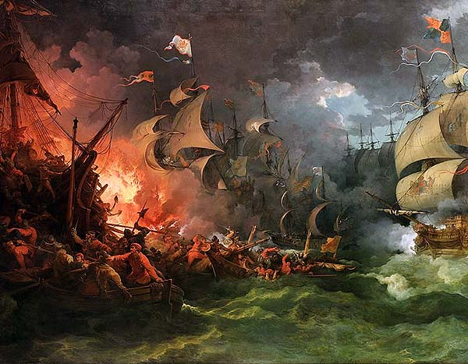
Spanish Armada
Philip sent Spanish Armada to attack England
Best Navy of 130 ships
Meets the English fleet with smaller, faster, ships better firing power
Combo of storms and bad food/water and poor munitions defeated the Spanish
Now England has the most powerful Navy

Slide 14
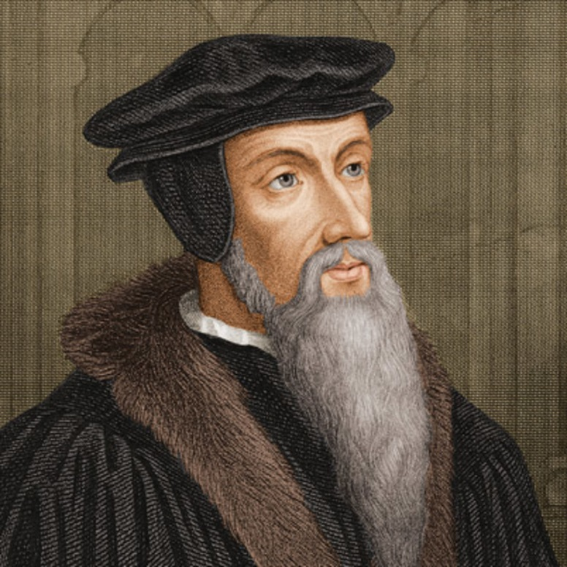
Calvinism
John Calvin, born in France converts to Protestantism
Was asked to help reform Geneva, Switzerland in 1541
Goal was to establish a well-disciplined Christian society with church and state acting together
Calvin’s ideas were written in The Institutes of the Christian Religion
Main belief—Predestination!!!!
God has already decided who will go to Heaven and Hell
No freewill, that would detract from God’s sovereignty
Cant change fate but hard work, thrift, moral conduct could show signs of the elect

Slide 15
Consistory—group of laymen and pastors who investigated and disciplined deviations from proper doctrine and conduct
Serious crimes and heresy were handled with civil trials but torture could be used
76 banished, 58 executed
Geneva became the model of a Christian community, many refugees and reformers
Calvinism became very popular In Europe (Puritans too)
John Knox instituted Presbyterian church in Scotland which was Calvinist

Slide 16
Reformation in Eastern Europe
Czech Bohemians were Catholic
German nobles were Lutheran
Habsburgs were Catholic, but remember Peace of Augsburg
Leads to 30years in 17th C
Poland-Lithuania
Polish nobles liked Calvinism (hated Germans, thus Lutheranism)
King Sigismund I was Lutheran
Catholic Reformation won

Slide 17
Continued
Hungary—students and King Louis II wanted Lutheranism
But Catholic nobles ordered confiscation and death to Lutherans
But Suleiman the Magnificent/ Ottomans attacked killed the king and took over Hungary
Turks didn’t care about which Christian religion, taxed Christians
Hungary became mostly Protestant
Turkish withdrawal in 1699, led to Habsburg Catholic restoration

Slide 18
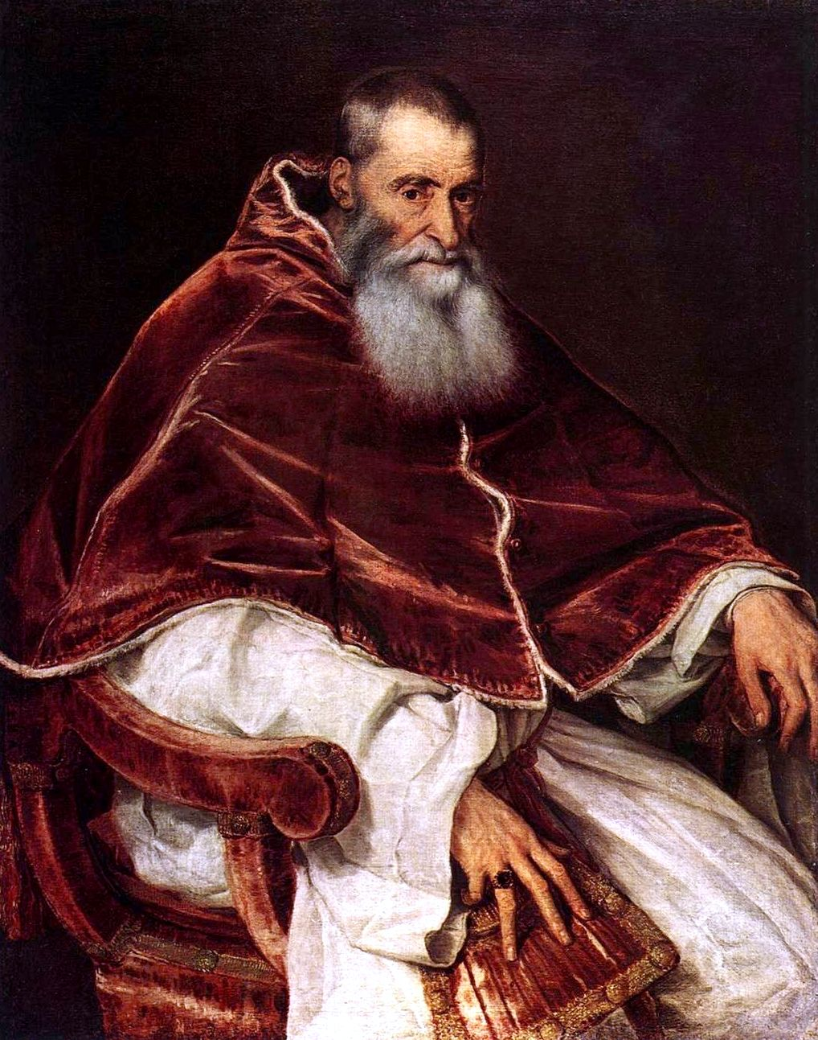
Catholic Counter-Reformation
2 goals—
internal reform of the Catholic Church and oppose Protestants intellectually, politically, militarily, and institutionally
Gain followers and power
Pope Paul III
Created Holy Office– agency to combat internal doctrinal heresy
Index of Prohibited Books (Christian humanists such as Erasmus)
Inquisition could arrest, imprison and execute heretics

Slide 19
Council of Trent 1545-1563
To reform church and reconcile with Protestants
Reconciliation hard
1. Protestants insisted on authority of scripture only
Charles V didn’t want to alienate Lutheran nobles
France wanted Catholics and Lutherans alienated to keeps HRE decentralized and weak

Slide 20
Council of Trent
Gave equal authority to Scriptures and church traditions
7 Sacraments and transubstantiation
Bishops had to reside in diocese, no absenteeism, no simony—selling church offices, no indulgences
Every diocese had to have a seminary for education
Effect on people—marriage had to be infront of a priest and witness, so no private, secret weddings

Slide 21
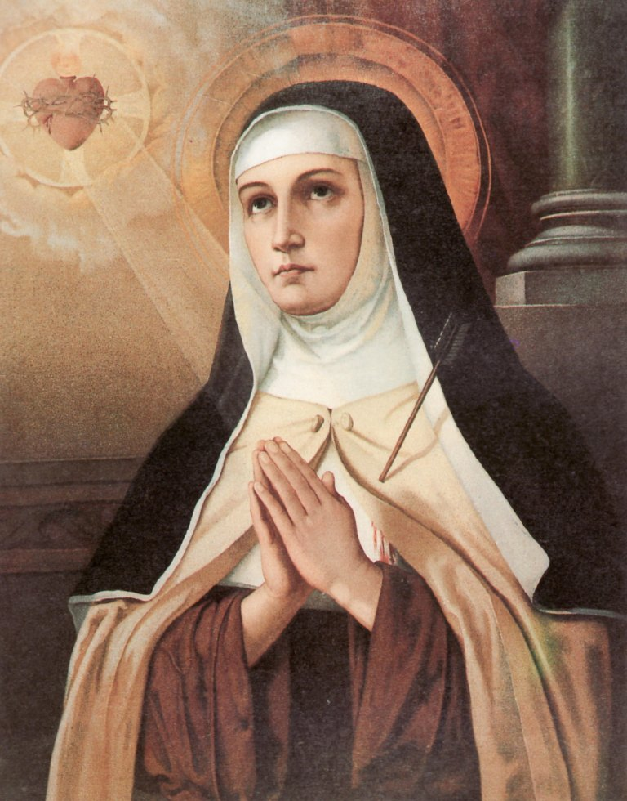
New and Reformed Religious
St. Teresa of Avila reformed the Carmelite nuns
Ursuline order of nuns focused on educating women
Jesuits (Society of Jesus) founded by Ignatius Loyola
Main mission was to attract new members
Missionaries who converted people in Americas, India, Japan and Congo
Lots of schools too

Slide 22
Baroque Art
Portuguese---Baroca--- “irregular shaped pearl” meaning strange, irregular and extravagant
Catholic Church used Baroque style in churches as part of the reformation and to separate from plain Protestant churches

Slide 23
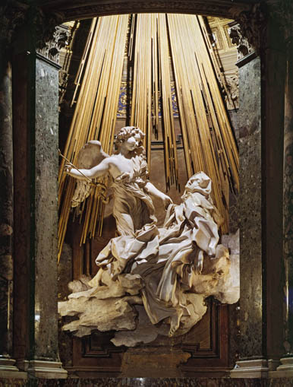
Ecstasy of St. Teresa by Bernini

Slide 24
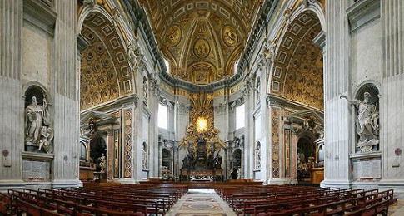
St. Peter’s Basilica

Slide 25
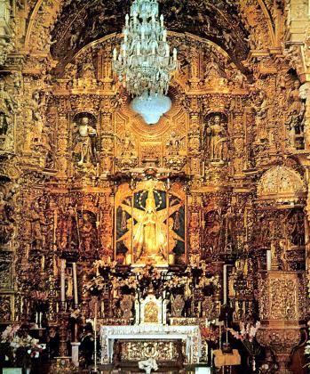

Slide 26
French Religious wars
Treaty of Cateau-Cambresis ended Habsburg-Valois war
France was broke from Habsburg-Valois wars.
King Francis I sold public offices
Concordat of Bologna– treaty with church that said King could appoint French church offices (and thus get money from those offices)
But Many French nobles were attracted to Calvinism
Huguenots---French Calvinists
Many nobles adopted Calvinism to defy weak Catholic Kings
So Catholics and Huguenots fought with mob tactics

Slide 27
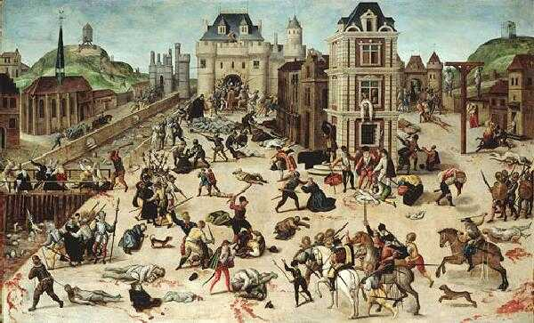
Saint Bartholomew’s Day massacre 8/24/1572
Catholics attacked Huguenots at the wedding of Margaret Valois and Henry Navarre (future King)
City goers massacred and even in the countryside
Over 20,000 killed
Led to a 15 year civil war

Slide 28
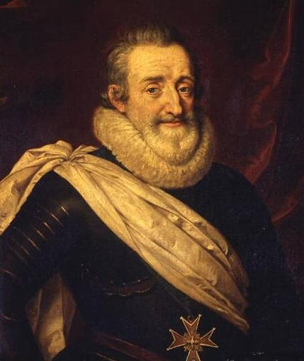
Politiques
Politique—catholic and Protestant moderates who held that only a strong monarchy could save the country from collapse
Henry III was assassinated and mom—Catherine de Medici died
Henry Navarre became King Henry IV of France
He converted to Catholicism and issued the Edict of Nantes
Granted liberty of conscience and public worship to Calvinists

Slide 29
Netherlands
Under Catholic Charles V many Lutherans challenged Catholicism
Under Philip II, Calvinism took hold
Spanish tried to suppress Calvinism and raised taxes in 1560s
So riots broke out
Spanish sent Duke of Alva to quell the riots
Council of Blood, 1500 executed
7 Prot, Northern provinces broke away under the Union of Utrech in 1581
Fought until 1609 when Spain finally recognized their independence and became the United Provinces of Netherlands

Slide 30
Witch Hunts
Witches were controlled by devil or demons
Thought to fly by night to sabbats, steal communion and unbaptized babies
So they are enemies of god
16th-17thC 100,000-200,000 were tried for witchcraft, 40-60,000 executed
75-85% were women, women were weak—so would give in to the Devil
Change in legal procedures made witch hunts easy
Old way—accusatorial, faced accuser and if guilt not found, accuser was punished
New Way—inquisitorial procedure---authorities performed an inquisition often with torture. So could accuse someone without penalty

Slide 31
Witches often accused of spoiling food, making children ill, killing animals or a hailstorm.
Often tensions within families or neighbors
HRE, Switzerland and France had the most witch troubles
We suspect these were due to jealousy, weak political power and religious tensions

