Slide 1
The Ottomans

Slide 2
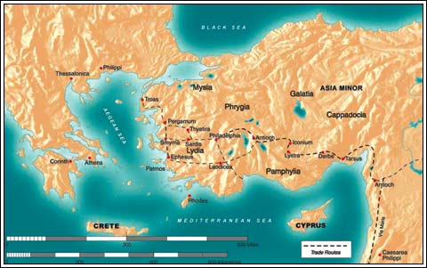
1. Original location of the Ottoman Empire
• Asia Minor (Turkey)

Slide 3
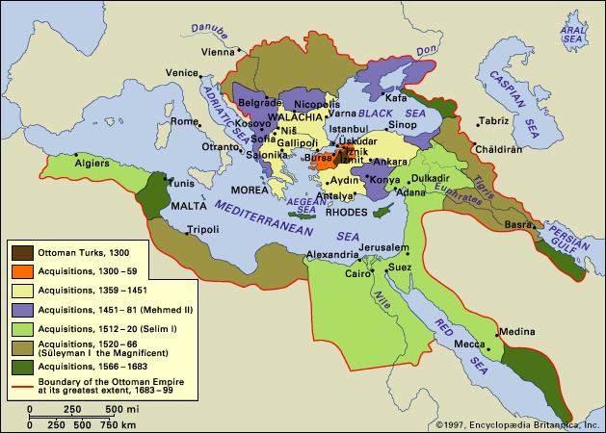
Who are the Ottomans?
Named after “Osman” an early Turkish leader
Conquest in Anatolia
Border b/w Islam & Byzantium

Slide 4
Leaders
Osman-founder of the Ottoman Empire (followers of Osman were called Ottomans)
Creates Empire from 1300-1326
Strong use of Gunpowder for success
At first ottomans acted kindly towards people they conquered

Slide 5
Expansion and extent of the Ottoman Empire
• Southwest Asia
• Southeastern Europe, Balkan Peninsula
• North Africa

Slide 6
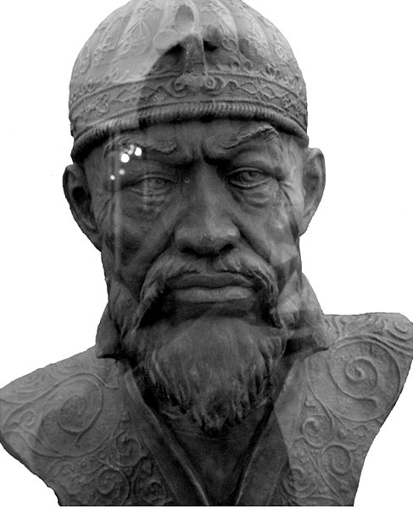
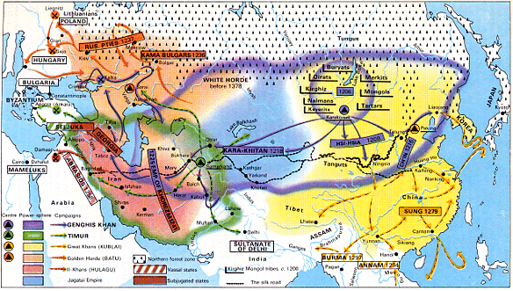
Leaders & Expansion
Timur the Lame (Tamerlame/Tamerlane)
Claimed to be a descendant of Genghis Khan
Burned Baghdad to the ground

Slide 7
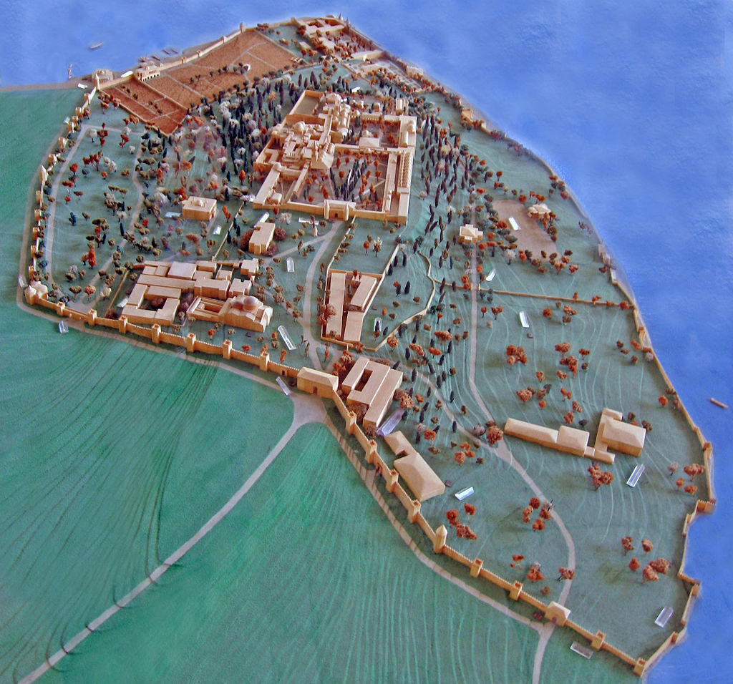
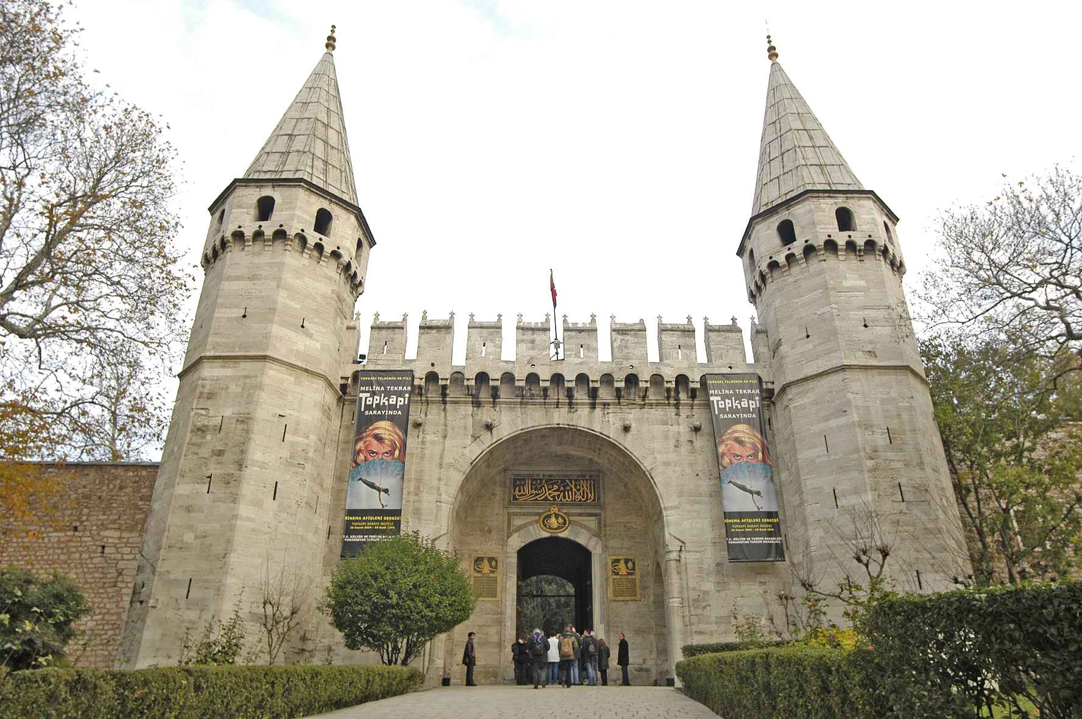
Leaders & Expansion
Sultan Mehmet II (1451-1481)
Control all of Anatolia
Defeat Byzantine Empire w/cannons that fired 1200lb. boulders
Rename Constantinople → Istanbul & opens it to all peoples
Mosques, markets, etc.
Encouraged migration to city
Even Jews mistreated in Europe
Topkapi palace complex, 1465

Slide 8
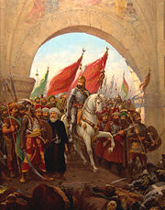
MEHMET II entering Constantinople

Slide 9
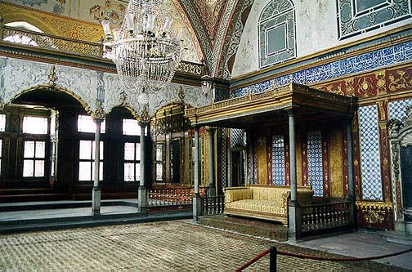
Sultan’s bedchamber

Slide 10
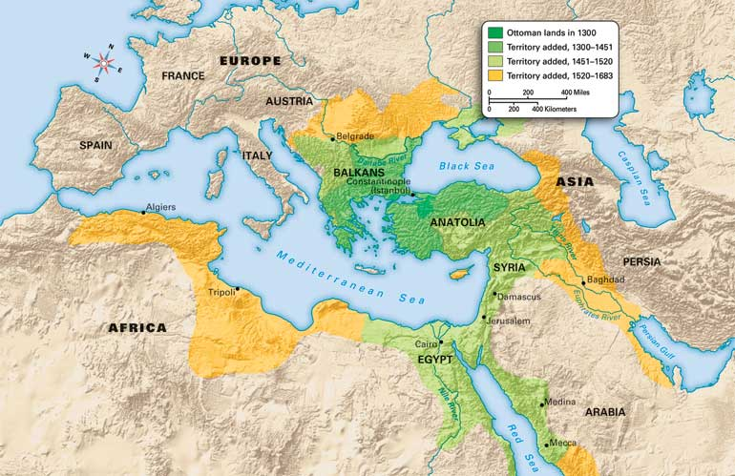
Ottomans control parts of three continents by 1566

Slide 11
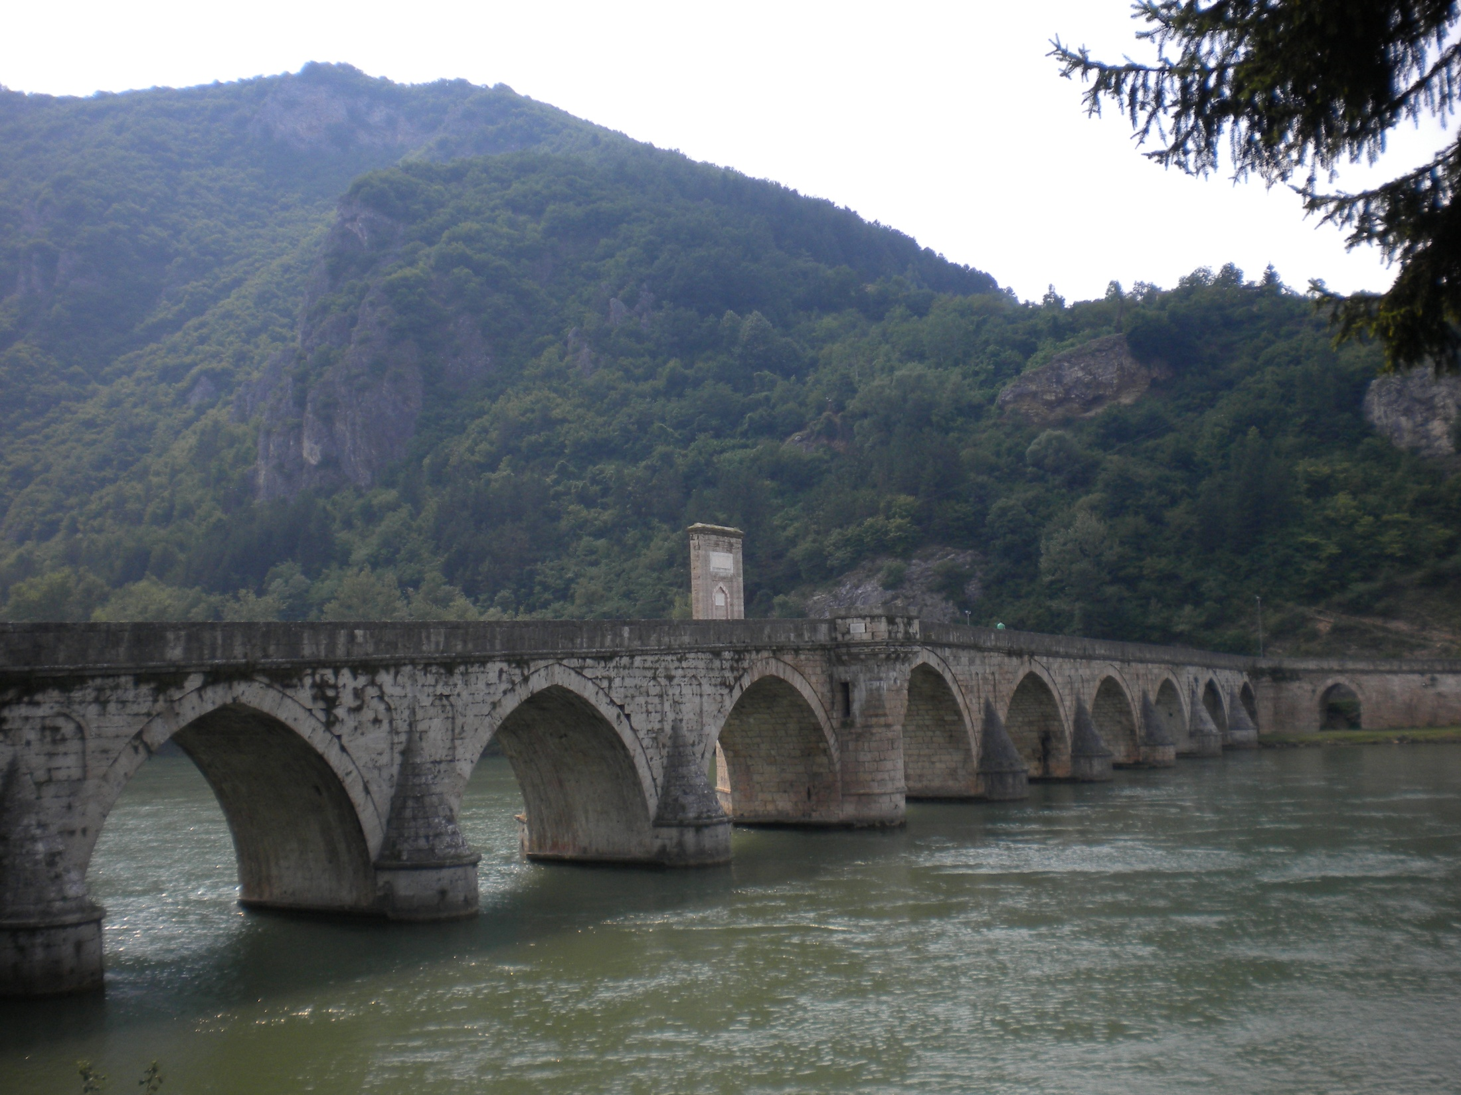
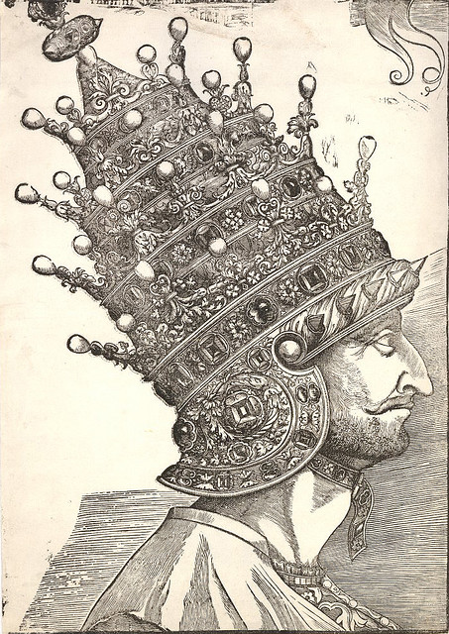
Leaders & Expansion
On Drina River modern Bosnia
Suleiman the Magnificent, the Lawgiver (1494-1566)
War & conquest
Code of law
Cultural Explosion → literary, artistic, & scientific achievements
Building → palaces, mosques, libraries, hospitals, roads
Title Caliph – role in Muslim world
Portrait in tiara commissioned in Venice
Notes:
The Magnificent to European for territory & extravagance/opulence, Lawgiver ot Muslims

Slide 12
Suleiman
Known as the Lawgiver
Ottoman Empire reaches height
Government Bureaucracy
Balanced Islamic law with tolerance of religion (Islam is religion of Ottomans)

Slide 13
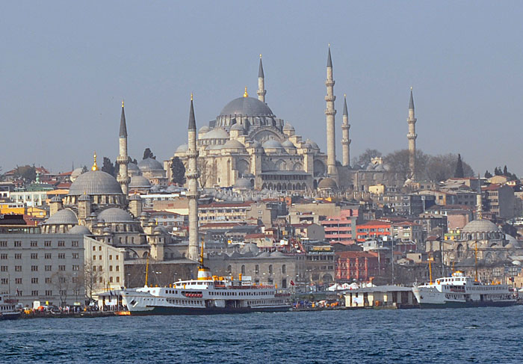
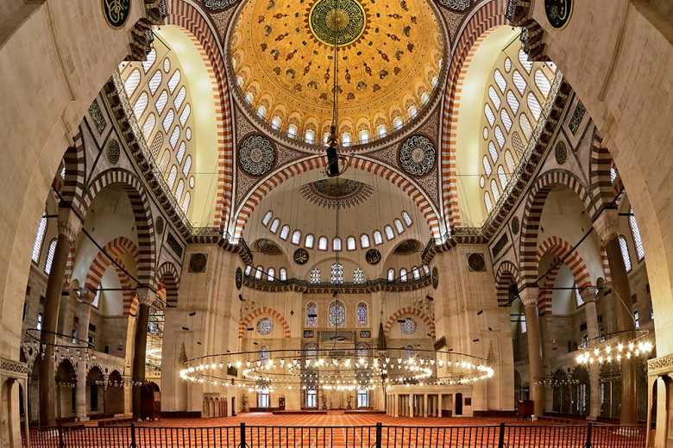
Suleymaniye Mosque

Slide 14
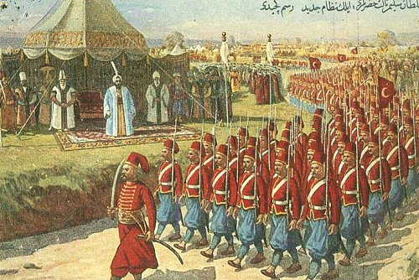
Ottoman Rule
Diverse
Religious tolerance – non-Muslim tax
Centralized bureaucracy - Gov’t officials Ottoman
Infrastructure – roads & bridges
Devshirme – captured Christian youth, converted
Top 10% - Civil Service training
Rest – Janissaries – elite military unit

Slide 15
The Ottoman Bureaucracy
SULTAN
Divans
Social / Military Divans
Heads of Individual Religious Millets
Muslims
Jews
Local Administrators & Military
Christians
Landowners / Tax Collectors

Slide 16
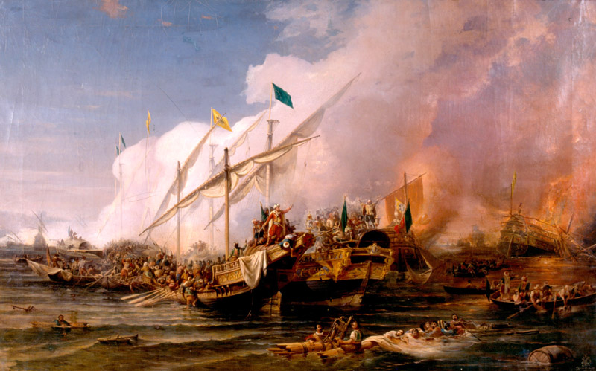
Ottoman Empire had one of the greatest navies in the world

Slide 17
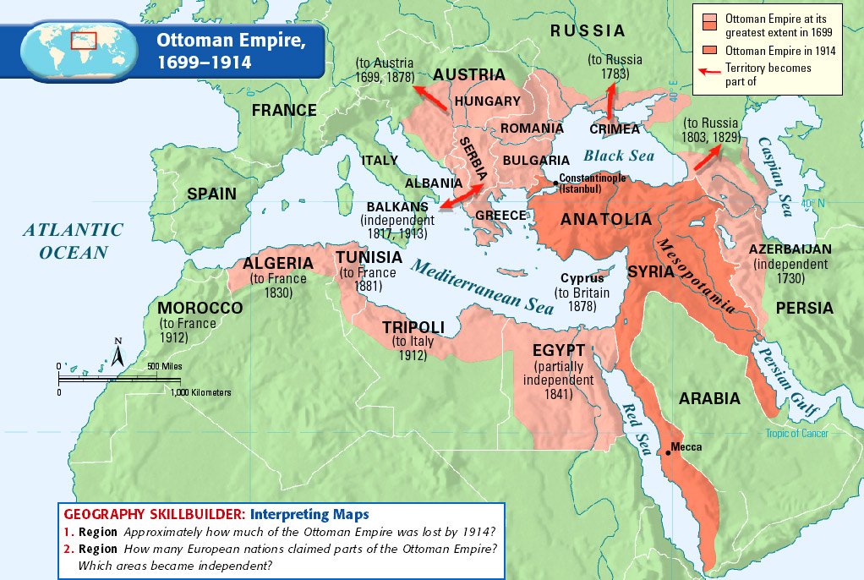
Decline
Weak Leadership
Ex Selim II the Sloth
Gov’t corruption
Janissary power & revolts
Heavy taxes
Peasant revolts
Decline in Intellectualism

Slide 18
Decline
Sultan’s kill ablest sons
Corruption of government
Finally dissolved and Turkey created after World War I

Slide 19
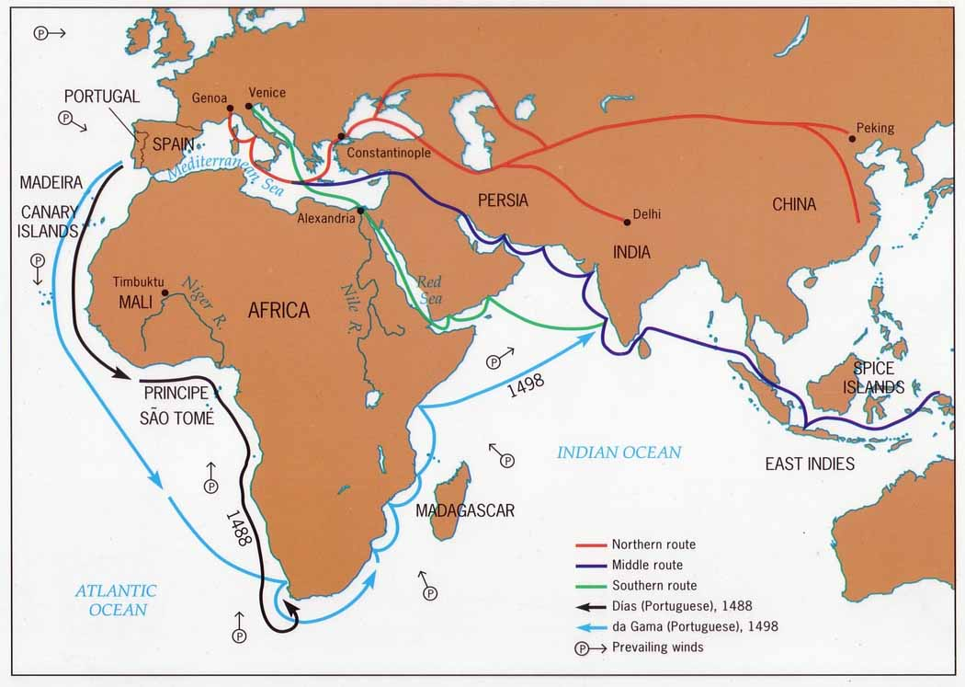
Age of Exploration
Inflation from imported silver (Americas)
Changing trade routes bypass taxes
Growing nationalist movement
Desire for a country based on common history, language, religion & culture

Slide 20
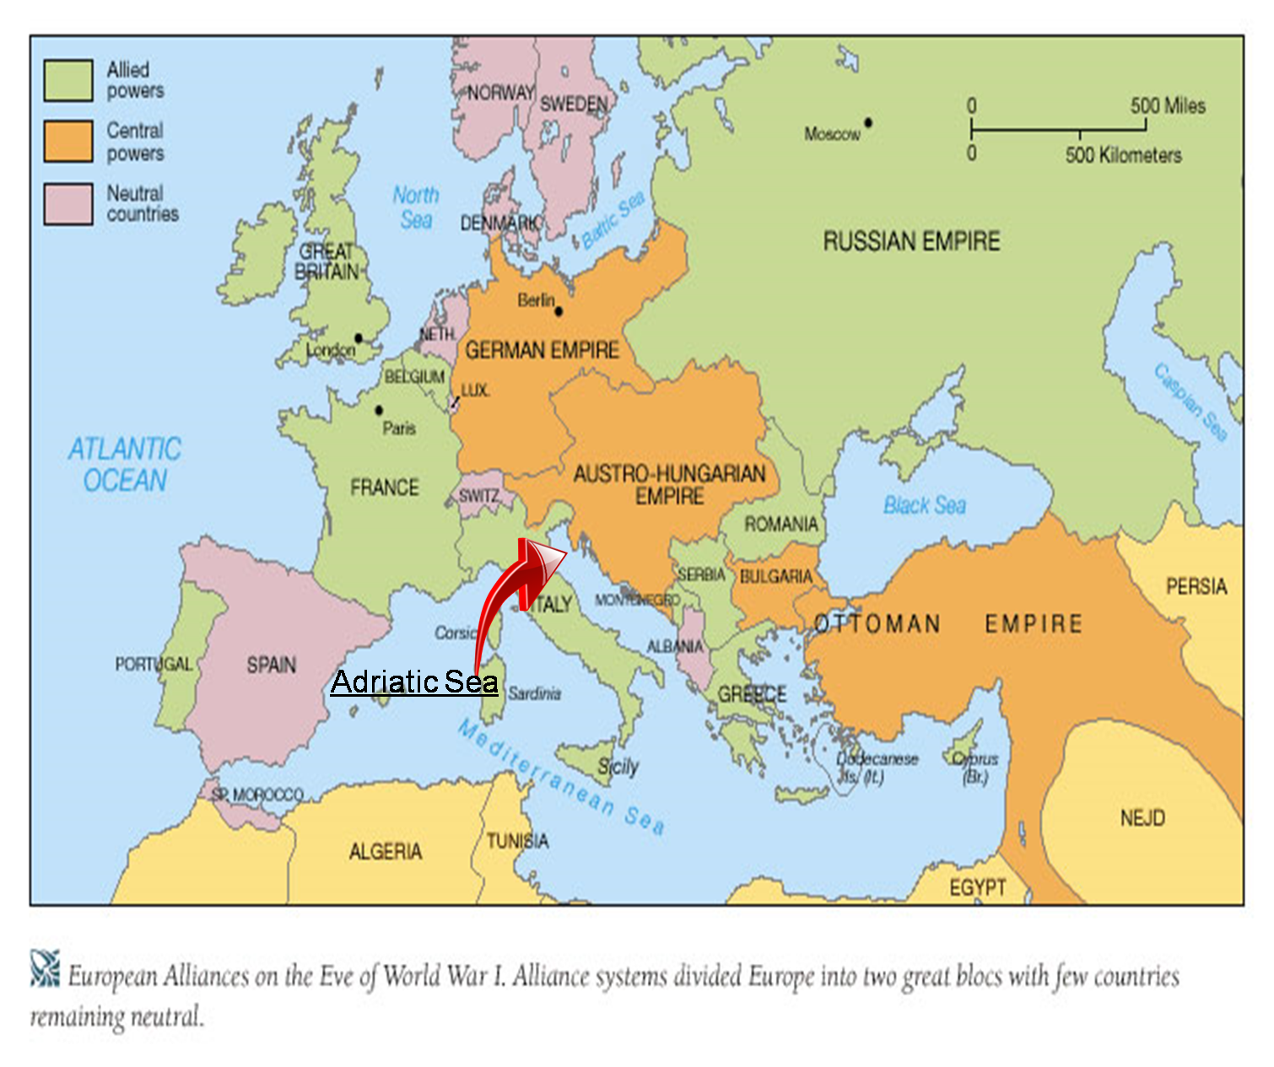
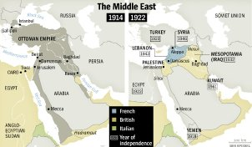
1922 Formal End of Empire
Allied with losing side in World War I
Empire broken up
Nation-state of Turkey
Many ethnic Turks had wanted independence!
Kemal Ataturk led independence mov’t
Nationalism
Secularism – non-religious gov’t

Slide 21
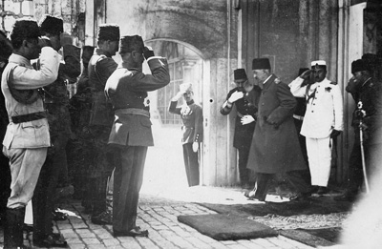
Departure of Mehmed VI, last Sultan of the Ottoman Empire, 1922.
Notes:
http://markhumphrys.com/Bitmaps/ottoman.jpg

Slide 22
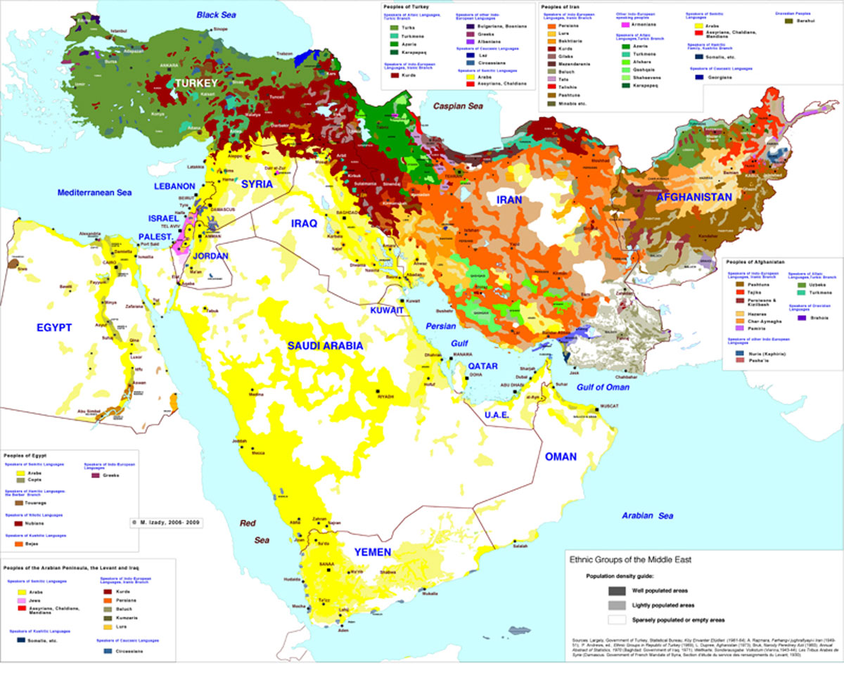
Why are Ottomans important?
Size of Empire
Location: Crossroads
Trade, exchange, & $$
Both Europe & Asia
Modern nation of Turkey
Secular democracy in Middle East today
Notes:
Note ethnic homogeneity of Turkey vs rest of Middle East
Dark red → Kurds
Purple → Jews
Yellow → Arabs
Orange → Persians

Slide 23
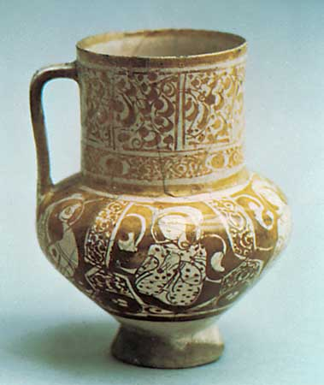
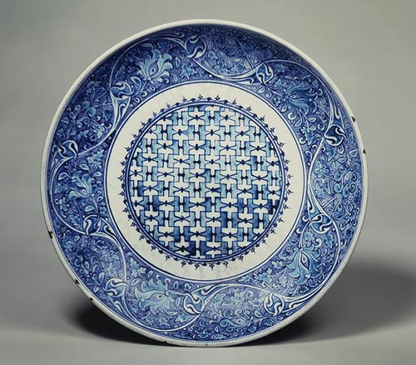
Trade Coffee and Ceramics

Slide 24
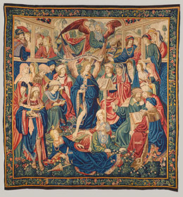
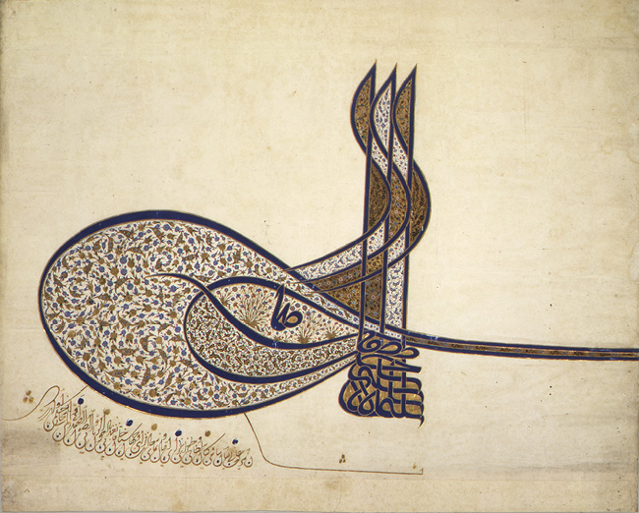
Suleiman spreads the Arts

Slide 25
Understandings
The Ottoman Empire emerged as a political and economic power following the conquest of Constantinople.
The Ottomans brought much of Muslim territory in Southwest Asia and North Africa under their rule.

Slide 26
1 - What was the original location of the Ottoman Empire?
2 - Name the three continents the empire spanned over at its greatest height?
3 - What city did the Ottoman Empire conquer that made it be realized as a major power?
4 - Which Ottoman ruler was the empire named after?

Slide 27
5 - What Ottoman ruler was known as the Lawgiver?
6 - Name the two most important trading resources that came from the Ottoman Empire
7 - What religion unified the Ottoman Empire?
8 - What was the capital Constantinople renamed after it was captured?

