Slide 1
Unit 4.1 Islamic Empires

Slide 2
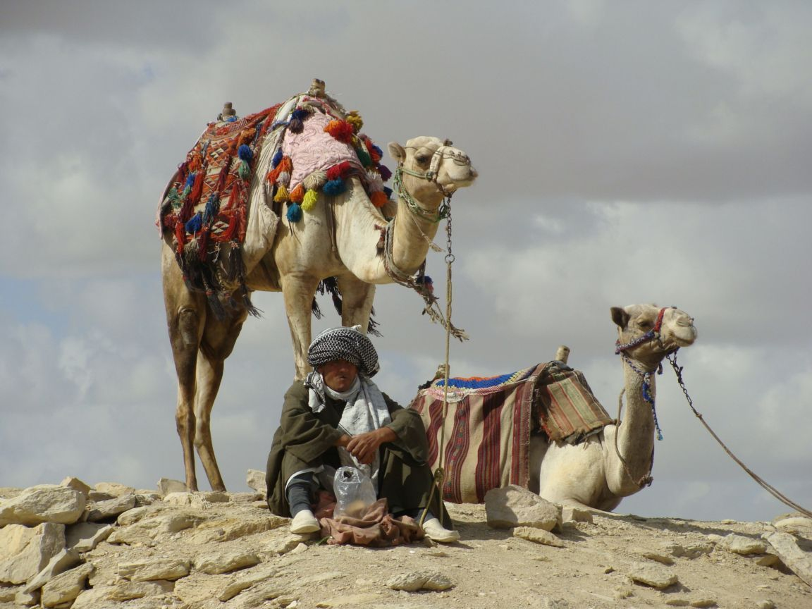
Islam arose in Arabia…
Tribal, Arab, nomads
Trade routes through Mecca
Many Bedouins (desert nomads) convert

Slide 3
Beliefs/Traditions
Five Pillars of Islam
These are the main religious duties of Muslims
There will definitely be a question on the Unit Test about the 5 Pillars, so you better know them!

Slide 4
Five Pillars of Islam
Shadah
belief in one god
Salat
prayer 5 times a day
Siyam
to fast from sunrise to sunset during the holy month of Ramadan

Slide 5
Five Pillars of Islam
Zakat
giving to charity and the poor every year
Hajj
pilgrimage to the holy city of Mecca in Saudi Arabia once in a Muslim’s life

Slide 6
After Muhammad…
Succession debates (who will rule next?)
Caliph – political & religious successor to Muhammad
Jihad – “Struggle” – many interpretations
Expand through “defensive” warfare to protect Islam

Slide 7
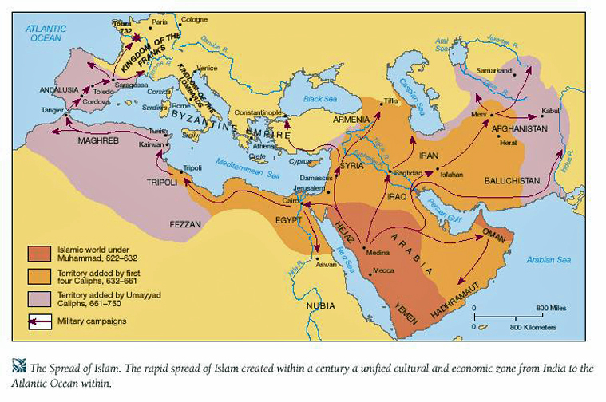

Slide 8
The Islamic Empire
The Rashidun Caliphate ( الخلافة الراشدية) or Rashidun Empire, was the first of the four Arab caliphates.
It was controlled by the first four successors of Muhammad, known as the "Rightly Guided" caliphs.
Founded after Muhammad's death in 632, the empire lasted until 'Ali's death in 661.
At its height, the power of the Rashidun Caliphs extended throughout North Africa, the Arabian Peninsula, and the Iranian highlands.
Dome of the rock Begun

Slide 9
The Four Caliphs
- 632–634 Abu Bakr
- 634–644 Umar
- 644–656 Uthman
- 656–661 Ali

Slide 10
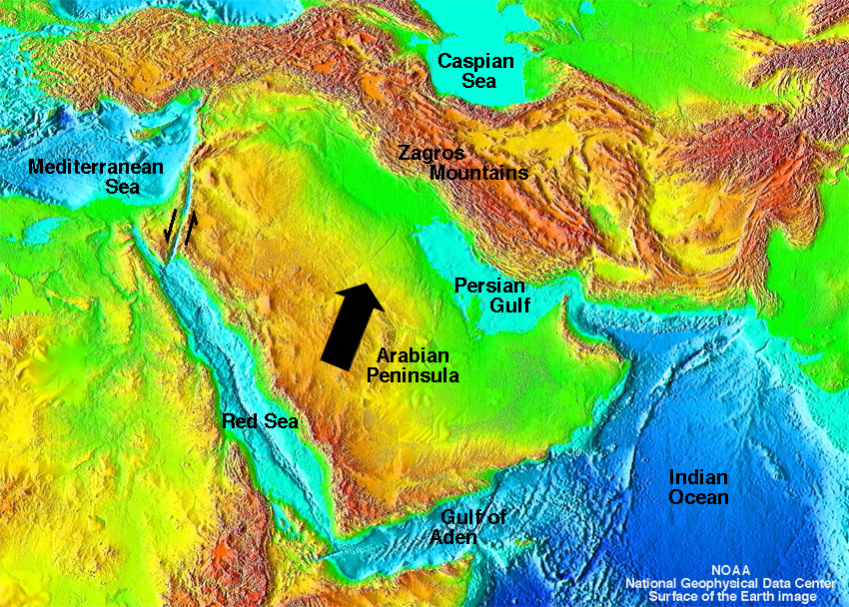
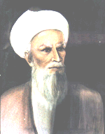
Muslim Expansion – Early Conquests
Leaders of the dominant Muslim group, the Sunnis, selected Abu Bakr as their leader. He was given the title of caliph, or successor. He set out to regain control of the Arabian peninsula.

Slide 11
Abu Bakr 632-634 [1st]
not particularly popular with the Muslim community
allowed raid, then invasions of Byzantine and Persian territory
subjugated any dissident elements or tribes
disposed of any “new prophets”

Slide 12
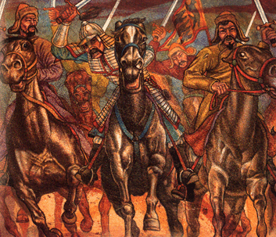
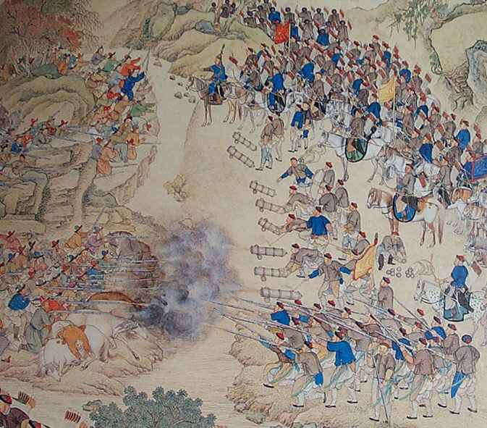
Muslim Expansion – Building an Empire
The next caliph, Umar ibn al-Khattab, used military force to spread Islam through Mesopotamia, Palestine, Syria, and on to Persia, and Egypt.
Over the next 100 years, Arab armies later moved into Afghanistan, India, North Africa, and Spain

Slide 13
Uthman 644-656 [3rd]
murdered: warfare broke out
Ali: cousin and son-in-law of Mohammed
originally passed over as too young
contested the succession
Uthman supported by the Umayyad clan
early enemies of Mohammed
refused to accept Ali’s claims

Slide 14
Ali 656-661 [4th]
Disagreements over selection of caliphs
Ali passed over for Abu Bakr [1st]
Ali would eventually serve as caliph from 656-661 CE, then he is assassinated along with most of his followers
Schism
Remaining followers organize separate party called “Shia”
Traditionalists: Sunni

Slide 15
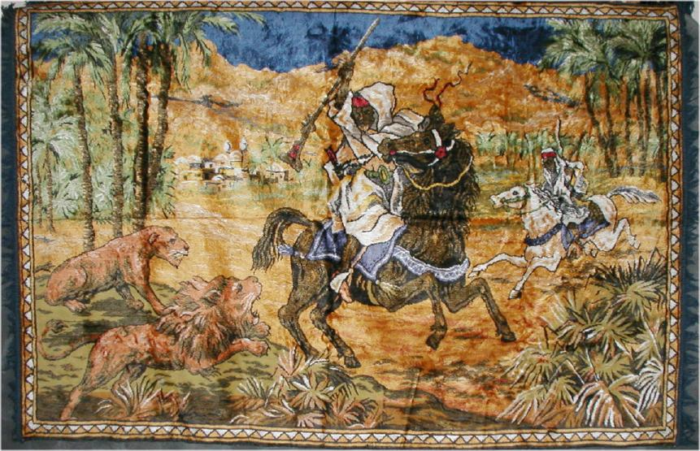
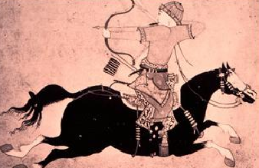
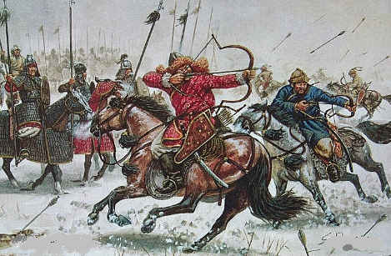
Muslim Expansion – Reasons for Success
The decline of the Byzantine and Persian empires
Skill of Arab armies: Muslims were expert horsemen
Religious conviction: Arab warriors fought the Jihad, or inner struggle. The fight was internal (to be good, loving Muslims), and External, to wage war to spread the Islamic faith

Slide 16
Islamic Rule
Generally tolerant
“People of the Book” allowed to practice own religion (Judaism & Christianity)
Pay a non-Muslim tax

Slide 17
Muslim Expansion – Religious Tolerance
Muslims were generally tolerant of other religions in the empire. They allowed people to practice their own customs and beliefs.
Muslims regarded both the Torah and the Bible as sacred books.
Though Christians and Jews did not have the same legal status as Muslims, and they had to pay the Jizya, a special tax, they were still allowed to practice their own faiths and follow their own laws.
Islam was an appealing religion. It emphasized equality, not social classes. A good Muslim just had to follow the Five Pillars. So, many people converted to Islam.

Slide 18
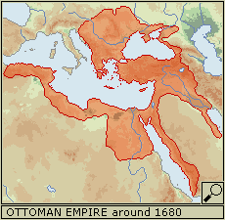
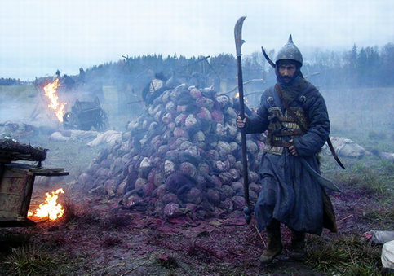
Muslim Expansion – Conquests of Non-Arabs
The Turks and the Mongols converted to Islam
The Seljuks, Muslim Turks, spread Islam into Central Asia
The Ottomans created a large Muslim empire in the 1400s
The Mongols adopted Islam as they swept across Asia, and took the faith into Central Asia and India.

Slide 19
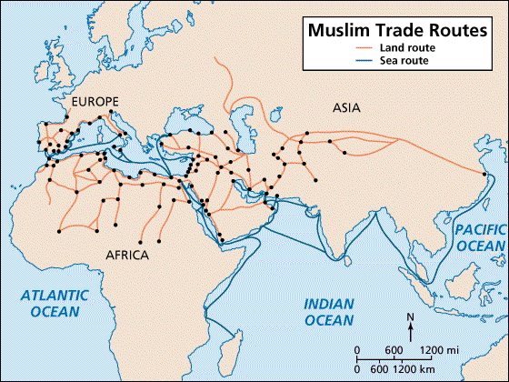
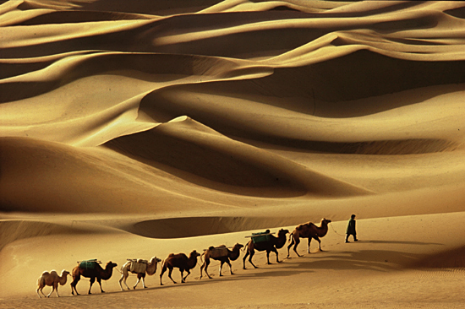
Muslim Expansion – Merchants & Missionaries
As Muslim merchants traveled to new lands for trade, they took Islam with them. Missionaries oftentimes went with them to spread the words of Allah.
Muslim merchants traveled to India, Malaysia, and Indonesia by ship. They traveled by camel caravans across North Africa and beyond the Sahara. They converted many Africans and Southeast Asians to Islam.

Slide 20
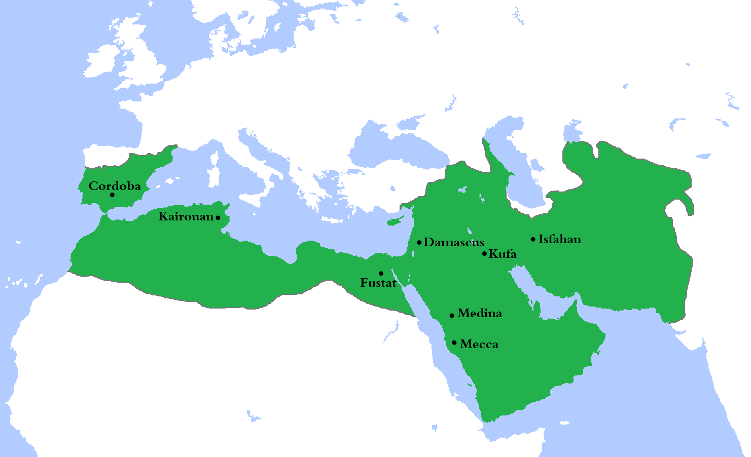
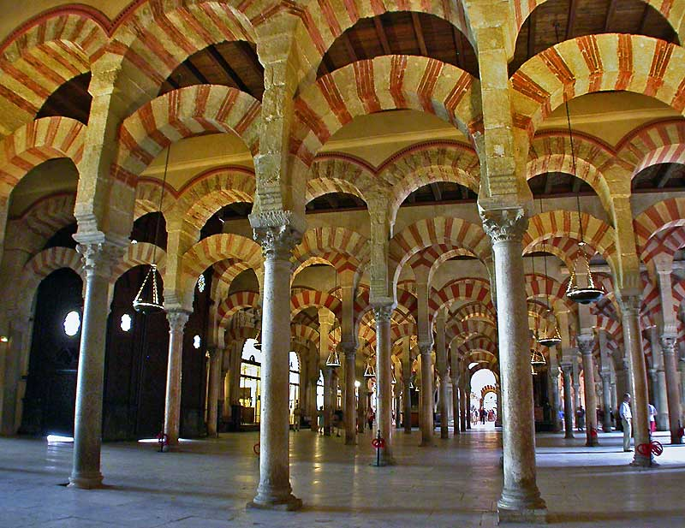
Umayyad Caliphate (661-750)
Arab & Berber (N. African Pastoralists)
732 Battle of Tours defeat halts advance into Europe
Capital – Damascus
Spread the religion!
Cordoba Mosque

Slide 21
Umayyad Empire
Main Caliphs: Muayiwa and Abd al Malik
When in power: 661 – 750
Capital: Damascus
Contibutions to Islam:
1. caliphate are handed to son
2. conquered North Africa + Spain
3. Battle of Tours (732): Europe stays Catholic not Muslim because Francs defeat Umayyad
4. mixed with Jews and Christians
5. provinces ruled by emirs (governors)
6. used bureaucracy
7. made Arabic the official language
8. made coins to have the same money
9. made many mosques in new places
Defeated: too many workers and not enough taxes so ……
… a secret society formed to overthrow the Umayyad.

Slide 22
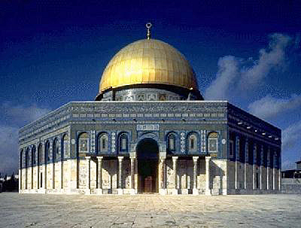
Umayyad Problems
Empire too big to manage
Economy in trouble !
Resentment b/w Arab & non-Arab Muslims
691 constructed shrine on Temple Mount in Jerusalem around “Foundation Stone” that once housed the Ark of the Covenant
Notes:
In umayyad, Arab Muslims had all top positions in gov’t etc.

Slide 23
Abbasid Caliphate (750-1258)
Founded by Abu al-Abbas
Capital – Baghdad
More Persian influence (not just Arab)
Very Diverse & Bureaucratic (less family & nobility influence)
Art & Culture
Translate & Preserve Greek works
Trade crossroads

Slide 24
Abbasid
Main Caliph: Abu Jafar al Mansur
When in power: 750 -1258
Capital: Baghdad
Contributions to Islam:
1. Trade was strong: the two rivers (Tigris and Euphrates) made a great place to trade with east and west.
2. More control over food production with so much water
3. Started a banking system and people could borrow money
4. Horse racing and polo were popular
5. Games like chess and backgammon were invented.
6. All mosques and books were decorated with Arabic words and patterns in calligraphy
7. They created Algebra (al jabr = the adding of one thing to another)
8. Some doctors performed surgery
Defeated: the huge Empire made enemies because of the rich lifestyle
Africa was taken by those who wanted to live simply, like Muhammad
Baghdad was taken by nomads called Turks, but they let the Muslims stay
The Empire fell the Mongols killed all the Abbasid leaders

Slide 25
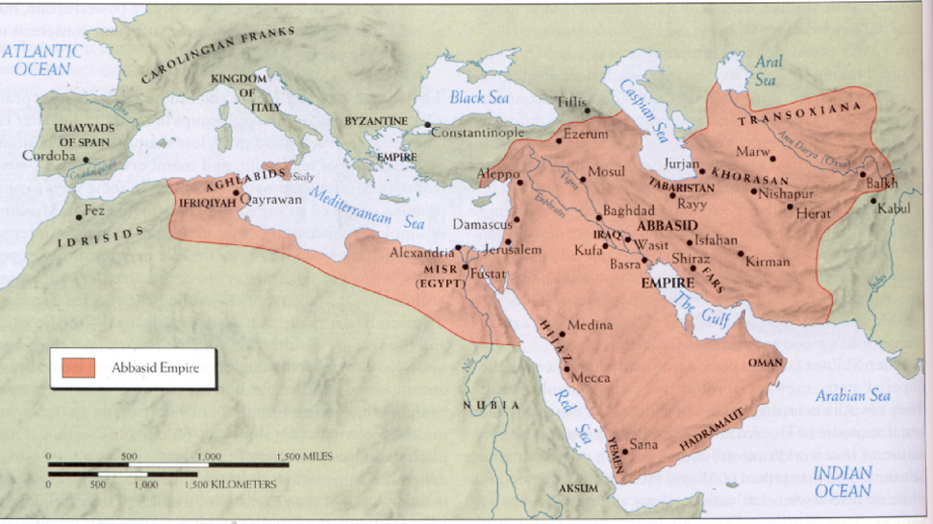

Slide 26
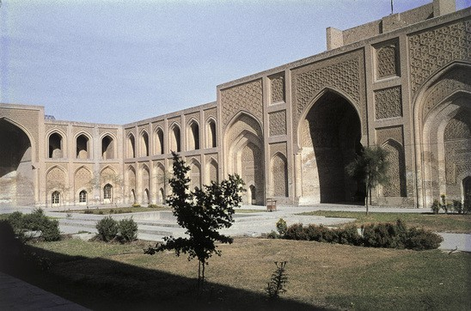
Abbasid Problems
Bureaucratic & financial corruption
Powerful factions
Provinces break off & independent
Cordoba, Morocco, Egypt
Weakens as other powers grow!
Madrassa in Baghdad
Notes:
Madrassa – religious school

Slide 27
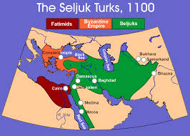
Other Groups
Fatimid Dynasty – Muslim Rule in Egypt
Seljuk Turks
Nomads
Convert
Ruler – Sultan

Slide 28
Society & Culture
Spread influence of Islam
Trade & wealth
Technology & Science - Astrolabe
Cities
Ex. Baghdad, Cairo, Cordoba
Palaces, Mosques, schools, libraries bazaars
Arabian Nights

Slide 29
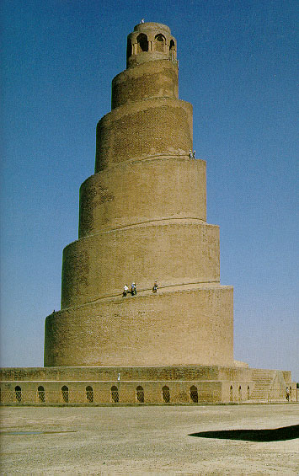
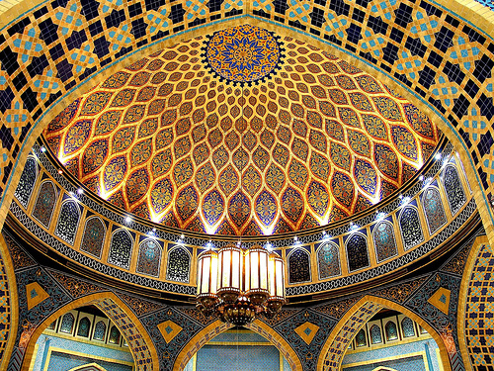
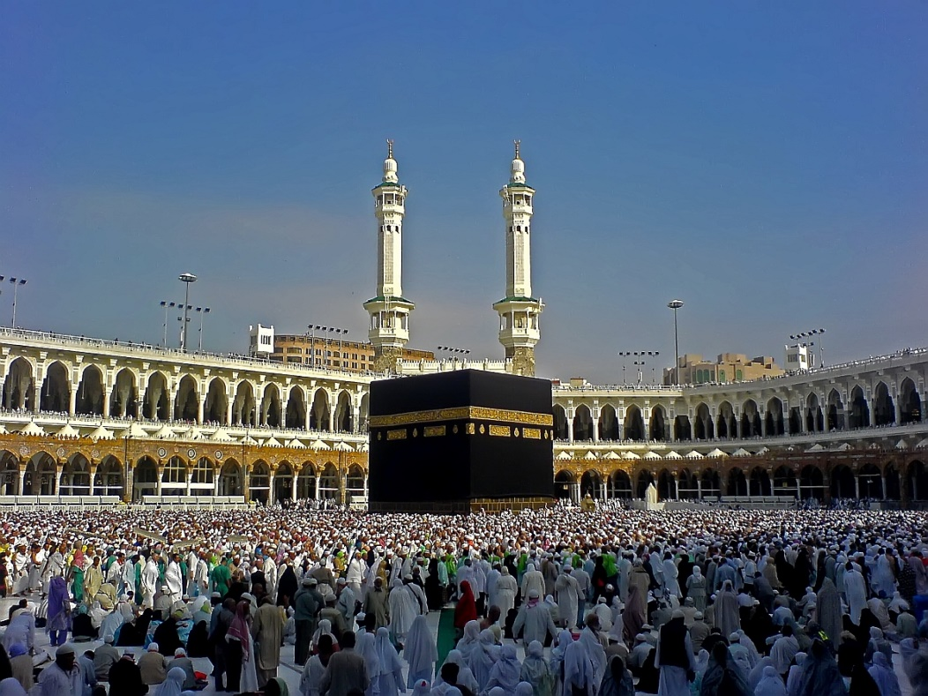
Art & Architecture – no representation of living things!

Slide 30
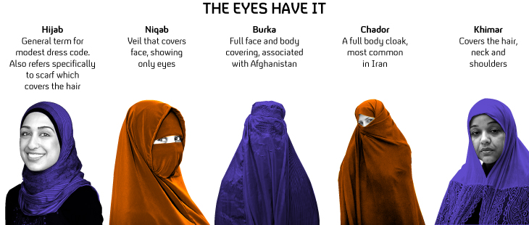
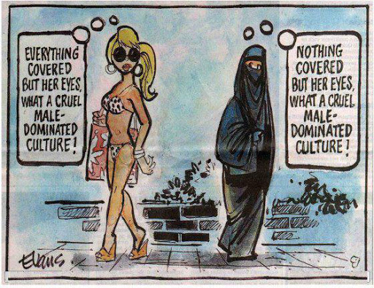
Islamic Society
In Gov’t – Caliphate
In Law – Sharia
Society –
over time increased patriarchy - Veil
Non-Muslims lower class even slaves
Notes:
Original Islam gave women lots of rights – property, jobs, divorce

Slide 31
The Ottoman Empire
Ottomans gain ground in Asia Minor (Anatolia) throughout the 1350’s
1453: Ottoman capture of Constantinople under the Ottoman sultan Mehmed II
Ottomans were a major power in the Arab World, the Balkans, and around the Black and Red Seas.

