Slide 1
Early River Civilizations:
The
Indus River Valley and the
Yellow River Valley

Slide 2
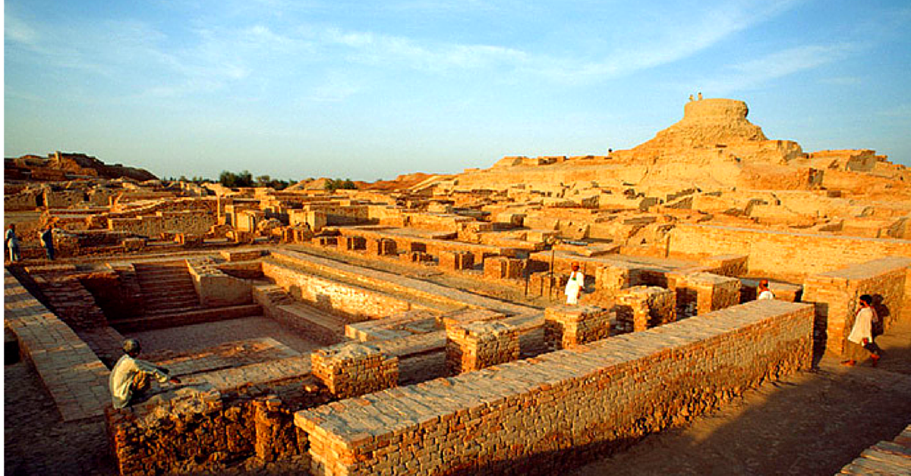
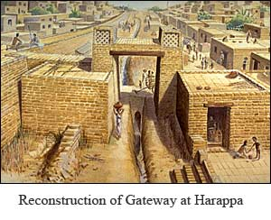
Mohenjo-Daro & Harappa
• Discovered along the Indus River in the 1920s – unknown to modern man before then
• Were they shared capitals?
• Very mysterious: their writing has never been deciphered, so not much to go on other than the archaeology
• Precisely planned cities, organized on a grid system, indicates the presence of government and sciences
• They even had indoor plumbing!
• Both cities eventually disappear. Likely reasons: changing climate, earthquake, invasion. The land is desert now.

Slide 3
India’s Geography
As large as Europe, minus Russia
Population: 1.15 billion (2010 estimate)
  Second only to China
Himalayan Mountains (northeast)
  Separate India from Tibet and western China
Northwest
  Historic route of land invasions
    Alexander the Great, Mughals
Indian Ocean (route of British conquest)
Climate
  Hot (except in highlands)
  Land – very fertile to semi-desert

Slide 4
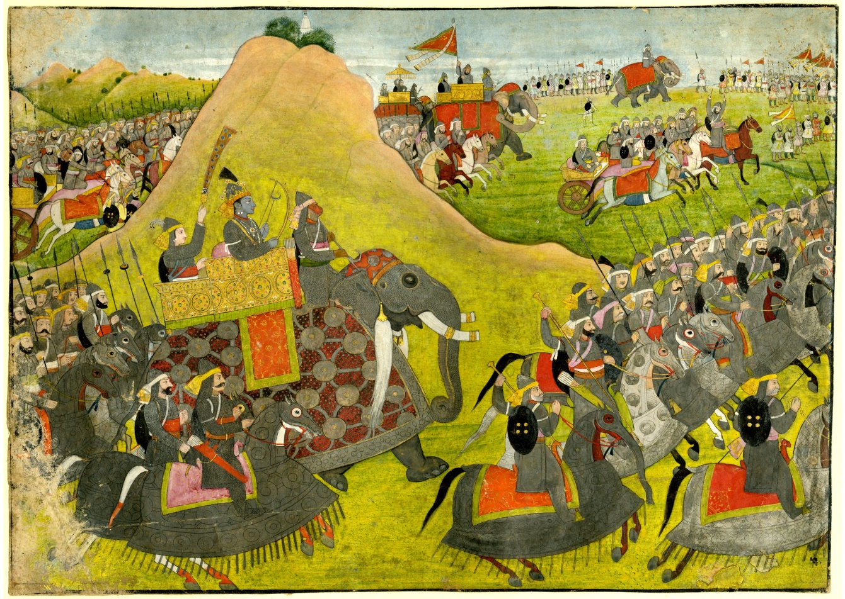
Classical India:
The Vedic Age
(1500-500BCE)

Slide 5
Aryan Invasion
(ca. 1700-1300 BCE)
Invaders came from Europe
  Traced through Indo-European language roots
Ruled India for hundreds of years
Set up small kingdoms ruled by rajahs
Conquered native Dravidians
Created modern Hinduism from Dravidian religious traditions and their own ideas
Established India’s caste system

Slide 6
The Aryan Invasion…

Slide 7
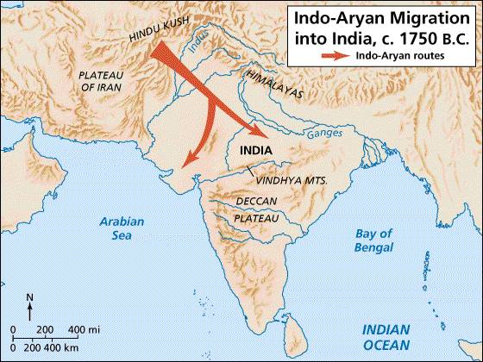
Vedic Age Migrations…
Aryan Migration
Dravidian Peoples
Pastoral (cattle)
Warriors
Think Hunter-Gatherers & early civilizations at Harappa & Mohenjo-Daro
Vedic Society is the blend over time!

Slide 8
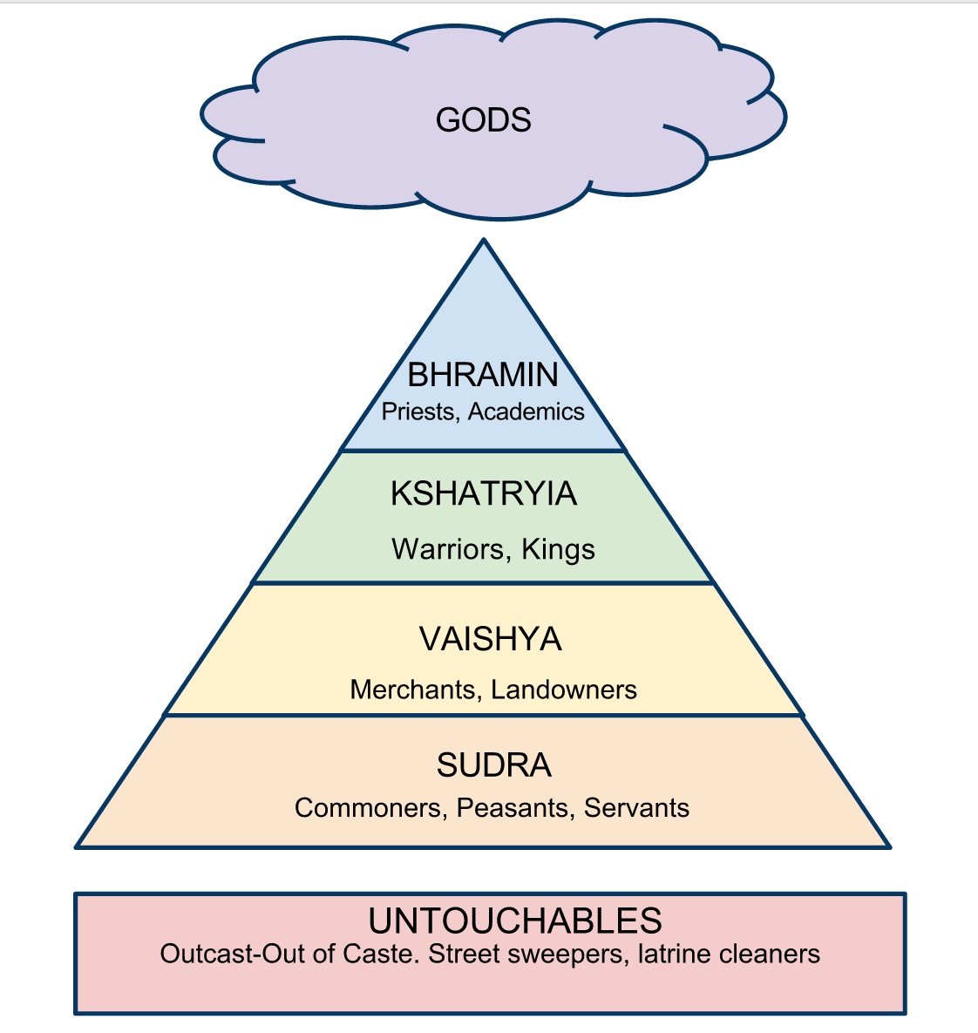
Varna
(Caste)
Rigid Class System
Move through reincarnation

Slide 9
Castes
Original castes
  Brahmin (priests)
  Warriors
  Farmers and traders
  Sudra (servants)
Eventually divided by occupation into thousands of castes
  Lowest – the Untouchables
    Strict purification rituals if others contact them
    Today – legal protections under Indian law, but prejudice still exists

Slide 10
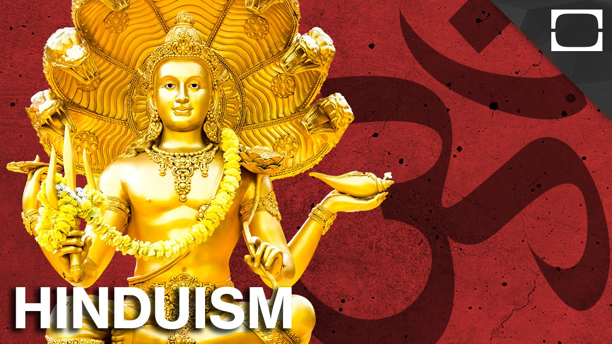
• No one person founded Hinduism
• Hinduism is a blending of early religions from both the Aryan races and India’s native Deccans
• Hinduism is a polytheistic religion, though Brahman is the all-encompassing supreme being

Slide 11
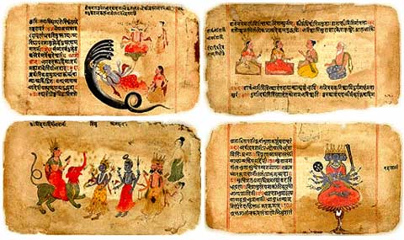
The Vedas – India’s sacred texts
Series in Sanskrit
  Rigveda (an ancient Indian collection of Vedic Sanskrit hymns. It is one of the four canonical sacred texts of Hinduism known as the Vedas.
• Contain hymns, rituals, ceremonies, meditation, philosophy
Core of Hinduism, & elements of Buddhism & Jainism

Slide 12
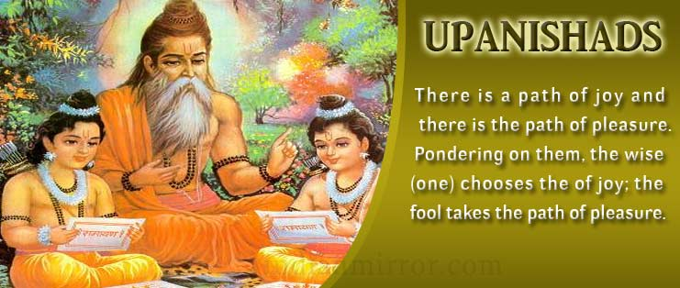
The Vedas & Hinduism…
Upanishads – A section of the Vedas that address mystical questions related to Hinduism
Mahabharata - A Sanskrit epic principally concerning the dynastic struggle and civil war in the kingdom of Kurukshetra about the 9th century BC, and containing the text of the Bhagavad-Gita.
• Ramayana - A Sanskrit epic that concerns the banishment of Rama from his kingdom, the abduction of his wife Sita by a demon and her rescue, and Rama's eventual restoration to the throne.
The principles of Hinduism are found in both the Upanishads and in Indian literary works such as the Bhagavad-Gita

Slide 13
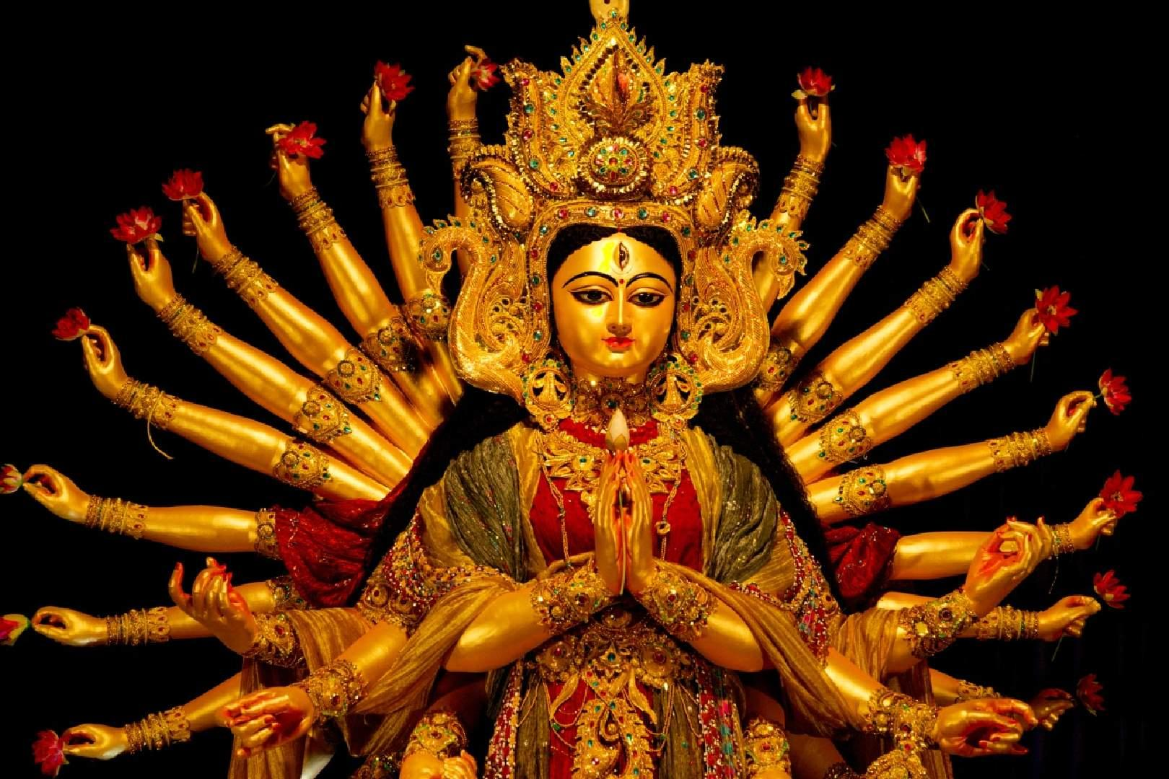
Hinduism…
“God is one, but wise people know it by many names”
– Hindu proverb
• No single founder – a blend of earlier religions
• Main goal of life: achieving Moksha
- to do that, one achieve unity with Brahman, the ultimate god
- sometimes that takes more than one lifetime: reincarnation
• Karma: what you put out into the world comes back to you
• Dharma: observing religious and moral duties to escape the cycle of rebirth.

Slide 14
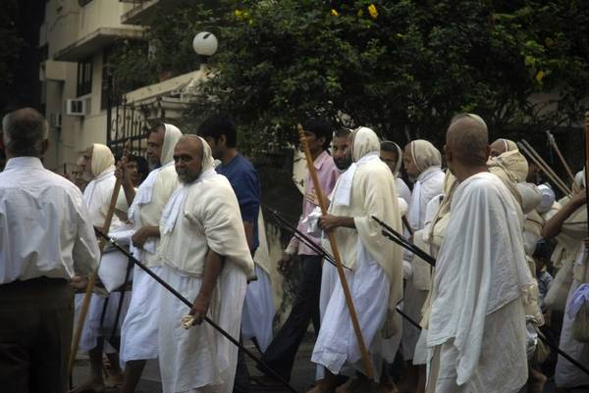
Jainism…
• Founded by Mahavira ca. 500 BCE
• Split from Hinduism because he didn’t believe only priests could perform sacred rites
• Emphasis: meditation, self-denial, and an extreme form of ahimsa (nonviolence) in which not even bugs can be harmed
• Often, Jain monks will walk along with brooms to sweep in front of their steps to make sure they don’t accidentally step on a living thing
Jainism is still practiced in India today

Slide 15
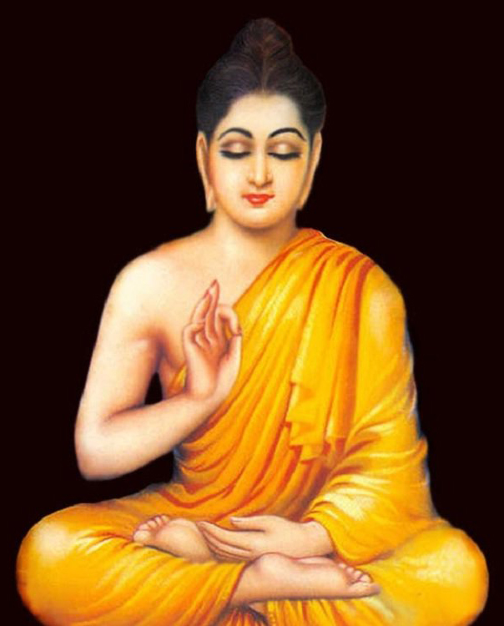
Buddhism…
• Founded by Siddhartha Gautama over 2,500 years ago
• Siddhartha was prince who was isolated by his family until adulthood, when he finally ventured outside
- he saw an old person, a sick man, and a dead body for the first time
- His sudden awareness of human suffering disturbed him, and he set out to discover “the realm of life where there is neither suffering nor death”
• Found his answers in meditation – became Buddha (“Enlightened One”)

Slide 16
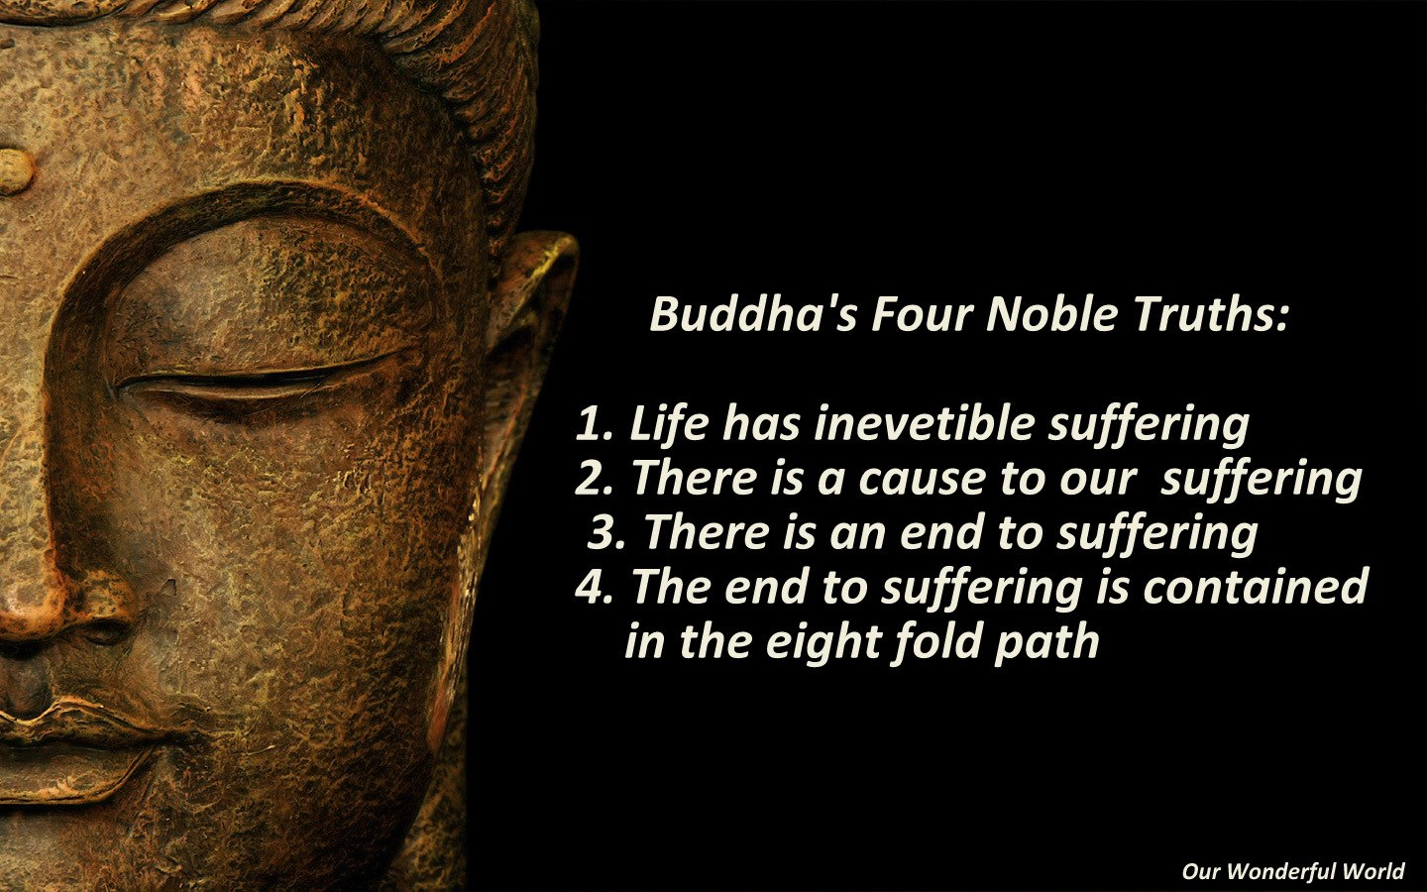
The Four Noble Truths…
Buddha’s meditations revealed to him the four truths that are the foundation of the Buddhist faith…

Slide 17
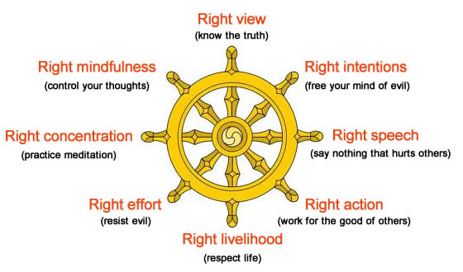
The Eightfold Path…
How to reach Nirvana
If you could live following these tenets, you reach oneness with the Universe (Nirvana)

Slide 18
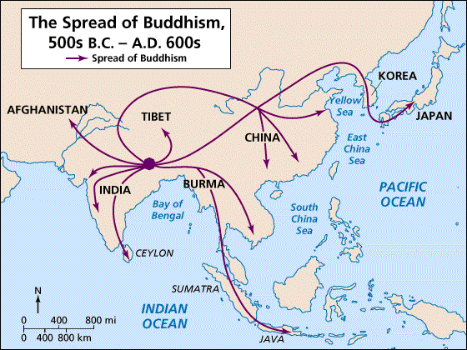
Buddhism spreads…
• Buddhism’s popularity was spread across Asia, from Afghanistan to Japan and Java, by monks and other followers who acted as missionaries.

Slide 19
Alexander the Great
(ca. 327/326 BCE)
Macedonian (Greek) who led conquering forces across northern India
Ruled briefly
Greeks expelled from most of India after Alexander’s death
Continued contact with Alexandrian successor state, the Seleucid empire, to the west

Slide 20
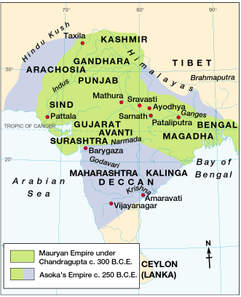
Maurya Empire
(321-185 BCE)
Chandragupta Maurya takes advantage of power vacuum after Alexander
Very Centralized → provinces, taxes, law enforcement

Slide 21
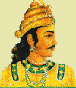
321 B.C.
Chandragupta Maurya claims throne; Mauryan Dynasty begins.
Supported his successful war efforts by levying high taxes on farmers
Taxed income from trading, mining, & manufacturing

Slide 22
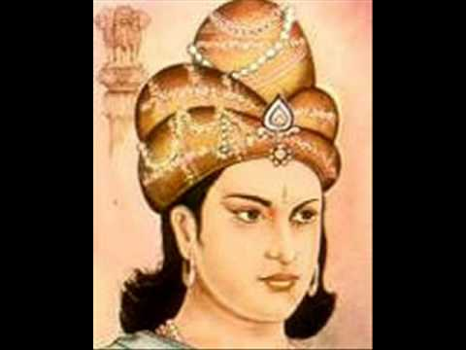
Mauryan Empire (322-185 BCE)
Dynasty begun by Chandragupta Maurya
Asoka (grandson), 273-232 BCE
  Ruled all of India
  Converted to Buddhism
  Religious tolerance, generosity, wisdom, and kindness
  Spread Buddhism – Burma, Ceylon, Siam, Tibet
  War and disunity after his death
Asoka

Slide 23
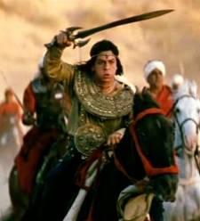
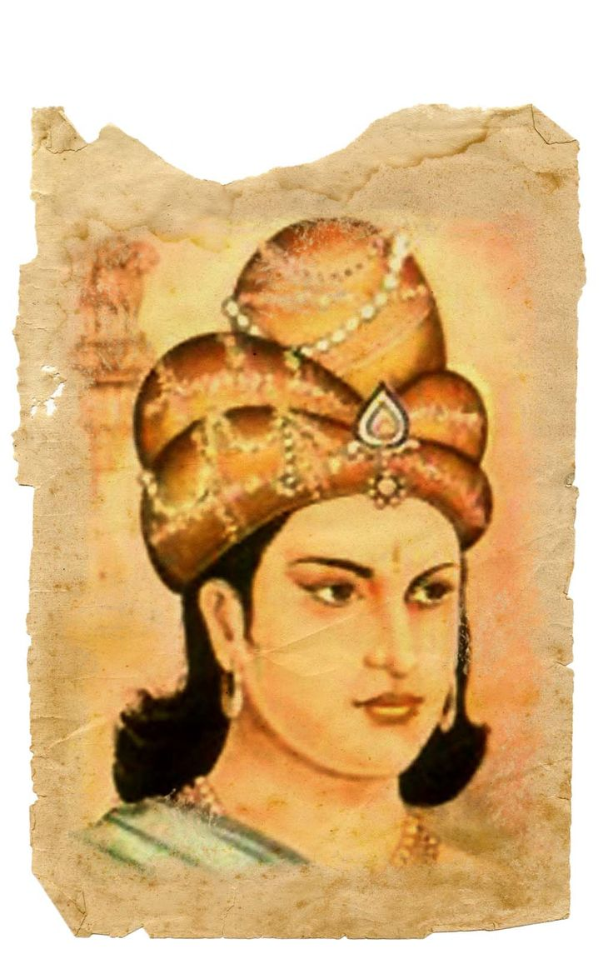
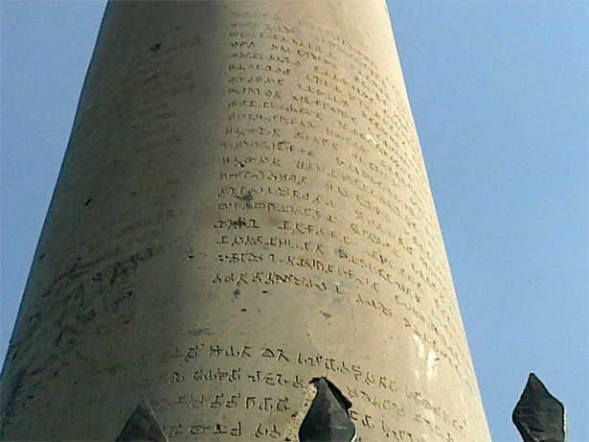
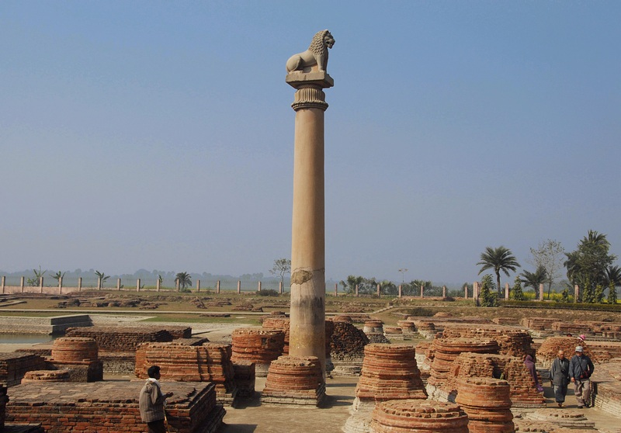
Asoka (grandson) most important leader
• Converted after being horrified over 100k combat deaths
  Religiously tolerant & diverse empire
  Converts to Buddhism
  Pillar edicts

Slide 24
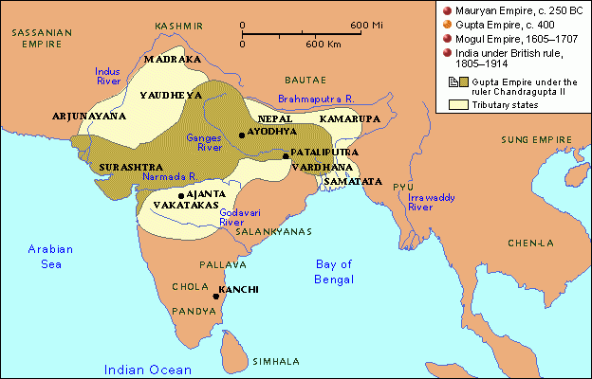
The Gupta Dynasty
(320-647 CE)
Founded by Chandra Gupta 320CE
Hindu
Less centralized
Lots of trade & $$$
A time of peace and prosperity
India’s “Golden Age”…

Slide 25
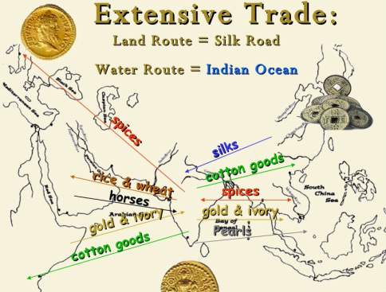

Slide 26
1000 diseases
classified
500 healing
plants identified
Gupta Achievements
Printed
medicinal guides
Medicine
Plastic
Surgery
Inoculations
Gupta
India
C-sections
performed
Solar
Calendar
Astronomy
Mathematics
Decimal
System
The earth
is round
PI = 3.1416
Concept
of Zero
Notes:
Noted Achievements: medicine (c-sections, inoculations); math (decimals, concept of zero and pi; astronomy (round earth – not flat, 365 day solar calendar;

Slide 27
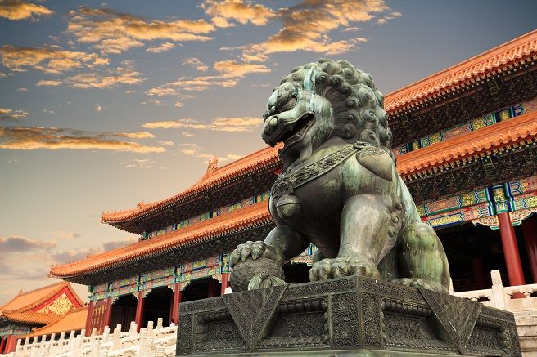
Ancient China…

Slide 28
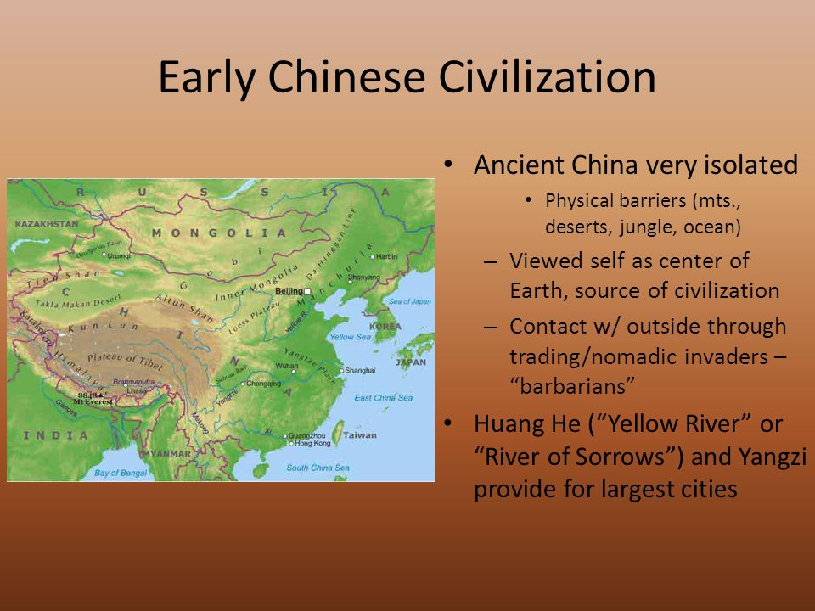

Slide 29
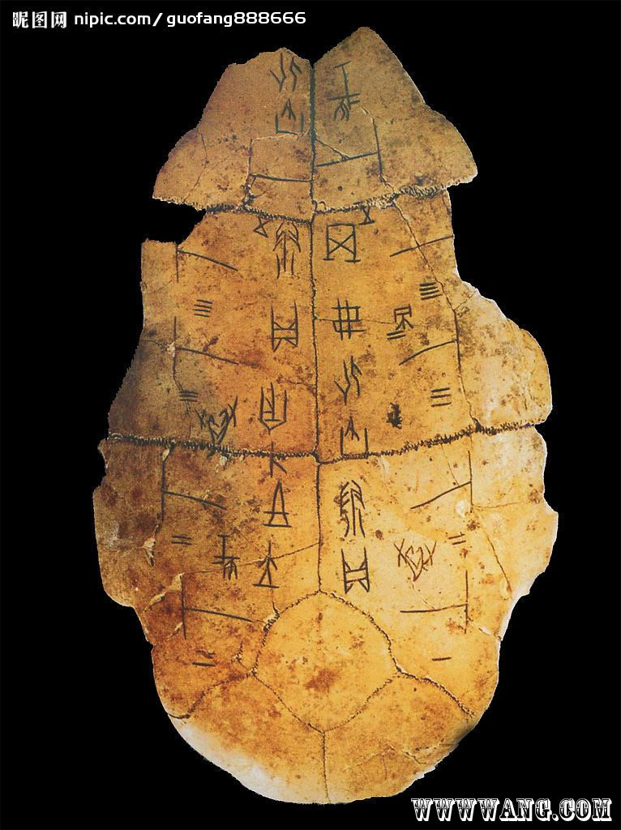
Oracle Bones…
• Early Chinese writing system
• Used both pictographs and ideographs to express thoughts and ideas
• Earliest examples used by priests to predict the future
• Priests wrote questions for their gods on animal bones or tortoise shells like the one on the right
• The bones were then heated until they cracked. Priests would “read” the resulting fissures as answers from the ancestors

Slide 30
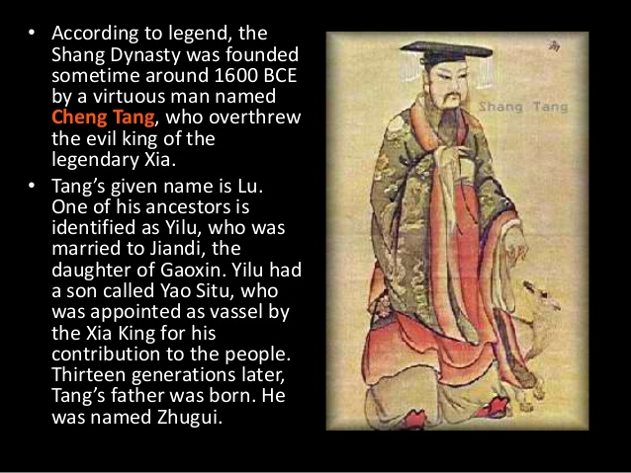

Slide 31
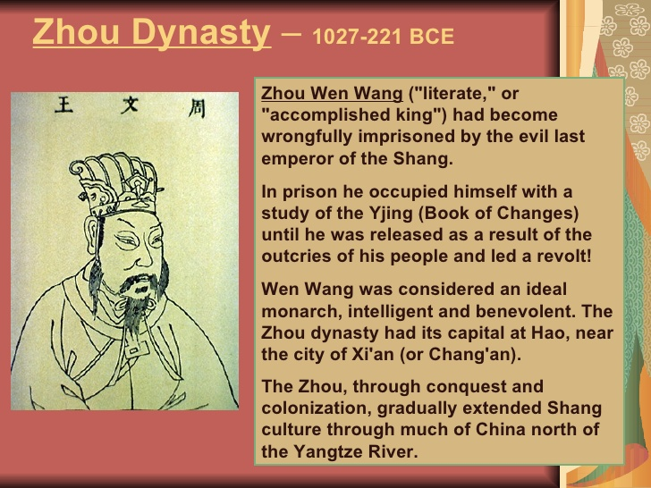

Slide 32
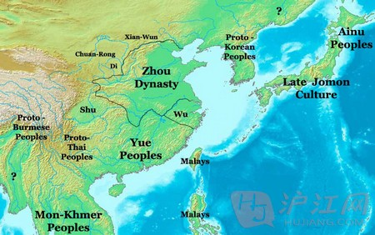
Zhou Dynasty Boundaries
• Overthrew the Shang ca. 1122 bce
• Justified the rebellion with the Mandate of Heaven

Slide 33
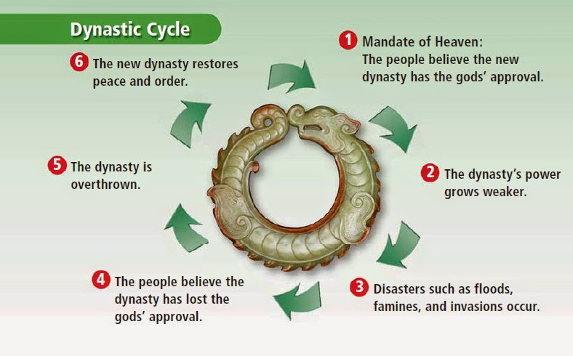
Mandate of Heaven
Justified the overthrow of previous dynasties

Slide 34
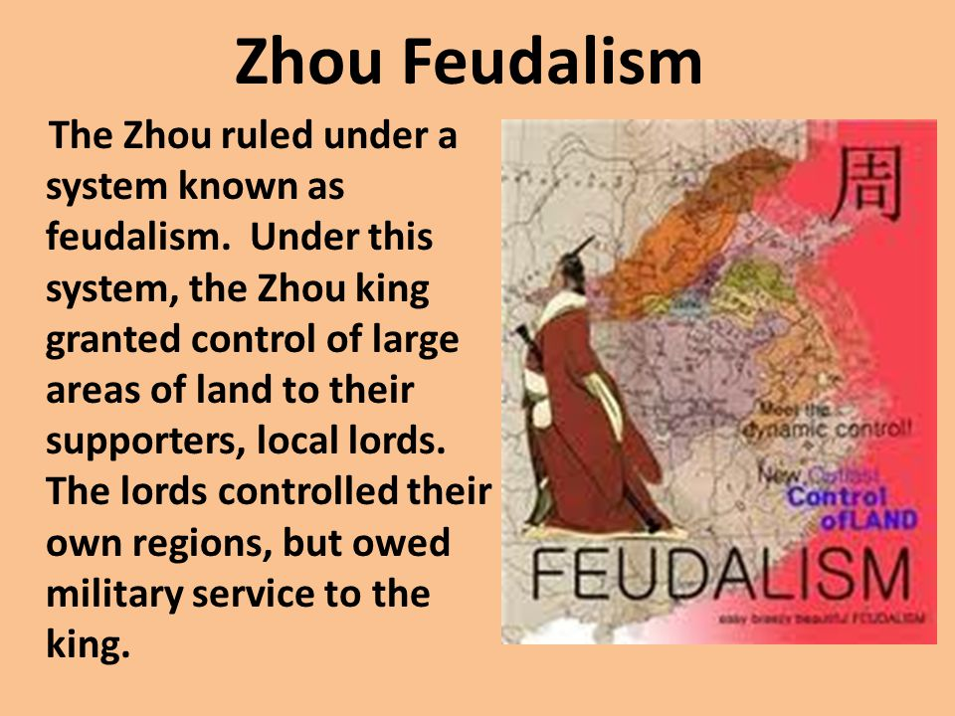
Zhou Feudalism…

Slide 35
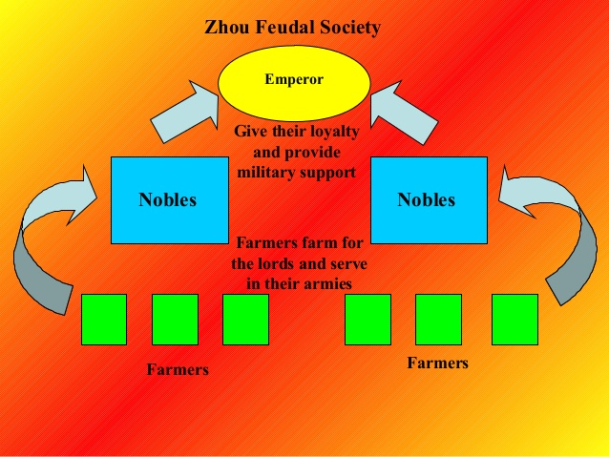

Slide 36
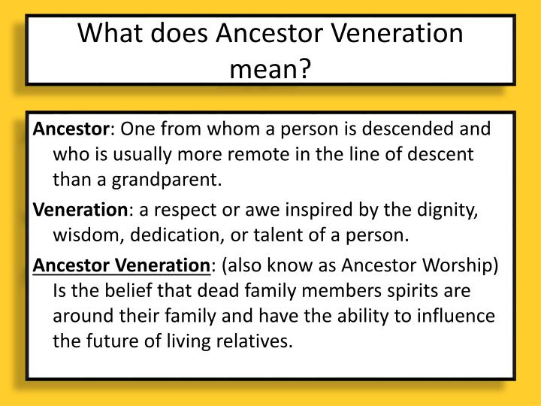

Slide 37
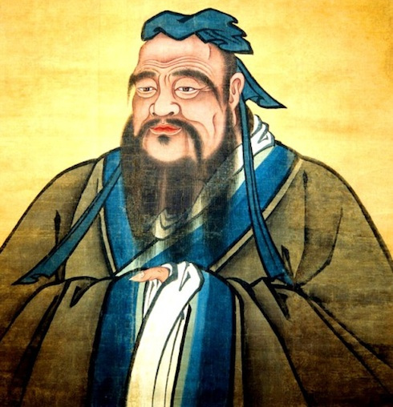
Confucianism…
• Confucius was born to a noble but poor family
• Sought a position in government but could not get one
• Turned to teaching, and earned a reputation for wisdom
• His sayings were recorded by his students in what are called the Analects, that offered advice on how to live a good and honorable life.
• Confucianism doesn’t bother much with the afterlife. Instead, it focuses on a philosophy of living.
• Built around five relationships that shape behavior.
“When you know a thing, to recognize that you know it, and when you do not know a thing, to recognize that you do not know it. That is knowledge.”
- Confucius, from Analects

Slide 38
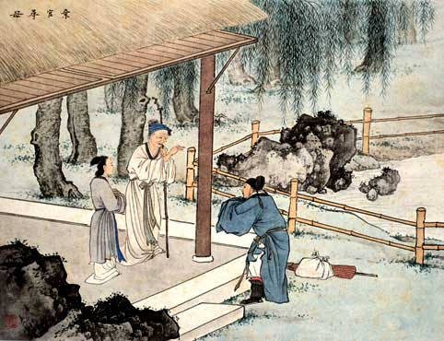
Filial Piety…
• Filial Piety is a cornerstone of Confucianism
• Filial Piety is all about honoring one’s parents – both living and dead
• Filial Piety is one of the five relationships Confucius said shapes our behavior

Slide 39
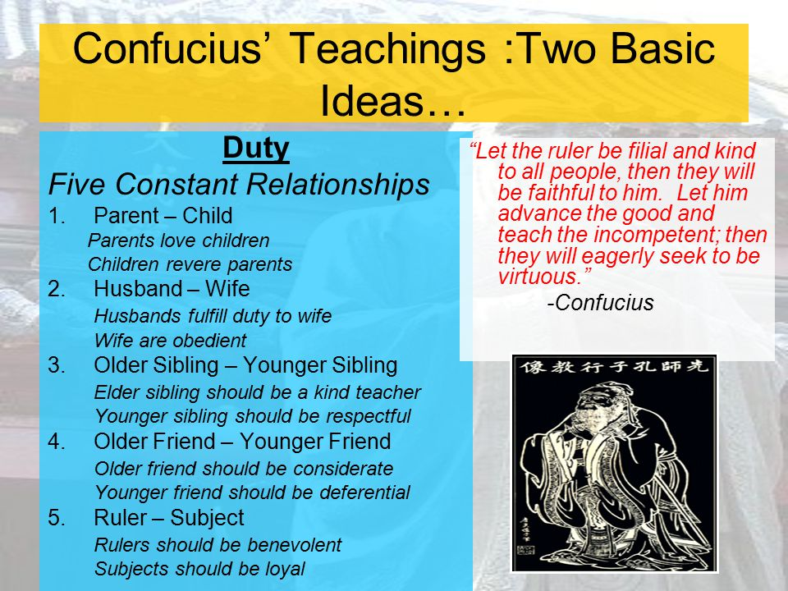

Slide 40


Slide 41
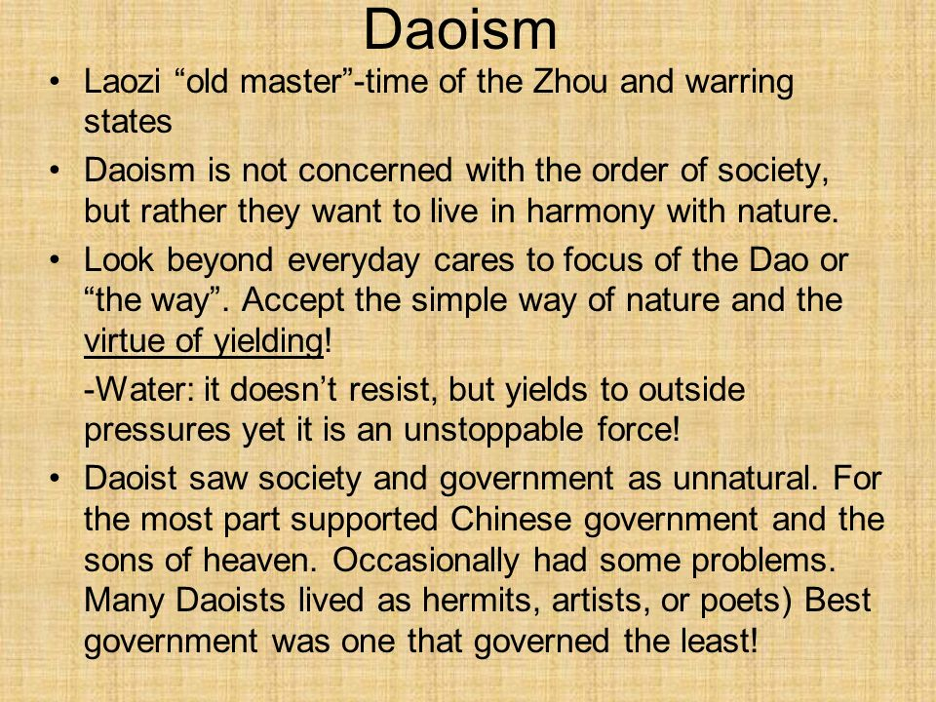

Slide 42
Zhou Dynasty Highlights…
• Ruled from 1122 BCE to 256 CE
• Its last 150 years was known as the “Warring States” period
• Ushered in feudalism for the first time
• Zhou dynasty created the world’s first books
• Economically, China’s fortunes grew under the Zhou through trade and new technology like iron working
• Confucianism emerges during this period to become a major belief system
• Daoism also emerges as a major belief system

