Slide 1

1790-1838

Slide 2

◻ After the American Revolution there were two main tribes located in the state of Georgia.
◻ The two main tribes were the Creek and Cherokee Indians.
◻ As settlers began to move west into newly acquired land from the American Revolution conflict arose between the Native Americans and the settlers.

Slide 3

1821

Slide 4

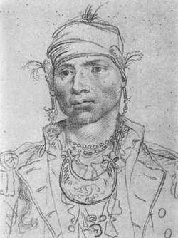
◻ Scottish and Creek decent.
◻ Against ceding Creek lands. Led attacks against white settlers on Creek land.
◻ In attempts to end the attacks on white settlers President George Washington called McGillivray for a meeting.
◻ Treaty of New York- Alexander McGillivray signed away Georgia land.
◻ Made Brigadier General in
U.S. Army
◻ Died on the way to Pensacola

Slide 5

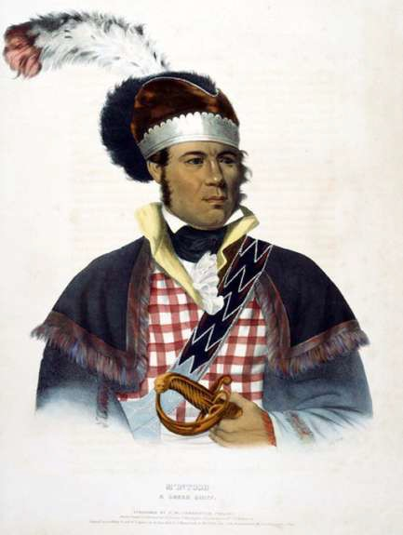
◻ Scottish and Creek
◻ Supported civilizing Creeks. Making them more like white settlers.
◻ Owned Plantations
◻ Gained $200,000 for signing Treaty of Indian Springs
Ceded all Creek land
◻ Signing the treaty angered the Creek people, in response they executed McIntosh.

Slide 6

1790-1838

Slide 7

◻ Of all the Native American tribes the Cherokee tribe adapted most to white culture.
◻ The Cherokee tribe lived in houses, farmed, owned property, and some even owned slaves.
◻ The Cherokee even had their own capital city called New Echota.
◻ Some of the more famous Cherokees were Sequoyah and John Ross.

Slide 8

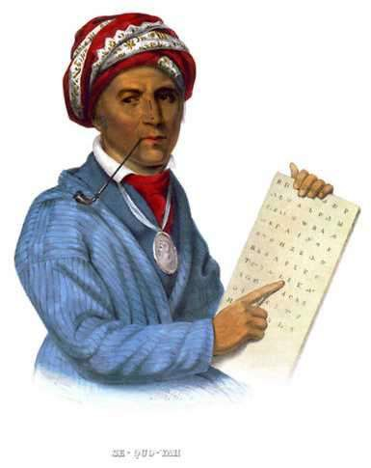
◻ Sequoyah was impressed with the whites written language.
◻ Developed Cherokee Alphabet
Syllabary-Eighty written symbols that represent syllables of Cherokee language
◻ Helped start Cherokee Phoenix Newspaper
Elias Boudinot Editor

Slide 9
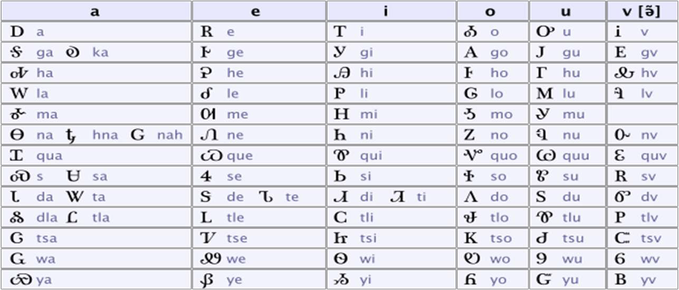

Slide 10

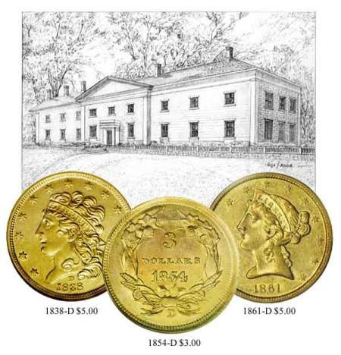
◻ 1828 Gold Discovered Gold was discovered in the Cherokee territory by a farmer named Benjamin Parks.
◻ After the discovery of gold over 10,000 settlers rushed into Cherokee land creating new cities. One of which was Dahlonega, which was name after the Cherokee word for Gold.
◻ Along with the influx of settlers, the Georgia state government began to pass laws which denied the Cherokees the right to stay on their land.

Slide 11
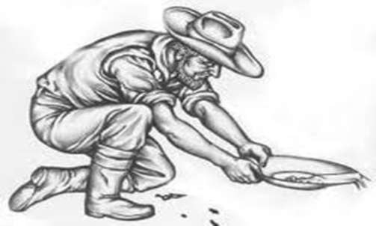
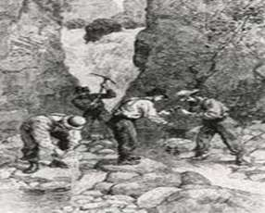
◻ Cherokee could do nothing to keep white settlers off their land
◻ 1830 state claimed all land occupied by Cherokee

Slide 12

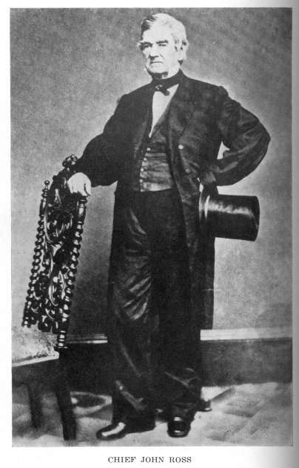
◻ Cherokee leader 1827-1866
◻ Opposed without success the
removal of his tribe to Oklahoma
◻ Made many trips to Washington in attempts to ask Congress to help protect the Cherokee and their land.
◻ On one of his trips he brought a petition with over 15,000 signatures in protest of the Indian Removal Act.
◻ He was not successful in keeping his Cherokee people on their land and along with his people was forced out to Oklahoma to designated Indian Reservations.
◻ Wife died on “Trail of Tears”

Slide 13

◻ Some whites wanted to come to the aid of the Cherokee tribe, but in an effort to keep whites from helping the Native Amerians Georgia passed a law stating that whites could not live in Cherokee land without swearing an oath of allegiance.
◻ Reverand Samuel Worchester and several missionaries refused to leave Cherokee land after Georgia Governor George Gilmar made it illegal for white citizens to live on Cherokee land.
◻ Goveror Gilmar stated that in order for white citizens to live on Cherokee land they must pledge allegiance to the state and receive a permit from the Governor.
◻ For not pledging allegiance and leaving Cherokee land Worchester was arrested and imprisoned. He filed an appeal to the US Supreme court, specifically Judge John Marshall in attempts to get out of prison.

Slide 14

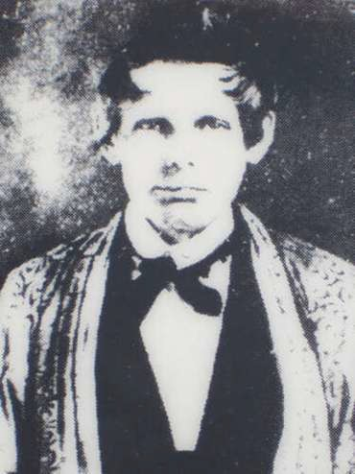

Slide 15

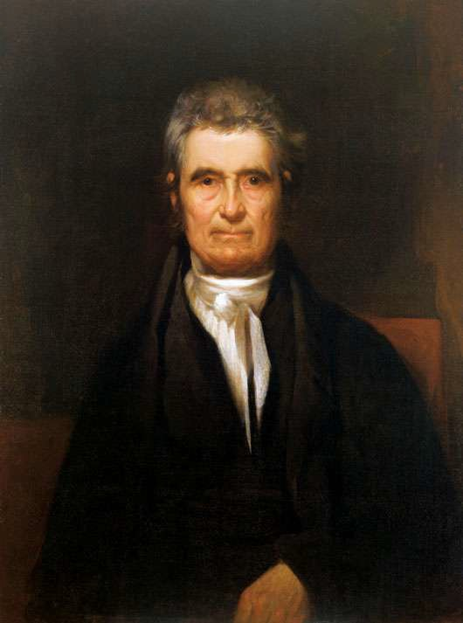
◻ Judge John Marshall ruled in favor of Worchester and said that he should be released from prison.
◻ Governor Gilmar and President Andrew Jackson ignored Marshall decision and refused to enforce it.
Worchester and Butler served 16 years in prison until eventually agreeing to pledge allegiance to the state and leave Cherokee land.

Slide 16

1829-1837

Slide 17

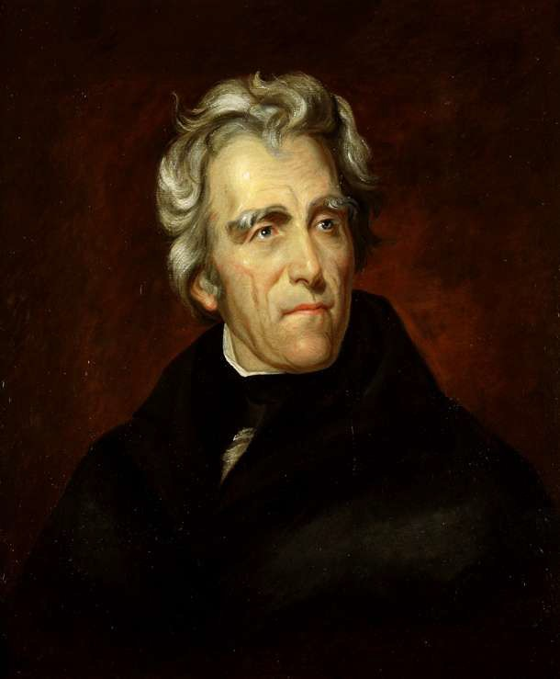
◻ After being elected president of the United States, Andrew Jackson passed the Indian Removal Act.
◻ The Indian Removal Act called for all Native Americans to be removed from the southeastern part of the United States and sent out west.

Slide 18

1838

Slide 19

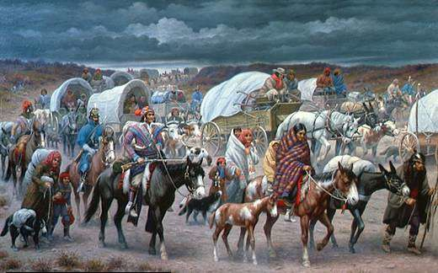
◻ A group of Cherokees signed Treaty of New Echota- giving up all Cherokee land.
◻ The Cherokee Indians were eventually forcibly removed from their land in the Southeastern region of the United States.
◻ The Cherokee were forced to move to Indian reservations out west in Oklahoma.
◻ The trip out west came to be known as the Trail of Tears because many Cherokee died from diseases and malnourishment while traveling.
◻ 4000 Cherokee die including John Ross wife

Slide 20
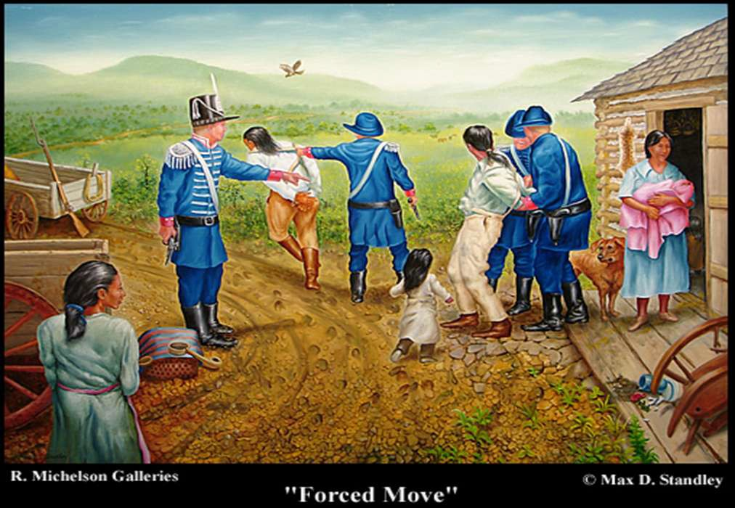

Slide 21
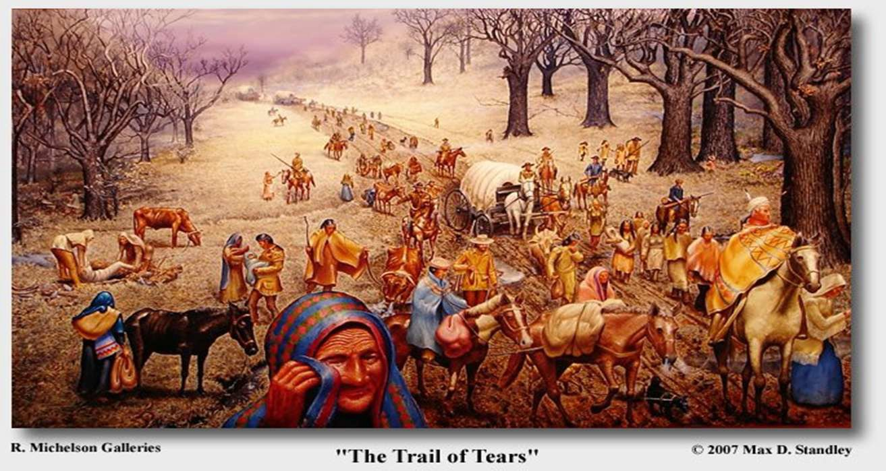

Slide 22
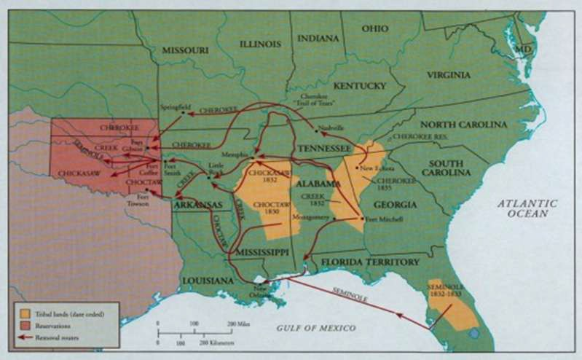

Slide 23


Slide 24
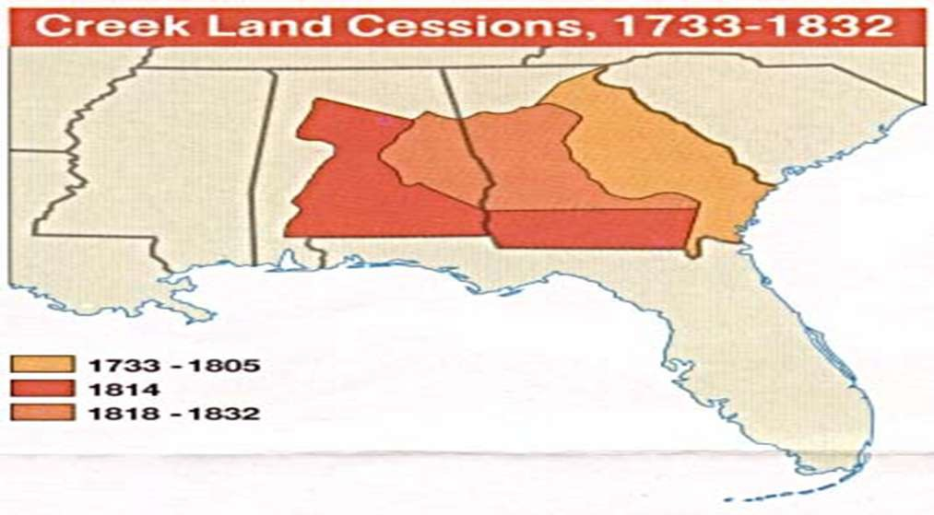

Slide 25
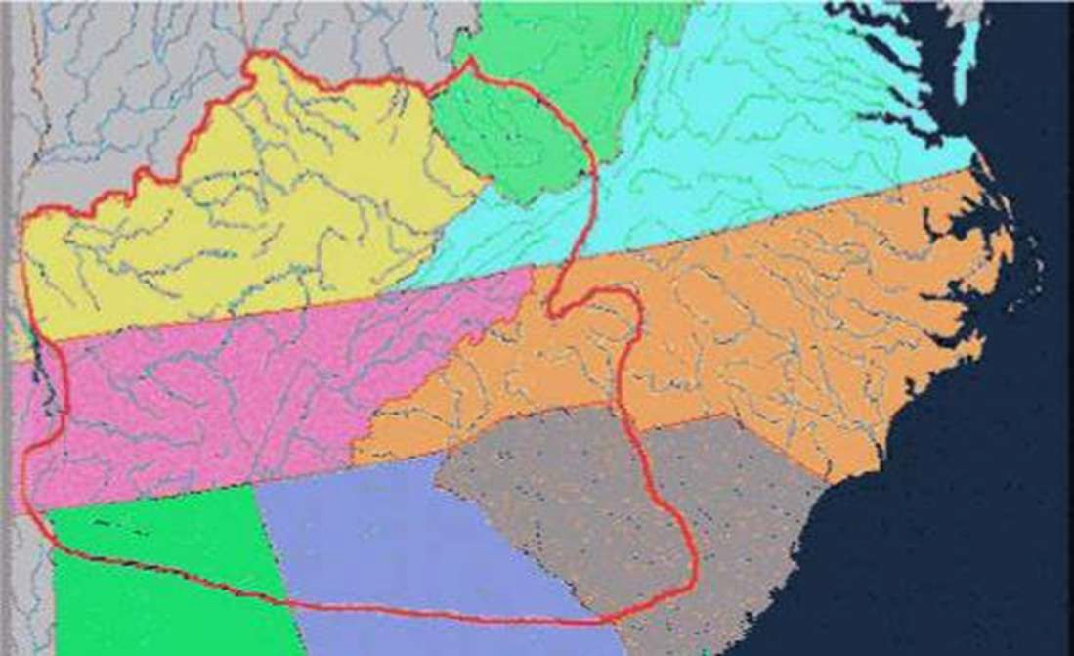

Slide 26

