Slide 1
The Upsurge of Nationalism
Monroe & The Era of Good Feelings (1817-1825)

Slide 2
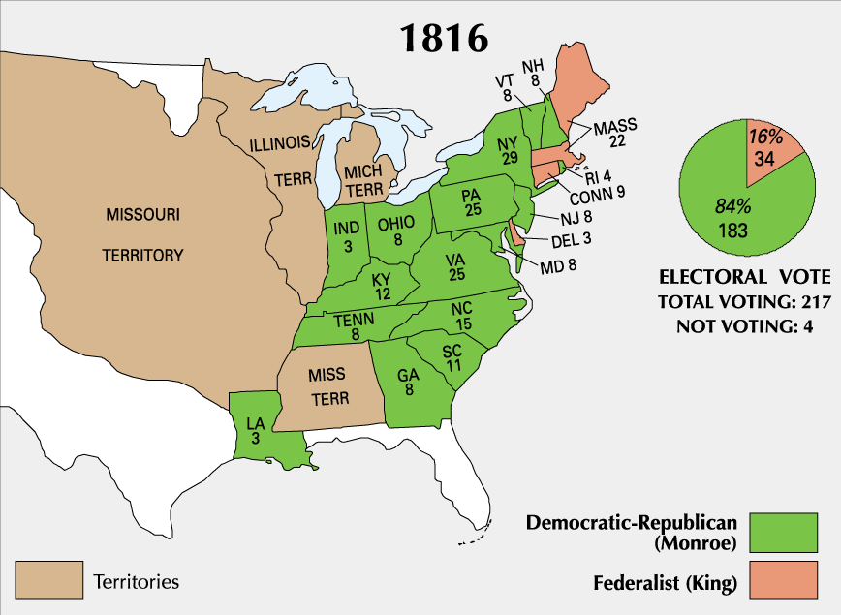
The Election of 1816

Slide 3
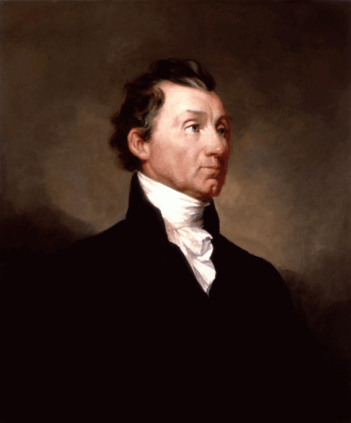
The Era of Good Feelings
Continued the so-called “Virginia dynasty”
Chose government officials from all areas of the nation and from both parties
Led to a vibrant nationalism that superseded partisan politics for a time
Took a goodwill tour of the country in 1818 & was acclaimed by all sections

Slide 4
The Era of Good Feelings
Monroe’s election in 1816 helped lead to the death of the Federalist Party
Federalist liabilities included:
"Disloyalty" during the War of 1812
Extremely sectional regarding the interests of New England
Jefferson had adopted many of their most important ideas (e.g. Hamilton’s financial plan, expansion, loose construction in certain cases)

Slide 5
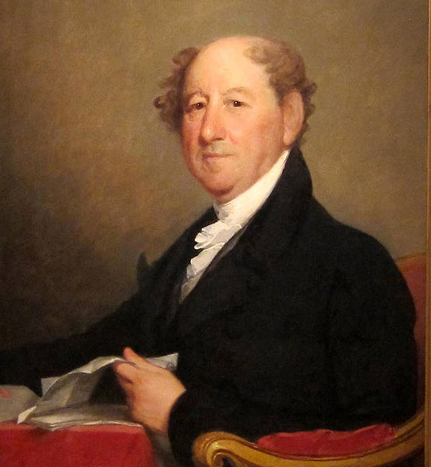
The Era of Good Feelings
Ironically, Federalists reversed many of their initial positions
Originally nationalistic; now opposed to Republican nationalism
Became strict constructionists, especially regarding internal improvements

Slide 6
The Era of Good Feelings
"Era of Good Feelings" was somewhat of a misnomer; serious issues were beginning to divide the nation
Second Bank of the United States
Tariff of 1816
Internal improvements
Sale of public lands
Panic of 1819
Missouri Compromise
Second Party System

Slide 7
The American System
Second Bank of the United States
Supported by the same Republicans who had opposed the First Bank of the United States
During the War of 1812, the US experienced severe inflation & had difficulty in financing military operations
As a result, Madison and Congress agreed to charter the Bank for 20 years

Slide 8
The American System
Tariff of 1816
The Tariff of 1816 was created to protect U.S. manufacturing from British competition
After the war, Britain flooded U.S. with cheap goods, often below cost to undercut new U.S. industries
Americans saw this as British attempt to crush U.S. factories
First protective tariff in U.S. History
Imposed roughly 20-25% duties on imports
Not really high enough to provide effective protection.
Started a protective trend in U.S. trade.

Slide 9
The American System
Tariff of 1816
The "Great Triumvirate"
Henry Clay (from Kentucky) represented Western views
War hawk & strong nationalist
Saw tariffs as a way to develop a strong domestic market
Believed that Eastern trade would flourish under tariff protection
Hoped that tariff revenues would fund roads & canals in the West, especially the Ohio Valley

Slide 10
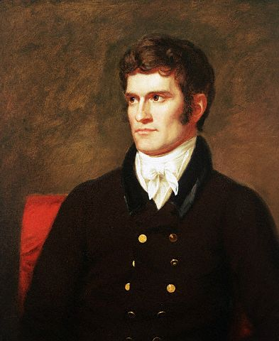
The American System
Tariff of 1816
The "Great Triumvirate"
John C. Calhoun (from South Carolina) represented Southern views
War hawk & strong nationalist*
Initially supported the tariff
Later claimed that it enriched New England manufacturers at the expense of the South

Slide 11
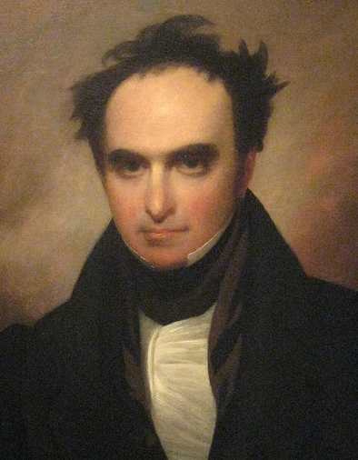
The American System
Tariff of 1816
The "Great Triumvirate"
Daniel Webster (from New Hampshire) represented Northern views
Opposed the tariff
Feared the it would damage the shipping industry
New England was not completely industrial yet

Slide 12
The American System
Internal Improvements
Calhoun's Bonus Bill (1817) would have given federal funds to states for internal improvements
Madison vetoed the bill, claiming it was unconstitutional
His successor, James Monroe, also vetoed the legislation
Jeffersonians opposed direct federal support of intrastate internal improvements; saw it as a states’ rights issue
New England opposed federally built roads & canals; feared it would drain away population and create competing states in the West

Slide 13
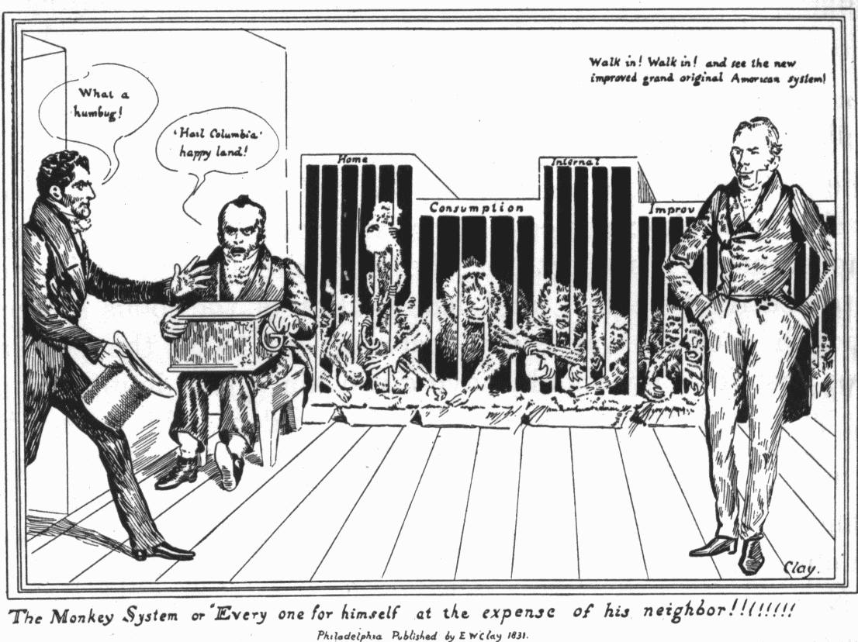
The American System

Slide 14
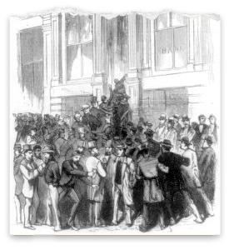
Panic of 1819
Economic panic & depression hit in 1819
First financial panic since the "Critical Period" of the 1780s under Articles of Confederation
Panics & depressions occur about every 20 years: 1819, 1837, 1857, 1873, 1893, 1907, 1929

Slide 15
Panic of 1819
Causes of the Panic of 1819
Over-speculation on frontier lands
BUS forced "wildcat" western banks to foreclose on farms
BUS stopped allowing payment in paper; now demanded payment in specie
State banks affected & called in loans in specie
Many farmers didn’t have specie so they lost their farms

Slide 16
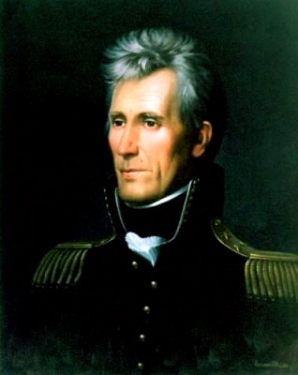
Panic of 1819
Results of the Panic of 1819
Western farmers begin to view the bank as an evil financial monster
Hard hit poor classes looking for more responsive government
New land legislation resulted in smaller parcels being sold for lower prices
Widespread sentiment to end the practice of imprisoning debtors

Slide 17
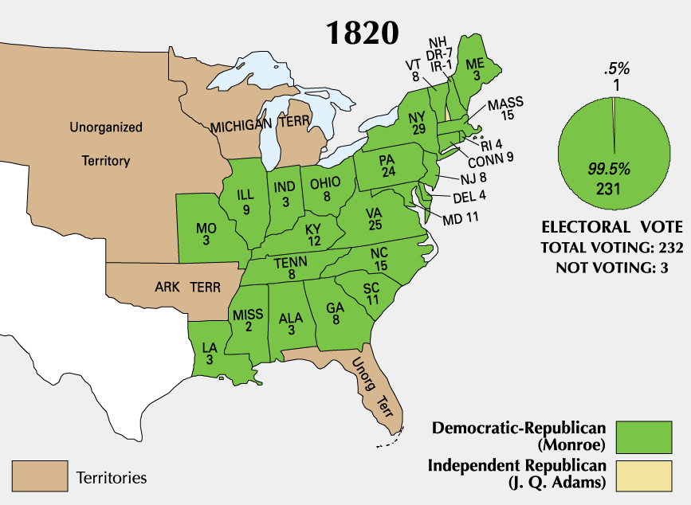
The Election of 1820

Slide 18
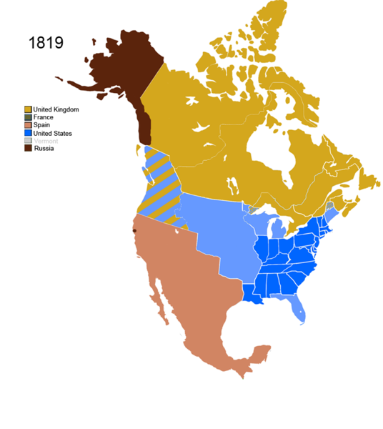
The Growing West
Nine new states joined the union between 1791 & 1819
Most had been admitted alternately free and slave
Maintaining a sectional balance in Congress was a supreme goal
The Growth West Animation

Slide 19
The Growing West
Reasons for Westward Expansion
Westward movement had been significant since colonial era.
Cheap lands in Ohio territory attracted thousands of European immigrants.
Land exhaustion in older tobacco states drove people westward.
Speculators accepted small down payments & made purchase of land easier.
Economic depression during the embargo years sparked migration westward.

Slide 20
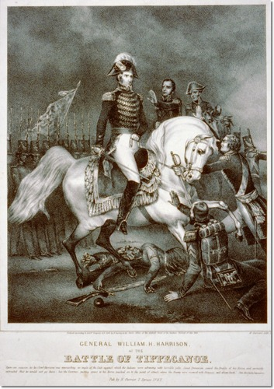
The Growing West
Reasons for Westward Expansion
Defeat of the Native Americans in previous decades cleared away much of the frontier.
Battle of Fallen Timbers (1794)
Battle of Tippecanoe (1811)

Slide 21
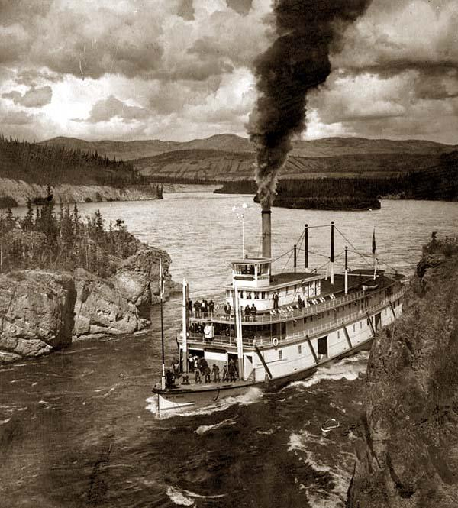
The Growing West
Reasons for Westward Expansion
Transportation Revolution improved land routes to Ohio Valley.
Cumberland Road begun in 1811; from Maryland to Illinois
Advent of steamboat in 1811 made upstream travel possible
Canals beginning in 1826 allowed for increased trade between west and east

Slide 22
The Growing West
West still remained weak in population and influence
Allied with other sections regarding national political issues.
Demanded land reform & cheap transportation, cheap money, created its own "wildcat" banks, & fought the BUS.

Slide 23
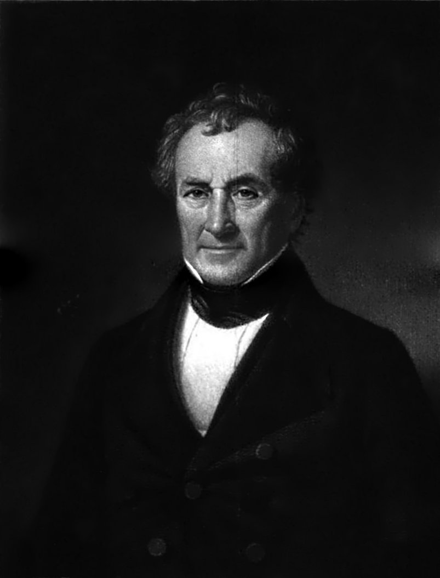
The Missouri Compromise
Missouri asked Congress to enter the union in 1819
Led to the debate over the Tallmadge Amendment calling for the end of slavery in Missouri in a generation
No more slaves could be brought into Missouri
Gradual emancipation of children born to slave parents already there.

Slide 24
The Missouri Compromise
Southerners viewed Tallmadge Amendment as huge threat to sectional balance.
Led to concern about the future of the slave system
Missouri was the first state entirely west of Mississippi made from Louisiana Territory
Tallmadge Amendment might set a precedent for rest of the region to be free.
If Congress could abolish slavery in Missouri, it might try in southern states.
Senate refused to pass the amendment; national crisis loomed

Slide 25
The Missouri Compromise
Henry Clay worked to negotiate a compromise
Provisions:
Congress agreed to admit Missouri as a slave state
Maine was admitted as a free state
Kept the sectional balance at 12 to 12 for the next 15 years
Future slavery was prohibited north of 36º 30' line, the southern border of Missouri
Ironically, Missouri was north of the 36-30 line

Slide 26
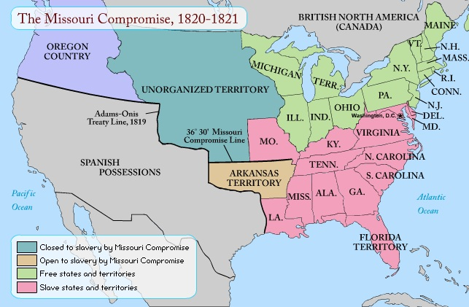
The Missouri Compromise

Slide 27
The Missouri Compromise
Compromise was largely accepted by both sides
South got Missouri
North won the concession that it could forbid slavery in the remaining territories above the 36º 30' line
North had an advantage as Spanish territory in southwest prevented significant southern expansion westward
Southerners were not too concerned about lands north of 36º 30‘ as climate not conducive to cash crop agriculture requiring slave labor

Slide 28
The Missouri Compromise
Legacy of the Compromise
Lasted 34 years and preserved the union (until Kansas Nebraska Act in 1854)
Slavery became a dominant issue in American politics
Serious setback to national unity
South began to develop a sectional nationalism of its own
Looked to the western states who were seeking allies as well.
Clay was later criticized by Northerners as an "appeaser"

Slide 29
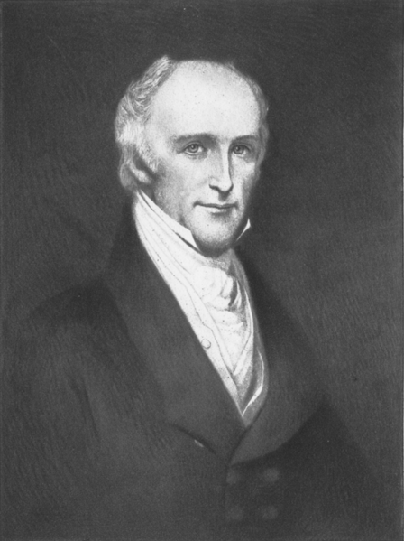
Foreign Policy after the War of 1812
Rush-Bagot Treaty (1818)
Provided for a large demilitarization of the Great Lakes & Lake Champlain, where many British naval arrangements and forts still remained
Laid the basis for a demilitarized boundary between the US & British North America

Slide 30
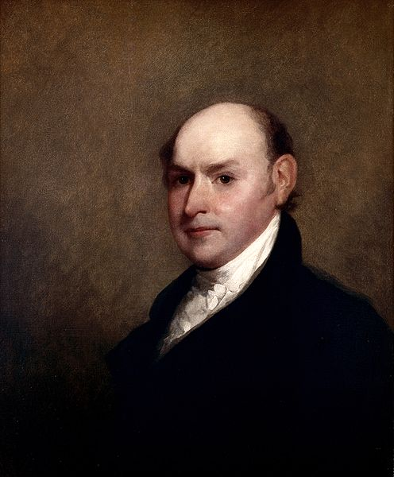
Foreign Policy after the War of 1812
Treaty of 1818
Negotiated by John Quincy Adams
Provisions:
Fixed the American-Canadian border at the 49th Parallel from Lake of the Woods to the Rocky Mountains
Created a 10-year joint occupation of Oregon Territory
Allowed Americans to share the Newfoundland fisheries with Canada

Slide 31
Foreign Policy after the War of 1812
Florida Purchase Treaty (1819)
Also known as the Adams-Onis Treaty
Background:
US already claimed West Florida as a result of the War of 1812
Revolutions in South America forced Spain to move its troops out from Florida
Indians, runaway slaves, and white outcasts poured across the border into US territory to attack settlers & then retreat south of the border
Monroe ordered Andrew Jackson to attack the Indians and, if necessary, pursue them back into Florida
He was to respect all Spanish posts

Slide 32
Foreign Policy after the War of 1812
Florida Purchase Treaty (1819)
Background:
Jackson swept through central & eastern Florida during the First Seminole War (1816-1818)
Captured Spanish cities and deposed the Spanish Governor (thus disobeying Monroe's orders)
Jackson executed 2 Indian chiefs & British supporters of Spain
John Quincy Adams convinced Monroe's cabinet to offer Spain an ultimatum
Control the outlaws of Florida (which Spain was not equipped to do) or cede Florida to the US
Spain realized it would lose Florida in any case; decided to negotiate

Slide 33
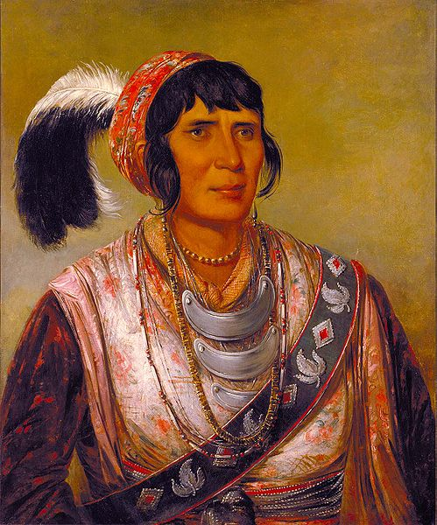
Foreign Policy after the War of 1812
Florida Purchase Treaty (1819)
Background:
Jackson swept through central & eastern Florida during the First Seminole War (1816-1818)
Captured Spanish cities and deposed the Spanish Governor (thus disobeying Monroe's orders)
Jackson executed 2 Indian chiefs & British supporters of Spain

Slide 34
Foreign Policy after the War of 1812
Florida Purchase Treaty (1819)
Background
John Quincy Adams convinced Monroe's cabinet to offer Spain an ultimatum
Control the outlaws of Florida (which Spain was not equipped to do) or cede Florida to the US
Spain realized it would lose Florida in any case; decided to negotiate
Provisions:
Spain ceded Florida as well as claims to Oregon to the US
US abandoned claims to Texas (later become part of Mexico)

Slide 35
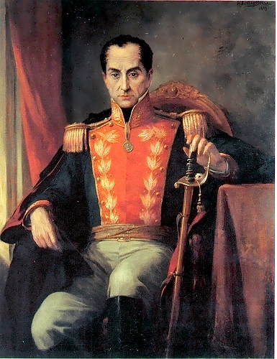
Foreign Policy after the War of 1812
Monroe Doctrine (1823)
Background:
European monarchies were concerned about democratic revolutions at home & abroad
Saw democracy as a threat to absolute monarchy.
Sought to restore newly independent Latin American republics to Spanish rule
Americans were alarmed at European hostility to democracy in the Western Hemisphere

Slide 36
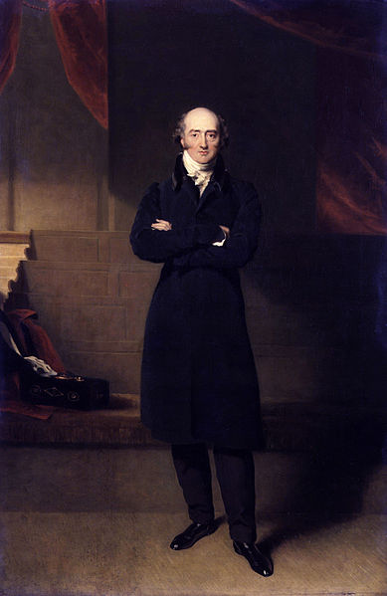
Foreign Policy after the War of 1812
Monroe Doctrine (1823)
Background:
Great Britain sought a joint alliance with the US
Secretary of State John Quincy Adams felt that Britain wanted an alliance in order to stop the US from expanding into Latin America

Slide 37
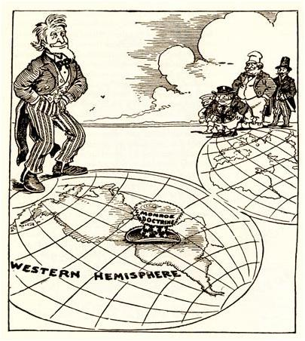
Foreign Policy after the War of 1812
Monroe Doctrine (1823)
President Monroe’s annual message to Congress warned Europeans:
Colonial powers could keep existing colonies but gain no new ones
Leave America alone; let new republics govern themselves
Directed largely at Russia which had designs on the Pacific coast

Slide 38
Foreign Policy after the War of 1812
Monroe Doctrine (1823)
Impact:
Immediate impact of the Monroe Doctrine was small
US army & navy remained small & relatively weak
Became more important when President Polk revived it in 1845
Long-term impact of the policy was significant
Served as the cornerstone of US foreign policy during last half of 19th century & throughout 20th century

Slide 39
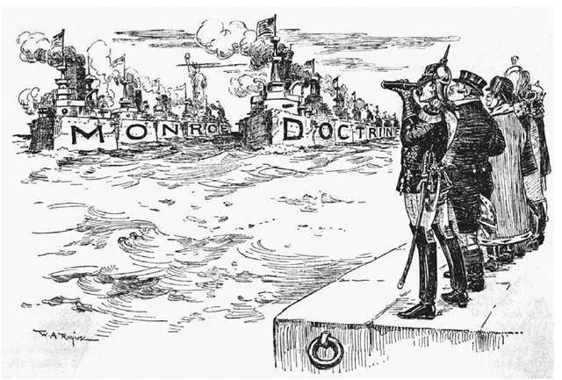
Foreign Policy after the War of 1812

