Slide 1
The 1960s: War, Hippies, Rock, & Riots

Slide 2
Kennedy beats Nixon
In one of the closest presidential elections in U.S. history, Kennedy defeated Nixon
“Ask not what your country can do for you, ask what you can do for your country.”
-- John F. Kennedy Inauguration Speech, 1961
In his inauguration speech, Kennedy inspired people with his optimism, his youthfulness and his ability to handle the media.
“Let the word go forth from this time and place, to friend and foe alike, that the torch has been passed to a new generation of Americans.”
-- John F. Kennedy, Inauguration Speech, 1961

Slide 3
The New Frontier
New Frontier Goals:
• Increase federal aid to education
• Provide health insurance for the elderly
• Create a Department of Urban Affairs

Slide 4
Peace Corps
One of Kennedy’s first presidential acts was creating the Peace Corps
Americans volunteered to help underdeveloped nations in areas such as education, farming, health care and construction
The main purpose of the Peace Corps was to fight poverty is less developed countries.

Slide 5
The Warren Court
Dwight D. Eisenhower nominated Earl Warren to be Chief Justice of the United States Supreme Court
Many thought Warren would be a conservative, but he was not
The Warren Court was an active one that made numerous key rulings

Slide 6
Key Supreme Court rulings
Gideon v.
Wainwright: Defendant in a state court had the right to a lawyer, regardless of his ability to pay
Engel v. Vitale: Court ruled that government- funded schools could not require prayer in public schools
Reynolds v. Sims: Voting districts in many states were unequal. The case ruled that voting districts had to be equal in size.
Established the principle of “one man, one vote.”

Slide 7
Miranda v. Arizona
Ernesto Miranda was arrested for raping an 18 year old. He later confessed to robbery and attempted rape under interrogation by police. The Supreme Court ruled that his constitutional rights were violated by the police who interrogated him.
Miranda had confessed without knowing that he had the right to remain silent (5th Amendment)

Slide 8
Assassination in Dallas
On Nov. 22, 1963,
Kennedy and his wife traveled to Dallas to make some political appearances
As the motorcade rode through downtown Dallas, JFK was shot in the head
Lee Harvey Oswald was the man who was accused of shooting Kennedy

Slide 9
LBJ becomes President
Hours after JFK’s
assassination, Vice-President
Lyndon Johnson of Texas was
sworn in as
president

Slide 10
The War on Poverty
In his book The Other America Michael Harrington showed that many Americans lived in poverty in the United States.
The book influenced the thinking of both John F. Kennedy and his successor, Lyndon B. Johnson, as they both made the elimination of
poverty a major goal.

Slide 11
LBJ’s Great Society
Once Johnson was elected in 1964, he began working on his plan for domestic programs to help the United States. He called his program the Great Society. Although there were many, the key programs of the Great Society were Medicare, Medicaid, Head Start, and HUD.
Key Successes of the War on Poverty:
• Medicare
• Medicaid
• Dept. of Housing and Urban Development (HUD)

Slide 12
In the 60s, thousands of teenagers became part of the “counterculture.” These “hippies” rebelled against the traditional American culture.
The hippie look was long hair, tie-dyed shirts, and use of drugs like marijuana, LSD and heroin
Hippies believed in a world free of war and hate and full of peace and love

Slide 13
The Hippy Movement
The term “hippy” comes from being hip. You were either hip or you were a “square” or a “pig.”
Hippie were looking for an alternative way to live life.
Most hippies valued freedom, nature, intimacy, peace, sharing, and spirituality.

Slide 14
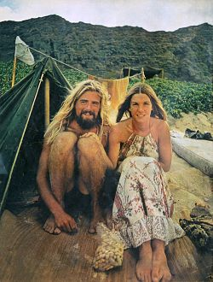
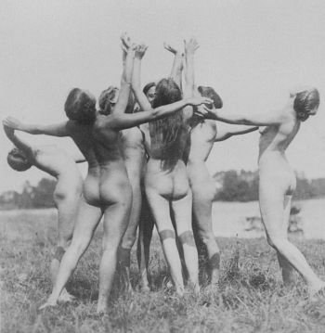
A Way of Life
Hippies wanted to distance themselves from mainstream ways of life.
They discarded possessions and often lived in parks or campsites in the woods.
Living like this made them feel free
Nudity was another form of freedom

Slide 15
Drug Culture
Drugs like marijuana and LSD were a big part of the hippy/counterculture movement.
Using drugs made hippies feel like the were rebelling from mainstream society.
Timothy Leary (a Harvard professor) was an advocate of LSD.
LSD was created by a Swiss scientist, used by the CIA, and tested for use by psychiatrists before it became illegal.

Slide 16
Counterculture Fashion
Hippies distanced themselves from mainstream culture by their dress.
Colorful, flowing clothing, beads, headbands bellbottoms, and tie-dye were popular.
Men grew their hair and beards long or in afros.
Hippies were often called “longhairs”

Slide 17
San Francisco and Haight Ashbury
San Francisco was the birthplace of the counterculture/hippy movement.
By 1965 hippies had taken over the Haight Ashbury district.
Haight Ashbury district contains Golden Gate Park, home of the Trips Festival and “be-ins.”
This is a 20,000-strong be-in at Golden gate park in 1967.

Slide 19
Hippy Music
The most popular music of the time was psychedelic rock
Bands like Jefferson Airplane, Quicksilver Messenger Service, the Jimi Hendrix Experience and the Grateful Dead played free concerts at Golden Gate Park.
Concerts and be-ins were places for hippies to protest, socialize, dance, or take drugs.
At Woodstock over 250,000 hippies showed up to hear artists like Janis Joplin, The Who, Canned Heat, The Allman Brothers, and County Joe and the Fish.

Slide 20
Famous music groups of the
Hippie Movement
Music played a large part of the Hippie Movement
The Beatles
Jimi Hendrix
Jefferson Airplane
Jim Morrison and the Doors
Bob Dylan

Slide 21
Woodstock
Music festival held in upstate
New York in 1969 that exemplified the counterculture of the 1960s
Thirty-two of the best-known musicians of the day performed in front of nearly half a million concert-goers
Woodstock is regarded as one of the greatest moments in pop music history

Slide 22
Woodstock
Woodstock was not just a music concert. “For thousands who couldn’t even hear the music” it was a “profound religious experience.”
Meager resources were shared with everyone.
Many people at Woodstock used illegal drugs

Slide 23
Overview
Woodstock was a music and art festival between August 15-18, 1969
There were about 500,000 attendees
It was intended to be a ticket show, but because of poor security, many jumped the fence, so the producers declared it free.
Tents were put up for food, water, drugs, a place to sleep, and to cool down and recover from a "bad trip"
There were three deaths and three births

Slide 24
Protesting
Woodstock reflected the hippie ideology if its protests of the Vietnam War, and equal rights for all during the 1960s.
Hippies protested American culture by forming their utopian communities.
Woodstock was a peaceful protest of the Vietnam War, its three days of peace and love greatly contrasting with the war.
"Festival organizers pointed out that anyone buying a ticket was contributing to a united front against the war. (History They Didn't Teach in School)
"If you want to stop the ******* war, you'll have to sing louder than that." - Country Joe (History They Didn't Teach in School)
"You had the war in Vietnam. You had civil rights, you had women's rights, gay rights, and you had the music, which was a form of communication that we used strongly back then." - Duke Devlin (10 Amazing Woodstock Era Quotes)

Slide 25
Social Unity/Harmony
Woodstock reflected the most important part of the hippie ideology, social unity and harmony during the 1960s.
Hippies believed in everyone being completely equal, sharing everything they had.
They shared everything, food, water, clothes, joints, places to sleep, etc.
"The way people were sharing at Woodstock, if you were wet and cold, they would offer you their extra shirt. They would offer you food. People were sharing everything. - Zeke Boyle (Woodstock Encapsulated an Era of Political and Social Protest)

Slide 26
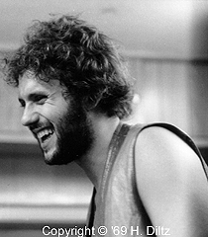
Social Unity/Harmony
"You know my best Woodstock memory, my favorite thing? It's in the movie. You see a kid taking a bite of a sandwhich, and passing it to the next kid, who takes a bite and passes it, on down the line until 12 kids have had a bite. Sharing, that's what woodstock was, people helping another." - Artie Kornfield (Sex, Drugs, and Rock n' Roll)
"All we are saying is to give peace a try." - John Lenon (10 Amazing Woodstock Era Quotes)

Slide 27
Student Activism in the 1960s

Slide 28
Signs of movement across the country
1962: come together to form Students for a Democratic Society (SDS)
Port Huron Statement:
“We are people of this generation, bred in at least modest comfort, housed now in universities, looking uncomfortably to the world we inherit.
When we were kids the United States was the wealthiest and strongest country in the world; the only one with the atom bomb, the least scarred by modern war, an initiator of the United Nations that we thought would distribute Western influence throughout the world. Freedom and equality for each individual, government of, by, and for the people - these American values we found good, principles by which we could live as men. Many of us began maturing in complacency.”

Slide 29
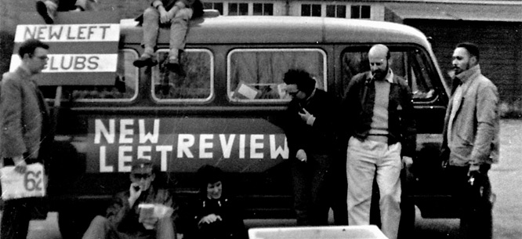
New Left
Self-identified as
New Left
Liberals want to work within the system, implicitly accept system
Leftists: work outside system; basic, radical change at root of system
“New”: not communist/USSR

Slide 30
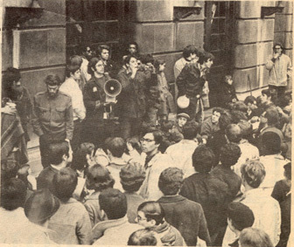
Impact of Vietnam: Columbia, 1968
• June 1965: threat of draft→ student movement primarily about war
• Columbia University, 1968: war research on campus
Two issues:
1) no more war research
2) racism of the university (it owned property in Harlem)
Kids saw the two as connected: racist imperialism

Slide 31
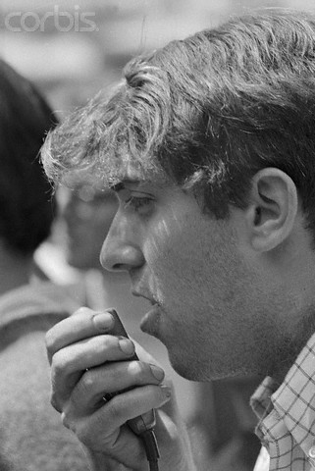
Kill the “brain” of the monster
How? Shut down the university→ seize buildings, strike, shut down classes
Mark Rudd

Slide 32
Madison, WI (Berkeley of Mid West)
• Sep. 7, 1970: “Okay pigs, now listen and listen good. There's a bomb in the Army Math Research Center—the university—set to go off in five minutes. Clear the building. Warn the hospital. This is no bull—, man.”
• OK City style: van w/fertilizer: kills Physics grad students + Madison anti-war movement
• Response to Kent State massacre

Slide 33
Martin Luther King shot in April of 1968
1968: A Turbulent Year
Tet Offensive showed U.S. was not winning the Vietnam War
Robert Kennedy shot in June of
1968

Slide 34
Election of 1968
Johnson refuses to run for re-election
After Johnson refused to run for re-election and Bobby Kennedy was assassinated, the Democrats ended up choosing LBJ’s vice- president, Hubert Humphrey, as their presidential candidate
Republicans nominate former vice-president Richard Nixon, who lost to JFK in 1960
"I shall not seek, and I will not accept the nomination of my party for another term as your President." March 31, 1968

Slide 35
Election of 1968
At the Democratic National Convention in Chicago in 1968, Democrats chose Vice President Hubert Humphrey as their candidate. But the biggest news was the rioting outside the convention and Mayor Richard Daley’s decision to send in the police, who beat hundreds of protestors in scenes that were carried on all nightly news broadcasts.

Slide 36
Delegitimizing Protest: Nixon’s “Silent Majority”
• 1968 Democratic National Convention, Chicago
• Anti-war Protestors sought to enter Convention→ beaten by police + National Guard
• Images most rabid, of unruly protesters—inevitably the focus of television coverage—best possible Republican counter-spin (Pat Buchanan)
• 1968 race riots→ Nixon “law and order”/”silent majority” victory, leads to demise of the mainstream Left, seriously scars Democratic Party right up to today (Solid Republican South, Dems “soft” on defense)

Slide 37
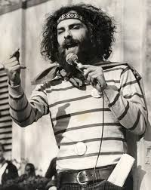
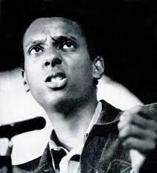
Activists Groups
• Students for a Democratic Society (SDS)
• Weather Underground (SDS splinter)
• Black Panthers
• The Yippies:
Abbie Hoffman
Abbot Howard "Abbie" Hoffman was a social and political activist in the United States who co-founded the Youth International Party . Later he became a fugitive from the law, living under an alias and working as an environmentalist.
- Jerry Rubin

Slide 38
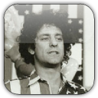
“
Abbie Hoffman:To steal from a brother or sister is evil. To not steal from the institutions that are the pillars of the Pig Empire is equally immoral. #Empire

Slide 39
“
Abbie Hoffman:You measure democracy by the freedom it gives its dissidents, not the freedom it gives its assimilated conformists. #Dissent

Slide 40
“
Abbie Hoffman:All you kiddies remember to lay off the needle drugs, the only dope worth shooting is Richard Nixon. #Loneliness

Slide 41
“
Abbie Hoffman:Usually when you ask somebody in college why they are there, they'll tell you it's to get an education. The truth of it is, they are there to get the degree so that they can get ahead in the rat race. Too many college radicals are two-timing punks. #Love

Slide 42
“
Abbie Hoffman:...in the nineteen-sixties, apartheid was driven out of America. Legal segregation - Jim Crow - ended. We didn't end racism, but we ended legal segregation. We ended the idea that you can send a million soldiers ten thousand miles away to fight in a war that people do not support. We ended the idea that women are second-class citizens. Now, it doesn't matter who sits in the Oval Office. But the big battles that were won in that period of civil war and strife you cannot reverse. We were young, we were reckless, arrogant, silly, headstrong...and we were right! I regret nothing! #Liberals

Slide 43
Election of 1968
Nixon becomes president!

Slide 44
Draft Lottery Begins
December 1st, 1969
Many Americans who were against the war believed the United States had an unfair draft system
Minorities made up a large percentage of soldiers in Vietnam. As the war continued, more people were drafted

Slide 45
Fortunate Son (CCR)
Some folks are born made to wave the flag, ooh, they're red, white and blue.
And when the band plays "Hail To The Chief", oh, they point the cannon at you, Lord,
It ain't me, it ain't me, I ain't no senator's son, It ain't me, it ain't me,
I ain't no fortunate one, no,
Some folks are born silver spoon in hand, Lord, don't they help themselves? oh.
But when the taxman come to the door, Lord, the house look a like a rummage sale, yes,

Slide 46
It ain't me, it ain't me,
I ain't no millionaire's son, no, no.
It ain't me, it ain't me,
I ain't no fortunate one, no.
Yeh, some folks inherit star spangled eyes, ooh, they send you down to war, Lord,
And when you ask them, how much should we give, oh, they only answer, more, more, more, yoh,
It ain't me, it ain't me,
I ain't no military son, SON, NO It ain't me, it ain't me,
I ain't no fortunate one, NO NO
It ain't me, it ain't me,
I ain't no fortunate one, no no no, It ain't me, it ain't me,
I ain't no fortunate son, son son son

Slide 47
Kent State Massacre
May 4, 1970
In April of 1970, President Nixon announced that American troops had invaded Cambodia. Anti-war protestors saw this as an escalation of the war, sparking violent protests on college campuses.
At Kent State University in Ohio, protestors became violent. The Ohio National Guard was called in and fired upon the student demonstrators, killing four students

Slide 48
Ohio (Neil Young)
Tin soldiers and Nixon's comin'. We're finally on our own.
This summer I hear the drummin'. Four dead in Ohio.
Gotta get down to it.
Soldiers are gunning us down. Should have been done long ago. What if you knew her and
Found her dead on the ground? How can you run when you know?

Slide 49
Gotta get down to it. Soldiers are cutting us down.
Should have been done long ago. What if you knew her and
Found her dead on the ground? How can you run when you know?
Tin soldiers and Nixon's comin'. We're finally on our own.
This summer I hear the drummin'.

Slide 58
26th Amendment ratified
Anger over the draft led to debates about the voting age. The average age of a American soldier in Vietnam was 19. Because you had to be 21 to vote, many people called for changes in voting laws, saying that if you’re old enough to fight in war, you should be old enough to vote. In 1971, the 26th Amendment was ratified, lowered the legal voting age from 21 to 18
President Nixon signs the 26th Amendment guaranteeing the right to vote for people over 18.

Slide 59
U.S. pulls out of Vietnam
In January of 1973, North and South Vietnamese reach a cease-fire agreement; by 1975, the United States withdraws all of its people from Vietnam

