Slide 1
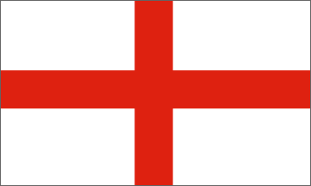
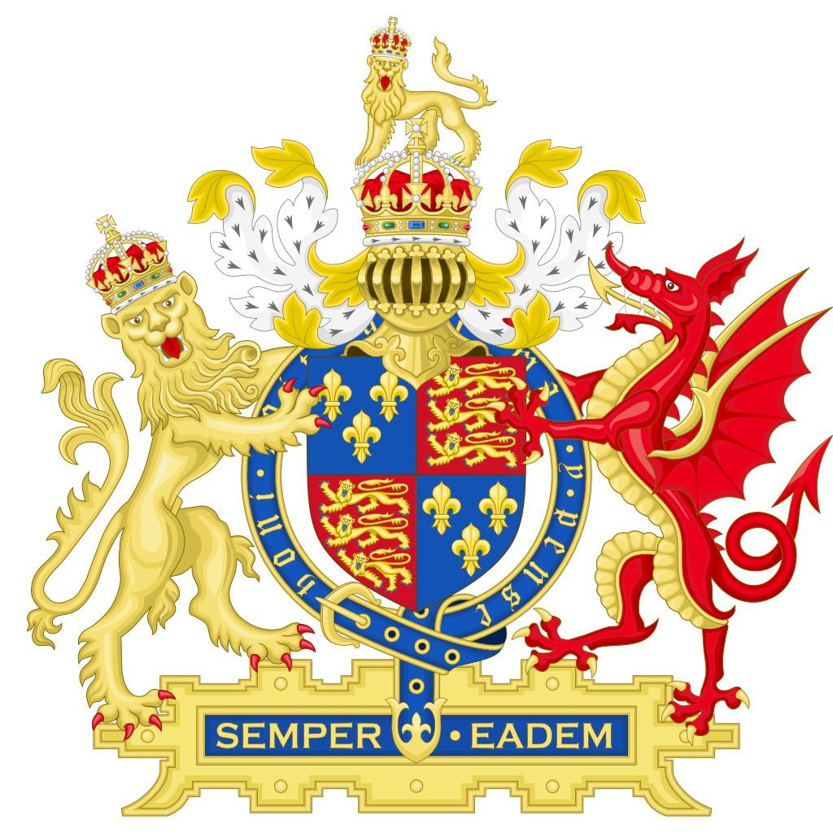
Jamestown
England comes to North America

Slide 2
Jamestown
1607

Slide 3
Things to remember about English colonization in North America…
The colonists intended and fully expected to transplant Old World society in the New World.
Although containing religious components, most of the colonies were, first and foremost, business ventures expected to turn a profit for their financial investors back in England.
Because the Crown chartered privately-owned, stock corporations that financed the colonial ventures or provided grants to proprietors, the colonies developed largely independent of government oversight and control.

Slide 4
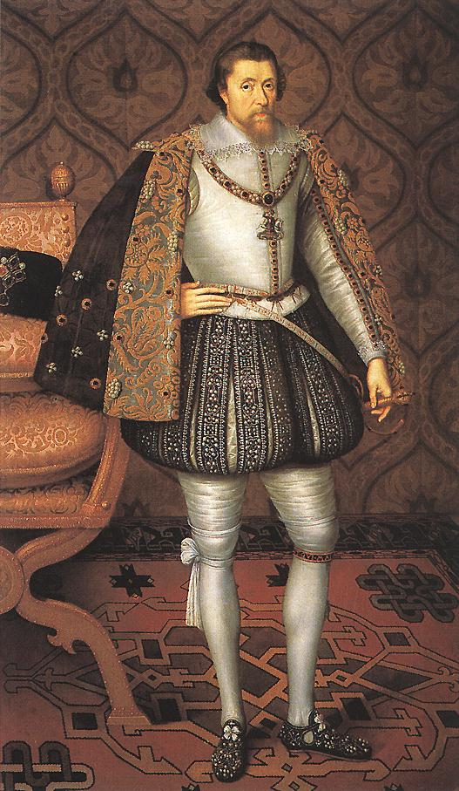
Long live the King…
1603
King James I, the son of “Bloody Mary,” Queen of Scots, who ascended to the English throne with the death of his cousin Queen Elizabeth I in 1603, also took an active interest in American colonization. In 1606, he chartered a joint-stock enterprise called the Virginia Company, with two divisions: the First Colony of London and the Second Colony of Plymouth.

Slide 5
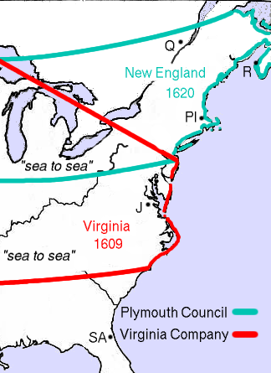
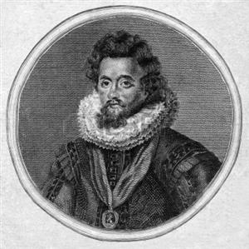
Newport’s New World expedition…
1606
The Virginia Company of London was the first to organize an expedition, dispatching a flotilla of three ships—the Godspeed, Discovery, and Susan Constant—led by Captain Christopher Newport (above), and bearing 105 men and boys bound for the Chesapeake, Virginia in late December 1606.
Christopher Newport

Slide 6
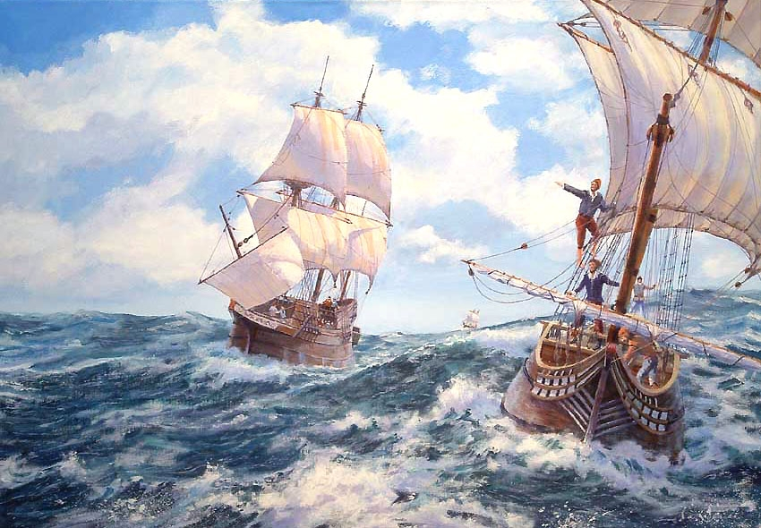
The Godspeed, Discovery, and Susan Constant spent four months at sea with a stopover in the Caribbean for water and provisions.

Slide 7
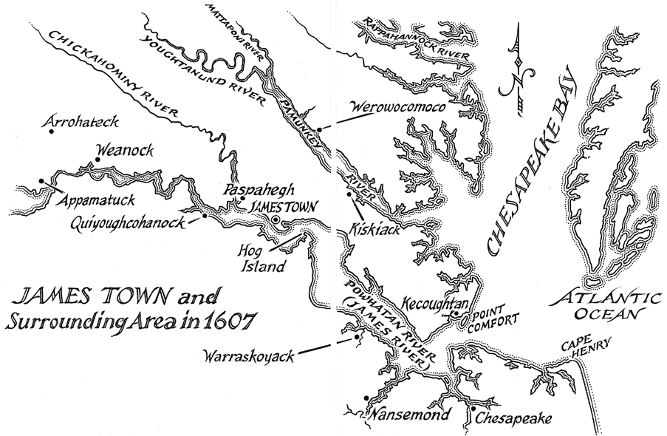
Newport makes landfall…
The expedition made landfall at Cape Henry on April 26, 1607.

Slide 8
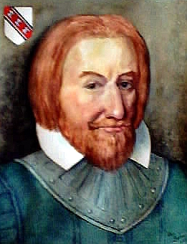
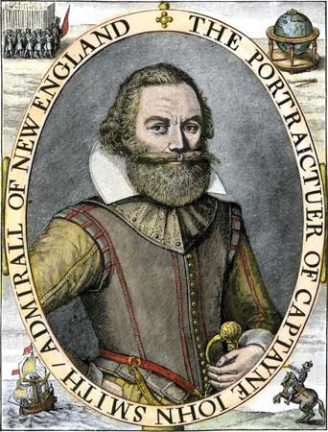
Edward Maria Wingfield, 1st president and founder of Jamestown
Captain John Smith, controversial member of the Jamestown council

Slide 9
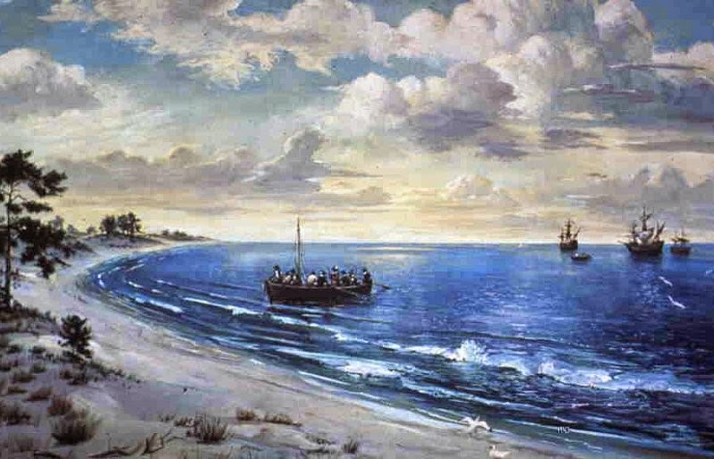
The colonists sailed far up the James River to find a safe place to establish a settlement, going ashore on May 4, 1607.

Slide 10
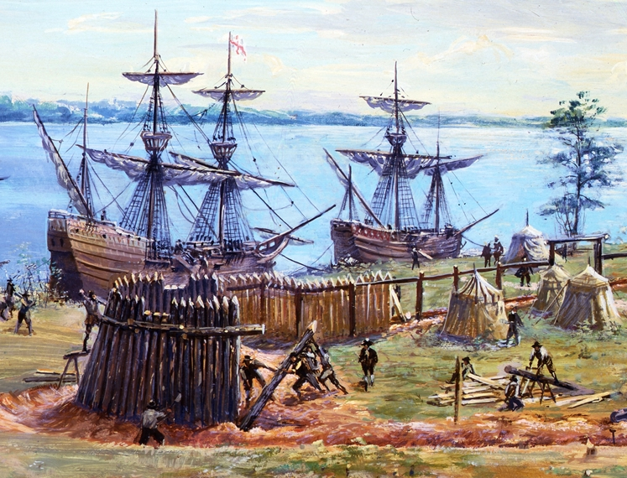
First business: build a fort…
For security purposes, the men immediately began constructing a palisaded defense, which they named James Fort.

Slide 11
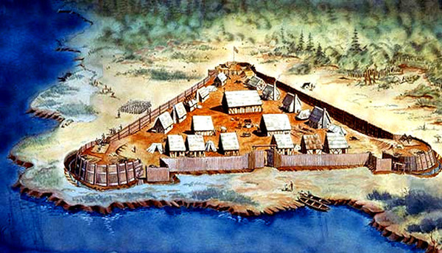
A stout defense against what might come…
James Fort was an impressive compound, with bulwarks on the corners for cannons and musketeers to guard against attack from Indians and European rivals.

Slide 12
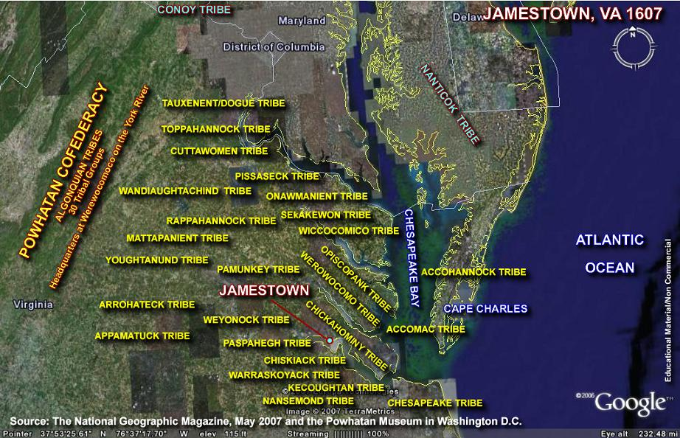
Newcomers surrounded by natives…
The English founded Jamestown on the southern border of Tsenacomoco, the Powhatan Indians’ name for eastern Virginia, which they controlled absolutely.

Slide 13
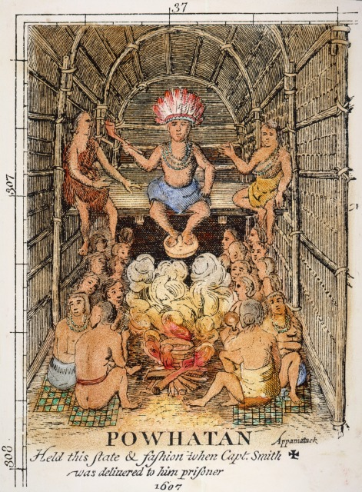
The English discovered a complex native culture…
The Jamestown settlers put down roots in a place where the Native American people around them had a highly developed culture and social structure. that today we refer to as the Powhatan Confederacy.
Seventeenth century engraving of Wahunsenacawh, werowance of the
Powhatan Indians.

Slide 14
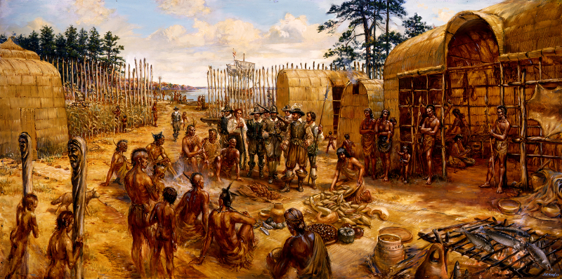
It all started out well…
The Powhatans initially traded with the Jamestown colonists, believing they could benefit from English technology while keeping control of the newcomers. Wahunsenacawh’s confederacy contained more than thirty groups that lived in an area that stretched from the James River, westward to the James River fall line, to the Potomac River.

Slide 15
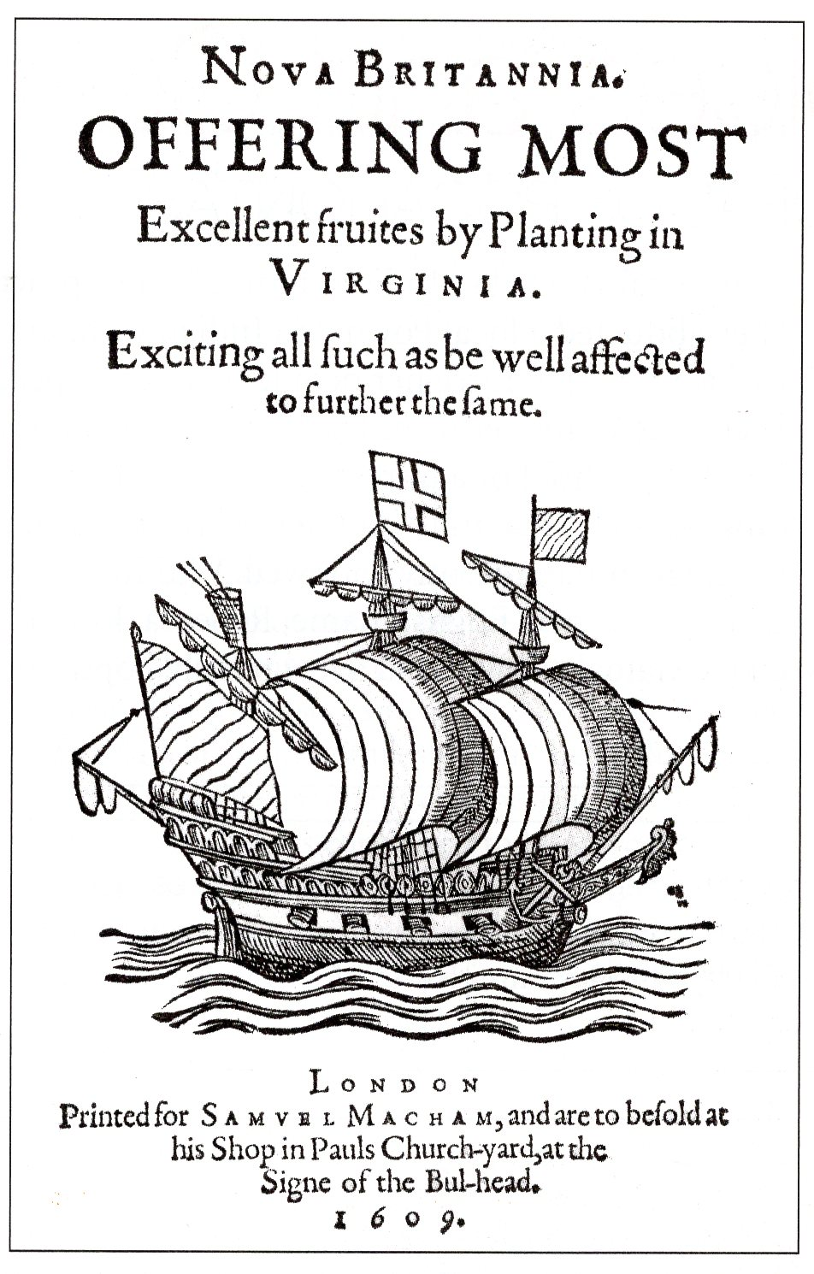
Wanted: Colonists for Virginia
Pamphlets like this one are typical of the sorts of propaganda that colonial backers used to lure settlers for their New World colonies like Jamestown. They tended to paint very rosy pictures of the sort of life that colonists lived there and the opportunities that were awaiting anyone who made the trip across the Atlantic.

Slide 16
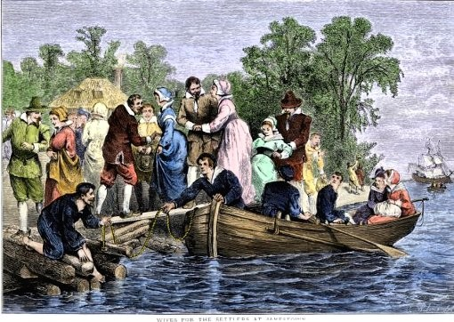
1608
The second re-supply expedition at Jamestown in the early autumn of 1608 included the first two women, Ann Burras and “Mistress Forrest.”

Slide 17
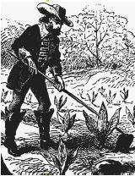
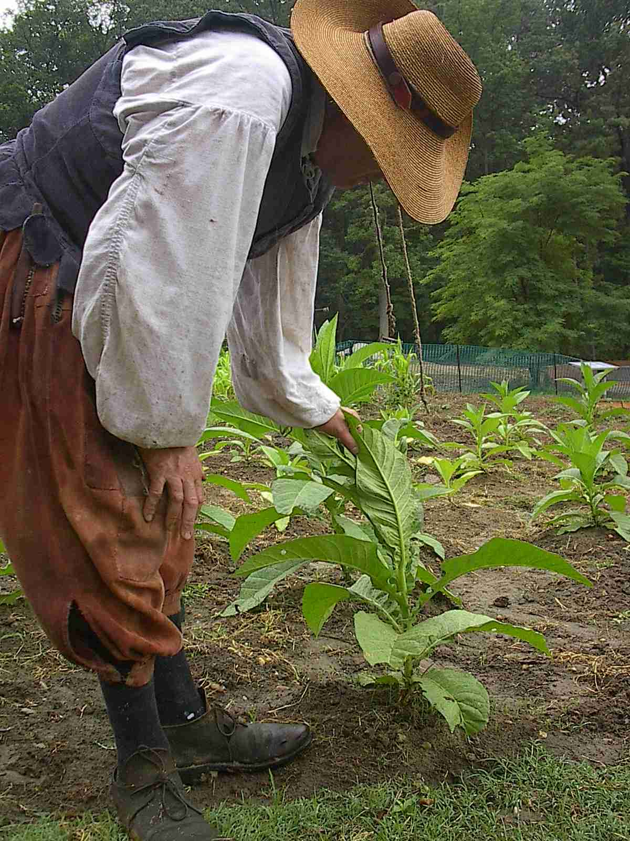
Tobacco, a hybrid strain grown by John Rofle, became Virginia’s cash crop and assured the colony’s survival.

Slide 18
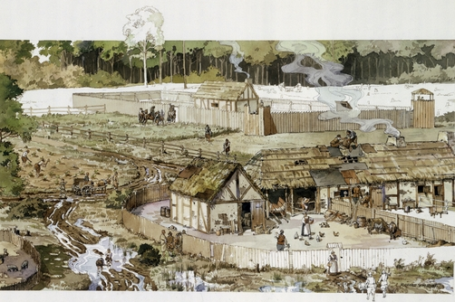
The success of tobacco cultivation in Virginia led to the establishment of a number of tobacco plantations and communities, including Wolstenholme Town, up and down the James River.

Slide 19
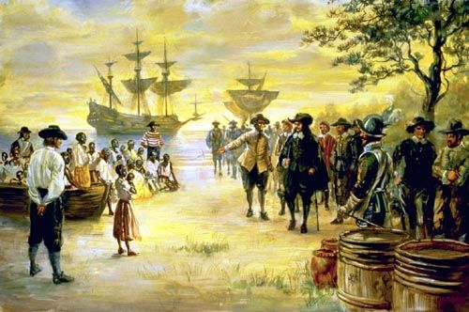
Africans arrive in Virginia…
1619
John Rolfe recorded in his journal: "About the latter end of August [1619], a Dutch man of Warr of the burden of a 160 tunes arrived at Point-Comfort, the Comandors name Capt. Jope, his Pilott for the West Indies one Mr Marmaduke an Englishman. He brought not any thing but 20. and odd Negroes, w[hich] the Governo[r] and Cape Merchant bought for victuall[s].”

Slide 20
Capt. John Smith & Pocahontas…
John Smith (1580-1631) and fellow Englishmen fell captive to a group of Powhatans, led by Opechancanough, brother or half-brother of the “Great Powhatan,” while exploring along the James River in December 1607.

Slide 21
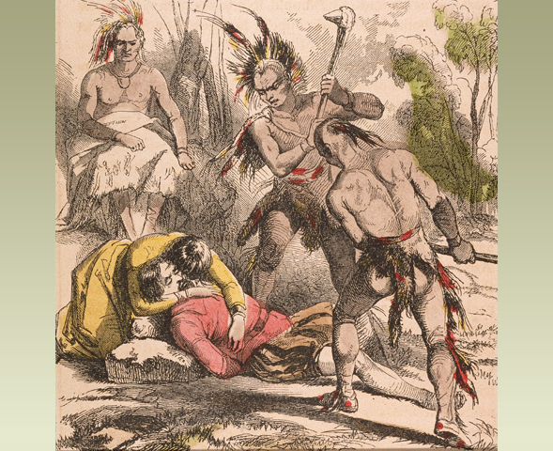
The legend…
Smith first mentioned the incident in a letter to Queen Anne in 1616, asking that the monarch treat Pocahontas with dignity. He also wrote about it in his Generall Historie of Virginia (1624), noting that Powhatan sentenced him to death, but “Pocahontas, the king’s dearest daughter,” saved him from having “his brains beaten out.”

Slide 22
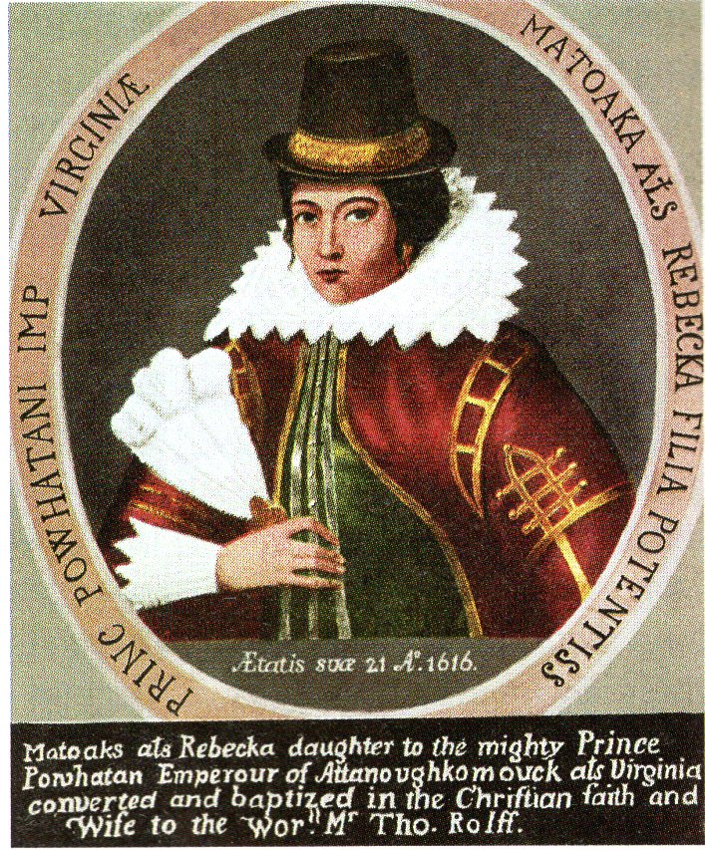
John Smith’s “Wild Child”…
Pocahontas was a nickname meaning the “naughty one” or, as we would say today, “wild child.” Her real name was Mataoka. Her birth date is unclear, with most accounts citing 1594 to 1597. Her anglicized name, given by the English, was Rebecca.

Slide 23
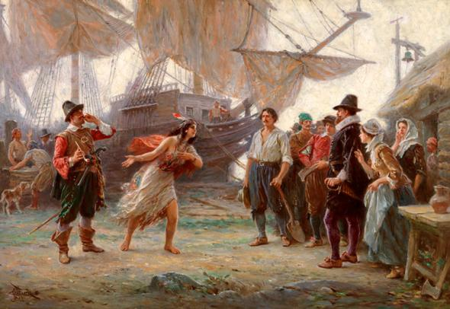
Holding the chief’s daughter…
1613
Pocahontas visited Jamestown in April 1613, and was taken hostage. The English hoped to use her as leverage to effect the release of whites taken hostage by the Powhatans.

Slide 24
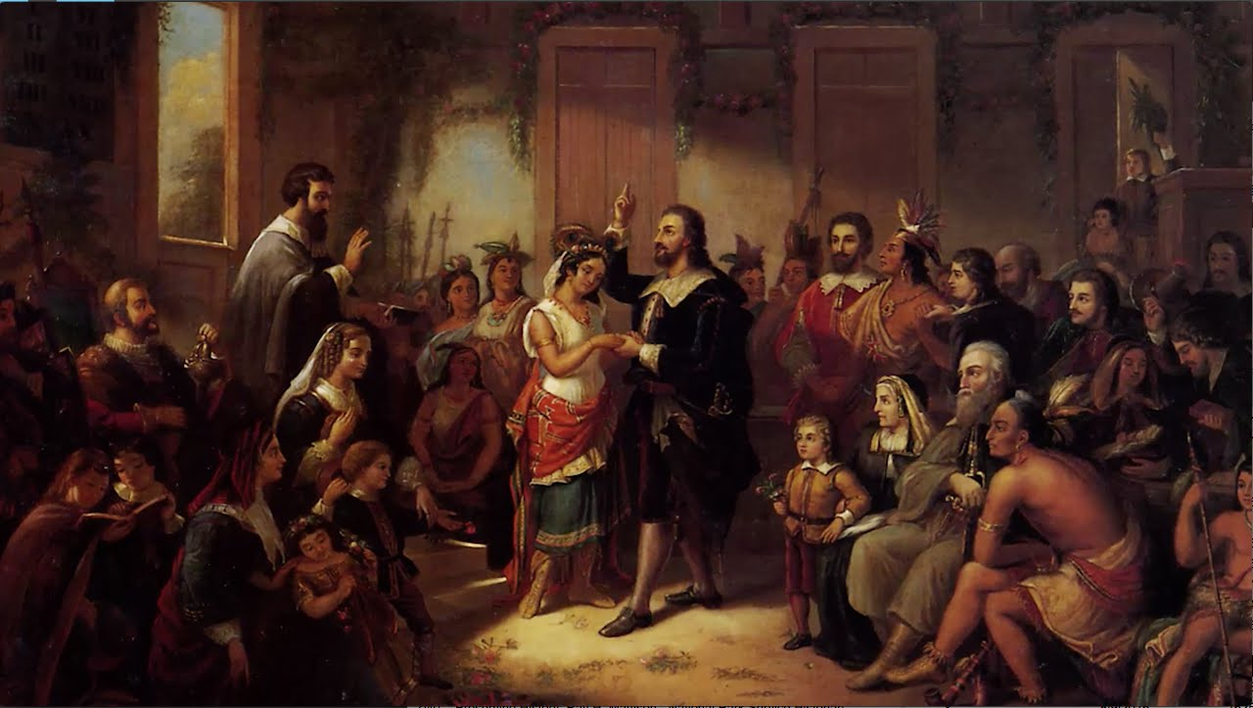
Pocahontas becomes Rebecca…
While in captivity Pocahontas learned English and became interested in the Anglican religion. She was baptized in Jamestown Church and took the name Rebecca. She also married planter John Rolfe, and voyaged overseas to meet the queen. She died there, never seeing home again.

Slide 25
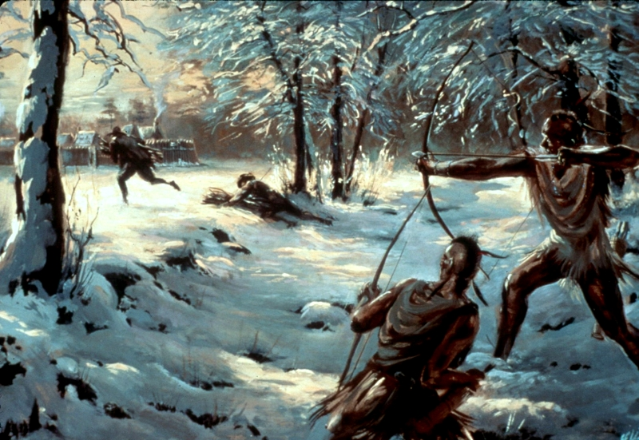
The natives go to war…
1609
Unable to completely isolate and control the English from trading and attempting to make alliances with other Native American groups, the Powhatans finally attempted to drive the Jamestown colonists out in the first Anglo-Powhatan War, 1609-1614.

Slide 26
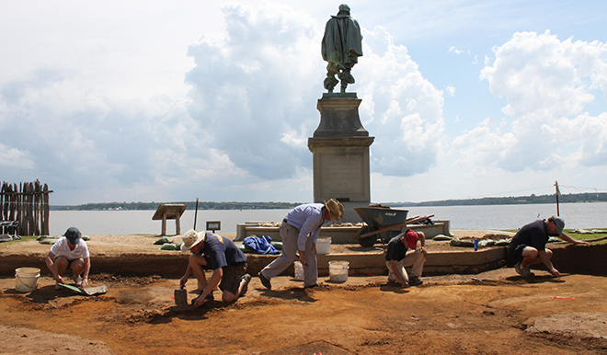
Dr. William Kelso conducts ongoing archaeological investigations of James Fort and Jamestown.
Digging up the past…

Slide 27
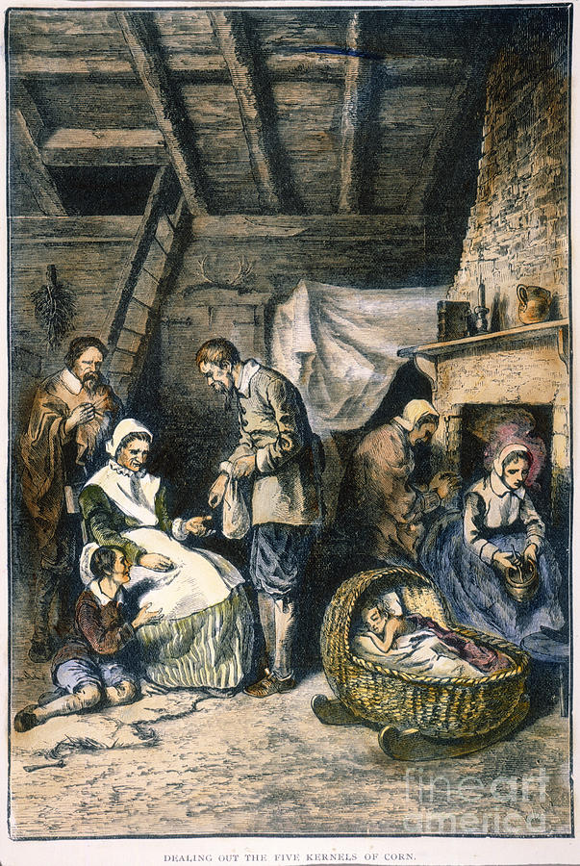
The “Starving Time”…
1609-10
• The winter of 1609-1610, in part because of the Powhatan War, poor crop yields, and tardy resupply ships, the Jamestown settlers faced a deadly crisis.
- 75% of the settlers would die of starvation or starvation-related diseases.
- Settlers were forced to eat snakes, vipers, rats, mice, musk turtles, cats, dogs, horses, and more to survive. Archaeological evidence has corroborated that settlers even devoured each other.

Slide 28
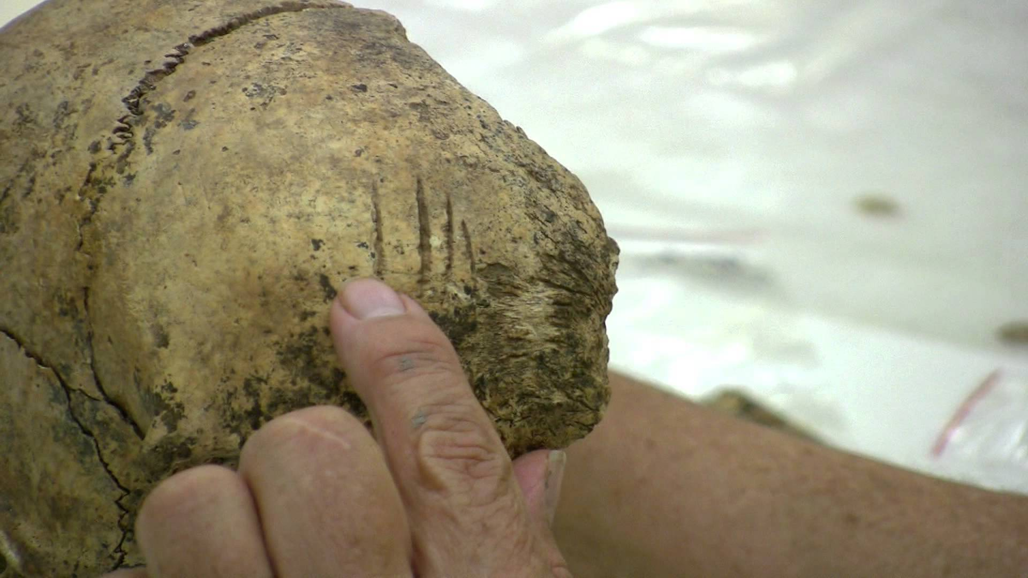
Cannibalism at Jamestown…
Knife cuts on the skull of this young girl prove that the colonists resorted to cannibalism during the “starving time” winter of 1609-1610.

Slide 29
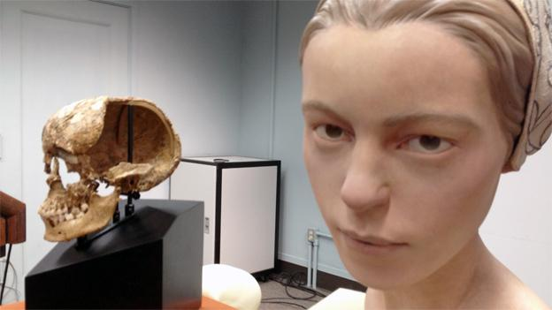
Meet Jane Doe…
Forensic anthropologists reconstructed the head of the young girl who was cannibalized at Jamestown.

Slide 30
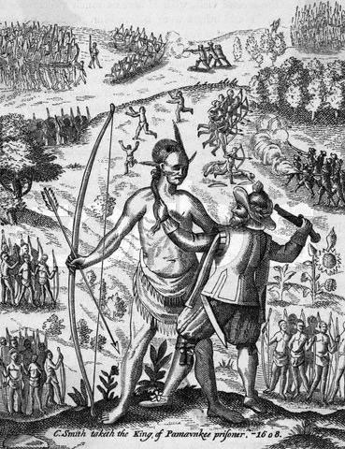
A second war with the Powhatans…
1618
Opechcanough assumed the leadership of the Powhatans upon the death of his brother, Wahunsenacawh, in 1618. He was determined to annihilate the English in Virginia.

Slide 31
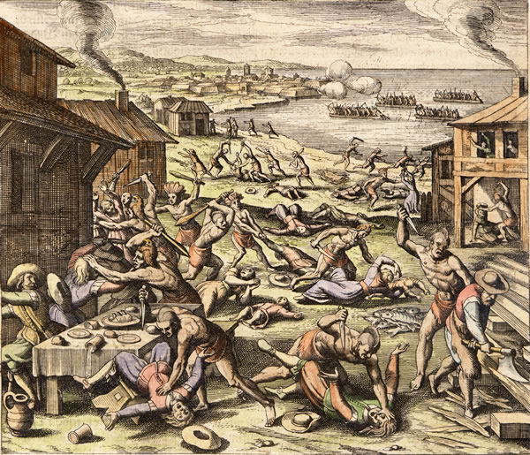
The Powhatans launched their attack on March 22, 1622, killing at least 350 settlers, including John Rolfe, approximately one-fourth of the colonists in Virginia.
The blood flows again…
1622

Slide 32
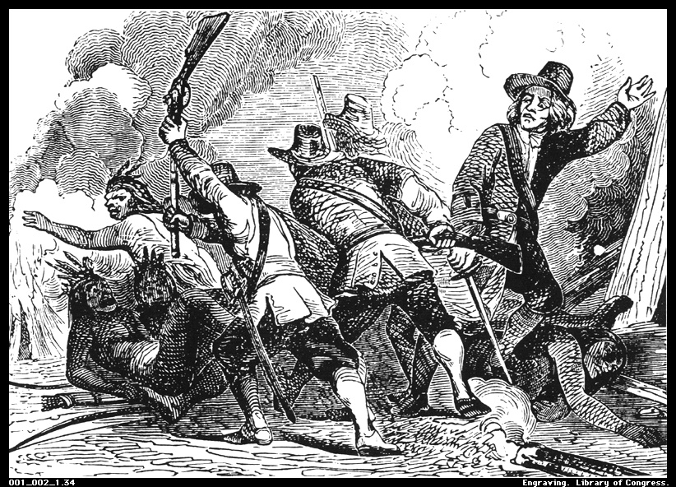
The English retaliate…
The English struck back mercilessly, decimating the Powhatans and other Native American groups. The 24,000 Algonquians who inhabited Virginia in 1607 were reduced to 2,000 by 1669. Opechancanough was captured and killed at Jamestown in 1646.

Slide 33
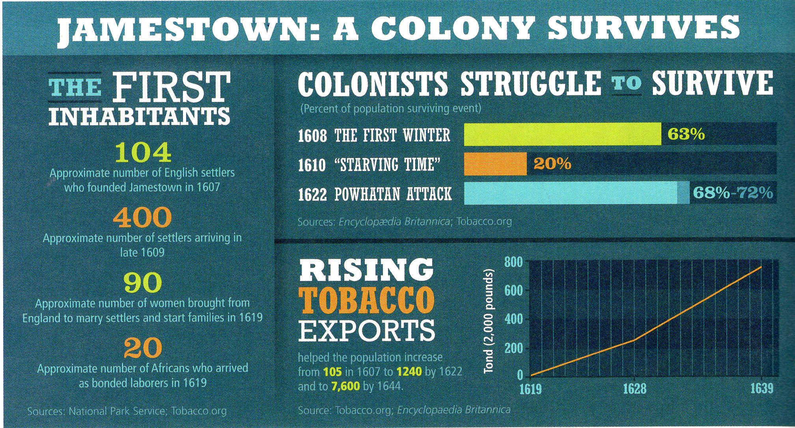

Slide 34
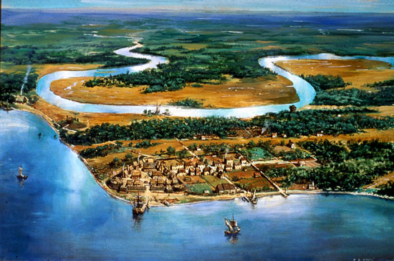
The Virginia Company is no more…
1624
In 1624, an English court dissolved the struggling Virginia Company, and Virginia became a royal colony.

