Slide 1
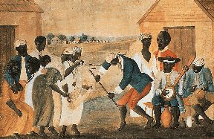
Black People in Colonial North America (1526-1763) [Part II]
The People of the Colonies, Servitude, Culture and Resistance

Slide 2
Reviewing the Primary Sources
John Marrant, “The Impact of the Great Awakening”

Slide 3
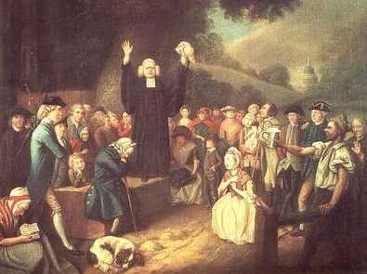
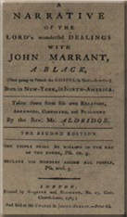
John Marrant, “The Impact of the Great Awakening”
John Marrant was a free black who gave an account of a conversion led by George Whitefield.
He was dared to blow his French horn in the room full of people, but was struck down by Whitefield with the phrase “Prepare to meet thy God O Israel.”
After becoming ill for several days following, a minister arrived and healed his ailments through prayer.
This was an example of the religious fervor and hysteria brought on by the Great Awakening and the Evangelical ministers, such as Whitefield.

Slide 4
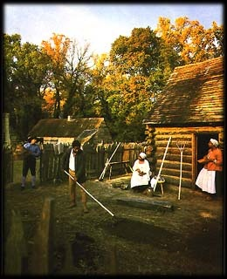
Slave Life In Early America
Slave housing in the 18th century was mainly in small log cabins with dirt floors, fireplaces, and maybe windows. The amount is was furnished varied, and depended on how long it had been occupied.
These primitive lodgings were used even after the abolition of slavery in 1865.
Slaves were clothed in breechcloths and women in skirts, and children went naked until puberty.
Later, men wore pants, shirts and hats. Women wore simple dresses and wore handkerchiefs on their heads. In the colder months, the masters would give them woolen and heavy cotton cloth as well as cheap leather shoes.
The slave diet consisted of corn, yams, salt pork, and salt beef and fish. They also caught their own fish and raised rabbits and chickens. They also supplemented their diet with vegetables grown in their own plots.

Slide 5
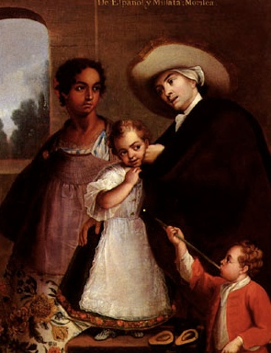
Miscegenation & Creolization
The early cultural and social interactions between Africans, white indentured servants and American Indians led many times to the mixing of races, or miscegenation.
Cultural exchanges between these various groups also led to a process known as creolization, which gave rise to the new generation of African Americans.
Any person of mixed race was seen as “black” by the British settlers.
Although the miscegenation that occurred was not as common as in the English sugar colonies, it was still extensive.
Colonial laws banned interracial marriages since they believed it would blur the lines between the inferior and superior race, particularly with white women and black men. The law did not target white men who exploited their slaves, this was seen only as immoral.

Slide 6
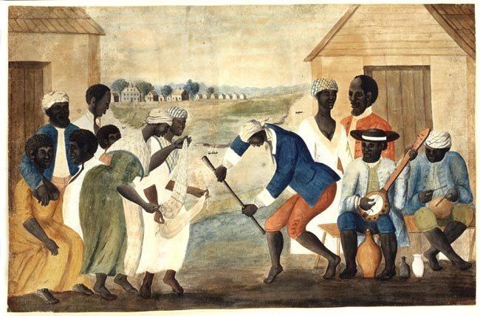
The Origins of African-American Culture
It was the extended family that served as the basis of African American culture. It was not until the decline of the slave trade that the ratio of men and women was balanced enough for this to occur though.
During the Middle Passage, Africans created “fictive kin relationships,” with shipmates to gain support. Once on plantations, slaves created kinship ties with cousins on other plantations and these ties would later be used to help slaves escape.
The West African naming process was retained as slaves picked the surname of their masters, much like a location indicator, and named their children after relatives.
Africans also preserved common names and ceremonies since Christianity was closed to Africans until the 18th century.
The “ring shout,” medicinal and burial practice were retained in the slave quarters into the 19th century.

Slide 7
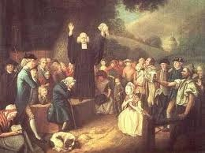
The Great Awakening
The turning point in African-American religion came with the religious movement known as the Great Awakening in the mid to late 18th century.
What two reasons had kept blacks from converting to Christianity before?
Masters feared converts would assume they gained a step toward freedom and equality.
Most blacks were not attracted to the religion and preferred their own.
African Americans, once converted, did link the salvation of the soul with the freedom of the body, and hoped for earthly equality.
The ability to have interracial churches impacted America, and some blacks would become ministers to these churches.
Although Christianity was used by slave masters as a form of control, many blacks formed their own churches and reinforced the idea of a collective identity.

Slide 8
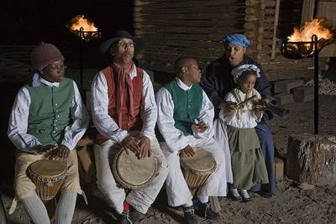
Language, Music, and Folk Literature
Creole languages and pidgins did not endure in the colonies, except in the low-country. But many word would remain in America English. Words such as gumbo, samba, voodoo, yam, and banjo still exist today.
Music may have been the most important aspect of African American culture and has influenced all forms of American popular music today. The strong beat, complex rhythms and improvisation used in their style was distinctive.
West African folk literature also survived in the colonies, and was mixed with Native American and European stories. Typical stories were of weaker animals outsmarting the stronger animals. These was a depiction of unjust rulers being tricked by the lowly.

Slide 9
Impact on Colonial Culture
Southern patterns of speech were greatly affected by African Americans since black women often raised white children.
Black cooks introduced BBQ pork, fried chicken, black-eyed peas, and collard/mustard greens to the southern diet.
The “gang system,” of work on plantations was a West African tradition.
Black builders also influenced architecture and styles/decorative techniques.

Slide 10
Slavery in the Regions
Northern colonies were impacted by colder climates and religious communities. This led to a less oppressive form of slavery, and lower numbers led to faster assimilation.
Spanish Florida and French Louisiana primarily used slaves for militia and as artisans. Also, the slaves were Roman Catholic and this led to social opportunities.
New Spain’s northern borderlands first blacks were part of exploratory groups. The majority of slaves were Indians, while blacks were employed as sailors, soldiers, artisans, traders, and cattle herders. Some even held high positions in Catholic missions.

Slide 11
Black Women in Colonial America
Black women in the Northern colonies differed greatly from the Southern colonies.
In the South, they primarily worked the fields. They would also raise the masters children, cook, and be house servants.
They were subject of abuse, particularly sexual abuse by their white masters.

Slide 12
Black Resistance & Rebellion
Resistance was a common response to the oppressive system of slavery.
Not doing tasks, sabotaging equipment, escape and rebellion were the various forms of resistance. It’s aim was not to destroy the slave system though.
Many who escaped would form “outlier” communities. Some joined Indians to form maroon communities like the Seminoles.
Revolts broke out in the British North American colonies in the 18th century. The most frightening was the Stono Rebellion near Charleston, NC in 1739.
Fear was rampant due to these rebellions and only served to tighten the control of master of slaves.

Slide 13
Conclusion
African American culture had a very strong impact on the future of American culture.
Slavery differed greatly in the various regions of North America.
Blacks resisted and revolted throughout the 17th and 18th centuries.

