Slide 1


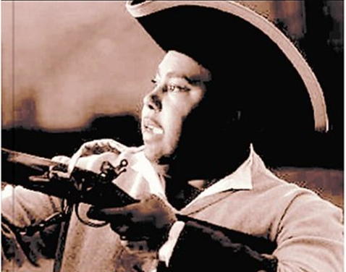
African Americans in NC during Revolutionary Times
To view this PDF as a projectable presentation, save the file, click “View” in the top menu bar of the file, and select “Full Screen Mode
To request an editable PPT version of this presentation, send a request to CarolinaK12@unc.edu

Slide 2

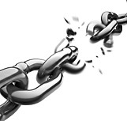
The Parallel Struggle for Freedom

Slide 3
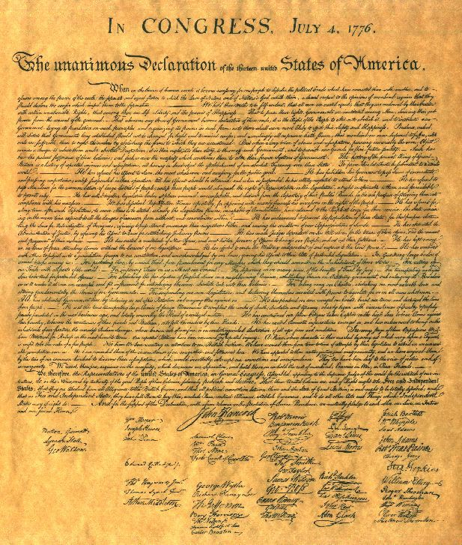
A Parallel Struggle for Freedom
qIn July of 1776, in his first version of the Declaration of Independence,Thomas Jefferson wrote a scathing indictment of King George for promoting slavery in the New
World.
qThe Declaration of Independence became the world’s manifesto for celebrating human rights and personal freedom.
q At the time he wrote it, Jefferson had over 200 slaves.

Slide 4
A Parallel Struggle for Freedom
q As colonists began to complain to England for “freedom and equality”, African Americans made the same plea for their own personal freedom and equality from slaveholders.
q By the 1760’s, as colonists began to wage a war of words and protests against the British, African Americans also began to write poems, letters, and petitions for the abolition of slavery.
q Prince Hall issued such a petition in 1777. Hall was enslaved but freed a month after the Boston Massacre. Hall made his living as a peddler, caterer and leather dresser, and was listed as a voter and a taxpayer. He owned a small house and leather workshop in Boston.
It is believed that Prince Hall may well have fought at Bunker Hill & he was active in the affairs of Boston's black community, using his position as "Worshipful Master" of the black Masons to speak out against slavery and the denial of black rights. For years, he protested the lack of schools for black children and finally established one in his own home.

Slide 5
A Parallel Struggle for Freedom
qA few white colonists noted the paradox between the Patriot’s demands for freedom and the widespread acceptance of slavery:
The slave trade is “the most shocking violation of the law of nature…What is a trifling three-penny duty on tea compared to the inestimable blessings of liberty to one captive?”
-James Otis

Slide 6
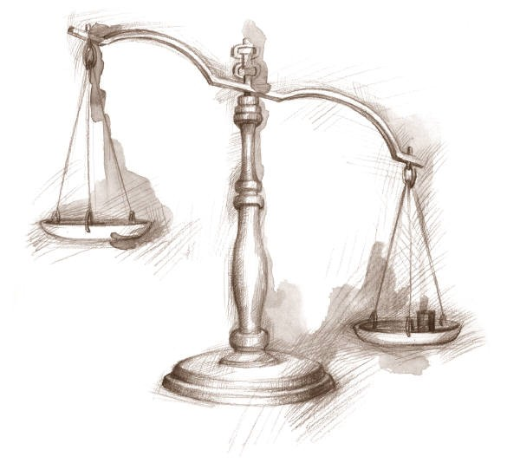
Black Choices During the War for Independence

Slide 7
Black Choices during the War for Independence
qAs the Revolutionary War swept through the colonies, colonists had to decide if they were Loyalists (loyal to the British) or Patriots (fighting for American independence).
qBlacks also had this decision to make, and usually fought for the side that promised them freedom.
qIn the struggle between the Patriots and the Loyalists, blacks refused to be pawns and took thoughtful steps to achieve their freedom.They fought for both sides during the American Revolution, provided significant manpower to the British and American armies, and initiated steps to better their lives.
qThose enslaved also considered choices such as rebellion or running away independently (not joining either army).
qAn estimated 100,000 blacks escaped or died during the revolutionary period.

Slide 8
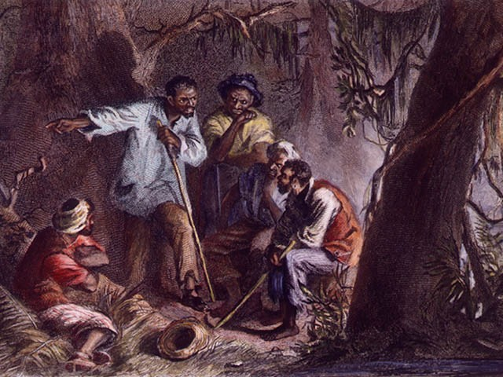
The Choice of Rebellion

Slide 9
Rebellion
qEven before the outbreak of the Revolutionary war, Revolutionary leaders (Patriots) recognized that the pending War would create a period of instability, thus heightened the risk of runaway slaves and slave revolts.
qLoyalists and Patriots also understood how vulnerable to military attack the South could be with its large slave population.
qSoutherners feared what would happen if the British convinced their slaves to turn on them, or if slaves took it upon themselves to take advantage of the unstable times and revolt.
“If American & Britain should come to hostile rupture I am afraid an Insurrection among the slaves may and will be promoted. In one of our Counties lately a few of those unhappy wretches met together and chose a leader who was to conduct them when English troops should arrive-which they foolishly thought would be very soon and that by revolting to them they should be rewarded with their freedom.”
James Madison, 1774

Slide 10
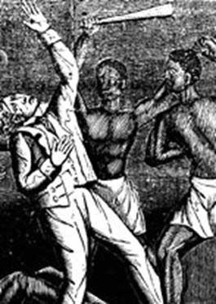
Rebellion
qJoseph Hewes, a North Carolina delegate to the Continental Congress, asserted in the summer of 1775 that the British intended “to let loose Indians on our Frontiers, and to raise the Negroes against us…”
qRoyal Governor Martin wrote in June 1775, “Although Virginia and Maryland are both very populous, the Whites are greatly outnumbered by the Negroes…a circumstance that would facilitate exceedingly the Reduction of those Colonies…”

Slide 11
Whites take protective steps against Revolutionary slave insurrection…
qIn 1774, the North Carolina Provincial Congress banned the importation of slaves “from any part of the world.” Carolinians did not want to take any risks in making a tense situation worse.
qBy the spring of 1775 rumors of a slave revolt spread through the south and terrified whites.
“We have to add to our misfortunes a report that the Negroes mean to take advantage of the times…” ~Robert Smith, Edenton, 1775
qJune, 1775-Slaves in Wilmington were disarmed to “keep the Negroes in order.”
qPatrols monitored the town each evening and a 9 PM curfew was instated.

Slide 12
Whites take protective steps against Revolutionary slave insurrection…
qIn July 1775, the Pitt County Safety Committee discovered a slave rebellion plot.
q The Committee ordered out patrollers to “shoot one or any number of Negroes who are armed and doth not willingly surrender their arms” & any party of four or more Negroes “who are off their Masters Plantations, and will not submit.”
qA posse of 100 men apprehended the “suspected heads” of the plot. They jailed more than 40 blacks, gave “80 lashes” to the 5 slaves thought to be the head of the insurrection, and cropped their ears.

Slide 13
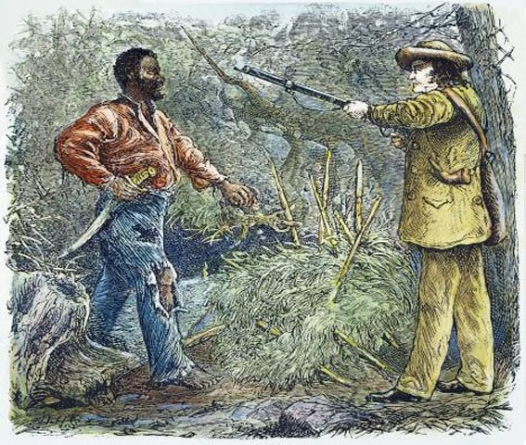
Whites take protective steps against Revolutionary slave insurrection…
qThe Committee of Safety in Wilmington ordered all citizens, including “apprentices or servants” to take an oath of allegiance to the Revolutionary regime.
qRumors spread of the British promising freedom to slaves should they murder their Masters, further inciting white fear.
qIn May 1776, the colony’s Fourth Provincial Congress appointed a committee “to enquire of ways and means …to prevent the
desertion of slaves.”
the

Slide 14
Good reason to be scared…
q In truth, the British Loyalists were aware of the benefit enslaved persons could bring to their side of the fight.
q Royal Governor Martin wrote in June 1775, “Although Virginia and Maryland are both very populous, the Whites are greatly outnumbered by the Negroes…a circumstance that would facilitate exceedingly the Reduction of those Colonies…”
q Blacks too stayed aware of the pending War, constantly weighing their options.
“The negroes have a wonderful art of communicating intelligence among themselves; it will run several hundreds of miles in a week or fortnight.” ~John Adams
q On Nov. 7, 1775 slaveholder’s worst fears came true. The royal Governor of Virginia, John Murray, earl of Dunmore, issued a statement promising freedom to any slave owned by a Patriot who would fight on the British side.

Slide 15
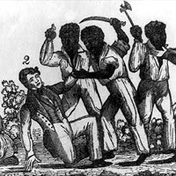
Good reason to be scared…
Throughout the war, slaves carefully monitored the progress of the
British army to calculate the appropriate moment to revolt or run.
For example, in 1780-1781, a slave revolt plot in Rowan County was revealed. Likely, slaves planned to take advantage of the fact that Rowan was directly in the path of Cornwallis’s march and would use the opportunity to fight for their own freedom against their masters.
It is said that the slaves chose a Sunday meeting – probably a religious gathering – as the occasion for collecting weapons and perfecting plans. Blacks were told to decide “which side” they were for – “the Americans or the British.” Usually, the British won Black allegiance.

Slide 16
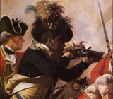
Choosing to Join the Loyalists

Slide 17
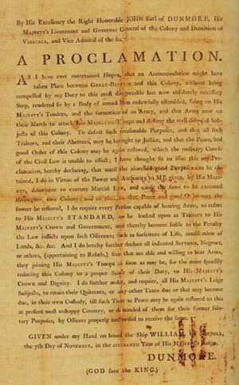
Black Loyalists
Within a month of Dunmore’s Proclamation 300 black men had joined the Loyalist fight in what was called “Lord Dunmore’s Ethiopian Regiment”.
Across the chest of each black was “Liberty to Slaves.”
In 1775-1776 Dunmore had approximately 2,000 men under his command, half of whom were black.
Beyond those fighting in the Regiment, the proclamation inspired thousands of runaways to follow the British through the war.

Slide 18
Black Loyalists
Blacks most frequently looked to the King’s troops as liberators.
Wherever the British marched, slaves followed.
Dunmore’s attempt to instigate a slave rebellion became official British policy.
In June 1779, Sir Henry Clinton, commander of the British Army in America issued his “Phillipsburgh Proclamation” in which he promised “to every Negro who shall desert the Rebel Standard full security to follow within these Lines, any Occupation which he shall think proper.”

Slide 19
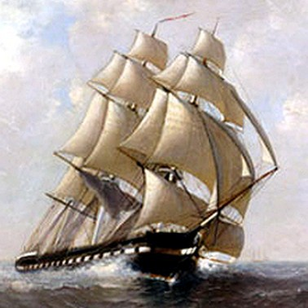
Black Loyalists –
“The Black Pioneers”
q The British fleet dropped anchor off Cape Fear in early 1776 leading many NC slaves to flee there. Free blacks also joined the British fight.
q British Captain George Martin, under command of Sir Henry Clinton, organized these blacks into the “Black Pioneers.”
q The Black Pioneers served as support troops to relieve British soldiers of harsh duties such as building fortifications, cooking, laundering clothes, etc.
q The Black Pioneers also provided valuable intelligence to the British regarding the roads and waterways of North Carolina, South Carolina, and Georgia.
q Blacks also joined the British for service in their Royal Navy.

Slide 20
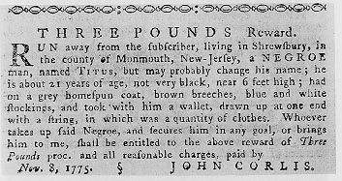
Black Loyalists
q Colonel Tye
Colonel Tye was the best known of the Loyalist black soldiers. Having escaped slavery from NJ, he lead the “Black Brigade” throughout NY and NJ. He commanded up to 800 men who fought the Patriots and freed slaves along the way.
Tye was shot in the wrist by a Patriot captain in 1780 and died from an infection.
q Boston King
King was an escaped slave who also joined the Loyalists, later writing about his experiences.
When King reached a local camp of Black Loyalists, it was infected with small pox. King became ill, and was removed from the camp to heal or die on his own.
King survived and then joined General Cornwallis’ Loyalist troops at Camden, SC, where he served as a messenger and orderly.
King was captured by a group of white Loyalists who tried to sell him back
into slavery. King again escaped, and again rejoined the army.

Slide 21
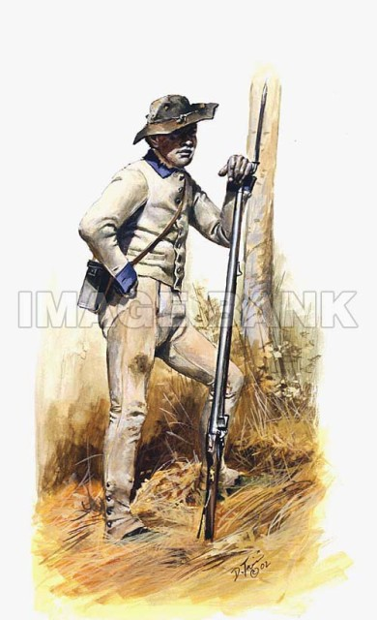
Choosing to Join the Patriots

Slide 22
Black Patriots
q Some blacks initially joined the Patriot cause, fighting side by side whites in the Battles of Lexington, Concord, and Bunker Hill.
q However, in the early stages of the Revolution, the Continental Congress made the decision to not allow slaves or free blacks to enlist.
q After Dunmore’s Proclamation, General George Washington moved to enlist free blacks to forestall their joining the British side.
q While Congress officially reversed its decision, southern states resisted efforts to arm blacks. Even still, many free blacks joined the army or navy in Virginia, North Carolina, Massachusetts, Delaware, & Connecticut.
q By 1778, the Continental Army had dwindled to 18,000 due to disease and desertion. This forced Washington to approve plans for a Black Regiment of free blacks and slaves.
q Hundreds of blacks bore arms for the Patriots, served as laborers, spies, guides, musicians, servants, weapons crafters, and more.

Slide 23
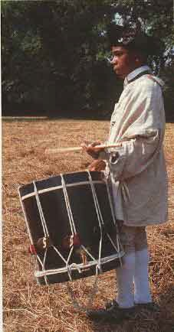
Black Patriots
qMany North Carolina blacks served in the Patriot army and naval forces:
The slave James of Perquimans County made “several Voyages from This State & Virginia” during the war. He was twice captured by the British and escaped. The county court granted him his freedom after his service.
John Chavis is North Carolina’s most famous black soldier.
  Chavis was originally an indentured servant for a lawyer in Halifax County.
  He enlisted in the Fifth Virginia Regiment in 1778 and served for 3 years.
  He later gained fame as a Presbyterian minister and teacher of both black and white students in Raleigh.
  In 1832 he wrote Senator Willie P. Mangum: “Tell them that if I am Black I am free born American & a revolutionary soldier & therefore out not to be thrown entirely out of the scale of notice.”

Slide 24
Black Patriots
qIn some cases slaves served as substitutes for their masters on the promise that their freedom would be granted for doing so.
Ned Griffen, “a man of mixed blood,” was to win his freedom by substituting for his master,William Kitchen, a soldier in the North Carolina Brigade.
Ned did so, but upon his discharge, Kitchen took back his offer and sold Ned to a slave owner in Edgecombe County!
Griffen petitioned the General Assembly in 1784 and was granted his freedom “forever hereafter.”
qThe Revolutionary regime also impressed (forced) blacks into service.
Under the North Carolina Confiscation Acts of 1777 & 1779 Patriots seized the property of loyalists, including their slaves. Such seizures were said to occur with “violence and barbarity.”

Slide 25
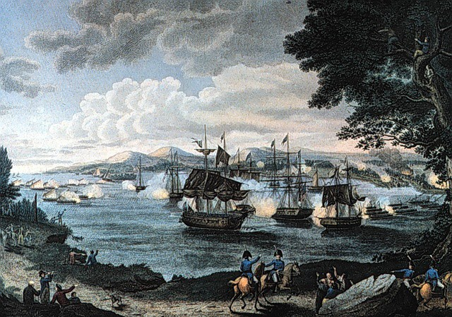
After the War

Slide 26
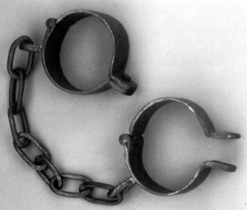
After the War
q Cornwallis' surrender atYorktown in October 1781 created a puzzle regarding what to now do with the thousands of black refugees.
q Slaveholders, Revolutionary governors, and American military leaders tried to block the mass evacuation of blacks from America. Slave owners wanted instead to round up the surviving blacks for re- enslavement.
q In November 1782, Britain and America signed a provisional treaty granting the former colonies their independence. As the British prepared for their final evacuation, the Americans demanded the return of American property, including runaway slaves.
q Sir Guy Carleton, the acting commander of British forces, refused to abandon black Loyalists to their fate as slaves. Regardless of the peace treaty that prohibited the British from carrying away “any Negroes or other Property,” Carleton demanded the slaves be freed.

Slide 27
After the War
qA list of blacks claiming to have fought for the Crown was created & known as “The Book of Negroes.”
qPerhaps as many as 5,000 blacks, including Boston King, sailed
with the British from Charles Town late in 1782, their
destinations ranging from Jamaica to London. While some were slaves accompanying Loyalists, others were escaping.
“This dreadful rumor [reenslavement] filled us with inexpressible
anguish and terror, especially when we saw our old masters, coming form
Virginia, North Carolina, and other parts, and seizing upon their slaves in the streets…” ~Boston King
qThe British agreed to settle some 1,200 black loyalists in Sierra
Leone, grant them their own government and equality as British subjects, and abolish slavery.

Slide 28
After the War
qNot all British promises to slaves were kept however.
q“Many thousands of African Americans who aided the British lost their freedom anyway. Many of them ended up in slavery in the Caribbean. Others, when they attempted to leave with the British, in places like Charleston and Savannah, were prevented. And there are incredible letters written by southerners of Africans after the siege of Charleston, swimming out to boats, and the British hacking away at their arms with cutlasses to keep them from following them. So it was a very tragic situation. And of the many thousands of Africans who left the plantations, not many of them actually got their freedom.” ~MargaretWashington, historian

Slide 29
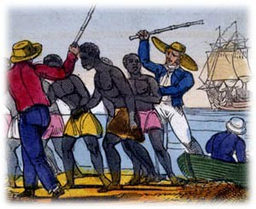
After the War
qThe disruptions to the Revolutionary War left the social arrangements of southern life in serious disarray.
qHundreds of bondsmen had been lost to the British. Other slaves had earned their freedom or attempted to pass as free.
qAfter the war, Georgia and South Carolina slaveholders tried to sue for recovery of their slaves. North Carolina legislature passed laws affirming the titles of slaves then held by North Carolinians.
qTo rebuild their plantations, slaveholders moved quickly to import more slaves.
qThe slave population of North Carolina thus grew faster during the 1790s than in any other decade.

Slide 30
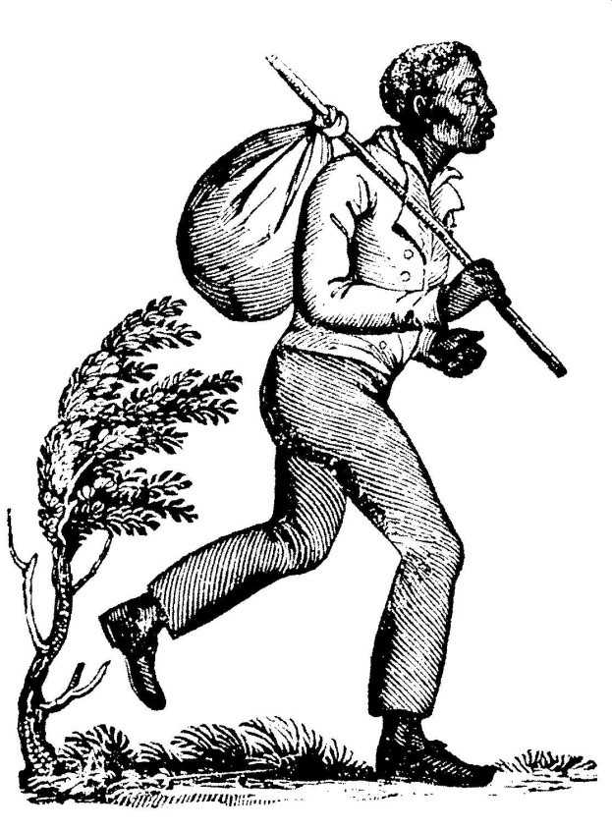
Continuing the Struggle for Freedom

Slide 31
Continuing the Struggle for Freedom
q Postwar adjustment to black agitation for freedom proved almost as unsettling and dangerous as the war.
q There was much confusion in North Carolina and the remainder of the new states. Hundreds of bondsmen had been lost to the British, others had earned their freedom, and still others had run away and were attempting to pass as free.
q In 1776, North Carolina Quakers declared that “keeping our fellow men in Bondage is inconsistent with the Law of righteousness” and further stated “that all the members…who hold slaves be…advised to Cleanse their Hands o them as soon as they possibly can.”
q The General Assembly reacted in 1777 by enacting a law “to prevent domestic Insurrections” and denounced the “evil and pernicious Practice of freeing Slaves in this State, [which] ought at this alarming and Critical time to be guarded against…”
q Thus, freeing a slave became illegal. County sheriffs were instructed to capture and auction any slave who had been freed.

Slide 32
Continuing the Struggle for Freedom
qQuakers introduced numerous bills in the General Assembly calling for an end to the slave trade and the emancipation of all slaves.
qIn a 1797 congressional debate, Nathaniel Macon declared the Quakers to be warmakers rather than peacemakers “as they were continually endeavoring in the Southern States to stir up insurrections amongst the negroes.”
qSouthern whites typically blamed “religious dissenters” and “outside agitators” for slave discontent, rather than acknowledge that the slaves themselves may be the agents of their own liberation.

Slide 33
Continuing the Struggle for Freedom
qThe years between the Revolution and 1800 proved turbulent as restless blacks tested the boundaries of their enslavement.
qAs word of slave revolts occurring in the West Indies reach America, southerners again feared revolts in America.
qIn 1795 Wilmington authorities reported being plagued by a “number of runaway Negroes, who in the daytime secrete themselves in the swamps and woods” and at night looted neighboring plantations. Posses eventually killed five of the runaways, including their leader, “The General of the Swamps”
qBertie County authorities arrested 3 black men and charged them with heading a conspiracy of 150 slaves; they were each given 39 lashes and cropped ears.

Slide 34
Continuing the Struggle for Freedom
q The most striking example of how the Revolution’s ideology inspired black hopes of freedom was the case of Quillo, a Granville County slave.
q In April, 1794, Quillo was accused of plotting an insurrection.
q According to testifying slaves, Quillo planned to create a government among rebelling slaves, holding an “election” for justices of the peace and sheriffs to ensure justice among the newly created community, and join with other slave rebels from Person County.
q Even though Quillo was caught, his attempt to create a shadow government of elected representatives, talk of “equal justice,” and goal to revolt and establish a free colony of blacks further worried slaveholders.

Slide 35
Sources
http://www.pbs.org/wgbh/aia/part1/narrative.html
http://www.rootsweb.com/~ncrevwar/africanamericanar.htm
 http://www.jstor.org/view/00218723/di982526/98p0003z/0
http://www.historycooperative.org/journals/wm/62.2/pybus.html
A History of African Americans in North Carolina
The Black Experience in Revolutionary North Carolina

