Slide 1
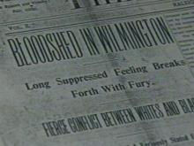
Power Point to accompany the Consortium’s lesson
“The Wilmington Race Riot
of 1898”

Slide 2
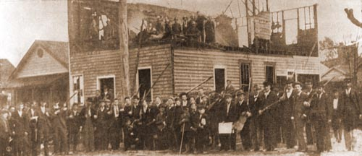

Slide 3
Wilmington Population

Slide 4

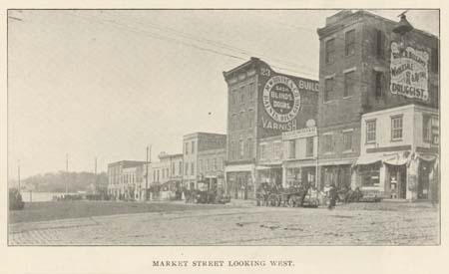
1890s Wilmington
Wilmington was a bustling, thriving port town for all levels of society and races during the last quarter of the 19th century.
It was the state’s largest city, with a majority of the population (two-thirds) being African American.

Slide 5
1890s Wilmington
Wilmington was the center of African American political and economic success, and was considered a symbol of “black hope.”
  A strong religious community supported charitable organizations, and promoted educational improvements for African Americans.
  African Americans from a wide range of backgrounds were able to manage their own businesses and buy homes throughout the city.
  African American entrepreneurs owned barbershops, restaurants, tailor shops, and drug stores. The city boasted numerous black professionals such as attorneys, and African Americans held positions as firemen and policemen.
  In greater numbers than in many other North Carolina towns, Wilmington’s African Americans participated in politics and held municipal and political positions.
  The black male literacy rate was higher than that of whites.
  Overall, the African American and white races existed peacefully, though separately.

Slide 6
1890s Politics
Democratic Party - 1800s
Originally the party supporting slave holding
Developed into a coalition of wealthy, working class, and rural white members
Controlled NC state and local governments from 1876-1894
Coalition weakened after 1880s
Republican Party – 1800s
Originally emerged as the anti-slavery party in the mid-1850s, though was not officially organized in NC until 1867
Platform consisted of free enterprise, racial toleration, and political equality for African Americans
Populist Party
Known as the “People’s Party”
Founded by working class and rural whites (predominately farmers) who left the Democrats

Slide 7
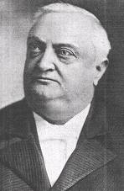
1890s Politics – The Fusion Movement
As an economic depression in the late 1800s deepened, white Populists joined forces with Black Republicans forming the “Fusion Coalition” (1894-1896).
By “fusing” their voters, they hoped to defeat the Democrats and regain control of local and statewide politics.
Fusionists championed local self-government, free public education, and electoral reforms that would give black men the same voting rights as whites.
“Fusion” was successful and the party won every NC statewide office in the 1894 and 1896 elections
Daniel Russell was elected to serve as the first Republican
Governor of North Carolina since Reconstruction.
Russell enacted changes to Wilmington and New Bern city
charters in order to reverse laws established by Democrats to
assure their control of those cities.
“Fusionists” allowed more African-American participation in government, although only a handful of positions were held by African Americans.
Governor Daniel Russell (Republican)

Slide 8
Preparing for the Election of 1898
White Democrats had lost control of state politics, but promised to avenge their defeat at the hands of white Populists and African American Republicans in the election of 1898.
The 1898 election was seen by Democrats as pivotal to regaining control of the state legislature; their plan was to reverse laws created by Fusionists.
Daniel Schenck, a Democratic party leader, warned, “It will be the meanest, vilest, dirtiest campaign since 1876” (the election that ended reconstruction in the South).
Furnifold Simmons developed a strong Democratic Party machine to use propaganda, printed media, speechmaking and intimidation to achieve victory at all costs.
The 1898 campaign was the most organized Democratic Party election campaign up until that time.

Slide 9
Preparing for the Election of 1898
Throughout the period leading up to Election Day on November 8, 1898, Wilmington became the center of the Democratic Party’s white supremacy campaign and the city was on edge.
Wilmington Democrats determined that a campaign of racism would appeal to Wilmington citizens; causing doubt and fear in white residents with white supremacist propaganda would ultimately shatter the fragile alliance between whites and blacks in the Fusion Coalition.
Intimidation of white Republicans and African Americans throughout the campaign was channeled through groups such as the White Government Union and Red Shirt brigades, both developed and engineered by Simmons.
Men of all races expected violence on Election Day as Red Shirts sought to intimidate voters and African Americans vowed to exercise their right to vote regardless of consequence.

Slide 10
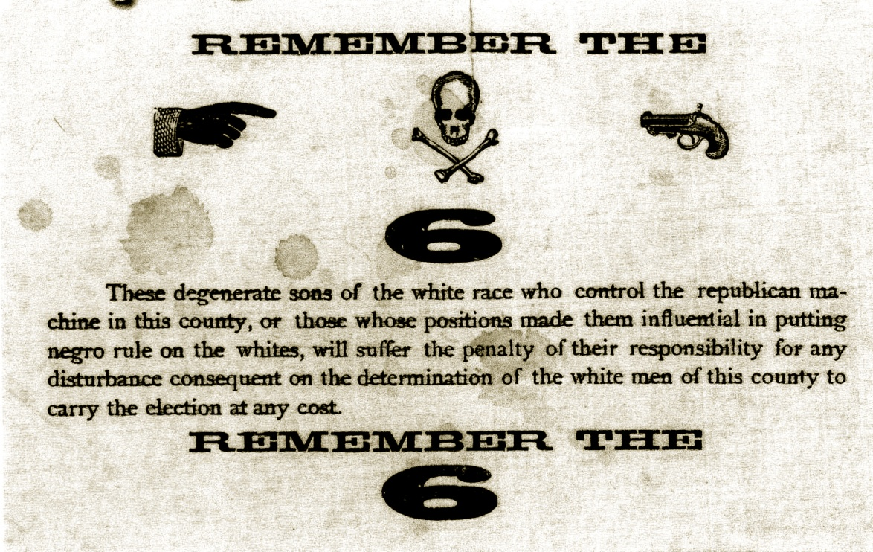
Preparing for the Election of 1898-
Propaganda & Intimidation

Slide 11
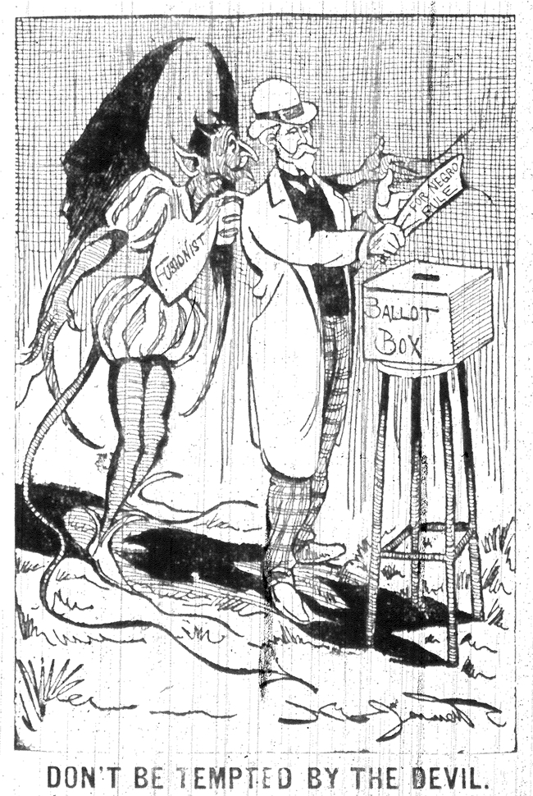
“You are Anglo-Saxons.
You are armed and prepared, and you will do your duty. Be ready at a moment’s notice.
Go to the polls tomorrow, and if you find the Negro out voting, tell him to leave the polls and if he refuses kill, shoot him down in his tracks.
We shall win tomorrow if we have to do it with guns”
Alfred Moore Waddell November 7, 1898

Slide 12
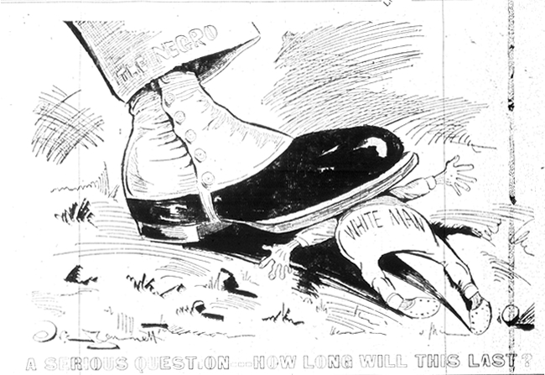
“You are Anglo-Saxons.
You are armed and prepared, and you will do your duty. Be ready at a moment’s notice.
Go to the polls tomorrow, and if you find the Negro out voting, tell him to leave the polls and if he refuses kill, shoot him down in his tracks.
We shall win tomorrow if we have to do it with guns”
Alfred Moore Waddell November 7, 1898

Slide 13
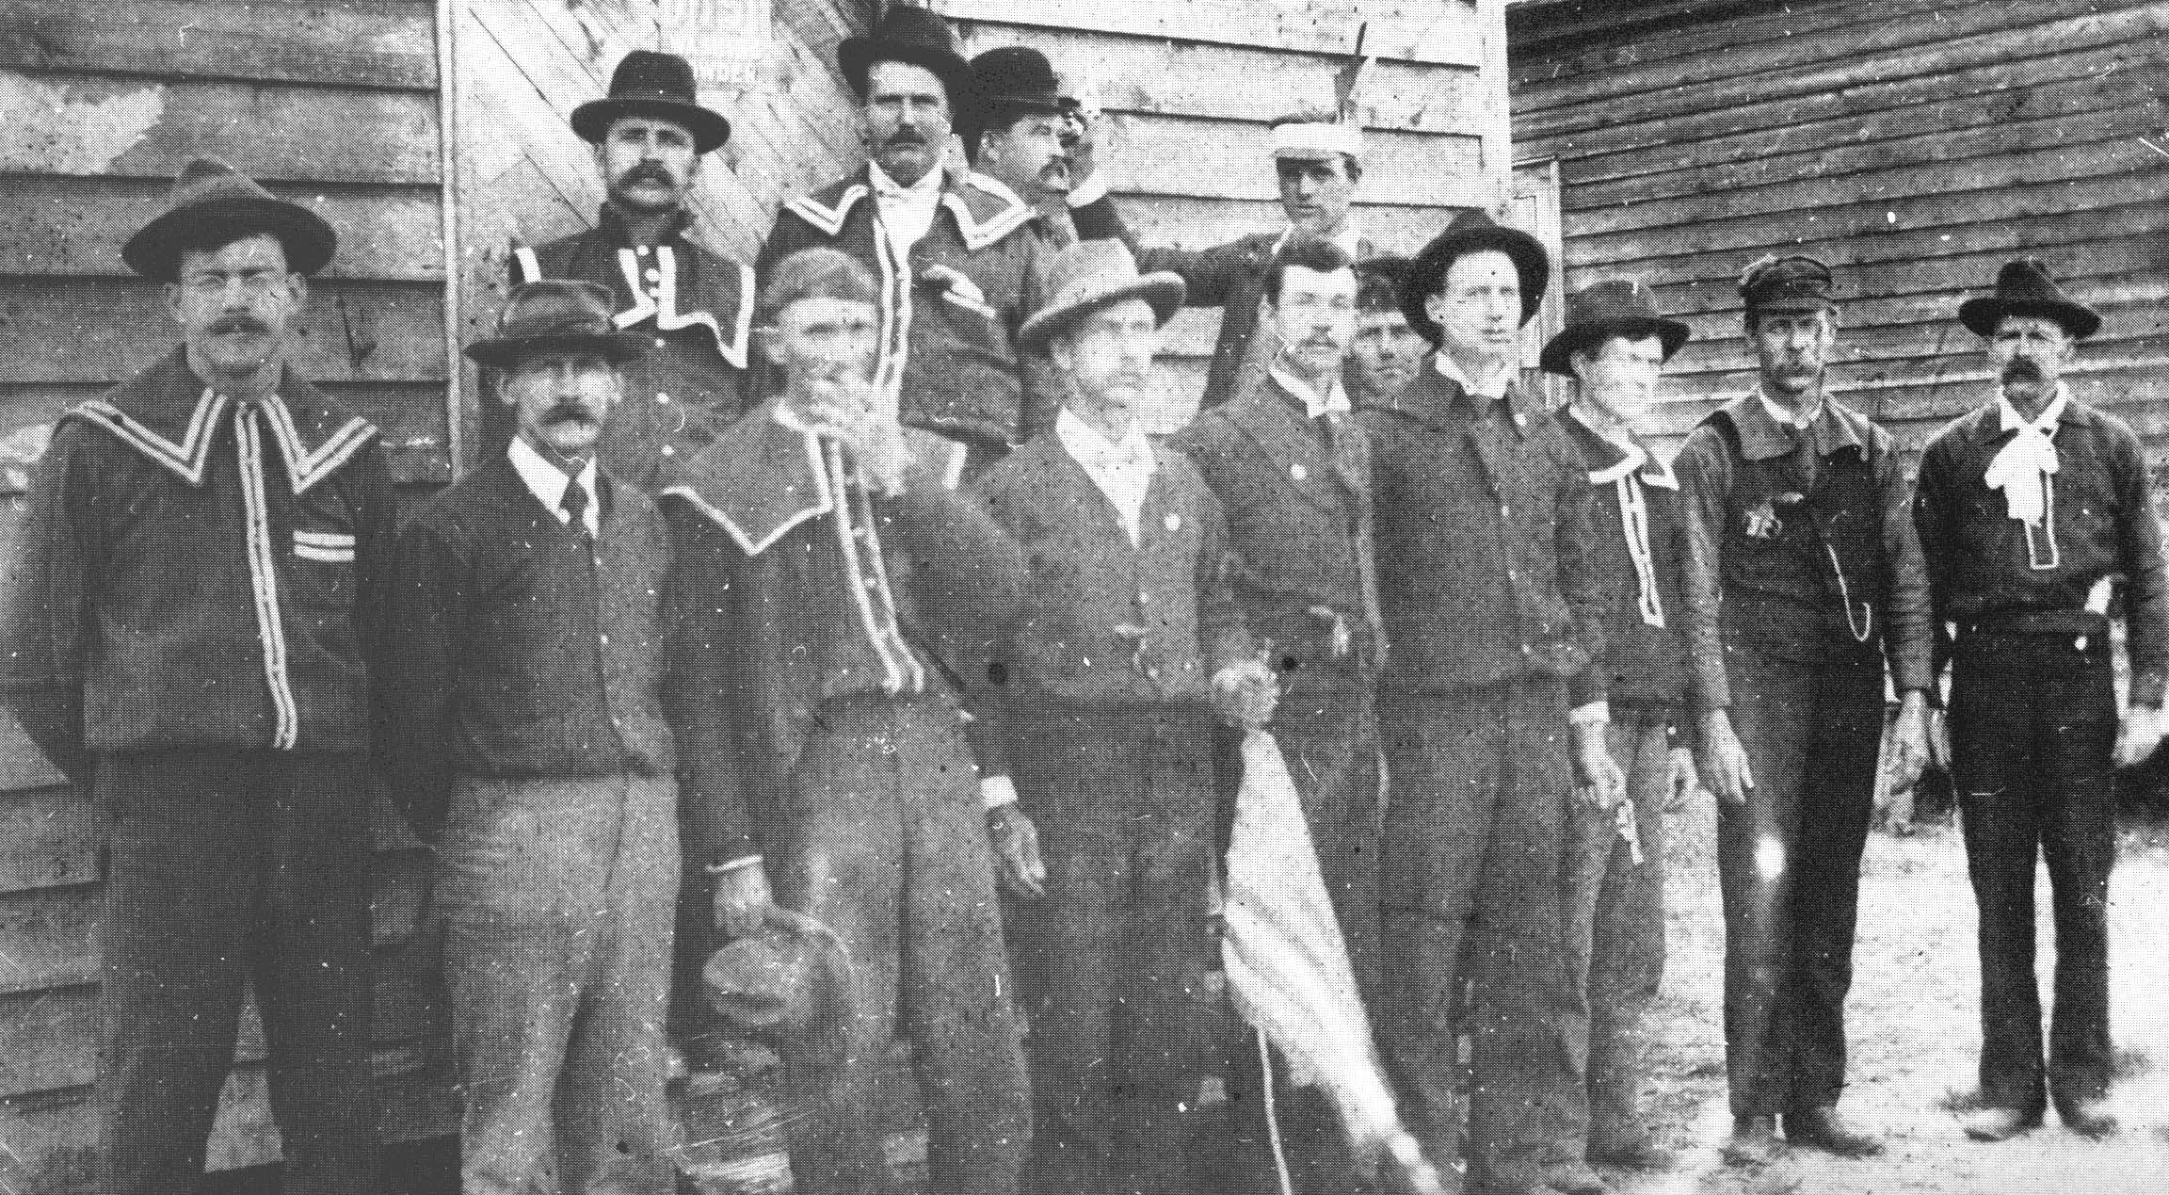
Propaganda & Intimidation
Red Shirts from Laurinburg, NC
The Red Shirts were a group of Democratic Party members whose goal was to intimidate black citizens from voting in the 1898 election.
They held racist rallies, disrupted African-American church services and Republican meetings, and patrolled streets with guns before the election to frighten blacks away from the polls.
The first Red Shirts appeared in North Carolina in the fall of 1898 and, by Election Day, the organization boasted membership in several eastern counties, including a strong contingent in New Hanover County.

Slide 14
Propaganda & Intimidation
Newspaper stories and public speeches of white supremacists were used to create fear of blacks in white citizens.
White society was cautioned of “black beasts” who would harm white women and white society if not stopped.
With the support of the racist editor of the News and Observer at the time, Josephus Daniels, who continually supported and printed such propaganda, white citizens were convinced that black equality would mean the end of society as they knew it.
One of the most glaring examples of such tension was illustrated in the burning of Wilmington’s only black-owned newspaper, The Wilmington Record, whose editor was likewise threatened and ran out of town.

Slide 15
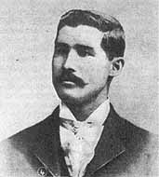
Propaganda & Intimidation –
Alex Manly & The Wilmington Record
Alex Manly was the mulatto editor of the Wilmington Record – the city’s only African American newspaper at the time.
In August, 1898, Manly printed an editorial in response to a speech given by a Georgia woman that the white-owned paper in Wilmington had published.
In the racist speech, the woman supported the lynching of African American males who had “inappropriate” relationships with white women. She cautioned white men to better protect white women from such behavior.
Manly was rightfully infuriated by the speech and its publishing. In his editorial response, he argued that white males were just as guilty for having relationships with African American females. He also noted that white women might enjoy the company of black men as much as white men enjoy that of black women.
The exchange of words between the two newspapers increased racial tensions.
Alfred Moore Waddell used these tensions to the Democratic Party’s advantage, calling for the removal of the Republicans and Populists in power in Wilmington at the time.
He proposed in a speech that the white citizens, if necessary, should “choke the Cape Fear with carcasses.”
Manly was run out of the city after the Nov. election, avoiding certain lynching. He lived the remainder of his life in northern states.
Alex Manly

Slide 16
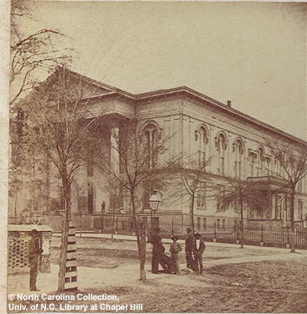
Propaganda & Intimidation
The day before the election, Democrats held a rally at Thalian Hall in which Alfred Moore Waddell gave a speech that demonstrated his party’s determination:
“You are Anglo-Saxons.
You are armed and prepared, and you will do your duty. Be ready at a moment’s notice.
Go to the polls tomorrow, and if you find the Negro out voting, tell him to leave the polls and if he refuses kill- shoot him down in his tracks.
We shall win tomorrow if we have to do it with guns”
Alfred Moore Waddell November 7, 1898

Slide 17
Election Day – Nov. 8, 1898
African American voters, brave in the face of hatred and intimidation, still turned out in large numbers for the election of 1898.
However, the number of Republicans and Populists was less than the extremely large number of Democratic voters who turned out.
The Democrats who favored white supremacy were also reported to “stuff” the ballot boxes.
  In Wilmington, ballot counting was undisturbed in most city precincts, but one polling place in the African American community was “stormed” by whites who stuffed the ballot boxes when lights were extinguished.
Democrats won most of their contests across the state with large majorities.
Overall, the day was peaceful with only a few incidents of unrest.

Slide 18
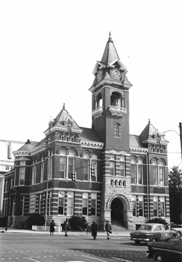
November 9, 1898
Emboldened by their Election Day victory, whites met at the Wilmington courthouse the day after the election to place a series of demands on the African American community.
Primary among the demands in the document known as the “White Declaration of Independence” was the instant removal from the city of editor Alex Manly and his newspaper.
Additional resolutions called for the resignation of the Mayor and Chief of Police of Wilmington. Waddell was named to lead the effort of a Committee of 25 to effect the document’s demands.
“We, the undersigned citizens of the City of Wilmington and County of New Hanover, do hereby declare that we will no longer be ruled, and will never again be ruled by men of African origin.”
Preamble to the White Declaration of Independence.

Slide 19
“Committee of Colored Citizens”
A Committee of Colored Citizens was called to hear the demands of the whites on the evening of November 9th.
Waddell presided at the meeting which was attended by approximately 25 whites and 32 African Americans. The African Americans in attendance were selected because they were seen by whites as the political, social and religious leaders who could effect change.
In response, the African American leaders drafted a response written in humble language that indicated they would do what they could to avoid conflict, even though they had no real ability to affect the wider community.
We the colored citizens to whom was referred the matter of expulsion from this community of the person and press of A.L. Manly beg most respectfully to say that we are in no wise responsible for nor in anyway condone the obnoxious article that called forth your actions. Neither are we authorized to act for him in this matter; but in the interest of peace, we will most willingly use our influence to have your wishes carried out.” Response of the Committee of Colored Citizens

Slide 20
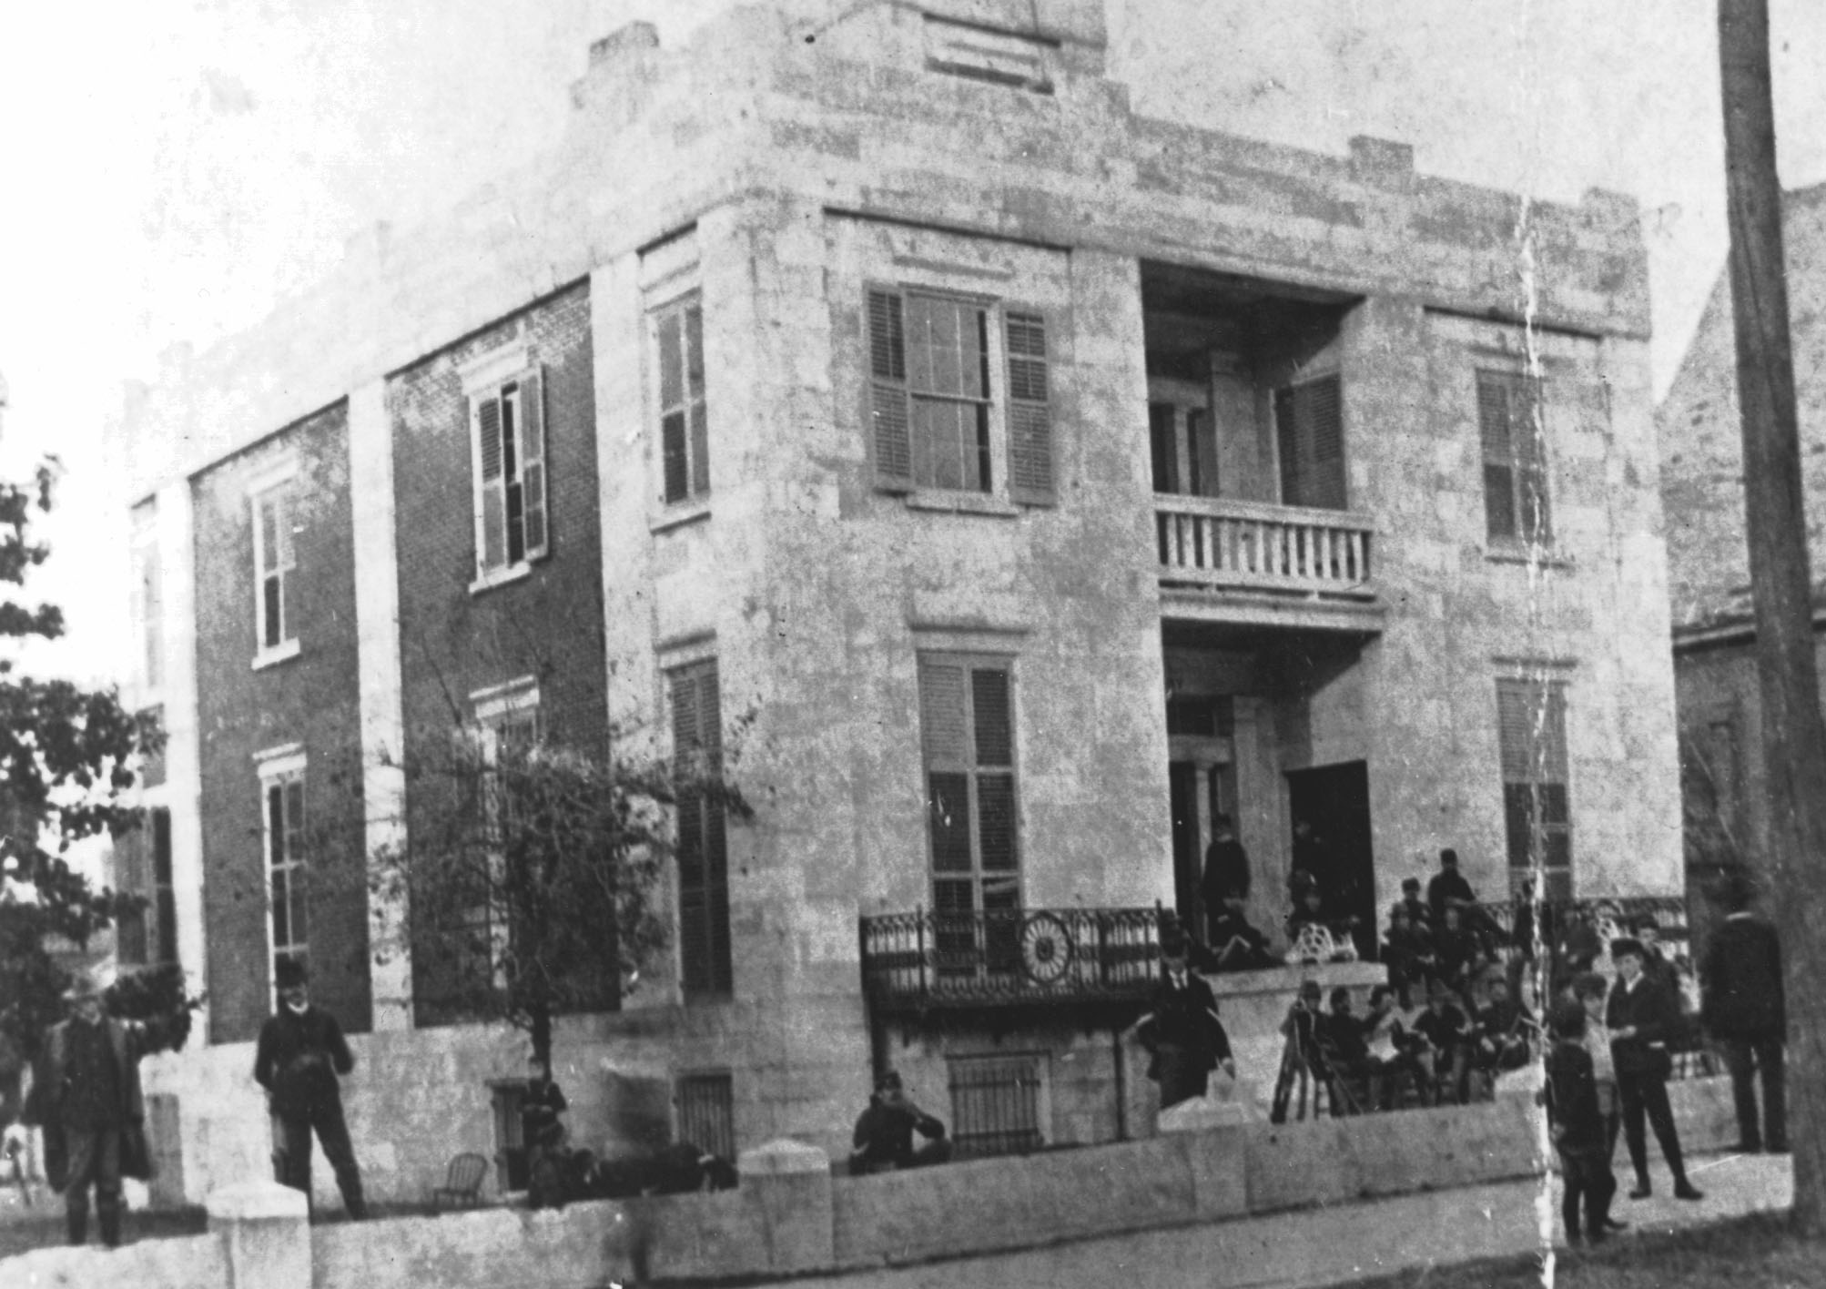
The Riot Begins –
White Supremacist Violence Erupts
Two days after the election, on Nov. 10th, 1989, violence erupted into what is now known as the “Wilmington Race Riot.”
Waddell had scheduled a meeting at the Light
Infantry Armory, where approximately 500 white
Men assembled; at the meeting it was anticipated
that he would receive the response from the Committee of Colored Citizens.
However, their response had not arrived and Waddell made use of the crowd’s furor -- leading a procession of men to Manly’s press building.
Waddell lead them to the Daily Record office several blocks away. The crowd following Waddell grew to about 2,000 people as they moved across town.
The men proceeded to break into the building, destroy the printing press and burn the building to the ground.
The whites demanded that Manly and his newspaper cease to publish and that Manly be banned from the community.

Slide 21
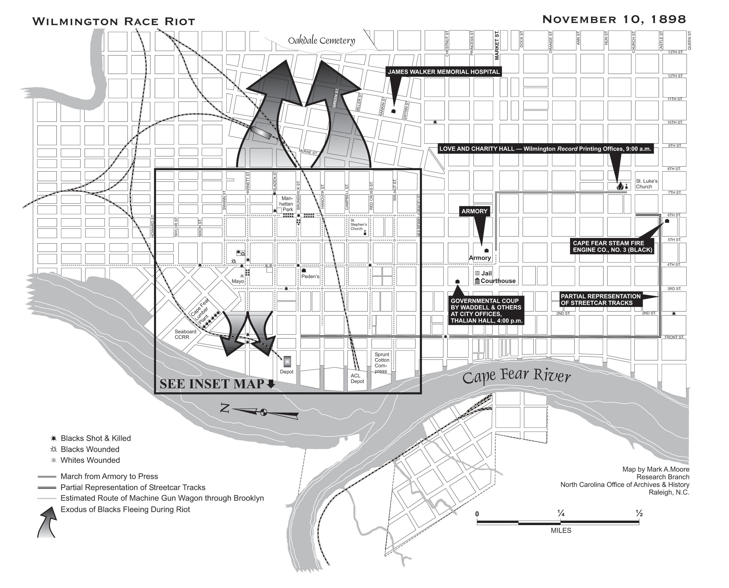

Slide 22
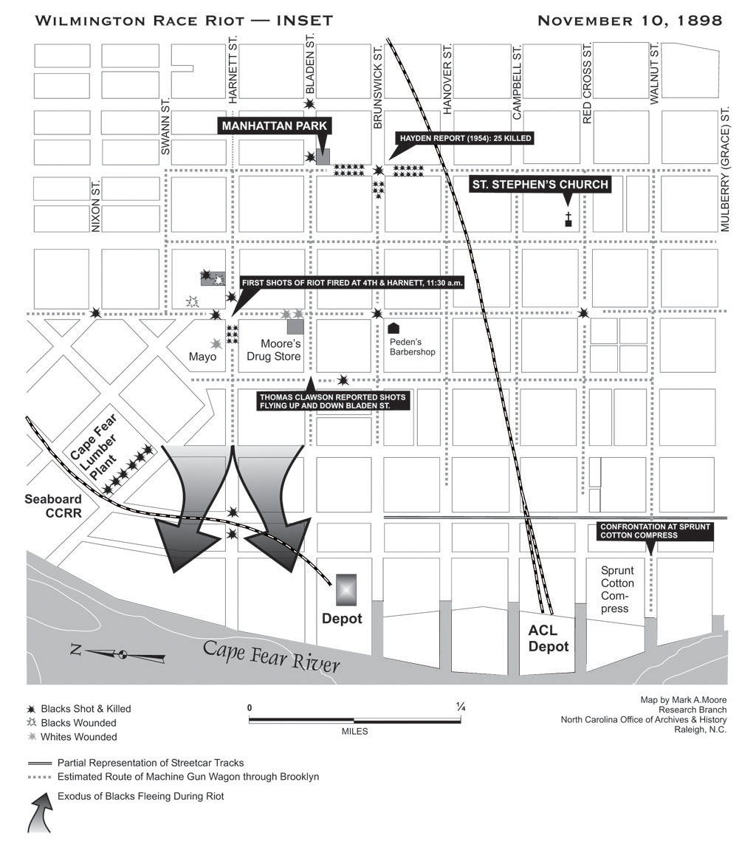

Slide 23
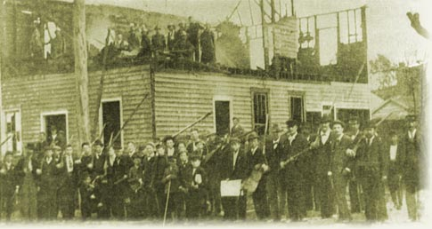
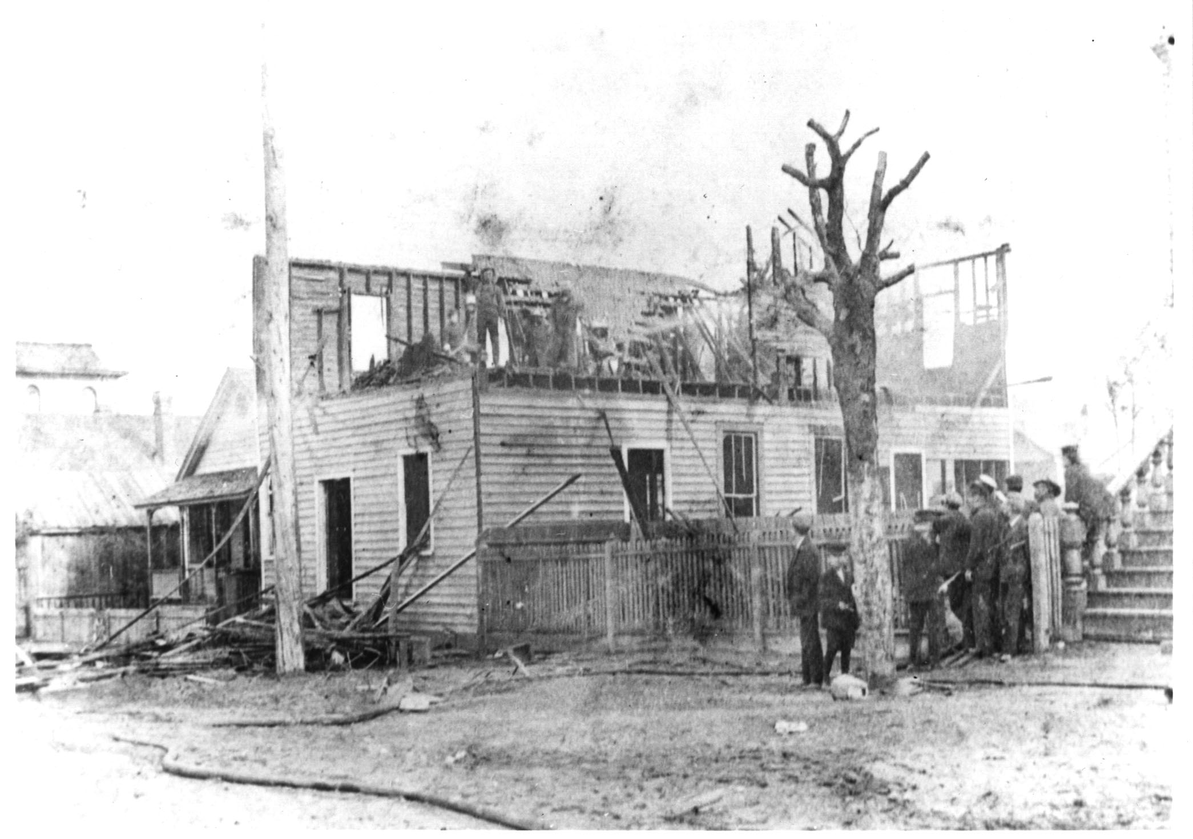
After the press was destroyed, a group of men paused for a news photographer in front of the building.

Slide 24
The Wilmington Race Riot –
Violence Spreads
African Americans armed themselves for protection and whites began to hunt and gun them down throughout the city.
The mob of whites included clergymen, lawyers, bankers, and merchants who all believed that they were asserting their rights as citizens.
According to one native Wilmington historian, “Hell broke loose” at around 11:00 AM near the intersection of Fourth and Harnett Streets in the predominantly African American Brooklyn community.
Shots were fired at this intersection and several black men lay dead or wounded.
After the first shots were fired, a “running firefight” erupted in the streets with armed men of both races rushing to the scene.
A white resident of Brooklyn, Will Mayo, was wounded near the site of the first gunshots and many whites sought to avenge his suffering by shooting at any black man that crossed their path.
Included as targets were a good number of African American men who were heading to their homes on lunch break or seeking to ensure the safety of loved ones.
Before officials could suppress the violence, shots continued to ring out around Manhattan Park, deep in the African American community, killing several more African Americans.

Slide 25
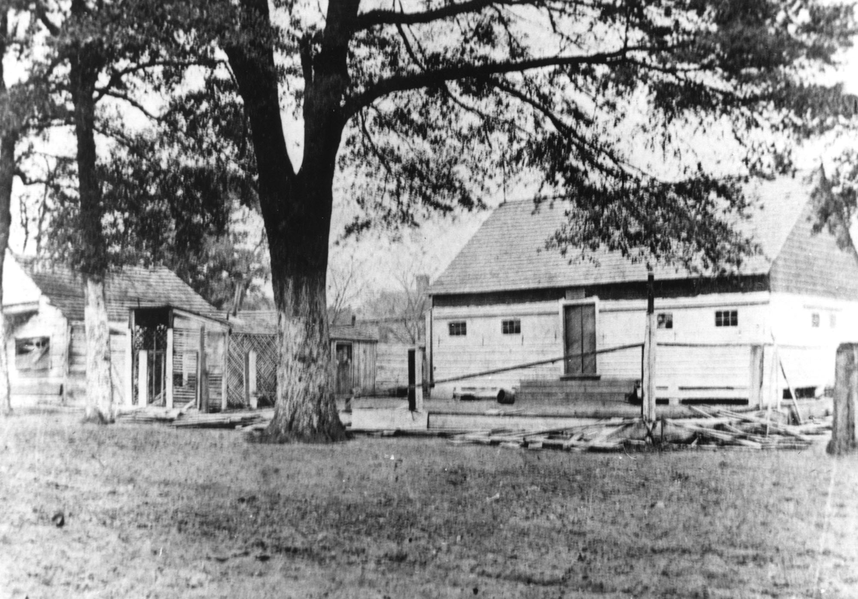
The Wilmington Race Riot
A fence had surrounded Manhattan Park but was “mowed down” by rifle fire. The day after the riot, one white participant wrote his future wife that he wanted to take her to see the “battle-scarred” trees and buildings in Brooklyn when she returned to the city.

Slide 26
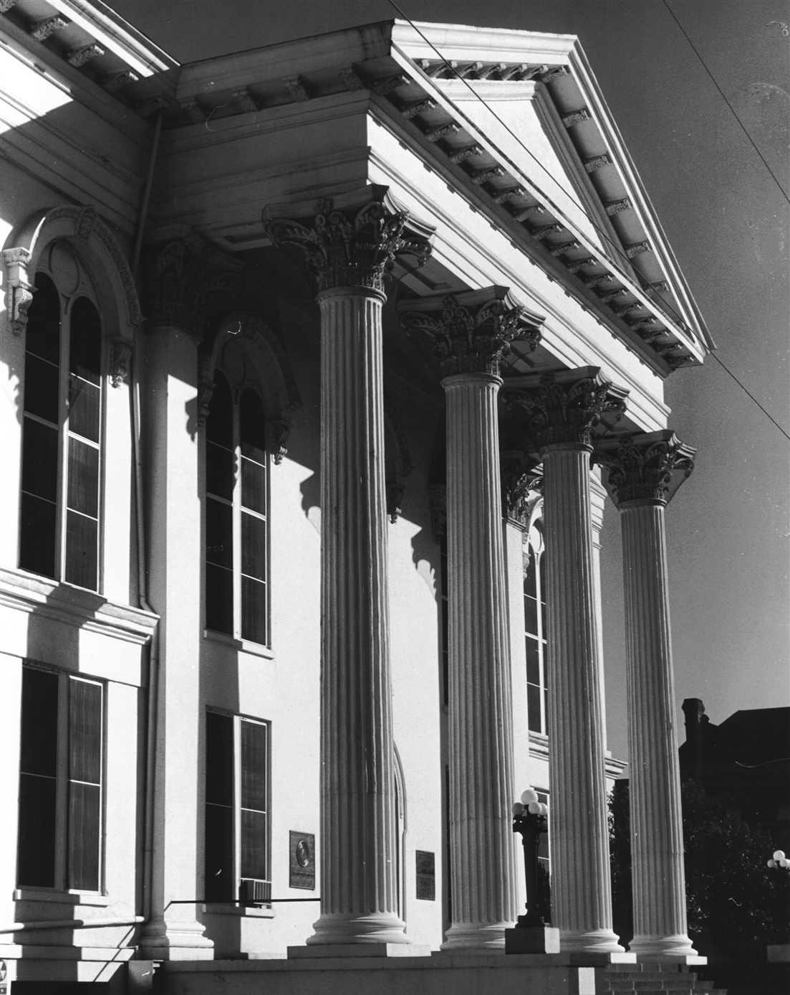
The Wilmington Race Riots -
A Coup d’etat of Wilmington’s Local Government
As gunshots echoed through the city, Waddell and other leaders sought the resignations of Wilmington’s Mayor and Board of Aldermen at 4:00 in the afternoon.
Waddell was then “elected” mayor by a new Board of Aldermen who had been hand-picked by leading Democrats to run the city.
Not long after Waddell assumed power, all black employees or appointed officers were fired or replaced.

Slide 27
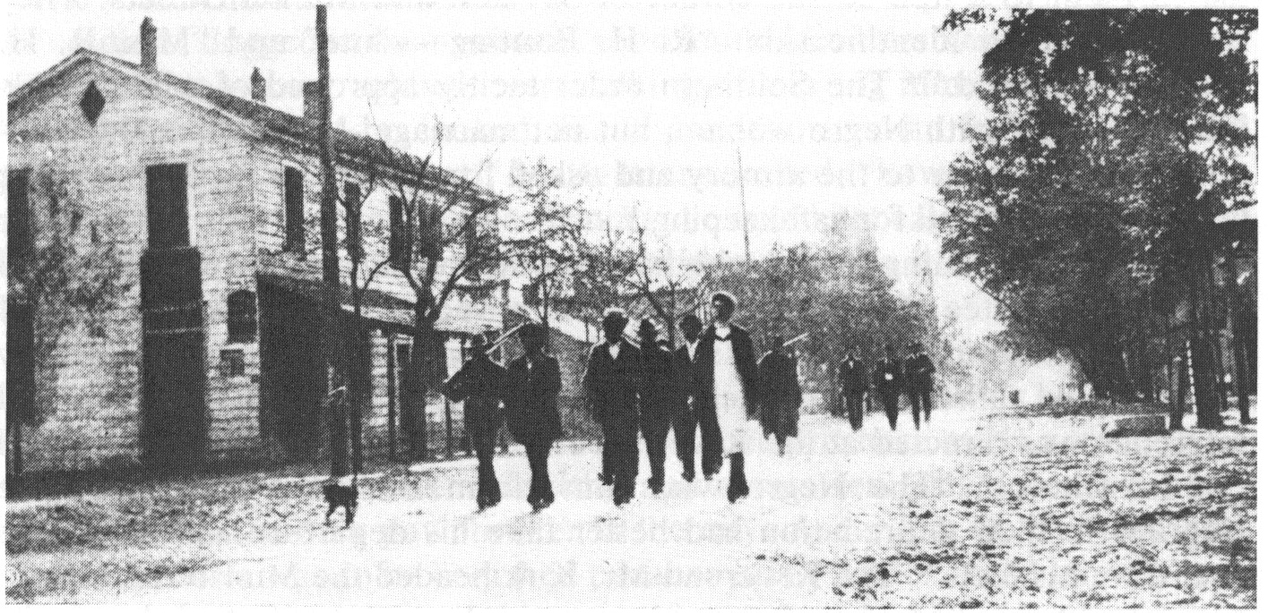
The Wilmington Race Riot –
Banishment Campaign
Another facet of the riot was that prominent African Americans – economic, religious and political leaders – were arrested, jailed, and banished from the city.
These men were promised that returning to their homes, families and businesses would result in physical harm and/or death.
Banished African American leaders being marched to the train station on November 11th.

Slide 28
Wilmington’s Changing Population

Slide 29
The Wilmington Race Riots –
In Summary, A Four-Pronged Plan
Steal the election.
  Under the banner of white supremacy, the Democratic Party used threats, intimidation, anti-black propaganda and stuffed ballot boxes to win the statewide elections on Nov. 8, 1898.
Riot.
  On Nov. 10, armed whites attacked blacks and their property.
State a coup.
  As the riot unfolded, white leaders forced the mayor, police chief and other local leaders to resign from their offices, placing themselves in charge.
Banish the opposition.
  After seizing power, whites removed opposition by banishing their most able and determined opponents, black and white.
  ~Source: J. Peder Zane

Slide 30
The Wilmington Race Riot – Aftermath
Casualties
  When the riot ended, it was reported that twenty-five African Americans had been killed. However, it was strongly suspected that hundreds of African Americans had been killed and their bodies dumped into the river.
  Actual numbers of dead and wounded have never been tallied and, due to inconclusive evidence.
Banishment
  During the riot and immediately afterward, hundreds of African Americans left the city to find less hostile homes for their families and businesses.
Changes in workforce
  African Americans who remained or moved to Wilmington faced harsh racism and a reduction in pay.
Suffrage Amendment (1900)
  Democrats won the Governor’s office in 1900 using election campaign tactics similar to those in 1898 Wilmington.
  In 1900 Democrats then passed a Suffrage Amendment to the NC State Constitution that virtually eliminated African American voting rights and perpetuated segregation that lasted until the Civil Rights movements of the 1950’s and 60’s.
  The North Carolina suffrage amendment – key to the 1900 campaign – held a grandfather clause – if one’s father or grandfather voted prior to 1867, an illiterate person could vote until 1908 and then must pass a literacy test.
Discrimination Across the Country
  The United States Supreme Court upheld the "separate but equal" doctrine in their 1896 Plessy v. Ferguson decision, throwing the country's High Court on the side of white supremacy.
  In the 1890s, starting with Mississippi, most southern states began more systematically to disfranchise black males by imposing voter registration restrictions, such as literacy tests, poll taxes, and the white primary.
  Race riots across the country took place, leaving scores of both whites and blacks dead. In 1919 alone, 26 riots took place across the US.

Slide 31
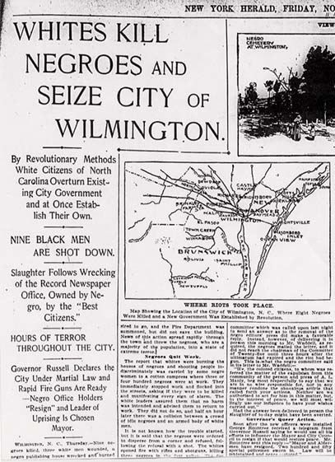
Notes:
NY Herald

Slide 32
Sources
News & Observer: “The Ghosts of 1898,” special feature by Tim Tyson
Wilmington Race Riot Commission: http://www.history.ncdcr.gov/1898-wrrc/
Wilmington Race Riot PowerPoint Presentation, by LeRae S. Umfleet:
http://www.history.ncdcr.gov/1898-wrrc/powerpoint/powerpoint.htm
Learn NC: http://www.learnnc.org/lp/editions/nchist-newsouth/8.0
Image Sources:
  http://www.lib.unc.edu/ncc/1898/sources/cartoons/0813.html
  http://www.mith.umd.edu/courses/amvirtual/wilmington/herald1.html
  http://www.mith.umd.edu/courses/amvirtual/wilmington/morningstar1.html

