Slide 1
Unit 3.1 Ancient Religions

Slide 2
Polytheism to Monotheism
Religious beliefs in the ancient Mesopotamian world underwent an interesting evolution toward a universal, central deity, as both a power in the universe and an object of worship.
This was instrumental to the rise and spread of monotheism throughout the Mesopotamian world, the belief in and worship of one personal Supreme God.

Slide 3
By 1000 BCE monotheism was widespread through the Mesopotamian world, as illustrated especially by the monotheism of the Hebrews (in the religion of Judaism) and the Persians (in the religion of Zoroastrianism).

Slide 4
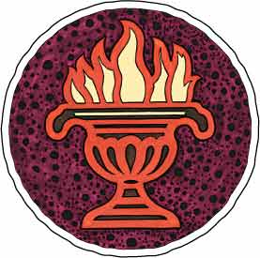
Zoroastrianism
One of the World’s Oldest Monotheistic Religions

Slide 5
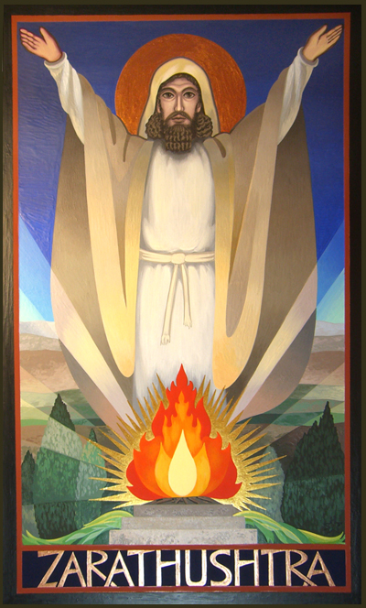
Zoroastrianism
Zarathustra (in Greek, Zoroaster) was a Persian prophet who lived in the sixth century B.C.E. At the age of 30, he believed he had visions of God (whom he called Ahura Mazda), the creator of all that is good and who alone is worthy of worship.

Slide 6
Monotheism
Zoroastrianism, the religion he inspired, was a departure from previous Indo-Persian polytheism. It has been termed the first non-biblical form of monotheism.

Slide 7
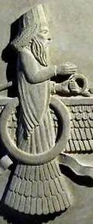
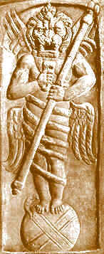
Dualism: Good v. Evil
Zoroastrian theology is strongly dualistic. In his visions, Zarathustra was taken up to heaven, where Ahura Mazda revealed that he had an opponent, Angra Mainyu, the spirit and promoter of evil.
Ahura Mazda
Angra Mainyu

Slide 8
Humanity Has Choice
Zarathustra taught that humans are free to choose between right and wrong, truth and lie, and light and dark, and that their acts, words, and thoughts would affect their lives after death.

Slide 9
Influenced Other Religions
Most religious historians believe that the Jewish, Christian, and Muslim beliefs concerning God and Satan, the soul, heaven and hell, the virgin birth, the slaughter of innocents, the resurrection, and the final judgment were all derived from Zoroastrianism.

Slide 10
Founder - Zarathustra
Zarathustra –Persian Prophet
Unclear dating on his birth – Some Zoroastrians claim 6000 BCE! Others think 600 BCE; modern historians date it to between 1500-1000 BCE
Belief that his birth was predicted and evil forces tried to kill him as a child
His message eventually won over the Persian king and it became the official religion of the Persian Empire until the 7th century CE (Islam replaced it)

Slide 11
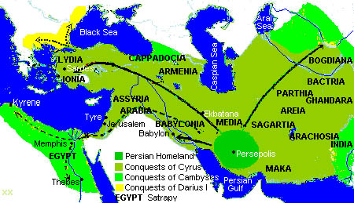
Persian Empire at its peak

Slide 12
After death, a person's urvan (soul) is allowed three days to meditate on his/her past life.
The soul is then judged by a troika Mithra, Sraosha and Rashnu.
If the good thoughts, words and deeds outweigh the bad, then the soul is taken into Heaven. Otherwise, the soul is led to Hell.
The universe will go through a total of three eras: 1. Creation 2. The present world where good and evil are mixed. People's good works are seen as gradually transforming the world towards its heavenly ideal 3. A final state after this renovation when good and evil will be separated.
Eventually, everything will be purified. Even the occupants of hell will be released.

Slide 13
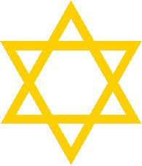
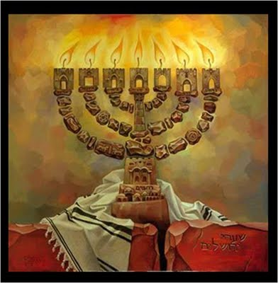
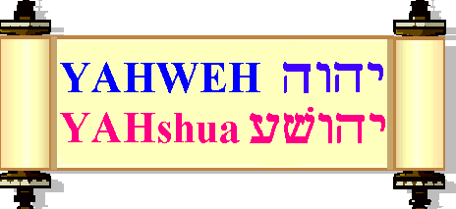
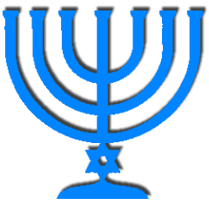
Judaism
Judaism is a monotheistic religion that holds that the world was created by a single, all-knowing divinity, and that all things within that world were designed to have meaning and purpose as part of a divine order.

Slide 14
Judaism: Core Beliefs
God’s (Yahweh) chosen people – community focus, “We”
Covenant (promise) with God
People be holy, worship Yahweh, & follow laws
Yahweh will favor his chosen people
Follow God’s laws – in letter & spirit, live holiness
Actions not just beliefs are important

Slide 15
Judaism: History
God choose Abraham to be “Father”
Hebrew slaves in Egypt, escape w/ Moses & 10 Commandments → official Founding!
Establish Kingdom of Israel, kings David & Solomon, build 1st temples
Kingdom in trouble → Diaspora

Slide 16
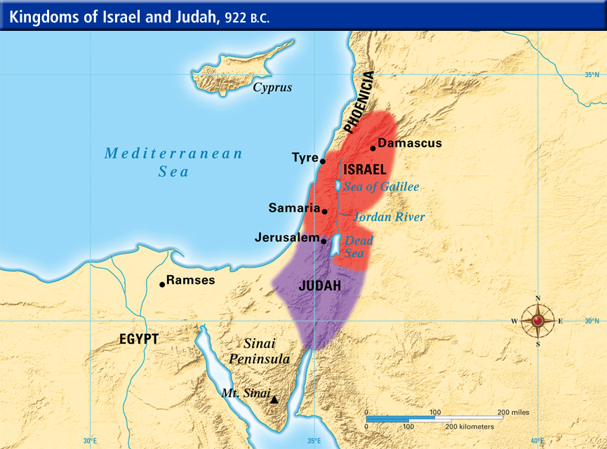

Slide 17
Holy Texts…
Text →
- Torah
1st 5 books of Christian Old Testament
Tanach – whole of Jewish scriptures
Talmud – Laws & commentaries
Place of worship → Synagogue
Leader → Rabbi

Slide 18
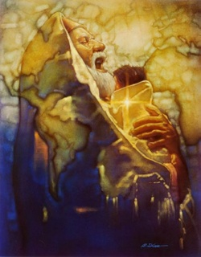
In the Image of God
Judaism teaches that every person was created "in the image of God." For this reason every person is equally important and has an infinite potential to do good in the world. People have the freewill to make choices in their lives and each of us is responsible for the consequences of those choices.

Slide 19
Ten Commandments
Jews believe that God's will for human behavior was revealed to Moses and the Israelites at Mount Sinai. The ten commandments, which are part of the Torah, indicate how humans are to live their lives.

Slide 20
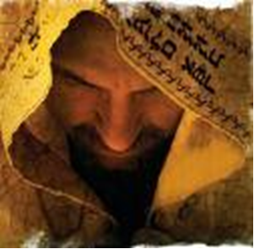
A Messiah
After the Romans took control of Israel in 63 B.C.E., many Jews anticipated the arrival of the Messiah, a religious-political-military leader who was expected to drive out the Roman invaders and restore independence.

Slide 21
Hinduism: History
Unclear!
With no clear doctrine how do you define a start?
Origins long ago, so little info
Aryan & Dravidian interaction
Vedic Age
Ritual, sacrifice, many gods
Move focus to worship gods (less sacrifice)
Divided kingdoms have own special god w/ large temples
As Islam & Christianity threaten, move toward less ritualized more devotional, culturally unifying religion
Notes:
Connect small kingdoms to decentralization post Maurya & Gupta, & think patron gods in Greece, Hinduism’s connection to nationalism & decolonization

Slide 22
Hinduism: Core Beliefs
No single founder, text, doctrine
So generally…
Belief in Supreme God, Universal Power → Brahman
May or may not “worship” it
May see series of gods as representations of Brahman
Samsara → cycle of birth – death- rebirth
Karma → every action has reaction, good leads to good

Slide 23
Hinduism: Texts & Leaders
Vedas → series of hymns, rituals
Epic Literature
Mahabharata (famous part – Bhagavad Gita)
Ramayana
Leaders
- Guru → religious teacher
- Brahmin → varna/caste of priests, religious teachers, in charge of rituals

Slide 24
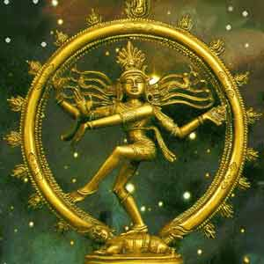
Hinduism
The Hindus believed that all living things possessed within them a part of a universal spirit. Therefore, all living things were sacred and should not be killed. For a spirit to achieve true joy and freedom, they must be united again with that spirit.

Slide 25
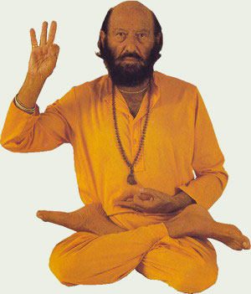
Yoga
In order to achieve tranquility, and bring themselves closer to the spirit, which they called Brahman Nerguna, they practiced a series of mental and physical exercises known as yoga.

Slide 26
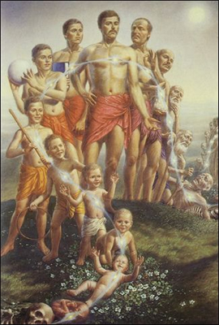
Reincarnation
The Hindus believed that the soul went through a series of rebirths, as it strived to obtain a oneness with the universal spirit. They believed that when a person died, they would be reborn again, living many lives, until they perfected themselves. This state of perfection was called Moksha.

Slide 27
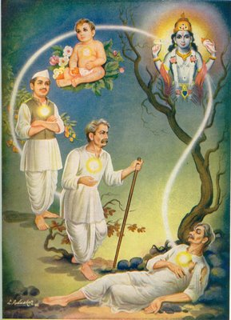
Moksha
When one obtained this state of Moksha, their cycle of rebirth after rebirth would finally stop, and they would live in eternal happiness at one with the Brahman Nerguna.

Slide 28
Comparisons…fill ‘em in !
Judaism | Both | Hinduism

Slide 29
And the answers are…
Judaism | Both | Hinduism
Monotheistic Vague on afterlife (debate w/in sects) Special covenant with God Diaspora Torah in Hebrew | Connected to ethnicity/birth Limited conversion Ancient origins Debate over “start” date No single founder Focus on right actions Key text in ancient language | Polytheistic (debatable) Samara – Reincarnation Try to live right to join Brahman Mostly in India Vedas in Sanskrit
Notes:
Note many Hindus would consider themselves monotheistic as all gods are part Universal God (Think Christian Trinity – 3in1)

Slide 30
Christianity: Core Beliefs
Jesus is Messiah & Son of God
Jesus was sent to die to save humanity from sin (against God)
Jesus died in crucifixion & was resurrected
Trinity → Father, Son, Holy Ghost

Slide 31
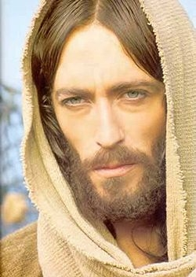
Christianity
Around C.E. 30 a new religious movement began among the Jews in the distant borders of the Roman Empire. A group of Jews began following the teachings of a new leader, Jesus of Nazareth. Slowly this movement expanded beyond the Jews, to many other peoples in the surrounding areas, and Christianity was born.

Slide 32
Christianity: History
Believe Jewish heritage + Jesus
Jesus born to Virgin Mary, a teacher & miracles
Crucifixion & resurrection
St Paul spreads Gospel of Jesus, persecuted
Series of Councils over doctrine, Catholic Church

Slide 33
Christianity:
Bible – Old & New Testament
Worship in Church
Leaders: priests, minister, preacher

Slide 34
Christianity: Sects
Catholic
Orthodox
Protestant

Slide 35
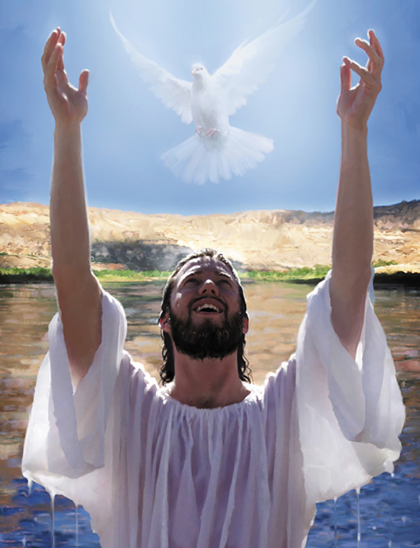
After the death of Jesus, his followers taught that he was the Son of God and the Messiah that the Jews had been waiting for. Many people throughout the Mediterranean accepted these teachings, and became known as Christians.

Slide 36
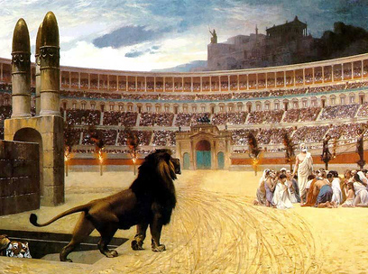
Persecutions
For the next 300 years, Christianity was practiced by many city dwellers in private. Roman officials viewed Christians as a threat, and often had them killed. Christians continued to establish churches, and to spread their religion, but they did so discreetly.

Slide 37
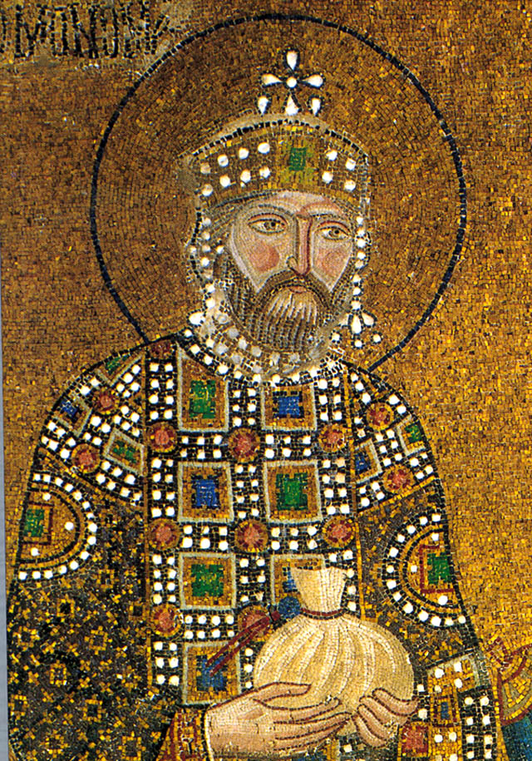
State Religion
In 312 C.E., the Roman general Constantine became emperor of Rome. He offered protection to Christians, allowing them to build churches and to spread Christianity more quickly. By 392 C.E., Christianity had become a powerful force in the empire and Emperor Theodosius declared Christianity the state religion.

Slide 38
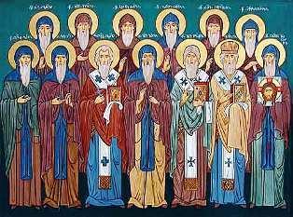
Church Organization
Christians began to organize their church into parishes, which were overseen by priests. Several parishes formed what was called a diocese. Each diocese was led by a bishop.

Slide 39
The Papacy
Eventually the bishop in Rome began to claim authority over all other bishops, and gave himself the title of Pope. The Western parishes readily accepted the authority of the Pope, however, the Eastern churches did not.

Slide 40
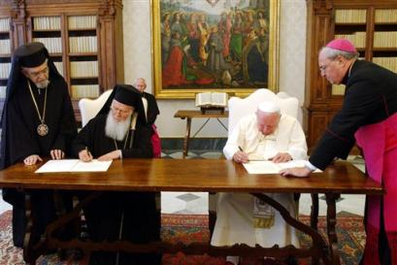
East-West Division in Christianity
The churches in the West eventually became known as the Roman Catholic Church, while the churches in the East joined together to form the Eastern Orthodox Church.

Slide 41
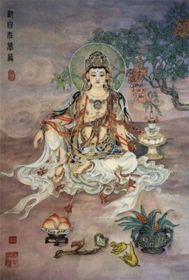
Chinese Ancestor Veneration
The religious history of China is complex, and has evolved over the centuries. Deeply interwoven into their beliefs is the veneration of their ancestors. The Chinese believed that the spirits of their ancestors were watching over them, and that they could be called upon during difficult times.

Slide 42
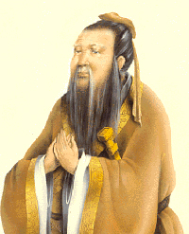
Confucianism
In 551 B.C.E. a man by the name of Kongzi was born to a poor family in the province of Shandong. Kongzi is known in the western world as Confucius.

Slide 43
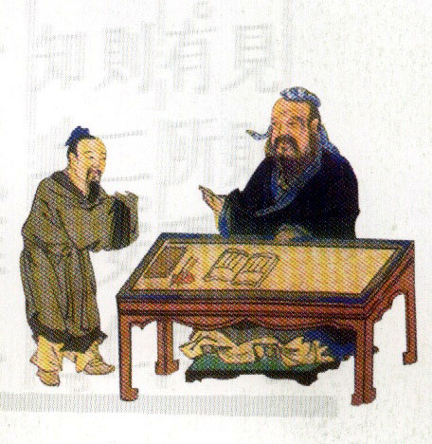
Confucius: the Teacher
Confucius saw many problems in the world and wanted to correct them. When his attempts to become an advisor to a number of different government officials failed, he became a teacher.

Slide 44
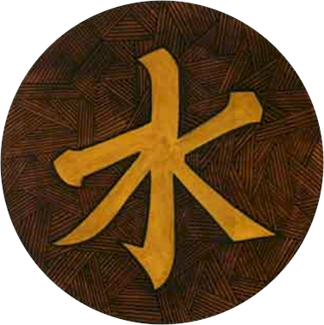
Peace and Order
The most important things to Confucius were peace, and order. He felt that everyone had a proper role in society, and that if people were willing to accept their role, and fulfill it, that peace and harmony would abound.

Slide 45
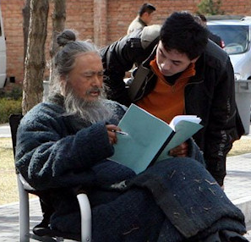
Respect for Elders
In order to help people accept their roles in society, and establish order, Confucius outlined how individuals should treat one another. The most important of these ethics outlined the responsibilities of children to respect and listen to their parents, and other elders.

Slide 46
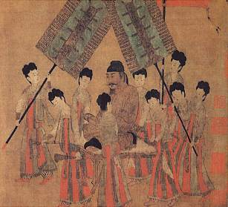
Social Ethics
He also laid out ethics for how subjects should follow rulers, for how rulers should treat subjects, how husbands and wives should treat one another, and how friends should treat each other.

Slide 47
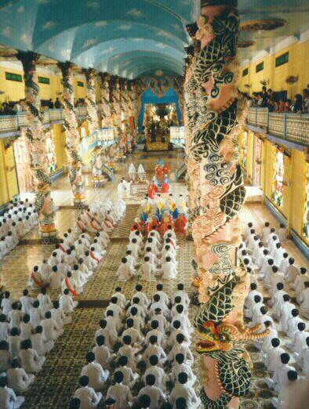
Spread of Confucianism
During his own lifetime Confucius’ teachings were not widely accepted. However, within a hundred years, they were being used by the emperor to help him rule, and eventually became a widely followed religion. Confucianism would remain a powerful force in Chinese history.

Slide 48
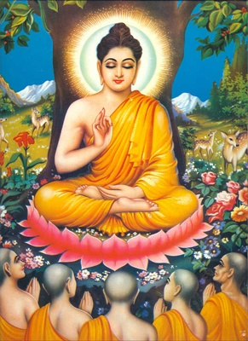
Buddhism
Buddhism was founded by an Indian prince, who called himself the Buddha. The Buddha or “Enlightened One” taught his people about Four Noble Truths, and an Eightfold Path. He also taught the people to use meditation.

Slide 49
Buddhism: History
Siddhartha Gautama (c. 563 BCE) born to nobility & privilege
Disturbed by pain & suffering
Meditated until reached Enlightenment
Minority religion in India (Ashoka!) but spread to SE Asia & China

Slide 50
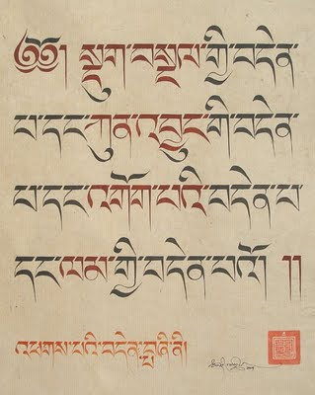
The Four Noble Truths
Suffering is part of human life.
Suffering is caused by people’s desires for pleasure and material things. (This results in an endless cycle of rebirths or reincarnation.)
Overcoming desires during lifetime eventually brings end to this cycle and suffering.
Desires can be overcome by following the Eightfold Path.

Slide 51
Buddhism: Core Beliefs
Personal spiritual development & understanding of true nature of life
Samsara – cycle of rebirth
Nirvana → ultimate goal, free of Samsara
4 Noble Truths: Life is suffering caused by desire, it can be cured by the 8 Fold Path (Middle Way)

Slide 52
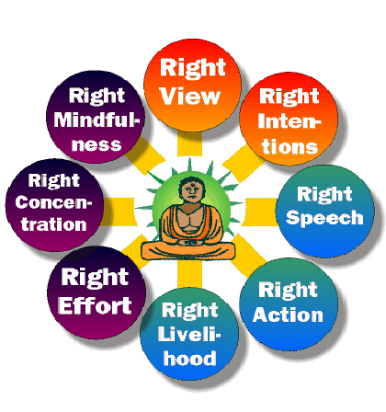
The Eightfold Path
In order to eliminate their desires for worldly things, and thus end the cycle of rebirths, the Buddha taught his people to follow eight principals:
Know the truth
Resist evil
Say nothing hurtful
Respect life
Free the mind from evil
Work in service to others
Resist evil
Practice meditation

Slide 53
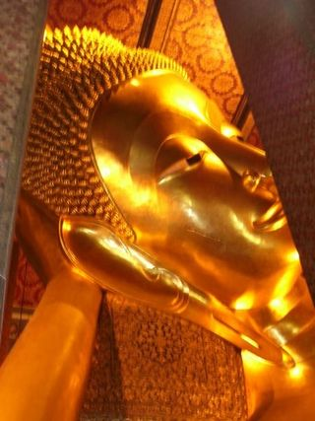
Nirvana
By following the eightfold path, and avoiding evil extremes, the Buddha taught that an individual could achieve nirvana. He taught that nirvana, which in their language meant to blow out a candle, was a state of non-existence.

Slide 54
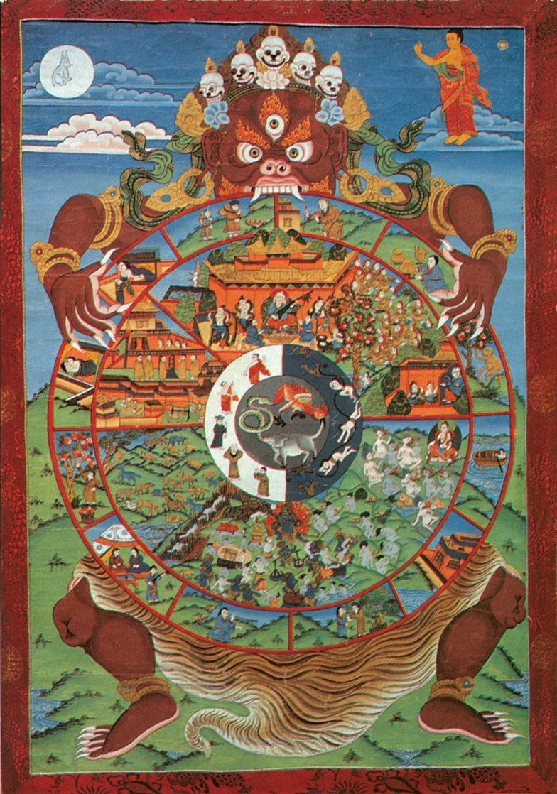
In Harmony with Universe
Nirvana was not a place, like heaven, but rather an actual state of non-existence. When someone reached nirvana, their soul was in harmony with the universe, and they would cease to exist.

Slide 55
Buddhism
Sayings of Buddha, lots of texts!
Sects
Mahayana
Theravada
Zen

Slide 56
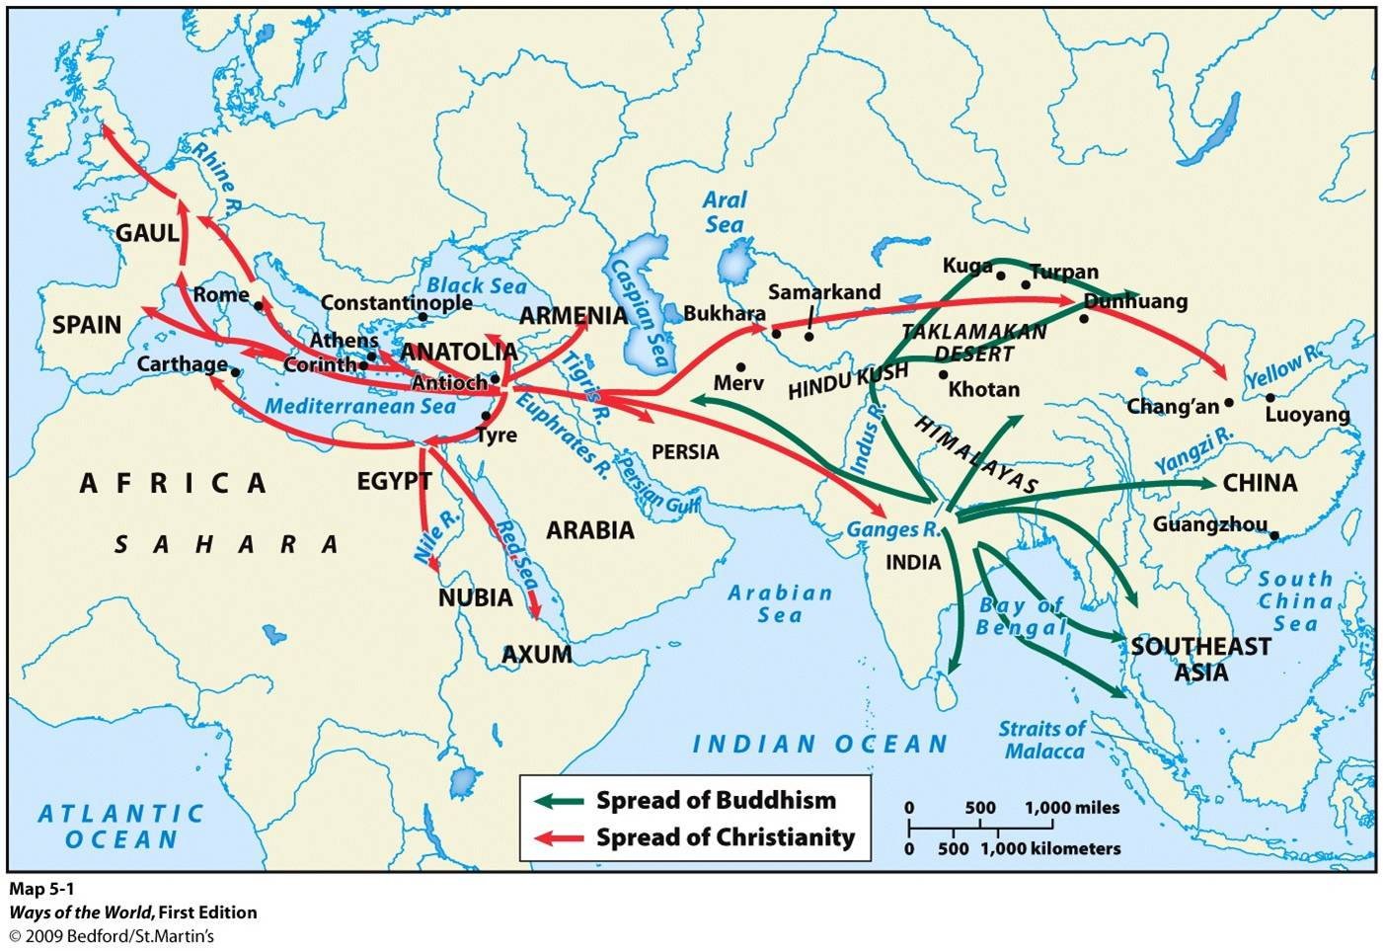
Spread of Buddhism & Christianity
Notes:
Cool video of spread of religions https://www.youtube.com/watch?v=AvFl6UBZLv4

Slide 57
Comparisons…Fill ‘Em In!
Christianity | Both | Buddhism

Slide 58
Christianity | Both | Buddhism
Monotheistic 1 core text – Bible Relationship with deity Salvation & Heaven Heaven or hell upon death Exclusive religion | 1 distinct, known founder Popularity largest outside of point of origin Kept core ideas from earlier religion in region (Judaism/Hinduism) Founder as a teacher Monastic tradition | No deity No single core text Personal international reflection Enlightenment & Nirvana Samsara – reincarnation Does not require condemning other religions

Slide 59
Islam: Core Beliefs
“Submission”
Muslim – “one who submits”
1 God – Allah
Jesus, Moses, Abraham important prophets
Muhammad final prophet
5 Pillars of Islam

Slide 60
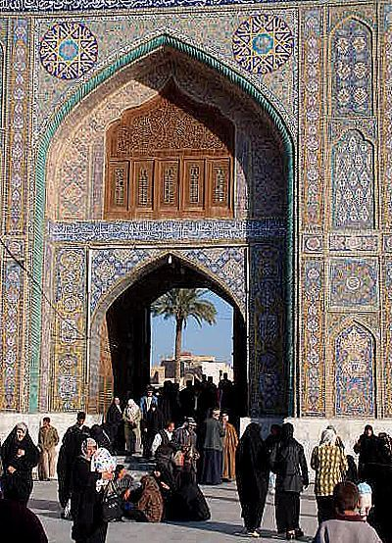
A Mosque
A Mosque is the place of worship for Muslims.

Slide 61
The Five Pillars of Islam
1. Faith: There is only one God, and Muhammad is the Prophet
2. Prayer: Five times a day
3. Sharing: All Muslims pay a tax to help the poor
4. Fasting: Not eating or drinking during daylight during the month of Ramadan
5. Pilgrimage (Hajj): All Muslims want to make a pilgrimage to the Holy City of Mecca once in their lifetimes.

Slide 62
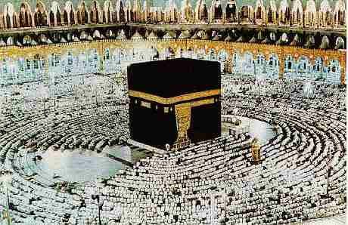
The Hajj: The pilgrimage to Mecca

Slide 63
Islam: History
Muhammad born in Mecca, 610 visited by angel who revealed Quran
Began to preach the revelations
Forced out of Mecca to Medina in 622 (Hijrah) & start of Muslim calendar
632 returns & conquers Mecca
Spreads in ME & N Africa through Empire & Trade
Notes:
Muslim view of Quran is different from Christian view of Bible. Christians acknowledge that the Bible is written by mortals and tells peoples stories in their words, rarely direct words of God. To Muslims, the Quran is not written by Muhammad but recording the direct words of Allah through revelation

Slide 64
Islam
Text –
Koran or Qu’ran → revealed words of Allah
Hadith → sayings of Muhammad
Sharia Law Code
Sects:
Sunni
Shia/Shiite

Slide 65
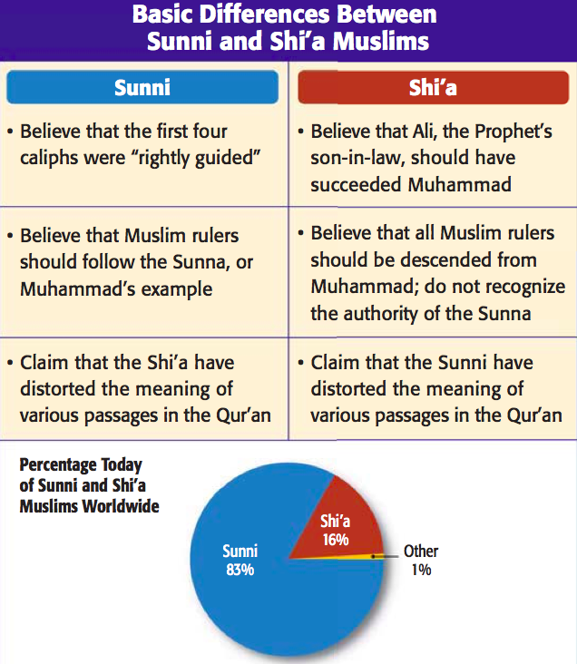

Slide 66
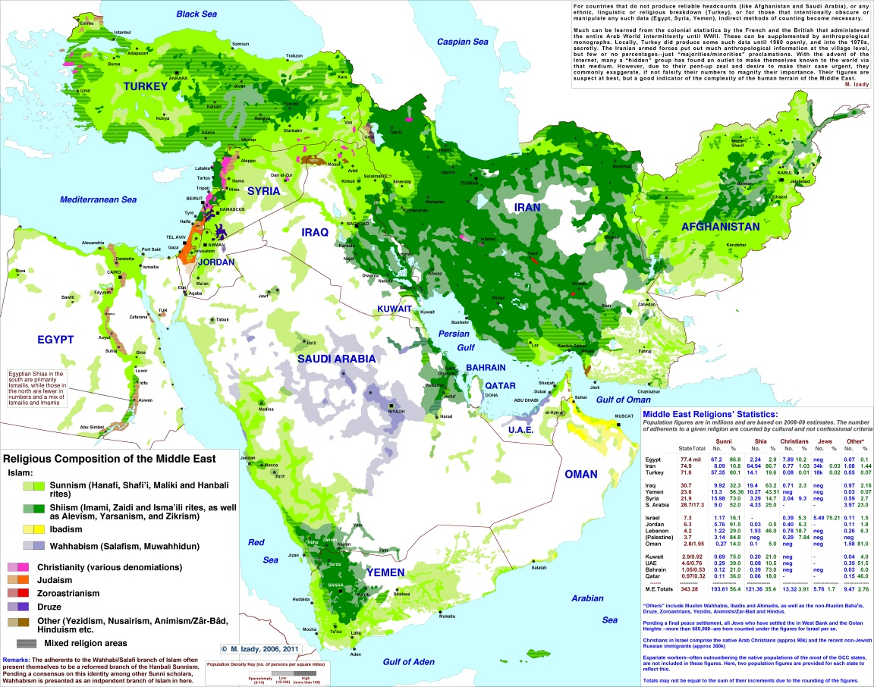

Slide 67
Ancient Religious Traditions
Religion | Founders | Main Tenets
Confucianism (Philosophy) | Confucius (Kongzi) | Peace and order Respect for elders Ethical human relationships
Daoism | Laozi | Reject material things Commune with nature Become one with Dao (force within all things)
Buddhism | Budda | Four Noble Truths Eightfold path Nirvana Harmony with the universe
Zoroastrianism | Zarathustra | Monotheism Dualism (Good v. Evil)
Judaism | Abraham | Monotheism Mosaic law
Christianity | Jesus | Jesus the Messiah (Son of God)

Slide 68
