Slide 1
GILDED AGE 1870-1900

Slide 2
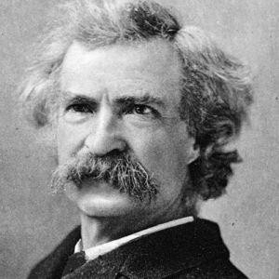
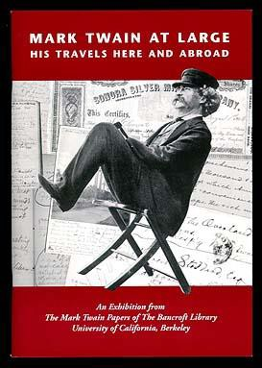
“GILDED AGE”
Gilded Age -Period when
corruption existed in society
but was overshadowed by
the wealth of the period
“gilded” is when something
is golden/beautiful on the
surface but is really
cheap/worthless underneath
Term comes from a book
written about the time
period by Mark Twain and
Charles Dudley Warner in 1873 The Gilded Age
View Intro to America’s Industrial Revolution

Slide 3
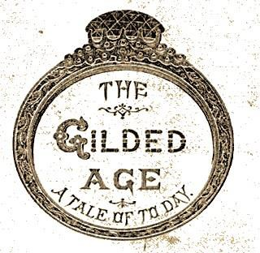
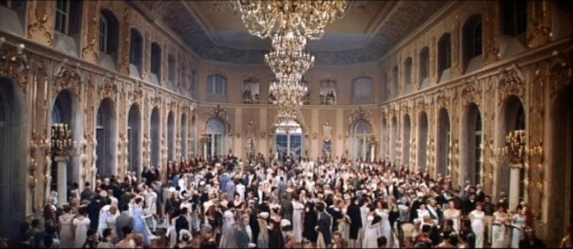
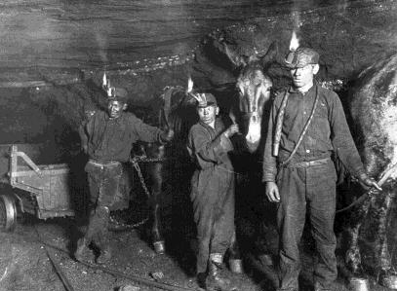
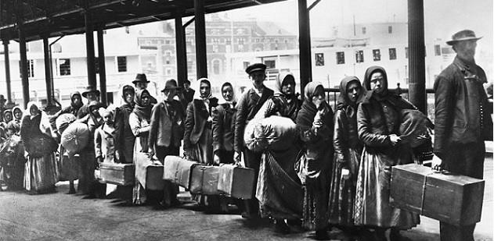
WHAT CAUSED THE “GILDED AGE”?
Lots of natural resources
Lots of cheap labor (slaves, immigrants)
New technology
Creation of corporations
Growing markets
Business-friendly government
Steam-engine revolution

Slide 4
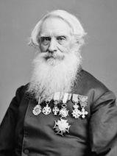
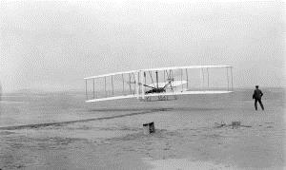
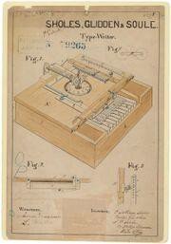
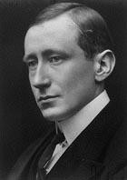
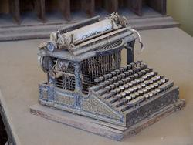
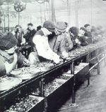
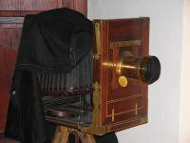
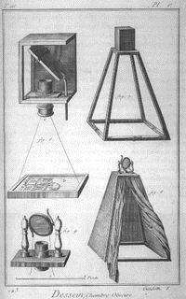
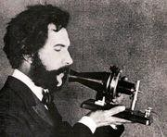
INVENTORS/INVENTIONS
Thomas Edison
  Perfected the light bulb in 1880,
and motion picture
  Organized power plants
  Established first research lab
Alexander Graham Bell
  Telephone (1876)
Henry Ford
  Assembly Line
George Eastman
  Camera (1885)
Samuel Morse
  Telegraph (1837)
Wright Brothers
  Airplane (1903)
Christopher Sholes
  Typewriter (1867)
Guglielmo Marconi
  Radio
Samuel Morse
Wright Brothers on 1903 Flight
19th Century Typewriter
Marconi
19th Century Camera
Alexander Graham Bell

Slide 5
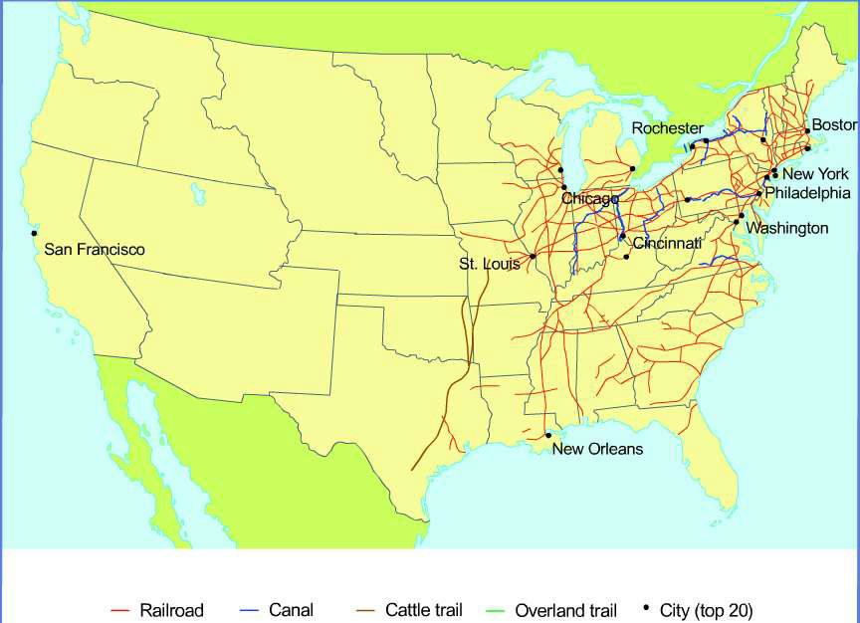

Slide 6
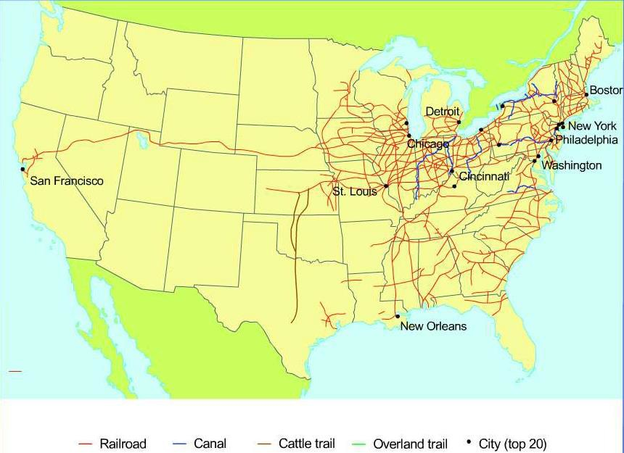

Slide 7
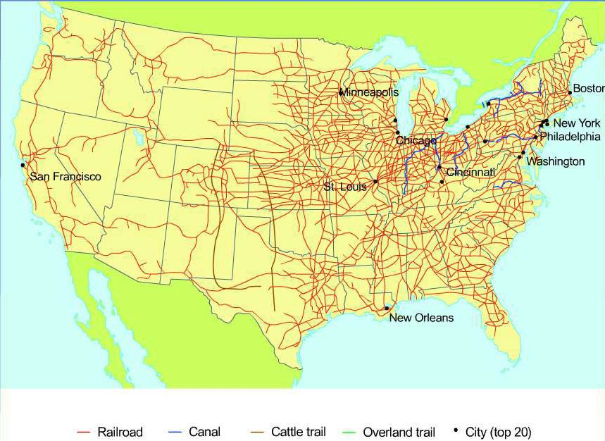

Slide 8
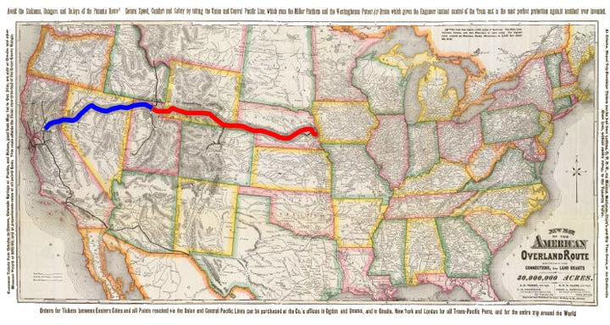
TRANSCONTINENTAL RAILROAD -- 1869

Slide 9
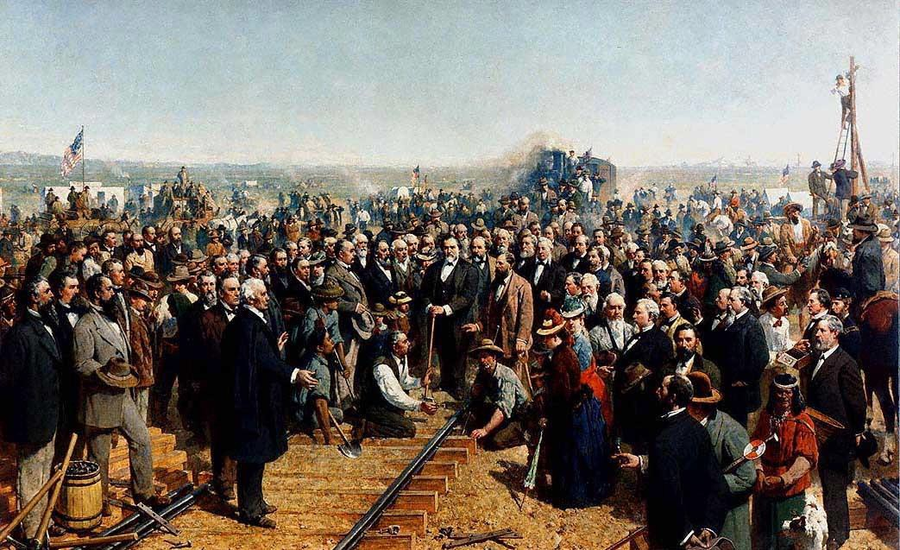

Slide 10
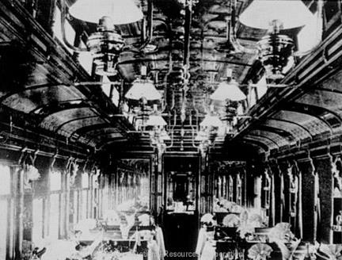
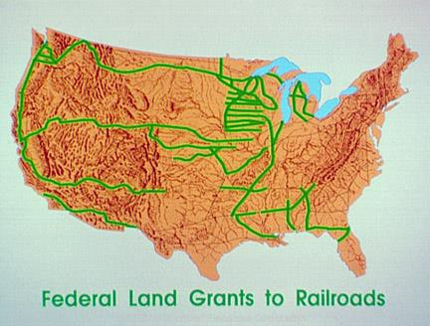
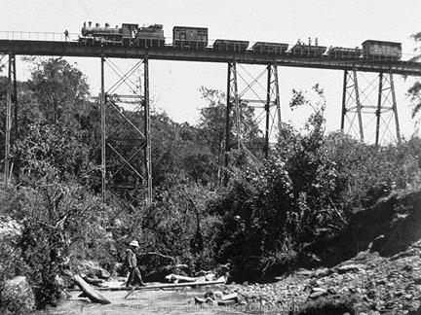
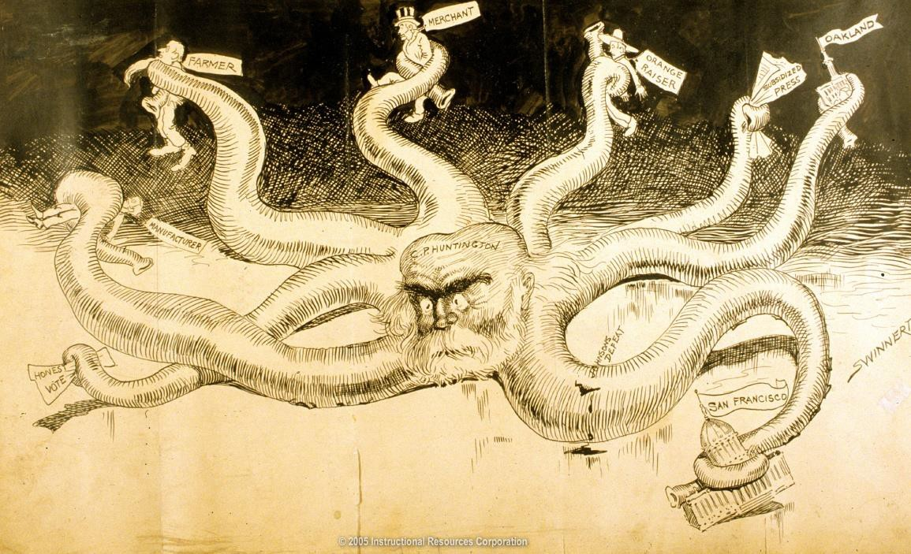
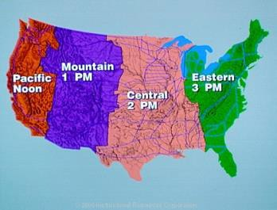
IMPACT OF RAILROADS ON AMERICA DURING THE GILDED AG
E
Benefits
  Stimulated growth of other industries (steel, iron, coal, lumber, glass)
  Helped cities grow
  Helped increase westward expansion of America
  Standard time zones were created
to get everyone on correct time
Corruption
  Charged much higher rates to western farmers
  Credit Mobilier Scandal 1868
    Union Pacific
    Fake construction company
    Bribed members of Congress
    Represented corruption of period
View Corruption in Railroads

Slide 11
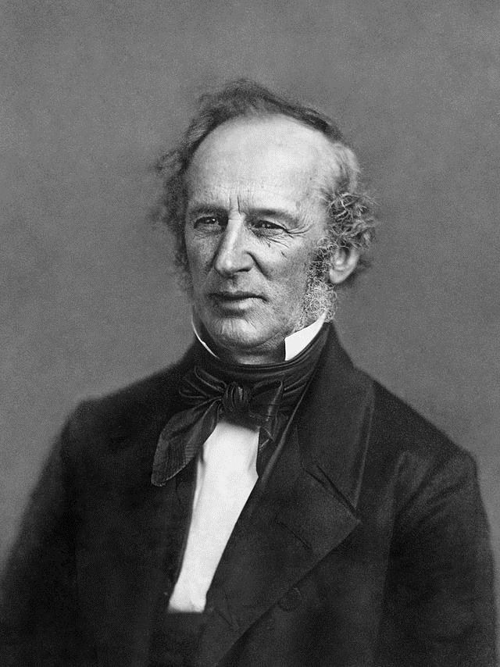
CORNELIUS VANDERBILT
Got started in business owning/operating
steamboats
Learned the trade from his father
Eventually enters the railroad business,
consolidating several companies through
aggressive and (now) illegal
tactics

Slide 12
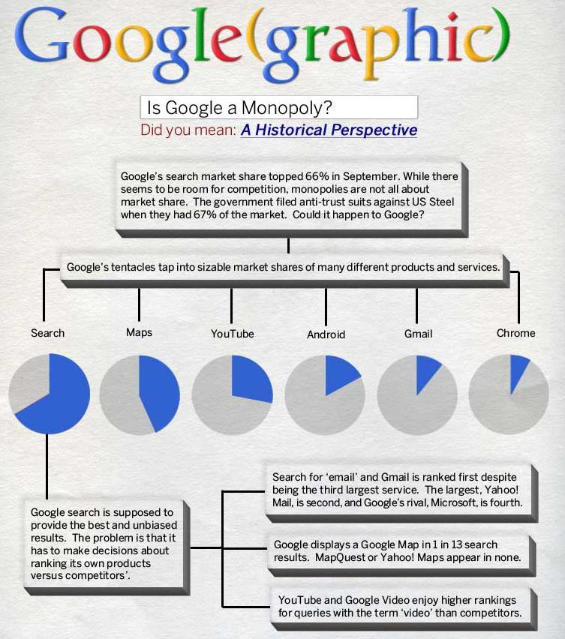

Slide 13
SEE IF YOU CAN ANSWER THESE!
What were at least five of the reasons why the “Gilded Age” occurred during the late 19 ^{th} century?
Why did Mark Twain call this period the “Gilded Age”?
Why were railroads such a “disruptive”, “game-changing” technology?
Why was Cornelius Vanderbilt important?

Slide 14
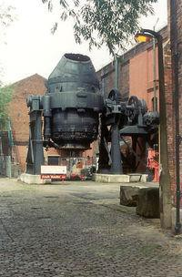
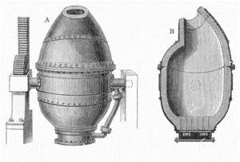
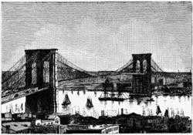
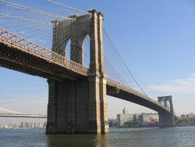
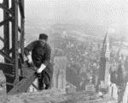
THE STEEL INDUSTRY’S IMPACT ON AMERICA
Bessemer Process-
developed around 1850
injected air into molten
iron to remove
impurities and make
steel-a lighter, more
flexible, rust resistant
metal
Steel is used in
railroads, farm
equipment, canned goods
Engineers use steel to
create skyscrapers and
longer bridges (Brooklyn Bridge)
View Steel Industry Video

Slide 15
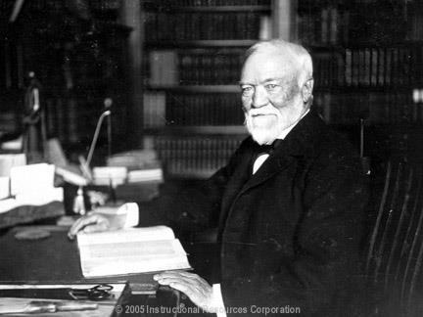
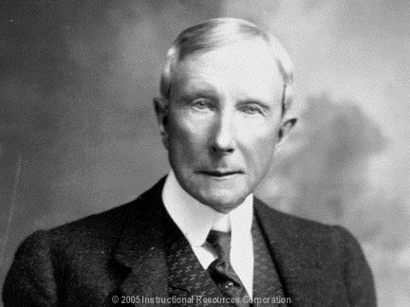
THE RISE OF BIG BUSINESS
Andrew Carnegie
  Industrialists who made a fortune in steel in the late 1800’s, as a philanthropists, he gave away some $350 million.
John D. Rockefeller
  Industrialists who made a fortune in the oil refining industry
  U.S. Standard Oil

Slide 16
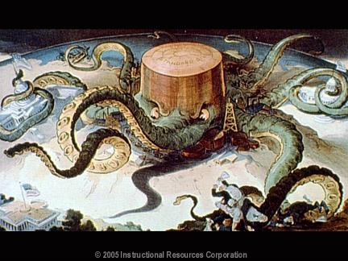
Standard Oil Cartoon based on Ida B. Tarbell’s book- The History of
Standard Oil

Slide 17
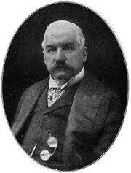
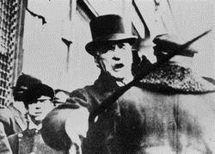
THE RISE OF BIG BUSINESS
J.P. Morgan
  Industrialists who started U.S. Steel from Carnegie Steel and other companies. Became 1st Billion dollar Corporation.
  Bailed out the U.S. economy on more than one occasion.

Slide 18
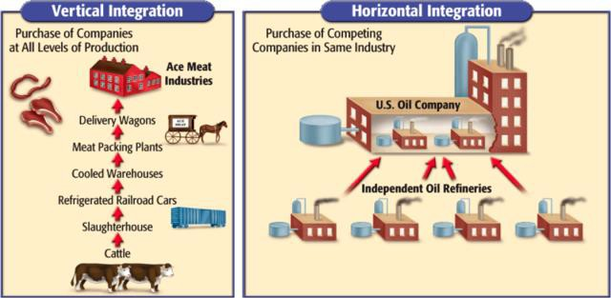
THE RISE OF BIG BUSINESS
Vertical Integration
  A process in which a company buys out all of the suppliers.
and iron mines, ore freighters, rr lines)
Horizontal Consolidation
(Ex. coal
-A process in which a company buys out or merges with all competing
companies (JP Morgan bought out Carnegie steel and other companies)

Slide 19
CHOOSE A COMPANY YOU LIKE/USE
Show what it might look like if this company tried to
integrate vertically.
Show what it might look like if this company tried to
integrate horizontally.

Slide 20
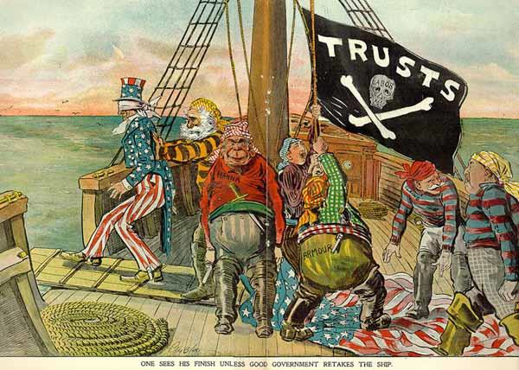
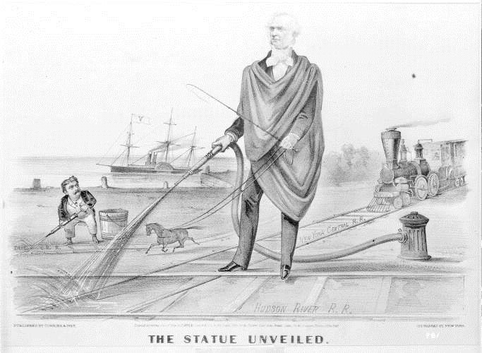
THE RISE OF BIG BUSINESS
Trusts - A group of
separate companies
placed under the control of a single managing
board
Similar to monopolies – total control of a good o service by one company
Critics called these
practices unfair and the business leaders
“Robber Barons”
r

Slide 21
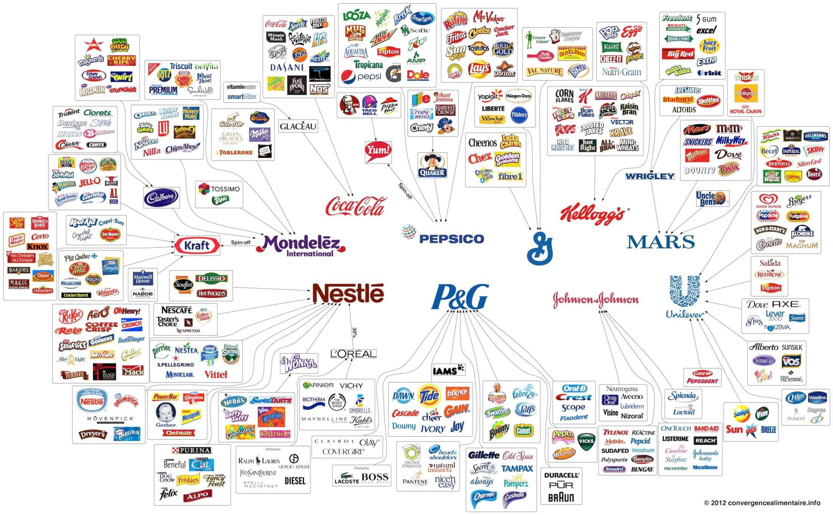

Slide 22


Slide 24
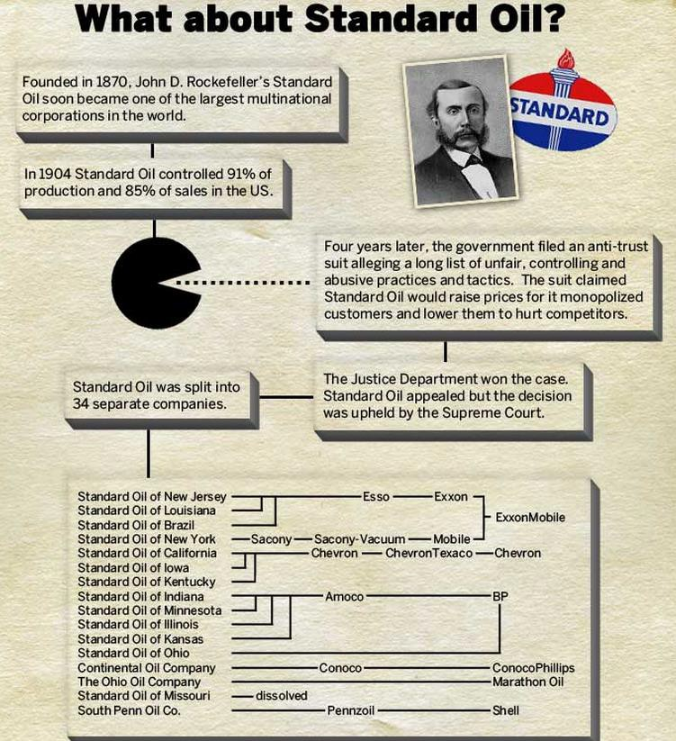

Slide 25
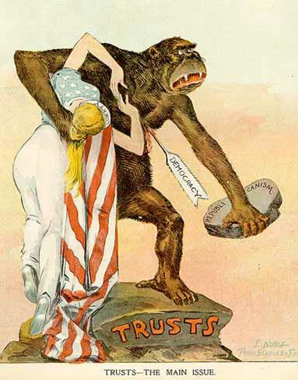

Slide 26

THE RISE OF BIG BUSINESS
Social Darwinism
  Used Darwin’s theory to explain business
  Natural Selection, Survival
of the Fittest
  Govt. should not interfere
  Laissez-faire -policy that US had followed since inception to not allow govt. to
interfere with business

Slide 27
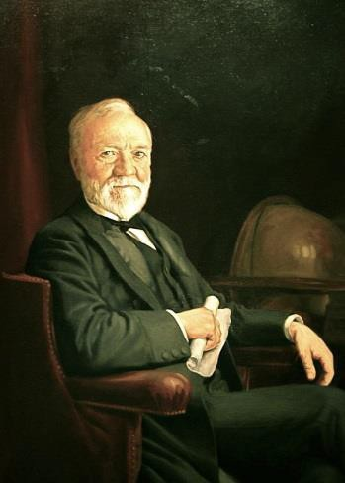
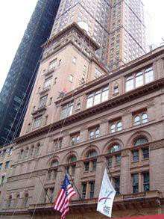
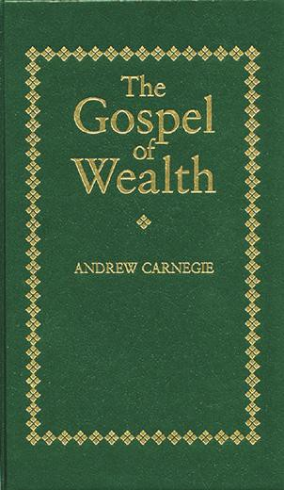
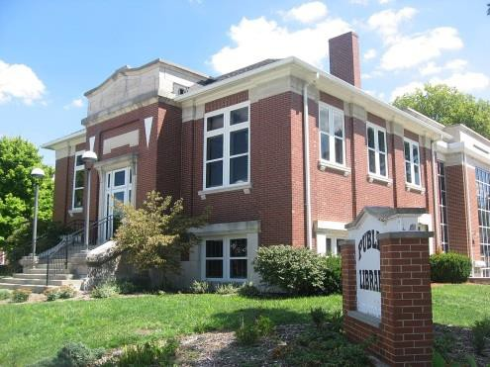
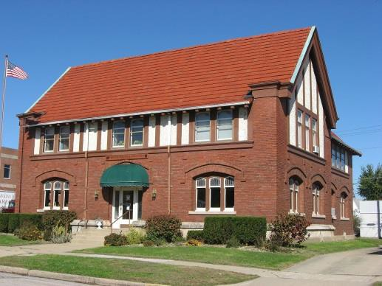
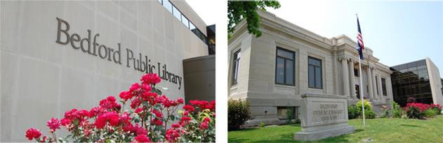
THE RISE OF BIG BUSINESS
Gospel of Wealth -belief that the wealthy are the “fittest” citizens and are therefore responsible to look out for the well
being of those less
fortunate.
Many Industrialist shared wealth although rarely
through direct welfare.
Started museums, libraries, etc.
Carnegie Hall
Carnegie Libraries in Bedford, Bloomfield and Linton, Indiana

Slide 28
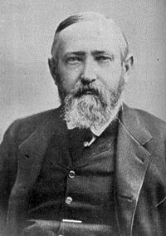

THE RISE OF BIG BUSINESS
Interstate Commerce Commission
  Created to oversee railroad operations
  First example of Federal gov’t monitoring a business
Benjamin Harrison
Sherman Anti-Trust Act of
1890
  Law outlawing a combination of companies that restrained interstate trade or commerce; important to prevent monopolies. Not initially enforced properly.
“What can I do when both Parties insist on kicking”

Slide 29





POOR WORKING CONDITIONS IN THE LATE 1800’
S
Most factory workers worked 12 hour days, 6 days a week
Steel mills often
demanded 7 days a week
No vacations, sick leave,
unemployment
compensation, or workers compensation for injuries on the job
Children as young as 5
often worked as much as _{Video on factory}
12 or sometimes 14 hour^{w}s^{ork} a day, for as little as .$27 a day.

Slide 30


THE RISE OF LABOR UNIONS
The Purpose of a labor union was “strength in
numbers.” Attempted to
gain better working conditions and pay.
The Knights of Labor
  Was the first union to accept workers of all races and gender. Pushed for 8 hour workday, equal pay for women, accepted skilled and unskilled workers

Slide 31

THE RISE OF LABOR UNIONS
The American Federation of Labor (AFL)- Accepted only skilled white males, won higher wages and shorter work weeks for its members
Head of AFL was Samuel Gompers

Slide 32




THE RISE OF LABOR UNIONS
Industrial Workers of the World (IWW) or Wobblies
  Created in 1905, was a radical group of mostly unskilled workers who believed in socialism
  Socialism-an economic or political philosophy that favors public (or social) control of property and income.

Slide 33


Slide 34

SETBACKS FOR LABOR UNIONS
Great Railroad Strike of 1877
  RR workers strike to protest wage cut
  Violence erupted in many
cities for a week
  President Rutherford B. Hayes sends in Federal Troops to put down strike
  Scab –worker called in by an employer to replace strikers
  Courts and Federal govt. often sided with business during Gilded Age

Slide 35

SETBACKS FOR LABOR UNIONS
Haymarket Riot 1886
  Workers protesting and holding demonstrations in Haymarket Square Chicago
  Speakers are socialist and
anarchist (no govt.)
  Police arrive and bomb is thrown at police killing some and causing riot
  Public blames labor unions and views them as radical, violent, and mostly foreigners

Slide 36





SETBACKS FOR LABOR UNIONS
Homestead Strike-1892
  Workers strike against Carnegie Steel plant
  Henry Frick was anti-union
leader of plant
Pullman Strike 1894
  Railroad industry strike in which 120,000 striking railroad workers were stopped only by the
intervention of the federal
government

Slide 37

THE NEW IMMIGRANTS
New Immigrants -Between 1870 and 1920-20 million Europeans-mostly from
Southern and Eastern Europe came to America-
(Jews/Catholics)
Hundreds of thousands more came from Mexico, Caribbean, and China
Looked and sounded
different than natives
Nativism-Movement to ensure that native-born
Americans received better
treatment than immigrants
Russian Jews

Slide 38

1888 PUCK MAGAZINE CARTOON ABOUT AMERICAN BUSINESSMEN ENCOURAGING IMMIGRATION FOR
CHEAP LABOR WHICH HURTS AMERICANS

Slide 39






THE NEW IMMIGRANTS
Ellis Island- In New York harbor where most European immigrants came to get processed
Angel Island- In San Francisco where most Asians entered US
Culture Shock
Melting Pot

Slide 40

THE NEW IMMIGRANTS
1882-Chinese Exclusion Act- prohibited Chinese laborers from entering the country. Was not
lifted until 1943.
Gentlemen’s Agreement 1907– was reached
between U.S. and Japan
in which Japan agreed to restrict immigration to the U.S.

Slide 41


Slide 42

Political Cartoon depicting how Chinese immigrants workers lived
and regular American workers lived. Rats, Yummy!

Slide 43


Slide 44



PROBLEMS OF RAPID URBANIZATION
Urbanization- growth of cities
3 reasons cities grew in late 1800’s and early
1900’s
  New immigrants arrived in cities for work
  As farm machines replaced farmers they moved to cities
  African Americans left South after Civil War and came to Northern cities.
View Rise of NYC video

Slide 45








ROBLEMS IN CITIES
P
1 . Housing shortages-
Tenement – crowded
apartment building with poor
standards of sanitation, safety, and comfort
2. Transportation –struggled to keep up with growth
3. Clean water – was difficult
to produce and transport
4. Waste and garbage
removal was a challenge and often neglected
5. Fires were very common
  Great Chicago Fire -1871
  San Francisco Earthquake
1906
6. Crime rose with urbanization
A trip down Market Street video

Slide 46





EARLY REFORMS TO FIX
PROBLEMS OF URBANIZATION
Settlement House –
Community center
organized to provide various services to
urban poor
Hull House -1889 –
most famous
settlement house
established by Jane Addams and Ellen Gates Starr
Social Gospel
Movement –social
reform movement that sought to fix social
problems in the name of Jesus

Slide 47

THE RISE OF POLITICAL MACHINES
Political Machines –an
organized group of people
that controlled the activities of a political party
  By giving voters services they needed, the machine won their vote and controlled city government
City Boss was head of Political Machines
  Controlled
    Jobs in police, fire, and sanitation departments
    Agencies that granted licenses to businesses
    Money to fund large construction projects
“All Politics center around the Boss”
View Gangs in New York Clip #1

Slide 48

POLITICAL MACHINES
Political machines loved immigrants, WHY?
  Never voted, tried to sway votes by bribery, intimidation, and other means
Political machines used power to
  Rig elections
  Become wealthy from
kickbacks-illegal payments
  Control police force to stay out of trouble

Slide 49





“BOSS TWEED” AND THOMAS NAST
William “Boss” Tweed City Boss of
Tammany Hall- Democratic Political Machine in New York City
Thomas Nast – political cartoonist who was critical of machines and Tweed

Slide 50





Slide 51



CORRUPTION IN GOVERNMENT
Patronage or Spoils System-
giving government jobs to
loyal party workers or friends
  Were not qualified
  Used position to get money
from government (graft)
President James Garfield is assassinated by
disappointed office seeker
favoring Spoils System
President Chester Arthur signs Pendleton Civil
Service Act of 1883
James Garfield
View video #2
View video #3
Charles Guiteau

Slide 52

PENDLETON CIVIL SERVICE ACT 1883
Attempted to end
Patronage/Spoils System
1. Creating the Civil
Service Commission which required appointed govt.
officials to pass the Civil
Service Exam to base jobs on merit instead of
friendship
2. Federal employees did not have to contribute to campaign funds
3. Federal employees could not be fired for political reasons
Chester A. Arthur signed Pendleton Act into effect

