Slide 1



Solomon Northup
and
TwelveYears a Slave
How To Analyze Slave Narratives*
*All images used in this classroom resource are from the digitized 1856 NewYork and Auburn edition of TwelveYears a Slave at the University of Toronto Libraries and made freely available at Internet Archive. https://archive.org/details/twelveyearsslave00nortuoft

Slide 2

Who Was Solomon Northup?
1808: Born in Minerva, NewYork
  Son of former slave, Mintus Northup; Northup's mother is unknown.
1829: Married Anne Hampton, a free black woman.
  They had three children.
  Solomon was a farmer, a rafter on the Lake Champlain Canal, and a popular local fiddler.

Slide 3
What Happened to Solomon Northup?
Met two circus performers who said they needed a fiddler for engagements in Washington, D.C.
  Traveled south with the two men.
  Didn't tell his wife where he was going (she was out of town); he expected to be back by the time his family returned.
Poisoned by the two men during an evening of social drinking in Washington, D.C.
  Became ill; he was taken to his room where the two men robbed him and took his free papers; he vaguely remembered the transfer from the hotel but passed out.

Slide 4
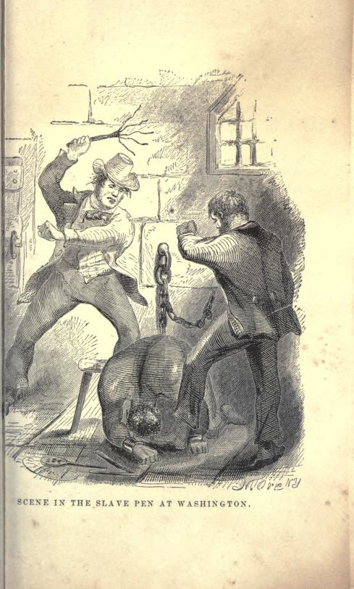
What Happened…?
Awoke in chains in a "slave pen" in Washington, D.C., owned by infamous slave dealer, Birch. (Note: a slave pen was where slaves were warehoused by slave traders before being transported to market.)
Transported by sea with other slaves to the New Orleans slave market.
Sold first to William Prince Ford, a cotton plantation owner.
  Ford treated Northup with respect due to Northup's many skills, business acumen and initiative.
  After six months Ford, needing money, sold Northup to Edwin Epps.

Slide 5
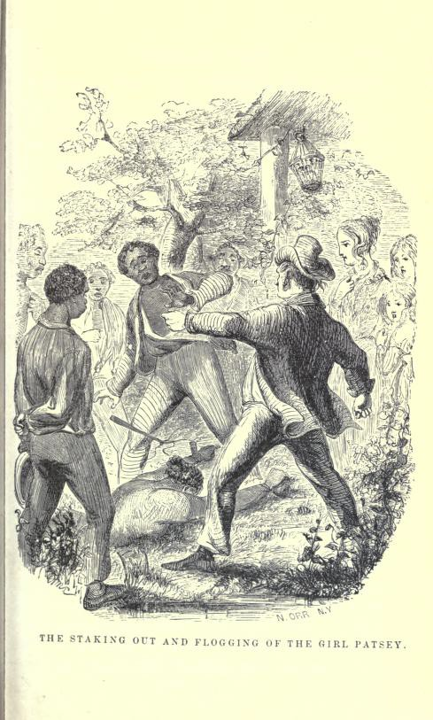
Life on the Plantation
Edwin Epps was Northup’s master for eight of his 12 years a slave.
  Epps had a small cotton plantation in the Red River area of Louisiana.
  Epps was a brutal master; used physical and sexual violence.
  Like Ford, Epps valued Northup's abilities; promoted Northup to "slave driver”.
The slave driver had the highest status position on the plantation; his job was to get maximum productivity from other slaves, principally through whipping.
  Northup had privileges, such as being protected from whippings.
  Northup disliked his role and describes resisting Epps’s orders by “faking whippings” and trying to prevent them.
  When Epps was in close proximity, Northup was compelled to carry out his orders to whip.

Slide 6
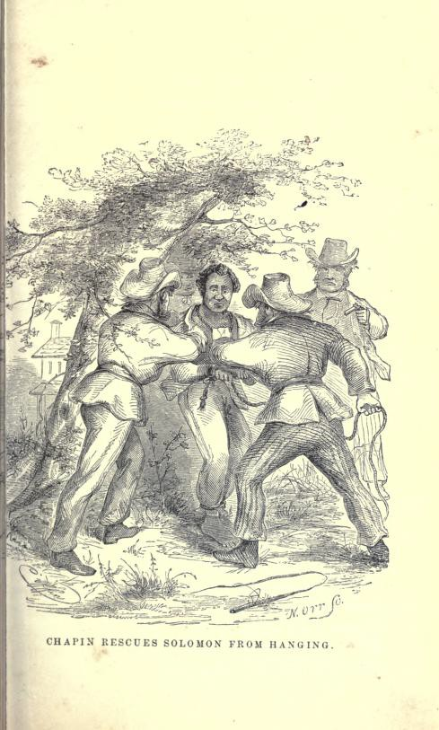
Northup’s Rescue
1852: Northup meets a sympathetic Canadian carpenter in the summer.
  With his aid, Northup put into motion a series of events that enabled him to be rescued.
  Recognizing an ally, Northup enlisted the carpenter's help writing letters to two white friends in Saratoga, NewYork.
  Ann Northup, his wife, spearheaded gathering the proper legal documentation to rescue her husband.
1853: Rescue on January 3

Slide 7
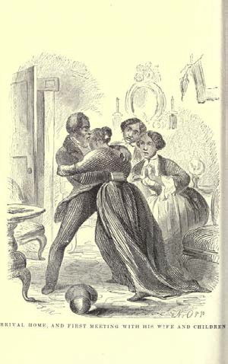
Efforts Failed to Bring the Washington, D.C. Slave Trader Who Illegally Purchased Northup to Justice.
This failure was in part due the fact that Northup was a black man who could not testify against a white man in Washington, D.C. courts.
Northup's later efforts to bring his kidnappers to justice also failed.

Slide 8
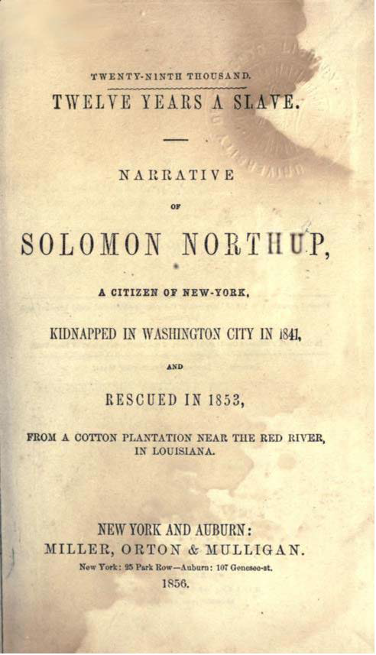
Northup's Sudden Fame: Popularity of Twelve Years a Slave
Newspaper stories appeared shortly after he returned home his family;
His fame thrust him into the limelight; he was in demand on abolitionist speakers' circuits.
By the summer of 1853, his narrative was published in Auburn and Buffalo, New York, as well as in London, England.
The book was highly praised and became a bestseller.

Slide 9

Twelve Years a Slave:
a rarity among popular slave narratives for two reasons:
Northup was a free black kidnap victim; most narratives were accounts of fugitive slaves — individuals born into slavery who escaped.
David Wilson, an author and sometime novelist penned Northup's narrative as a "ghostwriter."
  Wilson wrote in the first person as though Northup were himself telling it.

Slide 10
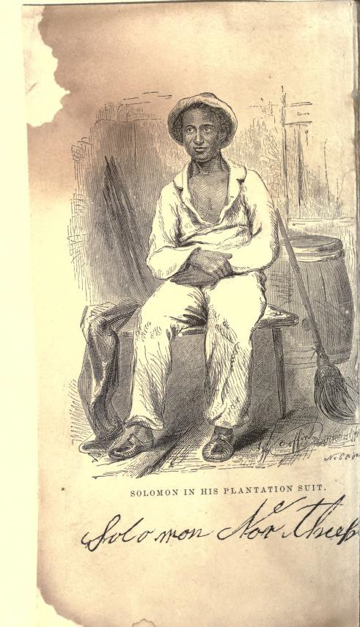
Slave Narrative Types
Northup's narrative was a rarity because it had a ghostwriter. It falls into the category of an "As told to" narrative. Most slave narratives were of two types: (Note: It is a learning outcome that students understand these two types.)
  “Written by himself/herself,” in which the former slave authored the narrative with little or no input from white editors.
  “Narrated by himself/herself,” in which the former slave recited his experiences and views to an editor, who transcribed the oral narration and shaped it into a publishable text.

Slide 11
Credibility, i.e.Truthfulness, of Narrative
Because Wilson was ghostwriter, the credibility of the narrative has been questioned.
  Wilson, in the editor's preface, goes to lengths to convince the reader of the narrative's credibility. (In Activity 2 students analyze this text.)
  Scholars today believe TwelveYears a Slave to be historically accurate and verifiable.
Credibility of slave narratives has always been an issue because:
  They were propaganda for the antislavery movement;
  The inhumanity they report can seem too depraved to be real;and
  The involvement of white editors calls into question who is actually doing the writing.

Slide 12
Bestseller in the 1850s; a 2013 Hollywood Movie
Whenever research has been done to authenticate the experiences and events reported in slave narratives, they have been verified.
By 1856, TwelveYears a Slave had sold 30,000 copies; this rivaled Frederick Douglass’ 1845 Narrative in its first five years of publication.
In 2013, 12Years a Slave, a major commercial movie, was released.The book made The NewYork Times Bestseller List.

Slide 13
Solomon Northup's Narrative in the Context of the Slave Narrative Tradition
(from William L. Andrews' Essay of the same name.)
Purpose of slave narratives: to convert readers' hearts and minds to the antislavery cause; narratives written after the Civil War aimed to expose the inhumanity and injustice of slavery.
Slave narratives have inspired major works of American fiction including:
  Harriet Beecher Stowe's Uncle Tom's Cabin (1853);
  Mark Twain's Adventures of Huckleberry Finn (1883);
  Ralph Ellison's Invisible Man (1952);
  Ernest Gaines' The Autobiography of Miss Jane Pittman (1971);
  Alex Haley's Roots (1976);
  Tony Morrison's Beloved (1987); and Edward P. Jones' The KnownWorld
(2004 Pulitzer Prize winner).

Slide 14
How Did Slave Narratives Aim to Achieve Their Purpose?
By documenting how slavery undermined and perverted the principal institutions upon which America was founded:
In the political sphere, representative democracy;
In the religious sphere, Protestant Christianity;
In the economic sphere, capitalism; and
In the social sphere, marriage and the family.

Slide 15
How Did Slave Narratives Aim To Achieve Their Purpose?
Basic Civil Rights: Freedoms of worship, to vote, to contract one’s labor, and to marry—were, for enslaved black Americans, unavailable or severely constricted before 1865.
Vocabulary:
  "undermine": to erode or destroy the foundation. As in "undermining the foundation" of representative democracy.
  "pervert:” to distort or alter something from what it was originally intended to be. As in "perverting" the institution of marriage so that it is so compromised and mutated that it no longer has traits that define a "marriage“.

Slide 16
Representative Democracy: How Did Slavery Undermine and Pervert It?
It did not/could not exist in half of the United States before 1865.
  The Three-fifths Clause, guaranteed the slave states that every slave, though denied the right to vote, would count as three-fifths of a person for legislative apportionment in the Congress.
  The power of the South in the Congress grew with the increase in numbers of slaves, even though representative democracy weakened (and was made a mockery of).
The legacy of slavery – segregation and racial discrimination
– continued in the U.S. for most of the 20th century and continued to undermine democracy.
Many argue this legacy continues in more subtle forms today to undermine representative democracy.

Slide 17
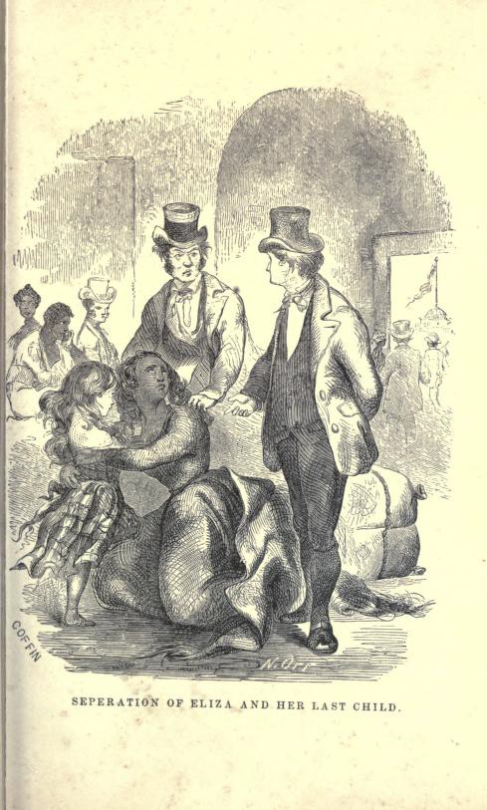
Protestant Christianity: How Did Slavery Undermine and Pervert It?
It challenged a Protestant Reformation fundamental tenet: the equality of every soul before God. According to the "chattel principal“, a slave was property and could therefore not have a soul.
  The institution of slavery held that blacks were inferior spiritually and needed white people to minister to and teach them how to believe and to be Christians.

Slide 18
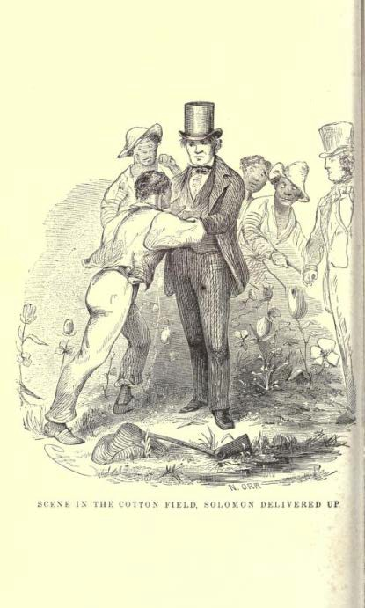
Capitalism: How Did Slavery Undermine and Pervert It?
A free market economy in half the United States was not possible until 1865; much of labor in pre-Civil War South was done by unfree workers.
Capitalism posits that there's a natural flow of supply and demand governed by voluntary, compensated, and contractual participation in markets.This is not possible with forced slave labor.
Governmental protection of the institution of slavery abetted the slaveholding minority in the South to concentrate its wealth in property and to resist joining the rest of the U.S. in modernizing its economy beyond agriculture.

Slide 19
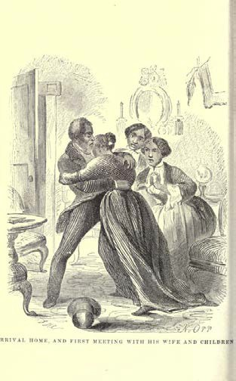
Marriage: How Did Slavery Undermine and Pervert It?
Forbade enslaved people the right to legally sanctioned marriage or any legal authority over the children born to an enslaved couple.
  The destruction or "breaking up" of enslaved couples and their children was common under slavery.
  The children of enslaved women by enslaved or white men had no protector beyond the slave owner; their physical abuse and sexual exploitation was common. Free black children risked being kidnapped and sold into slavery.
The belief that a slave's body belonged to the master led to sexual exploitation of enslaved women, who had no right to resist.
  The intense jealousy of legal wives and children directed toward enslaved women and often toward the mixed race enslaved offspring led to violence and destruction of white marriages and families, as well as destruction of the lives of enslaved women and children.
* (Note:Text analysis activities in the lesson will focus on this aspect.)

Slide 20
Wrap-Up and Transition to Activities
To reiterate: the institution of slavery undermined and perverted the principal institutions upon which the nation was built.
  Northup's narrative especially reveals how slavery undermined and perverted the institution of marriage and family.
    The challenge in Activity 1 is to identify examples of slavery's corrosive effects on the institution of marriage and the family. Re-emphasize what these are, (see: F. 1.– 4.)
    In Activity 2, the challenge is to analyze the Editor's Preface written by David Wilson, the ghostwriter. Identify and analyze how and why he aims in the preface to convince the reader of the narrative's truth.
  When analyzing the text excerpts, students will have to "read between the lines" or make inferences about what the text implies.

Slide 21
Bibliography and Image Citations
All images are from TwelveYears a Slave: Narrative of Solomon Northup, a Citizen of New-York, Kidnapped inWashington City in 1841, and Rescued in 1853. NewYork and Auburn [N.Y.]: Miller,
Orton, and Mulligan, 1856. At: Internet Archive
https://archive.org/details/twelveyearsslave00nortuoft. Images are listed below.
SOLOMON IN HIS PLANTATION SUIT [Title Page Image]; SCENE INTHE SLAVE PEN AT WASHINGTON; SEPERATION [sic] OF ELIZA AND HER LAST CHILD; CHAPIN RESCUES SOLOMON FROM HANGING; THE STAKING OUT AND FLOGGING OF THE GIRL PATSEY; SCENE INTHE COTTON FIELD, SOLOMON DELIVERED UP; ARRIVAL HOME, AND FIRST MEETING WITH HIS WIFE AND CHILDREN.

