Slide 1


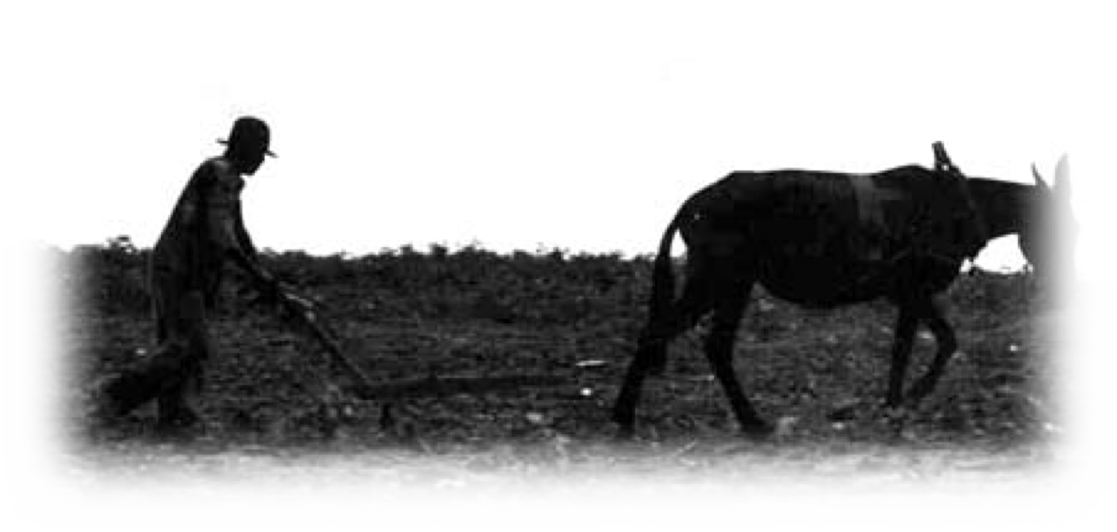





From Slavery to Sharecropping
To view this PDF as a projectable presentation, save the file, click “View” in the top menu bar of the file, and select “Full Screen Mode”
To request an editable PPT version of this presentation, send a request to CarolinaK12@unc.edu

Slide 2
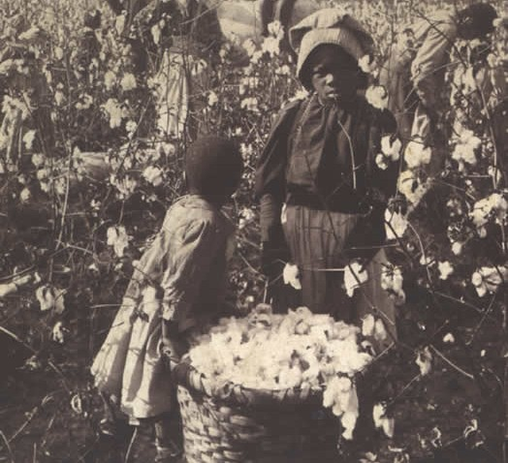

Slide 3
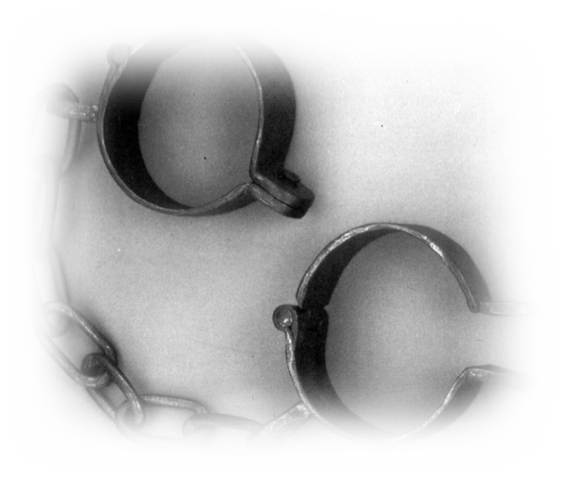

The End of Slavery
During the Civil War, President Lincoln issued the Emancipation Proclamation, which declared slaves in the Confederate States free.
When the North won the war, in 1865, Congress passed the
13th Amendment, prohibiting slavery.
Some freed slaves chose to leave the plantations; others moved to the North to seek work or to start their own businesses. Some people went out West to be settlers or cowboys and a few people went back to Africa.
Some remained where they were. Whether due to having family members who could not travel or lacking the resources to leave, some freed persons decided to stay in the South.
What do you think you would do?

Slide 4
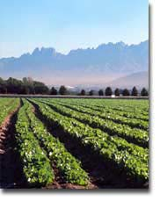
Sharecropping Originates at the End of the Civil War
Freedom came during the Spring, when it was time to plow the fields, put in seeds, etc. Plantation owners panicked regarding how the work formerly done by slaves would get completed.
Many of the freed Black Southerners who remained in the South wanted to work as FREE men. They wanted a chance to be their own person, provide for their families, and reap the rewards of their own labor.
Thus, out of duel necessity many Blacks made arrangements with their former masters to plant the crops that season, receiving a portion of the crop or other necessities as payment.
Such relationships evolved into tenant farming
and sharecropping.

Slide 5
Could Freed Slaves Succeed as Sharecroppers?
Many freedmen negotiated and struck bargains with the landowners.
“Boss, I've got my own mule. I've got my own plow and I’ve got five children who can work in the field. Look at the crop we produced last year. It was the biggest you’ve had.
How about you give us more land to sharecrop on, we’ll keep working just as hard, and you give us a larger portion of the crop this year?”
Why would a formerly enslaved person make such a decision/deal with their former owner?
Why might this new relationship between newly freed slave and former owner be complicated?

Slide 6
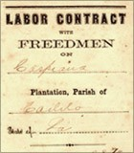
Could Freed Slaves Succeed as Sharecroppers?
Plantation Owner: Okay, I’ll tell you what. You and your family have always been excellent workers. I'm going to have you work that land over there. Let's see what you can come up with, and I'll pay you a certain amount per day.
Freedman: Well, boss, can we put that on paper?
You know, I need to be sure that we can get paid. Some folks have told me that up North, when you work for somebody else, you have a contract. You say right at the outset how much it's going to be and how much you’ll get paid.
Plantation Owner: You're doubting my word?
How dare you! Are you trying to accuse me of not paying you come the end of the year?
Freedman: No sir, I'd just feel better if we had a contract.

Slide 7
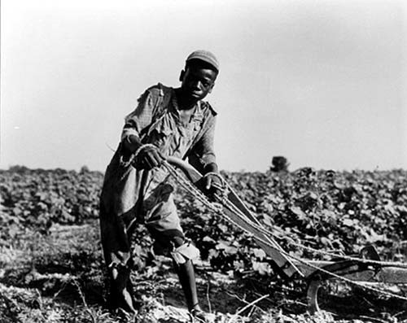
Could Freed Slaves Succeed as Sharecroppers?
The relationship between a white landowner and a freed Black was often challenging.
Keep in mind, landowners were used to their farmwork being done for free, without question. Landowners now had to get used to dealing with former slaves as FREE MEN.
Thus, landowners were often unfair and spiteful in their interactions with workers.
The Freedmen's Bureau could sometimes assist; for example, Bureau agents would sometimes create a contract for the two parties.
While the landowner would be furious over this notion, he was also desperate for workers.

Slide 8


Slide 9
Freedmen’s Bureau “Model Contract”
Freedmen's Bureau officer Martin R. Delany drew up a model contract for a sharecropping arrangement.
His contract required payment of one-third of the crop to the laborer and offered some protection from abuses by the landowner.
The following excerpts from this model contract gives a sense of some of the injustices sharecroppers needed protection from:
  No labor is to be performed by hand that can better be done by animal labor or machinery.
  All Thanksgiving, Fast Days, "Holidays" and National Celebration Days are to be enjoyed by contractors without being regarded as a neglect of duty or violation of contract.
  Good conduct and good behavior of the Freedmen toward the proprietor; and good and kind treatment of the Proprietor to the Freedmen, will be strictly required by the Authorities.

Slide 10
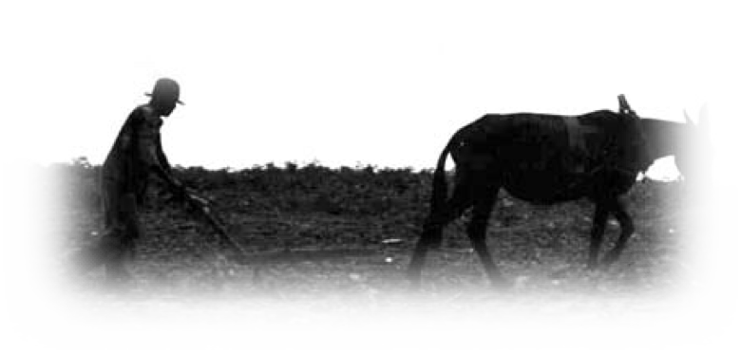
Freedmen’s Bureau “Model Contract”
In all cases where an accusation is made against a person, the Proprietor or his Agent, [and] one of the Freedmen selected by themselves, and a
third person chosen by the two shall be a council to investigate the accused.
In all cases where a decision is to be made to dismiss or forfeit a share of the crop, the officer of the Bureau or some other Officer of the Government must preside in the trial and make the decision. When the Proprietor is prejudiced against an accused person, he must name a person to take his place in the Council.
Based on these excerpts from the Bureau’s model contract, what types of mistreatment did sharecroppers need protection from?
How might contracts created by the landowner differ than a contract created by the Freedmen’s Bureau?

Slide 11

You are a Lawyer for John Dawson…
Is this a good contract for him to sign?
In your group, read over the contract once.
  Note that Solid South, the lessor, is the landowner.
  John Dawson, the lessee, is the sharecropper.
After an initial read, go paragraph by paragraph and try to decode the “legal” language. Discuss:
  According to the contract, what is Dawson responsible for?
  What powers does Solid South have over Dawson?
  What does the contract stipulate regarding how long Dawson can use and live on the land?
  What arrangement is made regarding supplies?
  What arrangement is made regarding Solid South’s cotton gin? Does this seem like a fair deal? Why or why not?
  How does Solid South secure his payment of rent and supplies? What might this mean for Dawson?
  Based on your critique of this contract, is it fair? Why or why not?
  Who does the contract benefit overall? What evidence makes you draw this conclusion?
  Why might Dawson agree to sign this contract?

Slide 12

Could Freed Slaves Succeed as Sharecroppers?
Often, when the end of the year came and it was time for a family to go get their share of the crop and/or money, the landowner would be full of excuses.
"Well, you've all got a good crop in this year, but remember when I loaned you that money for medicine for your little girl? And I see here that you got some supplies back
in December. When we add on all the food I’ve given you, it turns out you actually owe me some money.
But I tell you what I'm going to do… We'll make the same arrangement again this year. And, maybe you can work your way out of this debt.”

Slide 13
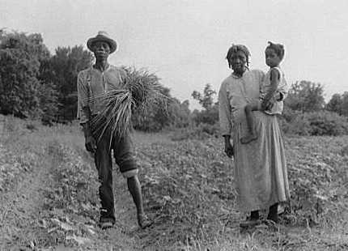
Could Freed Slaves Succeed as Sharecroppers?
"We worked this entire year, and we have nothing to show for it? All we've done is keep ourselves alive? All those days we worked in the scorching heat, and the late nights we’ve worked out there by the light of the moon, and all the times when my wife was just too sick to come out there but she did anyway, and we don't have anything? We
have less than nothing? But, what choice do we have? I guess we’ll have to do it again this year. Maybe we'll have better luck. Maybe the rain will come at the right time
this year and we'll get a bigger crop in. Maybe the prices will bounce back a little bit."

Slide 14
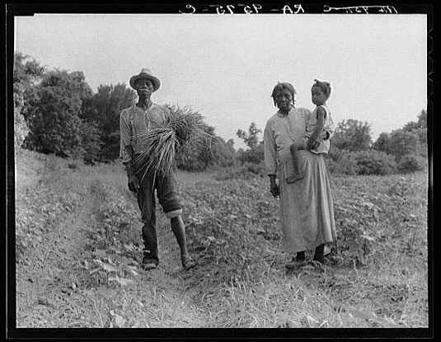

Slide 15

Could Freed Slaves Succeed as Sharecroppers?
But often, at the end of the next year, the outcome would be the same:
“It didn’t rain enough this year and our crop is smaller. Not to mention, the prices in North Carolina are down. You still owe me money so you're going to have to stay here. If you try to leave, the sheriff is going to come arrest you for running out on your debt."

Slide 16
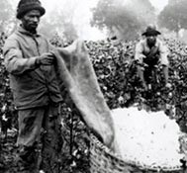
Could Freed Slaves Succeed as Sharecroppers?
Beyond white landowners taking advantage of sharecroppers, the larger economic context in the South after the Civil War was not good.
Cotton prices were falling and world demand for cotton was slowing.
The credit system in the South had been based on a "crop lien” system, where people would borrow money pledging the future cotton crop as their collateral to a merchant. This lead to over-production of cotton and further declines in the price.
Sharecroppers and tenant farmers often found themselves in debt at the end of the year, with more to come in future years.
While freed black families certainly had far more independence than they had as slaves, sharecropping often deprived them of the economic independence that they hoped for.

Slide 17
Amazing Accomplishments in Spite of Adversity
One of the miracles of the Reconstruction era and the period that followed is that despite having been slaves, despite starting over with absolutely nothing, through their hard work and perseverance, freed slaves were able to begin building a life.
Many sacrificed, scrimped and saved and bought land for themselves, building a better future for their children.
Illiterate freed persons found a way to educate their children and often themselves.
Even with all of the difficulties they faced in a period rife with racism, freed people used their intelligence and skills to do the best they could in an unjust world.
While the stories of subjugation and poverty are important to learn, it’s also important to acknowledge that despite all those things, African Americans in the South were able to fight their way up into a better life for themselves and their families.

Slide 18
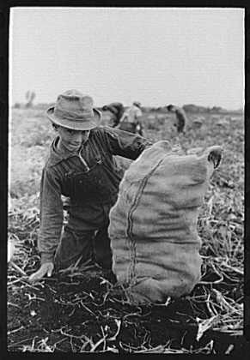
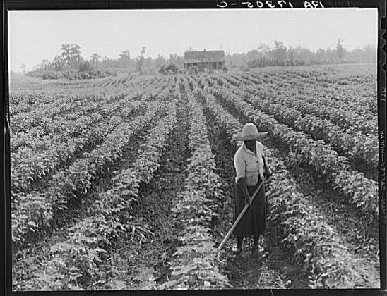
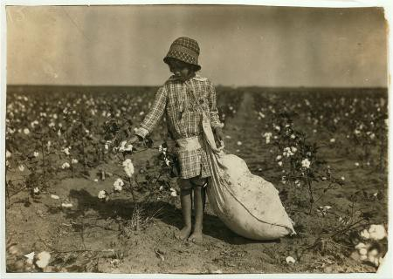
Sharecropping and Tenant Farming Continue
While sharecropping was a post-Civil War development, sharecropping and tenant farming remained a dominant form of business in the cotton South from the 1870s to the 1950s, among both blacks and whites.

Slide 19
