Slide 1
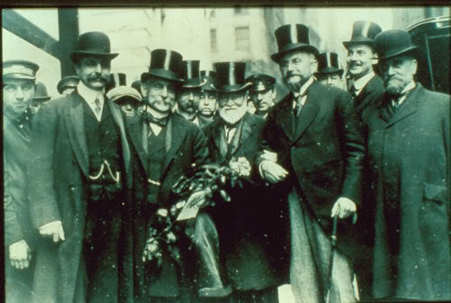
"Robber barons" or
"captains of industry"?

Slide 2
Bellwork terms to define:
Robber Baron: an American capitalist who got rich at the expense of others, exploited natural resources, or had unfair government influence.
Captains of Industry: business leaders who built a personal fortune and contributed positively to the country through jobs and philanthropy (charity)
Trust: a monopoly, where a single company or group owns nearly all of the market for a product/service
READING: The Gilded Age

Slide 3
Vocab Terms:
Trustbuster: a person or agency employed to enforce antitrust laws
Disparity: a great difference
Equitably: fair and impartial
Assimilate: take in and fully understand (information, ideas, or culture)

Slide 4
Who are these "Titans of Industry"
https://www.youtube.com/watch?v=b0bieBdh19k
Essential Questions:
How do these industrialists HELP America and how do they also perhaps HURT America?
How do the lives of the business owners and the workers compare/contrast?

Slide 5
Cornelius Vanderbilt
http://www.history.com/topics/john-d-rockefeller/videos/the-men-who-built-america-the-rise-of-cornelius-vanderbilt?m=528e394da93ae&s=undefined&f=1&free=false

Slide 6
Notes to take on the Tycoons/Business Owners:

Slide 7
"Commodore" Cornelius Vanderbilt
Made his name in the shipping industry
Began ferrying people across NY Harbor
Got a contract from the U.S. government during the War of 1812
Provided transportation to California for prospectors during the Gold Rush
Moved into railroads just before the Civil War
Acquired the NY Central Railroad in 1869
Built the Grand Central Depot in NY City
Shrewd businessman known for cutthroat business tactics

Slide 8
John D. Rockefeller & Standard Oil
http://www.history.com/topics/john-d-rockefeller/videos/the-men-who-built-america-monopoly

Slide 9
ROCKEFELLER:
America's first billionaire
Sold produce and candy as a young man to help make money for the family
Got into the oil refining industry in 1863
Saw a profit in the "waste by-products" of crude oil
He cut deals with the railroads and ran other companies out of business
Founded Standard Oil (controlled 90% of America's refineries)
Donated $500 million

Slide 10
Andrew Carnegie & U.S. Steel
http://www.history.com/topics/john-d-rockefeller/videos/andrew-carnegie?m=528e394da93ae&s=undefined&f=1&free=false

Slide 11
CARNEGIE:
Scottish born "Rags-to-Riches" story
Started work as a "bobbin boy" in a cotton factory for $1.20 a week, then as a telegraph operator for the superintendent of the Pennsylvania Railroad
Invested in telegraph, iron, and oil companies before creating Carnegie Steel
Amassed wealth through vertical monopoly strategies
His reputation was hurt by the violence of the Homestead Strike
Sold Carnegie Steel to Morgan for $480 million
Devoted the rest of his life to philanthropy through his "Gospel of Wealth"
"The man who dies thus rich dies disgraced." He gave away up to $350 million to build libraries, organs for churches, and Carnegie Hall

Slide 12
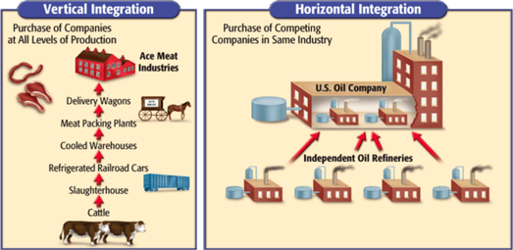

Slide 13
J.P. Morgan
http://www.history.com/topics/john-d-rockefeller/videos/the-rise-of-j-p-morgan?m=528e394da93ae&s=undefined&f=1&free=false

Slide 14
MORGAN:
Born into a wealthy New England family
Followed his father into banking
Used his wealth to consolidate and reorganize financially troubled railroads, gaining controlling stock in 1/6 of America's rail lines
In America's financial crisis of 1895, he loaned the federal government $60 million
Bought Carnegie Steel and then created U.S. Steel Corporation

Slide 15
So how and why did a select few get so prosperous?
SOCIAL DARWINISM:
Social Darwinism was the application of Charles Darwin`s scientific theories of evolution and natural selection to contemporary social development. In nature, only the fittest survived—so too in the marketplace. This form of justification was enthusiastically adopted by many American businessmen as scientific proof of their superiority.
GOSPEL OF WEALTH:
The Gospel of Wealth, or sometimes the Gospel of Success, was the term for a notion promoted by many successful businessmen that their massive wealth was a social benefit for all. The Gospel of Wealth was a softer version of Social Darwinism. The advocates linked wealth with responsibility, arguing that those with great material possessions had equally great obligations to society

