Slide 1
The American Revolution Part One: The events leading up the Revolutionary War (1750 – 1775)

Slide 2
Historically speaking, right now “we” are British.
The Colonies are an extension of Britain, so we share their government, their identity, their pride, and also their enemies.
There is NO United States of America.
Taunton Flag, flown by colonists to show unity with the British crown.

Slide 3
What brought the colonists?
Cheap land
Religious Tolerance
Economic Opportunity
Self-government!

Slide 4
Population of the Colonies Explodes
Because of religious freedom, success in farming and business, and the prospect of greatness, America quickly grew.
In 1607, there are barely 100 colonists.
In 1650, there were 50,000 colonists.
In 1750, there were 1,200,000 colonists.
Colonists are in love with their new home, but seek other opportunities. They have a little greed for more success, more money. They seek to move west for more of that!

Slide 5
Effects of the of French & Indian War
The Treaty of Paris officially ended the War.
As a result, the French lose every single possession in North America. They lose EVERYTHING! As a result:
The colonists had an open path to settle in the Ohio River Valley.
Also, the Native Americans are left with no allies or trading partners.
The colonists earn experience in large-scale warfare, not to mention the “mentorship” of fighting with the British for nearly 10 years.
Britain suffers huge expenses, and is forced to pay for the war by taxing the same people they believed they were fighting for...

Slide 6
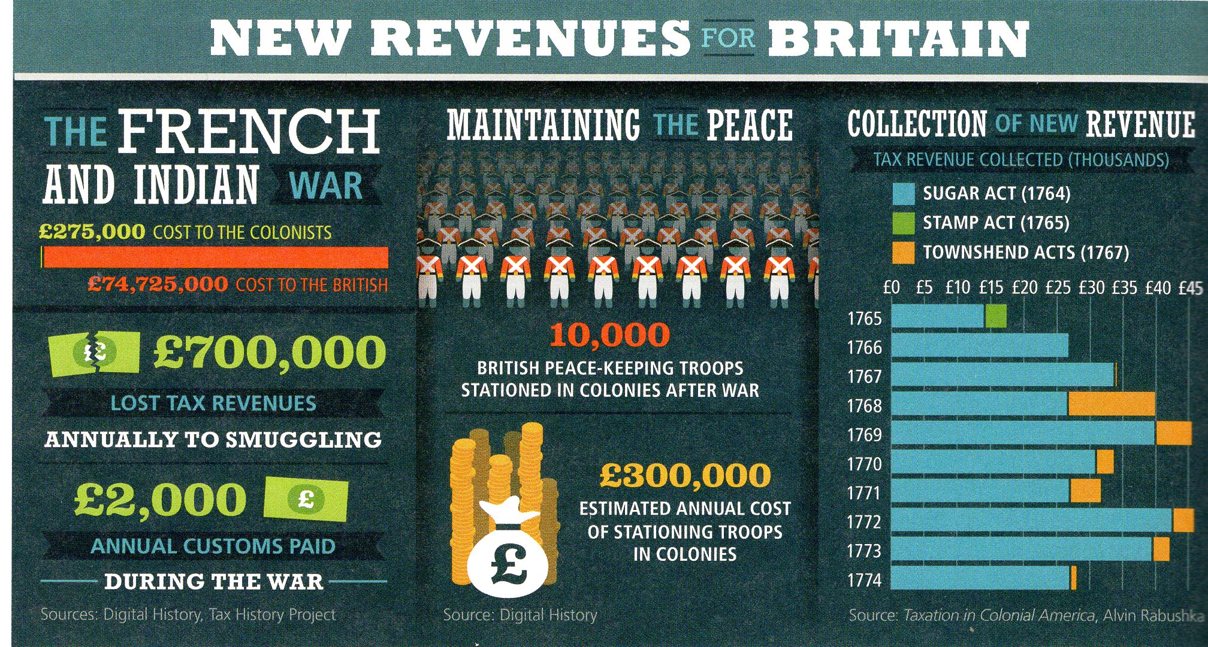
British Efforts Lead to Bad Results…

Slide 7
Road to Revolution
1763
Proclamation of 1763
Prohibited colonists from settling west of the Appalachian Mountains
Disliked by many of the colonists
2

Slide 8
Before the War
After the War
Colonists have moved westward
Colonies end at Appalachians
Why, again, are the colonists
moving west?

Slide 9
The beginnings of struggle between Britain and the colonies.

Slide 10
England In Debt Due to War
Fighting the French and Indian War was very expensive for England and King George III saw the colonies as his ticket out of debt

Slide 11
Paying for the War
King George began to create ridiculous taxes that the colonists would have to pay.
The idea was that this tax money was going to go back to England to help it recover some of the money lost during the French and Indian War. The colonists quickly grew very angry about the taxes they were now being forced to pay.

Slide 12
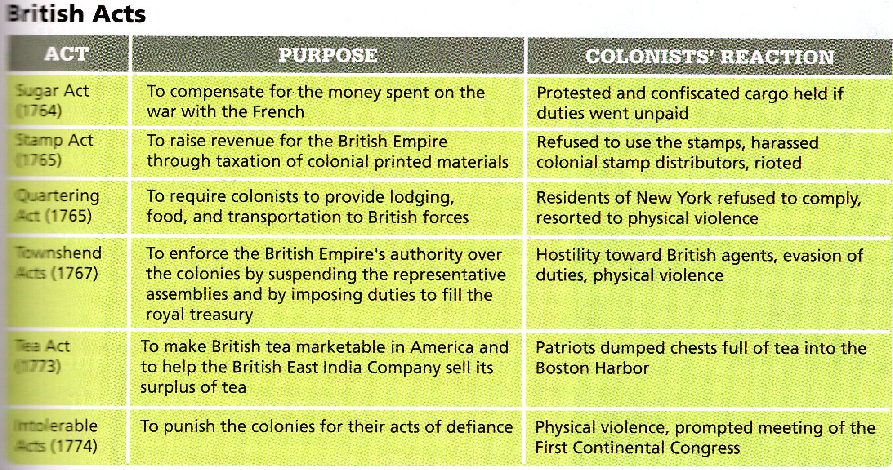
New Taxes Create Trouble…

Slide 13
After the F/I War, the British Apply
Three New Taxes within 5 years
Sugar and Molasses Act – 1764 – molasses (a major source of money for colonists) was taxed.
Was actually a renewal of a prior act, but angered the colonists with new provisions.
Forbid the colonies from trading with any other nation.
Traders now had to keep detailed records.
Those suspected of crimes were tried by a local judges (loyal to Britain?), without a jury.
Colonists began to boycott British goods. How do you think this could be a good thing?

Slide 14
Stamp Act – 1765 – all legal documents and printed papers.
Was viewed as the highest revenue-building tax.
As soon as the tax was approved by Parliament, British officials sent out tax collectors called “Stamp Agents.”
Says the law itself:
“Lastly, That it is the indispensable duty of these colonies, to the best of sovereigns, to the mother country, and to themselves, to endeavour by a loyal and dutiful address to his Majesty, and humble applications to both Houses of Parliament…”

Slide 15
Translated…
“Lastly, it is the central duty of these colonies, for the good of the King, for the good of Britain, and to themselves, to try to be loyal and dutiful to his Majesty, and respect the laws of both Houses of Parliament…”

Slide 17
Road to Revolution
Boycott
Refusal to buy goods or have dealings with a country or other entity
Colonists boycotted (or, refused to buy or sell) British goods
7

Slide 18
Road to Revolution
Sons/Daughters of Liberty
Protest group who helped organize boycotts
Sam Adams was an outspoken leader of the Sons of Liberty in Boston
Women signed pledges against drinking tea, promised not to buy British-made cloth, and met at spinning clubs to make their own cloth
6

Slide 19
TARRING THE TAX COLLECTORS
The colonists got so upset about the British taxes that there were several stories about the colonists grabbing tax collectors, dumping hot tar on them, and then pouring boiling hot tea down their throats.

Slide 20
Why are the colonists upset?
Continued taxation without representation.
Goes against their “freedom of speech.”
If papers publishing opposing views are taxed, aren’t they less likely to be published?
Made things more expensive!

Slide 21
A matter of perspective?
How do you think the British felt about the colonists “temper tantrum” in response to the Stamp Act?
“And now will these Americans, children planted by our care, nourished up by our Indulgence until they are grown to a degree of strength and opulence, and protected by our arms, will they grudge to contribute their mite to relieve us from heavy weight of the burden which we lie under?”
- Charles Townshend, British Politician

Slide 22
The colonists respond… well, they respond with “mixed maturity.”
The governments of several colonies (i.e. Virginia, Massachusetts) issue statements to Britain, demanding fair treatment.
They hung the tax collectors in effigy.
Sam and Abigail Adams led the new “committee of correspondence.”
Colonists storm the office of (tax collector) Andrew Oliver… and destroy it.
Many colonies gathered at the “Stamp Act Congress” to determine a unified, dignified solution.
Colonists storm the home of (Lt. Governor) Thomas Hutchinson… and destroy it.

Slide 23
Conclusion of this spat…
British Prime Minister Greenville loses his job.
The Brits repeal the Stamp Act just one year later, but would threaten the colonies even while doing so.
Parliament has… “full power and authority to make laws and statutes of sufficient force and validity to bind the colonies and people of America...in all cases whatsoever.“
-Declaratory Act of 1767
What message have the British and the colonists sent each other so far?

Slide 24
Townshend Act – 1767
Levied a tax on glass, lead, paper, paint and tea.
Also authorized writs of assistance.
Established new courts for colonists to be tried in (for expected protests?)
Colonists responded with more protests, calls for boycotts, and smuggling of illegal goods.
Eventually (3 years later), the taxes on goods would be taken away, leaving only a tea tax remaining.
Quartering Act – 1765
Britain asked the colonies to host 1,500 soldiers and supply them necessities to live.
Colonists flat out refused, and British soldiers had to sleep on their ships.

Slide 25
Britain’s continued actions lead the Colonists to unite in rebellion.

Slide 26
Road to Revolution
1770
Boston Massacre
Boston citizens were angry at the sight of red-coated soldiers on the streets.
Group of Boston civilians began insulting and throwing snowballs at a British guard. More soldiers arrived.
Mob of civilians surrounded soldiers in protest, and in the confusion the soldiers fired their guns into the crowd and 5 civilians died.
Following Boston Massacre, Townshend Acts were repealed (ended), except for the tax on tea.
10

Slide 27
Boston Massacre

Slide 28
What is Propaganda?
Propaganda is information that is spread for the purpose of promoting some cause.
What was the cause/reason for calling the shooting of five people in Boston a massacre by the English soldiers?

Slide 29
1772
Committees of
Correspondence
Network of communication for passing along news of British activity to the colonies
Organized by Samuel Adams in Massachusetts
Also formed in other colonies
11

Slide 30
The Tea Act
•
•
After the Boston Massacre, the colonies stayed calm
Britain repealed the Townshend Acts—they did keep the tax on tea
•
Britain faced a new problem—The East India Company (largest in England) was losing money—to help it recover, Parliament came up with The Tea Act.
The company was not taxed to ship the tea to the colonies, but the colonies had to pay a tax to England for the tea.
The Act also let the Company decide which American merchants could sell the tea
Colonists were angry that Parliament would give one company total control over a trade.
•
•
•

Slide 31
Boston Tea Party
In response to the Tea Act of 1773.
Tea was actually made cheaper, but the law cut colonial businesses out of money making.
Allowed the East India Company to become a monopoly, becoming the colonies only source of tea.
Naturally led to a boycott on tea, but it failed.
Believed to be initiated by the Sons of Liberty.
Attacked the British ships Beaver, Dartmouth, & Eleanor.
Inspired colonists to begin smuggling tea themselves.
In 1773, the EIC imported 555,000 pounds of tea.
In 1773, colonists illegally smuggled over 900,000 pounds.

Slide 33
Responses to the Tea Party
In the Colonies…
Colonists are split - many are energized at the protest for giving voice to their frustrations. However, a large minority is angry with the barbarian-like actions of SOL
Tea protests become widespread in the colonies, including the “Annapolis Tea Party,” where colonists demanded the HMS Peggy Stewart and its contents be destroyed.
In Britain…
“The die is now cast… the colonists must either submit or triumph.”
Most Brits are now united against the colonists. What was viewed as a law (Tea Act) to fairly tax the colonists and recoup the expenses of their war to defend the colonies was responded to horribly.
All allies and those defending the colonies are appalled, leading to widespread resentment of the colonies.

Slide 34
The Americans have tarred and feathered your subjects, plundered your merchants, burnt your ships, denied all obedience to your laws and authority; yet so clement and so long forbearing has our conduct been that it is incumbent on us now to take a different course. Whatever may be the consequences, we must risk something; if we do not, all is over"
- Lord North, Prime Minister of England; comments on the Coercive Acts

Slide 35
The Intolerable Acts of 1774
The British are determined – once and for all – to show the Colonists that they are to be loyal and obey all Parliament laws. Otherwise, to coerce the colonists into action.
They respond to the BTP with a great show of force:
Boston’s port is closed.
Severely limited town meetings.
Called for all trials to take place in Britain or Canada.
Forced Colonists to allow soldiers to live in their homes.
Also formally charges several men with “high crimes and treason” – including John Hancock, Samuel Adams.

Slide 36
Intolerable Acts…

Slide 37
First Continental Congress
The foundation for this was laid down with the Committee of Correspondence.
Sons of Liberty had set up a committee in each colony, made up of Anti-British leaders.
Paul Revere’s first ride was through the colonies to personally invite everyone to a meeting to plan a unified response to Britain.
What does this sound a lot like?
Can unity convince Parliament to respect their wishes?

Slide 38
Work of the FCC
Members were elected, just as our Congress is.
A unified boycott was approved, through all the colonies, of British goods.
Almost all trade with Britain was ended – 98%, in fact.
Colonists were given power to observe and enforce the laws the FCC passed, to ensure true unity and consistency.
Also established a Second CC to meet one year later, to evaluate the progress of British-American negotiations.
However, will the Brits take it seriously?

Slide 39
These Declarations (of grievances) and freedoms “would be but waste paper in England.”
- John Adams’ argument regarding how the Continental Congress’ petition
would be received by Parliament and King George.
"We must fight if we cannot otherwise rid ourselves of British taxation, all revenues, and the constitution or form of government enacted for us by the British Parliament. It is evil against right — utterly intolerable to every man who has any idea or feeling of right or liberty. Fight we must, finally, unless Britain retreats.”
- Major Hawley

