Slide 1

North Carolina’s Regulator Movement
Colonial Corruption, the Regulators’ Response, & the Battle of Alamance
  To view this PDF as a projectable presentation, save the file, click “View” in the top menu bar of the file, and select “Full Screen Mode”
  To request an editable PPT version of this presentation, send a request to CarolinaK12@unc.edu

Slide 2
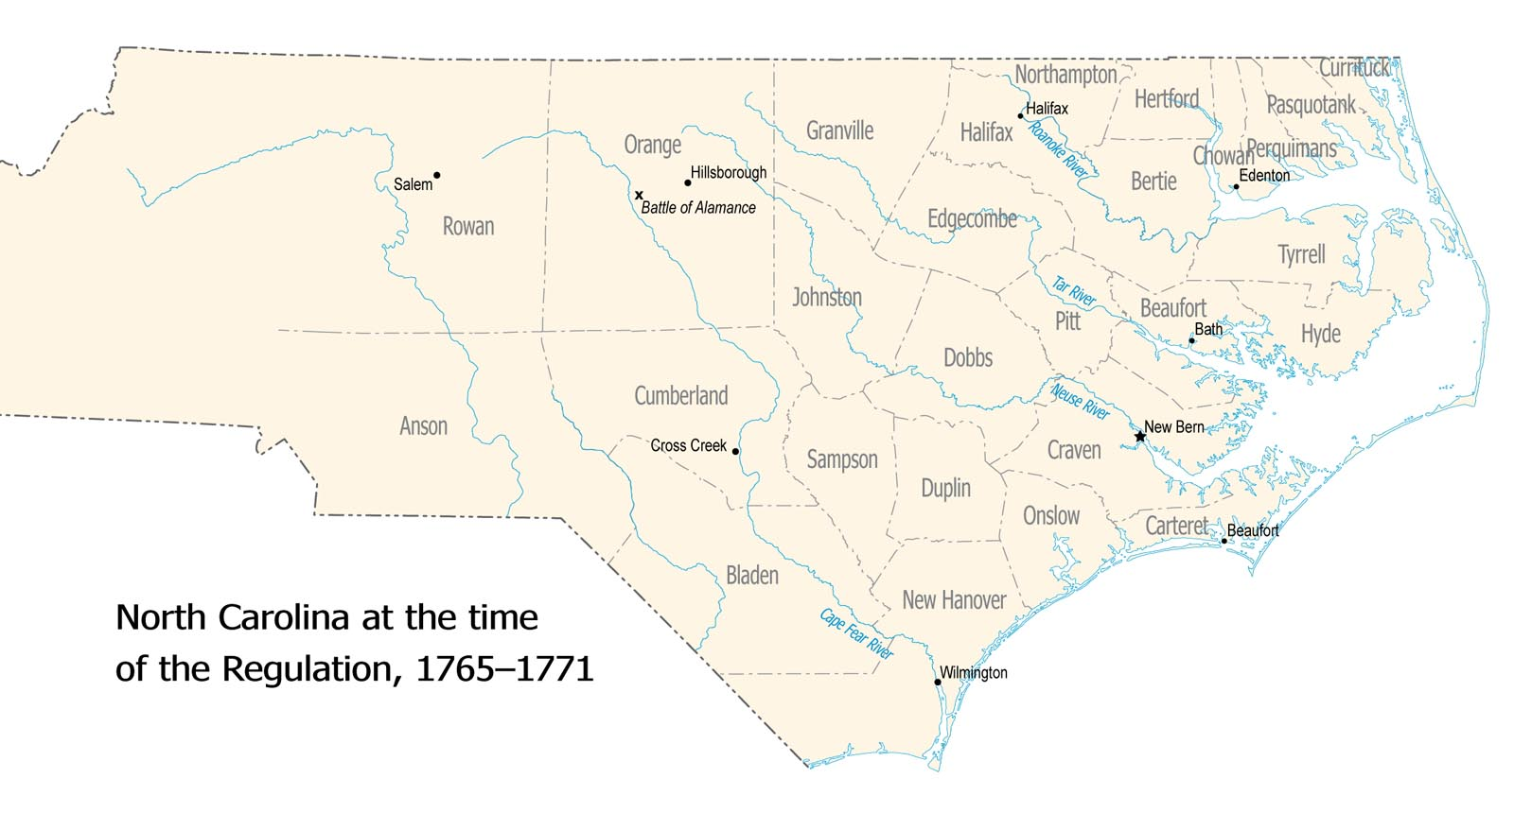
North Carolina in the 1700s
In the early 1700s, wealthy planters, merchants and lawyers were predominantly located in the eastern (and more developed) parts of North Carolina.
Lower-class citizens, such as working class people, farmers, newly arriving immigrants (i.e. Scots-Irish), etc. lived in the less expensive and less developed “back country” (further inland and what is considered today’s Piedmont region.)

Slide 3
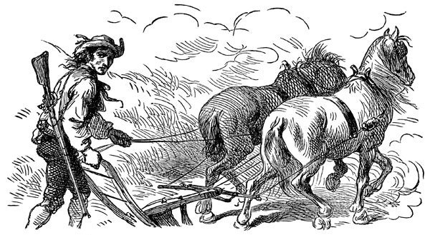
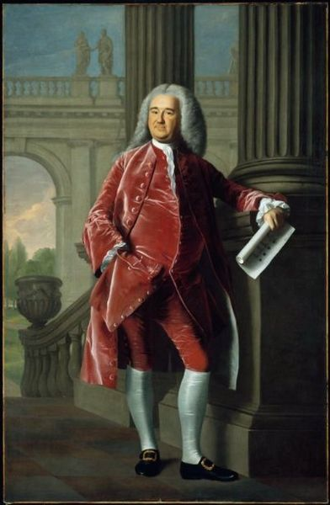
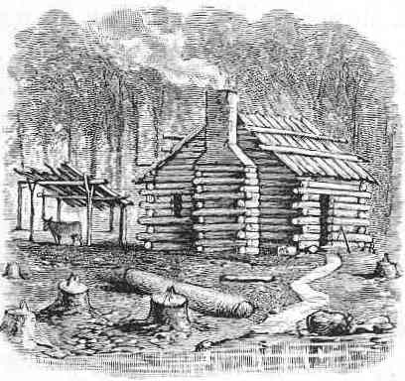
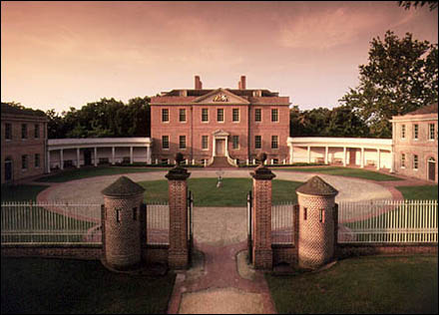

Slide 4
North Carolina – Population Changes & Sectionalism
Throughout the 1700s, deep-seated economic and social differences produced a distinct east-west sectionalism in North Carolina.
Originally, the western (today’s Piedmont) section of the Carolina colony was considered the “back country,” rustic land mainly composed of planters with an agricultural economy.
In the mid-1700s, thousands of farming families migrated from mid-Atlantic colonies to the back country, hoping to improve their lives and provide farms for their children.
Such newcomers became deeply disappointed by conditions in North Carolina, however.
  Speculators (men who bought land cheap, in order to sell it high) forced up land prices. This dashed newcomers’ hopes for cheap homesteads.
  The back country was also suffering from a deep economic depression, due to severe droughts that had previously occurred. The loss of crops removed the primary source of income & food for working farmers.
  This left many people financially vulnerable.
  Throughout this same period, wealthier people (merchants, lawyers, government officials, etc.) were moving into the “back country,” upsetting the social and political structure.

Slide 5
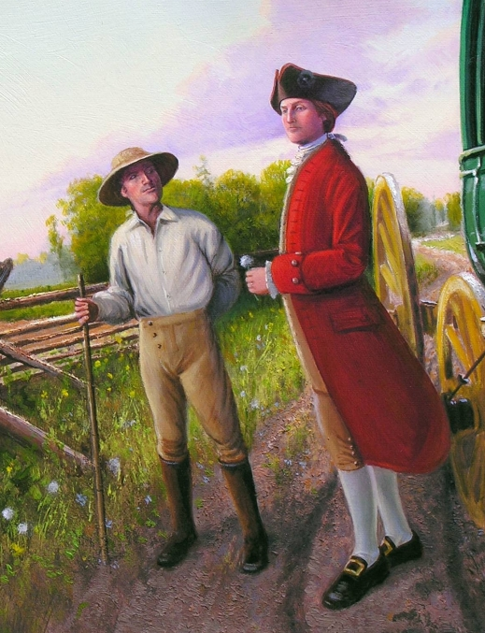
North Carolina Corruption
Such local officials were eager to get rich quickly, and often took advantage of back country planters.
They often charged high fees for government services, making it expensive for a farmer to go to court, pay his debts, or register his ownership of land.
This resulted in many farmers losing everything. They thus grew to resent the presence of the newcomers.

Slide 6
North Carolina Corruption
In addition, the colonial government was controlled by the eastern areas, and local county government officials were appointed by the royal governor. This meant citizens had no choice in who was in power and large-scale governmental decisions were often being made from “far away.
Such local officials (such as sheriffs) had the power to collect taxes, as supported by the courts. Yet, instead of turning over the taxes they collected to the government, as the law required, the sheriffs often kept the money for themselves.
  With tax collection occurring locally (with no oversight) & depending entirely on the honesty of local officials, extortion became problematic.
  For example, sheriffs would intentionally remove records of their tax collection in order to go back to residents to ask for more taxes.
  Eventually, a small clique of wealthy officials formed and became an exclusive inner circle in charge of the legal affairs of the area. The group was seen as a 'courthouse ring', or a small bunch of corrupt officials who grabbed most of the political power for themselves.
  The system was endorsed by the colonial governor, who feared losing the support of the various county officials.
As back-country people began to suffer from excessive taxes, dishonest officials, and exorbitant fees, they became more and more bitter towards the government and its officials.

Slide 7
Think, pair & share…
You are a hardworking farmer who lives in the back country. You have a small colonial homestead, which includes a one room cabin. You live here with your wife and 7 children. You’ve been working 14 hours a day for the past year trying to keep up with the debt of the purchase of your farm. (You purchased it from a speculator last year and have since learned that you paid more than it was actually worth.) Your days are spent trying to keep pests away from your crops, repairing fences and buildings, hunting for food, and doing everything in your power to keep food on the table for your family. You are a good citizen – you vote and you pay your taxes as demanded by the royal government. However, even though you paid your taxes to the sheriff last week, he recently returned insisting you still owe. He claims he has no record of your payment, and that if you do not turn over more money, you will have to answer to the judge. You have no more money to pay, but you feel sure the court will see that this is a mistake.
A neighbor insists that you need a lawyer, otherwise it will be difficult to prove your innocence. Even though you have no money to spend on a lawyer, you figure a small fee for legal representation will be better than repaying all of your taxes. You hire a lawyer and go to court. However, the judge ends up ruling in favor of the sheriff, claiming that if the record shows you owe the taxes then you must pay them. At the end of your hearing, your lawyer also demands twice as much money than the fee you originally agreed upon, claiming that your case required more hours of work than he originally thought.
You are furious. You feel that your hard earned money is being stolen by corrupt people in power. In talking to several neighboring farmers, you learn they have had similar experiences.
What do you do?

Slide 8
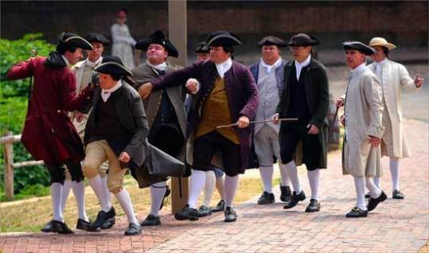
North Carolina Corruption
By 1764, several thousand people from North Carolina, mainly from Orange, Anson, and Granville counties had grown extremely dissatisfied with the wealthy North Carolina officials, whom they considered corrupt and unjust.
As citizen frustration grew, many appointed officials started to become targets of numerous threats and violence, including sheriffs, tax collectors, registrars, court clerks, and judges.
Royal governor Arthur Dobbs issued a proclamation against the taking of illegal fees, but that directive was ignored. Dissatisfaction grew and unrest spread among the people.

Slide 9
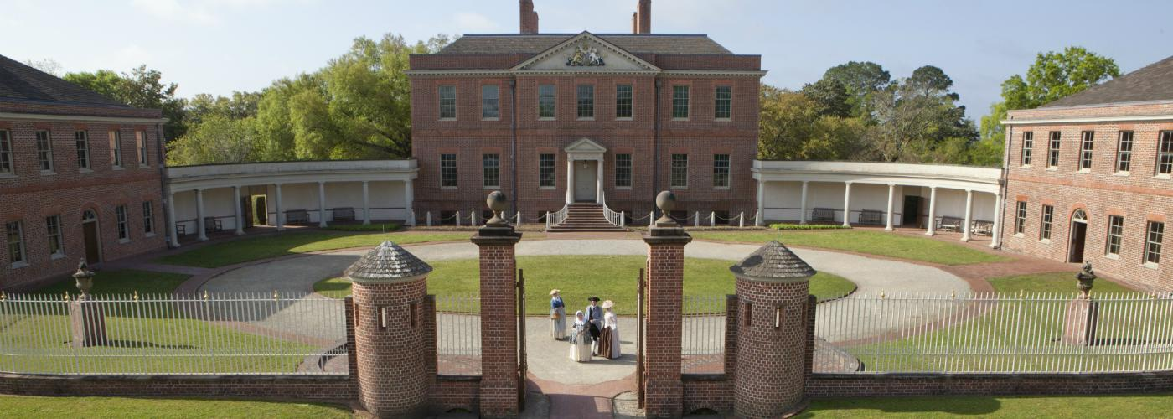
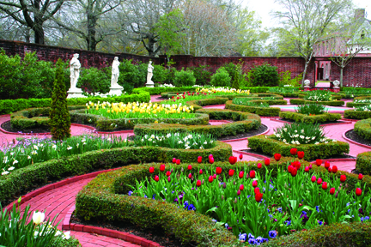

Slide 10
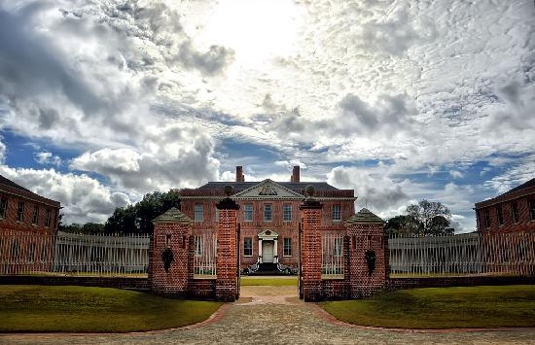
Governor William Tryon
1765-1771
Fanning the flames of anger…
A new governor, William Tryon, arrived in 1765.
He was a veteran army colonel.
Tryon became the cause of escalated anger, in part due to "Tryon's Palace," designed as both governor's home and capitol, which he constructed in New Bern at public expense (via a poll tax.)

Slide 11
The Regulators are formed
With their grievances having been largely ignored for years, a group of farmers assembled into an organization calling themselves the Regulators.
At first, the Regulators believed that if they simply explained their grievances to local officials, these men would grow ashamed and change their ways. But, perhaps not surprisingly, that strategy failed. Officials refused to meet with lowly farmers.
Next, the Regulators decided to complain to the governor and the colonial legislature, or Assembly. They presented petitions signed by hundreds of men (women were not supposed to sign petitions at that time). But petitioning did not work, either. Neither the governor nor the assemblymen wanted to make enemies among local officials, who, after all, managed elections.
Then the Regulators tried to take corrupt officials to court, to get them convicted for demanding illegally high fees. But judges and handpicked jurymen refused to convict their friends.
Lastly, farmers succeeded in voting several Regulator sympathizers into the Assembly. But there were not enough of them elected to pass new laws.

Slide 12
Imagine your friend, who is a Regulator, tells you about what he and other members have been doing, the lack of response they are getting, and asks for your advice on what to do next. What are some possible recommendations you could make? What do you predict the Regulators actually did next?

Slide 13
Dear Governor Tryon
Pretend you are a Regulator. Write a letter to Governor Tryon (3 paragraph minimum) stating the reasons you are unhappy with the colonial government. Tell him what changes you expect, and what will happen if your demands aren’t met. You must be accurate with the issues your letter addresses, but you can be creative in the Regulator personality that comes through in the letter. You may also wish to consider the artistic design of your letter, given that it is from the 1770s.

Slide 14
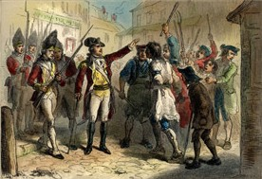

Slide 15
The Regulators escalate their actions.
The Regulators felt they had exhausted all legal means for change, with no results.
Frustrated, they decided on more extreme measures.
Regulators refused to pay their taxes to sheriffs, safeguarding the money instead until they could be sure it would not be embezzled.
Regulators urged people to avoid the official courts. Instead, they organized mediation meetings - or people’s courts - where no fees were charged.
They even shut down some courts, so no one could be sued and forced to pay high fees, and targeted corrupt government officials. Sometimes such events included violent actions. Two famous instances happened in Hillsborough in 1768 and 1770.

Slide 16
The Regulators:
Justified Protestors or Lawless Rioters?

Slide 17
The Battle of Alamance – March, 1771
For several decades now, tensions had been mounting; backcountry farmers believed that they were being overtaxed and had been paying excessive fees to local sheriffs and the colonial government.
The Regulators demands for changes to the law had escalated to publicly humiliating, intimidating, and sometimes beating officials whom they deemed corrupt (i.e. Edmund Fanning.)
After the Riot Act was passed, Regulators were angered and “swore that they would pay no more taxes.” Similar sentiment spread throughout the backcountry, so in 1771 Governor Tryon ordered a special court in Hillsborough.
Predicting that disgruntled Regulators would protest this action, Tryon sent out militia to the courthouse to quell any rebellious activity or interference with court sessions.
Governor Tryon marched from New Bern to Hillsborough, his army around 1,000 men. Approximately 2,000 Regulators assembled and met the militiamen at Great Alamance Creek.

Slide 18
The Battle of Alamance – March, 1771
On May 16, the Regulators sent message to Governor Tryon that they wanted to discuss their differences with government officials.
Tryon scoffed at the suggestion and returned a message stating that the Regulators disarm, giving them one hour to surrender.
The Regulators replied: “Fire and be damned.” Tryon and the militia answered with cannon fire.
The Battle of Alamance lasted for two hours.
The Regulators fired weapons behind trees and large rocks, and their effort lacked organization. Sometimes when a Regulator would run out of ammunition, he left the field of battle.
As to be expected, the militia was more organized in its attack and maneuvers, and Tryon defeated the Regulators.
The casualty count for the Regulators is unknown, but nine militia men died and sixty-one were wounded.

Slide 19
The Battle of Alamance – Aftermath
The immediate aftermath included ad hoc trials of certain Regulators. (For example, the next day, Regulator James Few was hanged without being convicted in a military court.)
Shortly after the battle, fourteen Regulators were tried and twelve were convicted. Of that number, six were hanged.
Government officials released half a dozen in a public relations strategy in which they hoped North Carolinians would consider them generous and forgiving.
On May 17, Tryon promised to issue amnesty to all those who took an oath of allegiance. In two weeks, 6,409 complied.
As time would tell, the battle and the swift execution of certain Regulators ended the Regulator movement.
Yet a distrust of far away, centralized power remained. The War of the Regulation illustrates the dissatisfied spirit building before the American Revolution.
The Regulator boldness to oppose royal authority provided a lesson in the use of armed resistance, which patriots employed a few short years later in the Revolutionary War.

