Slide 1
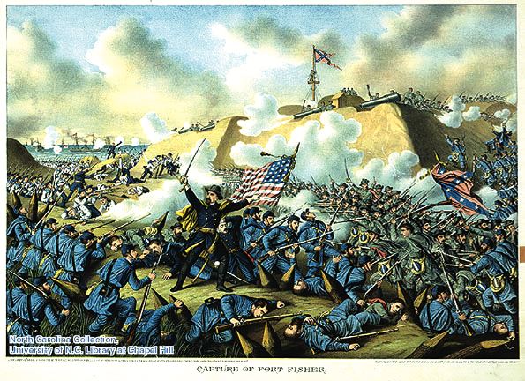
North Carolina in the civil war 1861-1865

Slide 2
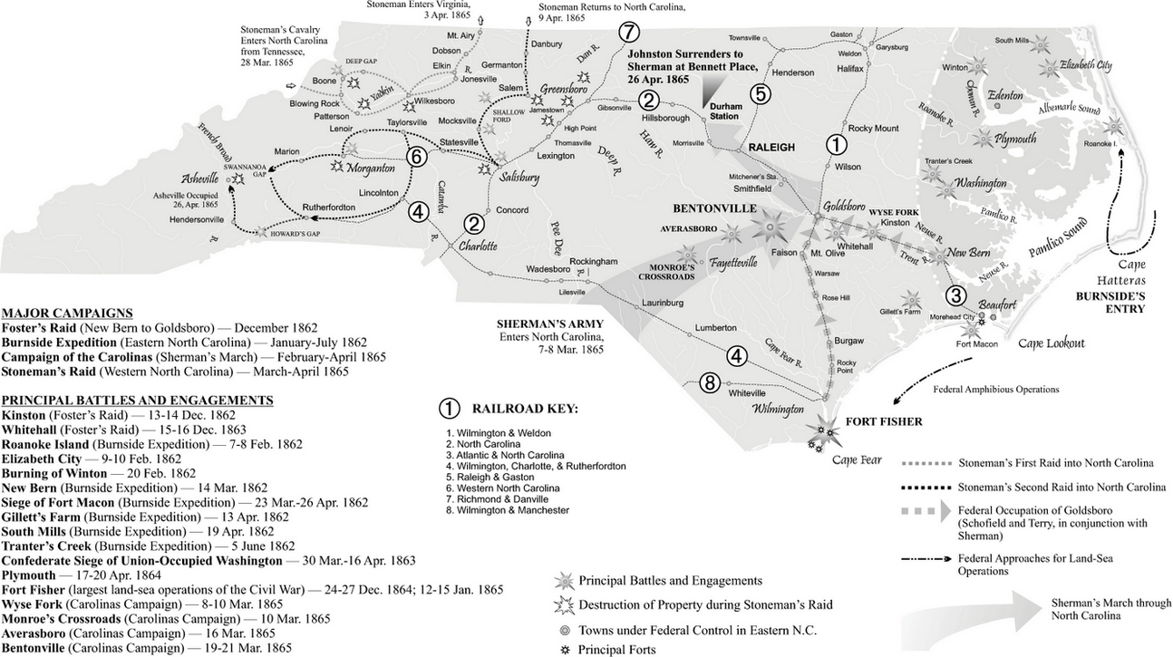
The Civil War in North Carolina

Slide 3
Secessionists Along the Coast…
In the months before the first shots of the war were fired at Fort Sumter, secession fever was spiking along the North Carolina coast. In Wilmington and Brunswick County, the Cape Fear Minutemen under John J. Hedrick crossed the river and seized Fort Johnston in Smithville and Fort Caswell on Oak Island from the U.S. Army caretaker sergeants posted there. But since NC had not yet left the Union, Gov. John Ellis made the militias give the installations back. Once Confederates fired on Ft. Sumter and Pres. Lincoln called for 75,000 NC troops to put down the rebellion, the forts were taken again. They would remain in Confederate hands until 1865.
Col. John J, Hedrick

Slide 4
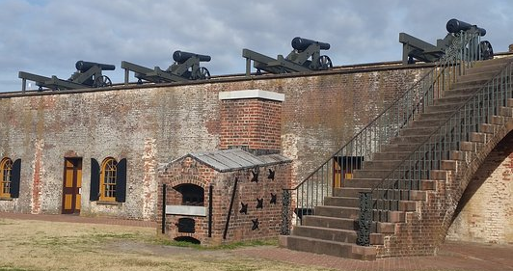
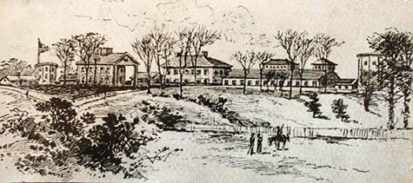
Confederates move to seize federal assets…
By April 1861, NC had reacted to Lincoln’s call for troops by moving to take control of Federal assets in the state. Among the most notable:
• April 15 – Confederates seize Fort Macon by order of Gov. Ellis
• April 22 – The Federal Arsenal at Fayetteville is seized
• May 20, 1861 – North Carolina
secedes from the Union!
Fort Macon (top), and
Fayetteville Arsenal (bottom).

Slide 5
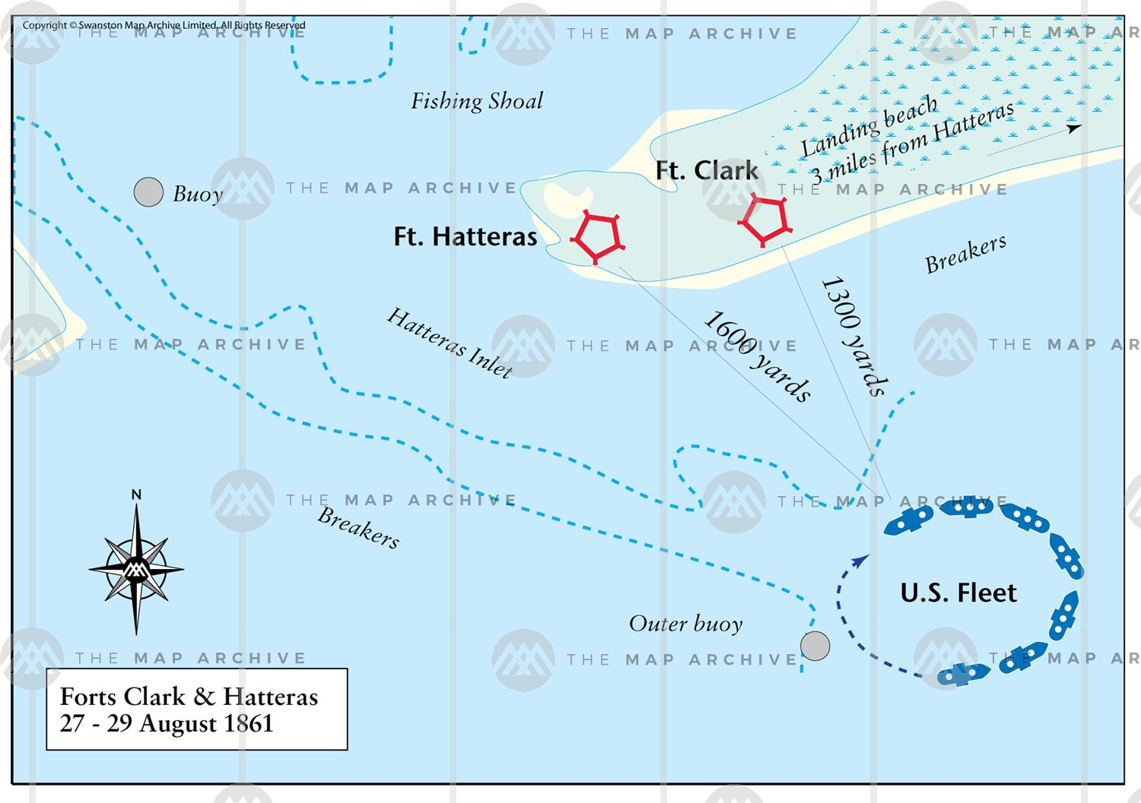
The Union strikes back…
Federal forces wasted no time in trying to establish a foothold in rebellious North Carolina. Along the Outer Banks and the northeast section of the state, they found willing allies among Tar Heels who sided with the Union against the new Confederate government and their state’s decision to rebel. In late August, Federal forces landed at Cape Hatteras to seize the two Confederate forts there and establish a Union base of operations for future strikes into the North Carolina interior.
Federal operations against Forts Hatteras and Clark, August 27-29, 1861.

Slide 6
Unionists in North Carolina…
Many people that lived in northeastern North Carolina did not agree with NC’s decision to leave the Union and join the other ten Southern states in the new Confederate States of America. That gave the Federals an advantage in trying to make inroads into the state. Locals acted as spies and scouts for Union forces, and slaves freed from bondage as Union troops reclaimed territory in many cases were enlisted in the U.S. Colored Troops, fighting under the Stars & Stripes by mid-war. Pro-Union sentiment became so strong that a regiment of Confederate troops were sent to Hyde County to counter them.
The shaded area of the map indicates parts of NC with strong pro-Union sentiment.

Slide 7
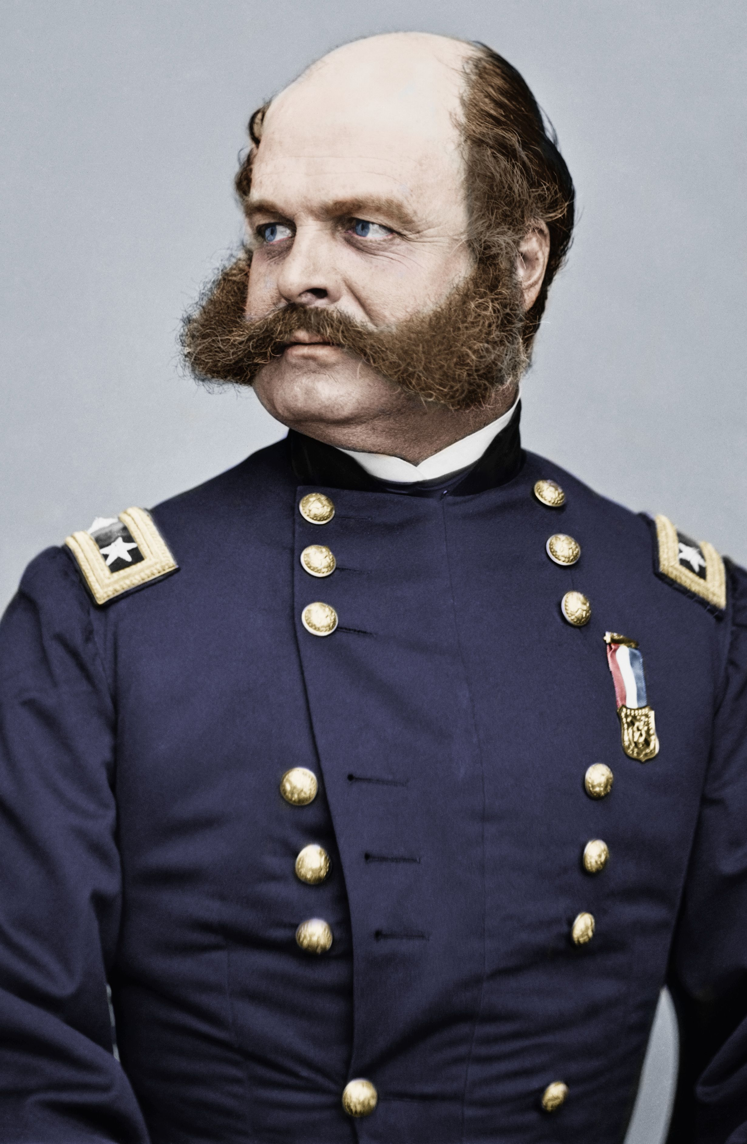
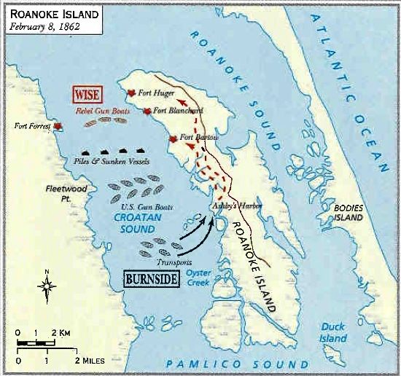
Burnside brings bluecoats in force…
Major General Ambrose Burnside led a Federal expedition to take Roanoke Island in February 1862. Roughly 2,907 casualties were sustained on both sides. The assault gave Union forces full control of the Albemarle Sound and Outer Banks. One of the first actions Burnside took was to establish a Freedman’s colony where former liberated slaves built a thriving community with churches and schools, all under Union protection.
Federal operations against Confederate forces at Roanoke Island, Feb. 7-8, 1862
MajGen. Ambrose Burnside

Slide 8
The Blue tide spreads…
Capitalizing on Union gains in northeastern North Carolina, Federal forces aimed to take more territory to the west and south. In February 1862:
• Federals and Confederates fight a naval action off Elizabeth City (2/10)
• A naval expedition raids Edenton, NC (2/12)
• Troops fight a skirmish at Winton, along the Chowan River (2/18-2/21)
By March 1862:
• Union troops move to occupy Beaufort, Havlock, Carolina City, and Morehead City, NC (early March)
• Federal forces move south to prepare for an attack on New Bern, NC (3/11-3/13)
• Union troops attack Confederate forces occupying New Bern, NC (3/14/62)

Slide 9
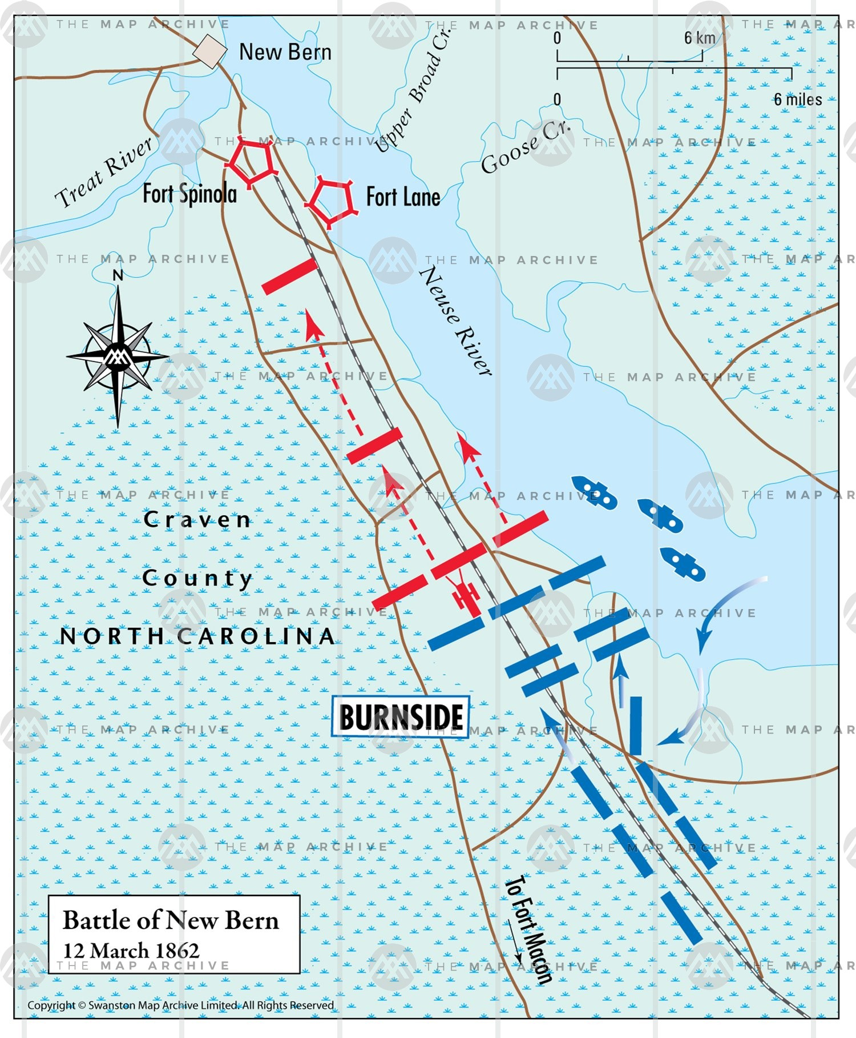
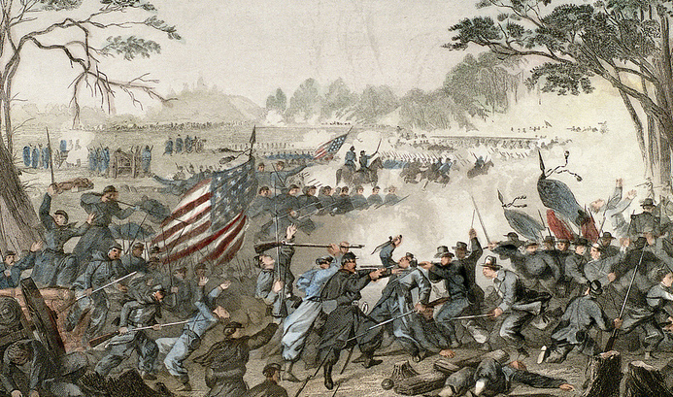
The Battle of New Bern…
March 12-14, 1862
Union troops under Ambrose Burnside landed south of New Bern and marched north to take the city. New Bern was important because it controlled access to the Neuse and Trent Rivers, and because it was a central hub close to both the Atlantic and North Carolina Railroad and the Wilmington and Weldon Railroad, vital to supplying Robert E. Lee’s Army of Northern Virginia.

Slide 10
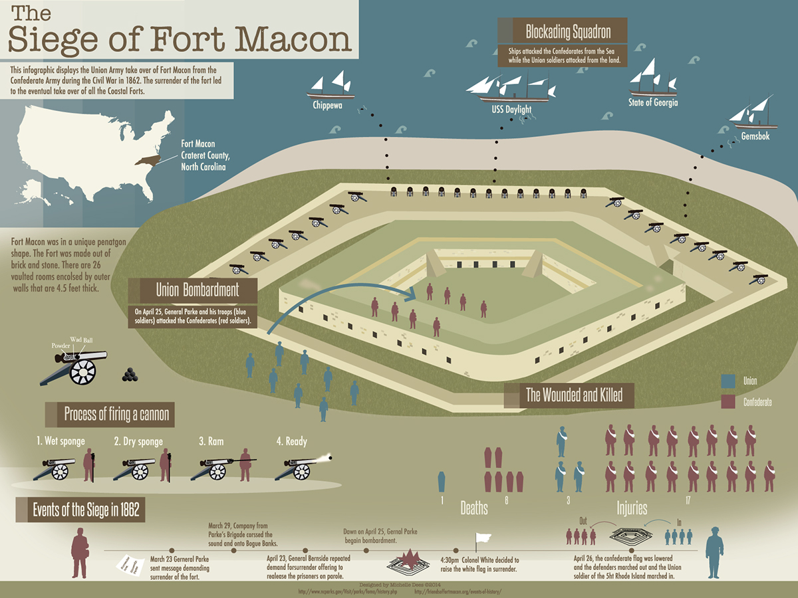
Consolidating Union Gains…
Burnsides forces immediately set out to consolidate their gains after taking New Bern:
• A combined army/navy force takes Washington, NC
• Federals lay siege to Fort Macon, outside modern Atlantic Beach. Ft. Macon was a War of 1812-era masonry fort guarding Beaufort Inlet. The siege lasts until the fort falls on April 26, 1862.

Slide 11
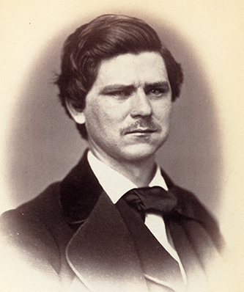
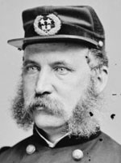
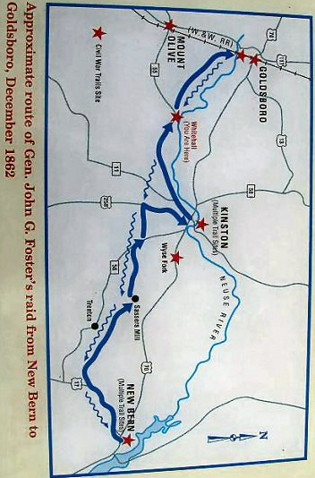
A new governor and a union raid…
In September 1862, former U.S. congressman and commander of the Confederate 26th NC Regiment is elected governor of North Carolina. He would be a strong wartime leader for the state.
By December, Union forces are finally ready to strike out into the NC interior. Gen. John Foster leads a raid from New Bern that reaches Goldsboro, striking fear into southerners along the way, destroying infrastructure, and forcing Confederates to scramble to respond.
December 11-20, 1862
Zebulon Baird Vance
Roughly 1,055 men are casualties on both sides
Gen. John G. Foster

Slide 12
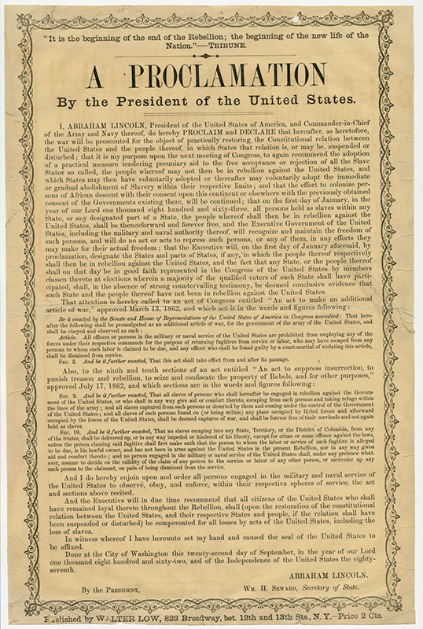
1863: new year, same war…
Lincoln’s Emancipation Proclamation was issued on the first day of the new year. It tried to free all slaves in the rebelling states, but saying it and making it so were two different things. In North Carolina, the fighting was still going strong:
• 1/5 – An expedition was mounted by Federals to capture Cape Fear River pilots
• Thomas’ Legion (Cherokees fighting for the Confederacy) hunt Bushwhackers in western NC throughout January 1863
• 3/30-4/20 - D.H. Hill’s Confederate troops try (and fail) to retake New Bern
• 7/3-7/7 – Union troops raid the Wilmington & Weldon Railroad
• Free blacks are organized into Union Army units
January 1, 1863

Slide 13
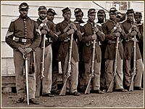
From slave to soldier…
As Union troops reclaimed North Carolina territory, they not only freed slaves, but enlisted those who were willing into newly formed units made up of free blacks and former slaves. The U.S. Colored Troops performed scouting, support, and engineer work for advancing white Union units, but as the war went on they were eventually allowed to contribute to the war effort in line units. In NC, units formed included:
• 1st North Carolina Volunteer Infantry, African Descent (6/30/1863)
Black Union troops participated in engagements wherever Union forces fought in North Carolina, including at Fort Fisher and the Wilmington Campaign.

Slide 14
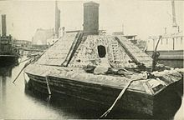
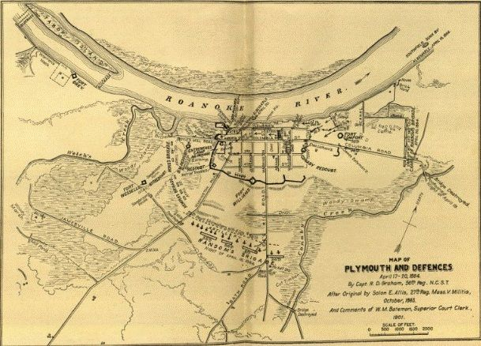
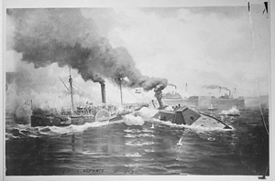
1864…
• 4/2 - Confederate raiders try to destroy the Cape Lookout Lighthouse
• 4/17-4/20 - Plymouth, NC captured by Confederate forces after a three day engagement that involved the Confederate ram CSS Albemarle. Roughly 88 men are killed or wounded on both sides.
CSS Albemarle (left)
CSS Albemarle ramming and sinking USS Sassacuss

Slide 15
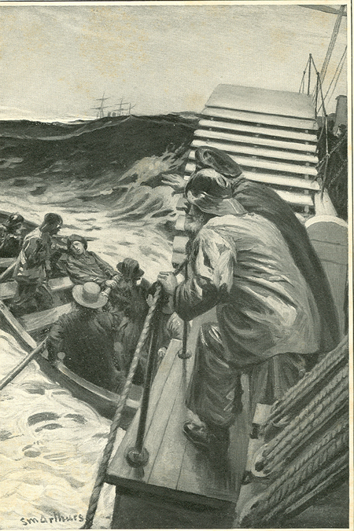
The End of Confederate Rose…
Rose O’Neal Greenhow was a Washington, D.C. socialite who acted as a spy for the Confederacy. After she was imprisoned in the Old Capital Prison, she went to Richmond, where she was given orders to cross the Atlantic and try to drum up support for the South’s war effort in Europe. On 10/1/1864, the blockade runner she was returning on, the Condor, ran aground in rough seas just off Fort Fisher. Rose insisted on being put ashore in a boat. The small vessel immediately capsized and the spy sank to her death in New Inlet, weighed down by a money belt full of gold coins.
Rose O’Neal Greenhow and her daughter in Old Capital Prison (above), and Rose leaving the Condor in New Inlet before drowning (left).

Slide 16
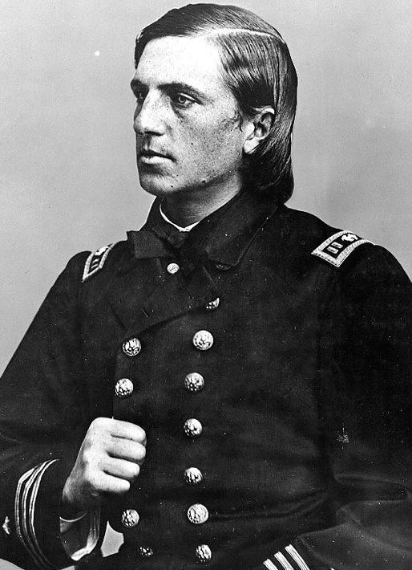
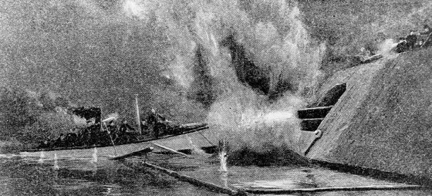
Cushing’s Raid and the end of the Albemarle…
Between October 27-29, 1864, Lieutenant Commander William B. Cushing (US Navy), conducted a daring raid to sink the CSS Albemarle. He was successful, but his own boat sank in the fight. Cushing swam to shore and escaped. Two days later, Plymouth was once again in Union hands.
Cushing blowing up the Albemarle
LtCdr. William B. Cushing, US Navy (above). Cushing might well have been the first Navy Seal!.

Slide 17
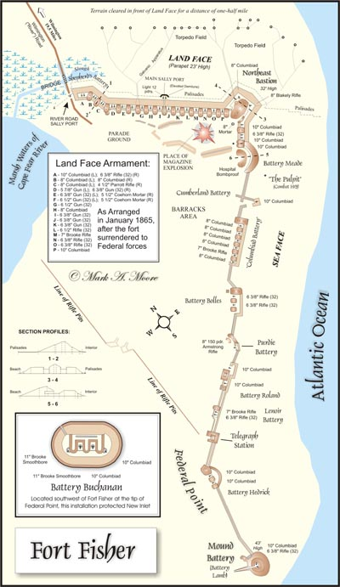
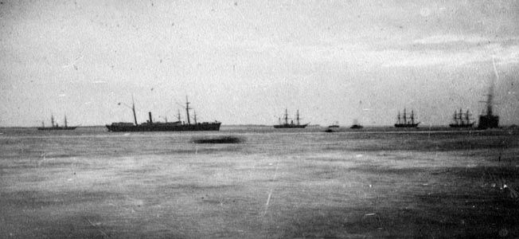
The First Battle of fort fisher…
On Christmas Eve 1864, a Union fleet arrived off Fort Fisher to make the first attempt to take the Cape Fear River. The fort was key to capturing Wilmington, which was the last open port of the Confederacy. As such, it was hugely important. The attack was called off when Federal troops found themselves caught between the fort’s guns and a line of infantry fortifications stretching across the peninsula to the north. But they would return in two weeks to finish the job.
The Union fleet leaving Hampton Roads enroute to Fort Fisher

Slide 18
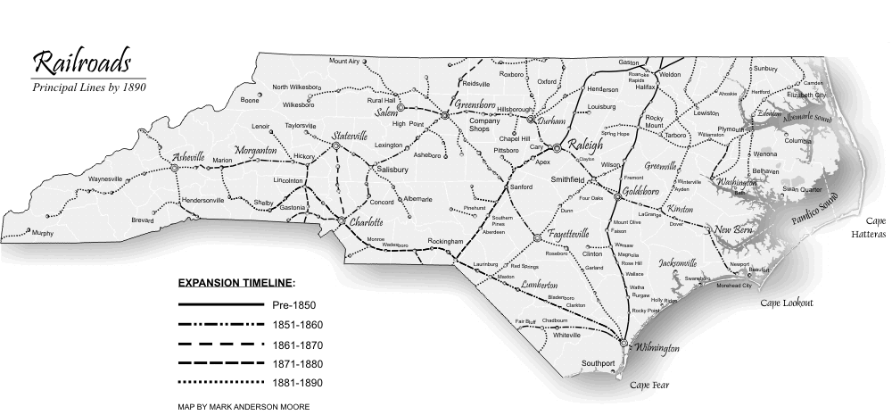
Wilmington was key…
Wilmington’s port and the railways connecting it to the rest of the South was crucial. Robert E. Lee said, “If Wilmington falls, I cannot keep my army in the field.” He was right. That was why Wilmington had to go.

Slide 19
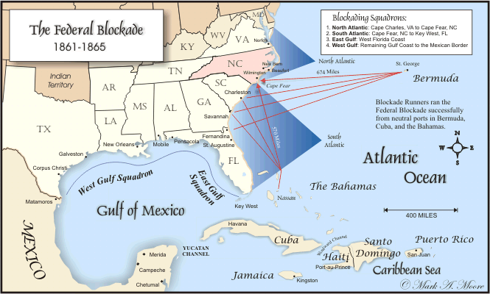
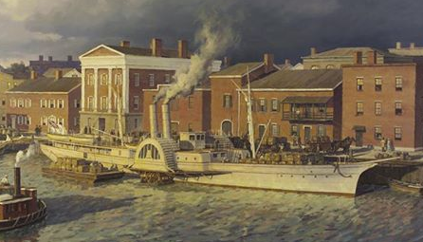
The Lifeline of the Confederacy…
Without the industrial base of the North, the South depended on fast, daring blockade runners to provide the manufactured goods the Confederacy needed to fight the war and survive. Wilmington became a key to that strategy due to its geography and relatively short distance from British ports at Bermuda and the Bahamas.
The Cape Fear was only 670 miles from Bermuda, and 570 miles from the Bahamas. Its geography made it extremely hard for the Federal fleet to blockade it.

Slide 20
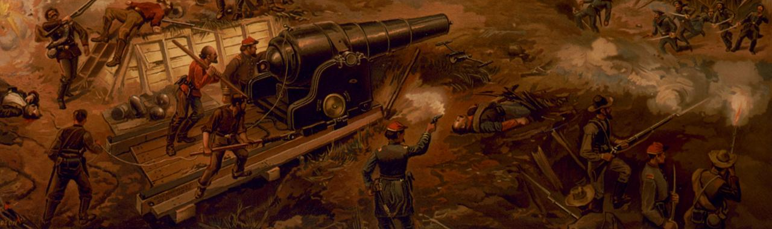
The Second Battle of Fort Fisher…
Union forces returned to Fort Fisher and resumed the bombardment of the fort on January 13, 1865. For the next two days, the fleet delivered the largest bombardment in history up to that time (more than 19,000 shells fired) against the sand fort, its guns, and its outnumbered defenders. The assault by ground troops came on January 15, and within the day Federals had taken the fort that had become known as the “Sebastopol of the South.”

Slide 21
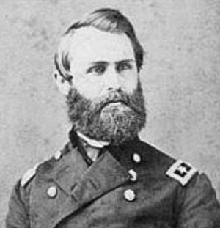
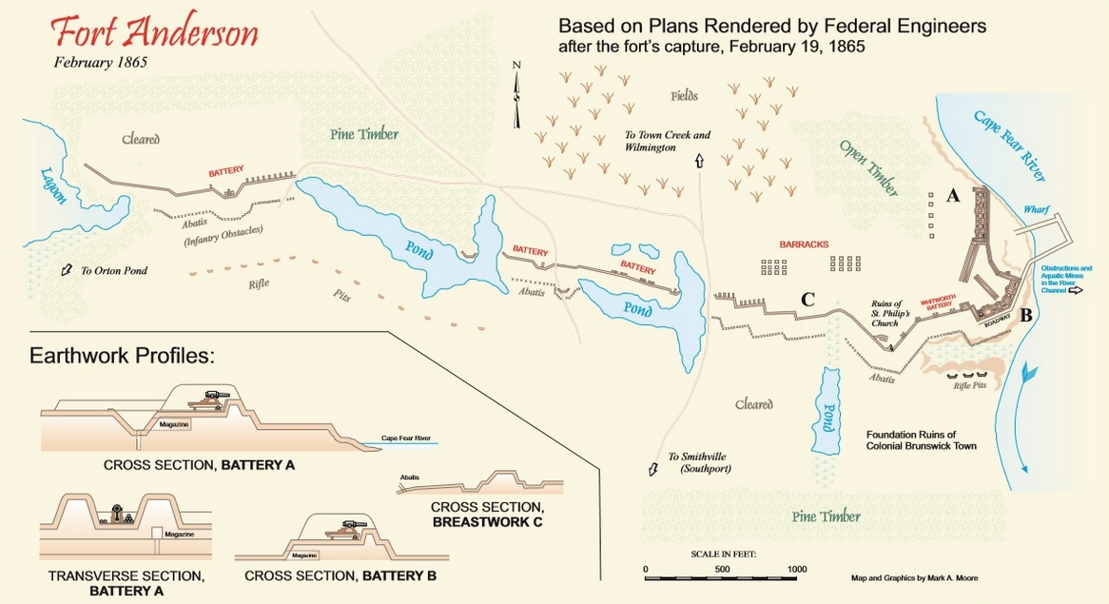
The Wilmington Campaign…
With the fall of Fort Fisher, the road was open to Wilmington, the Confederacy’s last open port. Rebel forts below Fort Fisher were evacuated, and their men sent to reinforce Fort Anderson, at the old colonial town of Brunswick. That installation was evacuated while a handful of defenders fought a rearguard action against Federals led by Brigadier General Jacob D. Cox on February 19, 1865. Next stop: Wilmington.
Union BGen. Jacob D. Cox

Slide 22
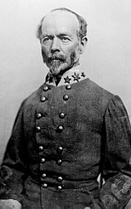
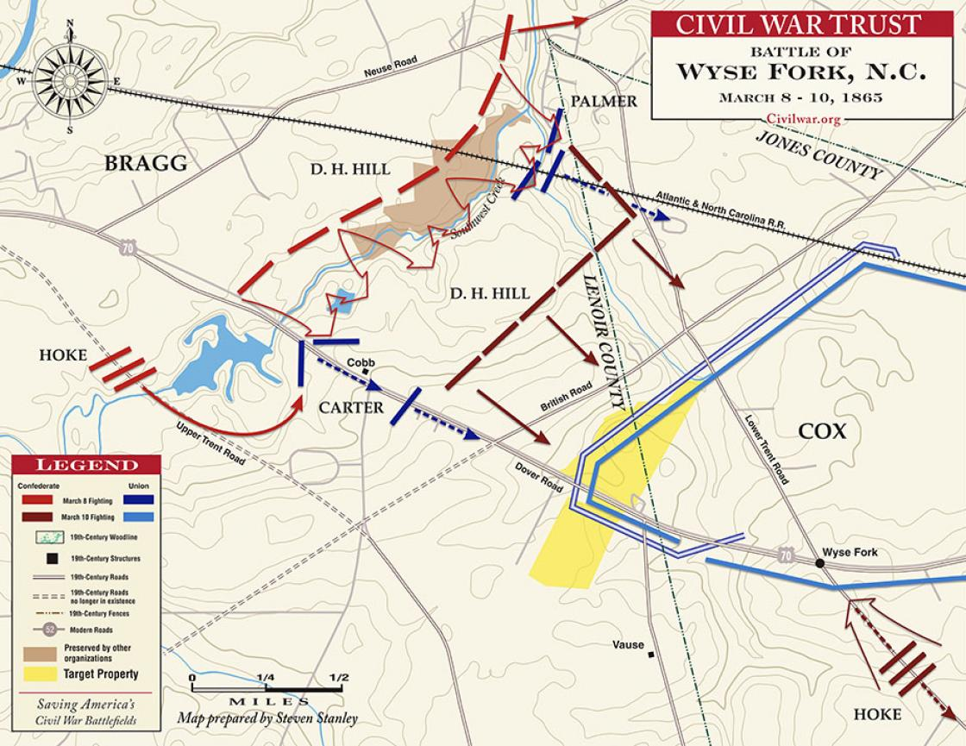
After Wilmington…
Confederate troops evacuated Wilmington ahead of advancing Union forces, and the city was in Federal hands by February 22, 1865. Meanwhile, Gen. Joseph E. Johnston assumed command of Confederate forces in the Carolinas. His chief enemy would be William T. Sherman’s men who were ripping a path through the central part of the state.
• 3/8-3/9 - At the Battle of Wyse Fork, below Kinston, Confederates clashed with elements of Gen. John Schofield’s Union forces and won. The Confederates captured 1,000 Union prisoners. Another 2,600 men were casualties.
• 3/10 - At Monroe’s Crossroads, Wade Hampton’s Southern Cavalry clashed with Union troops in the first organized resistance to Sherman in NC. Another 269 men were casualties of the fighting.
1865
Gen. Joseph E. Johnston (left), and the Battle of Wyse Fork outside of Kinston, NC (below).

Slide 23
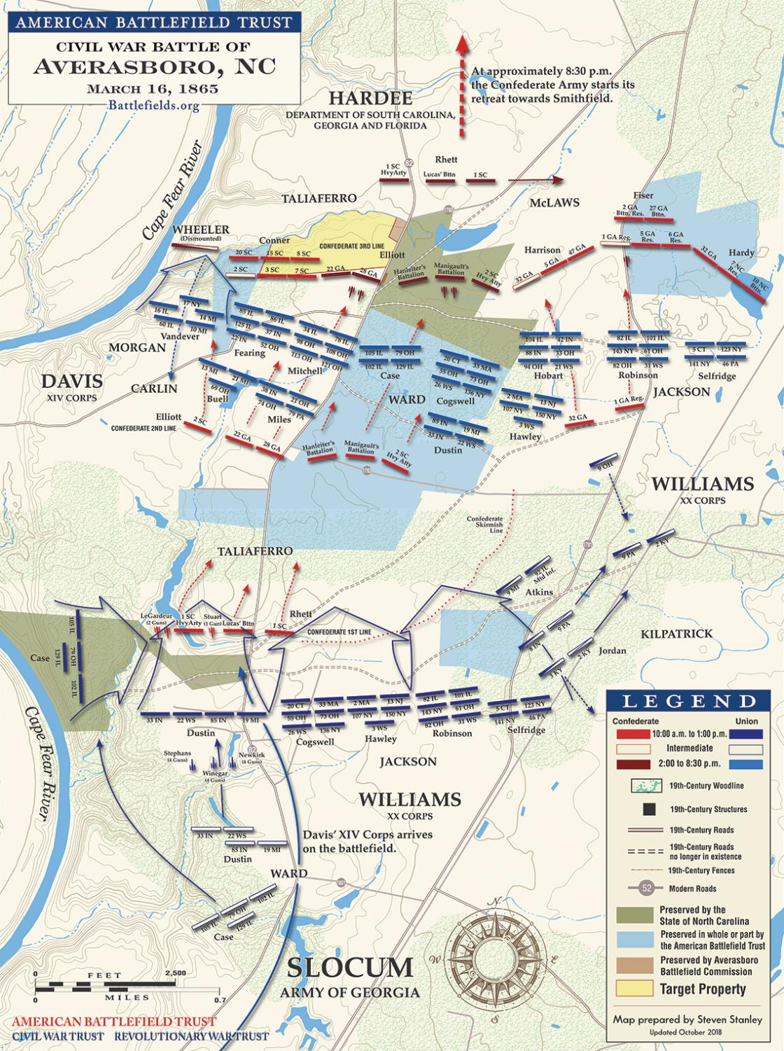
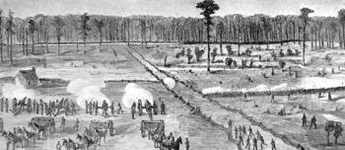
Battle of Averasboro…
Buying time for retreating Confederates under Johnston, Hardee’s Confederate troops fought a delaying action at Averasboro on March 16, 1865. The rebel troops engaged units of Sherman’s left wing. The action cost both sides 1,682 men as casualties.
Union and Confederate forces draw up in battle lines at Averasboro, NC.

Slide 24
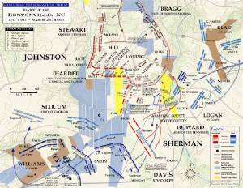
Battle of Bentonville…
Johnston’s retreating Confederates and Sherman’s bluecoats came together in the fields at Bentonville, southeast of Raleigh, NC, From March 19-21, infantry and cavalry from both sides clash in a fight that costs 4,500 men.
In the end, the Confederates were forced to retreat towards Smithfield, while the Federals advanced and took Goldsboro on their way to Raleigh.

Slide 25
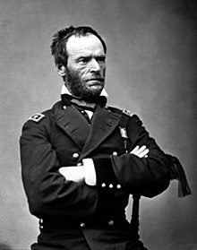
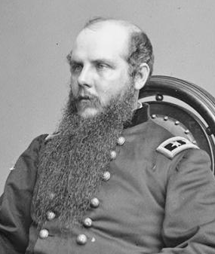
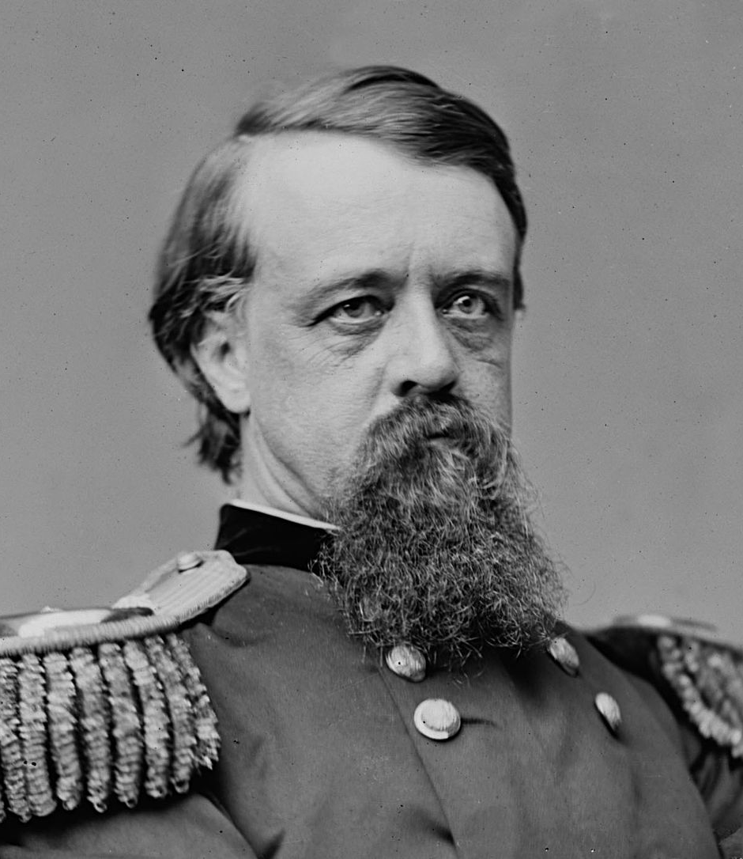
Union Armies Unite…
At Goldsboro, the Union troops under Sherman, Schofield, and Terry unite.
NOW THE FEDERALS HAVE AN ARMY OF 90,000 MEN IN NORTH CAROLINA!

Slide 26
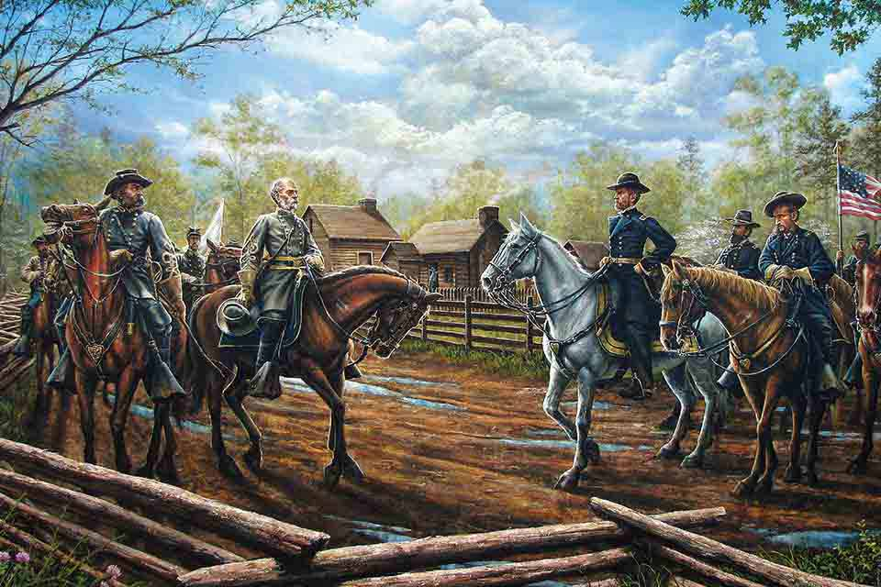
THE END COMES AND BENNEtT PLACE…
Even as Stoneman’s cavalry raids in western NC wreaked havoc, the writing was on the wall for the Confederacy in North Carolina. On April 26, 1865, Gen. Joseph E. Johnston surrendered all remaining Confederate forces left in the state to the Union’s Gen. William T. Sherman. The surrender was signed at Bennett Place in Durham. It was the largest troop surrender of the war, and included all Confederate troops in NC, SC, GA and FL.

