Slide 2
Objectives
examine WWI propaganda posters
discuss the objectives, uses, and successes of propaganda

Slide 3
Preview
Propaganda and advertising are very similar
  Advertising is often meant to get people to buy a product or use a service
  Propaganda is meant to get people to think, act, or feel a particular way
Advertisers and Propagandists use many of the same tools—slogans, humor, caricatures, emotional images or language, and visual symbols

Slide 4
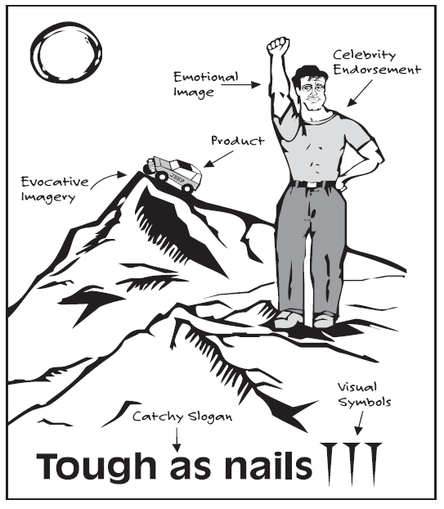
Preview
Look through the magazine or newspaper on your desk and find an advertisement that is particularly effective.
Write below the ad the objective you think the ad is designed to achieve.
Annotate the ad to indicate the tools the advertiser used to achieve their objective.

Slide 5
Common Objectives
of Wartime Propaganda
To recruit soldiers, either through a draft or voluntary enlistment
To finance the war effort through the sale of war bonds— loans from citizens to the government—or new taxes.
To eliminate dissent and unifying the country behind the war effort
To conserve resources—such as food, oil, and steel— necessary to wage war
To increase participation in organizations to support the war effort

Slide 6
Common Tools
Used in Wartime Propaganda
Demonization
Emotional Appeals
Name-Calling
Patriotic Appeals
Half-Truths or Lies
Catchy Slogans
Evocative Visual Symbols
Humor or Cariacatures

Slide 7
Primary Source Analysis
Let’s do the first poster together.

Slide 8
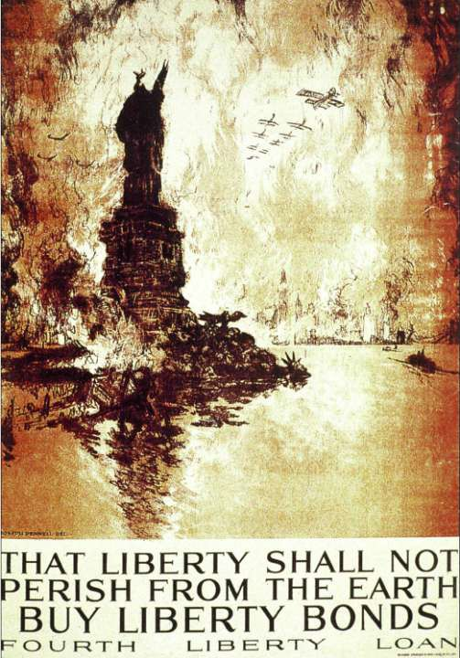
Poster A
What do you see here?
What is happening in
the poster?
Which country do you think produced this poster?
What objective is the poster designed to achieve?
What propaganda tools
are used in this poster?

Slide 9
Poster A
This is a U.S. poster showing the city of New York under attack by German forces.
The poster depicts the destruction of the Statue of Liberty and New York City in
flames. The caption of the poster
reads, “That liberty shall not perish from
the Earth. Buy Liberty Bonds.”
Many Americans showed their support for the war by purchasing Liberty Bonds from the government. The profits went to the war effort, which made those who bought the bonds feel they were doing their part for the war.
The objective of the poster is to eliminate dissent and unify Americans behind the war effort.
There is evidence of the following propaganda tools:
  demonization,
  emotional appeals,
  patriotic appeals,
  half-truths or lies, and
  evocative visual symbols.

Slide 10
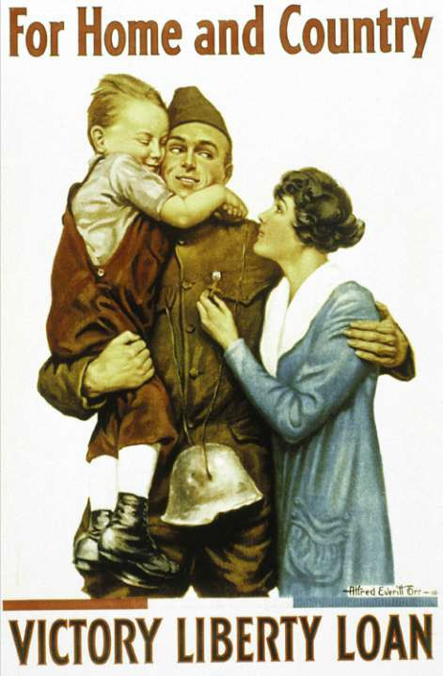
Poster B
This is a U.S. poster of a soldier returning from service in World War I.
The poster is designed to evoke feelings of patriotism and devotion to family among potential recruits. T
he soldier’s uniform and his loving family reinforce the poster’s caption, “For Home and Country.”
The enemy helmet hanging from the soldier’s neck symbolizes his success in service to his country.
The objectives of the poster are to recruit soldiers, eliminate dissent, and unify the country behind the war effort.
There is evidence of the following propaganda tools:
  emotional appeals,
  patriotic appeals,
  catchy slogans, and
  evocative visual symbols.

Slide 11
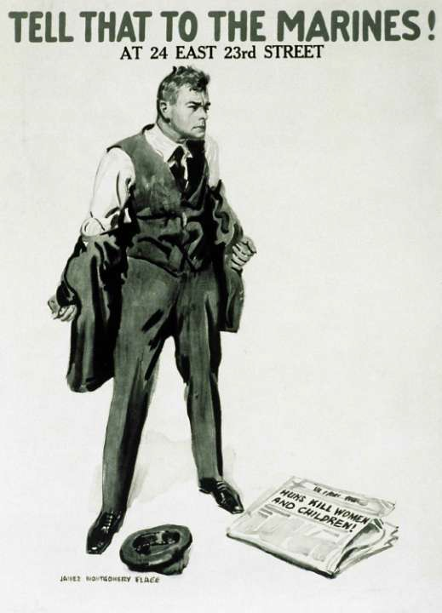
Poster C
This is a U.S. poster showing an enraged man ripping off his jacket.
The source of the man’s anger is revealed in the newspaper at his feet, which describes atrocities committed by the Huns.
Because of a comparison that a German Kaiser once made between the Germans and the Huns, a fearsome nomadic group from Asia, during World War I the term Huns was often used to refer to the Germans. Thus the newspaper headline implies savagery in recent German aggression.
The implication of the poster is that the man is responding to such outrages by choosing to give up civilian life to become a marine.
The objective of the poster is to recruit soldiers.
There is evidence of the following propaganda tools:
  demonization,
  emotional appeals,
  name-calling,
  patriotic appeals, and
  half-truths or lies.

Slide 12

Poster D
This is a a German poster depicting a fist in knight’s armor, which evokes Germany’s past military strength and medieval history.
The caption of the poster reads, “Das ist der Weg zum Frieden—die Feinde wollen es so! Darum zeichne Kriegsanleihe!” (“That is the way to freedom—the enemy wills it so!
Therefore sign up for war loans!”)
Despite the fact that Germany launched the offensive that initiated fighting in World War I, the poster claims that Germany had no choice but to fight in the war—that the war was forced on Germany by its enemies.
The objectives of the poster are to raise funds for the war effort, eliminate dissent, and unify the country behind the war effort.
There is evidence of the following propaganda tools:
  emotional appeals,
  half-truths or lies, and
  evocative visual symbols.

Slide 13

Poster E
This is a a U.S. poster showing a female gardener and a variety of fruits and vegetables going “over the top” of a hill.
A U.S. flag flies proudly in the background.
The phrase “over the top” originated during World War I, when soldiers had to climb over the top of the trenches before running into no man’s land to attack the enemy. The implication is that the woman and the produce are assisting in achieving victory over the enemy.
The poster encourages Americans to plant what the federal government called “victory gardens” to grow food for themselves so that commercial agriculture output could support World War I soldiers.
During the war, the U.S. Food Administration used posters like this one to promote victory gardens as well as food conservation efforts called wheatless Mondays and Wednesdays, meatless Tuesdays, and porkless Thursdays.
The objective of the poster is to solicit support for the conservation of resources during the war.
There is evidence of the following propaganda tools:
  emotional appeals,
  catchy slogans,
  evocative visual symbols, and
  humor.

Slide 14

Poster F
This is a a French poster showing a rooster—a French national symbol—on a coin attacking a fearful German soldier.
The coin is labeled
“liberty, equality, and fraternity,” the
slogan used during the French Revolution to declare the people’s values.
The caption of the poster
reads, “Pour la France, Versez Votre Or. L’Or Combat Pour La Victoire.” (“For France, pour out your gold.
Gold fights for victory.”)
The objective of the poster is to finance the war effort.
There is evidence of the following propaganda tools:
  patriotic appeals,
  catchy slogans, and
  evocative visual symbols.

Slide 15
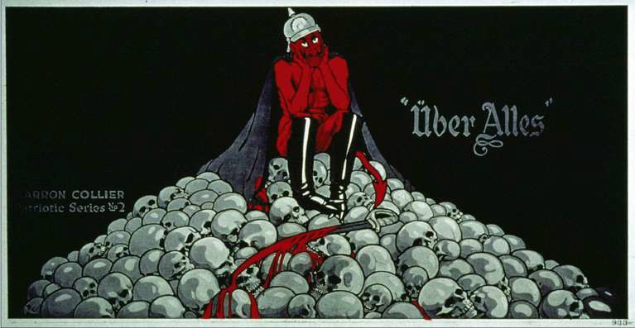
Poster G
This is a a U.S. poster depicting the German Kaiser as a devil.
The Kaiser is sitting on a stack of skulls, with a bloody sword at his feet. The caption reads, “Über Alles” (“Superior to everything”).
The objective of the poster is to eliminate dissent and unify the country behind the American war effort. In the poster, we see evidence of the following propaganda tools:
demonization, emotional appeals, half-truths or lies, catchy slogans, and humor or caricatures.

Slide 16
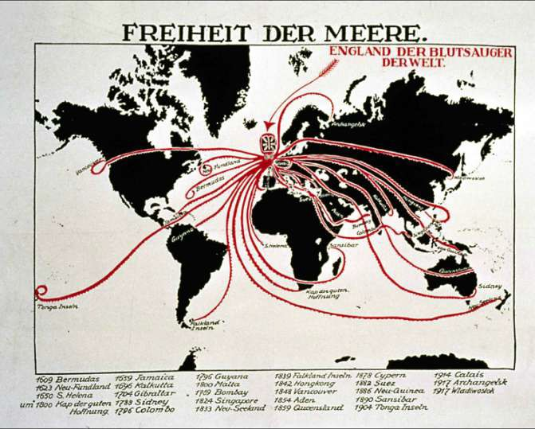
Poster H
This is a a German poster showing Great Britain as an octopus whose tentacles encircle the globe.
The caption of the poster reads, “Freiheit der Meere. England der Blutsauger der Welt.” (“Freedom of the seas. England is the
bloodsucker of the world.”)
The poster’s message is that Great Britain is the enemy of freedom in the world. The list of dates and locations at the bottom of the poster shows the places colonized by the British.
The objective of the poster is to eliminate dissent and unify the German people behind the war effort.
In the poster, we see evidence of the following propaganda tools: demonization, half-truths or lies, name-calling, and evocative visual symbols.

Slide 17





Poster I
This is a a British poster showing a German helmet filled with ferns. The caption of the poster reads, “Do you want a fern basket like this? Join the Sixth and come and get one.” The German helmet—proof of conquest—was a prized acquisition among Allied soldiers. The presentation of it as a fern basket glosses over the killing that would have gone into acquiring it. The objective of the poster is to recruit soldiers. In the poster, we see evidence of the following propaganda tools: patriotic appeals and evocative visual symbols.

Slide 18
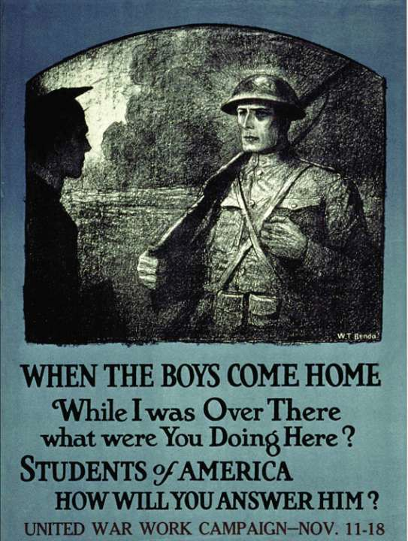
Poster J
This is a U.S. poster showing a soldier returning from war and facing a student in a graduation cap.
The caption of the poster
reads, “When the Boys Come Home. While I was Over There what were You Doing Here? Students of America how will you answer him?”
The poster was created for the United War Work Campaign, which raised funds for the war effort.
The objective of the poster is to recruit participants to the organization to support the war effort.
There is evidence of the following propaganda tools:
  emotional appeals,
  Patriotic appeals,
  evocative visual symbols, and
  participation in organizations to
support the war effort.

Slide 19
Debrief
What were some of the most common objectives you identified in the propaganda posters?
What are some of the most common tools you identified in the propaganda posters?
To what extent does propaganda appeal to emotions and not to reason? Why do you think this is so?
Can you think of any forms of propaganda that affect your life? How do these forms of propaganda appeal to emotions of fear, hatred, sympathy, patriotism, or consumerism?
How can you recognize propaganda in today’s world? Should the government try to limit or ban propaganda? Why or why not?

Slide 20
Your Assignment…
Using the paper provided, create your own propaganda poster.
• Choose a topic from the modern world you live in now
• Draw a poster and craft a message about your topic designed to influence an audience in a particular way.
• Use the propaganda methods described in the Powerpoint to get your message across:
Demonization • Emotional Appeals • Name-Calling • Patriotic Appeals • Half-Truths or Lies • Catchy Slogans • Evocative Visual Symbols • Humor or Caricatures

Slide 21
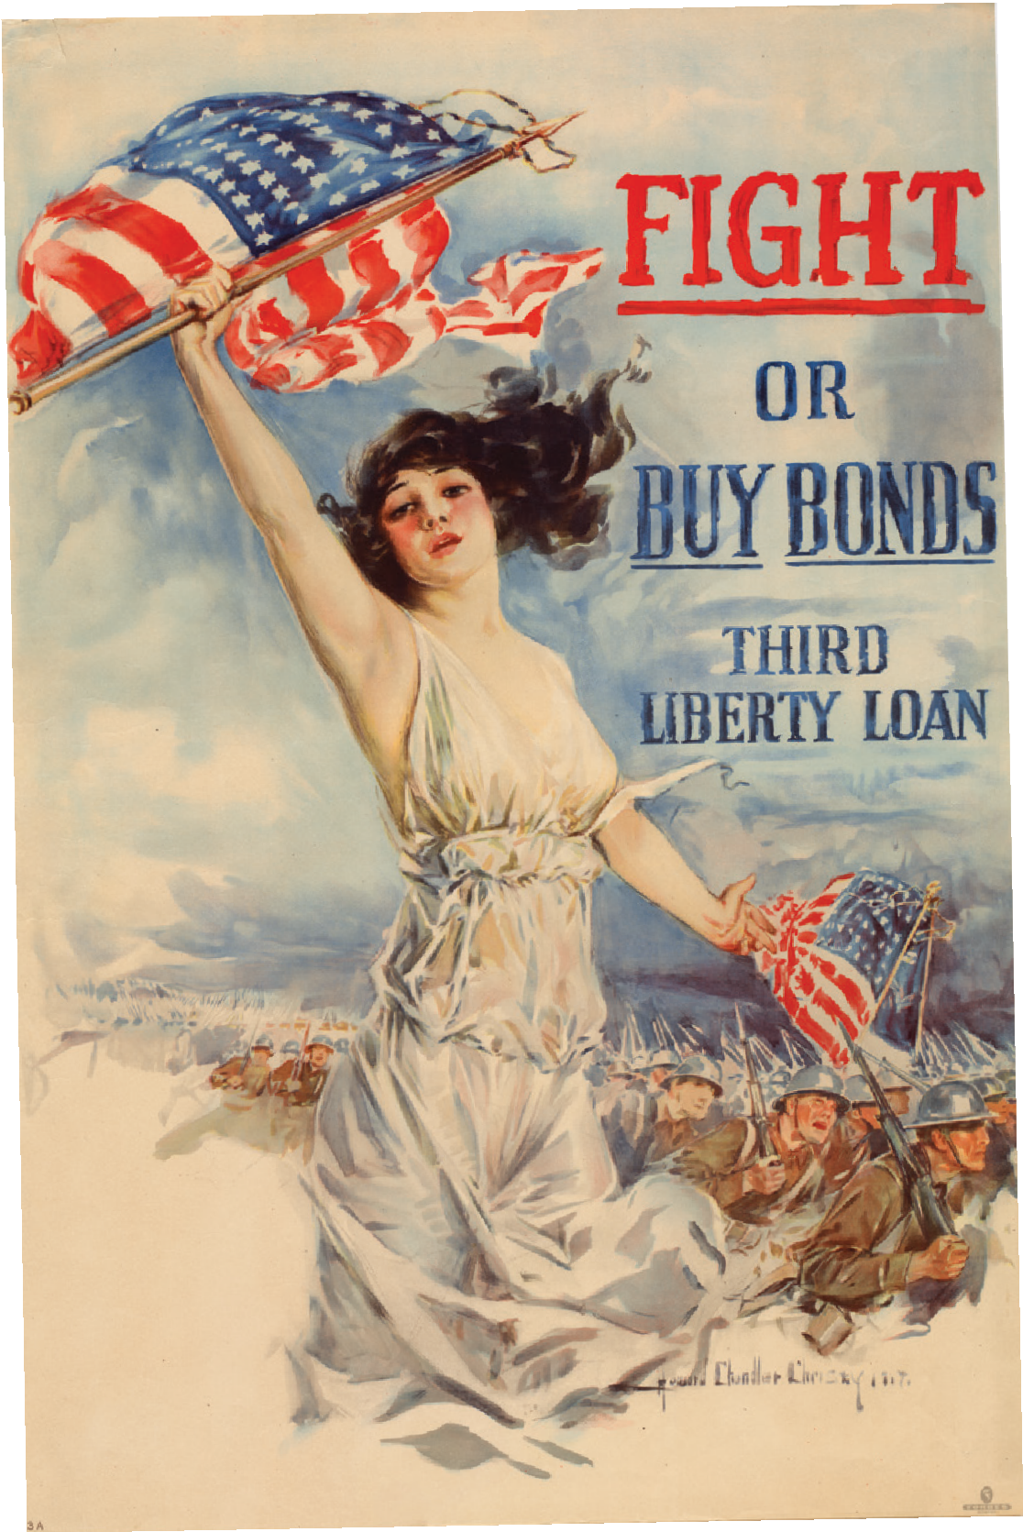
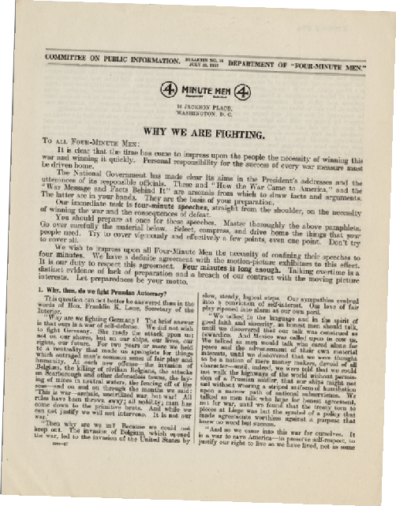
Assignment Part II:
Propaganda: How America “Sold” WWI America “Sold” WWI
The American government relied on propaganda to encourage citizens to support the war. The Four Minute Men program was one of the most successful propaganda programs of World War I. In merely 18 months, 75,000 people delivered
  million speeches to millions of people across the country.
These speeches covered all aspects of the war, encouraging people to conserve food, buy Liberty Bonds (war bonds issued by the government to help pay for the war), enlist for military service, and give their support to the war effort. They could be delivered in any public place, such as movie theaters, street corners, county fairs, and even churches and synagogues.
The Committee on Public Information (CPI) provided guidelines on how to write these speeches. The following is an adapted example on how to encourage the purchase of Liberty Bonds:
    Have an opening to grab the attention and interest of the audience.
    Write a body to present facts that will appeal to the rationality of the audience.
    Have an emotional appeal to stir sentiment and make the audience want to act and to buy Bonds.
    Have an ending that summarizes your closing appeal.

