Slide 1
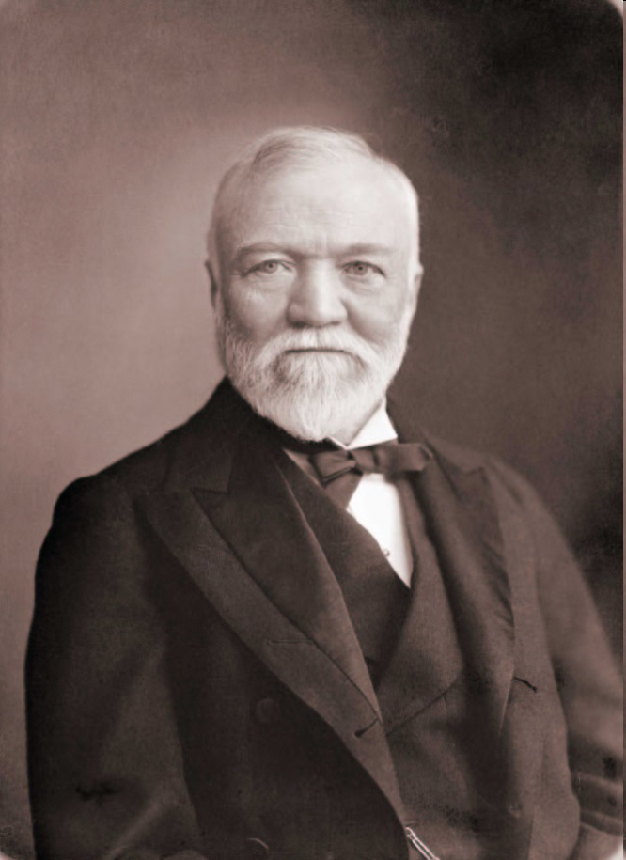
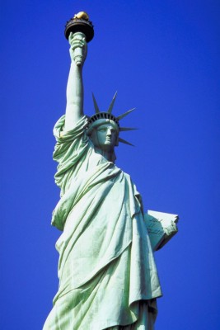
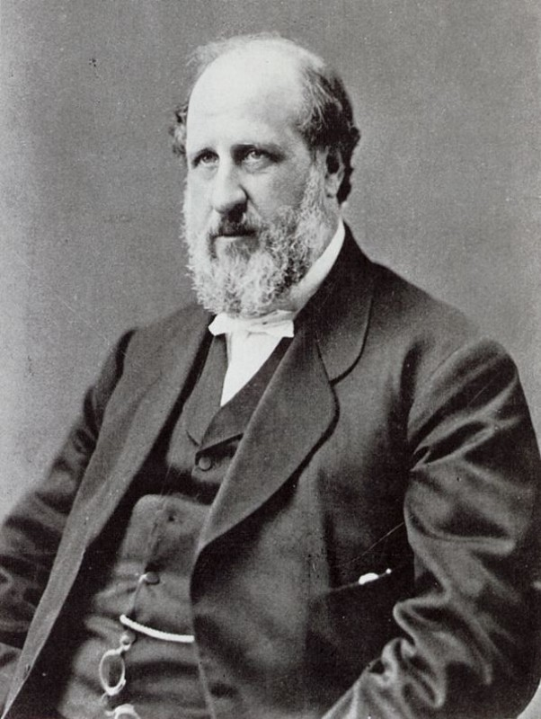
The Gilded Age
1865 - 1900

Slide 2


“Gilded Age” – 1870-1900
Post-Reconstruction America
Phrase coined by Mark Twain; used to represent America during this time
Also, think of a beautiful, shiny, red apple… that is rotten on the inside

Slide 3
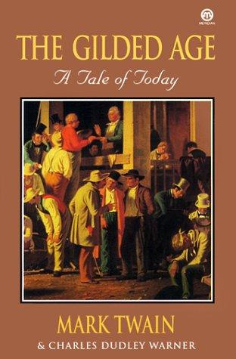
A Brassy, Flamboyant Age
The Gilded Age, the period between the end of Radical Reconstruction (1877) and the beginning of the Progressive Era (1901), was a brassy, flamboyant age dominated by big business values, political corruption, and extremes of wealth and poverty.
During the Gilded Age, the United States changed from a predominantly rural agrarian nation to an urban industrial one.

Slide 4
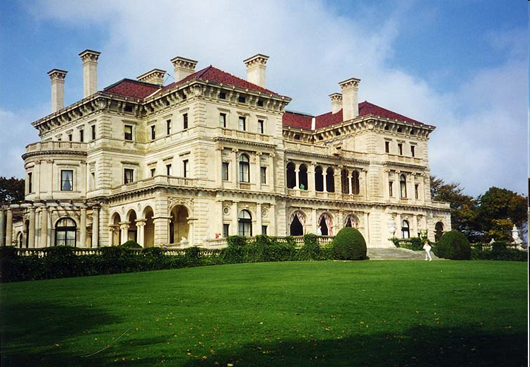
This was America during this time period (1870-1900)
On the outside, golden, shiny, beautiful:
Expanding economy, population growth
Extravagant displays of wealth by America’s upper class

Slide 5
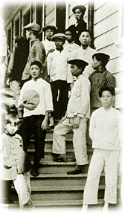
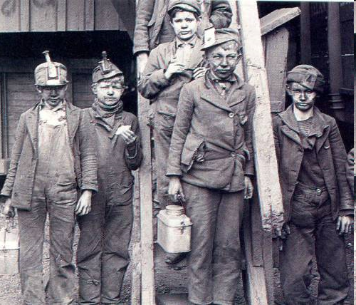
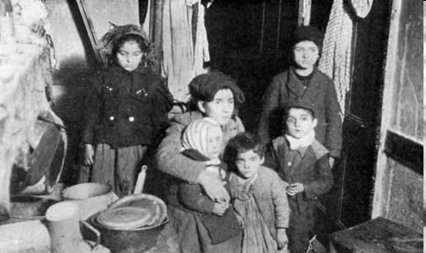
Hiding the rotten inside:
  Political corruption, scandals,
  greed, child labor, materialism,
  racial discrimination, etc.

Slide 6
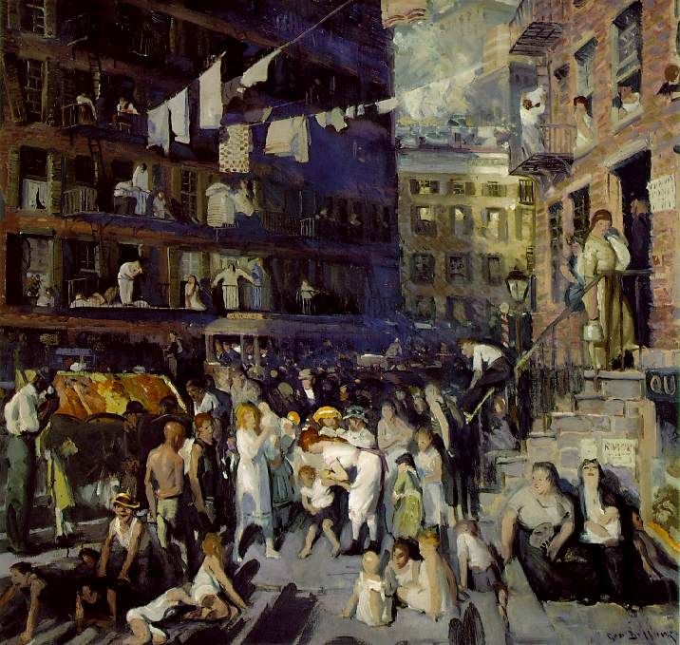
Major Developments
Establishing the foundation for 20th century America, the period witnessed these major developments:
  Industrialization
  Urbanization
  Immigration

Slide 7
Industrialization
Immigration
Urbanization
The Gilded Age
Discrimination in the
South & West
Populism
Political Corruption

Slide 8
Era Characteristics
Strong and rapid growth of industry, mass production, mechanization, and the factory system
Consolidation of wealth and creation of an American aristocracy
Political and corporate corruption and laissez-faire/hands off approach to government involvement
Exploitation of cheap, immigrant labor
The creation of the American city and the expansion and urbanization of the West
Rapid population growth (natural and migratory)
Increased social, racial, and labor tension
The beginning of social, political, and labor reform movements

Slide 9
Vocabulary
Laissez-faire: “Hands-off”, the idea that government should not be involved in business or regulation
Infrastructure: The “skeleton” of a country, referring to transportation (railroads, roads, canals), the postal service, tax collection, ability to vote, civil protection, sewage treatment, etc
Free Enterprise: a.k.a. “Capitalism” The idea that society benefits from free competition in the market price, yielding individual profit, a better/cheaper product, and wide availability of goods
Political Machines: Corrupt mafia-like organizations which sold votes for rewards and ran the cities corruptly

Slide 10
Changes in Daily Life
Life in the 1860s
No indoor electric lights
No refrigeration
No indoor plumbing
Kerosene or wood to heat
Wood stoves to cook with
Horse and buggy
In 1860, most mail from the East Coast took ten days to reach the Midwest and three weeks to get to the West Coast.
A letter from Europe to a person on the frontier could take several months to reach its destination.
Life in the 1900s
US Govt issued 500,000 patents—electricity
Refrigerated railroad cars
Sewer systems and sanitation
Increased productivity made live easier and comfortable.
Power stations, electricity for lamps, fans, printing presses, appliances, typewriters, etc.
New York to San Francisco to 10 days using railroad.
1.5 million telephones in use all over the country
Western Union Telegraph was sending thousands of messages daily throughout the country.

Slide 11

NEW INDUSTRIES
Oil
Mining
Sugar
Steel
Meatpacking
Beef/Cattle
Construction
Telegraph
Telephone
Railroad
Marketing
Sewing Machine
Vacuums
Typewriters
Automobile
Salt
Coal
Agricultural

Slide 12
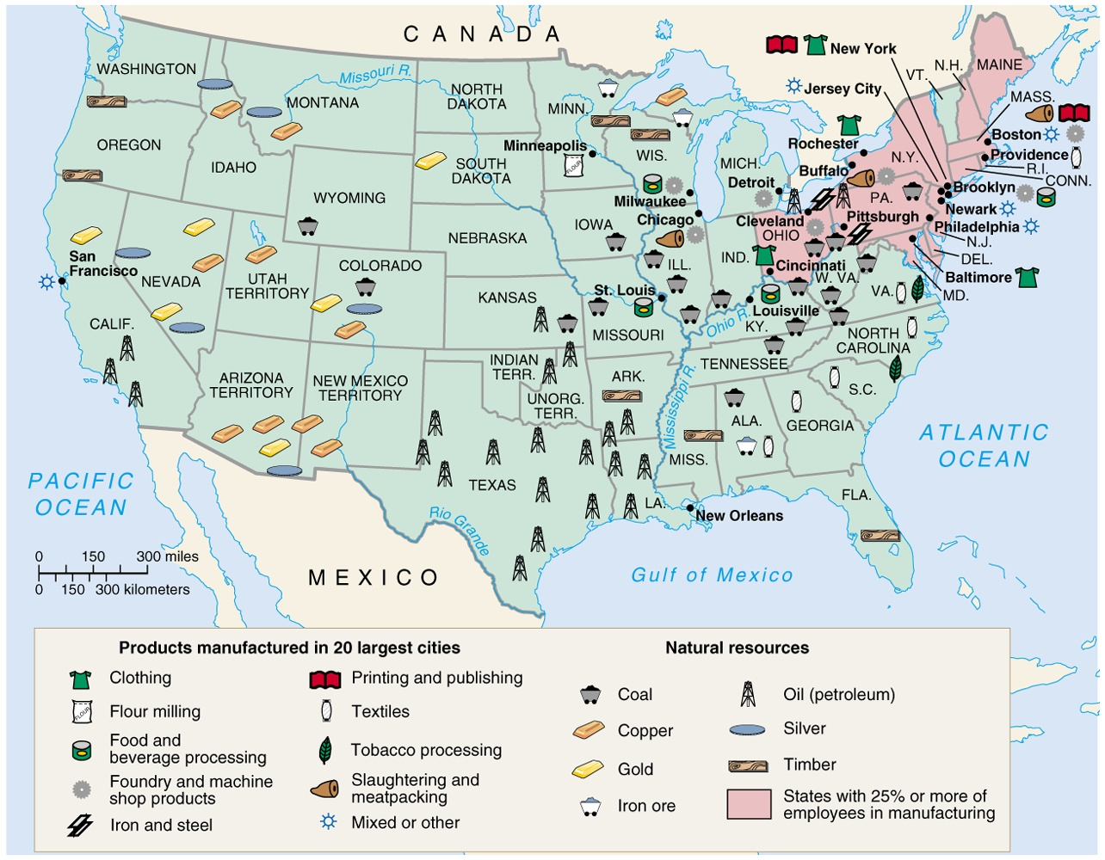

Slide 13
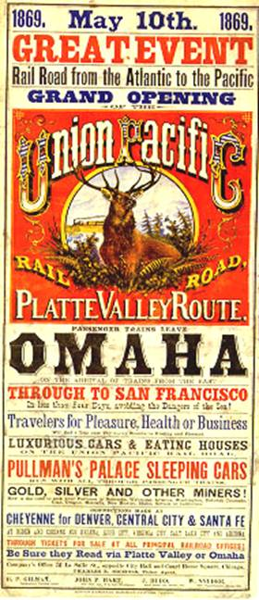
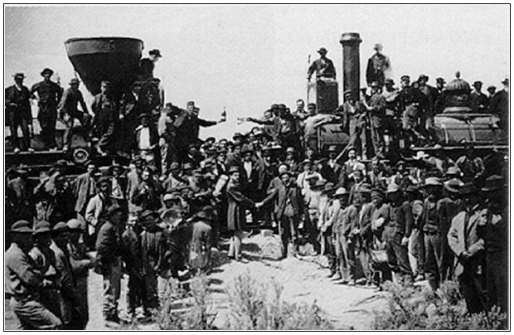
1st TRANSCONTINENTAL RAILROAD
May 10, 1869 at Promontory, Utah
“The Wedding of the Rails”
Central Pacific and Union Pacific

Slide 14
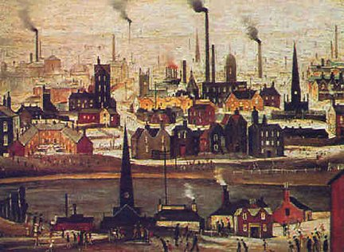
From Agriculture to Industry
During the Gilded Age, the United States experienced a rapid shift from an agricultural economy to an industrial one.

Slide 15
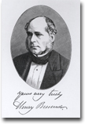
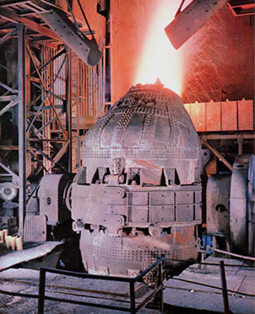
BESSEMER PROCESS
In 1856 Henry Bessemer devised a way of converting iron into steel on a large scale.
His invention involved blowing air through molten iron in a converter, or furnace, in order to burn off the excess carbon.
His invention revolutionized the Industrial Age.
New Uses for Steel
Steel used in railroads, barbed wire, farm machines
Changes construction: Brooklyn Bridge; steel-framed skyscrapers

Slide 16

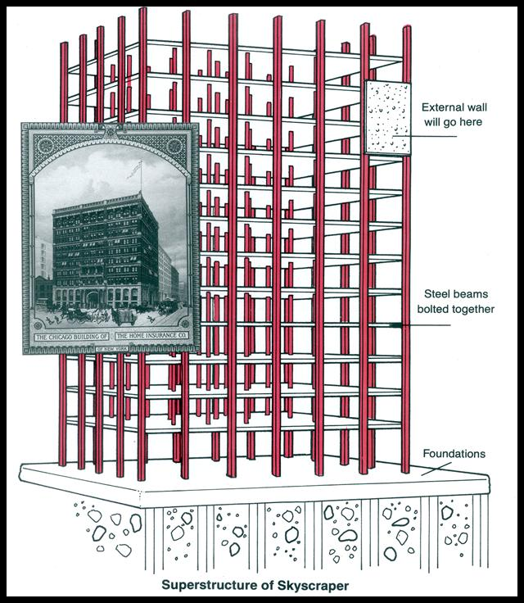
With the Bessemer Process and Carnegie steel, Skyscrapers revolutionized the building industry…..
Major city skylines would be dotted with this new type of building as the 1900’s begin.

Slide 17
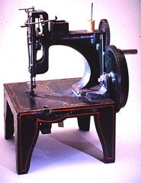







KEY INVENTIONS
BETWEEN 1860 TO 1900
Elevator---1852
Bessemer Process---1852
Sewing Machine---1853
Dynamite---1867
Typewriter---1868
Levi Blue Jeans/Basketball---1873
Telephone---1876
Phonograph---1878
Light bulb and cash register---1879
Zipper---1883
Gasoline automobile and skyscraper---1885
New York City---first city to have electricity--1890
Radio---1895
Subway---1897
X-ray---1900
Between 1800 to 1900, US Govt. issued 500,000 patents

Slide 18
Some other inventions created during Gilded Age
Cola-Cola (1886)
Streetcars (1888)
Record Player (1877)
Skyscraper (1885)
Airplane (1903)

Slide 19
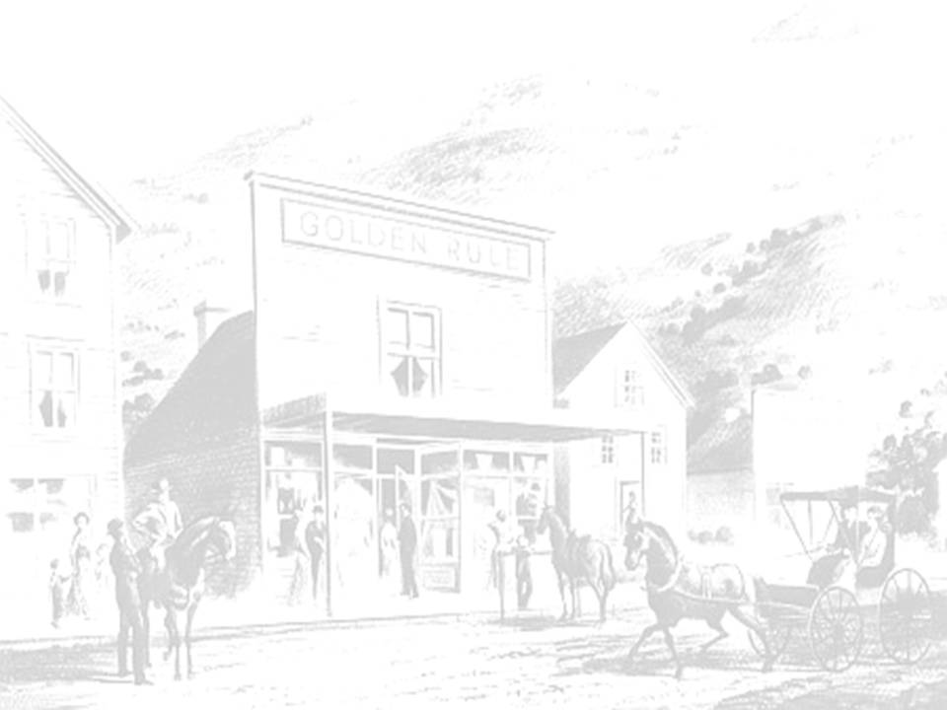
NEW STORES
BETWEEN 1860 TO 1900
Specialty stores----sold single line of goods
Department stores---combined specialty stores
Chain stores---stores with branches in cities
Mail catalog stores
New ways to advertise
Montgomery Wards, J.C. Penney, Macy’s, Sears and Roebuck and Woolworths

Slide 20
Causes of Rapid Industrialization
Steam Revolution of the 1830s-1850s.
The Railroad fueled the growing US economy:
    First big business in the US.
    A magnet for financial investment.
    The key to opening the West.
    Aided the development of other industries.

Slide 21
Causes of Rapid Industrialization
Technological innovations.
    Bessemer process
    Refrigerated cars
    Edison
      light bulb, phonograph, motion pictures.

Slide 22
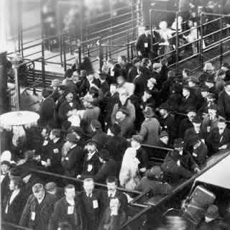
Causes of Rapid
Industrialization
Unskilled & semi-skilled
labor in abundance.
Abundant capital.
New, talented group of businessmen [entrepreneurs] and advisors.
Market growing as US population increased.
Abundant natural resources.

Slide 23
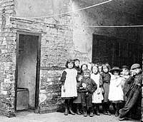
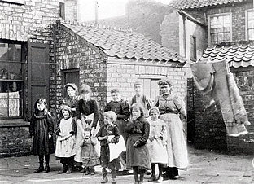
Took Problems into 20th Century
However, most problems generated by the Age of Energy -- the unequal distribution of wealth, large-scale unemployment, urban crowding, the decline of farm income, and reckless exploitation of natural resources -- would carry over into the 20th century.

Slide 24
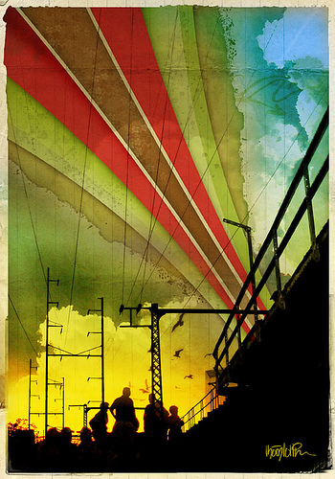
Captains of Industry
Entrepreneurs with the talent, vision, and willingness to take risks were able to achieve unprecedented wealth and power.

Slide 25
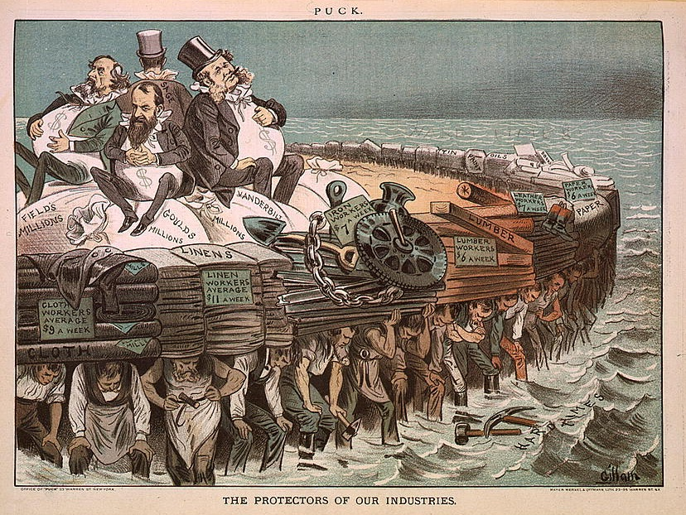
The Titans of Business
Private investors and businessmen contributed money to elections and campaigns in exchange for a “hands off” approach
Emphasis on business and making money over reform

Slide 26
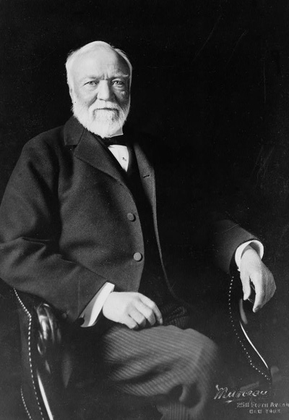
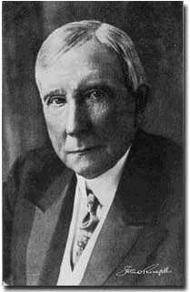
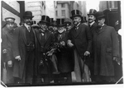
The Men
The Titans
  J.D. Rockefellar--Standard Oil
  J.P. Morgan--Investment banking and financier
  Andrew Carnegie--U.S. Steel
  Cornelius Vanderbilt, Jay Gould, and Jay Fiske--Railroads

Slide 27
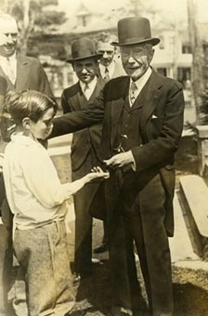
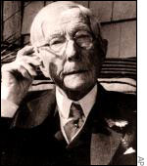
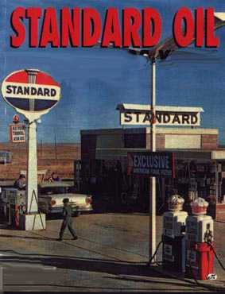
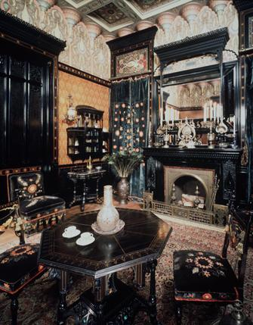
Standard Oil Trust
In 1882, John D. Rockefeller formed the Standard Oil Trust and consequently dominated 95% of the production, refining, and marketing of oil in the United States.

Slide 28
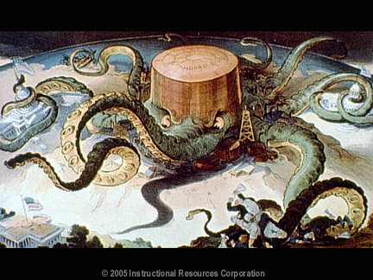
Standard Oil Cartoon based on Ida B. Tarbell’s book- The History of Standard Oil

Slide 29
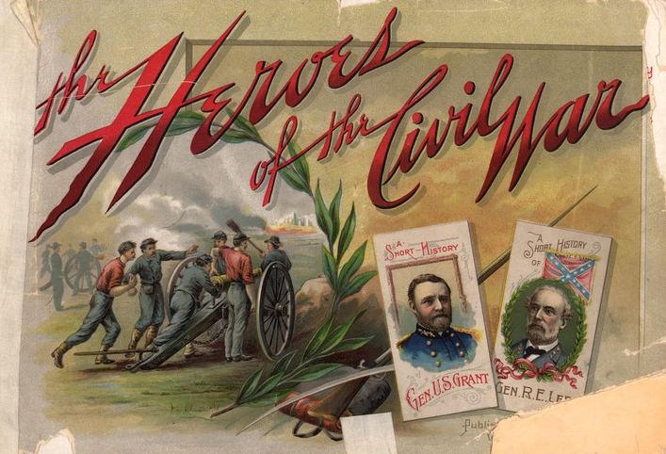
Giant Corporations
By 1900, two-thirds of all manufactured goods were being produced by giant corporations. Swift and Armour dominated meat packing, the Duke family controlled tobacco, and Andrew Carnegie took over every aspect of steel production.
armour
armour
Swift
1889 Duke Tobacco Advertisement

Slide 30
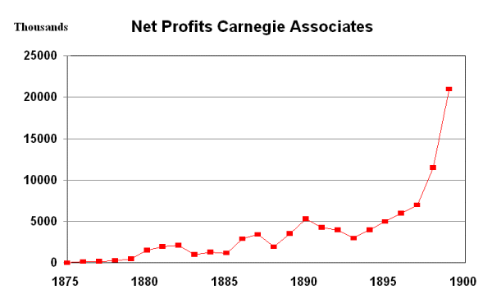
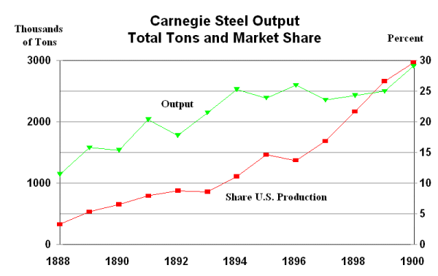
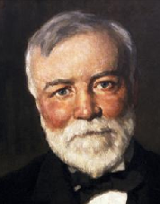
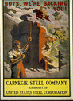
U. S. Steel Corporation
When he retired in 1901, he sold Carnegie Steel to financier J. P. Morgan for over $400 million dollars. Morgan subsequently reorganized the company into the United States Steel Corporation.
U
S
S

Slide 31
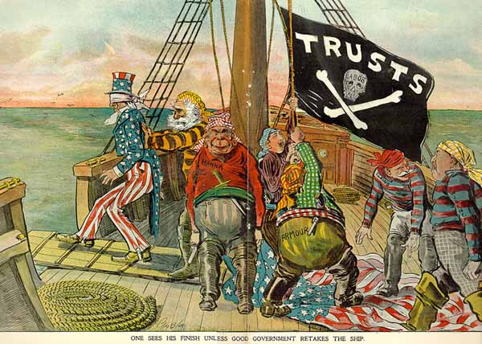
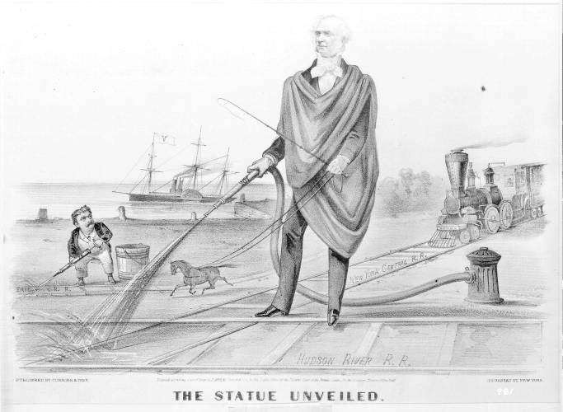
The Rise of Big Business
Trusts -A group of separate companies placed under the control of a single managing board
Critics called these practices unfair and the business leaders “Robber Barons”

Slide 32
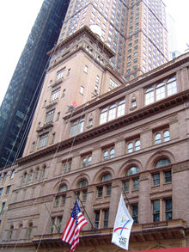
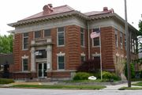

New Things in the World
Philanthropy
Laissez-faire -policy that US had followed since inception to not allow govt. to interfere with business
Captains of Industry
  A positive idea that industrial leaders worked hard and deserved their wealth
Monopoly-complete control of a product or service
Carnegie Library
Carnegie Hall

Slide 34
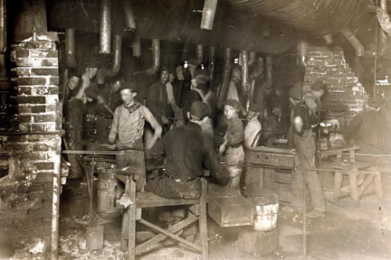
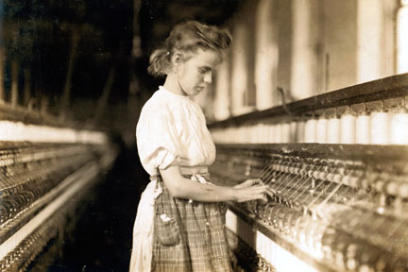
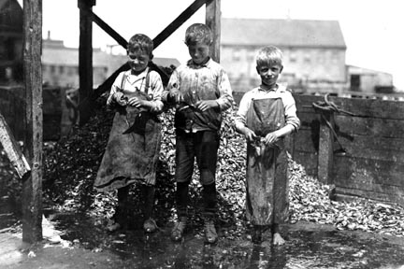
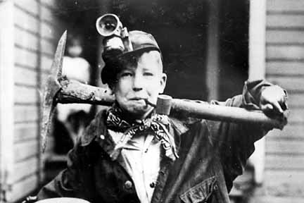
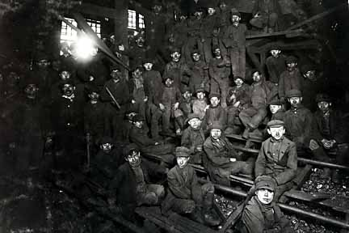
Poor Working Conditions in the Late 1800’s
Most factory workers worked 12 hour days, 6 days a week
Steel mills often demanded 7 days a week
No vacations, sick leave, unemployment compensation, or workers compensation for injuries on the job
Children as young as 5 often worked as much as 12 or sometimes 14 hours a day, for as little as .$27 a day.

Slide 35
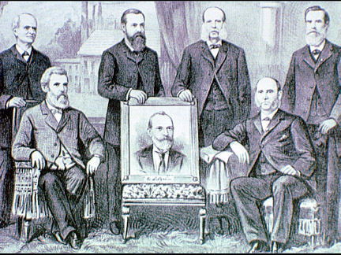
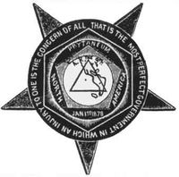
The Rise of Labor Unions
The Purpose of a labor union was “strength in numbers.” Attempted to gain better working conditions and pay.

Slide 36
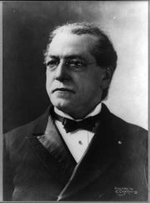
The Rise of Labor Unions
The American Federation of Labor (AFL)- Accepted only skilled white males, won higher wages and shorter work weeks for its members
Head of AFL was Samuel Gompers

Slide 37
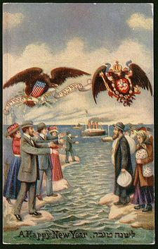
The New Immigrants
New Immigrants -Between 1870 and 1920-20 million Europeans-mostly from Southern and Eastern Europe came to America- (Jews/Catholics)
Hundreds of thousands more came from Mexico, Caribbean, and China
Looked and sounded different than natives
Nativism-Movement to ensure that native-born Americans received better treatment than immigrants
Russian Jews

Slide 38
Nativist

Slide 39
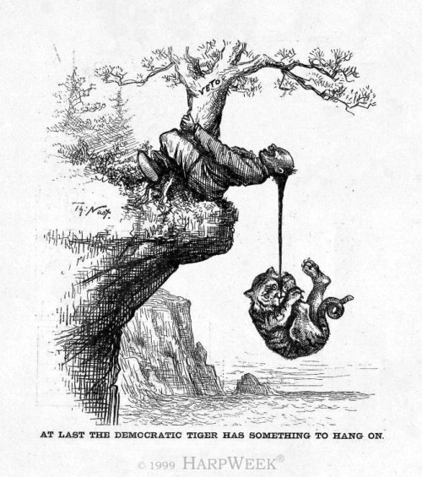
The New Immigrants
1882-Chinese Exclusion Act- prohibited Chinese laborers from entering the country. Was not lifted until 1943.

Slide 40

Political Cartoon depicting how Chinese immigrants workers lived and regular American workers lived. Rats, Yummy!

Slide 41



Problems of Rapid Urbanization
Urbanization- growth of cities
3 reasons cities grew in late 1800’s and early 1900’s
  New immigrants arrived in cities for work
  As farm machines replaced farmers they moved to cities
  African Americans left South after Civil War and came to Northern cities.

Slide 42








Problems in Cities
1. Housing shortages- Tenement – crowded apartment building with poor standards of sanitation, safety, and comfort
2. Transportation–struggled to keep up with growth
3. Clean water – was difficult to produce and transport

Slide 43
Problems in Cities
4. Waste and garbage removal was a challenge and often neglected
5. Fires were very common
  Great Chicago Fire -1871
  San Francisco Earthquake 1906
6. Crime rose with urbanization

Slide 44

Tenement

Slide 45

Tenement, NYC

Slide 46

Jacob Riis:
How the Other Half Lived
(1890)

Slide 47


Tenement Slum Living

Slide 48

Lodgers Huddled Together

Slide 49

Tenement Slum Living

Slide 50

Struggling Immigrant Families

Slide 51

Political Bosses
Ran local business and politics
Forced immigrants to vote for specific candidates in exchange for citizenship
Forced lower class to pay “protection” money
Stole money from city coffers through extortion, graft, bribes, private contracts, and misallocation of funds
Most famous political bosses were in the biggest cities William ‘Boss’ Tweed of NYC
Political bosses cartoon by Thomas Nast

Slide 52

“Tweed Ring” by Thomas Nast

