Slide 1
The Age of Enlightenment

Slide 2
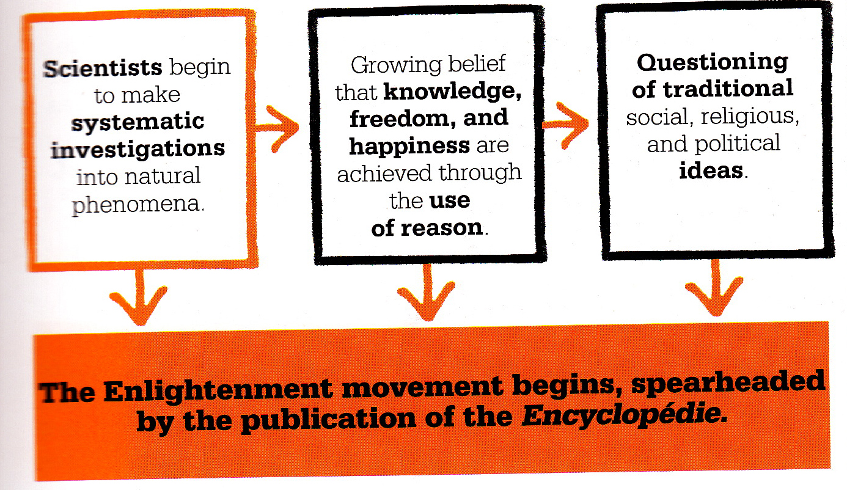
Enlightenment Big Picture…

Slide 3
Path to the Enlightenment
• 18th century philosophical movement by those greatly impressed with the scientific revolution
– Use systematic logic and reason to solve the problems of humankind
• Believed in the powers of humankind and saw themselves as part of a revolutionary development to replace superstition, rituals and corrupt traditions with reason and productive energy
– Commitment to reason
– Trust in modern sciences to solve problems
– Commitment to the idea of progress
– Belief in the essential goodness of human nature
– Emphasis upon the individual as master of his fate and fortune
– Engagement with the public in discussion and action

Slide 4
John Locke
• Philosophe - Enlightenment thinker
• Argued that every person was born with a blank mind – Tabula Rasa
• People shaped by experiences in the surrounding world
– Change the environment, change the people?
• Human beings possess free will
• Virtue can be learned and practiced
• The individual must become a
“rational creature”
• Divine Right is ridiculous - contract with the people

Slide 5
Isaac Newton’s Impact
• World is like a giant machine that operates according to natural laws
– Natural laws can be uncovered through systematic investigation
• Enlightenment believed the same systematic investigation could find the natural laws of human society
– Create an ideal society?

Slide 6
Montesquieu
• Charles-Louis de Secondat, Baron de Montesquieu
• The Spirit of the Laws (1748)
– Study of governments using the scientific method
– Discover natural laws of social and political relationships
– Identified three basic types of government:
• Republics – small states
• Monarchy – moderate-sized states
• Despotism – large states
– Identifies separation of power, checks and balances
• Limit any one part of government from growing too strong

Slide 7
Voltaire
• Criticized Christianity
• Championed religious toleration (Treatise on Toleration, 1763)
• Deism – religious philosophy based on natural law where a mechanic (God) created the universe
– Created it, set it in motion and allowed it to run without interference and according to its own natural laws

Slide 8
Denis Diderot
• Created the
Encyclopedia
– 28 volume collection of knowledge
– Many articles attacked religious superstition and supported religious toleration
– Called for social, legal and political reform
– Spread many Enlightenment ideas

Slide 9
Pages from the Encyclopedia

Slide 10
Pages from the Encyclopedia

Slide 11
Adam Smith & Economics
• If individuals are free to pursue their own economic self-interest, society benefits
• Government should allow the free play of natural economic forces
• Wealth of Nations, 1776
– Government should:
1. Protect society from invasion 2. Defend citizens from injustice 3. Maintain public works too
expensive for individuals

Slide 12
Social Contract
• Jean-Jacques Rousseau
• People enslaved by government in trying to preserve private property
• Social Contract: entire society agrees to be governed by its general will
– General will represents the best for humanity
– Rogue individuals must be forced to abide by the general will
• Appreciated emotion; education should foster children’s natural instincts

Slide 13
Women’s Rights
• Mary Wollstonecraft
– If arbitrary power of monarchs is wrong, so is the similar power of men over women
– Enlightenment was based on reason – since women can reason, they should have the same rights as men
– Founder of modern movement for womens’ rights

Slide 14
The Spread of Enlightenment Ideas
• Growth of Reading
– French publishers rise from 300 in 1760 to 1600 in the 1780s
– Daily newspapers and periodicals begin to take off
• The Salon
– Elegant sitting room where guests conversed about the new ideas of the philosophes

Slide 15
Religion in the Enlightenment
• While many philosophes attacked religion and the Christian church, most Europeans remained Christian
• Catholic Church remained important
• Most Protestant churches settled their own patterns
• John Wesley began the new religious movement of Methodism
– Gave lower and middle classes a sense of purpose and community
– Stressed the importance of hard work

