Slide 1
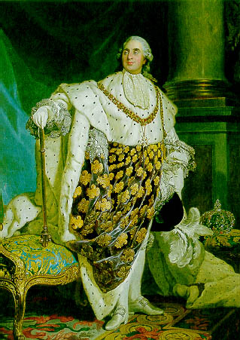
Louis XVI Decision Making Game

Slide 2
In this decision making simulation you will be given the same choices that Louis XVI faced during the Early Stages of the FR (1787-1791)
Select what way you believe is the best way to handle the situation.
You start off with a total of 100 respect points.
The total will change depending on the choices you make.
Keep score as you go through the simulation – it will affect your overall outcome at the end.

Slide 3
About Louis XVI
Louis had some very strong opinions about his role as the king of France.
“Power belongs to me alone – it is not shared with anyone else.” Louis XVI 1766
These views led to his eventual imprisonment and execution.
Can you do better?

Slide 4
Decision 1: You need more money
It’s February 1787: Your government is spending more money than it receives. To improve your situation, your finance minister has devised a new scheme to tax the rich landowners. These extra taxes will help raise some money.
He has invited a group of noblemen to Paris to approve the new tax. The nobles have said they do not have the power to approve the new taxes.
Back down and sack your finance minister.
OR
Stand firm and force the nobles to agree to the new tax.

Slide 5
You choose to back down and sack your finance minister
This was probably the best decision under the circumstances.
Your finance minister, however, is disgusted by your betrayal and the people are growing concerned by your lack of leadership.
Your financial situation is getting worse
Lose 5 respect points

Slide 6
You choose to force the nobles to agree
A poor decision
The noblemen refuse to give into your attempt at bullying and you are eventually forced to back down.
You have offended some of the most powerful people in the country. Your financial situation is worsening.
Lose 10 respect points you sucker!

Slide 7
What does Louis really do?
In real life, Louis chose to back down.
His finance minister, Charles Alexandre de Calonne, was sacked, and Louis was forced to consider other plans.
His reputation suffered as a result of his humiliation.
(Sad Face)

Slide 8
Decision 2: You are nearly bankrupt!
It’s August 1788: People are hungry and riots are occurring in many parts of France.
You have tried to introduce some new taxes through the Paris Parlement. The Parlement has said, however, that only the Estates can approve new taxes. The Estates General has not met for over 100 years.
Order that new elections be held for the Estates General.
OR
Look for other ways to earn some money.

Slide 9
You choose to order elections.
A good decision
The people are relieved you are taking action. They look to you, their King, for guidance in this time of need.
At last you have identified a way forward.
Earn 5 respect points.

Slide 10
You chose to investigate other ways to make money.
A poor decision
The people are angry that you are failing to take action. They are concerned with your apparent lack of interest in their problems.
They demand that you order the new elections. You are forced to give in.
Lose 10 respect points, sucker!

Slide 11
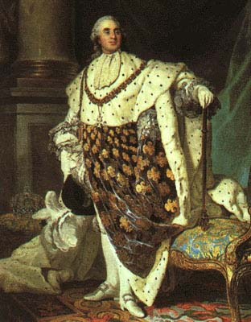
What did Louis really do?
In real life Louis recognized the need for urgent action.
He ordered the new elections to take place in 1789…not such a bad guy after all?

Slide 12
Decision 3: The Third Estate is UNHAPPY!
It’s February 1789: On your orders the Estates General is being re-established.
The members of the third estate, however, believe that the current voting system is unfair. They want twice as many members and feel like every member should have a vote. This would bring them into line with the other Estates.
Reject both demands
OR
Only agree to let them have more members
OR
Only agree to let them have one vote

Slide 13
You chose to reject both demands
A poor decision
Your hard-line approach offends many members of the Third Estate. They accuse you of being unsympathetic to the needs of the common people.
Be careful! You are becoming unpopular.
Lose 15 respect points – meanie!

Slide 14
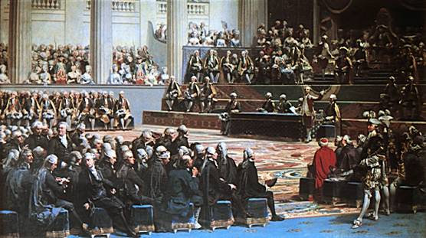
You choose to allow more members
A fair decision under the circumstances.
Your moderate approach satisfies the Third Estate, but your decision is ridiculed in the newspapers.
They suggest that the new members will not support your wishes. By allowing more third estate members, you have increased the number of enemies in the Estates General.
Your position is weakened – softie!
Lose 10 respect points.

Slide 15
You choose to allow each member one vote
The best decision under the circumstances.
Your moderate approach is very popular with the people. However, by allowing each member a vote you have still made your enemies powerful.
Lose 5 respect points

Slide 16
What did Louis really do?
In real life, Louis agreed to double the number of Third Estate representatives.
This decision, however, was made under the assumption that each Estate would meet separately. Louis thought that the extra members would make no difference since the Third Estate would still be outnumbered by the first and second Estates.
What happened next took Louis by surprise…

Slide 17
Decision 4: The Estates want to form a National Assembly
It’s May 1789: The Estates General has just met for the first time. You have told the different Estates that they are to meet separately in the future.
However, the members of the third Estate do not like this. They want all three Estates to form one National Assembly and to meet and discuss things together.
Some members of the First and Second Estate have threatened to join the Third Estate in protest at your interference.
Use your soldiers to make them meet separately
OR
Give in and let them meet together as a National Assembly

Slide 18
You choose to use your soldiers
A bad decision that backfires.
Your use of force is seen as too excessive. Your reputation suffers and you are eventually forced to give in.
Loose 15 respect points.
(Monument is located in Luzern, Switzerland – a dedication to the Swiss soldiers that died defending Louis XVI in 1792)

Slide 19
You choose to give in and accept the New National Assembly
The best decision under the circumstances
By accepting their wishes you have avoided a disastrous confrontation with the members you wanted elected.
Your reputation still suffers slightly from giving in.
Loose 5 respect points

Slide 20
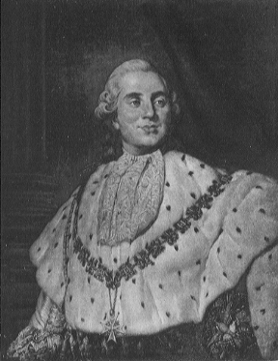
What did Louis XVI really do?
Louis was eventually forced to give in and allow the three Estates to meet together.
By this time he had already lost considerable power.
A National Assembly was formed thus signaling the end of the absolutism in France.

Slide 21
Decision 5: The people are uneasy
It’s June 1789:You are concerned that the French guards have become too sympathetic to the new National Assembly. You order that thousands of new soldiers be posted in Paris to provide you with more security.
Many people are worried by the arrival of extra soldiers. They suspect that you will use them to shut down the National Assembly.
Send some of your new soldiers away to calm down the people.
OR Call in even more soldiers to show that you are still in charge.

Slide 22
You choose to send some of your new soldiers away
A wise decision
The people are relieved that the soldiers are gone.
You have diffused a potentially difficult situation.
Gain 5 respect points.

Slide 23
You choose to call in even more soldiers
A bad decision.
Your extra soldiers upset the people – riots break out in parts of Paris.
You are becoming more unpopular by the day.
Lose 5 respect points.

Slide 24
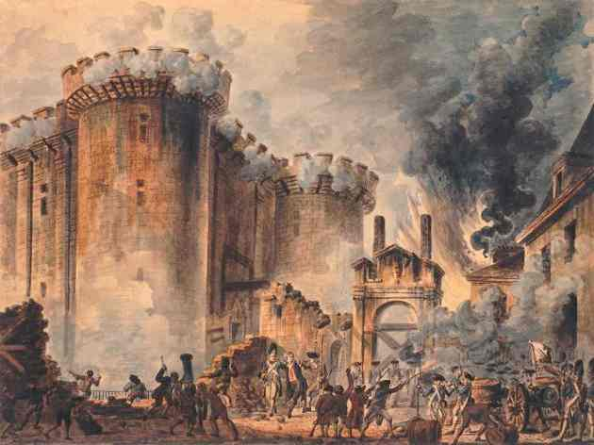
What did Louis XVI really do?
In real life, Louis decided to send in more soldiers.
The people were enraged by this decision. In anger they stormed the Bastille.
Louis was eventually forced to withdraw his extra soldiers.

Slide 25
Decision 6: A new Declaration is published
It’s July 1789: The security situation is deteriorating. The Bastille has just been attacked. Elsewhere, people are rioting in many parts of France.
The National Assembly has published a document titled “The Declaration of the Rights of Man and the Citizen.” This new declaration describes how all the French people should be treated as equals. It will affect many of the privileges that the French upper class enjoy.
Offer your support of the new Declaration
OR
Refuse to accept the new Declaration

Slide 26
You choose to support the new declaration
Although your wealthy friends are dismayed, the people respect your decision to support the declaration.
Many are pleased with your willingness to modernize and compromise with the National Assembly
Gain 5 respect points

Slide 27
You choose to reject the new declaration
The people are upset by your rejection.
Many are angered by your arrogance and your refusal to acknowledge equal rights. Anti-royal demonstrations occur.
Lose 15 respect points

Slide 28
What did Louis really do?
In real life, Louis rejected the declaration, claiming that it would undermine French society.
Many saw his decision as a desperate attempt to hold onto his remaining power.

Slide 29
Decision 7: A group of protesters has gathered
It’s October 1789: Thousands of protesters have marched to your palace at Versailles.
They have been stopped from entering the palace by your soldiers, but they are demanding bread and a meeting with you.
Use your soldiers to disburse the protestors
OR
Flee to avoid the danger
OR
Agree to their demands

Slide 30
You choose to use the soldiers to disburse the crowd
A DISASTEROUS move.
Your decision to use your soldiers to disburse the crowd is a complete over-reaction. The crowd disbands but violence quickly breaks out.
Your reputation suffers greatly.
You really are a bad ruler…
Lose 15 respect points

Slide 31
You choose to flee the danger
Your palace is surrounded by thousands of protesters.
Your feeble attempt to escape comes to nothing. You are quickly spotted and are forced to meet the protesters.
Your reputation suffers badly.
Lose 10 respect points…how many do you
even have left?!

Slide 32
You chose to accept their demands
The best decision under the circumstances
The decision to meet the protesters helps to calm things down a bit.
You are however, still humiliated by the experience.
Lose 5 respect points.

Slide 33
What did Louis XVI really do?
In real life Louis XVI was forced to meet the protesters.
They forced the royal family to come back to Paris, where they were confined to Tuilleries.

Slide 34
Decision 8: A new Constitution is written
It’s June 1791: You have been returned to Paris by the protesters. Although you are being held prisoners at Tuilleries, your living conditions are quite good.
You have been told to accept a new constitution that will limit your royal powers. You are more unpopular than ever before. It would not be a good idea to reject the constitution outright.
Agree to the terms of the new Constitution.
OR Flee from France and get help from someone who cares.

Slide 35
You have agreed to sign the new Constitution
A good decision
You realize your position is hopeless
By signing the constitution, you live to fight another day.
Gain 5 respect points, rockstar.

Slide 36
You chose to flee…
A bad decision
Even in disguise you don’t get far. You are caught and return to Paris immediately. It is obvious you have lost the trust of your people.
Lose 15 respect points

Slide 37
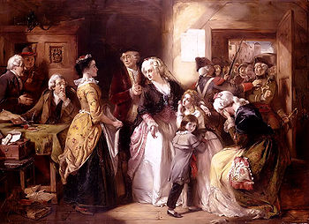
What did Louis really do?
Louis decided to flee to England with his family.
He was caught at Varennes and was accused of treason.
He was later forced to accept the Constitution limiting his powers.

Slide 38
How well did you do?
You have completed this simulation…how did you match up to Louis XVI?
How many respect points do you have left?
0-24
25-49
50-74
75-100

Slide 39
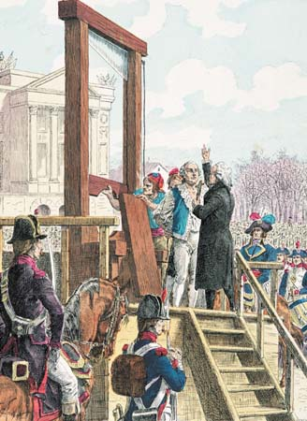
You have 0-24 points…WOW!
A poor performance for a “king”
You made too many bad
decisions…even Louis XVI could have done better!
You have lost your royal power and are hated by the people.
France will most certainly become a republic and at this very moment executioners are coming to send you to the Guillotine.

Slide 40
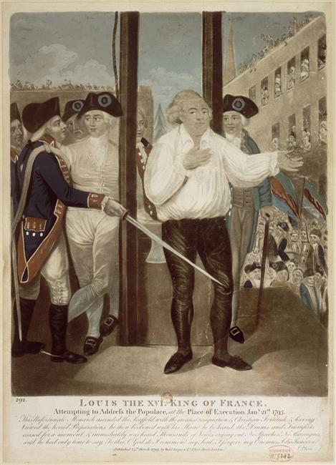
You have 25-49 points
A below average performance
You mainly made some BAD choices – just like Louis XVI.
You have lost your royal powers and are disliked by the people.
France will become a republic and your execution is very likely.
In short – it bites to be you.

Slide 41
You have 50-74 points left
An above average performance.
You made mainly good decisions – better than Louis XVI.
You have lost your royal power, but are still fairly popular with the people.
France will become a Republic, but your execution seems unlikely…for now.

Slide 42
You have 75 or more points left
An excellent performance
You made lots of good decisions – much better than Louis XVI.
You have lost most of your royal power, but you are still liked by the people.
France will become a Republic, but will not execute you.

