Slide 1
The Expansion of Industry & Big Business and Labor
Chapter 14 - Sections 1+3

Slide 2
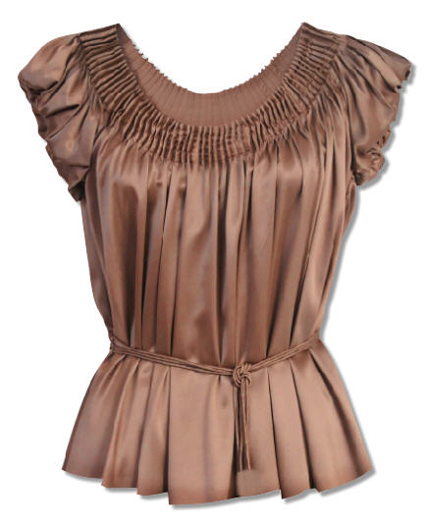
Activity:
Each of you will receive a blank sheet of paper.
You will have 3 minutes to draw a detailed picture of a woman’s blouse.
Begin your drawings now.

Slide 3

Factory competition
Notes:
In this activity, students experience the working conditions of the late 1800s by taking on the roles of workers on an assembly line. You will take on the role of a harsh factory supervisor, yelling at students and destroying unsatisfactory work. Historical analogies are noted as you move through the activity. Do not share these analogies with students until after they complete their Reading
Notes for the lesson:
The activity has roles for 32 students. If you have more than 32 students, add additional assembly-line workers and additional features to the blouse on the Information Master.
If you have fewer than 32 students, eliminate some of the immigrants or some of the workers, beginning with Worker 14. It is important to assign the same number of students to each assembly line; add or subtract immigrants as needed.
Place desks in two facing rows; desks should be at least 6 inches apart (14 on each side)
4 people will be posted as immigrants

Slide 4
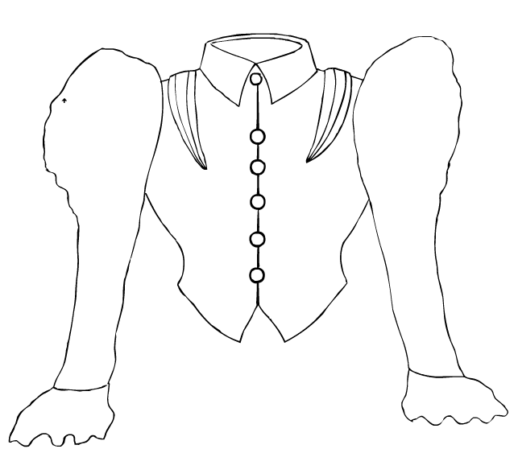
The Production Line
Assembly lines will produce as many of these shirtwaist shirts as possible
Each worker will specialize in producing one feature of the blouse

Slide 5
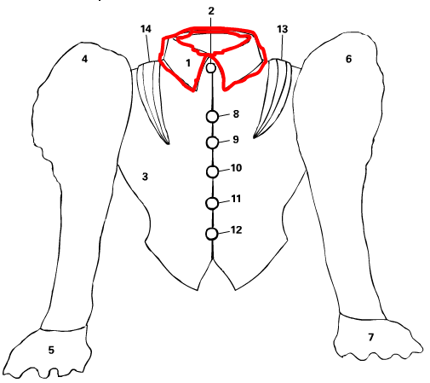
assignments
Each worker will only produce one aspect of the shirt
Refer to the diagram on the right for the piece which you will be producing

Slide 6
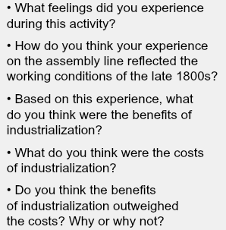
Reflection Questions:

Slide 7
Take out your exam review packets!!
JDI

Slide 8
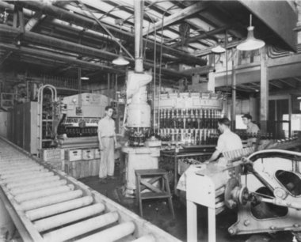
The Expansion of Industry & Big Business and Labor
Main Idea – At the end of the 19th century, natural resources, creative ideas, and growing markets fueled an industrial revolution. The expansion of industry resulted in the growth of big business and prompted laborers to form labor unions to better their lives.

Slide 9
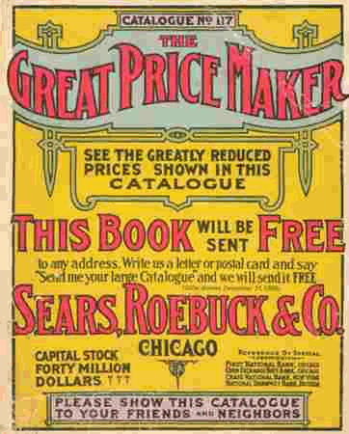
Post war changes to farm and city life
Mechanization (i.e. the Reaper) had reduced farm labor needs and increased production
Industrial development in cities had increased labor needs.
Industrialization provided access to consumer goods (i.e. mail order)

Slide 10
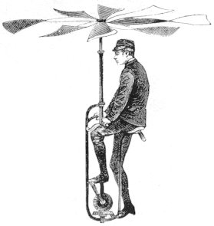
Inventions Promote Change
Bessemer Steel Process
Light Bulb
Electricity
Telephone
Airplane
Assembly-Line Manufacturing

Slide 11
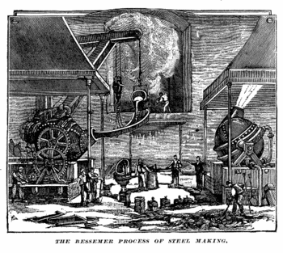
Bessemer Steel Process
Bessemer Steel Process: – def. - new manufacturing process to make steel (created by Henry Bessemer)
  SIG - new steel products used for building railroads and skyscrapers

Slide 12
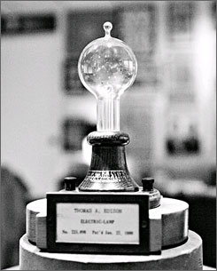
Light Bulb
Light Bulb: (Thomas Edison) – new development to serve as a source for light
  SIG – made work less dependent on natural sunlight

Slide 13
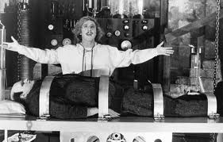
Electricity
Electricity: (Thomas Edison) - new power source for businesses and homes
  SIG – electric power ran industrial machines that could be located anywhere

Slide 14
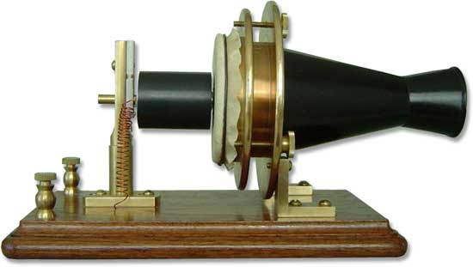
Telephone
Telephone: (Alexander Graham Bell) – revolutionized communications in business
  SIG – saved time and created new clerical jobs for women in business

Slide 15
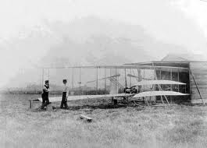
Airplane
Airplane: (Wright Brothers) – allowed for movement of goods and eventually people by air travel
  First flight = Kitty Hawk, NC in 1903
  SIG – led to the creation of a U.S. airmail system by 1920

Slide 16
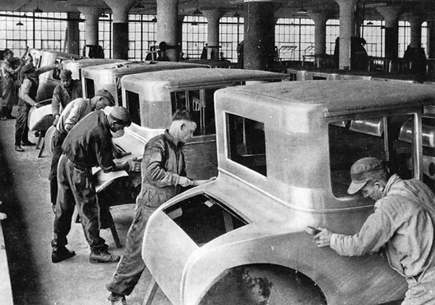
Assembly-Line Manufacturing
Assembly-Line Manufacturing: (Henry Ford) – broke industrial tasks down into simpler parts and improved efficiency in production of cars
  SIG – allowed for increased efficiency in production for many industrial products

Slide 17
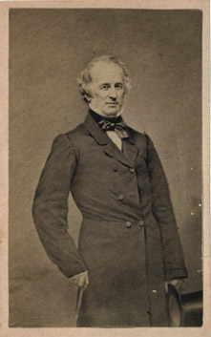
Leaders of Industry (aka “Robber Barons”)
Andrew Carnegie
J.P. Morgan
John D. Rockefeller
Cornelius Vanderbilt

Slide 18
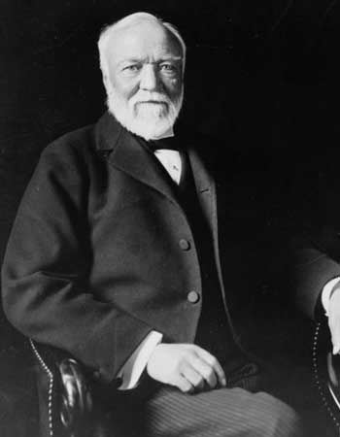
Andrew Carnegie
Andrew Carnegie: Steel Industry
  Scottish immigrant who rose from “rags to riches”
  Carnegie Steel Company – made more steel than any other company in US
  Developed a monopoly: – def. – complete control over an industry’s production, wages, and prices when all competitors are bought out

Slide 19
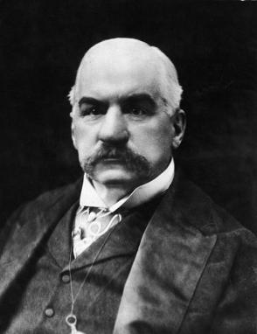
J.P. Morgan
J.P. Morgan: Banking and Finance
  Formed a holding company – def. – corporation that did nothing but buy out stock of other companies
  Bought out Carnegie Steel in 1903 to create U.S. Steel = world’s largest business

Slide 20
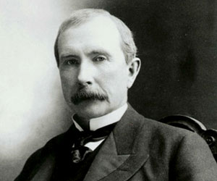
John D. Rockefeller
John D. Rockefeller: Oil Industry
  Standard Oil Company – controlled 90% of all U.S. oil production
  Controlled other companies by forming a trust – def. – several corporations made an agreement to be run by one executive board that ran the trust like one big company
  Standard Oil

Slide 21
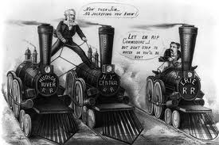
Cornelius Vanderbilt
Cornelius Vanderbilt: Railroads
  Dominated control of much of the nation’s railroad lines in the Northeast and Midwest

Slide 22
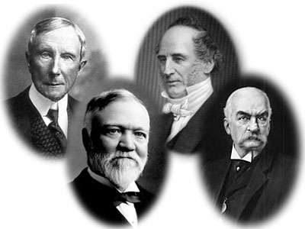
Reactions Against Industrialists
Carnegie, Morgan, Rockefeller, and Vanderbilt were called “Robber Barons” by critics
  Critics said they were making money in a corrupt manner

Slide 23
Captains of Industry assignment
You are to read the biographies of the 4 captains of industry and INDIVIDUALLY create your own wanted poster for the captain of industry you pick.
Please follow the directions on the assignment sheet!
See the example (Henry Ford) on the bottom of the assignment sheet.

Slide 24

Monopoly and Corporation

Slide 25
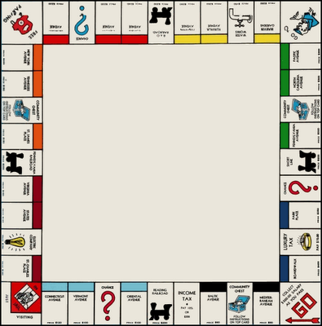
Monopoly
What is the goal of the game of monopoly?
How is that goal achieved?
Monopoly

Slide 26

Monopoly Example
Phase 3
King Steel Company
Phase 1
Phase 2
Carnegie offers lower prices and eliminates the competition (King Steel)
King Steel Company
King Steel Company
Carnegie Steel Company
Carnegie Steel Company
Carnegie Steel Company
Phase 4
Carnegie acquires the means to produce steel more efficiently thus lowering prices and putting strong steel out of business
Strong Steel Company
Strong Steel Company
Monopoly: gaining total control of a type of industry by one person or company.
Vertical Integration: the combining of companies that supply equipment and services needed for a particular industry.
Horizontal Integration: the combining of competing firms into one corporation.
Now that Carnegie is the only company, what can they do to their prices?
____________________________________________

Slide 27








Creating a Corporation
Local Companies
MC gives a % of corporate profits (dividends)
Corporation: is a business in which investors own a share of the company and the corporation expands as a benefit of the investor’s money.
Uncle Sam’s company
MC sells company stock
Murphy’s Company wants to expand to become a Corporation But it need $
Public Invests Money
Murphy’s Company
Murphy’s Company asks the public to invest
Green house Company
Murphy’s Company becomes a corporation, because it has investors

Slide 28
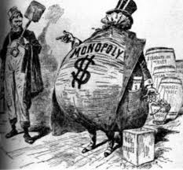
Reactions Against Industrialists
Sherman Antitrust Act: (1890) – made it illegal to form a trust that interfered with or “restrained” free trade
  SIG - limited impact at first – corporations were able to win court cases and continue consolidation tactics
Unsafe working conditions and low pay caused workers/laborers to form Labor Unions devoted to improving the lives of workers

Slide 29
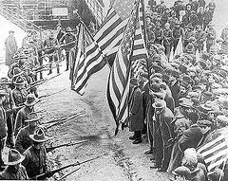
Labor Unions Emerge
Knights of Labor
American Federation of Labor (AFL)
American Railway Union (ARU)
International Ladies’ Garment Workers’ Union

Slide 30
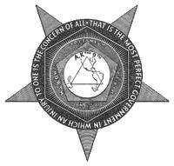
Knights of Labor
The Knights of Labor was founded by Uriah Stephens in 1869
  Open to all workers regardless of skill level, race or gender
  Supported an 8 hour workday

Slide 31
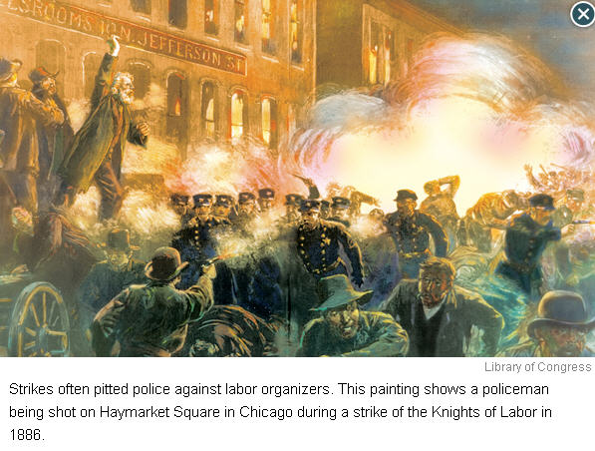

Slide 32
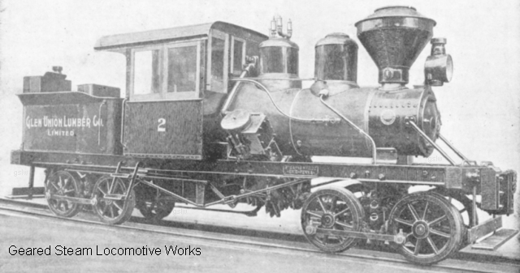
American Railway Union (ARU)
The American Railway Union (ARU) was founded by Eugene V. Debs (Socialist)
  Open to all workers within a specific industry (railroads) regardless of skill level
  Used strikes when necessary – involved in the Pullman Strike

Slide 33
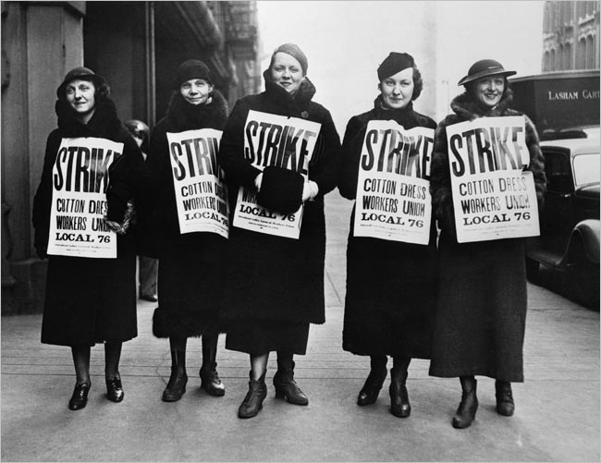
International Ladies’ Garment Workers’ Union
The International Ladies’ Garment Workers’ Union was founded by Pauline Newman
  Labor union devoted to female workers in the textile industry
  Used strikes when necessary
  Triangle Shirtwaist factory fire - New York City in 1911
    146 people (mostly women) died as a result

Slide 34
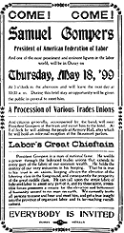
American Federation of Labor (AFL)
The American Federation of Labor (AFL) was founded by Samuel Gompers in 1886
  Open to skilled workers only
  Favored collective bargaining – def. – negotiation between management and representatives of labor to reach an agreement on wages, hours, and working conditions
  Used strikes when necessary

Slide 35
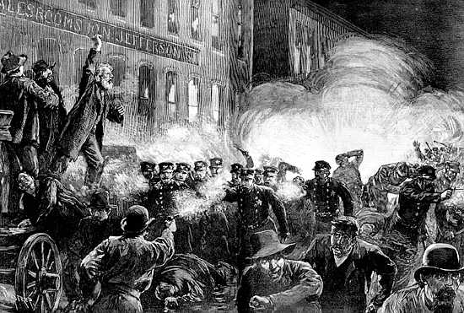
Strikes Turn Violent
Haymarket Square
Pullman Strike
Homestead Strike

Slide 36
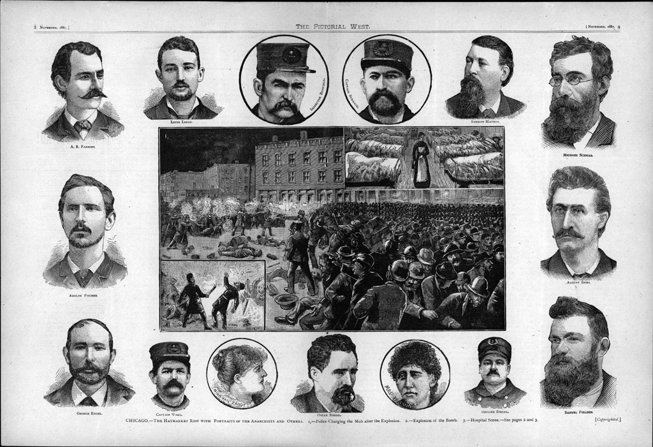
Haymarket Square
Haymarket Square , Chicago 1886
  A bomb exploded into a crowd of policemen and police fired into strikers
  The public started to turn against labor unions

Slide 37
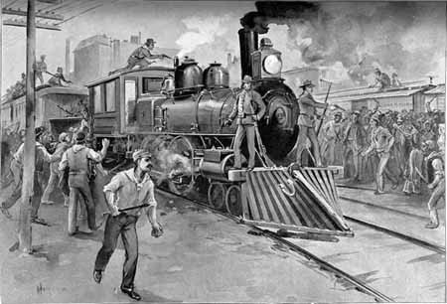
Pullman Strike
Pullman Strike , near Pittsburgh 1892
  Workers at the Carnegie Steel Plant went on strike when wages were cut
  Violence broke out and the Pennsylvania National Guard was called in to break up the strike

Slide 38
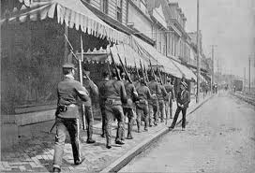
Homestead Strike
Homestead Strike, Chicago 1894
  Pullman employees went on strike after wages were cut
  Violence broke out – U.S. Army sent in by President Cleveland to break up the strike

Slide 39
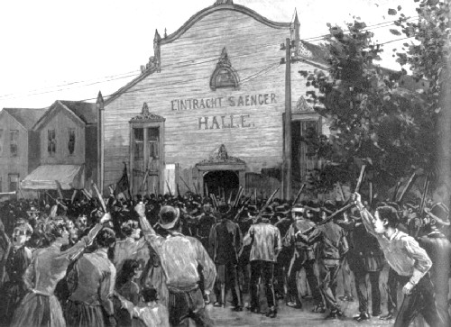
Strikes Turn Violent
SIG – violence associated with strikes caused the public to turn against labor unions

Slide 40
The New Immigrants
Chapter 15 – Section 1

Slide 41
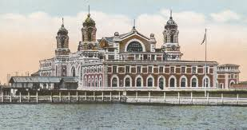
New immigrants
Main Idea – Immigration reached a new high in the late 19th and early 20th centuries. Most immigrants during this time period came from Southern and Eastern Europe as well as Asia. These immigrants often faced hardships and hostility from native-born Americans.

Slide 42
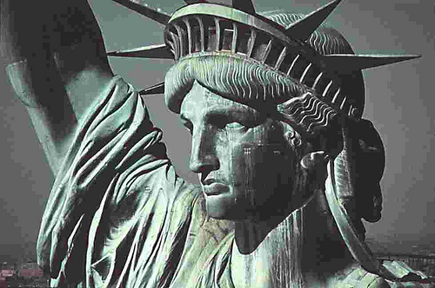
The “Golden door”
Old Immigrants
New Immigrants
Asian Immigrants

Slide 43
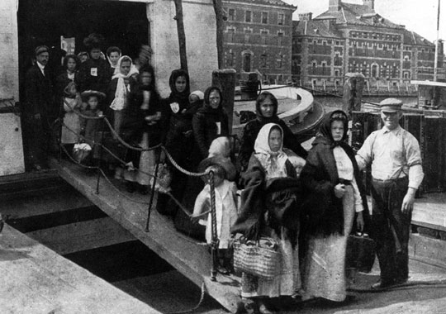
Through the golden door
Background: Millions of immigrants entered the U.S. in the late 19th and early 20th centuries
  “push” factors (reasons to leave their homeland) = famine, land shortages, religious or political persecution
  “pull” factors (reason to come to the U.S. ) = economic opportunity, freedom from persecution

Slide 44
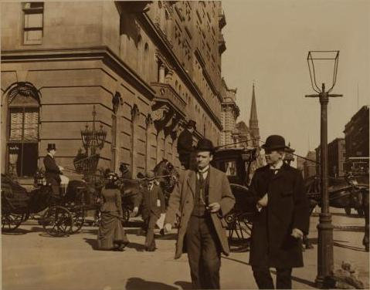
Old immigrants
Old Immigrants: immigrants who came to the U.S. prior to 1871, usually from countries in Northern and Western Europe
  Ex: Great Britain, Ireland, Germany, Norway, Sweden
  Many worked on canals or railroads, or in textile mills in the North and Midwest

Slide 45
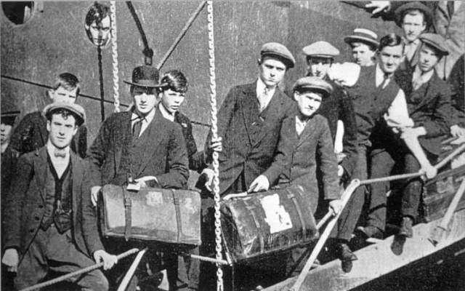
New immigrants
New Immigrants: immigrants who came to the U.S. from 1871 to 1921, usually from countries in Southern and Eastern Europe
  Ex: Italy, Greece, Poland, Russia, Austria-Hungary
  Many worked in textile or steel mills, or in coal mines in the Northeast
  Many worked in clothing industry in New York City

Slide 46
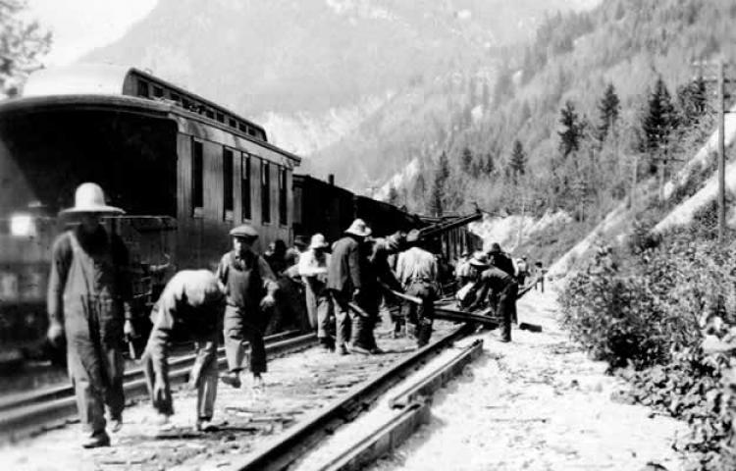
Asian immigration
Smaller numbers of immigrants from China and Japan came to the West coast of the U.S. between 1851-1883
  Ex: China, Japan
  Many Chinese immigrants helped to build the Transcontinental Railroad

Slide 47
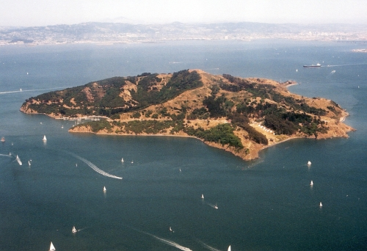
Entering the United states
Ellis Island
Angel Island

Slide 48
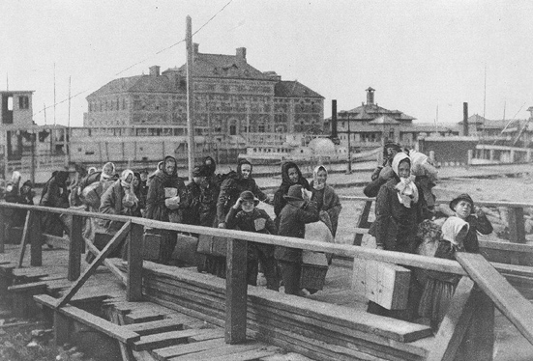
Ellis island
Ellis island: immigration center in New York harbor (1892-1924)
  Located near the Statue of Liberty = first view of U.S. for many immigrants
  Immigrants had to pass “inspection” to gain entry to the U.S.
    Inspection = physical exam, legal/document inspection, proof of no criminal record, proof of ability to work
  SIG – 17 million immigrants entered the U.S. through Ellis Island
  Interactive Tour

Slide 49
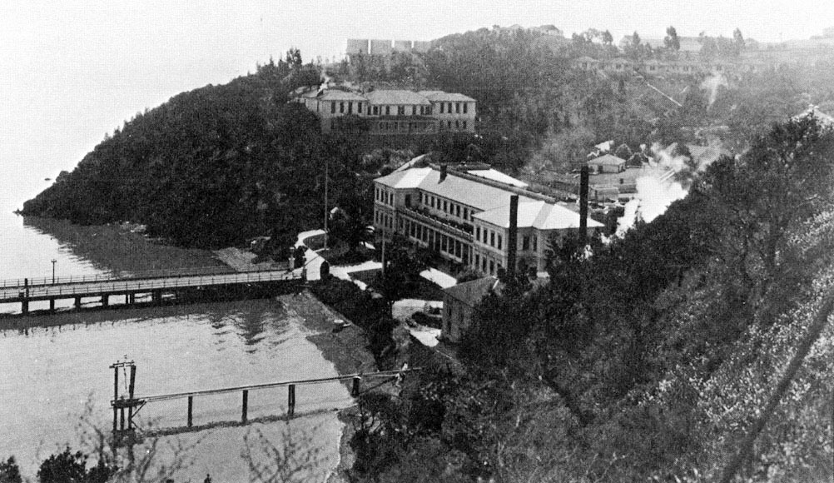
Angel island
Angel island: immigration center in San Francisco (1910-1940)
  Inspection process was more difficult than at Ellis Island
  SIG – 50,000 Chinese immigrants entered U.S. through Angle Island

Slide 50
Li Keng Wong’s experience on Angel Island
Each day, we sat and waited to be called for our immigration interview. The waiting was nerve-wracking. There wasn't anything to keep us occupied. We had no books to read and no toys to play with. We didn't study the coaching papers while being detained because we had memorized the questions and answers back in our village.
Each day, we were escorted to the dining area, where we ate Chinese food. We ate rice, meat, and vegetables. We also ate bread and fruit. The food was good and was supplemented by the government.
But we were not treated kindly. The officials seldom smiled or acknowledged us. I hated the detention and I was worried that we could be deported, but I did not have to worry for long.
After a week, we had our immigration interview. We were interrogated separately. Mother was questioned for one day, my older sister Li Hong was questioned for half a day, and I was questioned for two hours. My father had to make the trip from Oakland, taking the ferry to Angel Island, where he was questioned for two days. We didn't even know he was there until later because we had no way to communicate with him!”
http://teacher.scholastic.com/activities/asian-american/angel_island/chapter5.htm
“It is estimated that 175,000 Chinese immigrants came through Angel Island. Immigrants from Korea, the Philippines, and Japan also came through Angel Island, though they were usually not detained as long as Chinese. Many Chinese were detained in Angel Island anywhere from two weeks to several months because of the Chinese Exclusion Act of 1882. A few people were detained up to two years!
Some detainees carved Chinese poems on the walls to lament their fate. They were bored, lonely, sad, and isolated in the barracks. By patiently carving poems on the wooden walls, they helped to pass the slow ticking time and to express their frustrations.
Women and men were segregated in Angel Island, and while we were there, we were locked up in the women's barracks. The barracks had barred doors and windows. Guards wearing green uniforms stood outside and constantly watched us. Our barrack had a handful of women who came before us and were still waiting to learn their fate — would they make it into the United States or return home in shame?

Slide 51
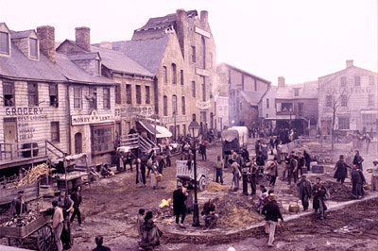
assimilation
Most immigrants settled in urban ethnic neighborhoods:
  areas with people of the same ethnicity, culture, religion, and language
  Made assimilation into American society easier
Most immigrants worked hard to learn English, adopt American customs, and become American citizens
Public schools = essential in the process of assimilating children of immigrants

Slide 52
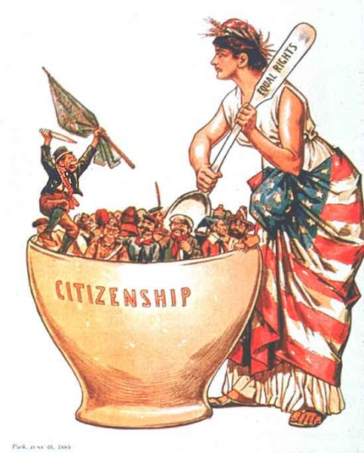
Melting pot
Melting Pot: a mixture of people of different cultures and races who blended together by abandoning their native languages and customs

Slide 53
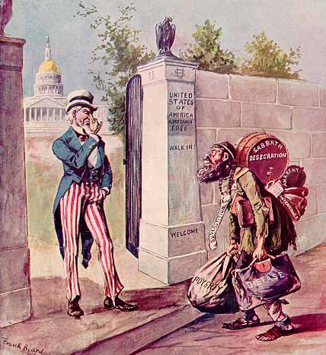
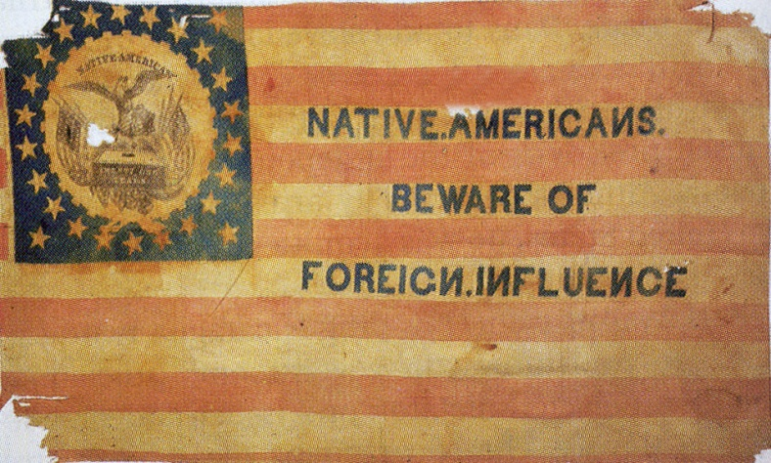
nativism
Nativism: favoritism of native-born Americans combined with anti-immigrant feelings
  Fear that immigrants would take jobs for lower pay than American workers
  Resentment that many immigrants did not give up their unique cultural identities
  Prejudice based on religious, cultural, and racial differences

Slide 54
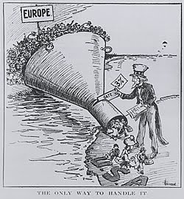
Immigration Restriction Legislation
  Chinese Exclusion Act of 1882 placed a 10 year ban on all Chinese immigration
  Immigration Restriction Act of 1921 – aimed at severely restricting the immigration totals of Southern and Eastern European immigrants

