Slide 1
Growth of the National Economy 1790-1850

Slide 2
How would you define “revolution?”
An overthrow or repudiation and the thorough replacement of an established government or political system by the people governed.
A radical and pervasive change in society and the social structure, especially one made suddenly and often accompanied by violence.
A sudden, complete or marked change in something.

Slide 3
Main Ideas
Industrial Revolution
“Interchangeable Parts”
Transportation Innovations: Cumberland Road and Erie Canal

Slide 4
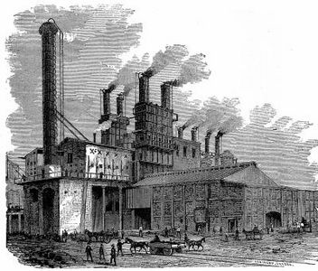
Inventions and Innovations
The Industrial Revolution
Rise of the Textile Industry
What characterized the 19th century textile factory?
Centralized
J.D. Rockefeller
Eli Whitney’s “Interchangeable Parts”
Who was the modern innovator that used this similar idea for his factory?
Other examples?

Slide 5
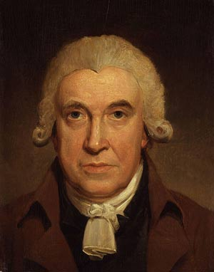
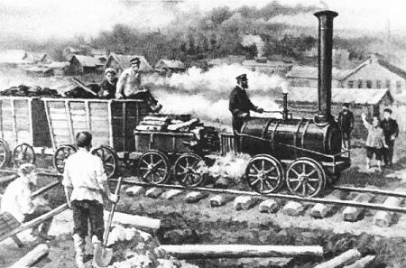
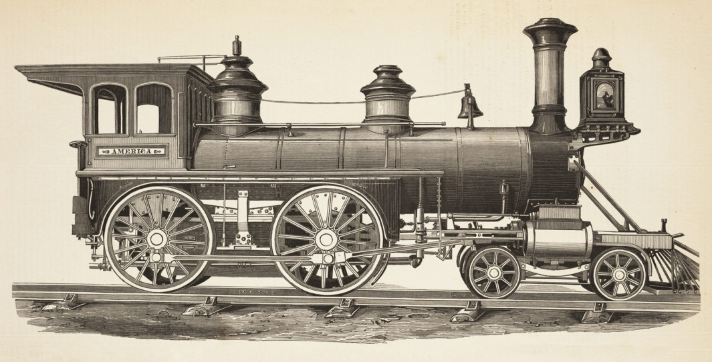
Development of Transportation
Roads
Cumberland Road
River Travel and Canals
Erie Canal
Would this be beneficial for farmers?
Railroads
James Watt
By 1840, more than 3,300 miles of railroad track.
How does the development of a progressive transportation system relate to communication?
Newspapers, magazines, books.

Slide 6
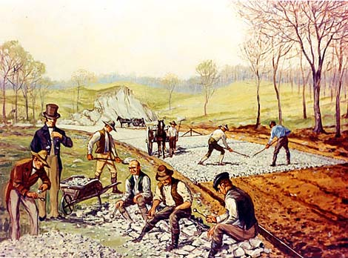
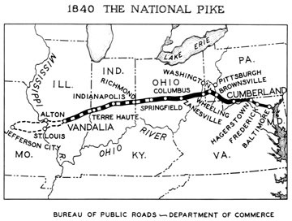
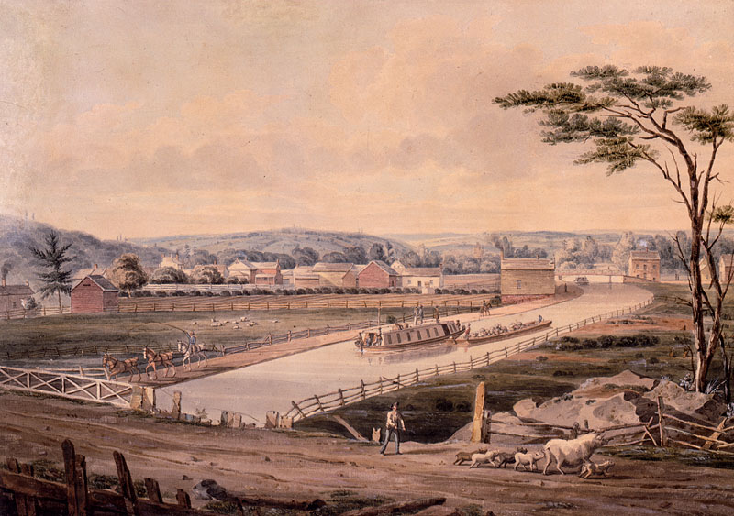
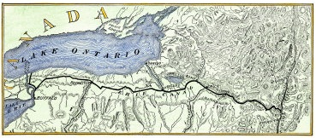

Slide 7
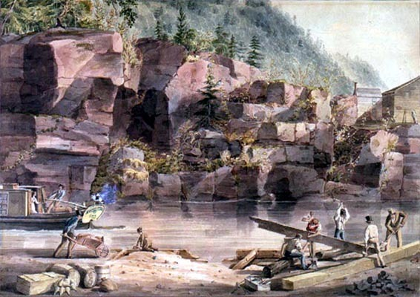
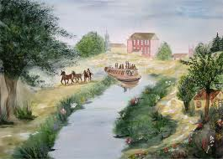

Slide 8
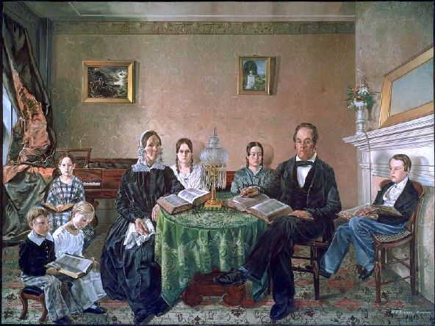
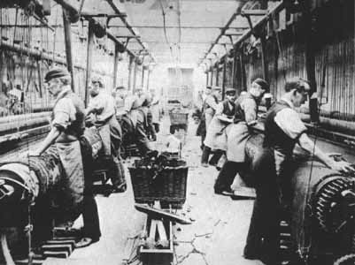
The Market Revolution
“Free Enterprise System”
What is the specialization of workers in factories?
A shopping culture
What affect would this have on the middle-class?
How might this blur social class lines?

Slide 9
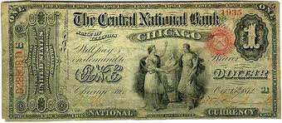
The Role of Banks
How did banks fit into the Market Revolution?
Investment Capital
What do we use “capital” for in our own lives?
Uncontrolled Lending by state banks
In part, what was the worst economic crisis in the U.S. from this practice?
What is a bank note?

Slide 10
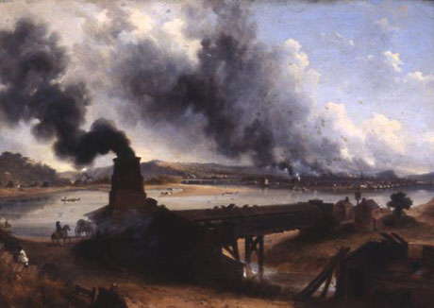
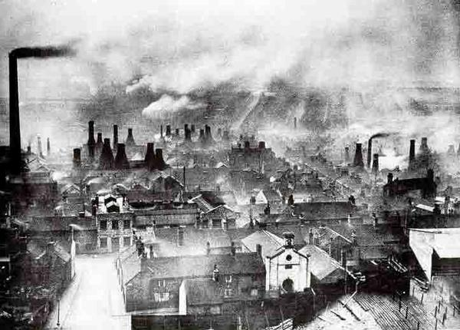
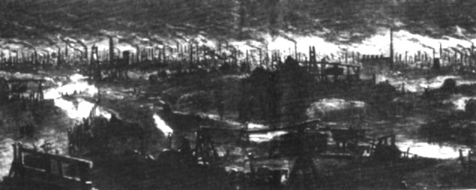

Slide 11
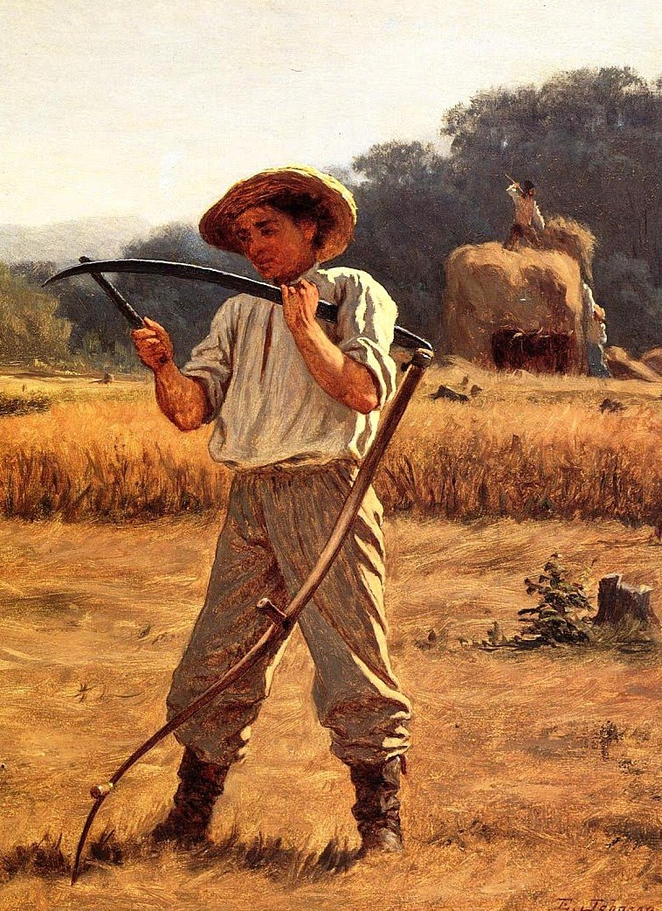
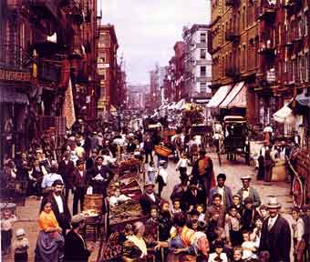
The Northern and Southern Economies

Slide 12
Essential Question
How did the Industrial Revolution help to heighten sectional differences, sectionalism, between the North and South?

Slide 13
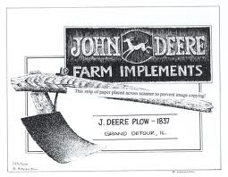
Industrialization in the North
Farming changes in the North
John Deere
Textile factories
How would the “transportation revolution” aide the more growing industrial farming techniques of the North?
What industries prosper from the Industrial Revolution in the North?

Slide 14
Northern Cities
What is urbanization?
The mass movement of people in the early 19th century into northern cities.
Why would people move to these areas?
What effect would this mass migration have on the cities?
Living situations were characterized by tenements.
What do you think it was like to live in a tenement apartment?

Slide 15
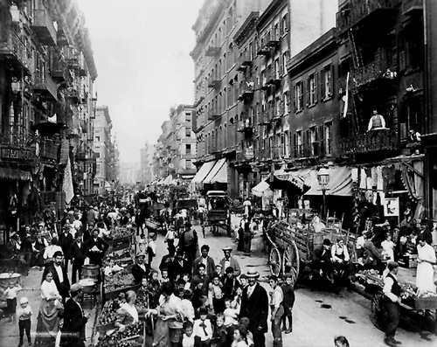
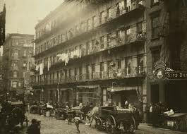
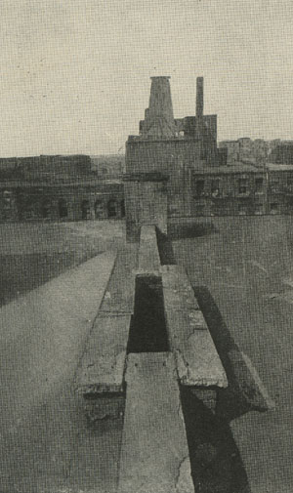
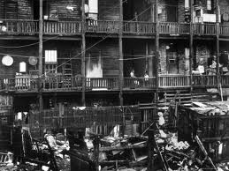

Slide 16
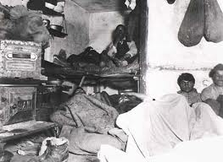
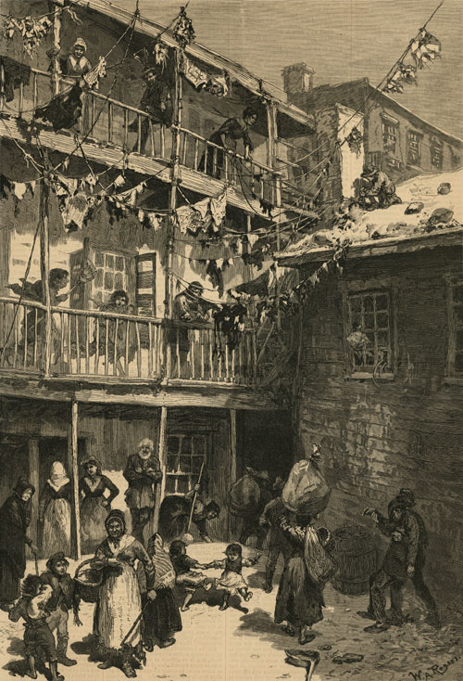
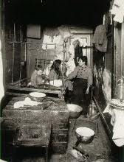

Slide 17
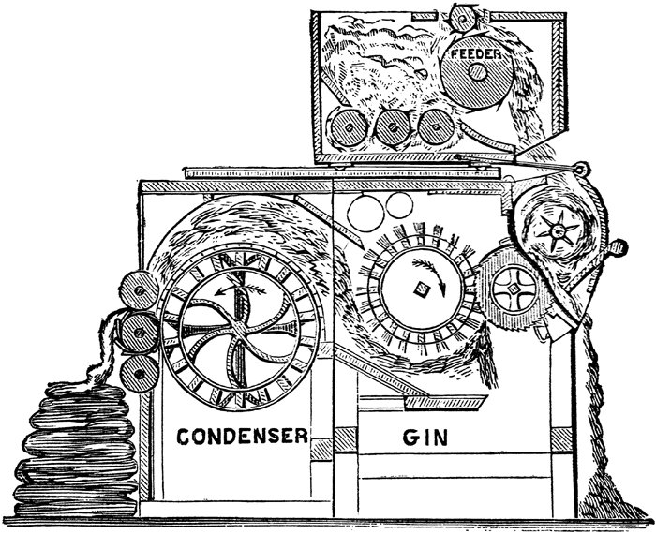
The Southern Economy
Eli Whitney’s Cotton Gin
What affect would that have on cotton production?
“King Cotton,” why is this phrase important to the South?
Cotton belt
Cities will develop.
Charleston, SC
Richmond, VA
New Orleans, LA

Slide 18
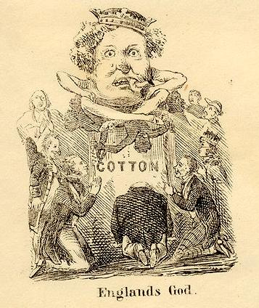

Slide 19
Slavery
In 1808, the foreign slave trade was banned by Congress.
Slave population steadily increased.
1820, 1.5 million
1850, over 3 million
Without the slave trade, how could the slave population grow?
Increased dependency on slaves from more modern cotton production.

Slide 20
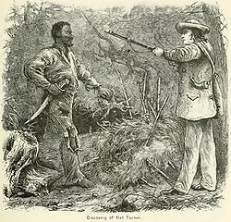
Slave Revolts
Turner’s Rebellion led by the slave Nat Turner.
70 slaves, killed more than 50 white people.
This event alarmed many white southerners.
Why? How would they answer?
What previous slave revolt occurred in South Carolina?

Slide 21
The Growth of Nationalism

Slide 22
Main Ideas
Nationalism
“Era of Good Feelings”
Monroe Doctrine
“The Corrupt Bargain”

Slide 23
Do you consider yourself a North Carolinian or an American?
What does “nationalism” mean?
Do you think that people feel this way today?

Slide 24
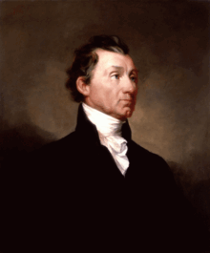
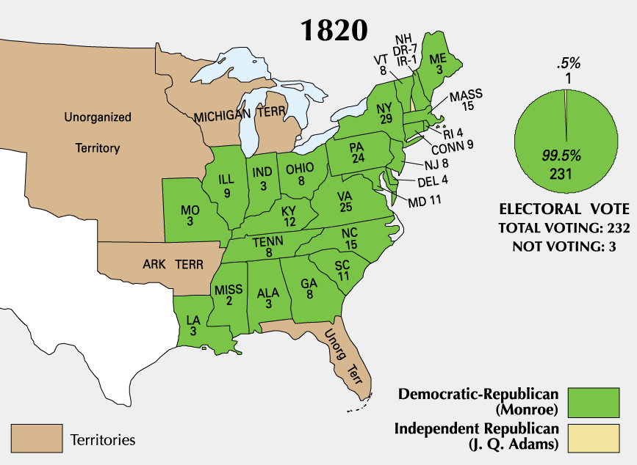
Growing National Spirit
James Monroe is the President from 1817-1825.
He is re-elected with an overwhelming majority.
“Era of Good Feelings”

Slide 25
Nationalism in the Courts
John Marshall
Dartmouth College vs. Woodward
United States Supreme Court decision dealing with the application of the Contracts Clause of the United States Constitution to private corporations. The decision settled the nature of public versus private charters and resulted in the rise of the American business corporation and the American free enterprise system.
Leads to Federal protection against contracts
What does a ruling like this do for the federal government?

Slide 26
Monroe Doctrine
It proclaims the United States’ growing prominence in the Western Hemisphere.
What does it say?
The U.S. would not become involved in European affairs, nor would it take sides among them.
The U.S. recognized the newly independent countries in the Western Hemisphere and would not try to dominate them.
The U.S. would not permit any further colonization of the Americas and any attempt by a European country to do would be seen as an act of aggression toward the U.S.

Slide 27
Impact of the Monroe Doctrine
Despite lacking a powerful military, no one challenged the U.S.
The U.S. positioned itself as the dominant country in the Western Hemisphere.
The U.S. established a precedent for setting world policy.

Slide 28
The Election of 1824
Candidates:
John Quincy Adams from Massachusetts.
Henry Clay from Kentucky.
John C. Calhoun from South Carolina.
Andrew “Old Hickory” Jackson from Tennessee.
All had their attributes and had devoted supporters.
Jackson won the most votes in the electoral college, but not a majority.
House of Representatives decided the President.

Slide 29
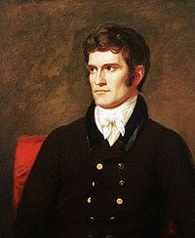
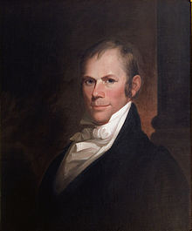
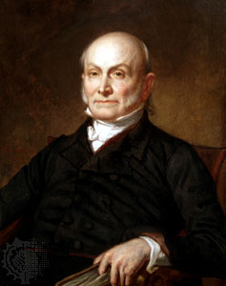
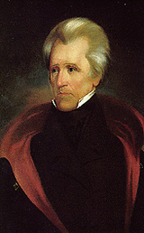

Slide 30
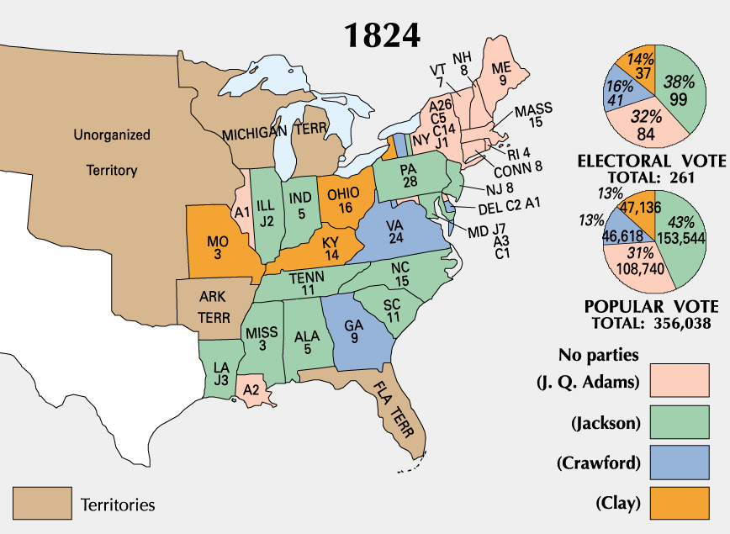

Slide 31
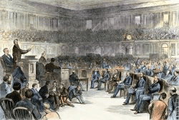
“The Corrupt Bargain”
Jackson did not win a majority in the electoral college.
Adams came in second.
Constitutional, the House of Representatives votes.
Clay used his influence to help Adams.
Became his Secretary of State.

Slide 32
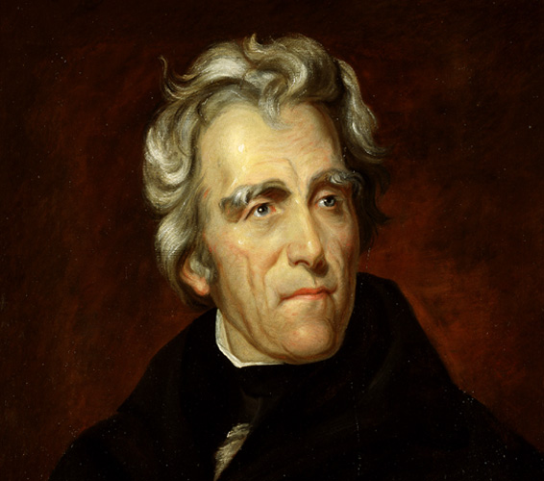
The Age of Jackson

Slide 33
Main Ideas
Spoils System
Nullification Crisis
Indian Removal
The Bank Wars

Slide 34
Andrew Jackson
Anti-Federalist, but believed the Union and the federal government had power over the states.
Ignored the Supreme Court
Took advantage of the veto.
Spoils System
What can that tell us about Jackson?
What will this do to his government?

Slide 35
Spoils System
Rewarded supporters with government positions.
He valued loyalty over experience.
He tried to get rid of the “old guard.”
1/5 of the federal bureaucrats were replaced.
Many of these individuals were upset by this.

Slide 36
What is Jacksonian Democracy?
How does this lead to an expansion of suffrage?
How is the Spoils System related to patronage?

Slide 37
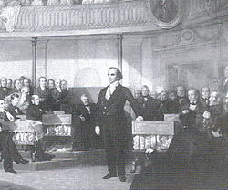
The Nullification Crisis
What was the main conflict which caused the Nullification Crisis?
What is the role of John C. Calhoun?
How does this crisis lead to a rise in sectionalism?
What future events are connected to the Nullification Crisis?

Slide 38
Why were Southerners upset?
The South felt the tariffs did more harm than good.
The South was growing slower than the rest of the nation.
Differences between the northern and southern economies?
Cotton prices were falling and good growing land was becoming scarce.

Slide 39
1832 Tariff Conflict
1828, “Tariff of Abomination”
South Carolina Exposition written
1832, new tariff, “Force Bill”
South Carolina’s reaction?
Andrew Jackson’s response?
Henry Clay’s “Compromise” Tariff?

Slide 40
The Nullification Crisis, cont.
The idea of “nullification” was proposed by Jefferson and Madison in the Virginia and Kentucky Resolutions.
South Caroline declared that states had the right to nullify federal laws, even secede from the Union.
After the Tariff of 1832, South Carolina declared the tariffs null and void and refused to collect the tax.
Jackson, with the Force Bill, threatened military intervention if South Carolina did not comply.
How did this crisis end?

Slide 41
The Nullification Crisis, cont.
The Tariff of 1828, heavy tax on imports.
What would this encourage Americans to do?
The industrial North typically favored this tariff, why would the South be opposed to it?
European reaction to it?
“Tariff of Abomination”

Slide 42
Indian Removal
What was Jackson’s goal?
1830, Indian Removal Act.
1831, Cherokee Nation vs. Georgia
1832, Worcester vs. Georgia
Jackson, “John Marshall has made his decision, now let him enforce it!”
The Bureau of Indian Affairs created in 1836 to deal with the Indians.
Resistance:
Black Hawk Wars
Second Seminole War

Slide 43
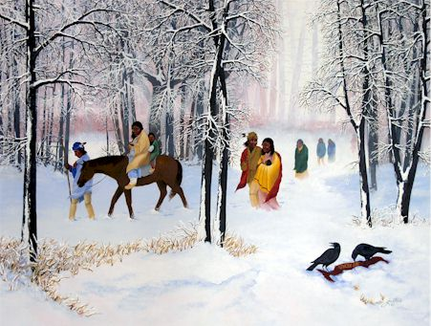
Trail of Tears
1838, the U.S. Army rounded up more than 15,000 Cherokees.
The journey is known as the “Trail of Tears.”
¼ died on the 116-day trip.
1,000 miles

Slide 44
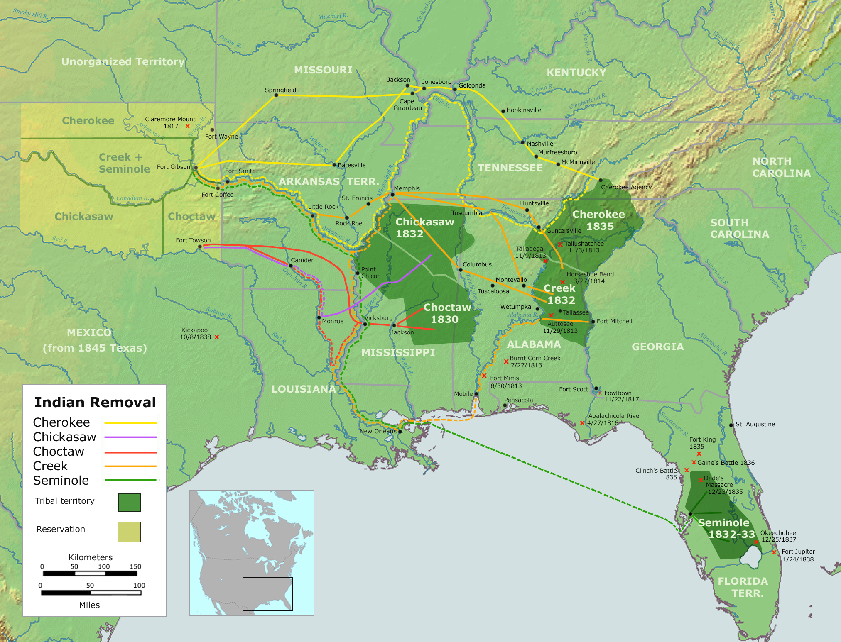

Slide 45
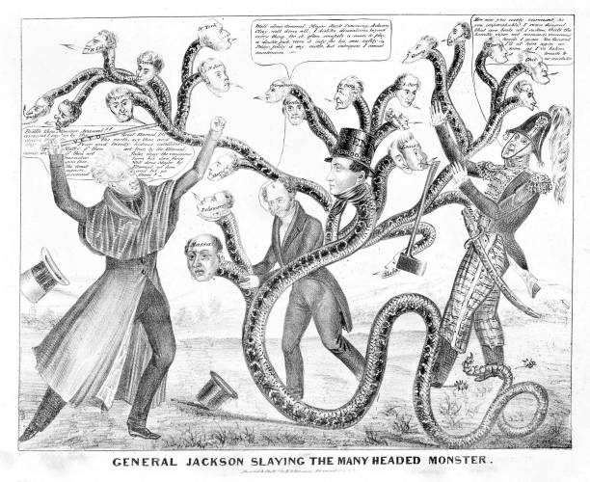
The Bank Wars
The U.S. Bank seen as a “monster”, Panic of 1819
The power of a veto
“The bank is trying to kill me, but I will kill it.”
Ruined the National Republicans

