Slide 1
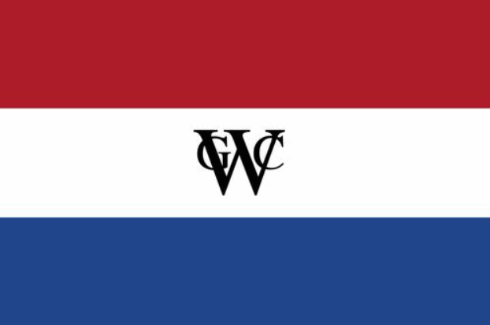
France & The Netherlands in the New World

Slide 2
Colonial Regions in North America
This map identifies the regions of North America settled by the English, French, Dutch, and Spanish.

Slide 3
The European Beaver
• France did not establish any colonies in North America in the 1500s, although French explorers did venture into the American wilds
• But when the European beaver became extinct, France turned to its American cousin and the Native Americans who could catch it to satisfy the demand for the hats made from its furry pelt.

Slide 5
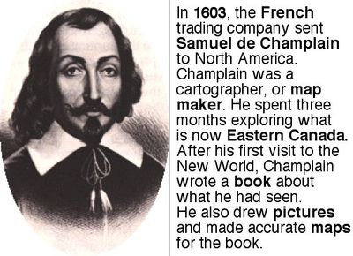
Samuel de Champlain

Slide 6
Champlain explored along the East Coast and down the St. Lawrence River to the Great lakes
Champlain established fur trading outposts at Port Royal (Annapolis), Acadia (Nova Scotia), and at the new city of Quebec.
Champlain earned the friendship of the Hurons by siding with them against their Mohawk enemies.

Slide 8
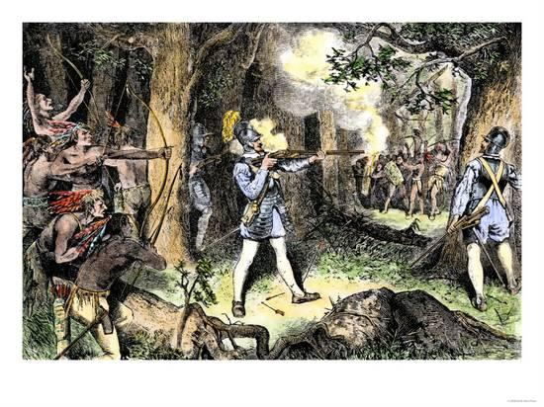
Champlain’s influence on North America
• He laid the groundwork for what would become Canada
• Champlain’s support took the warring native tribes from weapons of stone-tipped arrows, spears, and war clubs, to the use of firearms.
• By siding with the Huron against the Mohawks and other enemy tribes, the French transformed warfare in the northeast from small skirmishes for glory and petty booty into extended campaigns for the purpose of controlling the fur trade with the Europeans.

Slide 9
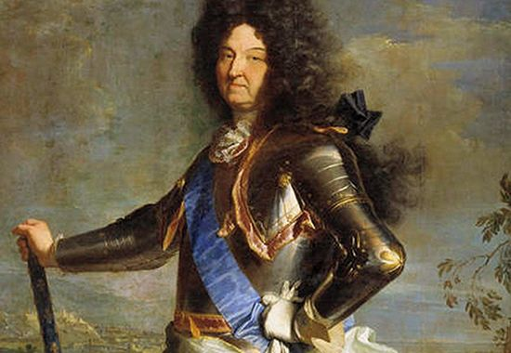
New France becomes a royal colony
• Settlement of New France was slow, in part because the Hurons lost their war with the Iroquois, who preferred trading with the Dutch.
The English seized Port Royal and Quebec for a short time in the 1620s, discouraging French settlers from crossing over to colonize. The two towns were eventually returned by treaty.
By 1665, French colonial policy was revamped under King Louis XIV, and New France was made a royal colony..
A new governor, some settlers and – most importantly – 1000 French troops arrived in Quebec. They broke the Iroquois hold on the fur trade, and for a while peace and prosperity reigned.

Slide 10
The King’s Loose reins…
With the exception of taxes on liquor, tobacco, beaver and moose skins, the French government did not try to manage New France from an ocean away.
A governor, intendant, and bishop were selected to run the colony. The governor was in charge of military affairs and relations with the Indians. The intendant was concerned with day to day administration and commercial and judicial matters. The bishop headed the church.
All three men served on the governing council (no member of which was ever elected by the settlers). When they worked together, the system worked fine. When not, it created real problems that hampered the growth of the colony.
The population of the colony was essential to its success, so more and more settlers were sent to New France through the 1680s.

Slide 11
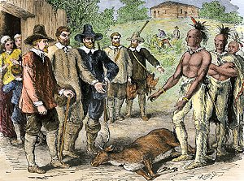
The French move west…
French administrators encouraged Indians to come to Quebec once a year to trade furs. The pelts were bartered for by the French in return for iron kettles, knives, guns, blankets, and brandy. These gatherings went on for weeks, and usually ended in a drunken spree.
The governor, Count de Frontenac, encouraged fur traders to establish posts closer to the Great Lakes where furs could be bought cheaper.
As a result of those frontier outposts near the Great Lakes, explorations of the Mississippi River were undertaken in earnest.

Slide 12
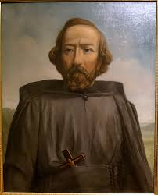
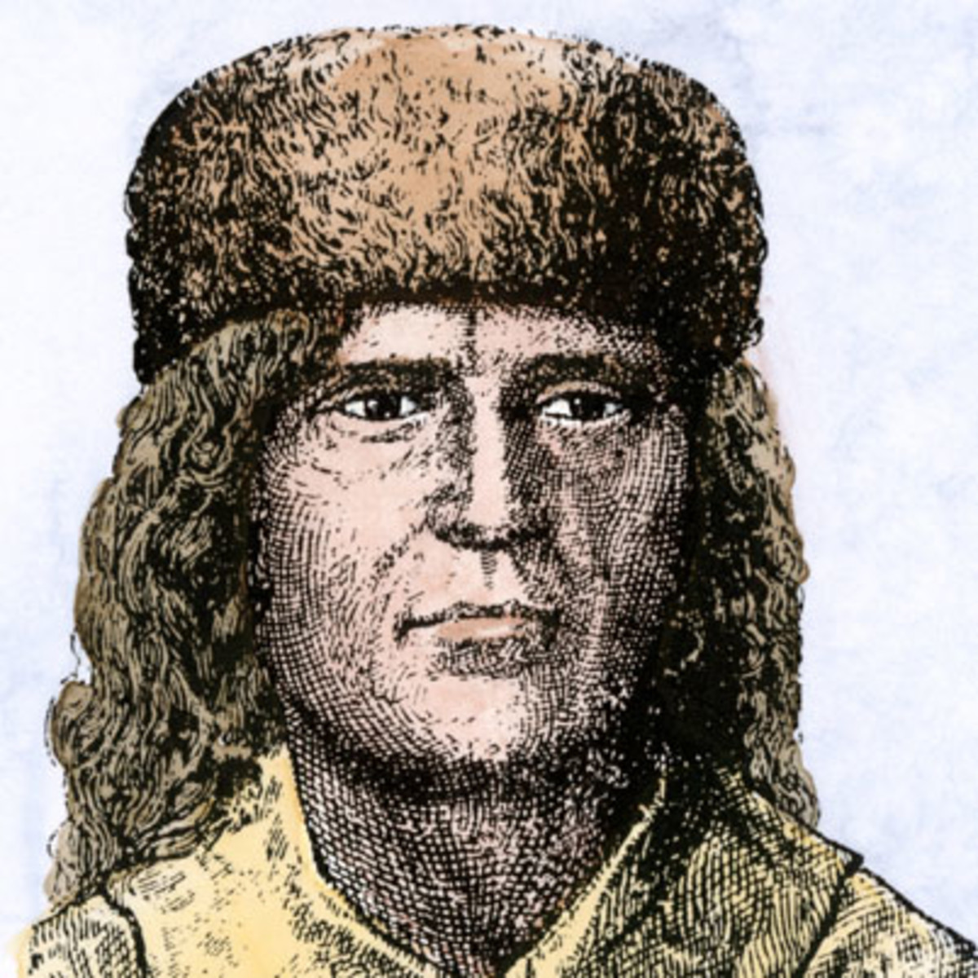
Father Jacques Marquette and Louis Jolliet “rediscovered” the Mississippi river in 1673
Father Jacques Marquette (left),
and fur trapper & explorer Luis Jolliet (right)

Slide 13
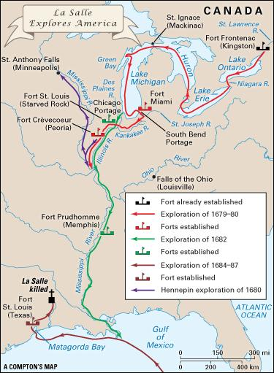
Robert LaSalle & The MIssissippi

Slide 14
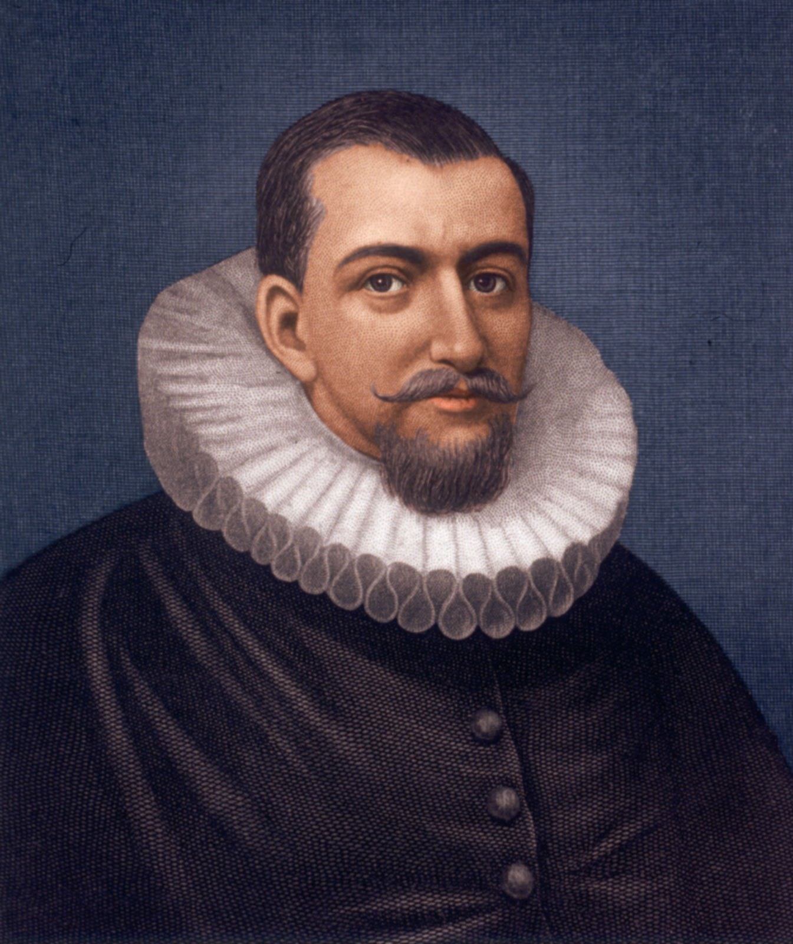
The Dutch & New Netherlands
Holland (aka, the Netherlands) did not win its independence from Spain until the 17th century, so it was late establishing North American colonies
But by 1609, a hired English captain named Henry Hudson was exploring along the Atlantic coast. He sailed up a river (which he named after himself) all the way to what is now modern Albany, NY. on behalf of the Dutch East India Company
Even though Verrazzano had sailed along the same coast for France earlier, the Dutch claimed the territory between Virginia and Canada based on Hudson’s expedition.

Slide 16
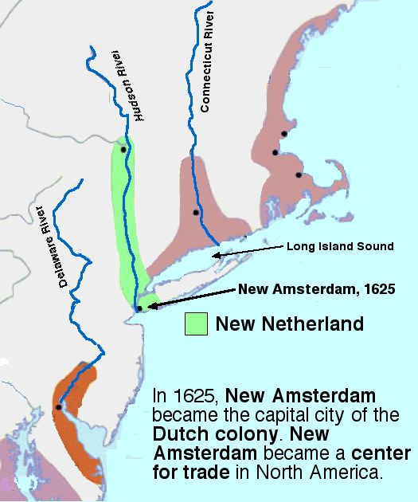
Dutch West India Co. Settlements
• The Dutch established trading settlements on the Delaware and Connecticut Rivers, and at New Amsterdam (New York City) and Fort Orange (Albany)
• Peter Minuit “bought” 22,000 acres of land on Manhattan Island for the Dutch from local Indians in exchange for $24 worth of beads and trade goods
- But there is some debate about whether or not the tribe owned the land in the first place
• In 1629, the company opened up the territory to anyone who would bring 50 settlers over. If they did, each settler family got
- tracts of land of eighteen miles along one side of the Hudson River, or nine miles along both sides

Slide 17
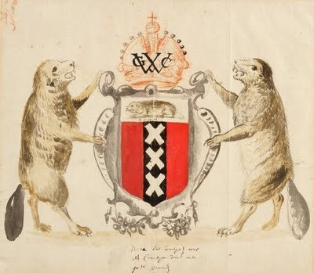
“Patroonships”
These company men who brought settlers over were known as patroons. They were to supply their tenants with homes, cattle, and tools.
In return, the tenants were to pay rent to the patroon, use his mill, keep the roads and buildings on his estate in good order, and accept the patroon’s jurisdiction in a manorial court.
Only five individuals became patroons, and not many settlers were willing to colonize under the terms set by the West India Company. Only one patroonship, located near Albany, survived.
To promote settlement, the company surrendered its monopoly on the fur trade in 1639 and allowed all settlers to trade with the Indians.

Slide 18
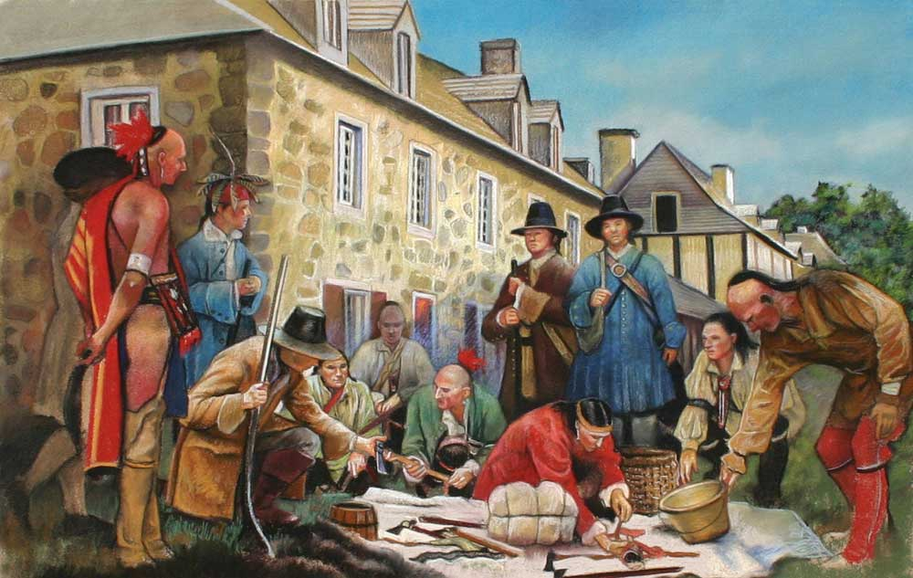
Trade with the Mohawks
• While the Native Americans of the Manhattan area were soon killed off or had departed for less contested areas, the Mohawks in the west became the prime source for beaver and deer skins for the Dutch
• Business was good, in part because the Dutch did not try to Christianize their Indian allies like France and Spain did

Slide 19
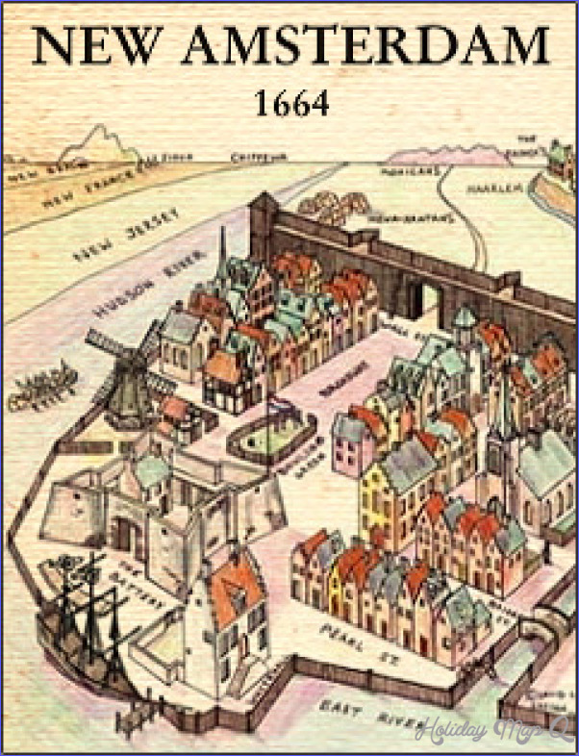
The Attractiveness of New Netherlands
• At the time, The Netherlands was both religiously tolerant and economically prosperous, so not many Dutchmen chose to emigrate to New Netherlands.
• But in the rest of Europe, that was in many cases religiously repressive and less bountiful, the attractiveness of New Netherlands was easy to see.
• By 1643, eighteen different languages were being spoken in New Amsterdam
• Originally Dutch officials required all colonists to be Calvinists, but by mid-century they had dropped that requirement. That opened the door for Catholics, Puritans, Lutherans, Anabaptists, Mennonites, Quakers, and Jews to relocate to Holland’s New World possessions.
• Gov. Peter Stuyvesant, the son of a Calvinist minister, protested against it, but the company allowed religious freedom and liberal civil rights to all settlers anyway.

Slide 20
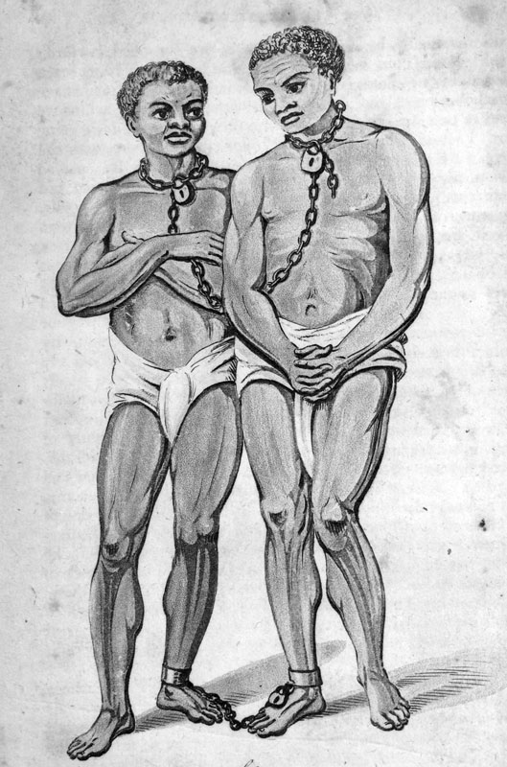
Solving a labor problem…
• Given that immigration to New Netherlands was slow, the Dutch turned to slavery to provide the laborers they needed to work their farms and tend their homes.
• The first African slaves arrived in the 1620s, and by the 1650s slaves made up as much as ten percent of the population - the highest percentage of any colony that far north.
• Unlike other colonies, manumission in the Dutch colony was relatively easy.
- Many slaves were granted “half freedom,” in which they worked part time for the West India Company, but the other time was their own.
- Freed slaves had no restrictions on them, and they could even intermarry with whites.

Slide 21
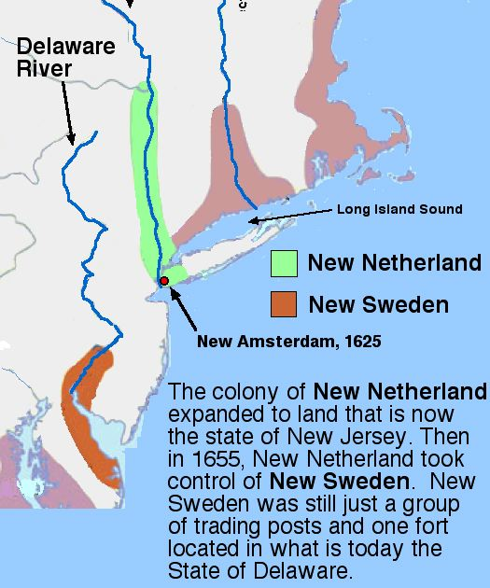
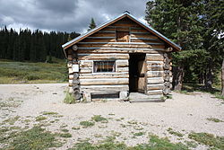
New World Competition…
• The Dutch were in competition with the French for the fur trade
• Sweden established a competing colony under Peter Minuit on the west bank of the Delaware River
- Gov. Peter Stuyvesant led an expedition to drive the Swedes out
- By 1655, the Swedes had been forced to accept Dutch rule
- It was the Swedes who introduced log cabins to North America

Slide 22
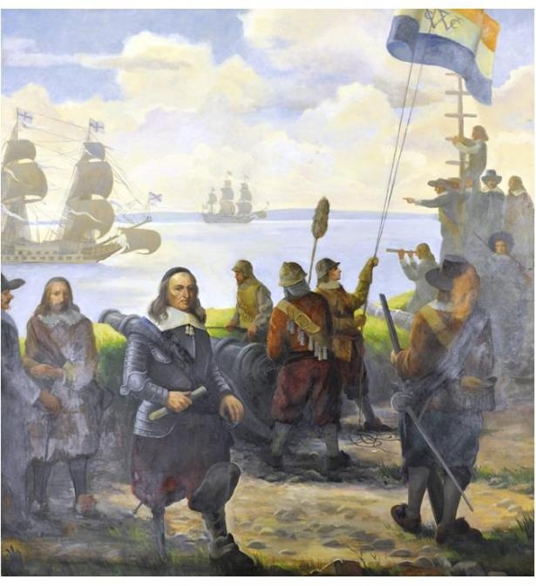
England Takes Long Island…
The biggest threat to the Dutch came from England
Englishmen forced the Dutch to cede the eastern half of Long Island by 1650
The English began moving west into the Dutch sector of the island, in large part to enjoy Dutch religious toleration
But they resented not having political democracy. By the 1660s, warfare had broken out
New Netherlands was swallowed up by the English when a British fleet under Admiral Nicholls arrived in 1664 and forced the Dutch to submit.
The English renamed New Amsterdam after King Charles II’s brother, James, Duke of York, . The settlement became New York in his honor.

Slide 23
In Summary…
Neither New France or New Amsterdam attracted large numbers of settlers
Only New Netherlands allowed religious and political dissidents to settle there
Both France and the Dutch tried to institute feudal systems in their New World colonies, but neither was really successful
Government in both colonies was autocratic – set up to benefit those who made the laws
The needs of the people in both colonies was largely ignored, and any benefit they realized was mostly coincidental
The French government only took control of New France after the Company of New France failed. New Netherlands was under the control of the West India Company the entire forty years it existed.
Both colonies were mercantilist colonies
Mercantilism required all colonial products and natural resources could be sold only to the mother country
All materials shipped to the colonies had to be carried in the ships of the mother country
Both New France and New Netherlands condoned African slavery as a labor force

