Slide 1
The French Revolution
THE EUROPEAN MOMENT (1750 – 1900)

Slide 2
Quick Video 1
The French Revolution – In a Nutshell
Below is a YouTube link to a very short, but very helpful introduction to the French Revolution.
http://www.youtube.com/watch?v=VEZqarUnVpo

Slide 3
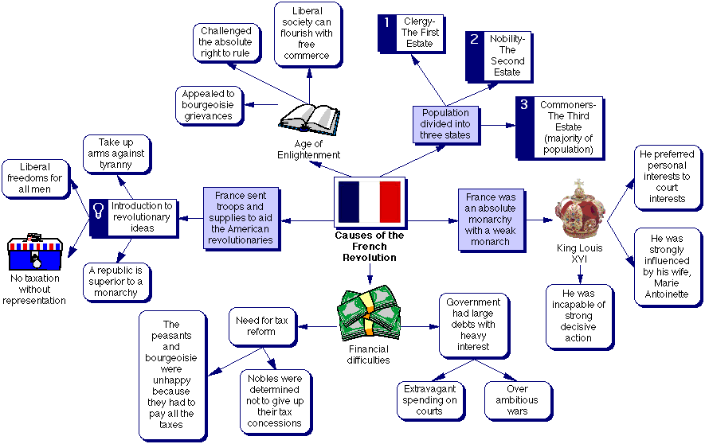

Slide 4
Revolution in France?
+ France had absolute rulers who lived lavish lifestyles and spent a lot of money
+ the lower classes paid most of the taxes
+ the Enlightenment brought about new ideas about better forms of government
+ the U.S. was an example of enlightened government
= revolution in France

Slide 5
French society was divided into 3 social classes:
1st Estate: Church clergy (less than 1% of population, owned 10% of land, paid virtually no taxes).
2nd Estate: nobles (about 2% of population, owned 30% of land, held positions of power, some were poor, paid very little taxes).
3rd Estate: everyone else (97% of population, half of their income was taken for taxes)

Slide 6
The 3rd Estate was a mix of mostly peasants (80% of the entire country’s population), but also bourgeoisie merchants, artisans, bankers, and even factory owners.
Some of them were well educated and embraced the ideas of the Enlightenment.
The middle class of the 3rd Estate in 1774 was 3x as large as it was at the end of Louis XIV’s reign in 1715.

Slide 7
During the late 1700s France’s economy was in trouble; the nation was in debt due to lavish spending and costly wars, poor harvests led to the price of bread doubling, and high taxes on the 3rd Estate made business difficult.

Slide 8
The nation’s poor was growing, urban living conditions were vile, women resorted to prostitution, and many children were simply abandoned.
King Louis XVI and Queen Marie Antoinette did not seem to notice and continued to spend money.
The middle class “were rich enough to fear the loss of their property and status, well educated enough to be aware of the growing criticism of the king, but too poor and marginalized to influence policy.”

Slide 9
Typically, revolutions only occur when those who are upset have no way to bring change under the current political system. (ex: You may not like the president, but you get to vote again in 4 years).
I have a question. This may not deal directly with the French Revolution, but when do revolutions typically occur? I mean like what causes them?
In other words, if a country’s government doesn’t allow people to have a say in politics, then people will eventually want to revolt and create a new system when things go bad.
– American Revolution (no representation)

Slide 10
Louis XVI called on the Estates General in 1789
(an assembly of the 3 estates, which had not met in 175 years)
to approve a new tax, this time on the nobles.
Historically each estate was given one vote, therefore the 3rd Estate could always be outvoted despite being the majority of France.
Looks like the vote is 2 ‐1,
bummer for you!

Slide 11
At the meeting the 3rd Estate refused to conduct business until the king ordered all three estates to sit together.
After weeks of stalemate they decided to form the National Assembly (a legislative body of their own) in effect proclaiming that France should be a constitutional monarchy.

Slide 12
However, three days later the 3rd estate found itself locked out of the meeting hall. Therefore, they met at an indoor tennis court and pledged to stay until they drew up a new constitution.
The Tennis Court Oath ended the king’s hopes that the Estates General’s agenda would just be about economics.

Slide 13
Rumors spread that the king was bringing in troops to massacre French citizens, so the people began to gather weapons.
On July 14, 1789 they
stormed the Bastille (an old
prison where gunpowder and arms were stored).

Slide 15
The National Assembly passed the Declaration of the Rights of Man (the document set forth the ideas of equality & representative government).
Before long a great fear swept over Paris and into the countryside. Peasants became outlaws by destroying the homes of nobles.
Thousands of Parisian women rioting over the price of bread marched to the Palace of Versailles and broke in.

Slide 16
At first, rival European monarchs welcomed the weakening of the French king, but as chaos escalated they feared revolutions in their own country.
The royal family tried to escape from France, but were captured. (Austria & Prussia threatened to destroy Paris if the royal family was harmed).
The new French legislators decided to declare war on Austria and Prussia when they heard rumors that they were going to help Louis XVI.

Slide 17
The revolutionaries responded by imprisoning the royal family and murdering thousands of French prisoners who were rumored to break out and help them.
The National Convention convicted Louis XVI of treason and sentenced him to death. In January 1793 he was killed by a machine called the guillotine.

Slide 18
As time passed more and more people accused of being against the rebellion were killed.
Many of the revolutionaries were Jacobins (a political club that urged democracy).
The most radical of the revolutionaries was Maximilien Robespierre. He set out to build a “republic of virtue.”

Slide 19
Ironically the revolution for liberty became a dictatorship and thousands of peasants were
killed (an 18 year old youth was killed for cutting down a tree
that had been planted as a symbol of liberty; women who were instrumental in starting the revolution now were repressed).
Robespierre’s reign became known as the Reign of Terror.

Slide 20
Quick Video 2
The French Revolution 8/9
One of the key figures of the French Revolution is Robespierre. In this video you will see how the revolution really begins to get out of hand.
One thing from this video you should take note of is how even “Christianity” is targeted by the revolutionaries.
http://www.youtube.com/watch?v=nff7PXPRnc0

Slide 21
People ultimately grew tired of terror and wanted change; in 1794 Robespierre himself was beheaded.
In 1799, the general Napoleon seized political power from the unpopular French government in a coup d’ etat.

Slide 22
Quick Video 3
The French Revolution – Crash Course
Below is a YouTube link to a “Crash Course” video on the French Revolution. Now that you know the main idea (and then some) of the French Revolution let this video serve as a review for you.
http://www.youtube.com/watch?v=lTTvKwCylFY

Slide 23
At first, Napoleon worked on the economy, he set up a national banking system, ended government corruption, and carried out legal reform (The Napoleonic Code (system of laws) gave the country a uniform set of laws, although also limited many liberties ex: freedom of the press).
In 1804, he decided to make himself emperor (The French people supported this, in a sense he had become a popular dictator).

Slide 24
However, Napoleon was not content with being the master of France, he wanted to control all of Europe (and he was close to being successful – see map).
Across the continent France’s empire continued to grow. The first major military setback was at the naval Battle of Trafalgar against the British (1805).

Slide 25
After Trafalgar, Napoleon makes a series of mistakes leading to his downfall.
Establishing a blockade he couldn’t enforce. Under his “Continental System” he tried to make continental Europe self‐sufficient from Britain. Smugglers still got stuff in.
The Peninsular War. After taking over Spain and putting his brother in charge outraged Spanish peasants used guerilla warfare to kill 300,000 French soldiers.

Slide 26
– Invasion into Russia. (why? Because Russia was trading with Britain) As his troops advanced the Russians retreated and burned the farm fields behind them leaving Napoleon’s soldiers with nothing to eat, therefore they had to retreat.

Slide 27
Napoleon lost favor with the French people and was exiled to Elba. However, a year later he returned and retook power only to lose once again at the Battle of Waterloo (1815) against an
alliance of European nations.
St. Helena off the coast of Africa).
(This time he was exiled to

Slide 28
Quick Video 4
All You Need to Know About Napoleon Bonaparte
This video is a quick summary of Napoleon's life and significance in European history.
http://www.youtube.com/watch?v=tfHnwqtJT9U

Slide 29
Quick Video 5
The French Revolution – From Louis XVI to Napoleon
This video starts off with a brief history of the French monarchy then goes into the French Revolution and the exploits of Napoleon.
Although its only four minutes long it’s a decent review of the French events at this time.
http://www.youtube.com/watch?v=IF4lPWU_qxY

