Slide 1
Section 1: Dawn of an Industrial Age

Slide 2
Agriculture Spurs Industry
In 1750, most people worked the land, using handmade tools
They lived in simple cottages lit by firelight and candles
Made their own clothing
Grew their own food
Might exchange goods at a weekly outdoor market
Then, a second agricultural revolution took place that greatly improved the quality and quantity of farm products

Slide 3
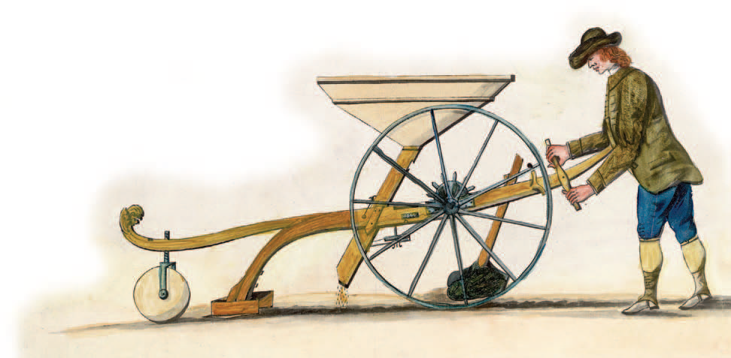
Agriculture Spurs Industry
Farming Methods Improve
Jethro Tull invented a new mechanical device, the seed drill, to aid farmers (helped trigger the Industrial Revolution)
It deposited seeds in rows rather than scattering them wastefully over the land

Slide 4
New Technology Becomes Key
An Energy Revolution
During the 1700s, people began to harness new sources of energy
One power source was coal, used to develop the steam engine
In 1712, British inventor Thomas Newcomen had developed a steam engine powered by coal to pump water out of mines
(helped trigger the Industrial Revolution)

Slide 5
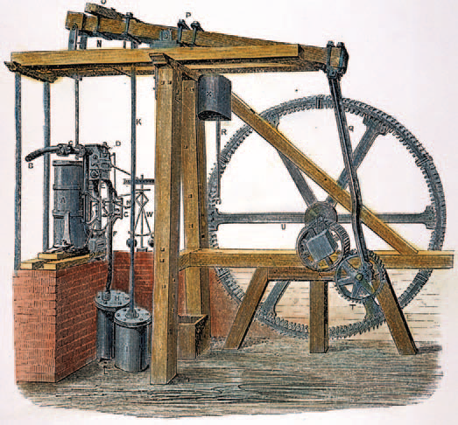
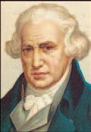
New Technology Becomes Key
Scottish engineer James Watt looked at Newcomen’s invention in 1764 and set out to make improvements on the engine in order to make it more efficient
Watt’s engine, after several years of work, would become a key power source of the Industrial Revolution
The steam engine opened the door not only to operating machinery but eventually to powering locomotives and steamships
Known as the “Father of the Industrial Revolution”

Slide 6
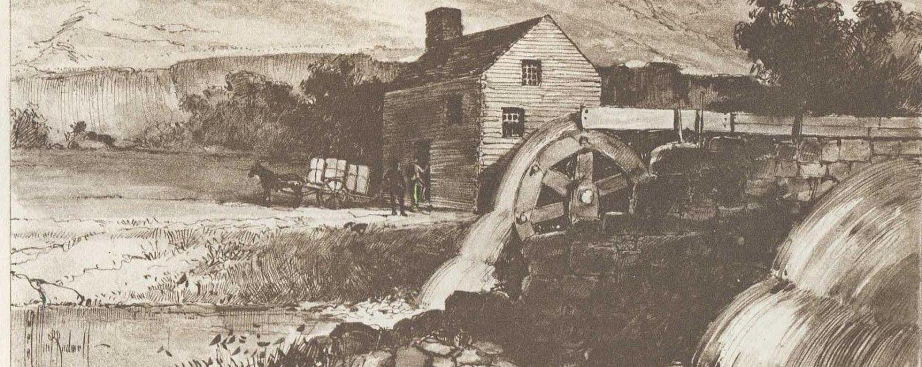
New Technology Becomes Key
Before long, cotton mills using steam engines were found all over Britain
Since steam engines were fired by coal, not water, they did not need to be located by rivers

Slide 7
New Technology Becomes Key
The Quality of Iron Improves
Coal was a source of fuel in the production of iron
A material needed for the construction of machines and steam engines
The Darby family of Coalbrookdale pioneered new methods of producing iron
In 1709, Abraham Darby used coal instead of charcoal to smelt iron
Separate iron from its ore
(helped trigger the Industrial Revolution)

Slide 8
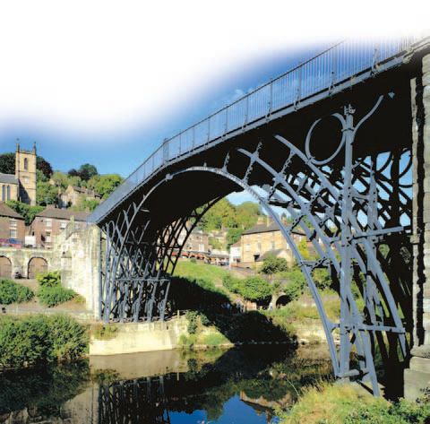
New Technology Becomes Key
Darby’s experiments led him to produce less expensive and better-quality iron
Used to produce parts for the steam engines
Both his son and grandson continued to improve on his methods
Abraham Darby III built the world’s first iron bridge
In the decades that followed, high-quality iron was used more and more widely, especially after the world turned to building railroads

Slide 9
Britain Leads the Way
Why Britain?
The Industrial Revolution began in Great Britain in the 1780’s
Took several decades to spread to other Western nations
5 factors contributed to make Great Britain the starting place
Agrarian revolution
Increase in population
Supply of money
Natural resources
Vast colonial empire

Slide 10
The Textile Industry Advances
The Textile Industry
The Industrial Revolution first took hold in Britain’s largest industry—textiles
In the 1600s, cotton cloth imported from India had become popular
British merchants tried to organize a cotton cloth industry at home
They developed the cottage industry
Raw cotton was distributed to peasant families who spun it into thread and then wove the thread into cloth in their own homes
Skilled artisans in the towns then finished and dyed the cloth

Slide 11
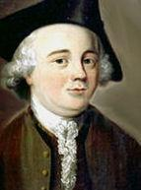
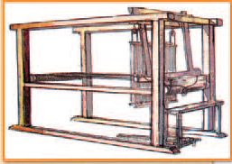
The Textile Industry Advances
Inventions Speed Production
Under the cottage industry, production was slow
As the demand for cloth grew, inventors came up with a string of remarkable devices that revolutionized the British textile industry
John Kay
Invented the flying shuttle – 1733
Enabled weavers to work so fast that they soon outpaced spinners

Slide 12
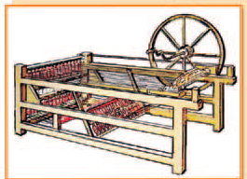
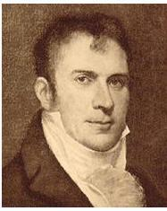
The Textile Industry Advances
James Hargreaves
Invented a machine called the spinning jenny – 1764
Spun many threads at the same time
Provided more thread so cloth could be produced at a faster rate
Spinners now produced thread faster than weavers could use it

Slide 13
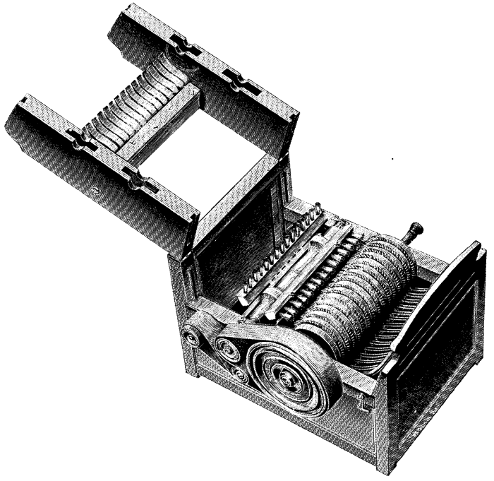
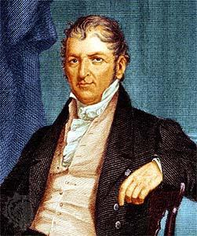
The Textile Industry Advances
Eli Whitney
Invented the cotton gin – 1793
Separated the seeds from the raw cotton at a fast rate
50 times faster than a human
Cotton production increased exponentially

Slide 14
The Textile Industry Advances
Factories Are Born in Britain
The new machines doomed the cottage industry
They were too large and expensive to be operated at home
Instead, manufacturers built long sheds to house the machines
At first, they located the sheds near rapidly moving streams, harnessing the water power to run the machines
Later, machines were powered by steam engines
Will become known as the Factory System

Slide 15
The Transportation Revolution
Transportation Revolution
As production increased, entrepreneurs needed faster and cheaper methods of moving goods from place to place

Slide 16
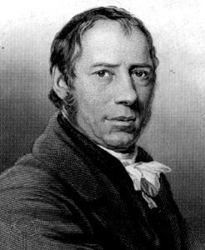
The Transportation Revolution
Richard Trevithick
Invented the first steam locomotive – 1804
Pulled 10 tons of ore and 70 people at 5 mph
Led to the first real railroad, Stockton & Darlington
Connected Liverpool to Manchester
The railroad did not have to follow the course of a river
Meant that tracks could go places where rivers did not

Slide 17
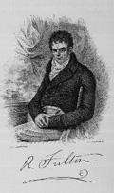
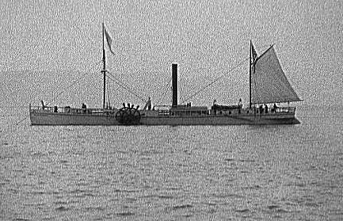
The Transportation Revolution
Robert Fulton
Invented the steam boat – 1807
Attached a steam engine to a ship which propelled it by making a paddle wheel to turn
Named it the Clermont

Slide 18
End Day 1

Slide 19
Section 2: Social Impact of the Industrial Revolution

Slide 20
People Move to New Industrial Cities
For the millions of workers who crowded into the new factories, the industrial age brought poverty and harsh living conditions
Working people would suffer with:
Dangerous working conditions
Unsafe, unsanitary, and overcrowded housing
Poverty

Slide 21
People Move to New Industrial Cities
People Move to New Industrial Cities
The Industrial Revolution brought rapid urbanization, or the movement of people to cities
What led to urbanization?
Changes in farming
Soaring population growth
Demand for workers

Slide 22
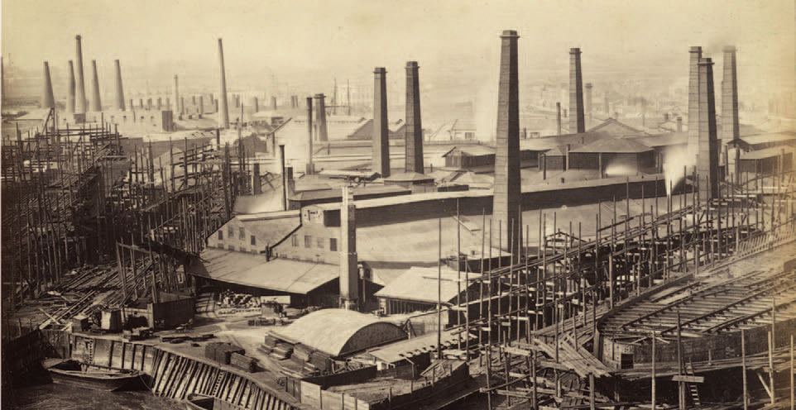
People Move to New Industrial Cities
Almost overnight, small towns around coal or iron mines mushroomed into cities
Other cities grew up around the factories that entrepreneurs built in once-quiet market towns

Slide 23
New Social Classes Emerge
The Industrial Revolution created a new middle class along with the working class
The Industrial Middle Class
Those in the middle class owned and operated the new factories, mines, and railroads, among other industries
Middle-class families lived in well-furnished, spacious homes on paved streets and had a ready supply of water
They wore fancy clothing and ate well
Only a few had sympathy for the poor

Slide 24
New Social Classes Emerge
The Industrial Working Class
When farm families moved to the new industrial cities, they became workers in mines or factories
Many felt lost and bewildered
They faced tough working conditions in uncomfortable environments
They packed into tiny rooms in tenements, or multistory buildings divided into apartments

Slide 25
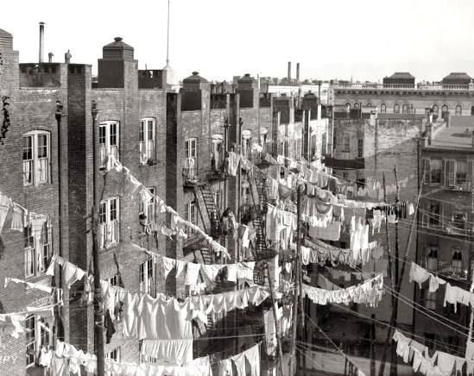
New Social Classes Emerge
These tenements had no running water, only community pumps
There was no sewage or sanitation system, so wastes and garbage rotted in the streets
Sewage was also dumped into rivers, which created an overwhelming stench and contaminated drinking water
This led to the spread of disease, such as cholera

Slide 26
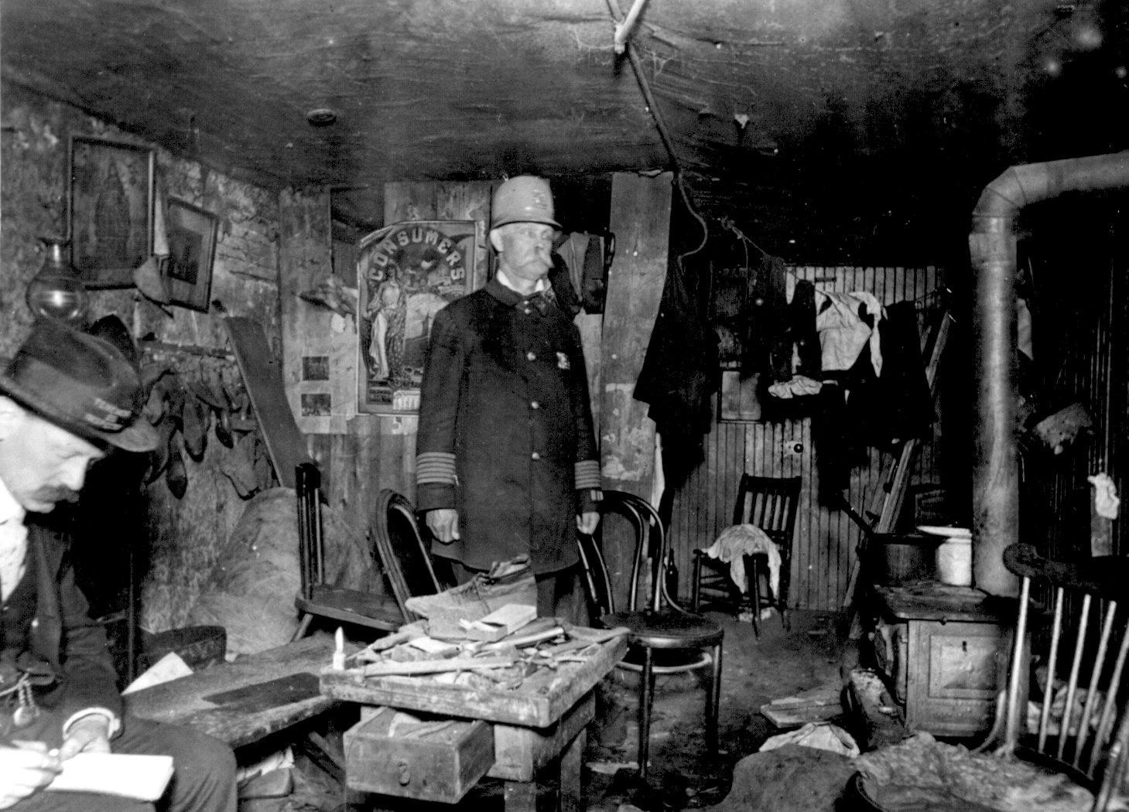
Tenement

Slide 27
Life in Factories and Mines
Working in a factory system differed greatly from working on a farm
In rural villages, people worked hard, but their work varied according to the season
Life was also hard for poor rural workers who were part of the cottage industry, but at least they worked at their own pace
In the grim factories of industrial towns, workers faced a rigid schedule set by the factory whistle

Slide 28
Life in Factories and Mines
Working hours were long, with shifts lasting from 12 to 16 hours, six or seven days a week
Workers could only take breaks when the factory owners gave permission
Exhausted workers suffered accidents from machines that had no safety devices
They might lose a finger, a limb, or even their lives
In textile mills, workers constantly breathed air filled with lint, which damaged their lungs
Those workers who became sick or injured lost their jobs

Slide 29
Life in Factories and Mines
Factory work created a double burden for women
Their new jobs took them out of their homes for 12 hours or more a day
They then returned to their tenements, which might consist of one damp room with a single bed
They had to feed and clothe their families, clean, and cope with such problems as sickness and injury

Slide 30
Life in Factories and Mines
Miners Face Worse Conditions
The Industrial Revolution increased the demand for iron and coal, which in turn increased the need for miners
Although miners were paid more, working conditions in the mines were even worse than in the factories
They worked in darkness, and the coal dust destroyed their lungs
There were always the dangers of explosions, flooding, and collapsing tunnels
Women and children carted heavy loads of coal, sometimes on all fours in low passages
They also climbed ladders carrying heavy baskets of coal several times a day

Slide 31
Life in Factories and Mines
Children Have Dangerous Jobs
Factories and mines also hired many boys and girls
These children often started working at age seven or eight, a few as young as five
Nimble-fingered and quick-moving, they changed spools in the hot and humid textile mills where sometimes they could not see because of all the dust
They also crawled under machinery to repair broken threads in the mills

Slide 32
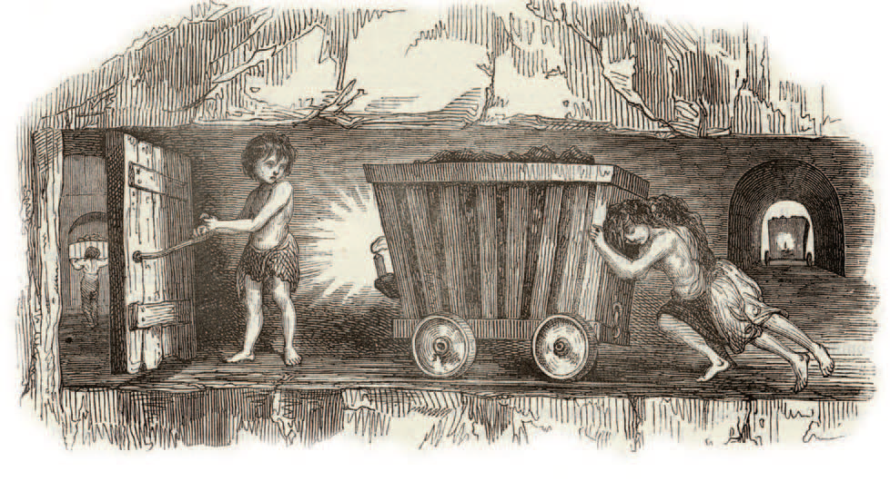
Life in Factories and Mines
Conditions were even worse for children who worked in the mines
Some sat all day in the dark, opening and closing air vents
Others hauled coal carts in the extreme heat
Because children had helped with work on the farm, parents accepted the idea of child labor
The wages the children earned were needed to keep their families from starving

Slide 33
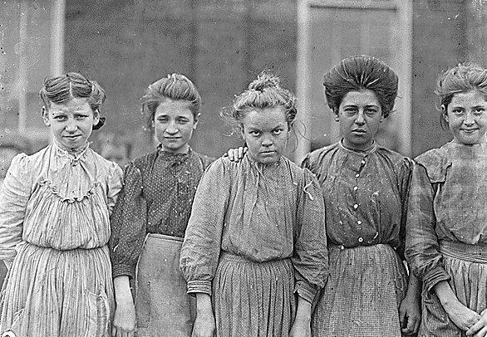
Adolescent girls from Bibb Mfg. Co. in Macon, Georgia

Slide 34
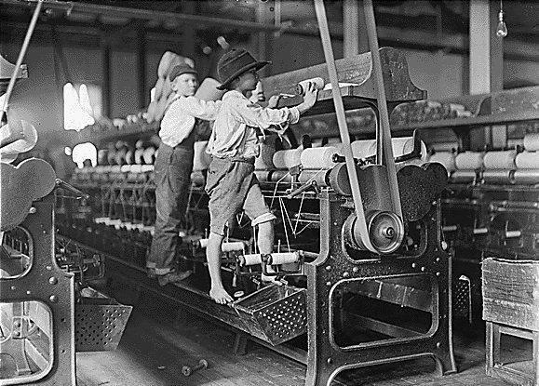
Some boys and girls were so small they had to climb up on to the spinning frame to mend broken threads and to put back the empty bobbins. Bibb Mill No. 1. Macon, Ga.

Slide 35
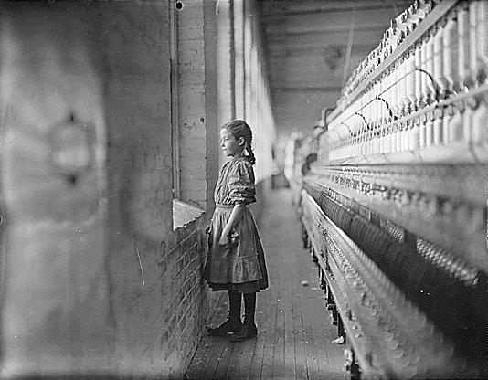
A momentary glimpse of the outer world. Said she was 11 years old. Been working over a year. Rhodes Mfg. Co. Lincolnton, N.C.

Slide 36
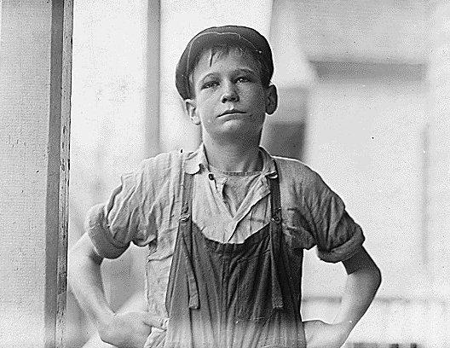
Furman Owens, 12 years old. Can't read. Doesn't know his A,B,C's. Said, "Yes I want to learn but can't when I work all the time." Been in the mills 4 years, 3 years in the Olympia Mill. Columbia, S.C

Slide 37
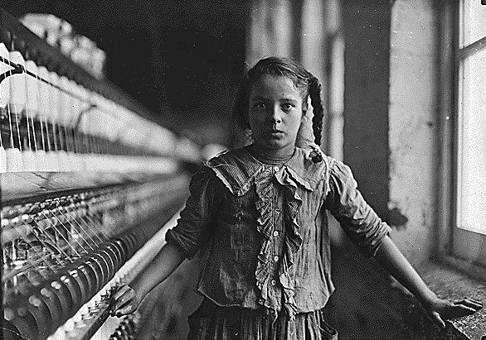
One of the spinners in Whitnel Cotton Mill. She was 51 inches high. Has been in the mill one year. Sometimes works at night. Runs 4 sides - 48 cents a day. When asked how old she was, she hesitated, then said, "I don't remember," then added confidentially, "I'm not old enough to work, but do just the same."

Slide 38
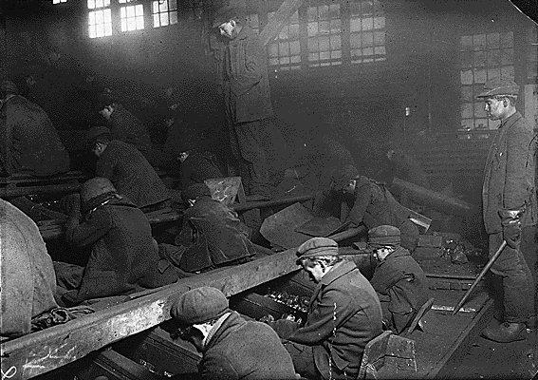
View of the Ewen Breaker of the Pa. Coal Co. The dust was so dense at times as to obscure the view. This dust penetrated the utmost recesses of the boys' lungs. A kind of slave-driver sometimes stands over the boys, prodding or kicking them into obedience. S. Pittston, Pa

Slide 39
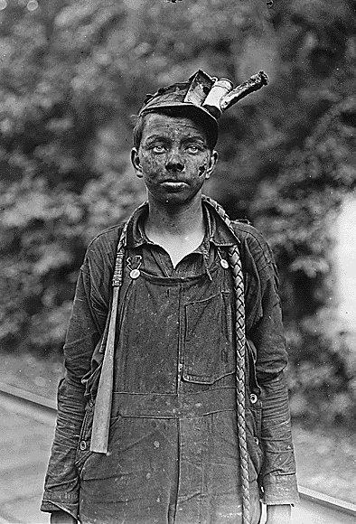
Young driver in the Brown mine. Has been driving one year. Works 7 a.m. to 5:30 p.m. daily. Brown W. Va

Slide 40
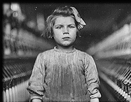
The youngest children in the textile factories were usually employed as scavengers and piecers. Scavengers had to pick up the loose cotton from under the machinery. This was extremely dangerous as the children were expected to carry out the task while the machine was still working.

Slide 41
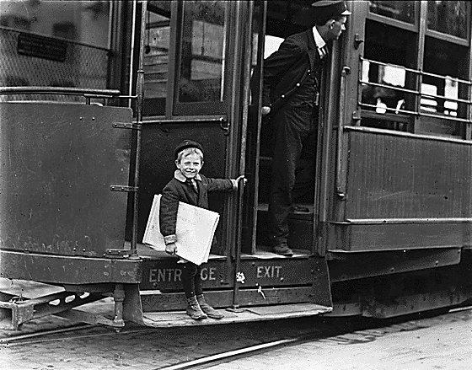
Francis Lance, 5 years old, 41 inches high. He jumps on and off moving trolley cars at the risk of his life. St. Louis, Mo.

Slide 42
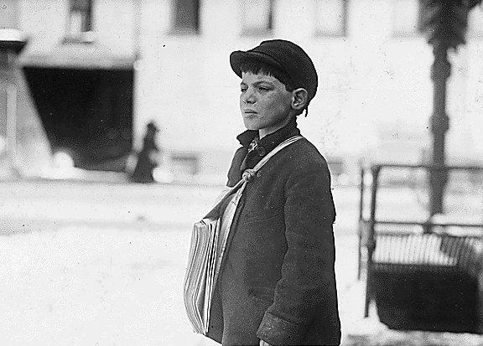
Tony Casale, age 11, been selling 4 years. Sells sometimes until 10 p.m. His paper told me the boy had shown him the marks on his arm where his father had bitten him for not selling more papers. He (the boy) said, "Drunken men say bad words to us." Hartford, Conn.

Slide 43
Life in Factories and Mines
Child labor reform laws called “factory acts” were passed in the early 1800s
These laws were passed to reduce a child’s workday to twelve hours and also to remove children under the age of eight or nine from the cotton mills
Because the laws were generally not enforced, British lawmakers formed teams of inspectors to ensure that factories and mines obeyed the laws in the 1830s and 1840s
More laws were then passed to shorten the workday for women and require that child workers be educated

Slide 44
The Results of Industrialization
Since the 1800s, people have debated whether the Industrial Revolution was a blessing or a curse
The early industrial age brought terrible hardships
In time, however, reformers pressed for laws to improve working conditions
Labor unions won the right to bargain with employers for better wages, hours, and working conditions
Eventually working-class men gained the right to vote, which gave them political power

Slide 46
Section 3: New Ways of Thinking

Slide 47
Socialist Thought Emerges
The transition to an industrialized society was very hard on workers
It made their lives difficult and forced them to live in crowded slums
They had to work long hours at mind-numbing tasks
Reformers of this era believed that industrial capitalism was heartless and brutal
They wanted a new kind of society
Moderates
Wanted gradual changes such as fewer hours, better benefits and safe working conditions
Radicals
Wanted to abolish the capitalist system entirely

Slide 48
Socialist Thought Emerges
To end poverty and injustice, they offered a radical solution
Socialism
The people as a whole rather than private individuals would own and operate the means of production
Factories, farms, railways, and other large businesses that produced and distributed goods

Slide 49
Socialist Thought Emerges
Robert Owen
He believed there was a way he could change society for the better
These early socialists were called Utopians
Implied that they were impractical dreamers
Owen set up his cotton mill in New Lanark, Scotland, as a model village
Reduced working hours from 17 to 10
Built homes for workers
Started a school for children
Opened a company store where workers could buy food and clothes
Proved that employers could offer decent living and working conditions and still run a profitable business

Slide 50
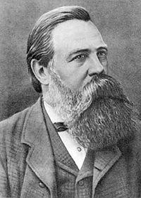
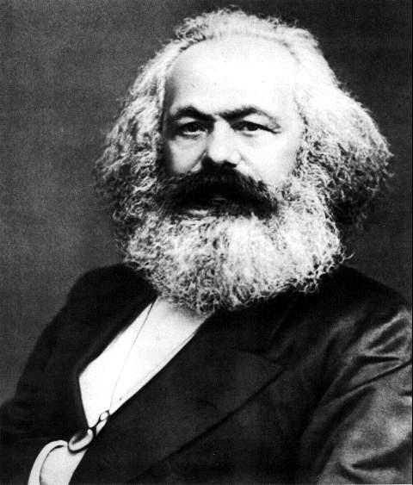
Socialist Thought Emerges
Karl Marx
German Philosopher
Condemned the ideas of the Utopians as unrealistic idealism
Teamed up with another German socialist, Friedrich Engels, whose father owned a textile factory in England
Marx and Engels wrote a pamphlet, The Communist Manifesto, published in 1848

Slide 51
Socialist Thought Emerges
Communism
A form of socialism in which an inevitable struggle between social classes would lead to the creation of a classless society where all means of production would be owned by the community
Karl Marx theorized that economics was the driving force in history
Argued that there was “the history of class struggles” between the “haves” and the “have-nots”
The “haves” have always owned the means of production and thus controlled society and all it’s wealth
In industrialized Europe, Marx said, the “haves” were the bourgeoisie
The “have-nots” were the proletariat
Working class

Slide 52
Socialist Thought Emerges
According to Marx, the modern class struggle pitted the bourgeoisie against the proletariat
In the end, he predicted the proletariat would be triumphant
Workers would take control of the means of production and set up a classless, communist society
Such a society would mark the end of the struggles people had endured throughout history, because wealth and power would be equally shared
Marx hated capitalism
Believed it created prosperity for only a few and poverty for many
He called for an international struggle to bring about its downfall
“Workers of all countries, unite!”

Slide 53
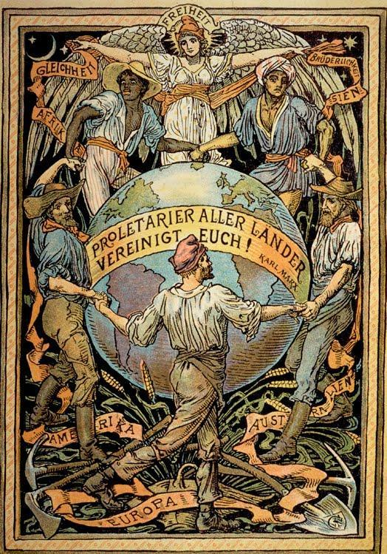

Slide 54
Marx’s Theories
History did not go by Marx’s plan
Why didn’t Karl Marx’s ideas take hold?
Workers could buy more
Workers gained the right to vote and used it to correct the problems of society
Remained loyal to their nations rather than ally with workers in other countries to promote revolution

Slide 55
End Day 2

Slide 56
Section 4: The Industrial Revolution Spreads

Slide 57
New Industrial Powers Emerge
The first phase of industrialization had largely been forged from iron, powered by steam engines, and driven by the British textile industry
By the mid-1800s, the Industrial Revolution entered a second phase
New industrial powers emerged
Factories powered by electricity used innovative processes to turn out new products
As the twentieth century dawned, this second Industrial Revolution transformed the economies of the Western world

Slide 58
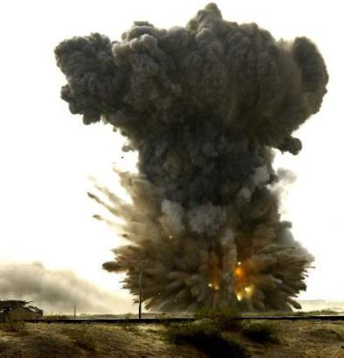
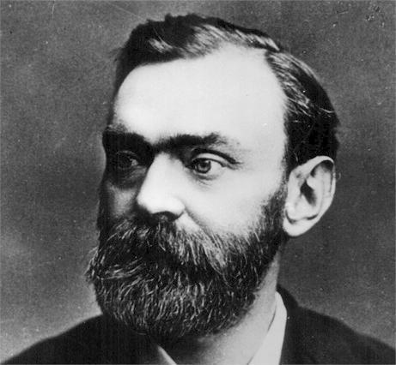
Technology Sparks Industrial Growth
Alfred Nobel
Invented dynamite in 1866
An explosive much safer than others to use at the time
Widely used in construction and, to Nobel’s dismay, in warfare
Earned Nobel a huge fortune
He willed to fund the famous Nobel prizes that are still awarded today

Slide 59
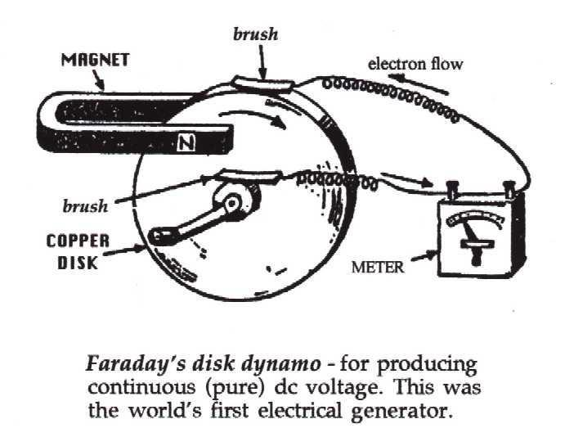
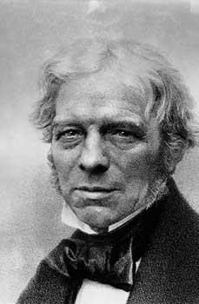
Technology Sparks Industrial Growth
In the late 1800s, a new power source – electricity – replaced steam as the dominant source of industrial power
Michael Faraday
Created the first simple electric motor and the first dynamo
A machine that generates electricity
Today, all electrical generators and transformers work on the principle of Faraday’s dynamo

Slide 60
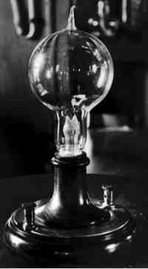
Technology Sparks Industrial Growth
Thomas Alva Edison
Made the first electric light bulb
Soon, Edison’s “incandescent lamps: illuminated whole cities
The pace of city life quickened, and factories could continue to operate after dark
By the 1890s, cables carried electrical power from dynamos to factories
By the time he died, Edison held more than a thousand patents

Slide 61
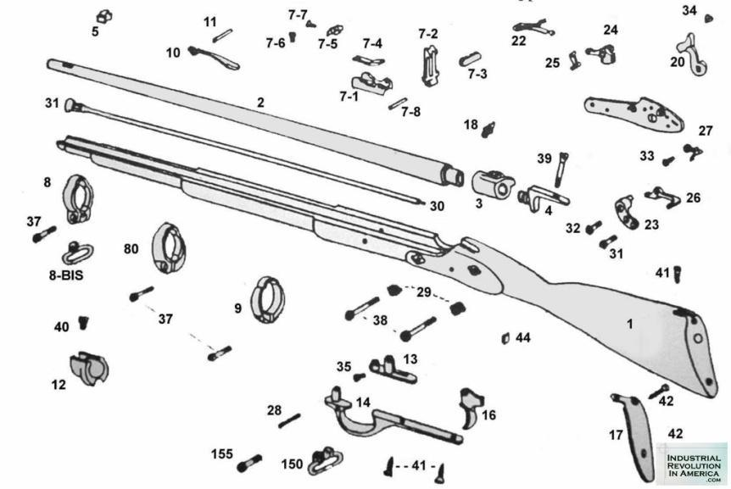
Technology Sparks Industrial Growth
New Methods of Production
The basic features of the factory system remained the same during the 1800s
Factories still used large numbers of workers and power-driven machines to mass-produce goods
Interchangeable Parts
To improve efficiency, manufacturers designed products with identical components that could be used in place of one another
Interchangeable parts simplified both the assemble and repair of products

Slide 62
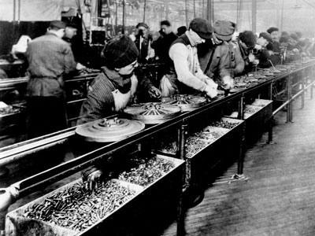
Technology Sparks Industrial Growth
Assembly Line
Workers on an assembly line add parts to a product that moves along a belt from one workstation to the next
A different person performs each task along the assembly line
This division of labor made production faster and more cheaper, lowering the price of goods
Also took much of the joy out of the work itself

Slide 63
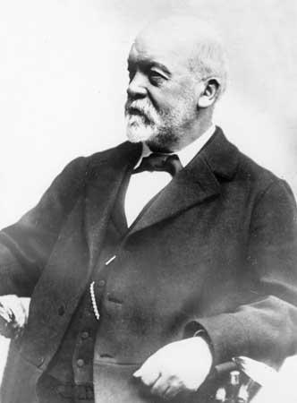
Transportation and Communication
The Automobile Age Begins
Nikolaus Otto
Invented a gasoline-powered internal combustion engine
Karl Benz - 1886
Received a patent for the first automobile, which had three wheels
Gottlieb Daimler
Introduced the first four-wheeled automobile
People laughed at the horseless carriages, but they quickly transformed transportation

Slide 64
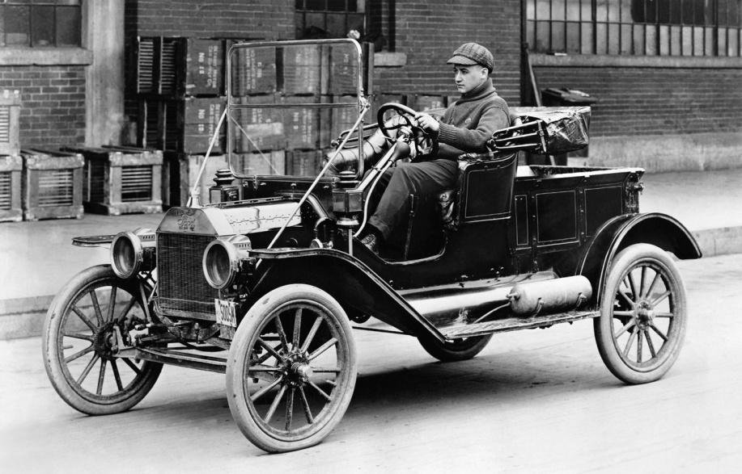
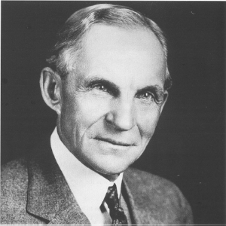
Transportation and Communication
Henry Ford
Started making automobiles that reached the breathtaking speed of 25 mph
In the early 1900s, Ford began using the assembly line to mass-produce cars
Made famous by his Model T automobile
Made the US a leader in the automobile industry
$5 dollar days

Slide 65
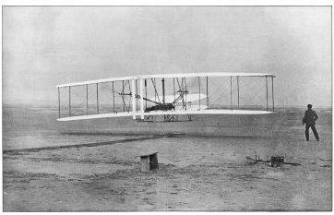
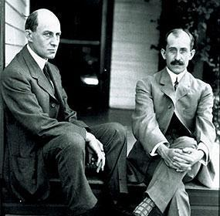
Transportation and Communication
Humans Take Flight
The internal combustion engine powered more than cars
Made possible the sustained, pilot controlled flight
Orville and Wilbur Wright
Designed and flew a flimsy airplane at Kitty Hawk, NC
Although their flying machine stayed in flight only a few seconds, it ushered in the air age

Slide 66
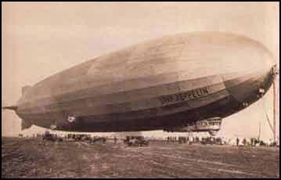
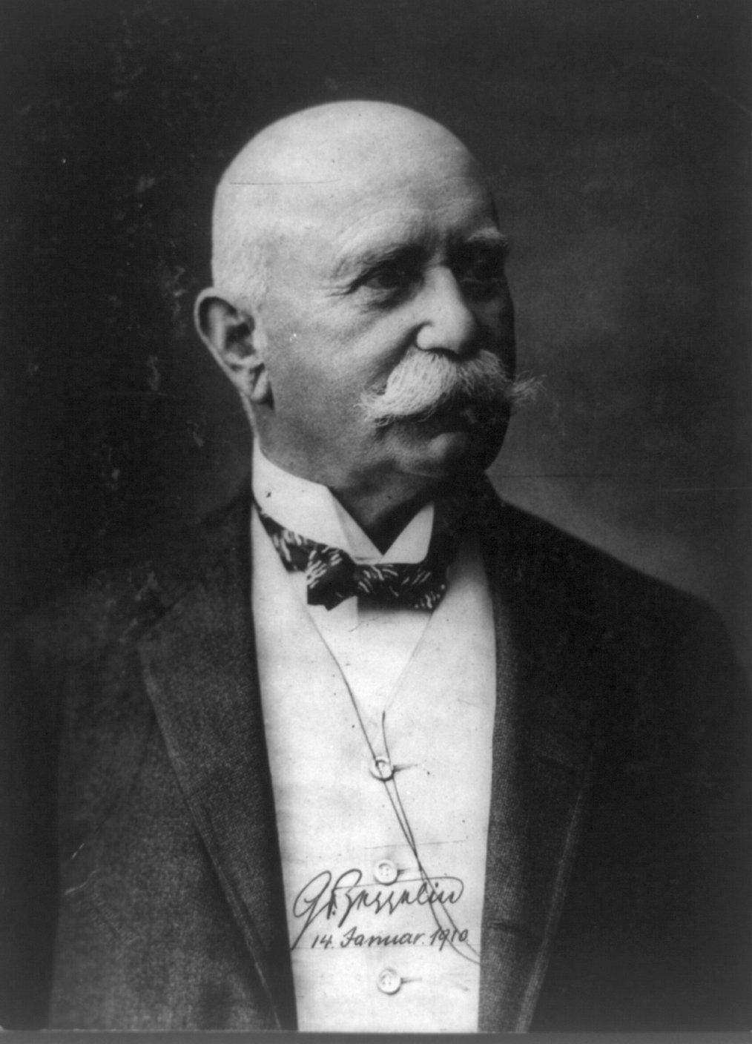
Transportation and Communication
Ferdinand von Zeppelin
Inventor of the rigid airship, or dirigible balloon known as a Zeppelin

Slide 67
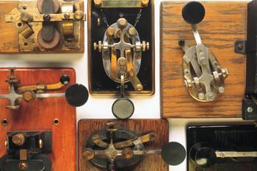
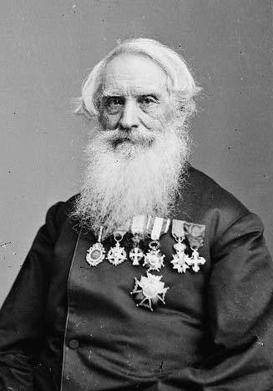
Transportation and Communication
Rapid Communication
A revolution in communications also made the world smaller
Samuel F.B. Morse
Developed the telegraph – 1832
Could send coded messages over the wires by means of electricity
First words out of the telegraph – “What hath God wrought?”
In 1848, a group of newspapers pooled their resources to collect and share news over the telegraph
This organization was the Associated Press

Slide 68
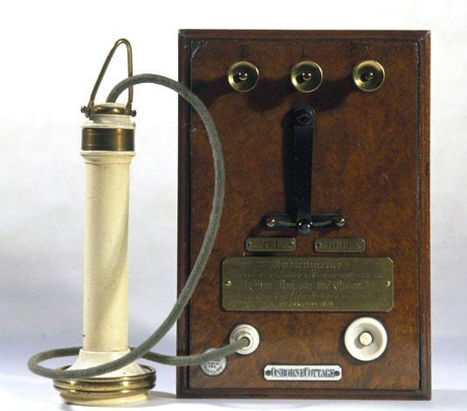
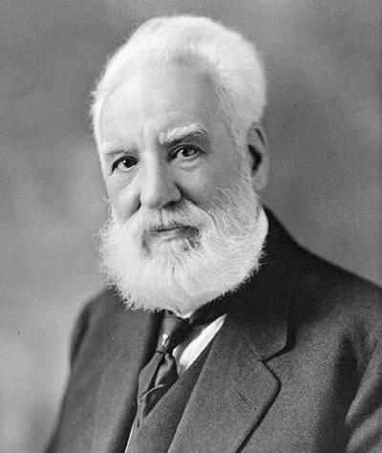
Transportation and Communication
Alexander Graham Bell
Invented the telephone – 1876
Not coast to coast until 1915
Very slow and expensive

Slide 69
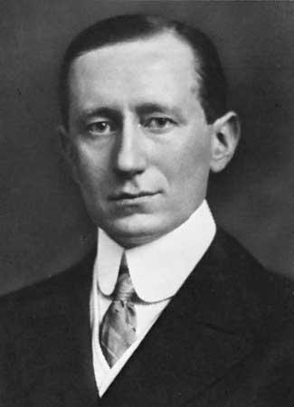
Transportation and Communication
Guglielmo Marconi
Invented the radio – 1901
Sent the first radio waves across the Atlantic
Radio would become a cornerstone of today’s global communications network

Slide 71
Section 5: New Science and Ideas

Slide 72
New Science and Ideas
During the 1800’s and early 1900’s, scientific discoveries were beginning to unravel some mysteries

Slide 73
Science Takes New Directions
Debating the Earth’s Age
The new science of geology opened avenues of debate
Charles Lyell
Wrote Principles of Geology
Offered evidence to show that Earth had formed over millions of years
His successors concluded that Earth was at least two billion years old and that life didn’t appear until long after earth was forced
These ideas did not seem to agree with biblical accounts of creation

Slide 74
Science Takes New Directions
Charles Darwin
Published On the Origin of Species
Argued that all forms of life, including human beings, had evolved into their present state over millions of years
To explain the long, slow process of evolution, he put forward the theory of natural selection
Natural forces “selected” those with physical traits best adapted to their environment to survive and to pass the trait on to their offspring
Became known as “survival of the fittest”

Slide 75
Science Takes New Directions
The Fight Against Disease
Louis Pasteur
In 1870, clearly showed the link between microbes and disease
Went on to develop of vaccines against rabies and anthrax
Discovered a process called pasteurization that killed disease-carrying microbes in milk

Slide 76
Science Takes New Directions
Edward Jenner
Discovered the Smallpox vaccination
Used a small boy as an experiment

Slide 77
Science Takes New Directions
Gregor Mendel
Experimented with pea plants
Concluded that characteristics are passed from one generation to the next by tiny particles called genes
His work became the basis for genetics
The science of heredity

Slide 78
Social Sciences
Other scientists used the scientific method to study human behavior
Sociology – the study of human behavior in groups
Psychology – the science of human behavior in individuals

Slide 79
Social Sciences
Ivan Pavlov
Believed that human actions were unconscious reactions to stimuli and could be changed by training
Pavlov’s bell

Slide 81
Social Sciences
Sigmund Freud
Held that an unconscious part of the mind governs human behavior
Led to psychoanalysis, a method of treatment to discover people’s motives

